Slide 1
BrDR Technical Support Center How-To
Herman Lee, P.E.
2014 RADBUG Conference
August 12, 2014

Slide 2
What is JIRA?
JIRA is an issue tracking and management system
An issue is a task that requires an action from a person
Grand opening on September 2013, replacing the IssueNet Support Center we used for 15 years
It is a web-based system hosted in the cloud by Atlassian
AASHTOWare Bridge Management also uses JIRA, the same system

Slide 3
Who have access to JIRA?
Unlimited License – 2 accounts
Single Workstation License – 1 account
Agency that purchases the Agency Sponsored Consultant Licenses – 2 accounts
Currently we have 116 members

Slide 4
How-To …
Login and Getting Started
Navigation Bar
Create an Issue
Issue Navigator
Search for an Issue
Quick Search, Basic Search and Advanced Search
Dashboard

Slide 5
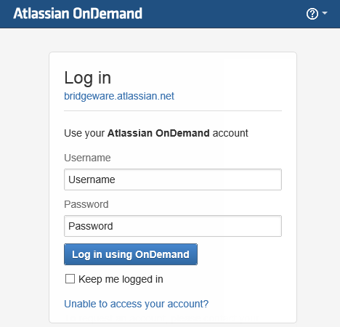
Login and Getting Started
Go to bridgeware.atlassian.net

Slide 6
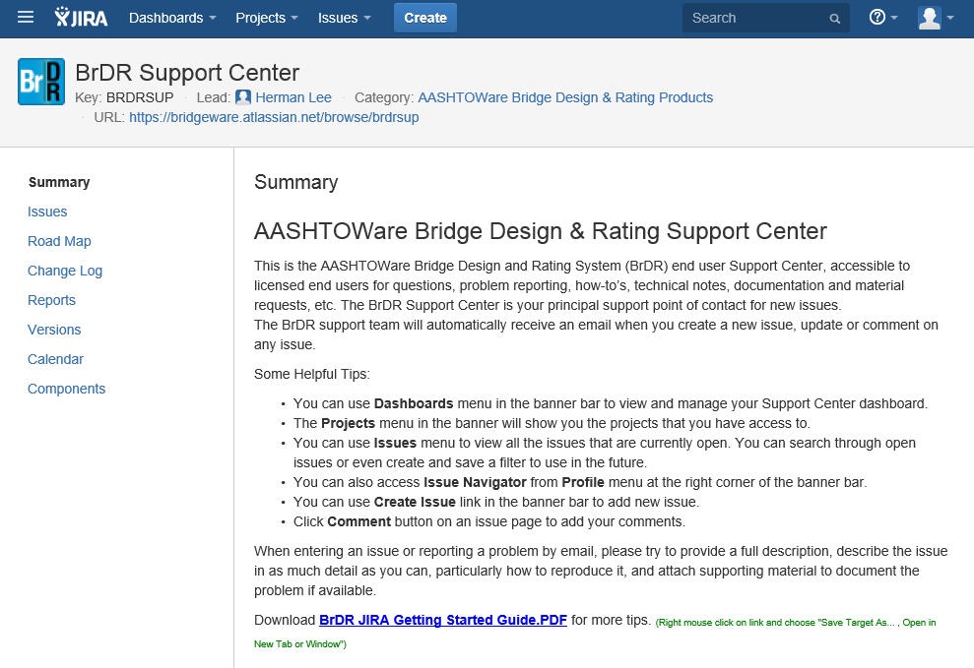
Login and Getting Started

Slide 7
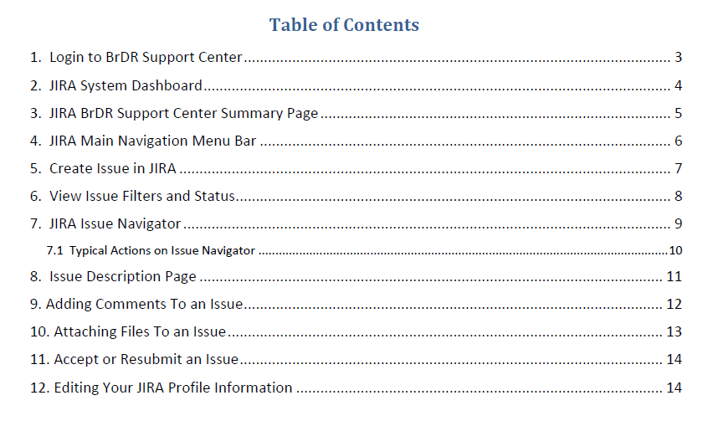
Login and Getting Started

Slide 8
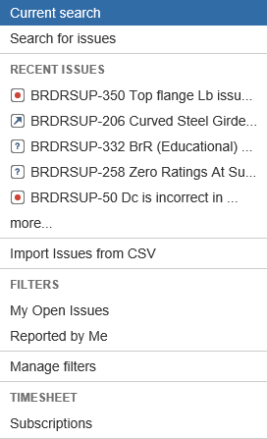
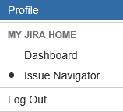
Navigation Bar

Slide 9
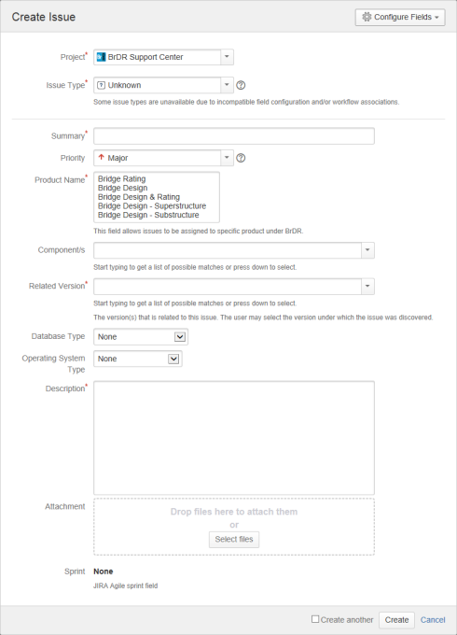
Create an Issue
Project
Issue Type
Summary
Product Name
Related Version
Description
Notes:
What is the project about?
Define the goal of this project
Is it similar to projects in the past or is it a new effort?
Define the scope of this project
Is it an independent project or is it related to other projects?
* Note that this slide is not necessary for weekly status meetings

Slide 10
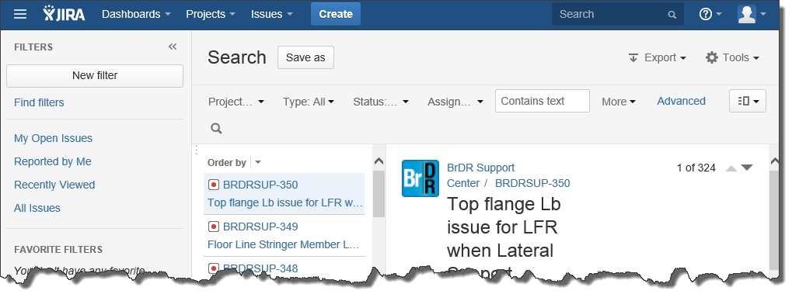
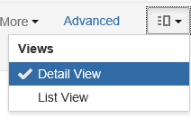
Issue Navigator – Detail View
Filters List of Issues Detail of the selected Issue
Notes:
What is the project about?
Define the goal of this project
Is it similar to projects in the past or is it a new effort?
Define the scope of this project
Is it an independent project or is it related to other projects?
* Note that this slide is not necessary for weekly status meetings

Slide 11
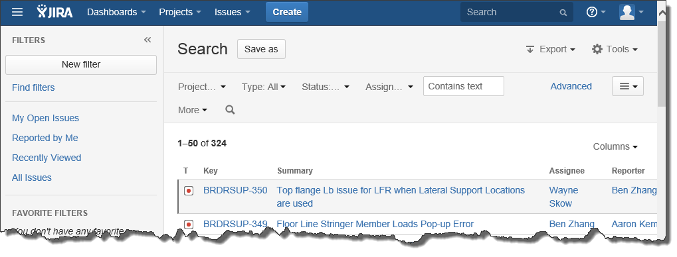
Issue Navigator – List View
Filters List of Issues
Notes:
What is the project about?
Define the goal of this project
Is it similar to projects in the past or is it a new effort?
Define the scope of this project
Is it an independent project or is it related to other projects?
* Note that this slide is not necessary for weekly status meetings

Slide 12
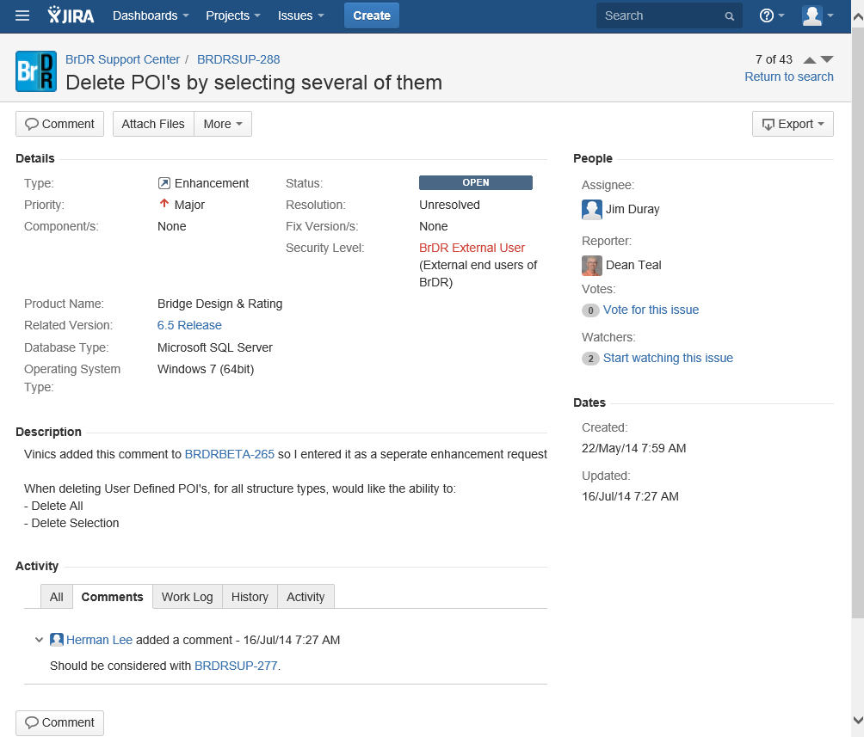
Notes:
What is the project about?
Define the goal of this project
Is it similar to projects in the past or is it a new effort?
Define the scope of this project
Is it an independent project or is it related to other projects?
* Note that this slide is not necessary for weekly status meetings

Slide 13
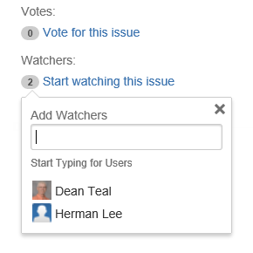
Issue – Votes and Watchers
Issue Voting
Voicing your preference for that issue
Issue Watching
Signing up for notifications of any updates for that issue
Notes:
What is the project about?
Define the goal of this project
Is it similar to projects in the past or is it a new effort?
Define the scope of this project
Is it an independent project or is it related to other projects?
* Note that this slide is not necessary for weekly status meetings

Slide 14
Search for an Issue
Quick Search
Fastest way to define search criteria
Basic Search
More precise than the quick search
Has a user-friendly interface to define criteria
Advanced Search
Most powerful of the three search methods
You need to know how to construct structured criteria

Slide 15
Search for an Issue – Quick Search
Quick Search box is located in the Navigation Bar
Jump to an Issue
Text searching

Slide 16
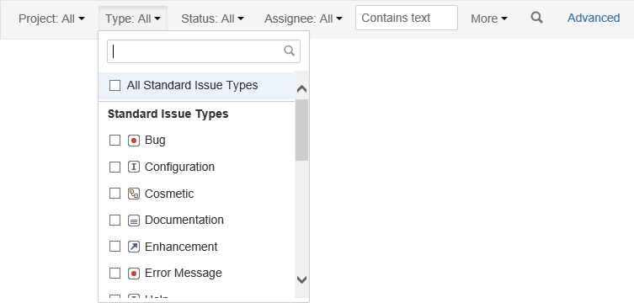
Search for an Issue – Basic Search
Basic Search is located in the Issue Navigator
User-friendly interface to define criteria

Slide 17
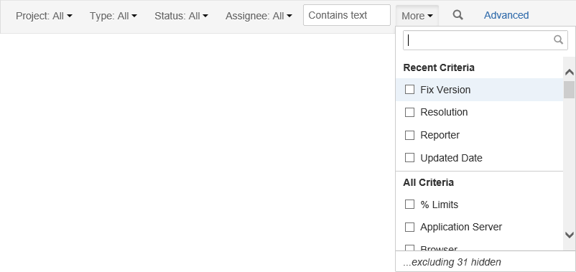
Search for an Issue – Basic Search
My 3D enhancement requests that are still open

Slide 18
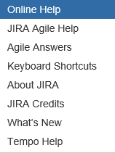
Search for an Issue – Advanced Search
Advanced Search is also located in the Issue Navigator
See Online Help for the syntax of defining structured criteria

Slide 19
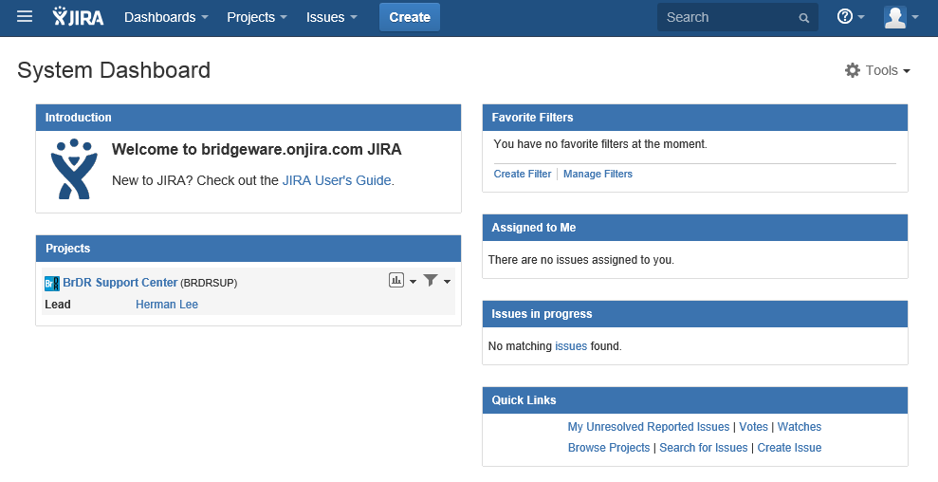
Dashboard

