Slide 1


RADBUG 2014
Keynote Address
August 12, 2014
Director Kirk T. Steudle, P.E.

Slide 2


Slide 3
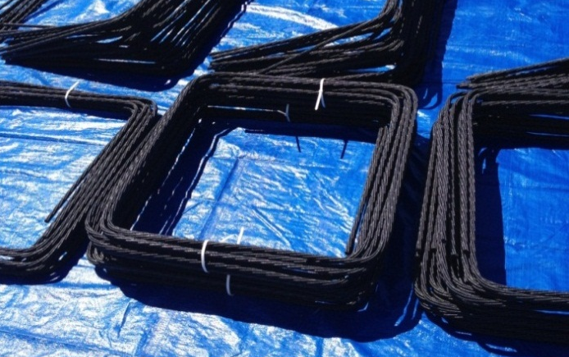
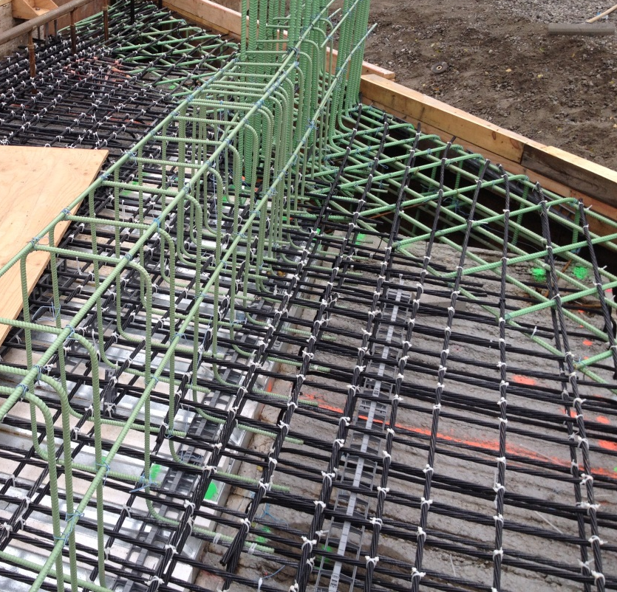
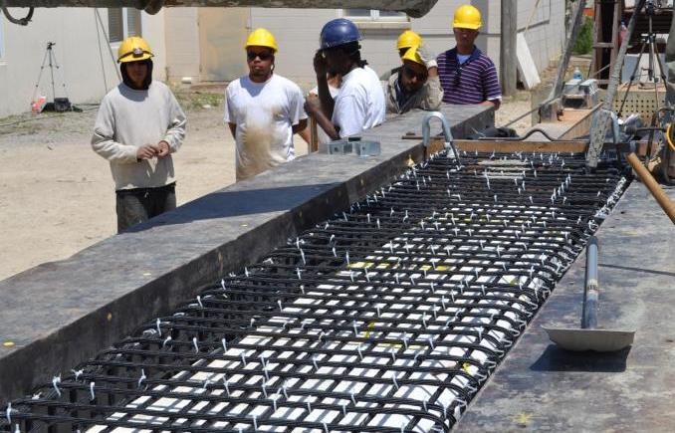
Carbon Fiber Reinforcing Strands
M-102 over Plum Creek utilized Carbon Fiber strands for box beam prestressing and shear reinforcement, as well as deck reinforcement.

Slide 4


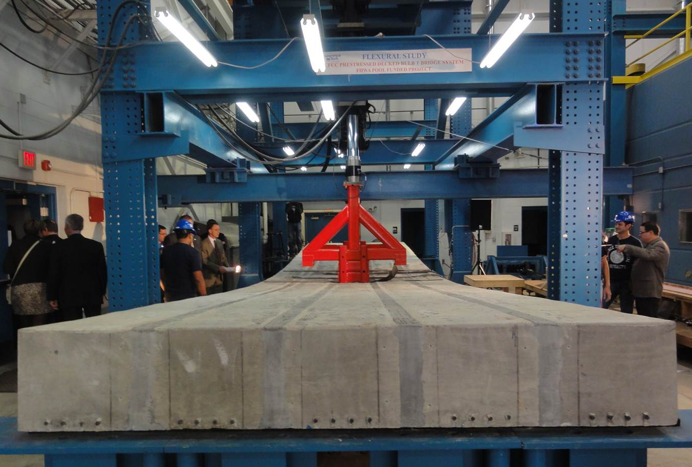




Carbon Fiber Decked Bulb-T Transportation Pooled Fund Research

Slide 5
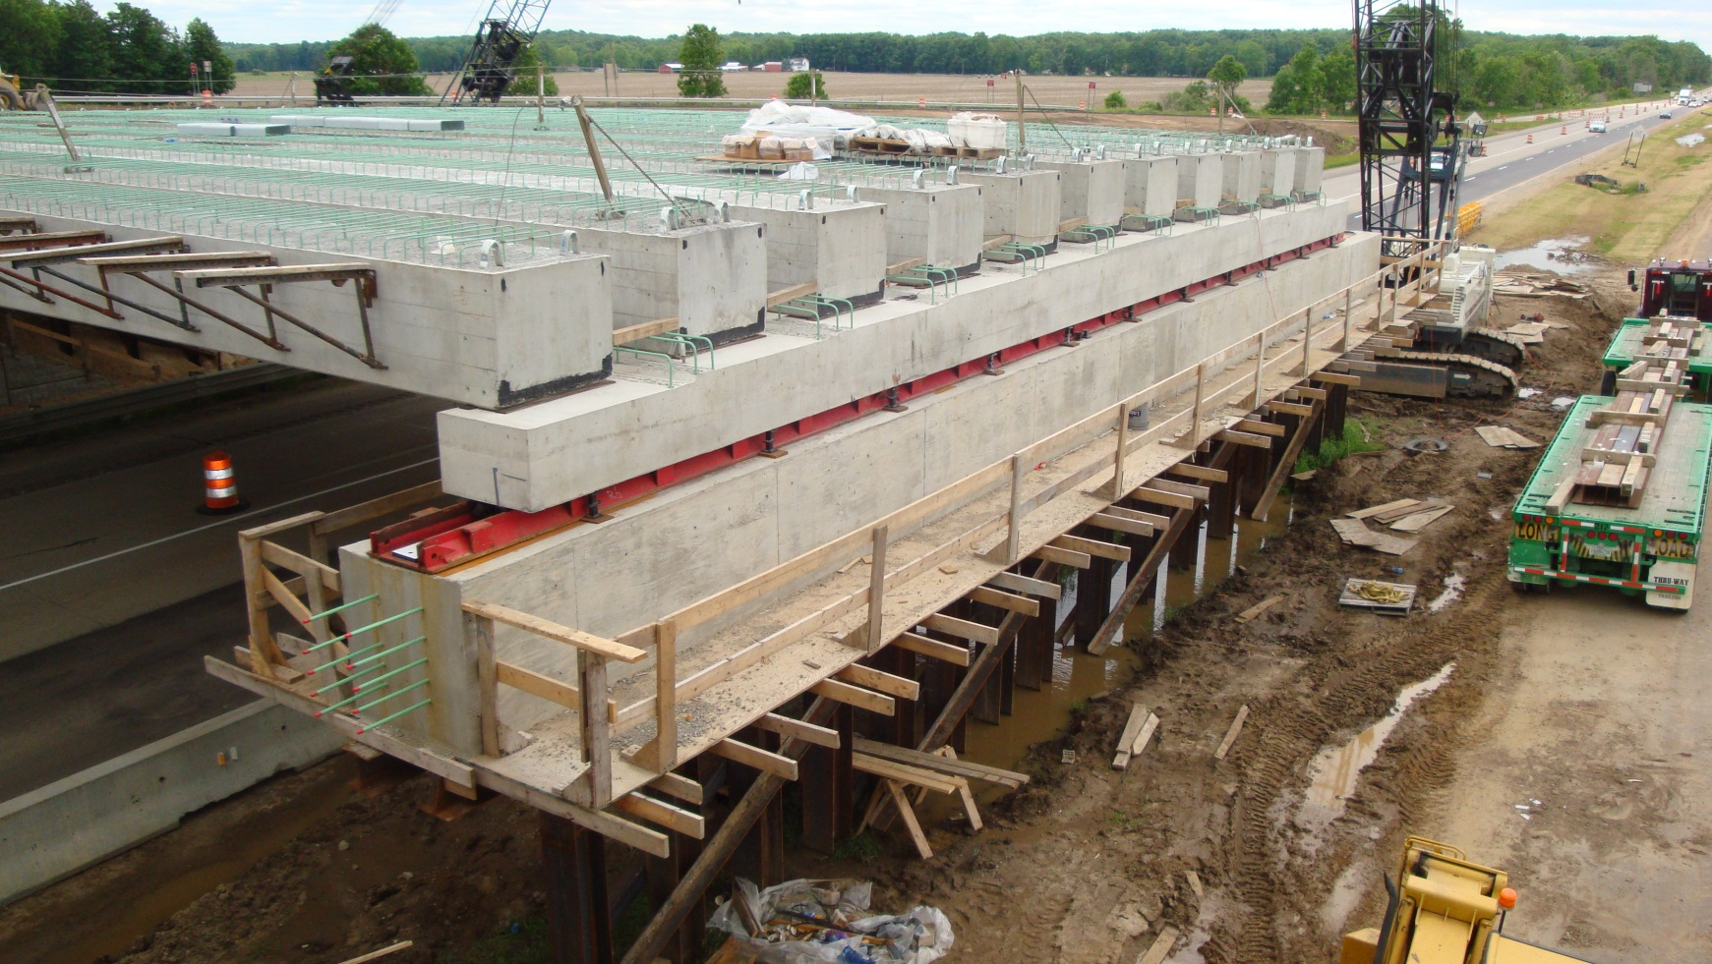
Accelerated Bridge Construction

Slide 6

Accelerated Bridge Construction

Slide 7
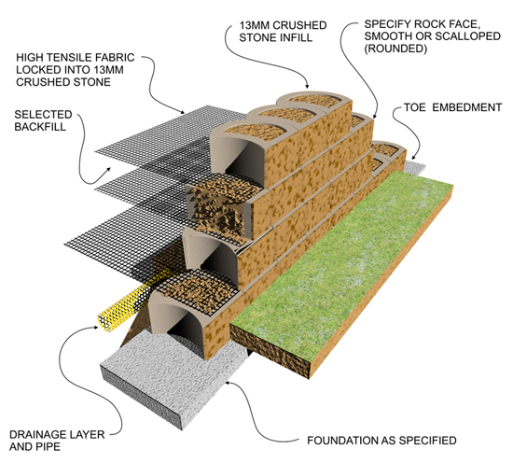
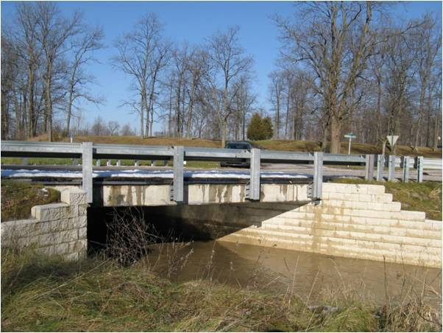
GRS-IBS Bridge

Slide 8
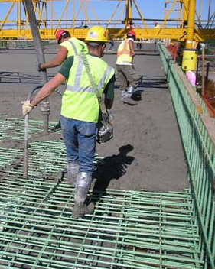
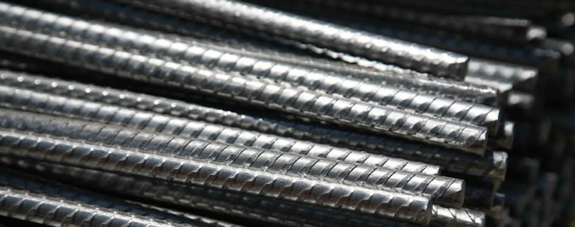
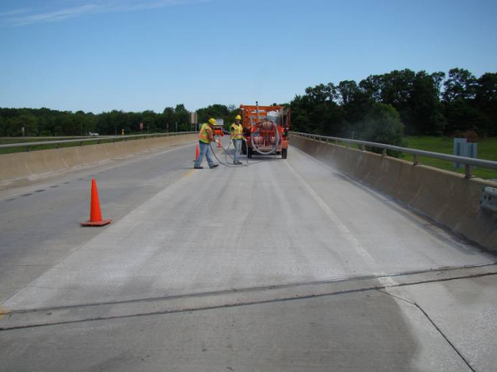
Bridge Deck Materials
Stainless Steel Reinforcement
Grade D Modified Deck Concrete
Epoxy Bridge Deck Overlay

Slide 9
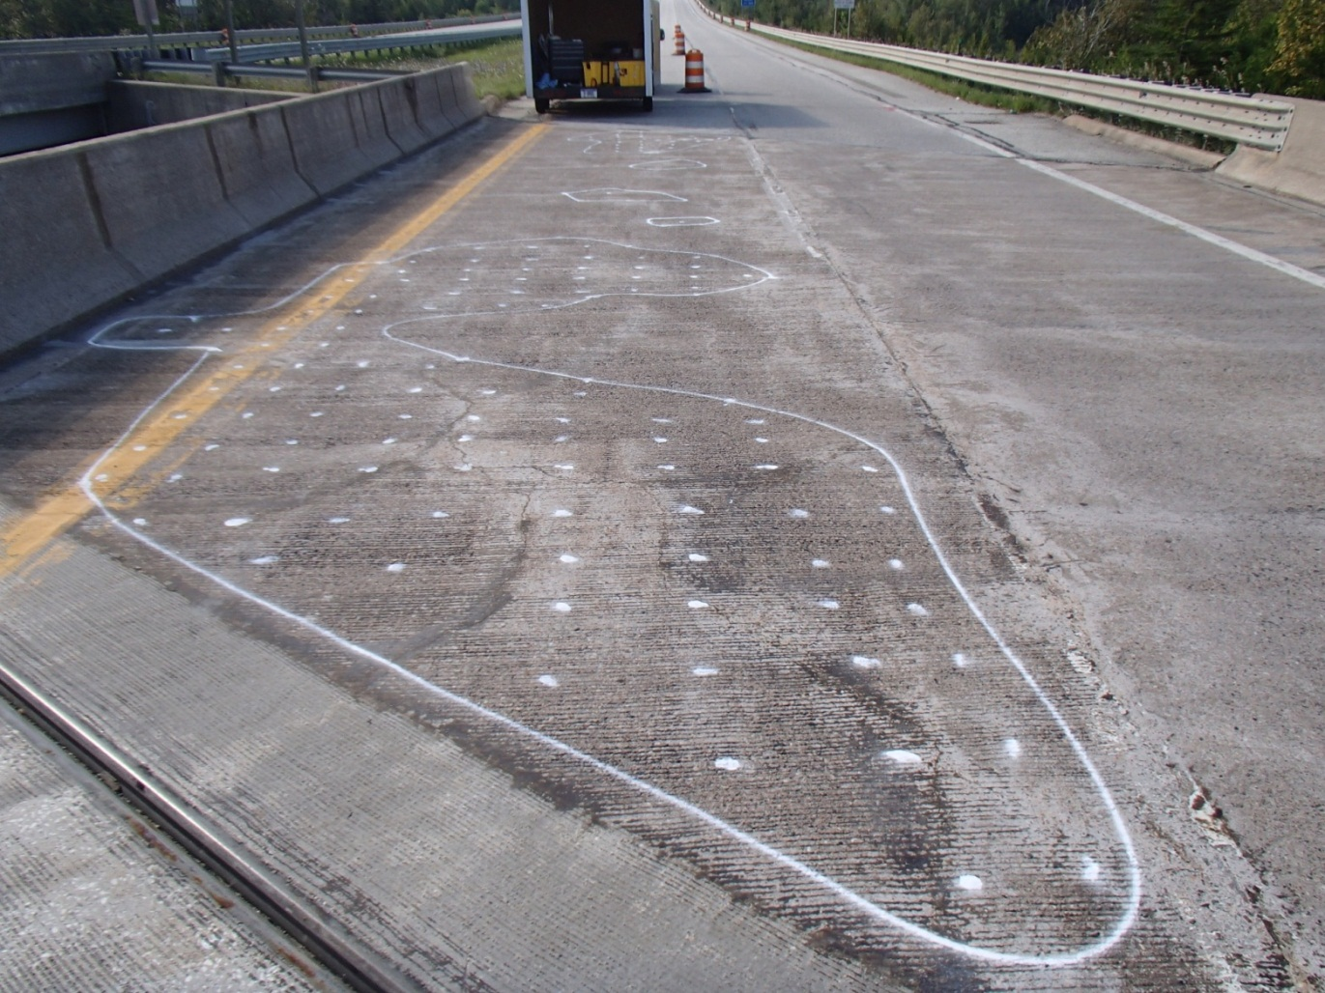
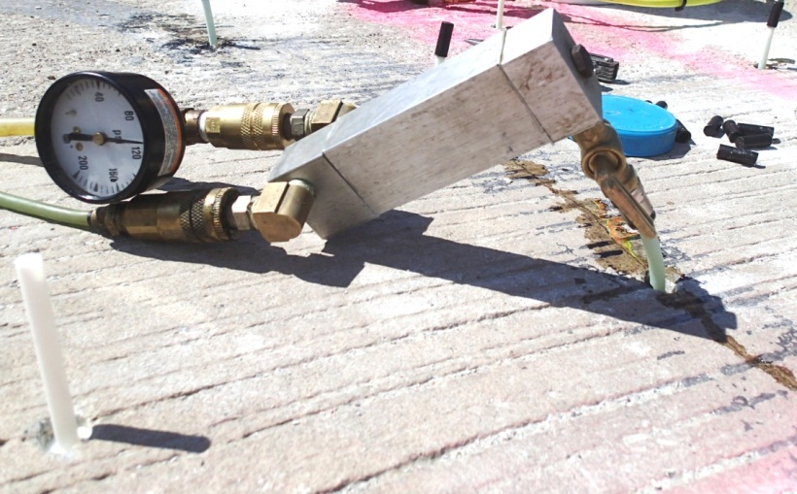
Bridge Deck Materials
Epoxy Injection of Delaminated Overlays

Slide 10

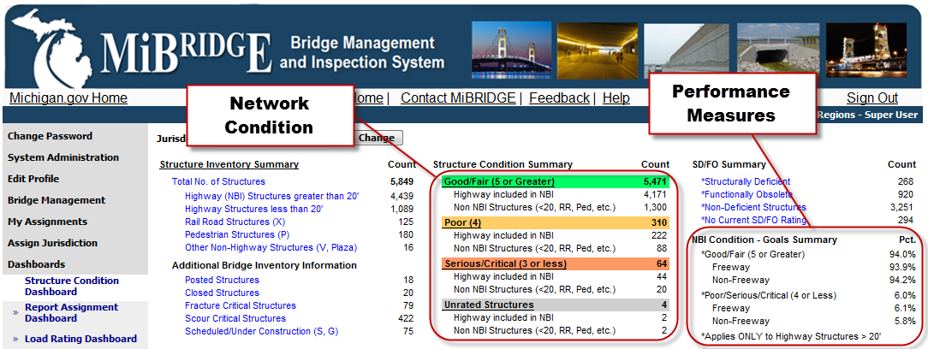
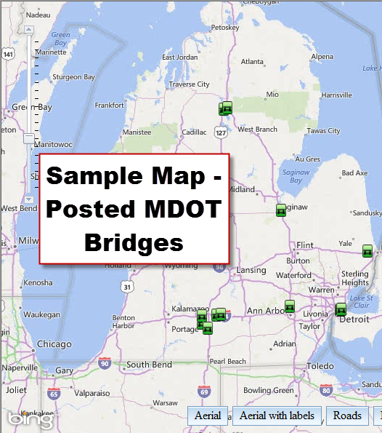
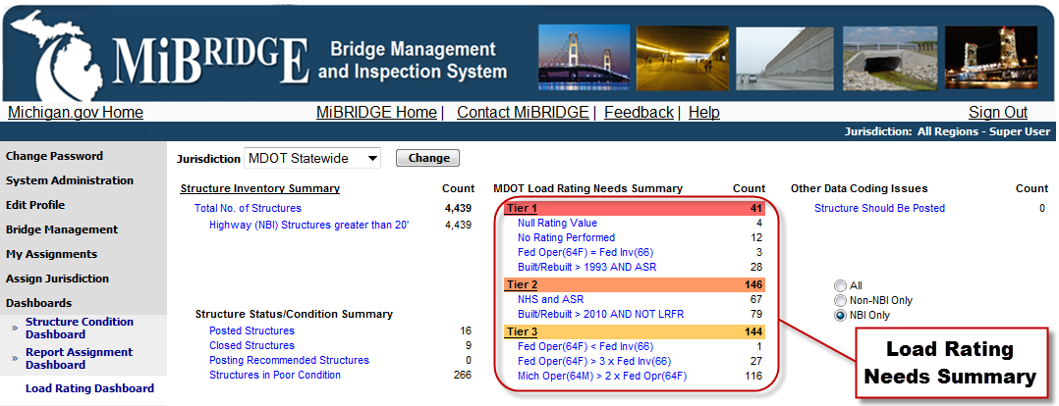
Bridge Inspection and Reporting System
MiBridge: Web based bridge inspection and management system

Slide 11

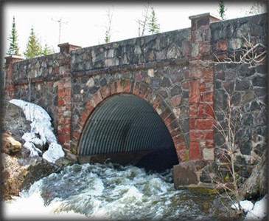
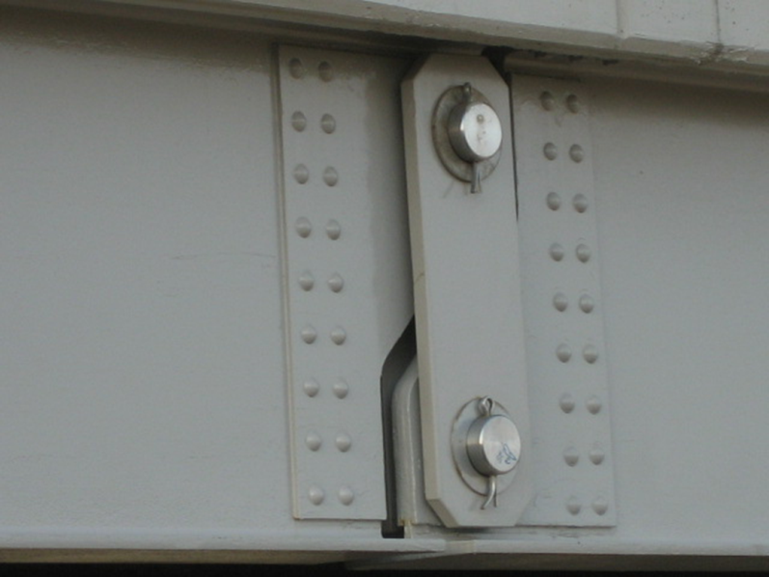
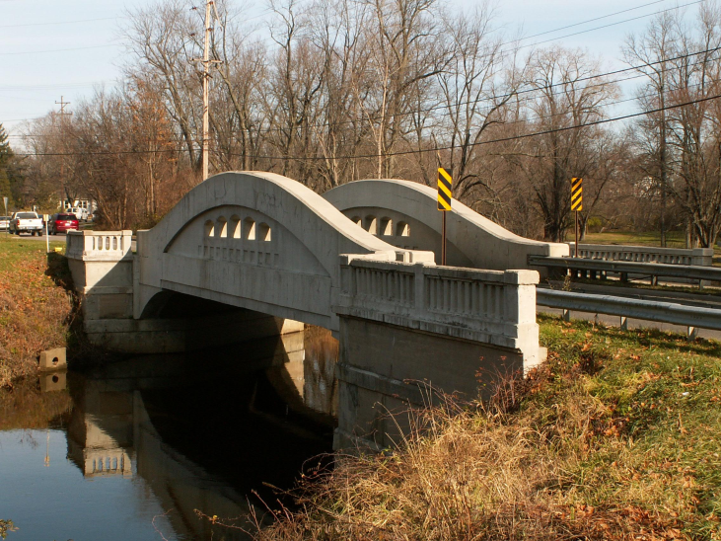
Local Agency Technical Assistance
Provides technical support to local agencies and their consultants
Develops and supports load rating tools including CMPs, camelbacks, and pin and hangars

Slide 12
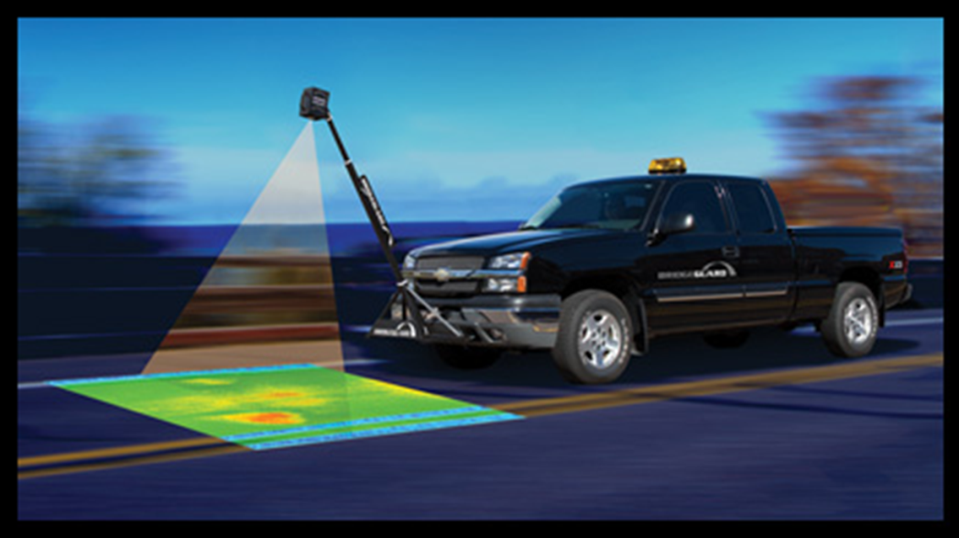
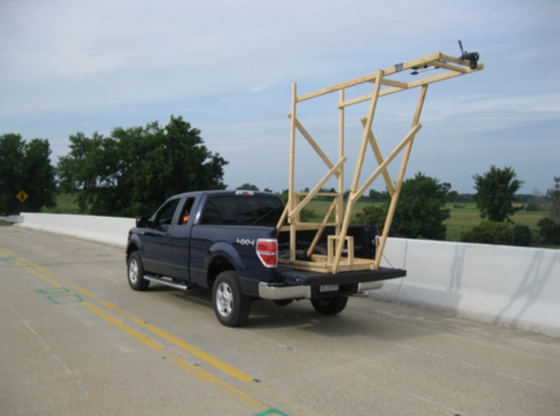
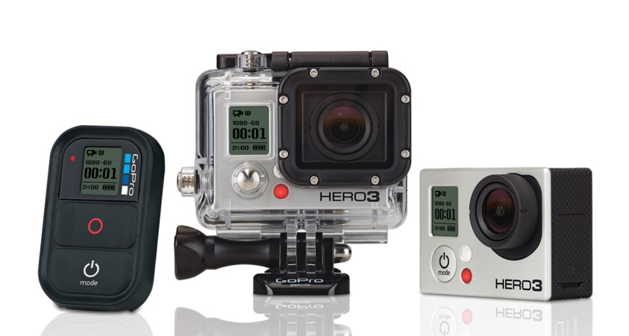
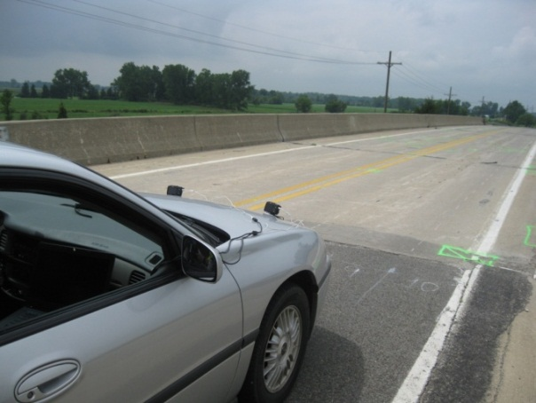
High-Speed NDE of Bridge Decks
Evaluating Thermal Imagery, 3-D Optical, and Remote Camera systems

Slide 13
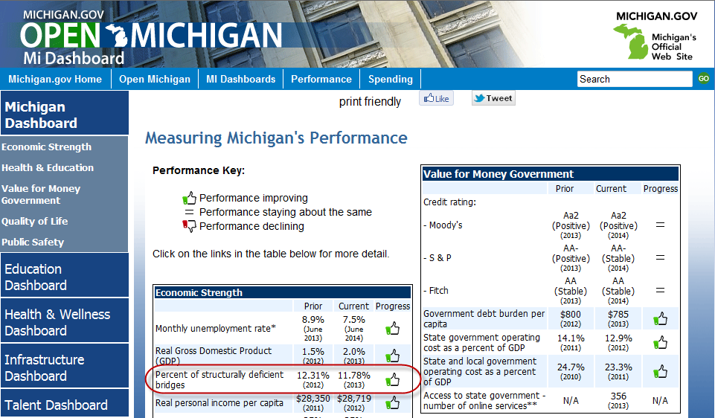
Performance Measures

Slide 14
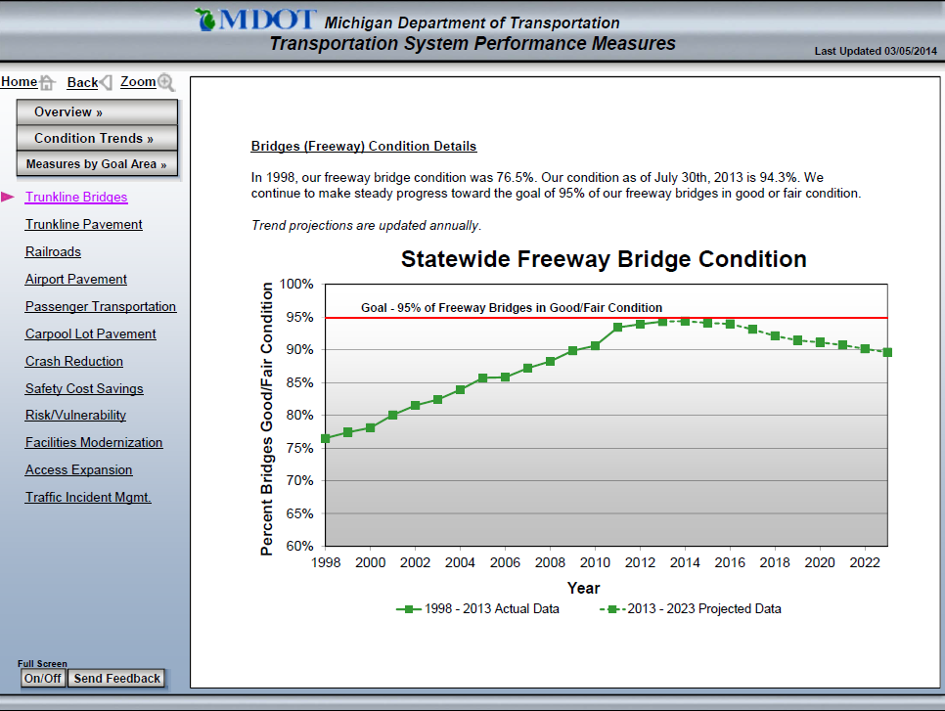
Performance Measures

Slide 15
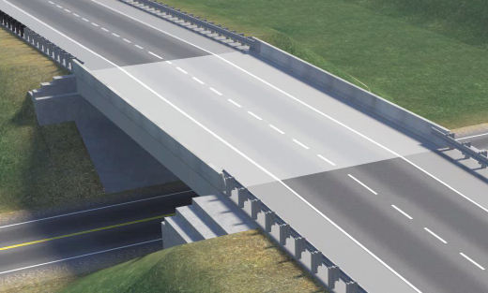
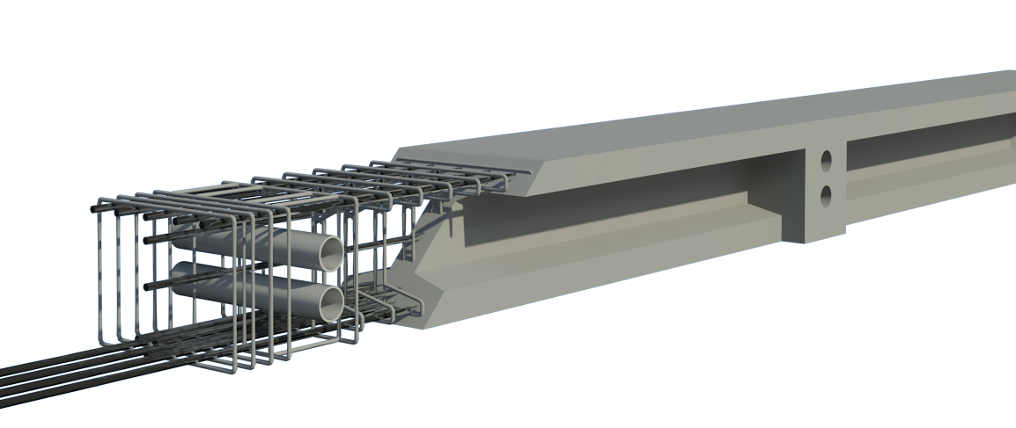
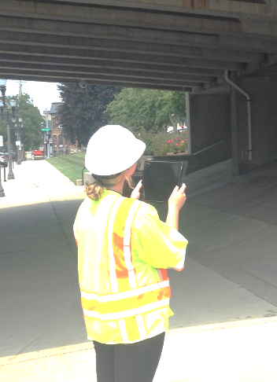
Bridge Cycle of Life
Design
Construction
Operations and Inspection
Load Rating
Rehab and Replacement
3D
Model

Slide 16
Thank You.

