Slide 1

Bridge Design-Rating
AASHTO Overview
2019 RADBUG Meeting
South Lake Tahoe, CA
Judy Skeen Tarwater, P.E.

Slide 2
Outreach / Marketing
Opportunities to expand the Bridge Design and Bridge Rating user base
Incorporation of both products into NCHRP projects
Partnership with NSBA to establish interface with SIMON
Product presentations at numerous meetings and conferences
Invitations extended to DOT personnel to attend the RADBUG and Task Force meetings in their home locales
Communication tailored for specific audiences

Slide 3
Outreach / Marketing
Newsletters – hardcopy for conference distribution and online for wider consumption
Incorporation of Ideas / suggestions from the BrDR Community
Post BrDR Modernization – Identifying enhancements to be incorporated into the modernized system
AASHTOWare Marketing Manager
  Akeia Carter
AASHTOWare Customer Success Manager
  Tinika Fowlkes

Slide 4
FY2018 Bridge Design-Rating Revenue
BrDR
Modernization
Project
Design
Licenses
Service
Units
Rating
Licenses

Slide 5
FY2019 Bridge Design-Rating Revenue
BrDR
Modernization
Project
Design
Licenses
Service
Units
Rating
Licenses

Slide 6
FY2018 Expenditures
Modernization
64%

Slide 7
FY2019 Expenditures
Modernization
58%

Slide 8

DOT Driven
Software Solutions
Notes:
Board of Directors & Executive Committee Meet Twice a Year… Establishes and revises policies governing the Cooperative Computer Development Program as called for within and consistent with this Administrative Resolution and AASHTO's Governing Documents.
Approves the creation of projects and products and the revenue and expenditure budgets of the activities within this Program as part of its overall budget approval role. Approves the appointment by the AASHTO President of the members of the Special Committee on Joint Development.
Special Committee on Joint Development provides management oversight of AASHTOWare Program & Products. The SCOJD studies all policy issues and topics with respect to the AASHTOWare program in consultation with all active product and project task forces and brings recommendations before the AASHTO Board of Directors and Executive Committee for action, as appropriate.
They review and approve all procedural documents, manuals and other guidelines pertaining to the process and management of the AASHTOWare program
Include in their charge is the approval of appointments [and removal] of Product and Project Task Force members as necessary and the designation of chairpersons. They review project proposals and authorize solicitation of membership for participation and funding for AASHTOWare projects; and, establish advisory and user groups when appropriate on the recommendation of the product and/or project task forces
A full-time AASHTOWare Project Manager is retained to coordinate product/project activities, and fulfill contract administration and project management functions.
As authorized by the executive director, the project manager leads/participates in contract negotiations and revisions; oversees invoices, payments, and other financial transactions; coordinates software development activities with other AASHTO committees; promotes awareness of the product capabilities and gathers potential enhancements for the products; and assists the task force in related matters as needed.
The Task Force provides the day to day management of the product. They guide software support and development services performed by contractors, determine the functionality to be included in enhancements; they oversee the development and execution of the annual work plans, including the associated budget, for the product and work with SCOJD to improve the overall AASHTOWare program.
The task force typically are comprised of 7 to 9 representatives from the agencies and serve on a rotating basis; they represent expertise in functional areas as well as IT. Included with their many duties, the task forces are responsible for (1) long range product direction, (2) annual consultant contracts, (3) quality assurance and control, and (4) responding to questions from users. The task force also determines the appropriate software platforms needed to meet the overall needs of the participating agencies and review and approve product releases. A typical member is a long-term or high-level administrator or user and has been active in the User Group for several years.
The Task Forces are oftentimes assisted by Technical Advisory Groups which provide subject matter expertise in defining functionality and software requirements and fulfill a variety of other roles; the TAG’s also oftentimes perform detailed reviews of beta code and make recommendations to the task force on approval of deliverables and product releases.
The Technical Advisory Group(s)s are appointed by the Task Force and assist the Task Force in working with contractor in development of new product/enhancement(s). Their composition and the number of members setting on the TAG are based upon need; the members are users familiar with the product/functions and are usually from agencies contributing funding. Their duties/business is generally conducted by e-mail, conference calls, and [sometimes] face-to-face meeting as required; typically, the TAG is chaired by a Task Force member.
User Groups are independent organizations with their own Constitution and/or Bylaws. The User Group represents member department’s interest in the product, and provides advice and recommendations on the product’s (1) effectiveness, (2) deficiencies, and (3) any needed product enhancements.
The User Group also recommends product training and support needs, details and recommends prioritized maintenance, enhancement, and support needs. The outcomes of the User Group are submitted to the Task Force as recommendations and helps for the basis for the upcoming fiscal year’s work plan.

Slide 9
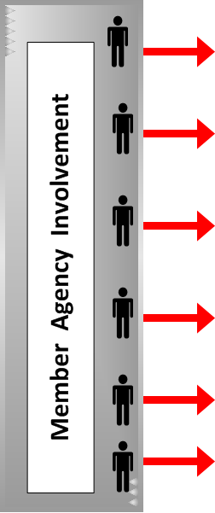
AASHTOWare Program Management
Notes:
Board of Directors & Executive Committee Meet Twice a Year… Establishes and revises policies governing the Cooperative Computer Development Program as called for within and consistent with this Administrative Resolution and AASHTO's Governing Documents.
Approves the creation of projects and products and the revenue and expenditure budgets of the activities within this Program as part of its overall budget approval role. Approves the appointment by the AASHTO President of the members of the Special Committee on Joint Development.
Special Committee on Joint Development provides management oversight of AASHTOWare Program & Products. The SCOJD studies all policy issues and topics with respect to the AASHTOWare program in consultation with all active product and project task forces and brings recommendations before the AASHTO Board of Directors and Executive Committee for action, as appropriate.
They review and approve all procedural documents, manuals and other guidelines pertaining to the process and management of the AASHTOWare program
Include in their charge is the approval of appointments [and removal] of Product and Project Task Force members as necessary and the designation of chairpersons. They review project proposals and authorize solicitation of membership for participation and funding for AASHTOWare projects; and, establish advisory and user groups when appropriate on the recommendation of the product and/or project task forces
A full-time AASHTOWare Project Manager is retained to coordinate product/project activities, and fulfill contract administration and project management functions.
As authorized by the executive director, the project manager leads/participates in contract negotiations and revisions; oversees invoices, payments, and other financial transactions; coordinates software development activities with other AASHTO committees; promotes awareness of the product capabilities and gathers potential enhancements for the products; and assists the task force in related matters as needed.
The Task Force provides the day to day management of the product. They guide software support and development services performed by contractors, determine the functionality to be included in enhancements; they oversee the development and execution of the annual work plans, including the associated budget, for the product and work with SCOJD to improve the overall AASHTOWare program.
The task force typically are comprised of 7 to 9 representatives from the agencies and serve on a rotating basis; they represent expertise in functional areas as well as IT. Included with their many duties, the task forces are responsible for (1) long range product direction, (2) annual consultant contracts, (3) quality assurance and control, and (4) responding to questions from users. The task force also determines the appropriate software platforms needed to meet the overall needs of the participating agencies and review and approve product releases. A typical member is a long-term or high-level administrator or user and has been active in the User Group for several years.
The Task Forces are oftentimes assisted by Technical Advisory Groups which provide subject matter expertise in defining functionality and software requirements and fulfill a variety of other roles; the TAG’s also oftentimes perform detailed reviews of beta code and make recommendations to the task force on approval of deliverables and product releases.
The Technical Advisory Group(s)s are appointed by the Task Force and assist the Task Force in working with contractor in development of new product/enhancement(s). Their composition and the number of members setting on the TAG are based upon need; the members are users familiar with the product/functions and are usually from agencies contributing funding. Their duties/business is generally conducted by e-mail, conference calls, and [sometimes] face-to-face meeting as required; typically, the TAG is chaired by a Task Force member.
User Groups are independent organizations with their own Constitution and/or Bylaws. The User Group represents member department’s interest in the product, and provides advice and recommendations on the product’s (1) effectiveness, (2) deficiencies, and (3) any needed product enhancements.
The User Group also recommends product training and support needs, details and recommends prioritized maintenance, enhancement, and support needs. The outcomes of the User Group are submitted to the Task Force as recommendations and helps for the basis for the upcoming fiscal year’s work plan.

Slide 10
AASHTO Administrative Overhead
AASHTO Administration & Overhead
  Staff salaries, benefits, and overhead
  Contracted Project Manager
  Proportional share of SCOA, T&AA and indirect costs
  Legal Services
Technical and Applications Architecture Task Force
  Technical resource for SCOA and product task forces
  Develops and maintains software standards and perform QA Reviews

Slide 11
Why Use AASHTOWare?
Incorporates “best practices”
Users share solutions and costs
License fees cover overall expenses ensure software products are kept current with technology, AASHTO specifications and functional requirements
Each product is self-supporting
Non-profit operation
Management and oversight by agency (DOT) personnel
AASHTO staff project management/assistance
Notes:
The AASHTOWare Program offers member agencies a number of unique advantages over custom or commercially available solutions including:
The incorporation of best practices; both thru the design and development of software based on AASHTO specifications and the fact that task force direction comes about through the formation of consensus
Because the program is operated on not-for-profit basis, our sole focus is on satisfying the membership’s needs and priorities
– there is no other motivation for operating the program–
license fees are set to cover expenses– and products are supported, maintained and enhanced to keep products current with functional requirements and technology– as long as their is

Slide 12
Task Force Member Appointment Process
Conduct broad solicitation of interest to member community
Candidate resumes reviewed by Task Force Chair, SCOA Liaison, and AASHTO Project Manager
Interviews conducted by same to find subject matter expertise needed to compliment the current Task Force membership
Candidate recommendation and all resumes received submitted to SCOA for approval
Members allowed to serve two, three-year terms. Special terms may be extended at the direction of the SCOA

Slide 13
AASHTOWare Service Units
AASHTOWare Software Renewal Process

Slide 14
AASHTOWare Bridge Design-Rating Modernization
Planned
$14.8M (20 member agencies @ $740,000 ea.)
Actual
$8,059,000 (committed by 15 agencies)
Remainder funded through BrDR license fees targeted for Phase 3 enhancements
Code / Architecture Modernization | Phases 1 and 2 (fiscal years 2017, 2018 and 2019) - Funds from Solicitation
Functionality Enhancements | Phase 3 (fiscal year 2020) – funded through license fee revenue collected over the four years of the project

Slide 15
BrDR Modernization

Slide 16
BrDR Modernization Road Map
2018 | Legacy Release - 6.8.3 Legacy User Interface Legacy & Modernized AASHTO Engine Modernization Phase 1 Modernized AASHTO Engine
2019 | Legacy Release - 6.8.4 Legacy User Interface Legacy & Modernized AASHTO Engine Modernization Phase 2 – 7.0 Modernized User Interface Modernized AASHTO Engine
2020 | Modernization Phase 3 – 7.1 Modernized User Interface Modernized AASHTO Engine User requested high priority enhancements

Slide 17
2019 Bridge Design-Rating
Customer Survey Results
Conducted June 20 – July 19, 2019

Slide 18
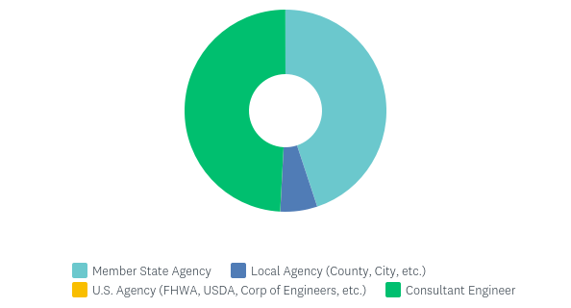
Organization Type
118 Responses
Organization Type | Responses Received
Member State Agency | 53
Local Agency | 7
U.S. Agency | 0
Consultant | 58

Slide 19
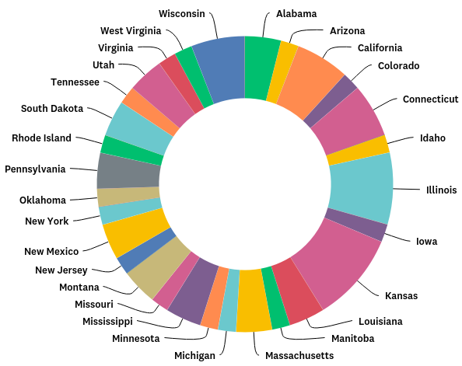
Member Agency State
53 responses from 29 member agency states (including Manitoba)
Notes:
Five (5) responses from Kansas
Four (4) responses from Illinois
Three (3) responses from California, Connecticut, and Wisconsin
Two (2) responses from Alabama, Louisiana, Massachusetts, Mississippi, Montana, New Mexico, Pennsylvania, South Dakota, and Utah
One (1) response from Arizona, Colorado, Idaho, Iowa, Manitoba, Michigan, Minnesota, Missouri, New Jersey, New York, Oklahoma, Rhode Island, Tennessee, Virginia, and West Virginia

Slide 20
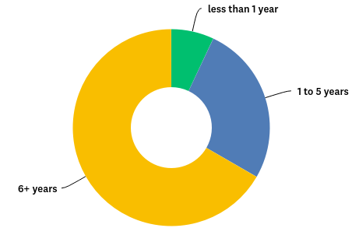
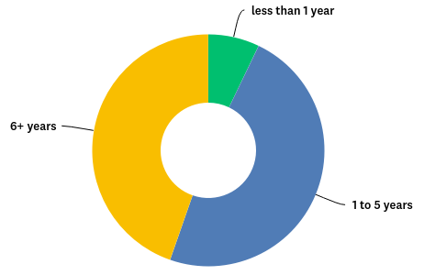
AASHTOWare Bridge Software – Experience
Member Agency / Local Agency / U.S. Agency
Consultant

Slide 21
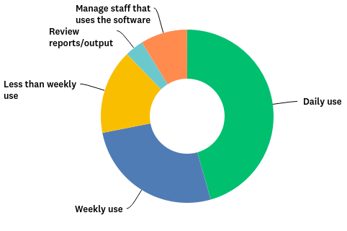
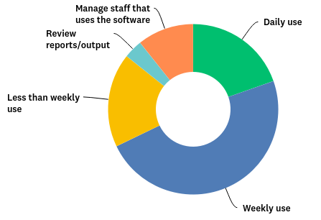
AASHTOWare Bridge Software Interaction
Member Agency / Local Agency / U.S. Agency
Consultant

Slide 22
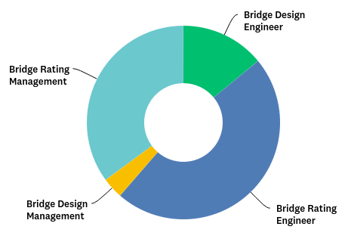
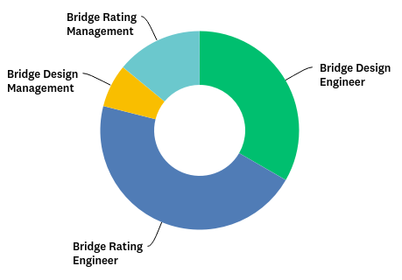
Respondent’s Role
Member Agency / Local Agency / U.S. Agency
Consultant

Slide 23
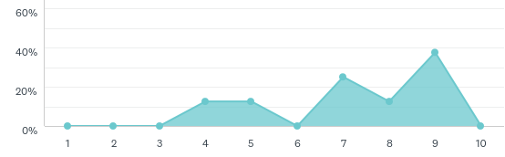
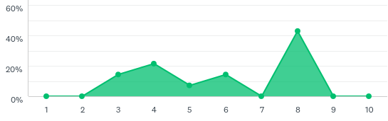
AASHTOWare Bridge Design Ease of Use
Design
Member Agency / Local Agency / U.S. Agency Design
Consultant Design
Scale: 1 (very difficult to use) to 10 (very easy to use)

Slide 24
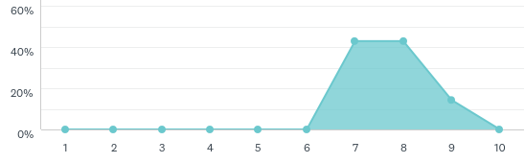
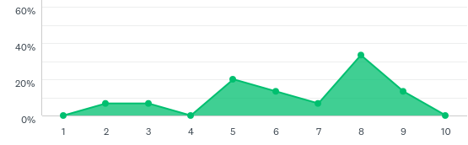
AASHTOWare Bridge Design Functionality - the ability to design bridges commonly constructed in your state
Design
Member Agency / Local Agency / U.S. Agency Design
Consultant Design
Scale: 1 (significantly lacking functionality) to 10 (meets all of my needs)

Slide 25
Recommendations on how to make BrD a better tool for bridge design
Design
Input clarity - unit of measurement (ft vs. in., kip vs. pound)
Error message details
Reporting tools
Substructure design
Structure types
3D imaging tools
Analysis time

Slide 26
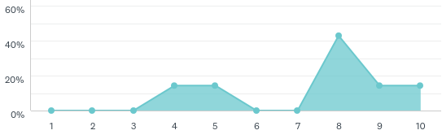
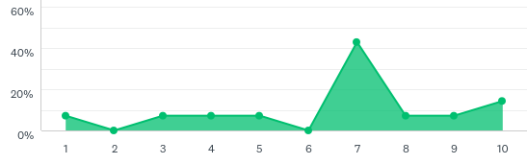
Help features provided with BrD; informational tips inside the product, tutorials, sample bridges, etc.
Design
Member Agency / Local Agency / U.S. Agency Design
Consultant Design
Scale: 1 (needs significant improvement) to 10 (meets all of my needs)

Slide 27
Recommendations on how to better support BrD users
Design
User support
Clear definition of variables
Bridge design examples
Detailed standard bridges
Error message details

Slide 28
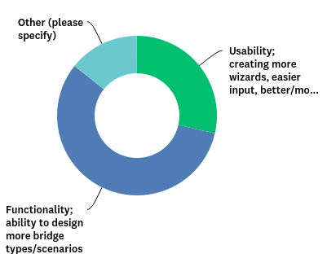
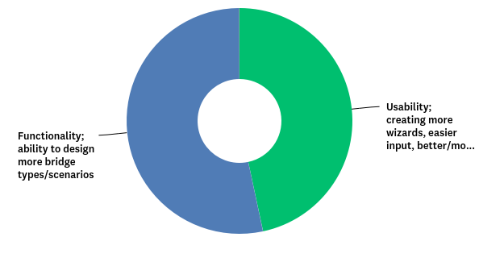
Most important topic to address in future enhancements
Design
Member Agency / Local Agency / U.S. Agency
Consultant
Other: Reporting features, documenting a design, load rating reports

Slide 29
Top priority/request for future development of BrD
Design
User interface
Shape options for steel/concrete girders
Design options
Specification checks in PDF or Word format
Reporting features
Output options
Analysis time

Slide 30
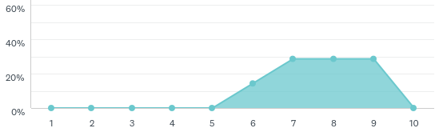
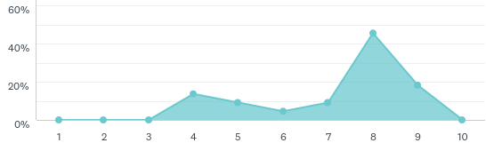
How well does AASHTOWare and the Bridge Task Force perform at developing the AASHTOWare Bridge Design/Rating products to meet State DOT needs?
Member Agency / Local Agency / U.S. Agency Design
Design
Rating
Scale: 1 (my state’s needs are not addressed) to 10 (my state’s needs are fully addressed)

Slide 31
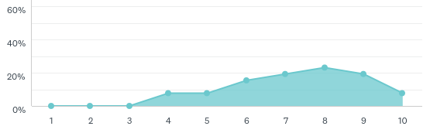
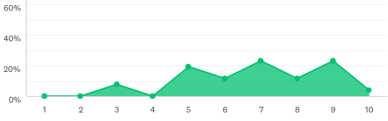
AASHTOWare Bridge Rating Ease of Use
Rating
Member Agency / Local Agency / U.S. Agency Rating
Consultant Rating
Scale: 1 (very difficult to use) to 10 (very easy to use)

Slide 32
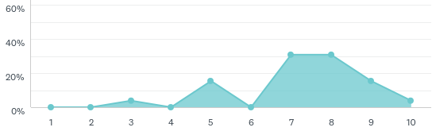
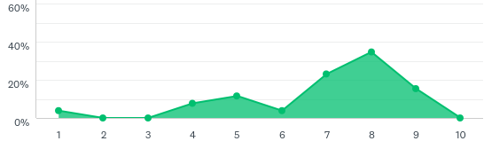
AASHTOWare Bridge Rating functionality - the ability to rate / analyze bridges commonly found in your state
Rating
Member Agency / Local Agency / U.S. Agency Rating
Consultant Rating
Scale: 1 (significantly lacking functionality) to 10 (meets all of my needs)

Slide 33
Recommendations on how to make BrR a better tool for bridge rating
Rating
Member Agency / Local Agency / U.S. Agency
User walk-through guide
Export/Import facility (Excel)
Print out model data for archiving
Import DXF files for bridge layouts
Input/Create girders and floorbeams
Consultant
Rate longitudinal nail-laminated timber slab bridges
Rate corrugated metal box culverts
Rate bascule bridges and rigid frames.
Welded Wire Fabric (precast box beams)

Slide 34
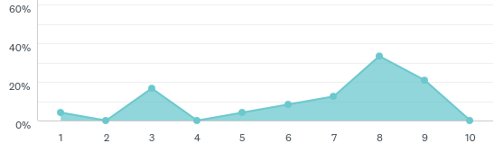
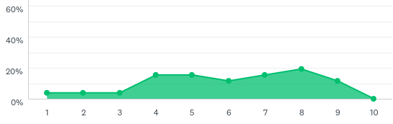
Help features provided with BrR; informational tips inside the product, tutorials, sample bridges, etc.
Rating
Member Agency / Local Agency / U.S. Agency Rating
Consultant Rating
Scale: 1 (needs significant improvement) to 10 (meets all of my needs)

Slide 35
Recommendations on how to better support BrR users
Rating
Member Agency / Local Agency / U.S. Agency
User Group Discussion Forum
More detailed examples
More detailed explanations
Consultant
Accelerated patch releases for program fixes
Better explanations/descriptions of input options
Expand online examples
Better training
More diagrams showing measurements

Slide 36
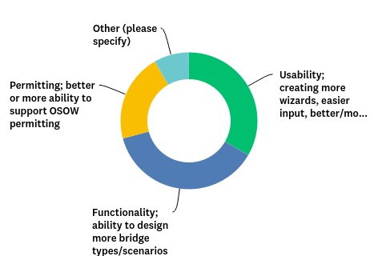
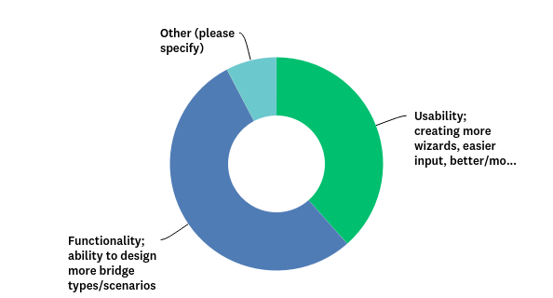
Most important topic to address in future enhancements
Rating
Member Agency / Local Agency / U.S. Agency
Consultant
Other: fixing all of the issues that exist within the software should be of vital importance to all users / Too many bugs, and odd program quirks
Other: better quality control as far as errors and issue where files don't run / Speed of analysis

Slide 37
Top priority/request for future development of BrR
Rating
Member Agency / Local Agency / U.S. Agency
User friendly interface
Faster software execution
Improved quality control
Import CAD developed models
Ability to model complex framing
Import DXF files for bridge layouts
Flexible options to produce, format, and control analysis output
More output reports in xml format
Support the following:
  timber decks on all structure types
  more complex structure types; curved, girders framing into girders, diaphragm analysis on curved/skewed structures
  enhancements for gusset plate ratings
  buried metal/concrete bridges and culvert pipes
  steel box girders
  longitudinal nail-laminated timber slab bridges.
.

Slide 38
Rating
Top priority/request for future development of BrR
Consultant
Improve functionality for input and rating of truss bridges.
Provide more complex rating examples
Add the ability to rate truss bridge floor systems that utilize both simple span and continuous stringers, or where the support conditions for adjacent stringers differ due to stringers being staggered by design.

Slide 39
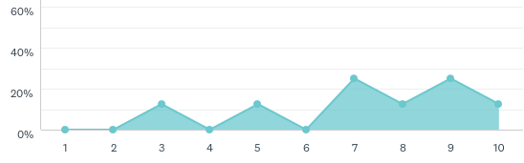
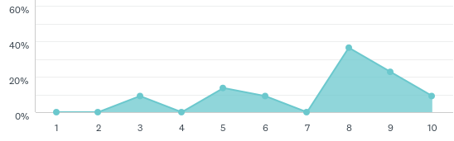
Support provided by Michael Baker through JIRA?
Member Agency / Local Agency / U.S. Agency
Design
Rating
Scale: 1 (needs significant improvement) to 10 (meets all of my needs)

Slide 40
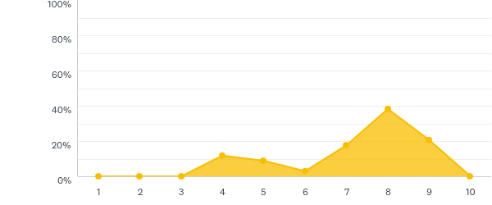
Staff Satisfaction with the AASHTOWare bridge products
Mgmt
Member Agency / Local Agency / U.S. Agency / Consultant Design/Rating Management
Scale: 1 (extremely dissatisfied) to 10 (extremely satisfied)

Slide 41
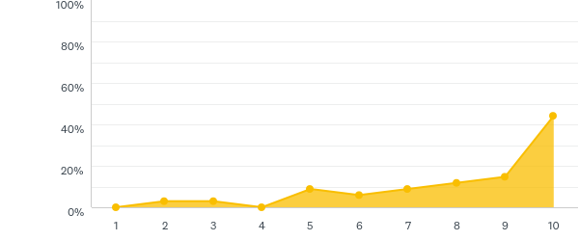
How integral is AASHTOWare BrR/BrR in the day-to-day business of your bridge section?
Mgmt
Member Agency / Local Agency / U.S. Agency / Consultant Design/Rating Management
Scale: 1 (we use AASHTOWare for a small number of bridges) to 10 (AASHTOWare is our primary design/rating software)

Slide 42
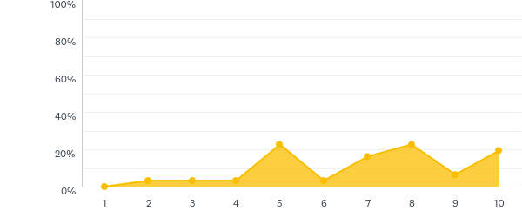
Relative to the cost, how would you rate the value that the AASHTOWare bridge products provides for your agency?
Mgmt
Member Agency / Local Agency / U.S. Agency / Consultant Design/Rating Management
Scale: 1 (low value) to 10 (high value)

Slide 43
Top priority/request for future development of the AASHTOWare BrD/BrR products
Mgmt
Member Agency / Local Agency / U.S. Agency / Consultant Design/Rating Management
Correct errors/bugs and outstanding JIRA issues before adding new features
User Interface / User Manuals
Faster analysis
Save ratings and design spec checks
Integration with BIM structure modeling
Improved integration with automatic OW/OS permitting software, including support for LRFR.
Include, for each type of bridge, and each past/current module;
  a standard load rating model that can be run to test for errors and be compared to the prior release, and
  an alternative version of the same rating in either hand calculation, MathCAD, or similar format, so the user can follow the process that the software is using
Steel design tool and prestressed design tool enhancements
Increase the number of culverts that may be rated

Slide 44
Top priority/request for future development of the AASHTOWare BrD/BrR products? (continued)
Mgmt
Member Agency / Local Agency / U.S. Agency / Consultant Design/Rating Management
Support the following
  three-sided buried structures
  culverts with variable slab thickness
  curved non-concentric girders
  GFS systems
  curved girders
  'dog-legged' or 'kinked' RC girders (straight girders on curved alignment)
  post-tensioned box girder bridges

Slide 45
Specific comments to share with the AASHTOWare Bridge Task Force and/or AASHTO
ALL
Quality / Testing
Improve beta testing (third party testing)
Ensure releases don’t introduce systemic problems
Increase focus to address JIRA ticket issues faster
Fix/update substructure design tools
Ensure 3D FE analyses take advantage of all available computer resources
Support
Consultants using the software should have access to Baker for support rather then being required to route support issues through their sponsoring DOT
Improve reliability in generating and maintaining load rating tool precomputed data
Ability to cut and paste multiple inputs from Excel, or even between inputs (currently this is limited to being able to paste into a single input box)
Functionality
Make the design materials simple but effective
Provide the ability to generate permit rating factors for Service I for concrete structures
When modeling single angles for diaphragms, provide the ability to reduce the stiffness of those members in accordance with BDS Article 4.6.3.3.4 & C4.6.3.3.4

Slide 46
Specific comments to share with the AASHTOWare Bridge Task Force and/or AASHTO
ALL
Ability to completely save results (major time saver rather than needing to re-run the rating)
Make the LRFR method a higher priority when member agency LFR enhancements are made to the software. The Task Force should also fund the LRFR feature in the enhancement.
Reporting features are a high priority.
Kudos
Thanks for your time and work to continue to improve and update BrDR.
Have done a great job in enhancing the software over time
We think you are doing a great job! The BrR software is our go-to tool and we look forward to working with it and benefiting from the continual improvements/enhancements long into the future. Thank you!

Slide 47
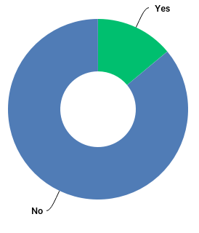
Do you wish to be contacted by a member of the AASHTOWare Bridge Task Force?
Seven (7) member agency respondents and six (6) consultant respondents requested to be contacted by a member of the AASHTOWare Bridge Task Force.

Slide 48
Questions / Comments?

Slide 49
AASHTO Expense Reimbursements
Concur – A majority of the AASHTO travel reimbursements will be handled via electronic input, submission, and approval.
Judy Tarwater will conduct a brief Concur “how-to” session this afternoon at 4:30 for AASHTO member agency attendees.
Current Travel Reimbursement form on the RADBUG website
For those AASHTO-reimbursable attendees who require travel reimbursements to go through their agency, the manual travel expense reimbursement process may be used. Sign reimbursement form, scan form and receipts, email submission to Judy Tarwater jtarwater@aashto.org

