Slide 1


Batch Analysis of BrR Models
July 2019
Presented by: California DOT / Igor Chernioglo, P.E.

Slide 2
Contents
Managing Bridge Rating Data
Caltrans Rating Data Archiving
Available Batch Analysis Tools
CT Batch Analysis Tool
Possible Future Tool Development
for AASHTOWare

Slide 3
I. Managing Bridge Rating Data (1)
California DOT (CalTrans / CT) Bridge Ratings:
About 25,000 bridges (state + local)
6,700+ BrR models as of July 2019
Currently load rating for 20 vehicles (1-design, 8-legal, 2-EV, 9-CA permit). New vehicles or adjustments sometimes necessary.
  Analyze existing models for EV2/EV3; county estimate $3,500 or about 20 hours per bridge.
Load ratings need to be maintained and updated periodically for changes in conditions, code, and software.
Notes:
We have ~350 bridge models that were analyzed before EV2 / EV3 requirements came out. These bridges needed to be re-analyzed to include these vehicles by December 2019.

Slide 4
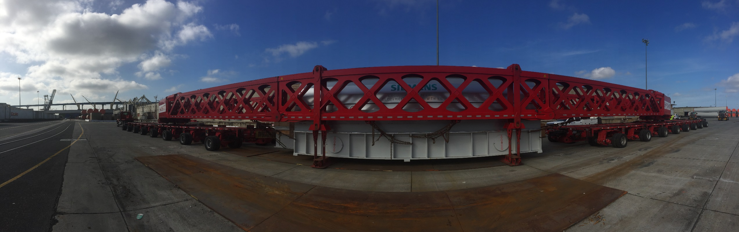
I. Managing Bridge Rating Data (2)
California DOT (CalTrans / CT) Bridge Ratings (cont):
BrR software, the main bridge rating tool, is updated 1-2x a year.
Regularly route heavy permit vehicles.
To manage all of the above efficiently, need automation when possible/applicable.
Notes:
Desirable to check new versions of software by running test models on new version and comparing results to previous version. Provides user confidence.
About 350-400 permit requests are routed through the load rating Permits Specialist. This is in addition to the automated system.
Biggest load to date ~1.6 million pounds
Before going into batch analysis, will discuss Caltrans rating data archiving

Slide 5
II. CT Rating Data Archiving (1)
For each bridge that is load rated in BrR, CT generates and archives a detailed report.
In-house ‘BrRSummary’ spreadsheet tool is used to extract and archive results for each vehicle and each member using data from BrR ‘Detailed Rating Results’ report
  Summary sheet: controlling RF, load action and location.
  Detailed output: Shear and Moment demand, capacity and RFs are reported at all 1/10 pts
Notes:
Here’s a brief description of the type of data that Caltrans archives when a bridge is load rated in BrR.
BrRSummary spreadsheet tool is not able to handle some superstructure types: truss, FBS. Detailed report is generated in BrR and copied into tool. Tool generates desired format of summary and detailed results.

Slide 6
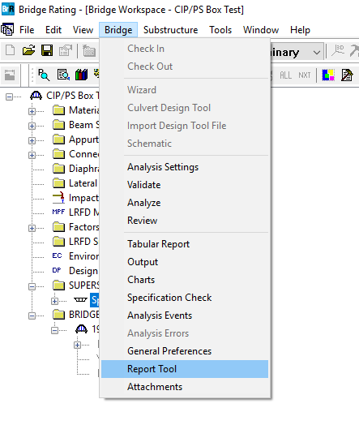
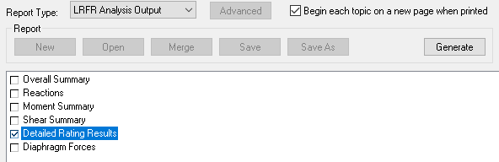

II. CT Rating Data Archiving (2)
To generate report for archiving, CT load rater:
Runs analysis in BrR
Generates ‘Detailed Rating Result’ report in BrR
Notes:
Process to generate archive data.

Slide 7
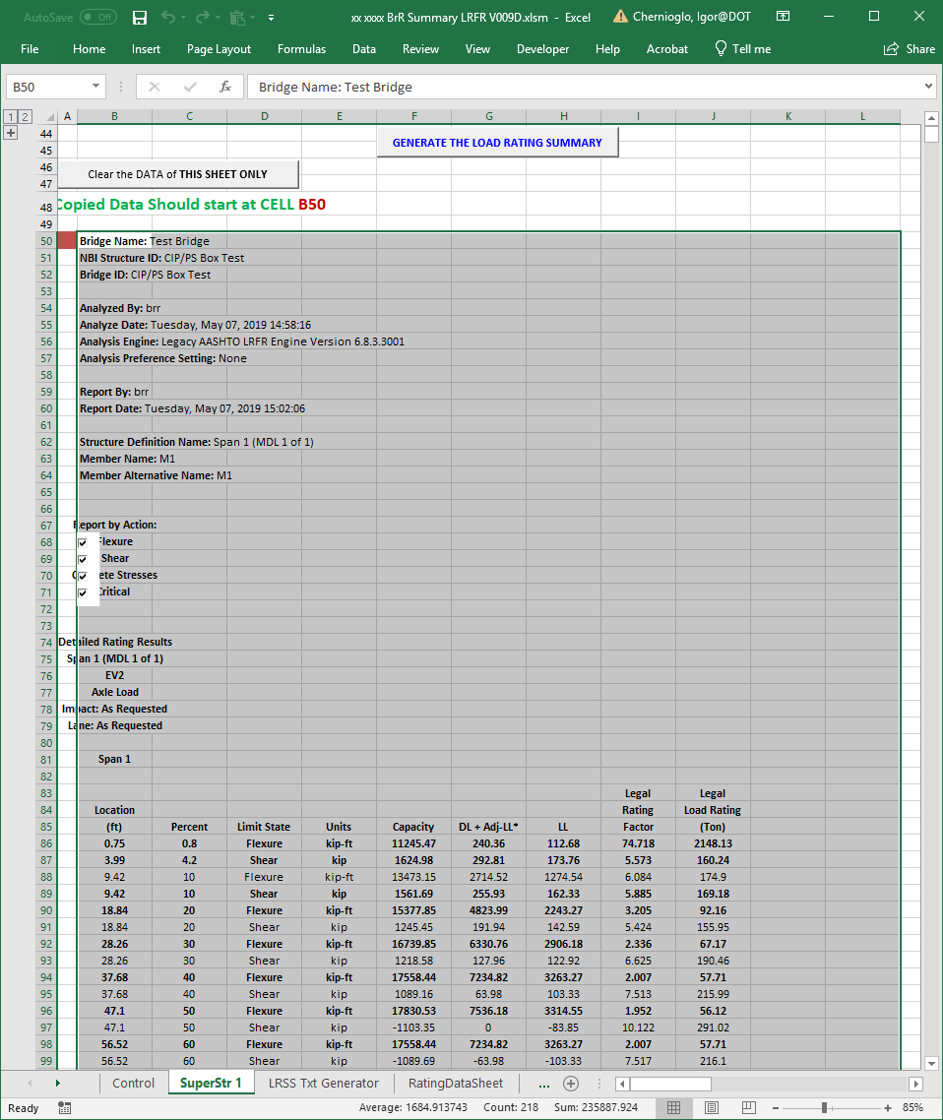
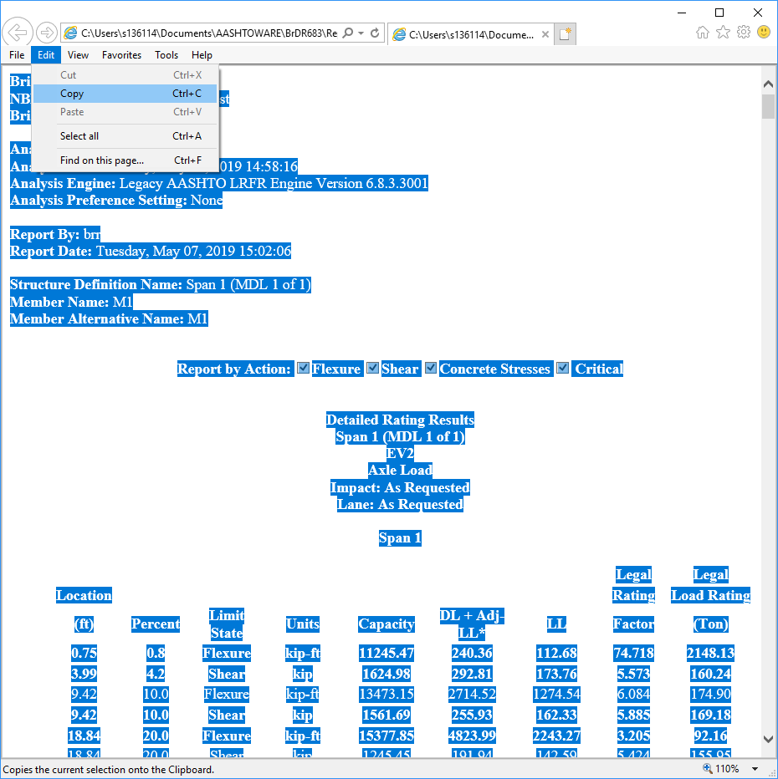

II. CT Rating Data Archiving (3)
3. Copy and paste report contents into BrRSummary spreadsheet and click ‘Generate…’
Notes:
Process to generate archive data.
Hope that format will remain the same for 7.0 so we can continue using this tool

Slide 8
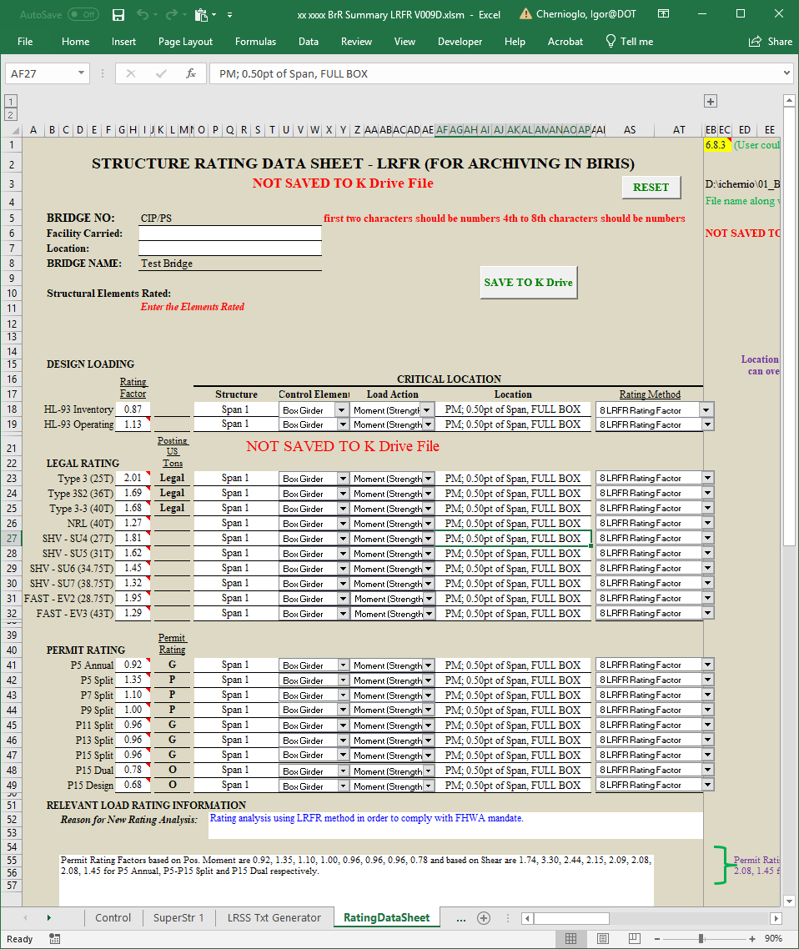
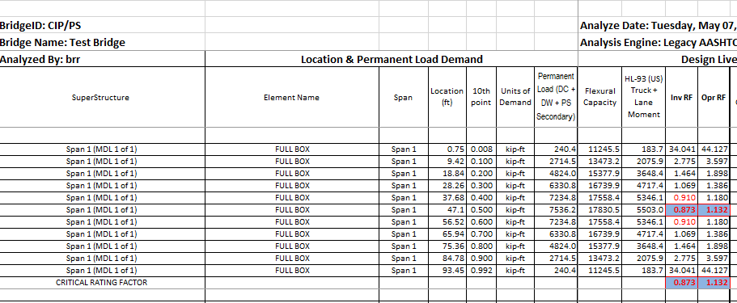
II. CT Rating Data Archiving (4)
Summary of controlling RFs is reported
Detailed rating information in separate tabs
Report is saved in PDF form and archived
Notes:
Process to generate archive data.

Slide 9
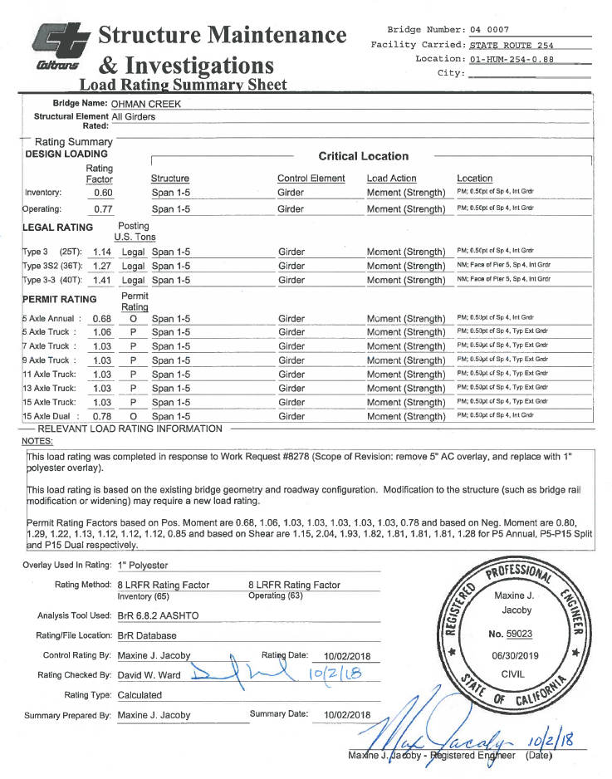
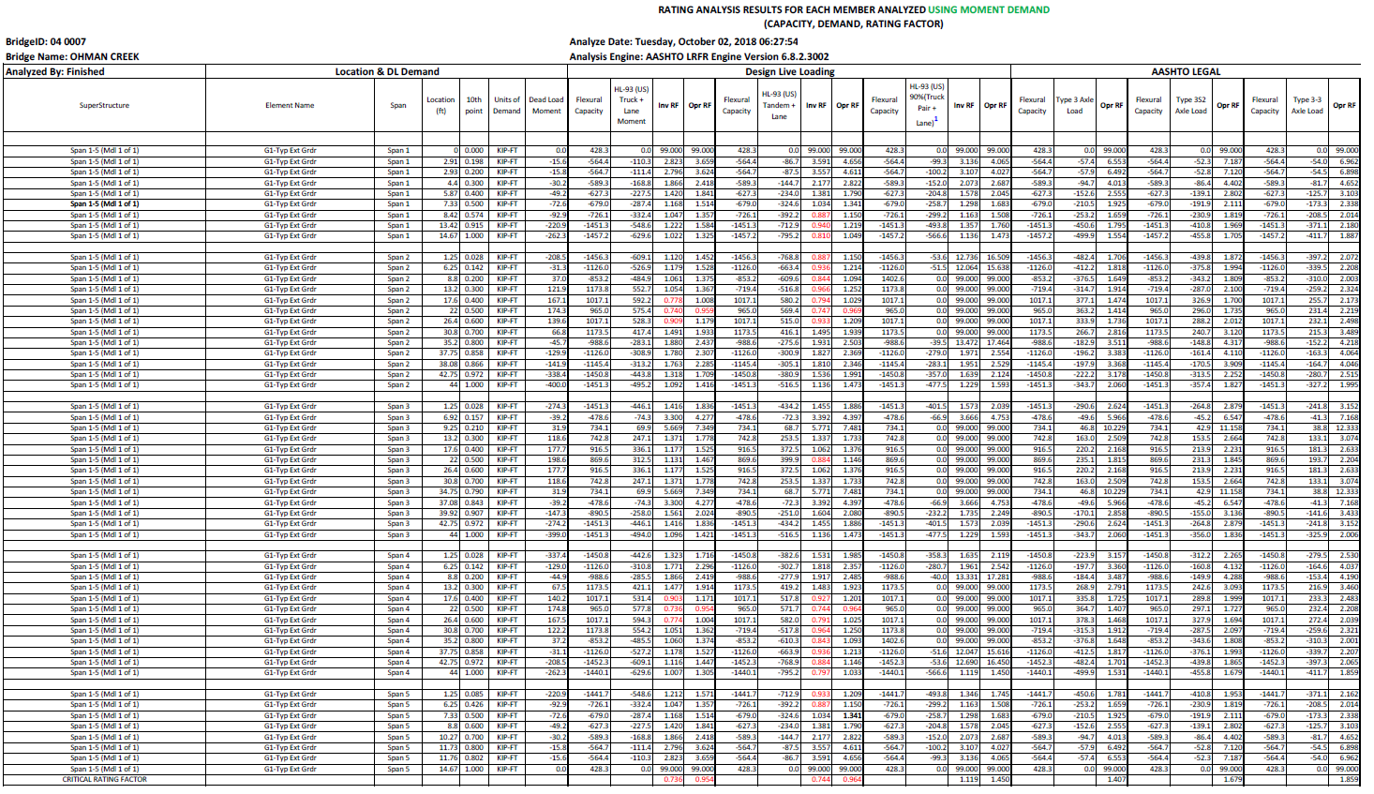
II. CT Rating Data Archiving (5)
BrRSummary tool output.
Sheet 1 of 19 of detailed results for this bridge:
Some bridges have over 100 pages of results.
Notes:
Sample of archive data of completed bridge.

Slide 10
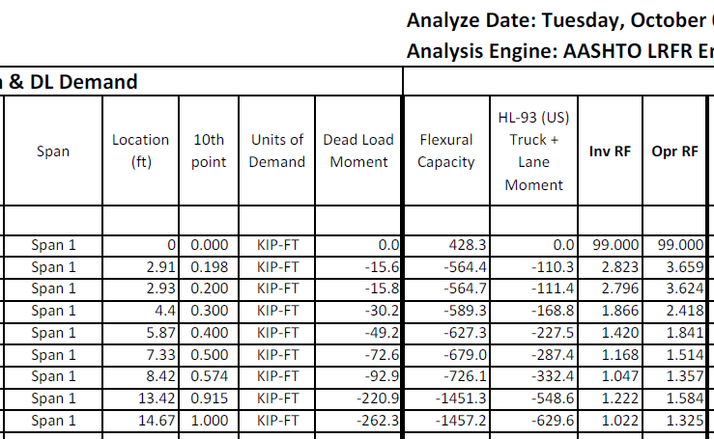
II. CT Rating Data Archiving (6)
Sheet 1 of 19 clip of detailed results for this bridge:
Notes:
Sample of detailed archive data of completed bridge.
We have similar results for Flexural, Shear, Overload as applicable. For Each girder, each vehicle, “Full box”, and Individual Webs of MCB.
Archive provides a detailed rating record, allows us to answer questions from internal/external partners quickly (counties, Caltrans bridge design).

Slide 11
II. CT Rating Data Archiving (7)
Lots of data for lots of bridges.
Need automated Batch analysis and processing tool to utilize when applicable.
Some built-in tools are available in BrR to analyze multiple bridges. Each has its own functionality and limitations.
(1) Load Rating Tool
(2) Regression Testing Utility
(3) Rating from Project Explorer

Slide 12
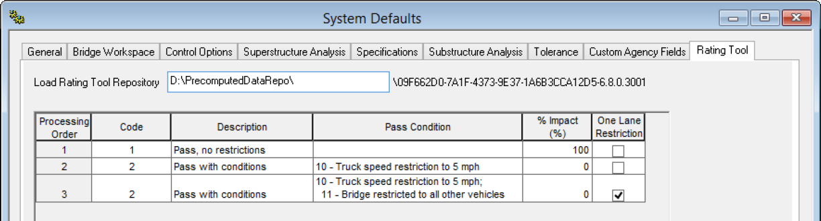
III. Available Batch Analysis Tools (1):
(1) Load Rating Tool
Multiple bridges can be analyzed.
Multiple scenarios can be run (e.g. no restrictions, speed restricted with reduced or no IM)
After analysis is pre-computed and stored, rating is very fast
Notes:
Comes with default BrR installation but needs to be enabled in GUI using Admin Utility.
Pre-computed data is generated in Tool and influence lines stored for high-speed rating when needed at a later date.
1st scenario is run. If passes, analysis stops. If 1st scenario fails, continues to 2nd and so on.
Tool has restriction for speed (remove impact) and restrict traffic to no other vehicles on bridge (One Lane Restriction) which are CT’s most common restrictions for permitting.

Slide 13
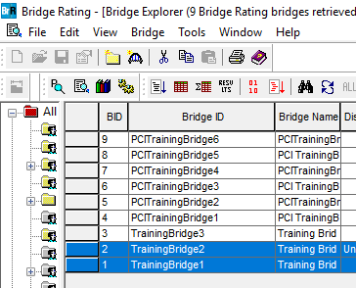
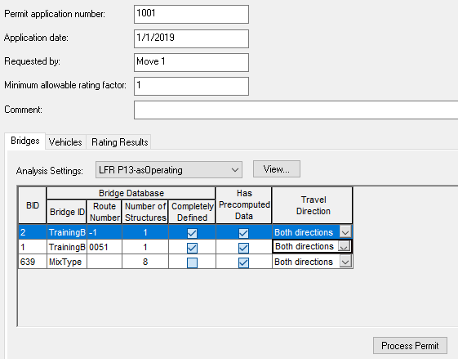
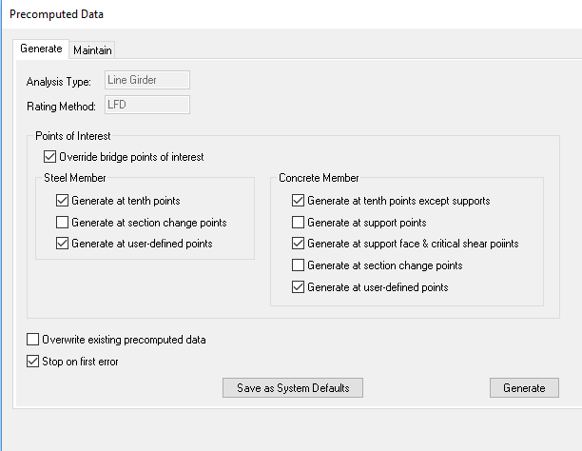
III. Available Batch Analysis Tools (2):
(1) Load Rating Tool
Notes:
1. Generate pre-computed data
2. Process Permit

Slide 14
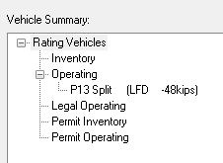
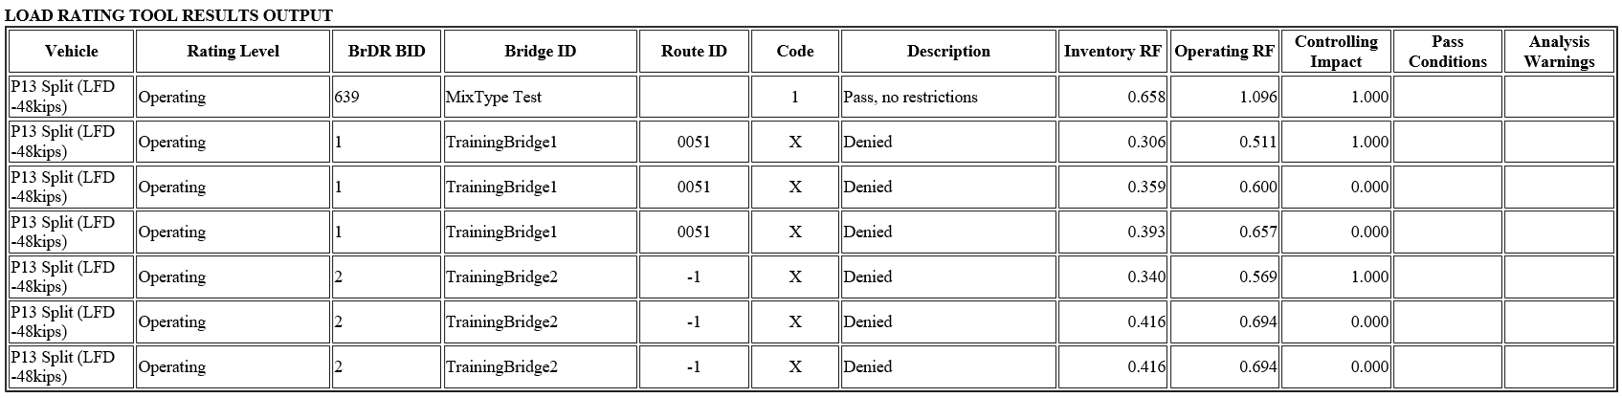
III. Available Batch Analysis Tools (3):
(1) Load Rating Tool
Limitations:
  LFR only. Most CT bridges analyzed with LRFR.
  Variable axle vehicles not supported.
  Only Inventory and Operating category vehicles.
  Report very limited. Only controlling RF reported.
  Pre-computed data is lost when BrR is updated to newer version.
Notes:
There’s an ongoing effort to add LRFR into Rating Tool.
Currently, this tool is available only for ‘multi-girder bridge with steel, RC or PS concrete members.
Other girder types will be added to the Rating Tool in 7.1 version.
Since ‘Permit’ vehicle category can’t be rated, not able to rate mixed type vehicles, e.g. permit with adjacent design/legal traffic

Slide 15
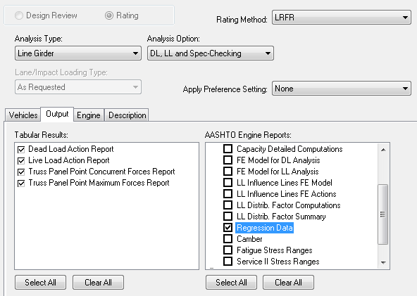
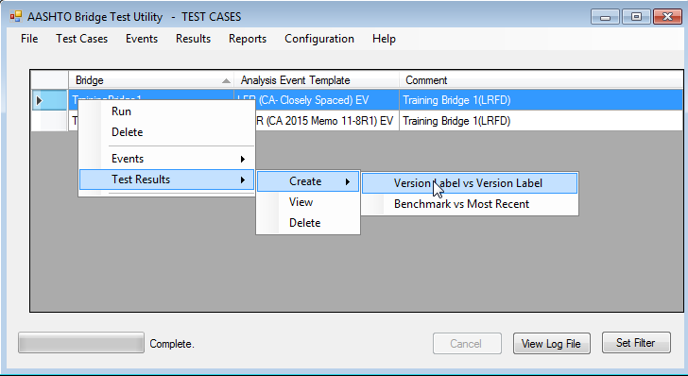
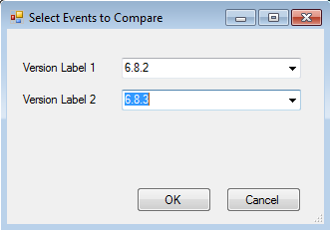
III. Available Batch Analysis Tools (4):
(2) Regression Testing Utility
Multiple bridges can be analyzed.
Use: Analyze model(s) in 2 versions of software and compare results (NCHRP 12-50 report formats) and spec articles
Notes:
Regression data can be generated 2 ways:
Run in BrR with Output/Regression data analysis setting checked
Run within Tool
When analysis is run, 1 RTU and 1 SCA file is generated for each member alternative
RTU: data for NCHRP 12-50 reports (DL, LL, capacity, etc)
SCA: spec article data

Slide 16
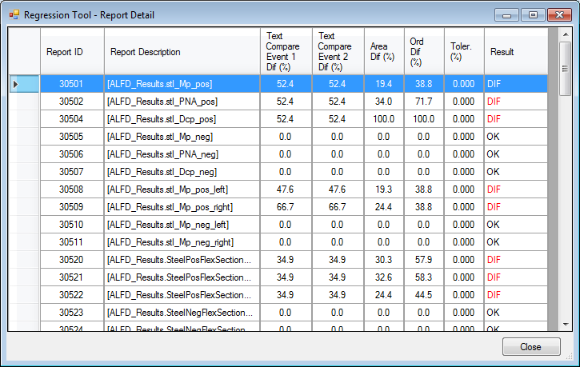
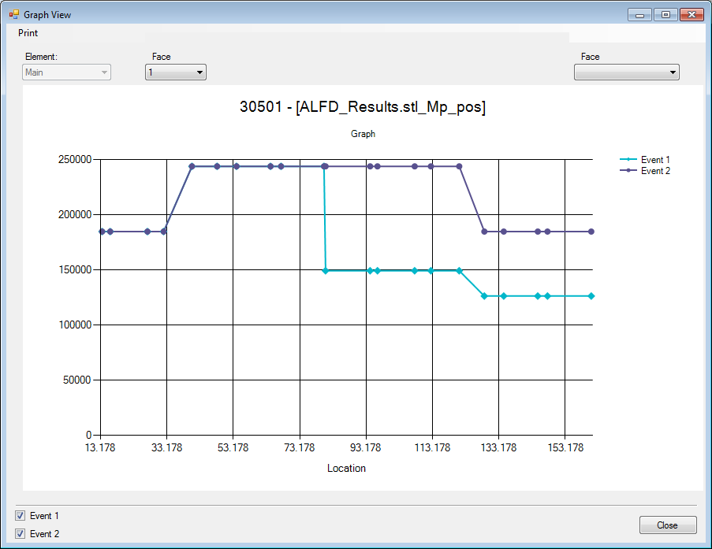
III. Available Batch Analysis Tools (5):
(2) Regression Testing Utility
Comparison of .rtu reports:
Notes:
Tolerance is set and report summary shows which Reports are out of tolerance
Plot of both runs is available for each Report ID for comparison

Slide 17
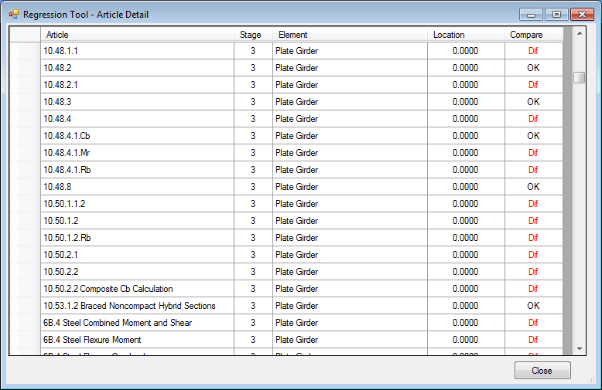
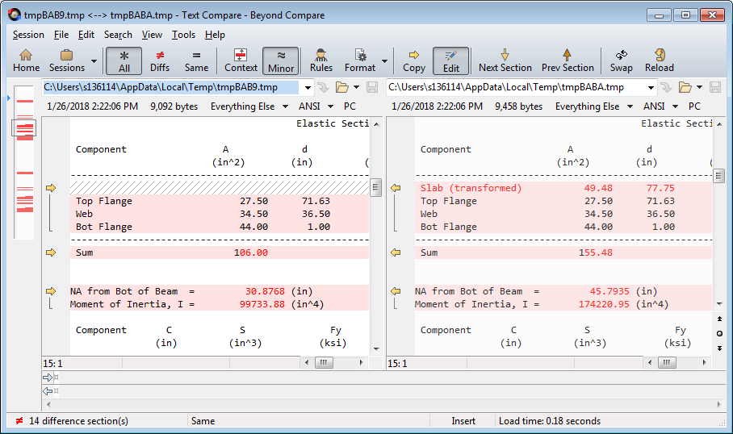
III. Available Batch Analysis Tools (6):
(2) Regression Testing Utility
Comparison of .sca reports:
Notes:
Need to download separate text comparison software
For each article, side by side text comparison. Differences are highlighted.

Slide 18
III. Available Batch Analysis Tools (7):
(2) Regression Testing Utility
Works wells for detailed comparison of differences between runs. Good for ‘digging in’.
Limitations
  No comparison available for RFs.
  Comparison is at member level. Not available at superstructure or bridge level.
  Not available for all structure types (e.g. box girders).
  Always checks all reports making testing of batch tedious.
Notes:
Currently limited to the following types:
Steel and open concrete girders
Trusses
Concrete deck
Wood deck and beams
Batch analysis version of RTU does not have option to compare only selected reports, only all. Single bridge version has option to select only desired reports.

Slide 19

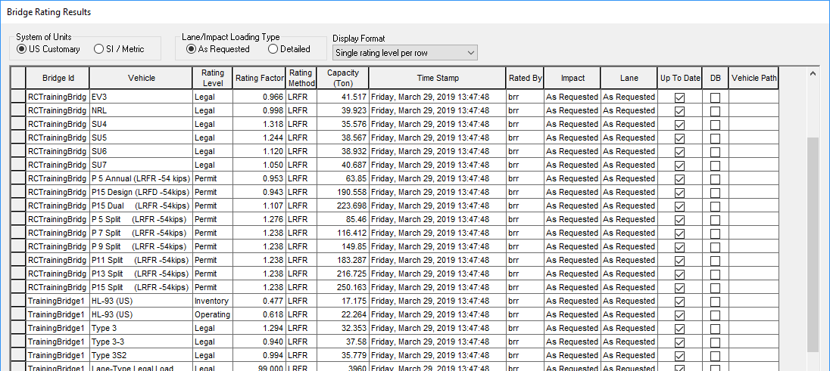
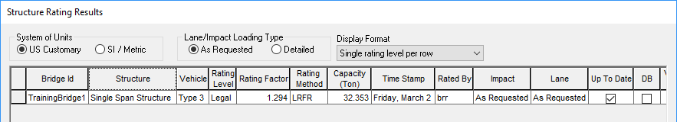

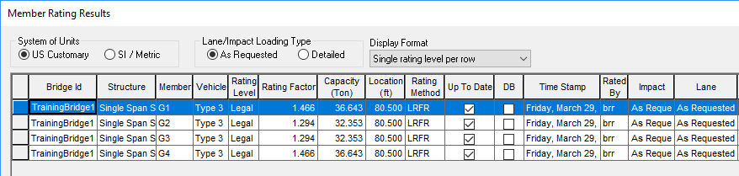
III. Available Batch Analysis Tools (8):
(3) Rating from Project Explorer
Multiple bridges can be selected and rated at the same time
Limitations:
  Limited results: load rating as RF and Tons and for structure and each member.
  Reports are not available & no export option
Notes:
Select multiple bridges.
Right click, ‘Rate’. Pick ‘Analysis Setting’. Click OK to begin rating analysis.
Right click, ‘Rating Results’ to view results of each bridge
‘View Structure Rating Results’ for the selected vehicle gives RFs for all superstructure definitions
‘View Member Rating Results’ for the selected superstructure gives RFs for all members.
Print option available for each window of results.

Slide 20
IV. CT Batch Analysis Tool (1)
Needed a tool that can:
  Analyzes bridges in batches
  Store detailed rating information at bridge, superstructure and member level
  Compare RFs, capacity, demands with previous runs
  Existing built-in tools (1) Load Rating Tool, (2) Regression Testing Utility, (3) Rating from Project Explorer did not meet our needs.
New in-house ‘Batch Analysis’ spreadsheet tool in combination with other tools developed.
Notes:
Tools available with AASHTOWare had limitations and did no meet our immediate needs

Slide 21
IV. CT Batch Analysis Tool (2)
Tool Function: Batch analysis of bridges.
  Save BrRSummary spreadsheet for each.
  BrRSummary spreadsheet includes detailed and summarized rating information for bridge, each superstructure definition and each member (RF, capacity, demand) that can be used for various purposes.
Tool Methodology:
  Mimics actions of a user. Controls the mouse pointer to open, extract pre-determined bridge data, analyze in BrR, and save results in BrRSummary spreadsheet for each bridge.
  Macros automate repetitive actions of user to analyze and save results for batch of bridges.
  If a model fails to run, Tool makes note and moves on to next bridge.
Notes:
Developed by student assistant and engineer with basic knowledge of VBA.
Why VBA with Excel? That is what we knew and had available to us.
Lots of Google ‘how to…’
VBA macros used to interact with BrR by clicking the pointer at specific locations on screen in the proper sequence and proper timing in order to execute the desired actions in BrR to extract needed information or to run analysis.

Slide 22
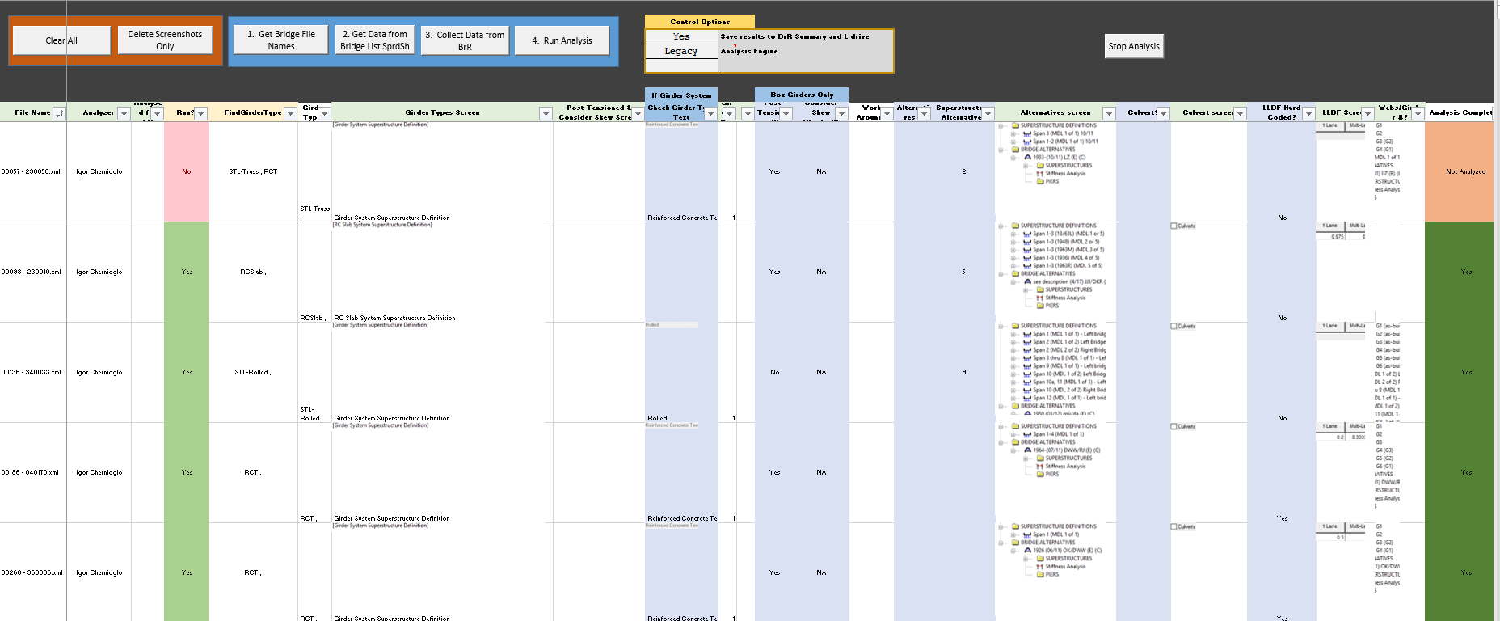

IV. CT Batch Analysis Tool (3)
Play video recording of screen
Notes:
Explain the parts of the spreadsheet

Slide 23


IV. CT Batch Analysis Tool (4)
Process:
Initial set-up requires user to size BrR window to a specific size, locate (x,y) coordinates of certain locations of BrR window, and define location of files (models, BrRSummary).
Export BrR models to a folder on local or network drive.
User selects folder where models are located and all file names are gathered.
Girder type data is imported from external list of all CT bridges
Notes:
Girder type data is imported since the BrRSummary spreadsheet cannot handle all girder types (e.g. truss). Tool determines if it should/shouldn’t auto analyze bridge based on girder type.

Slide 24


IV. CT Batch Analysis Tool (5)
Pre-determined data is extracted from BrR models. Auto screenshots are taken of data from BrR and saved.
Online text recognition tool is used to automatically extract data from some screenshots
User reviews data. Based on gathered screenshot data, user converts remaining required entries to digital data (e.g. number of superstructure definitions).
Models are auto run sequentially and BrRSummary spreadsheets are saved for each bridge.
Notes:
Auto screenshots include superstructure and girder type of 1st superstructure, number of superstructure definitions, if LLDFs are hard-coded.
This is data that we were interested in gathering; not all are necessary for purpose of batch analysis.

Slide 25
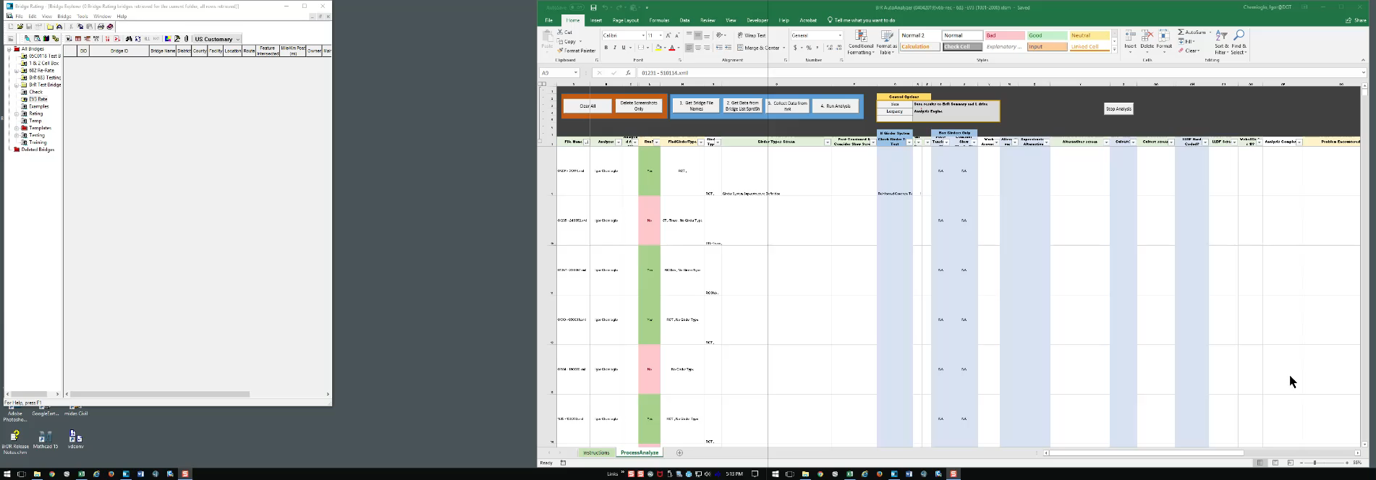
IV. CT Batch Analysis Tool (6)
Play video recording of screen
Notes:
Screen recording shows Tool in action.
Describe what will happen before clicking ‘Play’
Click ‘Collect Data from BrR’
Each bridge on list is processed sequentially
Data is extracted from model and stored in spreadsheet

Slide 26
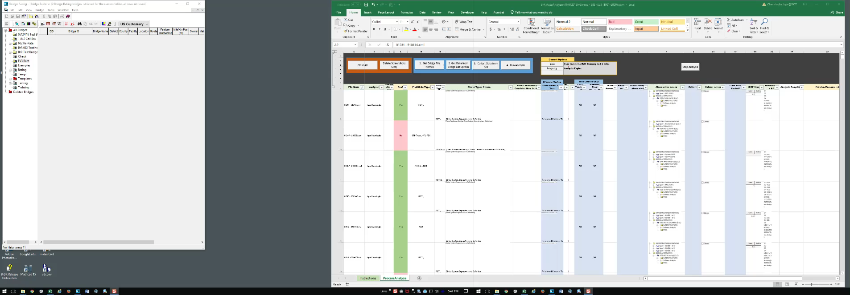
IV. CT Batch Analysis Tool (7)
Play video recording of screen
Notes:
Describe what will happen before clicking ‘Play’
User reviews extracted data and in blue shaded columns, converts screenshot data to digital data if macro hasn’t.
Click ‘Run Analysis’
Screen recording shows Tool in action. Each bridge is:
Analyzed in BrR
Detailed report is generated
Results are saved in BrRSummary spreadsheet

Slide 27
IV. CT Batch Analysis Tool (8)
Uses to date:
  Re-analyzing old models (760+) with current version of BrR (initial step to load rating maintenance).
  Analyzing existing models of 350 bridges for EV2/EV3
  Beta testing of 6.8.3.
    Batch of bridges (tot 140) run in official release and beta versions of software. Results saved in BrRSummary spreadsheets.
    Additional spreadsheet tools with macros developed to compare results (RF, demand, capacity) in order to identify bugs in beta version of software. Multiple batch runs due to multiple Beta releases.
Notes:
As mentioned previously, one of the counties in CA had estimated $3,500 per bridge to re-analyze for EV2/EV3

Slide 28
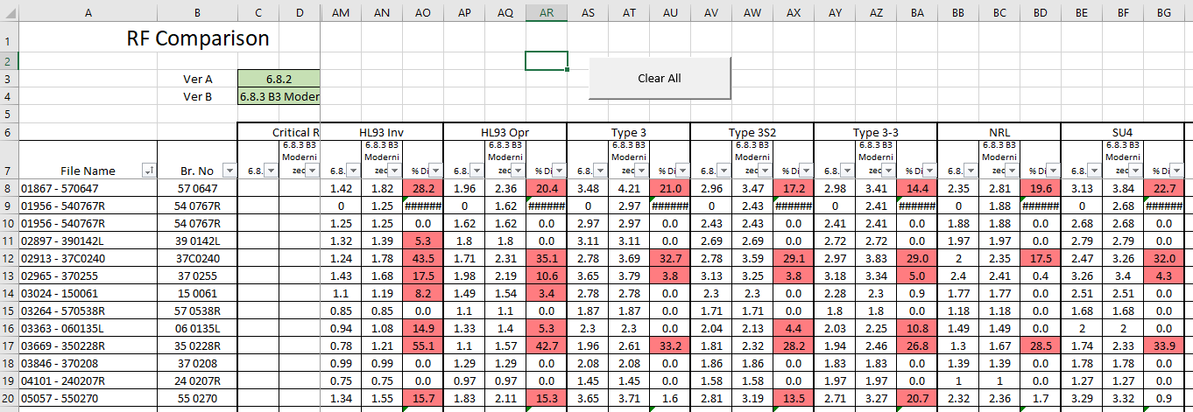
IV. CT Batch Analysis Tool (9)
  Beta Testing:
    1. Run Batch Analysis Tool for (a) benchmark and (b) new version of software.
    2. Level 1 Comparison.
      ‘RF Comparison’ of all test bridges, all vehicles.
Notes:
Saves detailed results in BrRSumary spreadsheet for each bridge. Benchmark (Ver A) and beta (Ver B)
Using separate tool with macros (shown) for all test bridges auto compare RFs, all vehicles. Results outside of tolerance (set at 5%) are shaded red.

Slide 29
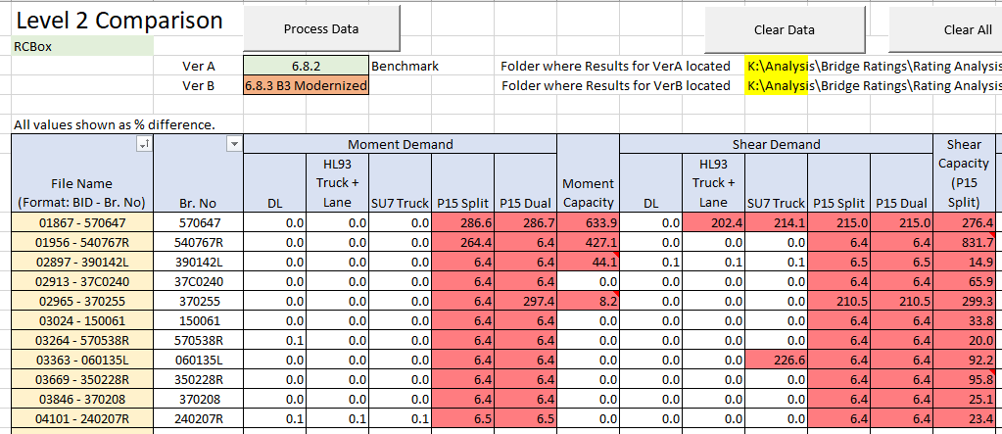
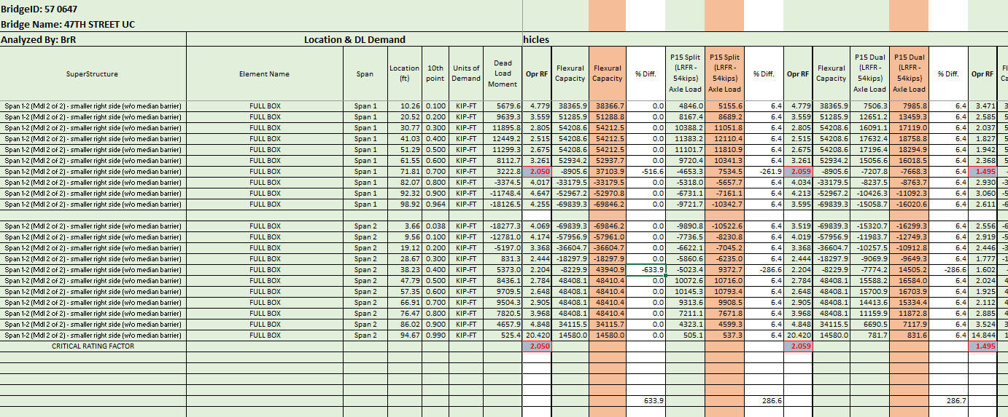
IV. CT Batch Analysis Tool (10)
  Beta Testing (cont):
    3. Level 2 Comparison.
      For bridges outside of tolerance for RFs, generate detailed comparison for selected vehicles to determine source of discrepancy.
Notes:
3. Separate spreadsheet tool with macros.
Compares moment/shear, DL/LL, capacity.
Max differences are summarized and differences outside of tolerance (set at 5%) are shaded red.
Side by side comparison at all 1/10 pts can be viewed.

Slide 30
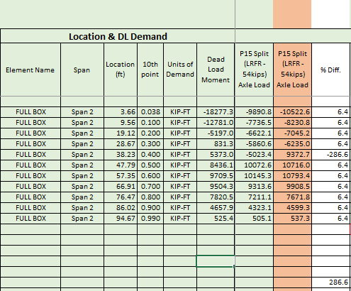
IV. CT Batch Analysis Tool (11)
  Beta Testing (cont):
    3. Level 2 Comparison.
      Side-by-side comparison of results from 2 runs.
      Maximum discrepancies are summarized.
Notes:
Example of moment demand comparison of permit P-15 truck.

Slide 31
IV. CT Batch Analysis Tool (12)
Possible future use:
  Permitting. Run batch of bridges along proposed route and determine controlling bridge. View detailed results for controlling bridge if needed.
  Maintenance plan for load ratings. Run all bridge models at regular interval to keep ratings up to date.
    Auto-compare to previous ratings. For results within tolerance, finalize new rating with minimal work.
    Ensures ratings reflect current condition of structure.
    Ensures ratings are per current code.
    Ensures models remain usable.
Notes:
Can select batch of bridges for permit request and view rating in detail for controlling bridge.
Maintenance plan: update model as needed (overlay, condition, etc) and re-analyze in new version of BrR every 2-4 years

Slide 32
IV. CT Batch Analysis Tool (13)
Benefits of Tool | Limitations of Tool
Repetitive tasks automated Production can be increased Auto run after hours Run on multiple PCs | Sensitive to the monitor settings, OS, Office version. Use on a specific machine may require ‘fine-tuning’ of code. Requires dedicated PC, preferably 2 monitors. Needs maintenance. If BrR update changes GUI, the Tool may not work. Since in-house BrRSummary spreadsheet is used, results that can be saved are limited to BrRSummary capability
Notes:
Benefits
Turn on for a batch of bridges when leaving work, come in morning with batch complete
Frees engineer from repetitive tasks to focus on other work
Can be run on multiple PCs to analyze large batch of bridges quickly and run after hours without impacting other work
Limitations
Sensitive since Tool uses excel VBA and relies on manipulating the pointer
7.0 changes GUI, won’t work as-is

Slide 33
V. Possible Future Development (1)
Develop similar tool with AASHTOWare:
New 3rd party API . With API, BrR functions and model data can be accessed directly (no need to mimic manual methods). Can run in background.
Enhance one of existing BrR Tools.
The software can be developed with the following desirable features:
  a. Flexible, multi-criteria search and filter of BrR bridges to be analyzed.
  b. Reporting of results:
    Overall summary Report of results for all bridges in batch.
    Summarized and Detailed Report of results for each bridge, similar to CT BrRSummary tool.
Notes:
API = Application Programming Interface
Existing tools: (1) Load Rating Tool
(2) Regression Testing Utility
(3) Rating from Project Explorer
In my opinion, the most promising tool for enhancement is the Regression Testing Utility since it already has most of the detailed data and results.
E.g. location (route, post mile, county), bridge type, year built, etc with option to add and remove individual bridges from rate list.
**Permitting: case w/ & w/o IM, pass or fail, if multiple structures in model, which structures pass, which fail. Pos M, Neg M, Shear

Slide 34
V. Possible Future Development (2)
  c. Comparison of results:
  M=Moment S=Shear
  Can be generated using separate ‘Report’ for each level
Bridge Level | Superstructure Level | Member Level
M&S RFs for each vehicle | For all 1/10 pts. & critical POIs: M&S RFs for each vehicle LLDFs | For all 1/10 pts. & critical POIs: M&S RFs for each vehicle LLDFs M&S capacity M&S DL demands M&S LL demands for each vehicle
Notes:
Comparison used for comparing new run with older run and determining reasons for differences
or
For comparing versions of software and determining reasons for differences . Provides user confidence.
Allow user to generate more detailed reports directly from within higher level reports.

Slide 35
Questions?

