Slide 1
AASHTOWare Bridge Design & Rating (BrDR)
3D FEM Analysis Capabilities
AASHTOWare RADBUG Meeting
July 30-31, 2019
South Lake Tahoe, CA

Slide 2
AASHTOWare Bridge Design & Rating (BrDR)
Concrete Beam Modeling
Steel Beam Modeling
Mesh Generation
Support Conditions
Concrete Deck Behavior
Loading
Specification Checking

Slide 3
BrDR 3D Capabilities
Straight multi-girder systems
  Steel beams
  Reinforced concrete beams (I’s and Tee’s)
  Prestressed concrete beams
Curved multi-girder systems
  Steel beams

Slide 4
BrDR 3D Capabilities
Beam elements are Timoshenko beam elements that capture shear deformations
Shell elements have 4 nodes with six DOF at each node
Shell elements use a locking-free formulation that can be used for thin and thick shells. These elements will not lock as the shell becomes thinner. Shear deformations are captured.

Slide 5
3D Reinforced Concrete Beam Modeling
Stage 1 Model (for dead load analysis)
  Beam element with I and A of full beam shape including the deck
Stage 3 Model (for live load analysis)
  Girder web and bottom flange (if applicable) modeled as beam elements
  Slab modeled with shell elements
  Master-slave connections connect the girder beam element (master) to the middle of the deck shells (slave)

Slide 6
3D Reinforced Concrete Beam Modeling

Slide 7
3D Prestressed Concrete Beam Modeling
Stage 1 Model (non-composite section)
  Beam element with I and A of PS beam shape
Stage 2 and Stage 3 Models (composite sections)
  Girder modeled as beam elements
  Slab modeled with shell elements
  Master-slave connections connect the girder beam element (master) to the middle of the deck shells (slave)

Slide 8
3D Prestressed Concrete Beam Modeling

Slide 9
3D Steel Beam Modeling
Stage 1 Model (non-composite section)
  Girder flanges modeled using beam elements, girder web modeled using shell elements
Stage 2 and Stage 3 Models (composite sections)
  Girder flanges modeled using beam elements
  Girder webs and deck modeled using shell elements
  Master-slave connections connect the girder top flange beam element (master) to the middle of the deck shells (slave)

Slide 10
3D Steel Beam Modeling

Slide 11
3D Steel Beam Modeling
Cross-frames modeled using beam or truss elements based on the end connection type specified by the user.
Curvature is represented by straight elements with small kinks at node points instead of curved elements

Slide 12
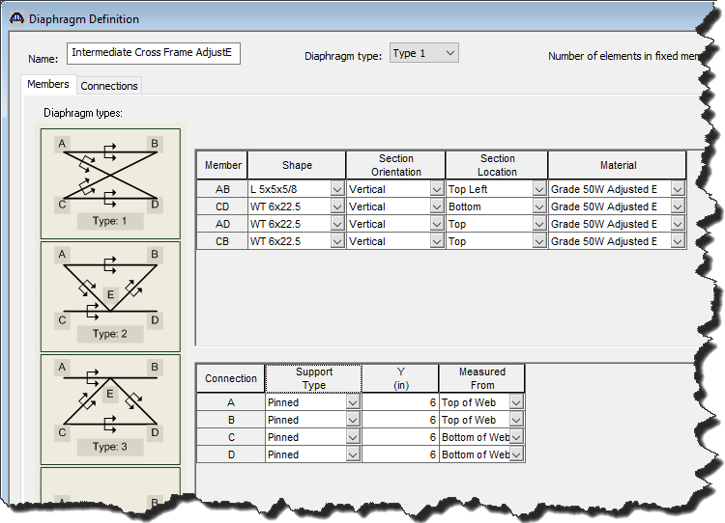
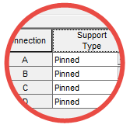
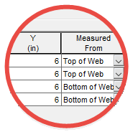
3D Diaphragm Modeling
Diaphragm definitions are assigned to locations along the structure.
Users can control the 3D modeling of the diaphragms through these definitions

Slide 13
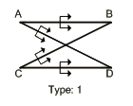
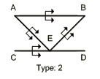
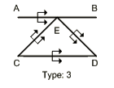
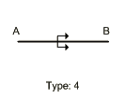
3D Diaphragm Modeling
Steel beam systems – All diaphragm types
Concrete beam systems – only Type 4

Slide 14
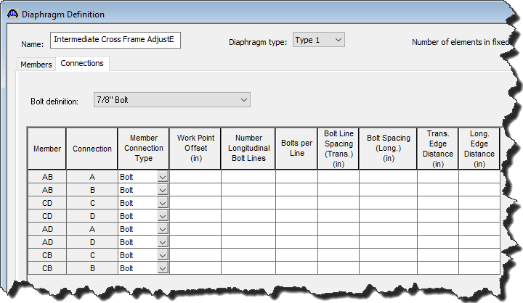
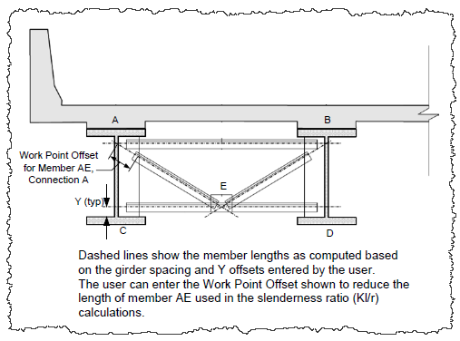
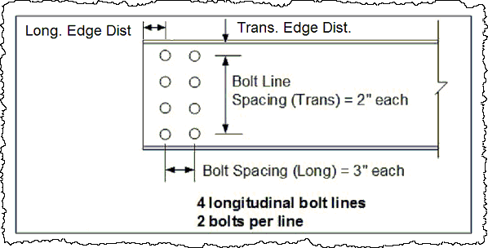
3D Diaphragm Spec Checking

Slide 15
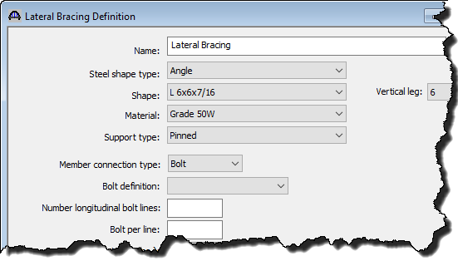
3D Bottom Flange Lateral Bracing

Slide 16
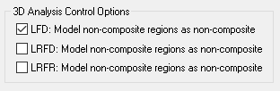
3D Analysis Control Options
If checked, master-slave constraint in non-composite region only binds vertical displacement

Slide 17

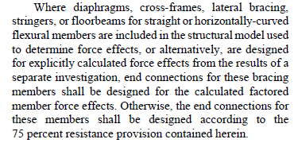
3D Analysis Control Options
LRFD 6.13.1:

Slide 18

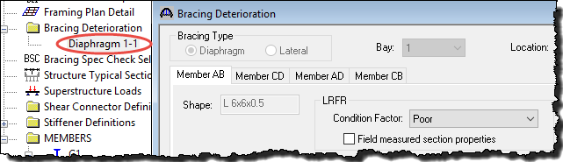
3D Analysis Control Options
Default
Location override

Slide 19
3D Mesh Generation
Automatic mesh generation with user controls
Nodes always created at:
  Tenth points
  Section change points
  Diaphragms, bottom flange lateral brace points
  Supports
  User defined points of interest

Slide 20
3D Mesh Generation
Rectangular deck slab shells require same number of nodes along each girder
Equal number of nodes per span for each girder
Nodes kept at same percentage of span length

Slide 21
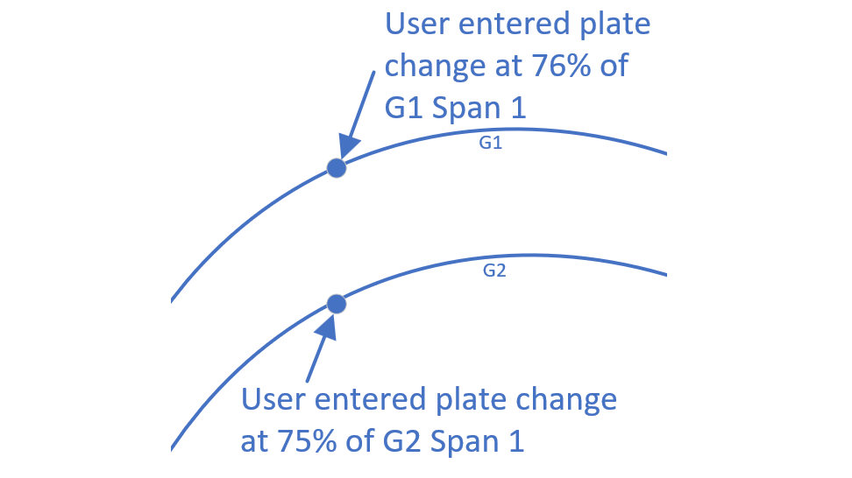
3D Mesh Generation
Point added at 75% of G1 Span 1 (bitmask 0)
Point added at 76% of G2 Span 1 (bitmask 0)

Slide 22
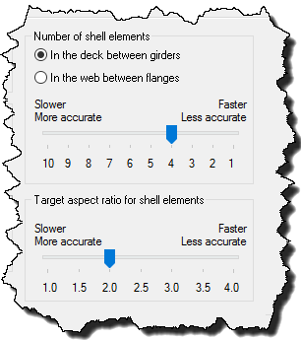
3D Mesh Generation
The user sets either the number of shell elements in the deck between girders or the number of shell elements in the web along with a target aspect ratio.
Presence of nodes at standard locations may result in some elements falling outside the target aspect ratio

Slide 23
3D Diaphragm Modeling
Original web nodes are evenly spaced over the web height
Web nodes closest to diaphragm connection points are found and shifted to match the user input diaphragm connection points
Beam nodes are held constant. If a diaphragm connection point is within ½ the web shell height of a beam node, the diaphragm connection is moved to the beam node

Slide 24
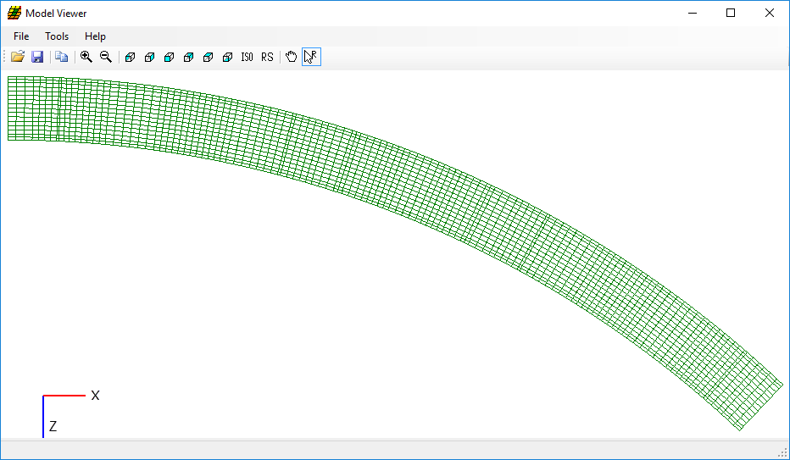
3D Mesh Generation

Slide 25
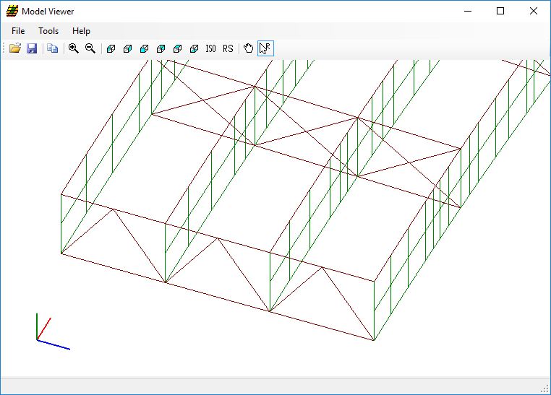
3D Mesh Generation
Y
X
Z

Slide 26
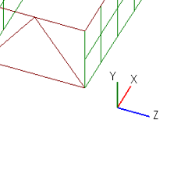
3D Support Conditions
For all support types other than “fixed’, only the bottom-most node of the beam is set as a support.
If the support type is specified as “fixed”, then all nodes vertically above the support node and including the support node and deck node are set as supports according to the following rules:
  All nodes are fixed for all translation constraints
  Rotation X is never constrained
  Rotation Y is restrained for just the beam elements
  Rotation Z is restrained for all nodes

Slide 27
Example of a Fixed End Support

Slide 28
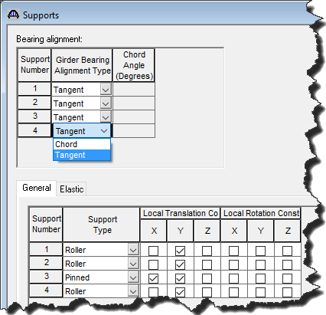
Curved Structure 3D Support Conditions
Bearing constraints are specified by the user in a local coordinate system at each support
This local coordinate system can be specified as either tangent to the member at the support or along a specified chord angle at the support

Slide 29
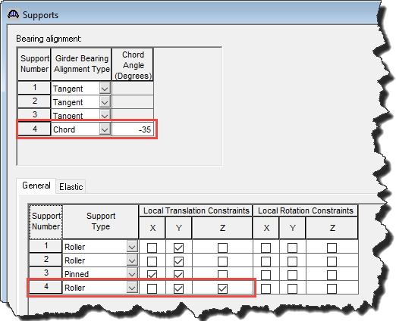
Example of Movement Along a Chord

Slide 30
Inclined Supports
Restricting movement in a direction other than the global axes is accomplished through inclined supports
Inclined supports define the local X and Z components of a point that when connected to the global X and Z coordinates of the support form a line oriented in the direction of the constraint.

Slide 31
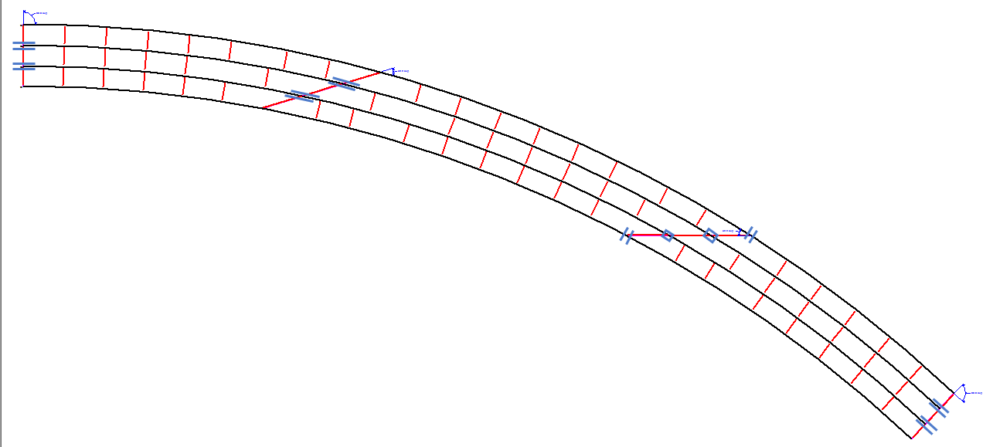
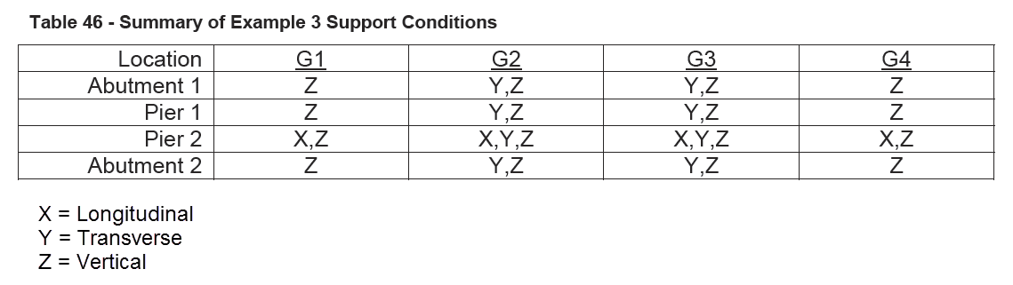
Sample Boundary Conditions

Slide 32
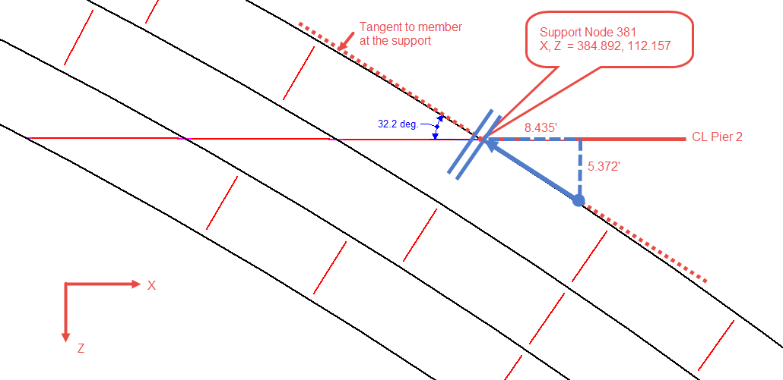
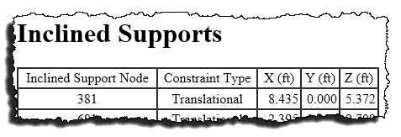
Inclined Support Example

Slide 33
Concrete Deck Behavior
Non-Composite Dead Load Model
  Wet concrete deck load is computed for the user and applied to the top flange beam elements
Composite Dead Load Model
  Composite deck is considered based on the shell thickness and concrete properties. Stiffness is not adjusted by the sustained modular ratio factor.
Composite Live Load Model
  Composite deck is considered based on the shell thickness and concrete properties.

Slide 34
Dead Load Analysis
Dead loads computed for user include:
  Girder and diaphragm self-weight
  Concrete slab and haunch
  Parapets and medians
  Future wearing surface
User can enter member loads for stay-in-place forms or utilities

Slide 35
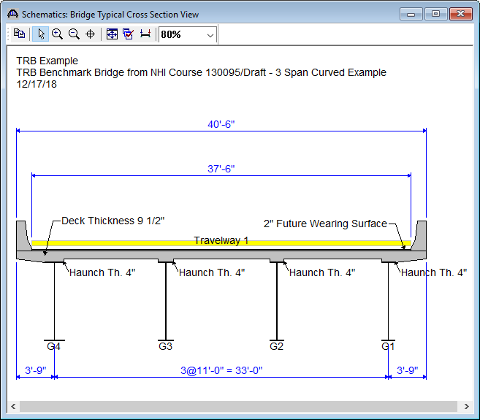
Live Load Analysis
Influence surfaces are generated for each deck shell node within the user defined travel way
User can define travel way anywhere on deck including under parapets

Slide 36
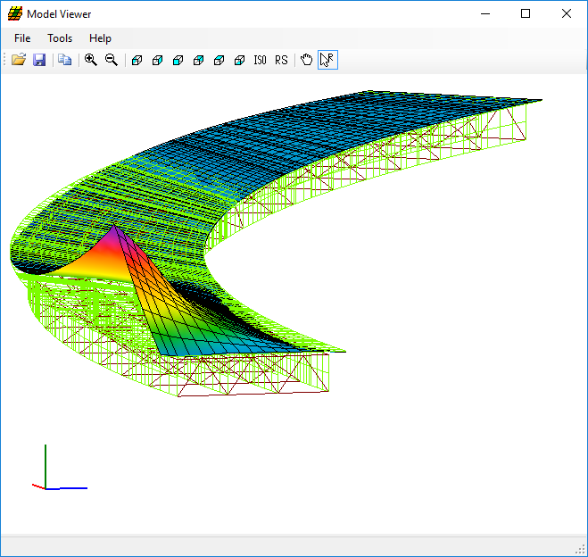
Influence Surfaces

Slide 37
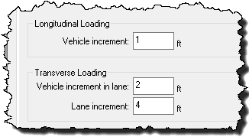
Live Load Analysis
The user controls the application of live load to the user defined travelway

Slide 38
Live Load Analysis – Transverse Loader

Slide 39
Live Load Analysis – Transverse Loader

Slide 40
Longitudinal Live Load Analysis - Truck
Truck is positioned based on lane positions generated by transverse live loader and moved along the length of the structure at user specified intervals
The influence value for a wheel is interpolated from the values at the 4 corners of the FE shell the wheel is on.
Considers Notional trucks – only wheels adding to the force effect are considered
Variable axle spacing is considered

Slide 41
Longitudinal Live Load Analysis - Truck
Position of maximum force effect found
Reposition truck on deck at smaller intervals ahead and behind
Recalculate force effects - new maximum location identified
Iterate until max is located
Compute simultaneous forces
Unless truck is symmetrical or specified as single direction, truck’s orientation is reversed and the process is repeated

Slide 42
Longitudinal Live Load Analysis - Lane
Each shell on the deck is loaded with the uniform lane load based on the lane positions generated by the transverse loader
A shell may be fully or partially loaded
Only those shells producing a positive force effect are added together to produce the maximum positive effect. Likewise for negative force effect.

Slide 43
Live Load Analysis
Centrifugal force is applied to truck loads
The worst case between with and without centrifugal force is selected
Truck and Lane loads are combined and multiple presence factor is applied

Slide 44
Live Load Analysis
90% of HL-93 truck pair loading is considered
Optional HL-93 tandem pair loading can be selected
User can also specify a vehicle path instead of robustly loading the full deck
Non-standard gage vehicles can be used in the vehicle path loading option

Slide 45
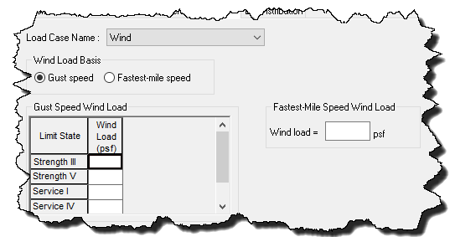
Wind Load Analysis

Slide 46
3D Moment Calculation

Slide 47
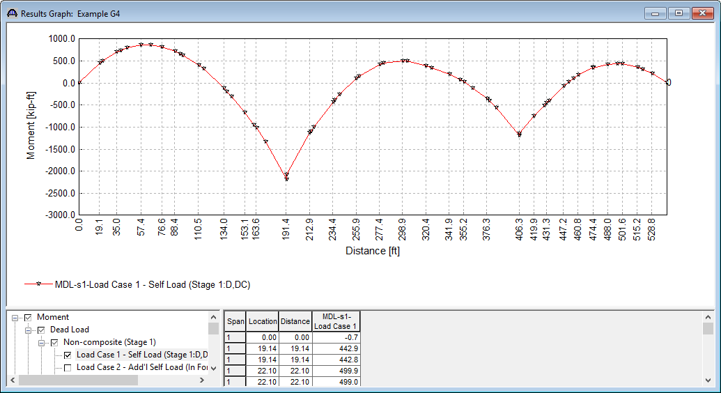
3D Moment Calculation

Slide 48
Specification Checking
ASD - not supported
LFD
  Straight Steel, PS, RC: AASHTO Standard Specifications
  Curved Steel – AASHTO Guide Specifications for Horizontally Curved Steel Girder Highway Bridges, 2003
LRFD/LRFR
  AASHTO LRFD Bridge Design Specifications

Slide 49
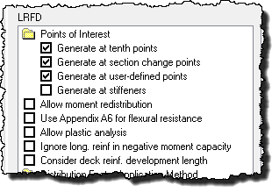
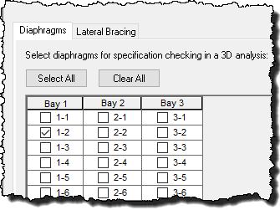
Specification Checking

Slide 50
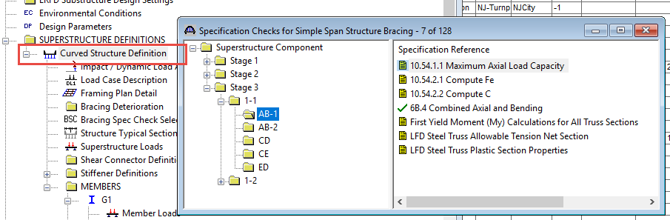
Diaphragm Specification Checking

Slide 51
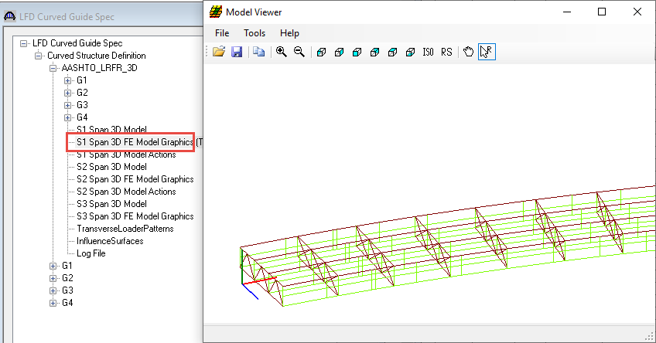
Model Viewer

Slide 52
Thank You

