Slide 1
AASHTOWare Bridge Design & Rating (BrDR) 3D FEM Analysis Troubleshooting
AASHTOWare RADBUG Meeting
July 30-31, 2019
South Lake Tahoe, CA

Slide 2
BrDR 3D FEM Analysis Troubleshooting
Hardware recommendations
Factors that influence analysis speed
Tips for successful analysis
Troubleshooting
Non-zero moments at end supports
Different number of nodes per girder

Slide 3
Hardware Recommendations
Machine: Intel Core i7 processor or equivalent
Memory: 32 GB or more
Hard Disk: Solid State Drive

Slide 4
Factors that Influence 3D Analysis Speed
Number of degrees of freedom
Number of live load vehicles
Live loading increments
Analysis output selections

Slide 5
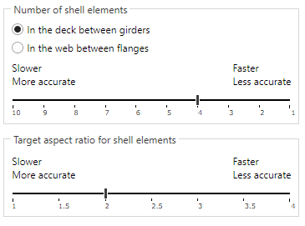
Number of Degrees of Freedom
Number of shell elements in the deck between girders or in the web between flanges
Target aspect ratio for shell elements
Found on Superstructure Definition: Analysis tab

Slide 6
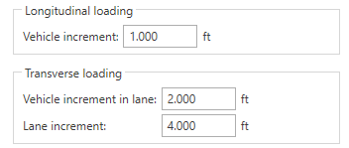
Live Loading Increments
Vehicle increment for longitudinal loading
Vehicle increment in lane and lane increment for transverse loading
Found on Superstructure Definition: Analysis tab

Slide 7
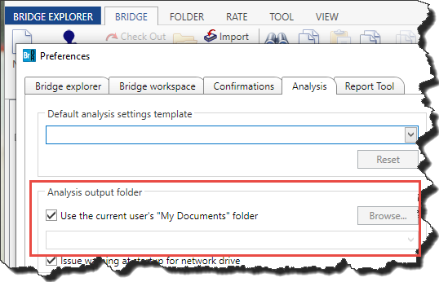
Analysis Output Selections
Choose a local folder as the Analysis Output Folder. Writing analysis output to a network folder will degrade the performance of the analysis.

Slide 8
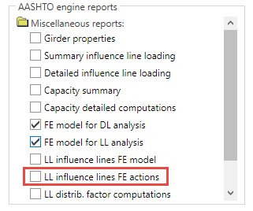
Analysis Output Selections
Select only the necessary analysis output for the analysis. Disk operations are expensive from the analysis performance perspective.

Slide 9
Tips for Successful Analysis
Fine tune the model while running the DL only

Slide 10
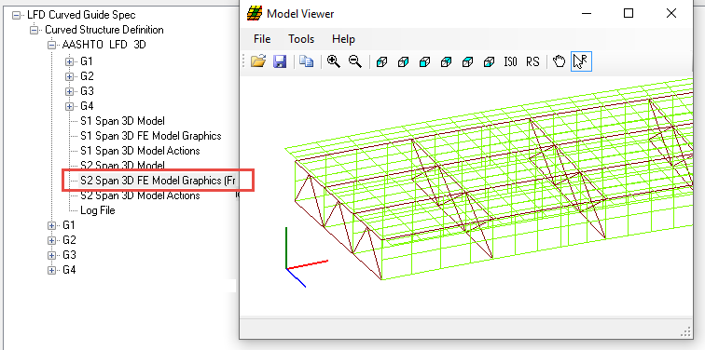
Tips for Successful Analysis
Review the DL model with Model Viewer

Slide 11
Tips for Successful Analysis
Check the moments to see if they look ‘normal’
Run coarser meshes initially and only then fine tune the model

Slide 12
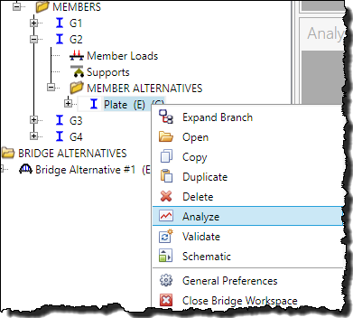
Tips for Successful Analysis
Do initial live load analysis for a single vehicle only
Do first spec check of 1 girder only
Launch 3D analysis from the member alternative
Only “Existing” alternatives have influence surfaces loaded and are spec checked

Slide 13
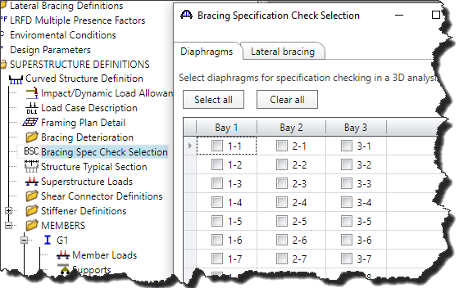
Tips for Successful Analysis
Do not select diaphragms for spec checking until satisfied with girders

Slide 14
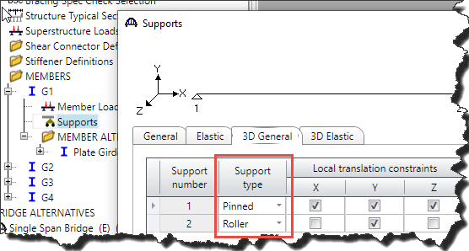
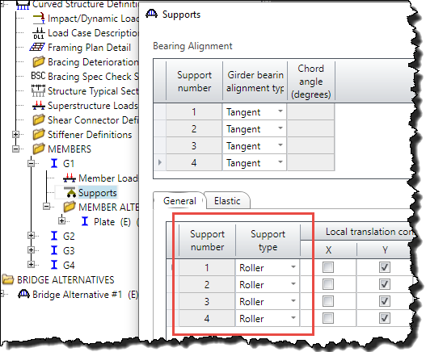
Troubleshoot Non-Zero Moments at End Supports
Evaluate “Pinned” support conditions

Slide 15
Troubleshoot Different Number of Nodes

Slide 16
Troubleshoot Different Number of Nodes
“3DGirderNodes.txt”
Comma delimited file contains node locations and reason why node was generated
Developed for debugging, now shared with users
6.8.3: File generated when unable to generate mesh
6.8.4/7.0.0: File always generated

Slide 17
Troubleshoot Different Number of Nodes
Reasons why node was generated
Diaphragm, support, tenth point, cross section change point
“bitmask 0” : node was added to either get the same number of nodes in a span or added based on the number of shell elements selected on the Structure Definition: Analysis tab

Slide 18
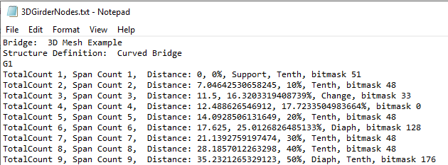
Troubleshoot Different Number of Nodes

Slide 19
Troubleshoot Different Number of Nodes

Slide 20
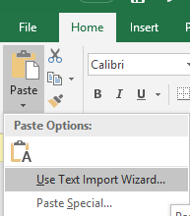
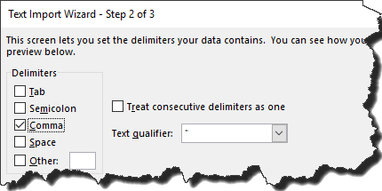
Troubleshoot Different Number of Nodes
Step 1: Use Paste/Use Text Import Wizard to copy each girder’s data into its own column in Excel

Slide 21
Troubleshoot Different Number of Nodes
Step 2: Examine total number of nodes per girder looking for differences

Slide 22
Troubleshoot Different Number of Nodes
Step 3: For girders with difference, examine number of nodes per spans

Slide 23
Troubleshoot Different Number of Nodes
Diaphragm at 70.536605’ (support 2) + 259.018115’ = 329.55472’
Pier 4 is at 329.650012’

Slide 24
Troubleshoot Different Number of Nodes
Change the number of diaphragm spacing from 15 to 14
Add a new row at 0’ from Support 5(Pier 4) with 0’ spacing
Move Span 5 data down a row

Slide 25
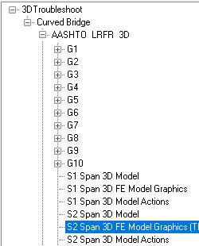
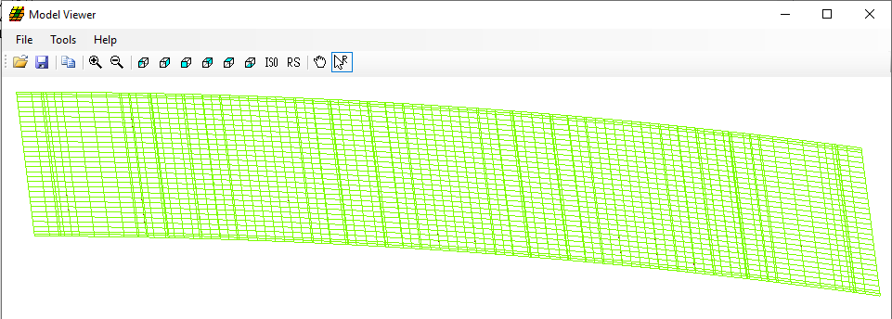
Troubleshoot Different Number of Nodes

Slide 26
Thank You

