Slide 1
Load Rating of RC Box Culverts
Issues Encountered by
the State of California
by Mark Simonsen
California Department of Transportation
7/31/19
Notes:
California was not able to obtain realistic calculated ratings for our RC Box Culverts. Our efforts toward rating the culverts are presented.

Slide 2
Presentation Overview
1. What is an RC Box Culvert Bridge?
2. Rating Efforts:
California’s Efforts at Rating RC Box Culverts using BrR
Issues Encountered in Rating RC Box Culverts
3. Summary:
Realities of Rating RC Box Culverts
Possible Options for Rating RC Box Culverts
What we need from AASHTO
What we need from AASHTOWare
Notes:
These three groups of topics will be discussed.

Slide 3
What is an RC Box Culvert Bridge?
Rectangular shaped culvert
Constructed from reinforced concrete
Components: Top Slab, Walls, Bottom Slab
Single or multiple barrels
Overall length of 20 feet makes it a BRIDGE.
Photos
Rebar patterns
Notes:
Having a bottom slab makes it a box culvert. Otherwise it is a framed structure.

Slide 4
Typical RC Box Culvert Bridge - 1
Notes:
Typical RC Box Culvert Bridge. Roadway spans 20’ between inside faces of abutment walls.

Slide 5
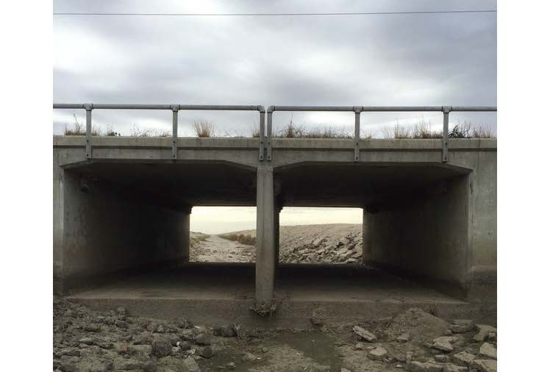
Typical RC Box Culvert Bridge - 2
Notes:
Same bridge with the canal drained. Walls and invert exposed for inspection.

Slide 6
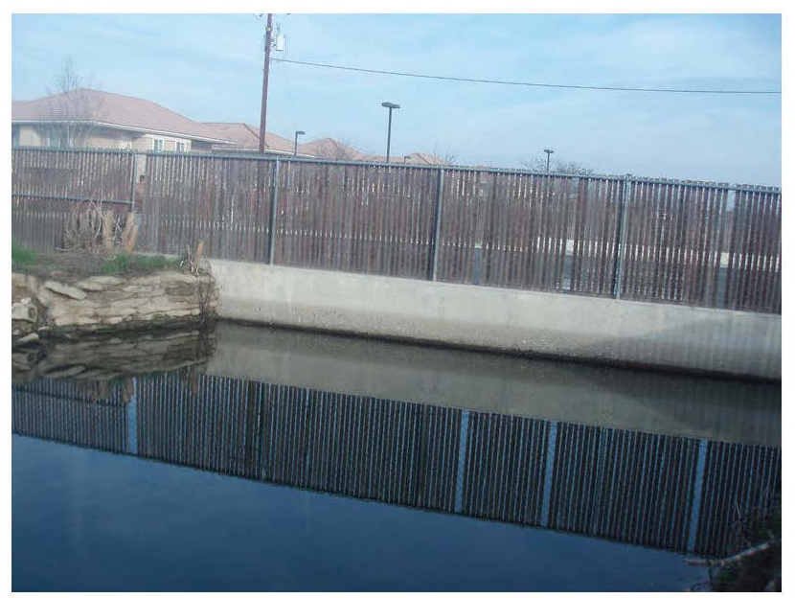
Typical RC Box Culvert Bridge - 3
Find a photo of a culvert running full.
Notes:
Inaccessible. Irrigation canal running full. Common in the central valley of California.
In the mountain regions of California, streams run high in the winter but are commonly low or dry in the summer.

Slide 7
Typical RC Box Culvert Bridge - 4
Find Photo of a silted up culvert.
Notes:
Special arrangements and coordination are necessary to inspect irrigation culverts with the canal drained.
Often there is still substantial silt in the invert.

Slide 8
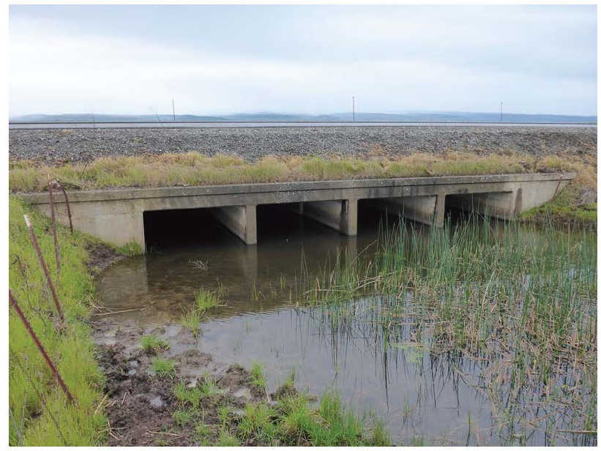
Typical RC Box Culvert Bridge - 5
Find Photo of a culvert with fill.
Notes:
RC Box Culvert Bridges can have considerable fill over the deck. Fill height can also vary along the culvert length, or transverse to the barrel. Establishing the exact depth at a given location is difficult. Material gradation and compaction can vary.

Slide 9
General 2-Cell RC Box Culvert
1981 - 2010
Notes:
Typical California 2-cell RC Box Culvert shape and rebar pattern.
Continuous top slab, continuous bottom slab, exterior walls, and interior wall; haunches at top corners.
Truss bar resists positive and negative moments in the continuous deck. Interior wall ends are typically pinned connections.
Left side shows a pinned wall/slab connection (for short spans), with walls reinforced to resist inward lateral load only.
Right side shows rigid wall/slab connection (for spans > 8’); with walls reinforced to take inward and outward bending. Wall moments affect slab moments.
Currently BrR does not provide for modelling both pinned and rigid wall connections to the same slab. Either all wall tops are modeled as pinned, or all wall tops are modeled as rigid connections. The same is true for the bottom ends of culvert wall/slab connections.

Slide 10
Historical Reinforcement Patterns
1948 - 1975
1924 - 1944
Notes:
Historical rebar variations:
1948 – 1975 a truss bar was used. The top “c” bar only extended to the middle of exterior cells; except that after 1952 it was made full length if the slab was built at grade. Live load from the adjacent span creates negative moment in the deck slab. Pinned exterior wall corners. Pinned interior wall ends.
1924 – 1944 Short and long negative moment steel over interior walls. Pinned exterior wall corners. Pinned interior wall ends.

Slide 11
Historical Reinforcement Patterns
Single Cell Box Culverts
Pinned Corners:
Long Spans 1924 - 1933
Short Spans: ALL YEARS
Rigid Corners:
Long Spans 1948 - 1952
Rigid Corners:
Long Spans 1966 - 2010
Notes:
All corners are pinned for short spans (less than 6’ - 8’) for all years. Longer spans for years 1924-1933 are also pinned. In longer spans after 1948 the single cell reinforcement is for rigid corners. Special upward and downward facing C-shaped and Trussed C-shaped bars were used from 1948-1952. From 1966-2010 the reinforcement is similar to that for the exterior wall/slab details of a 2-cell box.

Slide 12
California’s Efforts at Rating RC Box Culverts
Initial BrR Ratings of Standard Plans
410 Models for NCHRP 15-54 Culvert Study
HOLD: pending NCHRP 15-54 Study Results
California RC Box Culvert Inventory Database
About 3,000 in Bridge Inventory
Notes:
We made serious efforts to rate our culverts using BrR. We investigated the loading and materials parameters. Then we began rating Standard Plan culverts representative of our bridge inventory. We got low Rating Factors.
The NCHRP 15-54 culvert study was initiated to address issues that many states were encountering. We contributed our initial study models (about 190); and then created about 220 more models specifically for the NCHRP study representing the range of design years, culvert sizes, and rebar details for our bridge inventory.
Our rating efforts are on HOLD pending the results of the NCHRP 15-54 study.
Our current efforts are focused on collecting information for our 3000 RC Box Culvert Bridges, so we will be able to analyze them when a workable rating procedure is developed.

Slide 13
Initial BrR Ratings of Standard Plans
Initial Idea:
First Effort:
Rate all Standard Plans. Create a book of Standard Plan Ratings.
Correlate each culvert in our inventory to a given Standard Plan.
Read the rating from our book of Standard Plan Ratings.
Second Anticipated Effort:
Rate all special design culverts which have as-built plans using BrR.
Third Anticipated Effort:
Justify or modify the Assigned Culvert rating procedures for all
other culverts, for which no plans are available.
Notes:
Our efforts to rate the Standard Plans were not successful, since the calculated rating factors came out low for legal trucks; and our typical culverts do not show signs of distress from legal trucks.
It is pointless to try to analyze “special design culverts” when the parameters are not clear for rating standard designs.
It has become clear that a modified Assigned Rating process will be needed to rate most of our culverts. We simply do not have enough information to do a full calculated rating for most of our culverts.

Slide 14
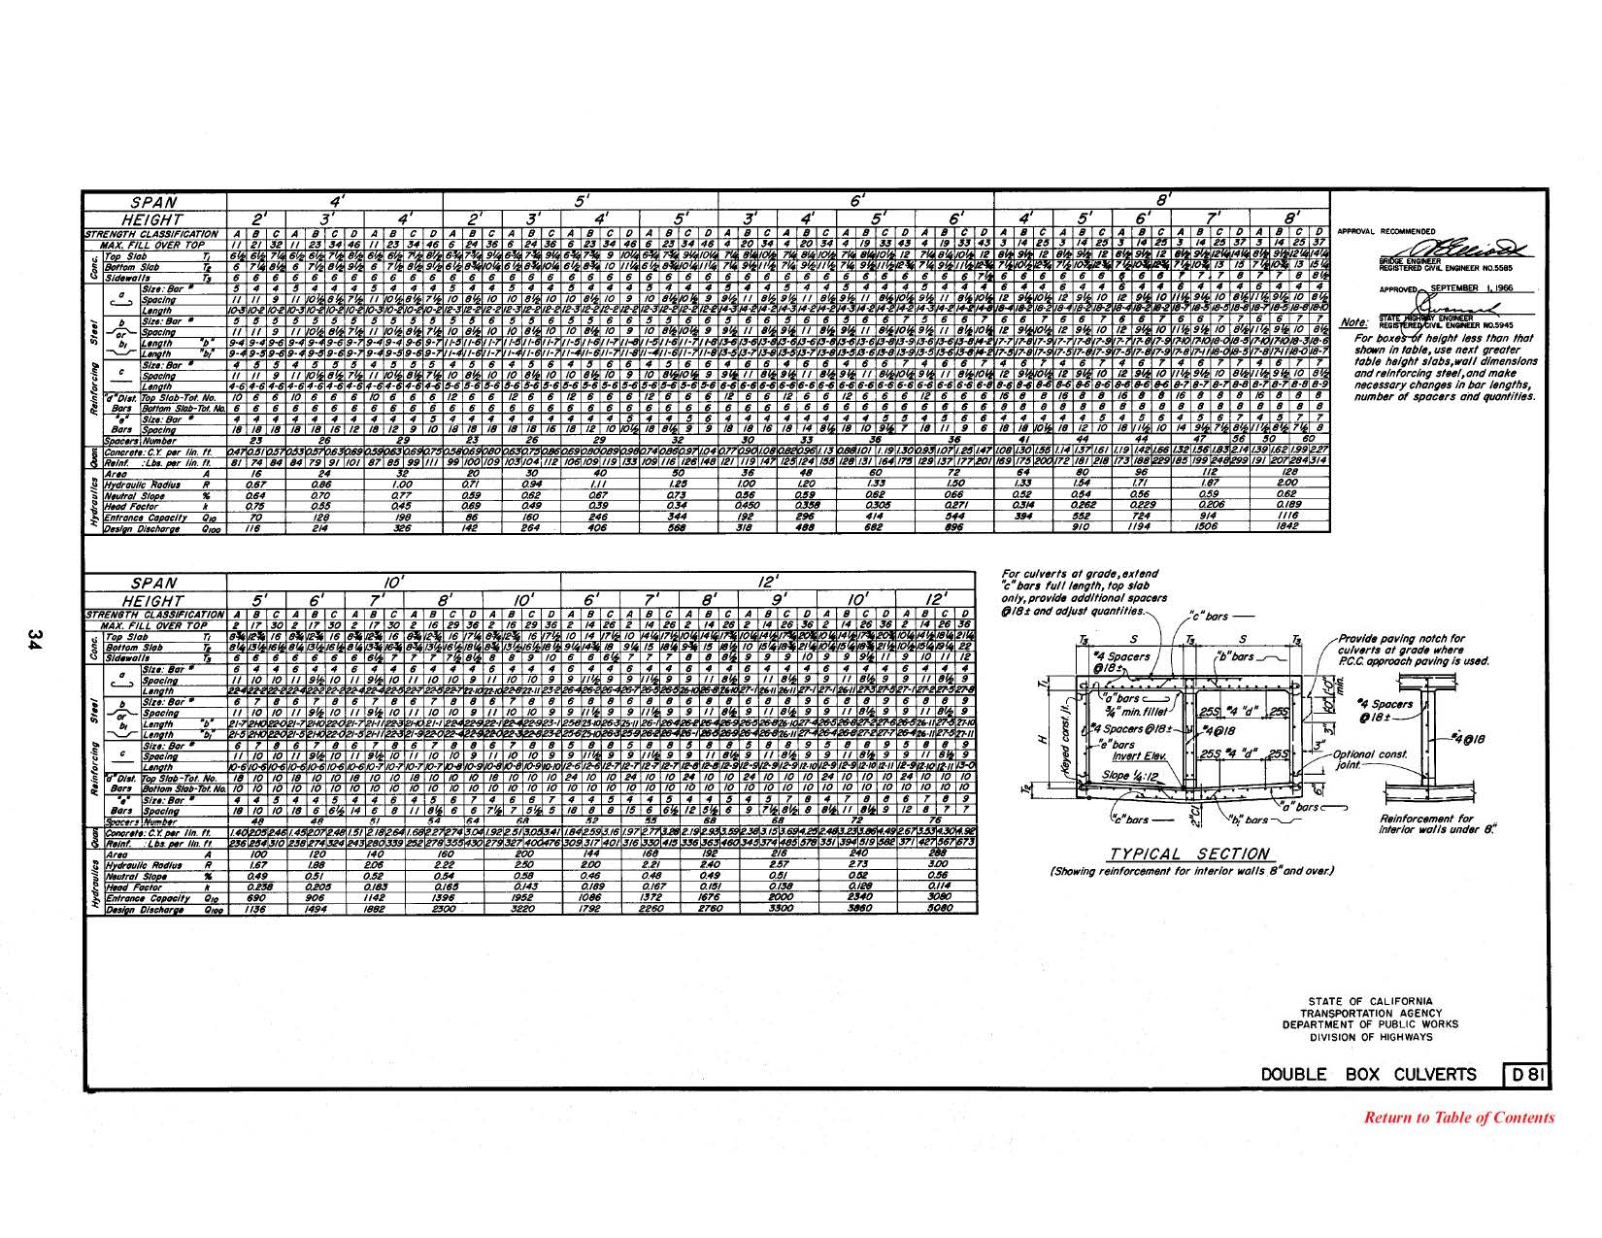
Typical Table of Standard Plans-1
Notes:
Typical data page of our Standard Plans. 1966 Double Box Culvert. Sketch of Typical Section and tables of dimensional and reinforcement data. A separate General Notes page gives the design parameters including Live Loading.

Slide 15
Typical Table of Standard Plans-2
Notes:
Typical Section: Slab and wall dimension designations, and reinforcement details with bar names.

Slide 16
Typical Table of Standard Plans-3
Notes:
Table of culvert details: For a given culvert design the Span, Height of opening, and the Maximum Fill designed for are presented in columns across the table. The Top Slab, Bottom Slab, Sidewall thicknesses and the rebar sizes and spacings for each given design are presented in rows down the table.

Slide 17
BrR RC Box Culvert Model-1
Create the model using the BrR Tree similar to a bridge
A CULVERT DEFINITION is comparable to a SUPERSTRUCTURE DEFINITION
A culvert section with a rebar schematic is available to help verify proper rebar entry
The rating results table is very similar to the rating results table for a bridge
Notes:
I suspect that most BrR users have modeled regular bridges, but probably not RC Box Culverts. The modeling process is similar. The details and the loads need to be determined and entered. The BrR Tree entry format is very much like that for a regular bridge. The relevant portions of the BrR Tree and input panels are addressed in the following 11 slides. (Slides 19 – 28 were skipped during the presentation to conserve time.) This is a BRIEF overview, and not a thorough lesson in creating a model. The slides are from an internal Caltrans training presentation, and reflect Caltrans modeling and naming convention; but they show the basic process of constructing a BrR model.

Slide 18
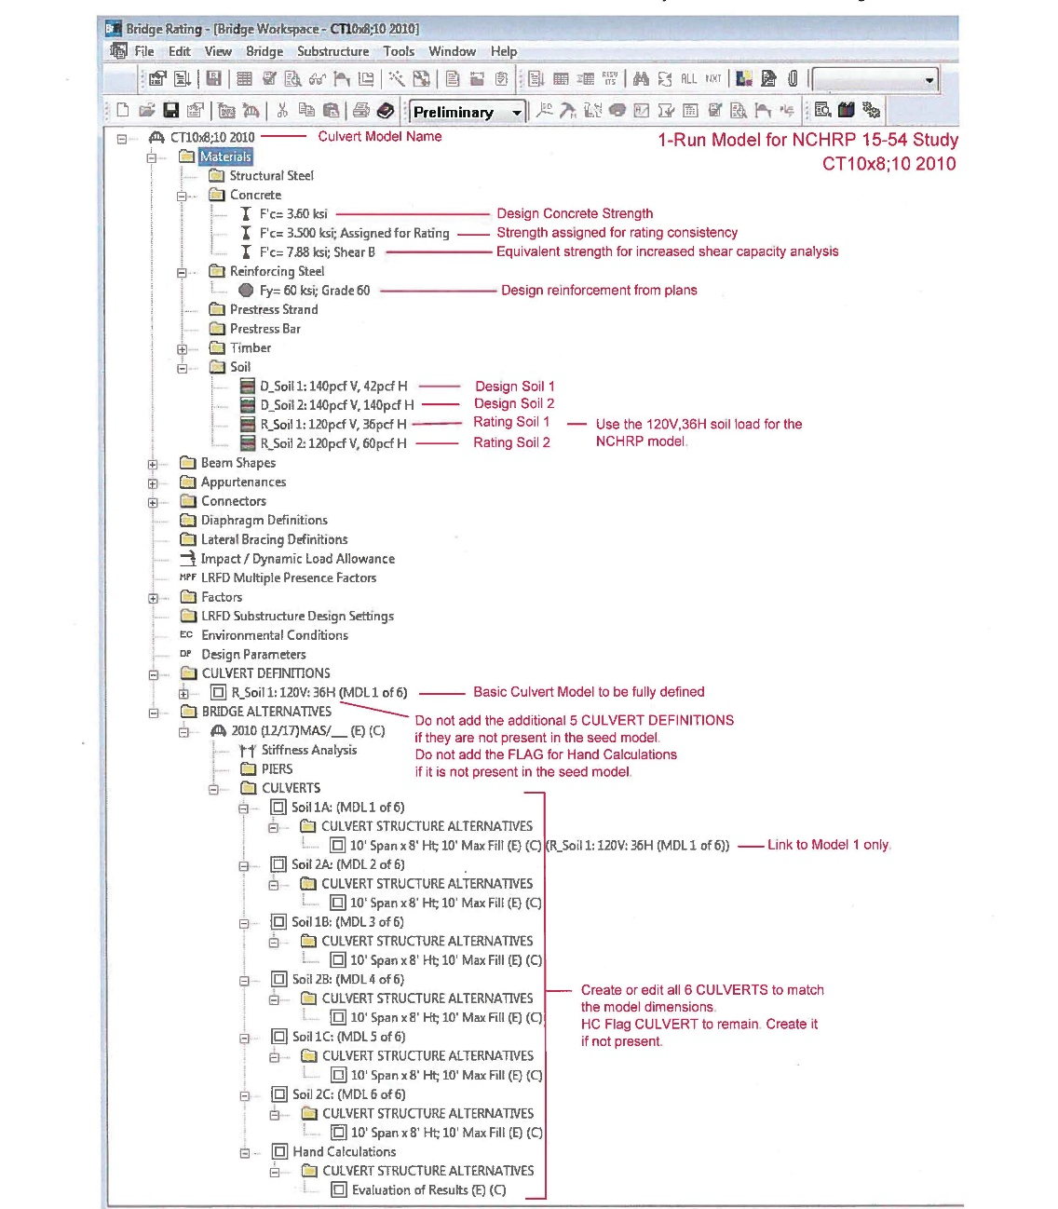
BrR RC Box Culvert Model-1A
Notes:
The TREE format is very similar to that for any other bridge. Caltrans’ naming convention is used throughout the tree in the examples. The Model Name at the very top reflects the number of cells, span, opening height, design fill height, and year of the standard plan. The Culverts box must be checked in the name editing window. The Materials entry region is the same as for any bridge. The CULVERT DEFINITIONS branch (near the middle of the tree) is comparable to the SUPERSTRUCTURE DEFINITION for a bridge model. This is the heart of the model. The BRIDGE ALTERNATIVES branch is used for managing the analysis of the models, similar to a bridge model. An analysis template named “Culvert_______” must be created and used to analyze the model as a culvert.

Slide 19
BrR RC Box Culvert Model-2
Notes:
The Materials entry region. Concrete and Steel entries are identical to entries for bridges. Soil data is new.

Slide 20
BrR RC Box Culvert Model-2A
Notes:
Soil Data entry panel. Caltrans naming convention is shown. We used 120 pcf soil. We used an “At-rest” soil pressure for our LRFR analysis with a coefficient of 0.30 which results in an equivalent fluid pressure of 36 pcf.

Slide 21
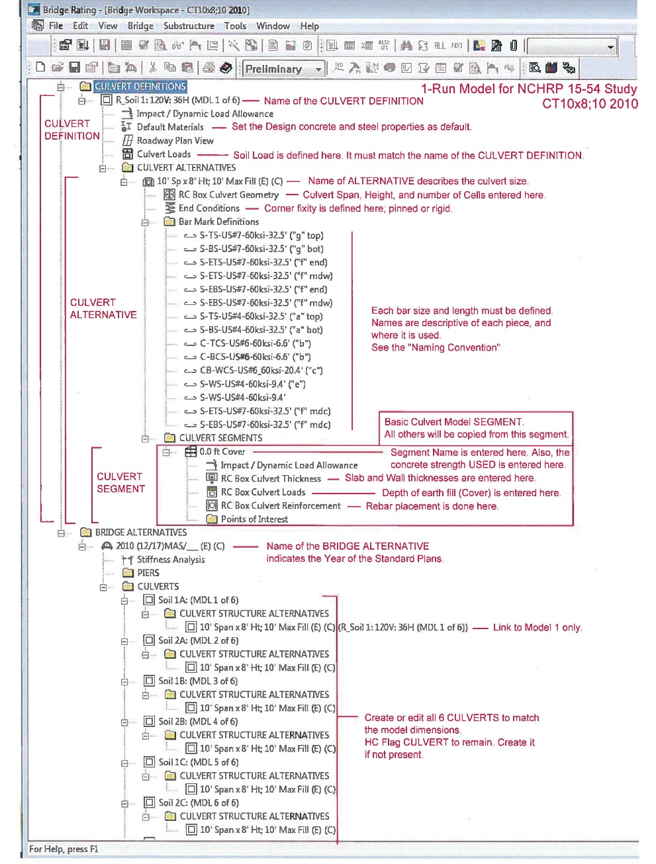
BrR RC Box Culvert Model-3
Notes:
BrR Tree with the CULVERT DEFINITIONS branch opened up; and the upper Materials region cropped. The BRIDGE ALTERNATIVE region is shown. Each CULVERT STRUCTURE ALTERNATIVE can be linked to a CULVERT DEFINITION.

Slide 22
BrR RC Box Culvert Model-4
Notes:
The CULVERT DEFINITIONS branch, with sub-branches. The Name and Soil Loading are entered here. The Name is representative of the soil loading.
The CULVERT ALTERNATIVES branch defines the overall geometry. Span, Height, Number of Cells, and corner fixity are defined here. Also each piece of Rebar is defined here.
The CULVERT SEGMENTS branch defines the amount of fill applied, and we named it accordingly. The slab and wall thicknesses are entered here. The rebar is placed here.
(The slab and wall thicknesses and the amount of rebar are directly related to the design fill height, so this is the proper place to enter them. For our Standard Plans ratings we have one Design fill height for each model, so the thicknesses and rebar for all Culvert Segments are the same. But we vary the APPLIED fill within different segments. For example the “0.0 ft Cover” Culvert Segment would be used to analyze 0’ fill, and a copy named “2.0 ft Cover” ((not shown)) would be used to analyze 2’ fill for the same culvert model.)

Slide 23
BrR RC Box Culvert Model-4A
Notes:
The “RC Box Culvert Geometry” panel; under CULVERT ALTERNATIVES: Number of cells, cell width (span), cell height, and haunch data is entered here.

Slide 24
BrR RC Box Culvert Model-4B
Notes:
The “Bar Mark Definition” panel; under CULVERT ALTERNATIVES: Each piece of rebar is defined here. Name, material, bar size and bar type are entered. The name can be used to give information about the bar. Here S=Straight bar, ETS= Equivalent Top Slab Steel, US#6=standard #6 bar, 40ksi=yield strength, 38.8’= overall length, and(“b” end) is specific to the plan data. (This particular bar models the end section of a truss bar. The segment is 9.66 feet long, but the truss bar is 38.8’ OAL.)

Slide 25
BrR RC Box Culvert Model-4C
Notes:
The “Culvert Segment” main panel; under CULVERT SEGMENTS: The Segment Name is entered here. The concrete strength used is entered here from a dropdown list.

Slide 26
BrR RC Box Culvert Model-4D
Notes:
The “RC Box Culvert Thickness” panel; under CULVERT SEGMENTS: The thicknesses of top slab, bottom slab, and walls are entered here.

Slide 27
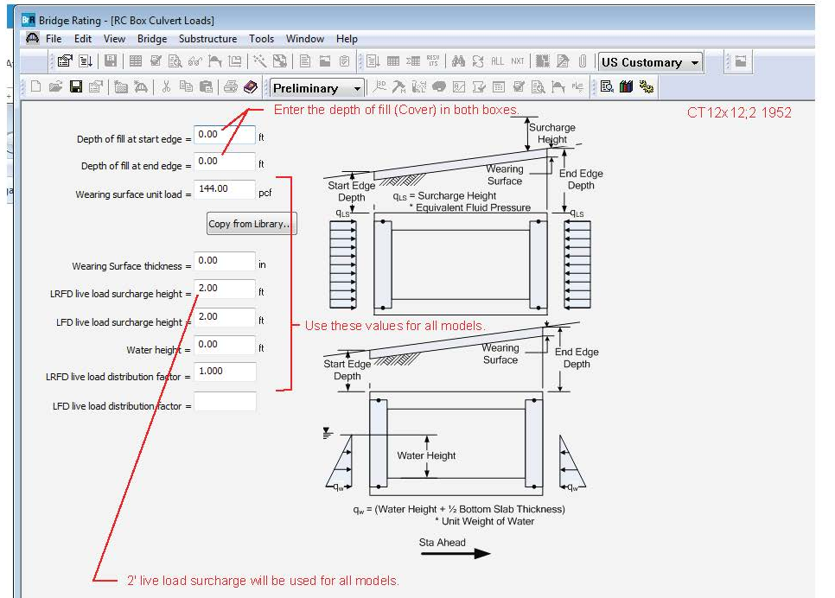
BrR RC Box Culvert Model-4E
Notes:
The “RC Box Culvert Loads” panel; under CULVERT SEGMENTS: The depth of fill used in the analysis is entered here. The live load surcharge is entered here.

Slide 28
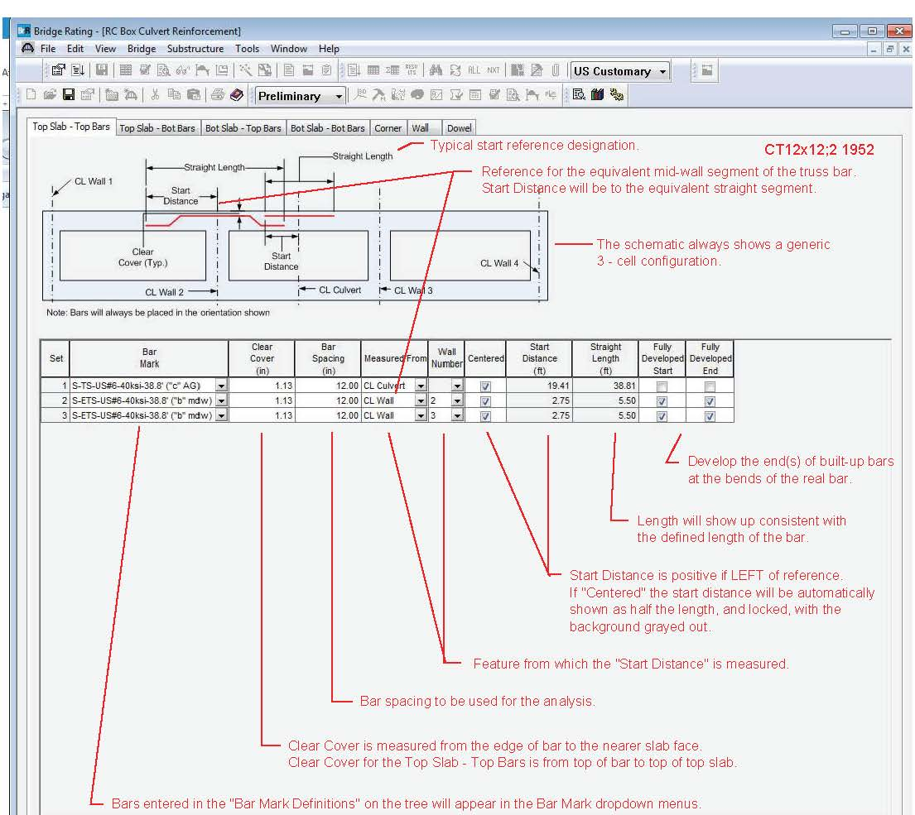
BrR RC Box Culvert Model-4F
Notes:
The “RC Box Culvert Reinforcement” panel; under CULVERT SEGMENTS: The “Top Slab – Top Bars” tab is shown. Entry in other tabs is similar. Each bar is chosen from a dropdown list which is populated from the previously defined Bar Marks. The clear cover and spacing are entered. Bars are located relative to a wall centerline or the culvert centerline; with the “Start Distance” left of the centerline being positive. The length shows up as defined in the Bar Mark. Each end of the bar may be designated as Fully Developed. Entry for other panels is similar.

Slide 29
BrR RC Box Culvert Model-4G
Notes:
BrR Graphic Display: Once it is fully defined, the culvert segment rebar can be viewed. [Highlight the “RC Box Culvert Reinforcement” branch for the segment and click the little green icon (View schematic) in the ribbon; or use Bridge>Schematic in the menu bar.] Enough detail is shown to be able to see that the rebar was entered correctly.

Slide 30
BrR Rating Results- 0.0’ Fill
Notes:
This is the BrR output for the rating of a given culvert design. The information in the headers showing Standard Plan year, soil load, culvert designation, and cover analyzed are a result of the naming convention used within the BrR model. Each live load truck loading, rating factor, governing component, and governing limit state are shown in this tabular report.

Slide 31
Book of Standard Plan Ratings
Format and Content:
Using an Excel Spreadsheet:
Each published year of Standard Plans has its own section in the book. (Standard Plans are published about every 2 to 4 years)
Each culvert design has its own section on a page.
Number of barrels (Cells)
Span – Clear normal opening
Height of opening
Design Fill Height.
3. Ratings for all Trucks and various Fill conditions are presented
Each Truck has its own column, spread across the page.
Each Fill has its own row down the page.
Ratings are presented in the resulting table for each truck and fill.
Governing Element, Governing Mode, and Rating Factor are shown.
Notes:
We planned to rate each different Standard Plan culvert design using BrR and include these in our book of Standard Plan Ratings. The format is described on the slide.

Slide 32
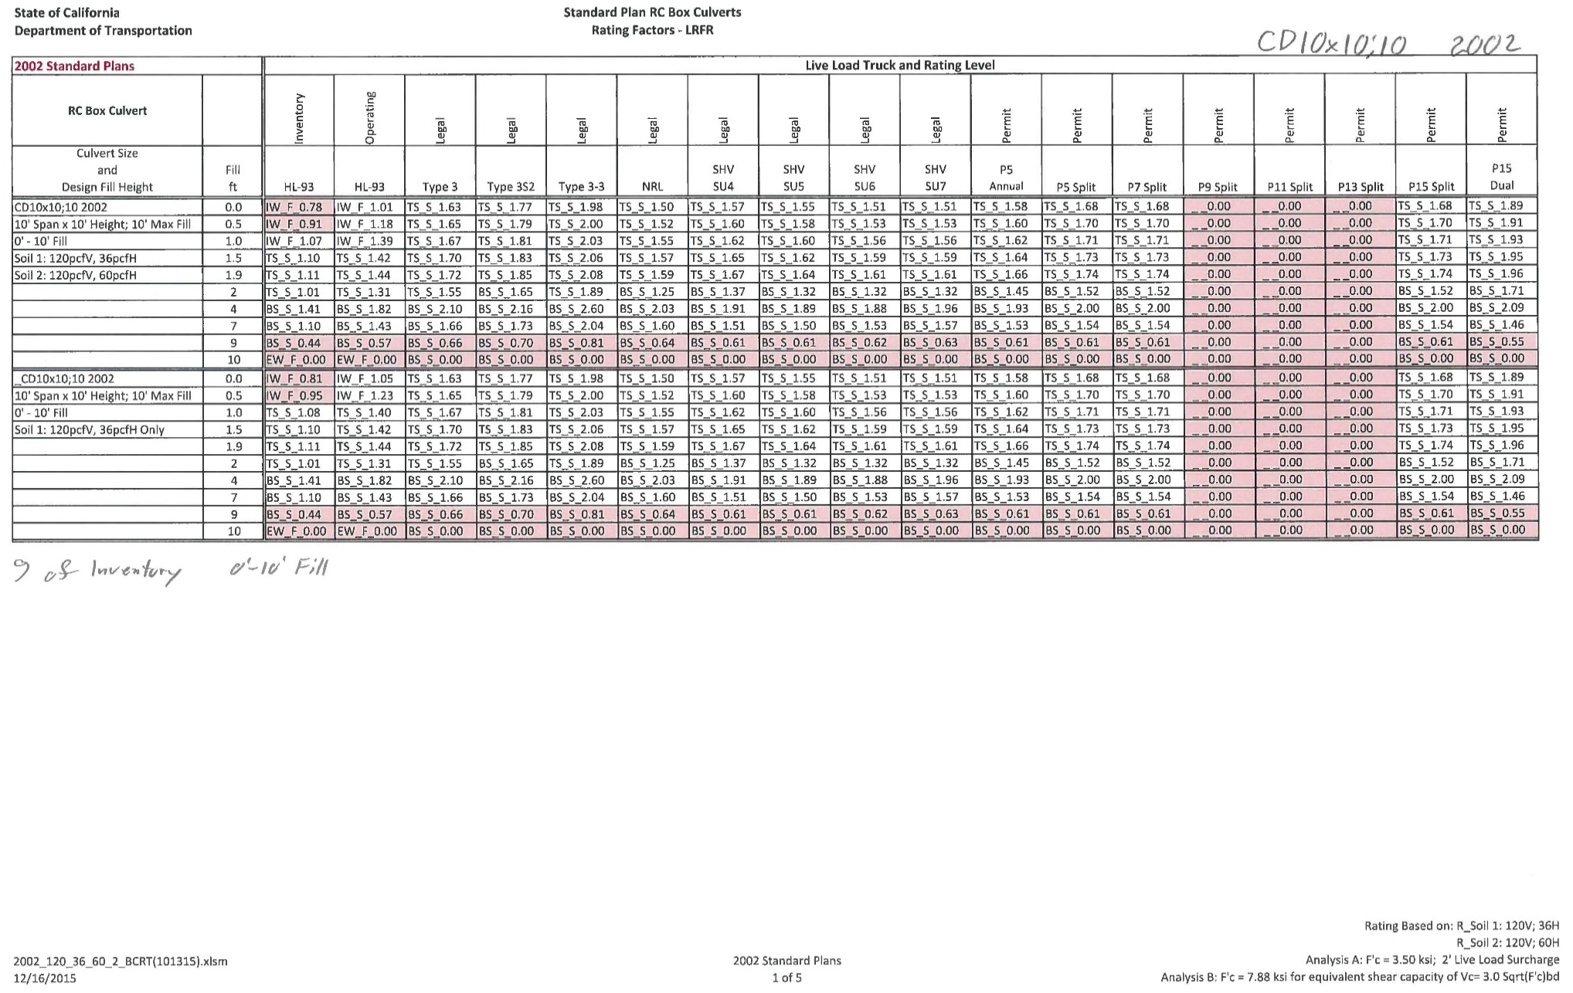
Book of Standard Plan Ratings-1
Notes:
Representative page from our book of Standard Plan ratings. Each published year will have its own section within the book. Each culvert design has its own block of data on the sheet. There is room for 4 culvert designs on each sheet; but only 2 are shown on this page. Ratings for each Truck are shown in columns across the page. Each fill height actually analyzed is shown in its own row down the page. The rating factors are given in the table, along with the governing component and governing limit state. (TS = Top Slab; S = Shear; 1.63 = Rating Factor) Conditional formatting turns cells RED if the Rating Factor is less than 1.

Slide 33
Book of Standard Plan Ratings-1A
Notes:
Closeup view of the previous slide. The two blocks of data shown on this sheet represent the same culvert design (CD10x10;10 2002) shown in the upper left of the data block. The culvert was subjected to two different sets of soil loading conditions, per the notes at the left of the blocks of data.
Note that rating factors (RF) tend to increase slightly with fill, and then drop off sharply when the design fill is reached.
Note also that this culvert was designed in 2002 (by LFD) for 10 feet of fill. The calculated inventory rating factor should be about 1.0 for 10 feet of fill.

Slide 34
Book of Standard Plan Ratings-1B
Notes:
Closeup: 2002 Standard Plans. Culvert design CD10x10;10 2002 (Double culvert, 10’ span, by 10’ opening height; 10’ design fill, 2002 Standard Plans) [CS= Single, CD= Double, CT=Triple, CQ= Quadruple, 5+ by numbers] Ratings for each Truck are shown in columns across the page. Each fill actually analyzed is shown in its own row down the page. The rating factors are given in the table, along with the governing component and governing limit state. (TS = Top Slab; S = Shear; 1.63 = Rating Factor) Conditional formatting turns cells RED if the Rating Factor is less than 1.

Slide 35
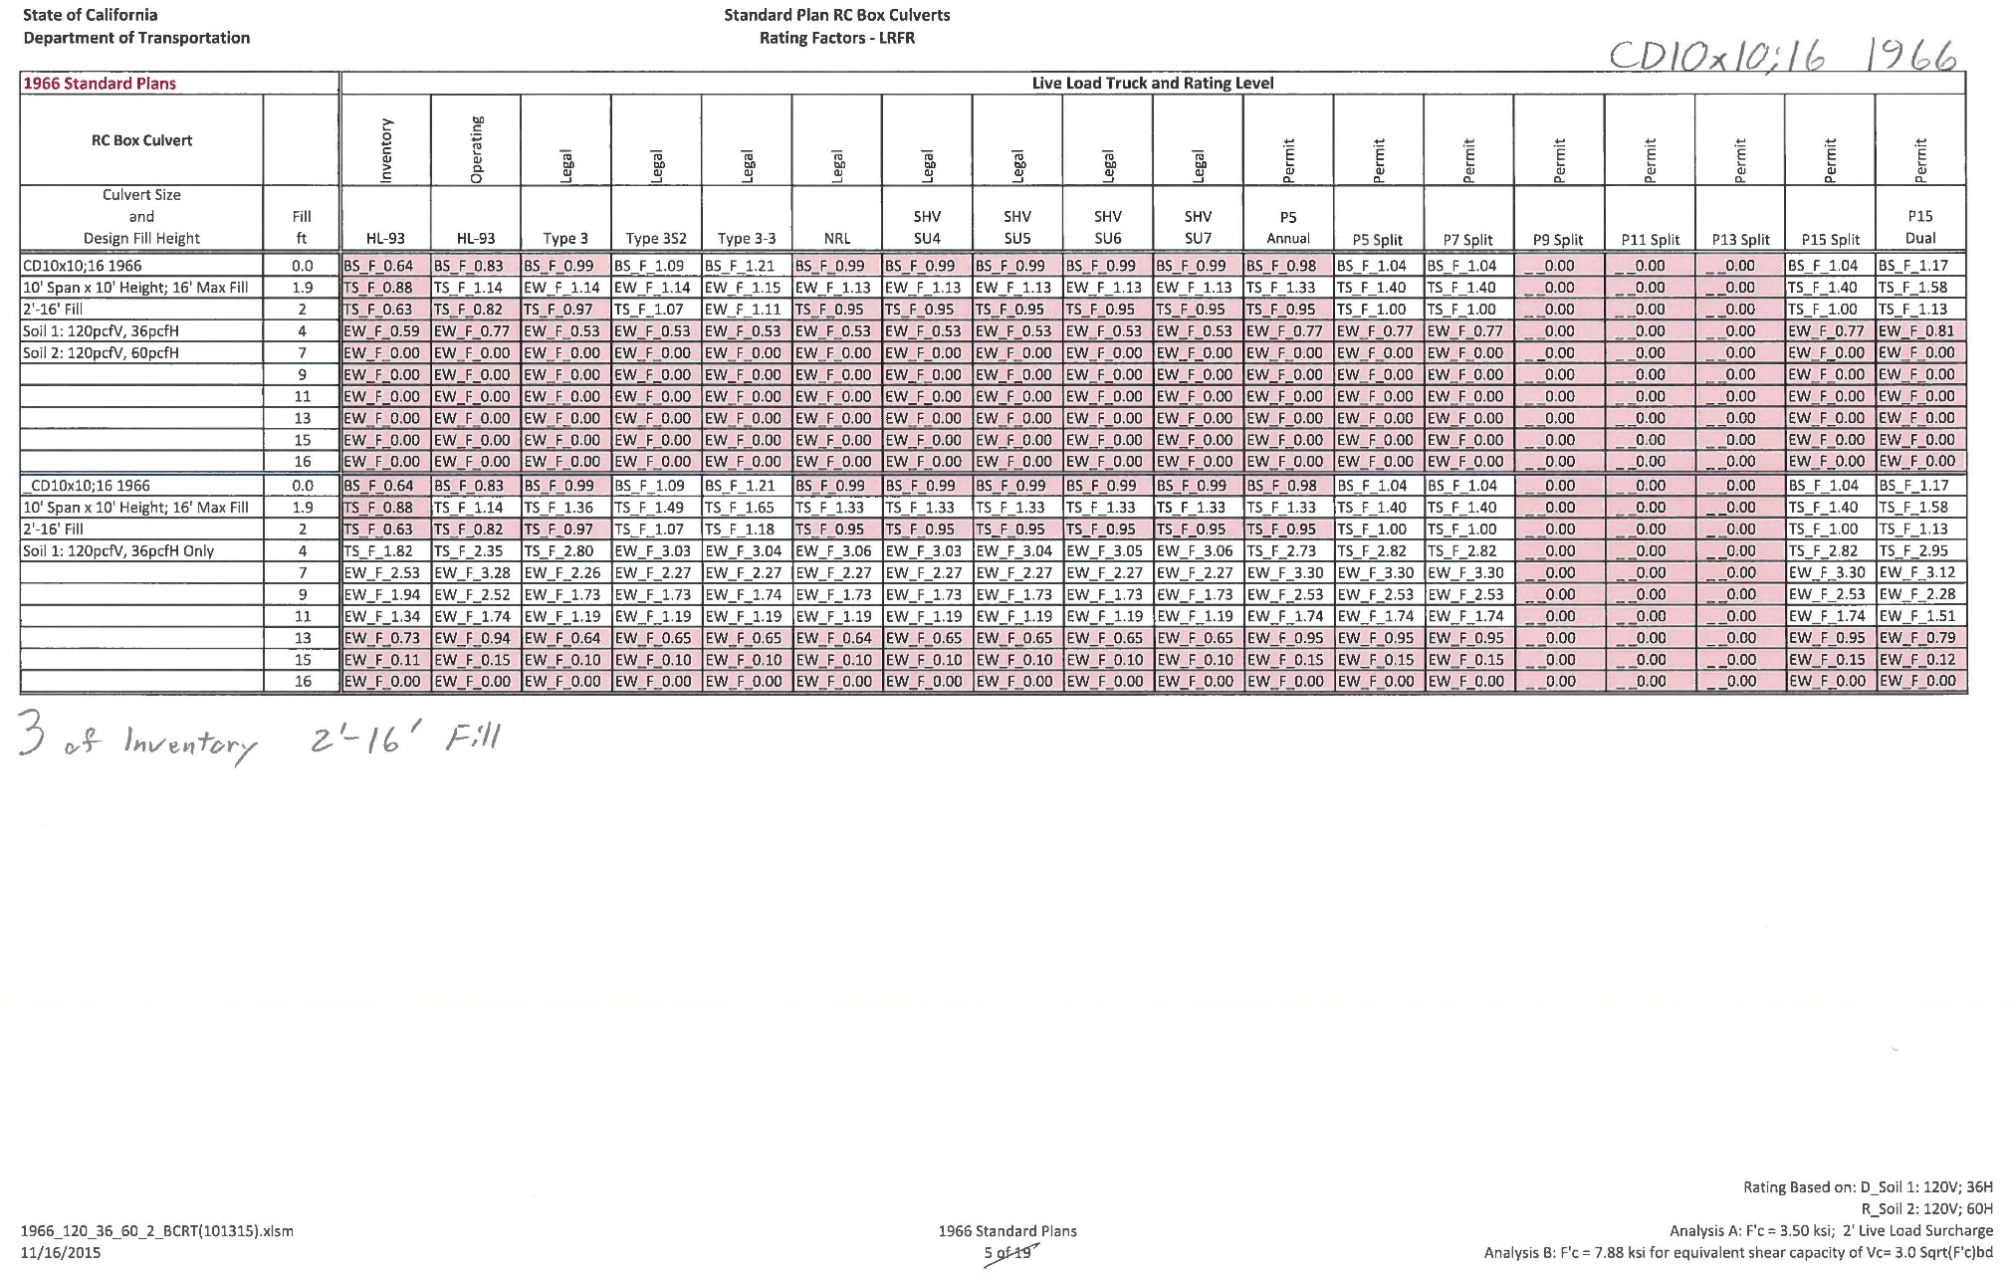
Book of Standard Plan Ratings-2
Notes:
RF results for 1966 Standard Plan design CD10x10;16 1966 analyzed for two different lateral soil loading conditions. This is a pinned corner design. Rating factors are primarily governed by flexure in the exterior walls.
The upper block results are for 60 pcf lateral soil pressure. Most Rating factors are ZERO.
The lower block results are for 36 pcf lateral soil pressure. Rating factors are more realistic when analyzed for 36 pcf lateral soil pressure.
This culvert was designed for 16 feet of fill and HS20 live load; so a calculated rating factor in the vicinity of 1.0 would be expected for 16 feet of fill.
Only the governing wall RF is reported. The deck rating factor may or may not be reasonable, but it cannot be discerned from the currently available BrR reports.

Slide 36
Issues Encountered in Rating of RC Box Culverts
Loads for Culvert Analysis
Soil Parameters
Concrete Shear Capacity
BrR Analysis – follows MBE requirements
Spreadsheet to address variables: 6 Analyses
Low Rating Factor (RF) per calculated ratings
At high fill, RF is meaningless. Consider C/D.
RC Box Culvert is a robust structure which performs well in service.
Notes:
The first task was to establish realistic loading and strength parameters in order to rate the culverts.
Since the BrR analysis follows the MBE, it was not always possible to use our desired parameters directly. We ended up needing 6 BrR analysis runs for each culvert design which we analyzed.
Our efforts resulted in low rating factors for the culverts we analyzed.
For higher fills, the capacity to demand ratio C/D may be more meaningful than the Rating Factor.
BOTTOM LINE: RC Box Culverts are performing well in service, which is inconsistent with the low rating factors indicated by our calculated rating results.

Slide 37
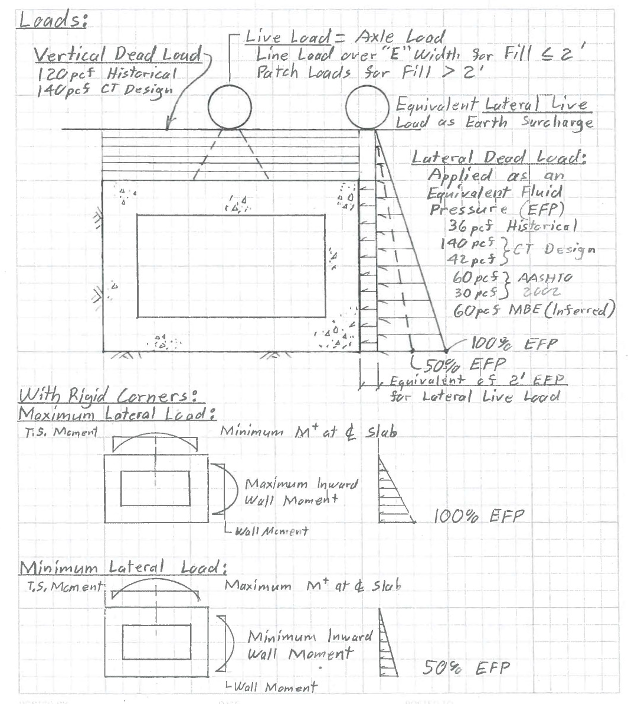
Culvert Loading
Notes:
Diagram showing soil loads on a culvert, and live load distributed through the soil to a culvert. Lateral soil loads are traditionally applied as an equivalent fluid pressure, with units of pounds per cubic foot (pcf). Historical loadings are listed. If corners are pinned, lateral loads on the walls do not affect the deck slab. If corner connections are rigid, the lateral load on the wall reduces the positive moment in the deck slab. Only 50% of the reduction is allowed to be used for positive moment deck steel design.

Slide 38
Concrete Shear Capacity
Ignore?
Vc = 2.0 Sqrt(f’c)bd ?
Vc = 3.0 Sqrt(f’c)bd ?
Vc = 3.5 Sqrt(f’c)bd ?
Vc = [2.14 Sqrt(f’c) + 4600ρ(V_{u}D/M_{u})]bd ?
Slabs with 2’ min Fill
Vc < 4 Sqrt(f’c)bd Max
Vc < 2.5 Sqrt(f’c)bd Single Cell, Simple Support
Vc < 3 Sqrt(f’c)bd Single Cell, Rigid Support
Notes:
Traditionally shear has been ignored in the design of bare deck slabs. In 2002, AASHTO used the long equation for decks with 2’ or more fill, and shear was ignored if less than 2’ fill. The equivalent equation in ksi is in the current AASHTO for slabs with 2’ or more fill; but Vc = 2.0 Sqrt(f’c)bd is used for decks with less than 2’ fill, and for culvert walls. The Caltrans design spec (BDS) in 2003 allowed Vc = 3.0 Sqrt(f’c)bd for slabs and walls. In 1981 the Caltrans Standard Plans showed Vc = 3.5 Sqrt(f’c)bd. Which is appropriate?

Slide 39
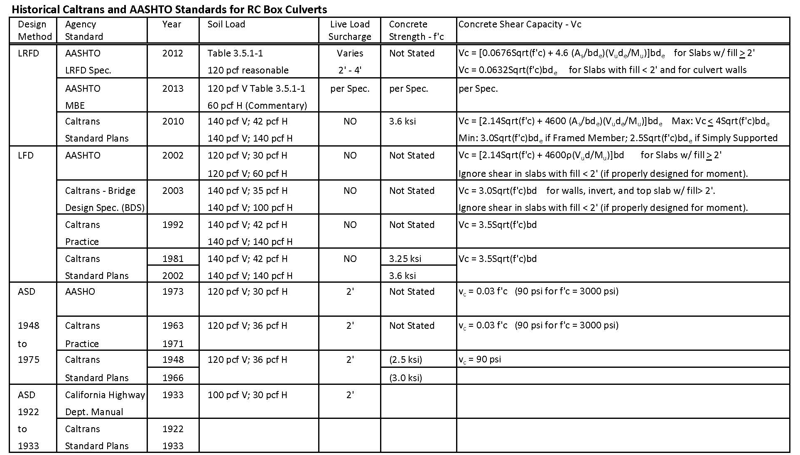
Design Standards; RC Box Culverts
Design Standards; RC Box Culverts
Notes:
Table of AASHTO and Caltrans Design Standards through the years.

Slide 40
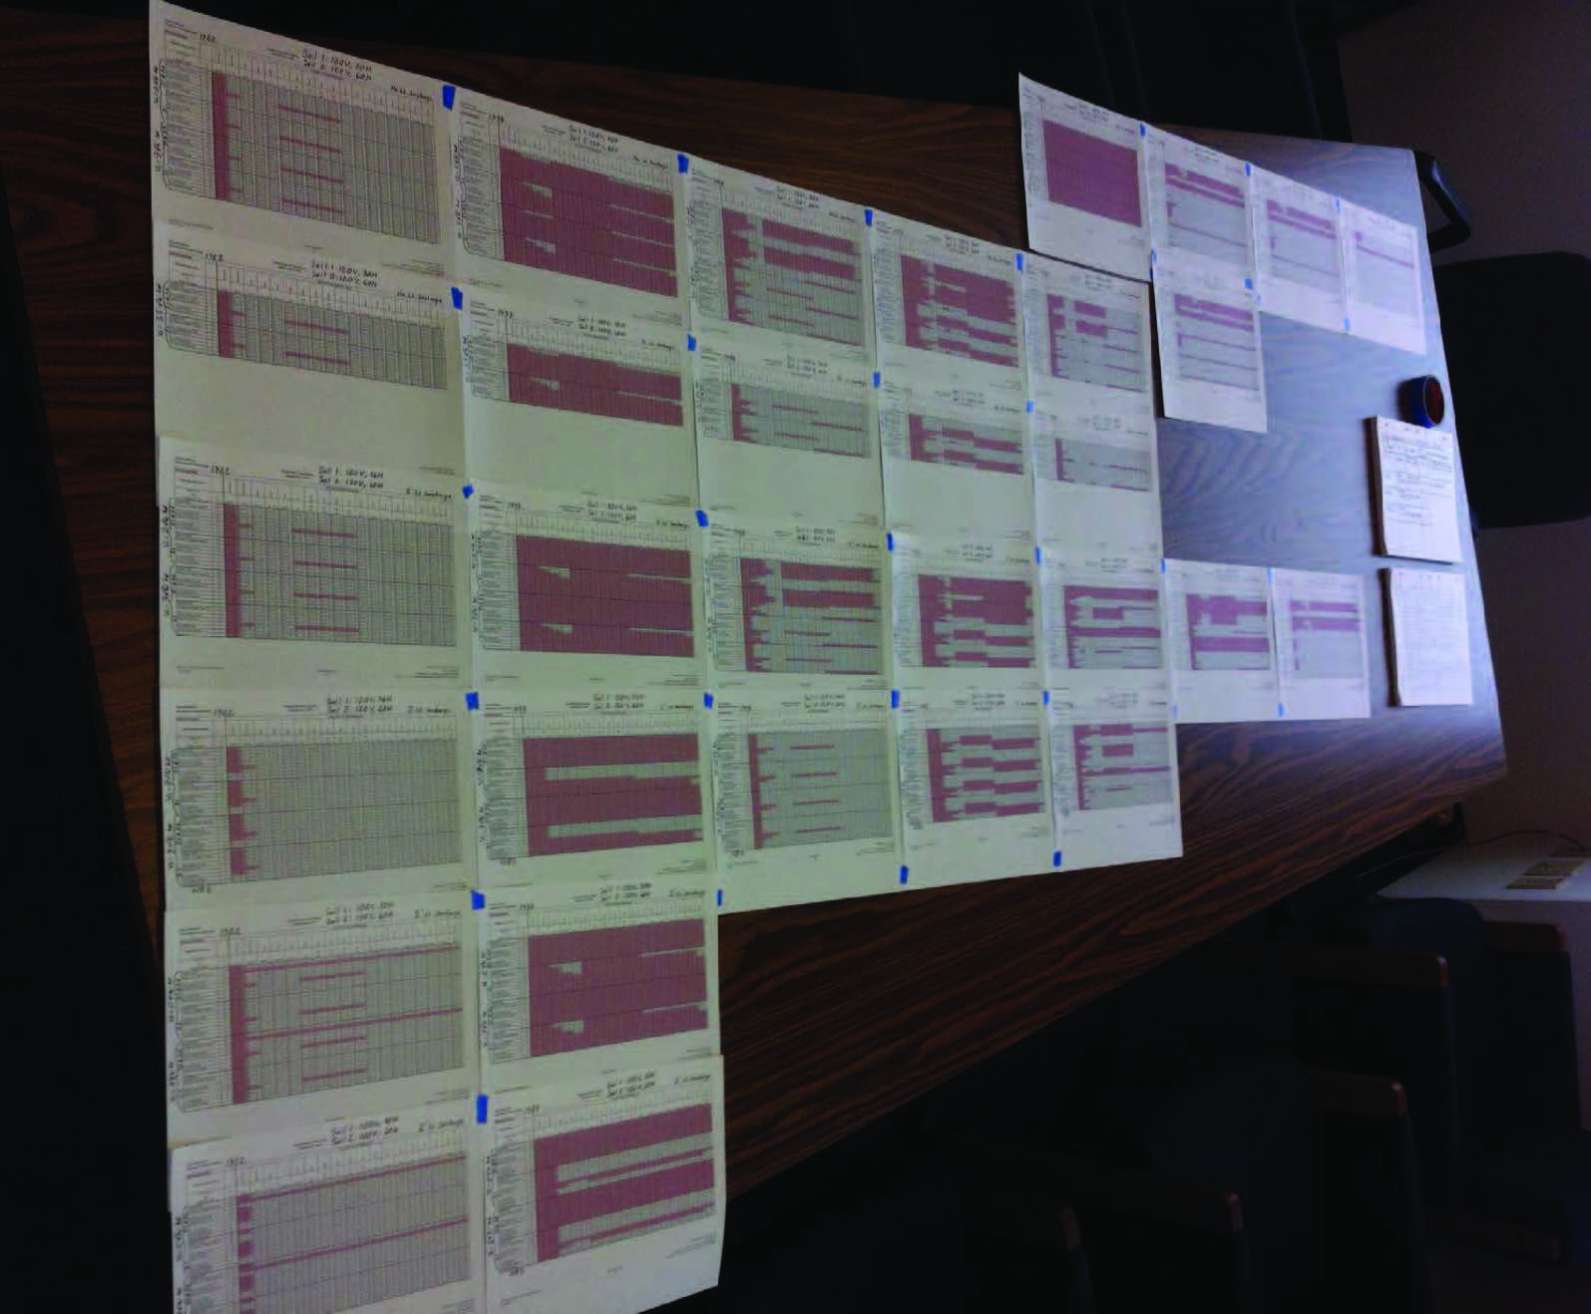
Initial Parameters Decision Matrix
Notes:
Initial decision matrix for the design parameters. Single 10’ x 8’ culverts were modeled. Designs for 1922, 1933, 1948, 1952, 1966, 1981, 2002, 2010 are represented in vertical columns. Various design parameters for the various years were applied to each design along each row, with the oldest at the bottom. Numerical details are illegible, but the concept is illustrated, recognizing that red areas represent Rating Factors less than 1.
The second column (1933) appears worst, but we have culverts that still look fine after 80 years of service.

Slide 41
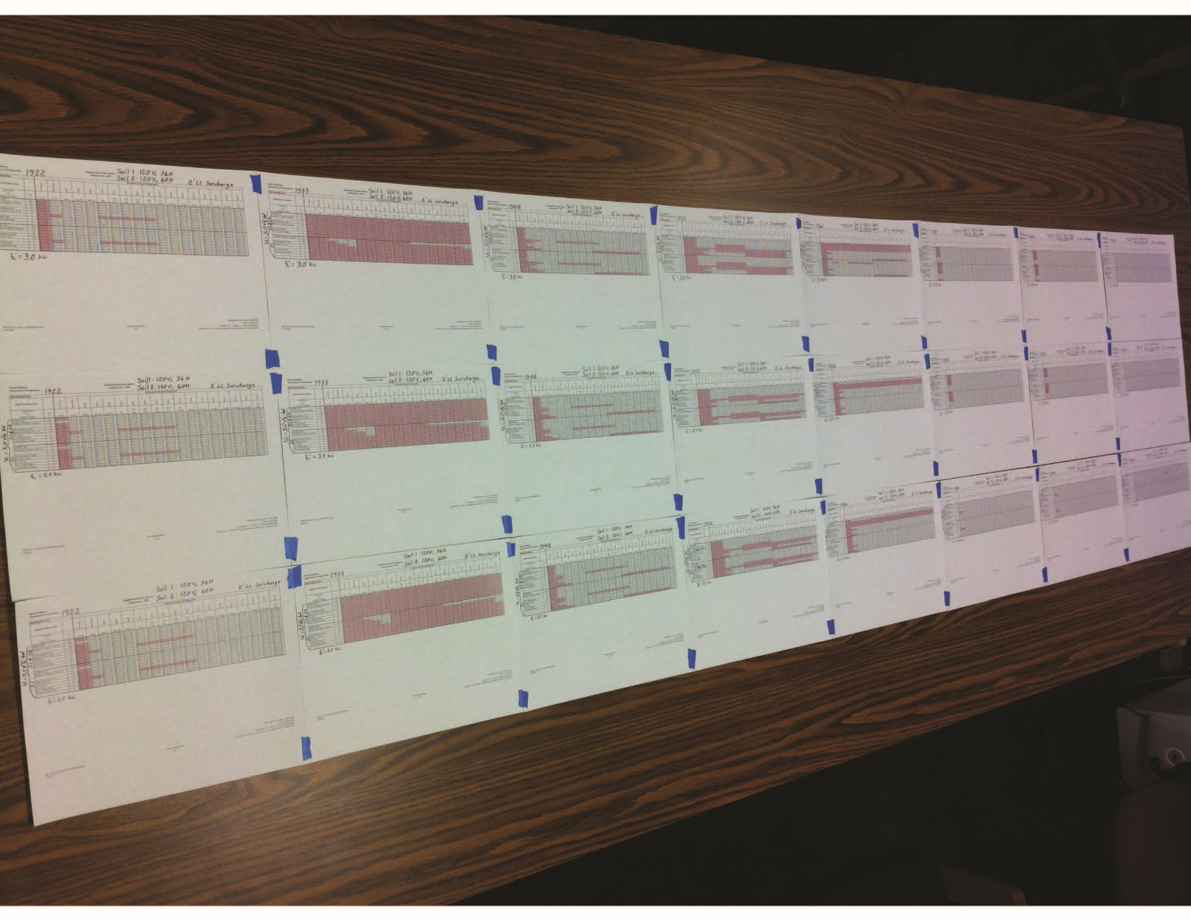
Second Parameters Decision Matrix
Notes:
Second decision matrix for the design parameters. Narrowed down to 2 sets of soil loadings, 2 values for f’c, and 2 values for shear capacity.
The second column (1933) still does not rate well.

Slide 42
Rating Parameters
Soil 1; 120 pcf V, 36 pcf H
Soil 2; 120 pcf V, 60 pcf H
Concrete: f’c = 3.5 ksi
Concrete Shear Capacity: Vc = 3.0 Sqrt(f’c)bd
Concrete for Shear Analysis: f’c = 7.88 ksi
2.0 Sqrt(7.88) = 5.6 = 3.0 Sqrt (3.5)
Rebar: per Standard Plans
Live Load Surcharge: 2’
Notes:
We began rating our RC Box Culvert Bridges based on these criteria. We used BrR with LRFR. We analyzed each design for two sets of soil loadings, to compare results. We used Vc = 3.0 Sqrt(f’c)bd for shear in culvert walls, and for slabs with less than 2’ cover. This required 6 BrR analyses for each culvert design, and a spreadsheet to sort out the governing load case. (Bending and Shear at f’c, Shear at an increased f’c, and Flexure only at f’c; with all three done for two soil loadings.) We used 2’ surcharge for consistency. RESULTS are represented in Slides 32 through 35.

Slide 43
RF vs. C/D Ratio
Rating Factor:
RF =
Capacity to Carry Live Load
Live Load Demand
RF =
Capacity – Dead Load
Live Load
C – DL
LL
=
Capacity to Demand Ratio:
C/D =
Total Capacity
Total Demand
Capacity
Dead Load + Live Load
=
C
DL + LL
C/D =
Notes:
Rating Factor (RF) and Capacity to Demand Ratio (C/D) defined and compared. When the dead load demand nears the total capacity and the live load becomes small, which is the case for high earth fills, the Rating Factor becomes very sensitive to slight variations in dead load or live load. The Capacity to Demand Ratio is less sensitive, and may be a better method of determining the adequacy of a culvert under high fill.

Slide 44
RF vs. C/D Ratio
EXAMPLE: Extremely High DL and Low LL:
C = 1000
LL = 1
Dead Load:
Rating Factor:
Capacity to Demand Ratio:
C – DL
LL
C
DL + LL
RF =
C/D =
DL = 950
1000 – 950
1
= 50
1000
950 + 1
= 1.051
1000 – 998
1
= 2
1000
998 + 1
DL = 998
= 1.001
1000
999 + 1
DL = 999
1000 – 999
1
= 1
= 1.000
1000
1000 + 1
DL = 1000
1000 – 1000
1
= 0.999
= 0
Notes:
Example of the sensitivity of the Rating Factor (RF) versus the Capacity to Demand Ratio (C/D) for very low live load, and dead load approaching the total capacity.

Slide 45
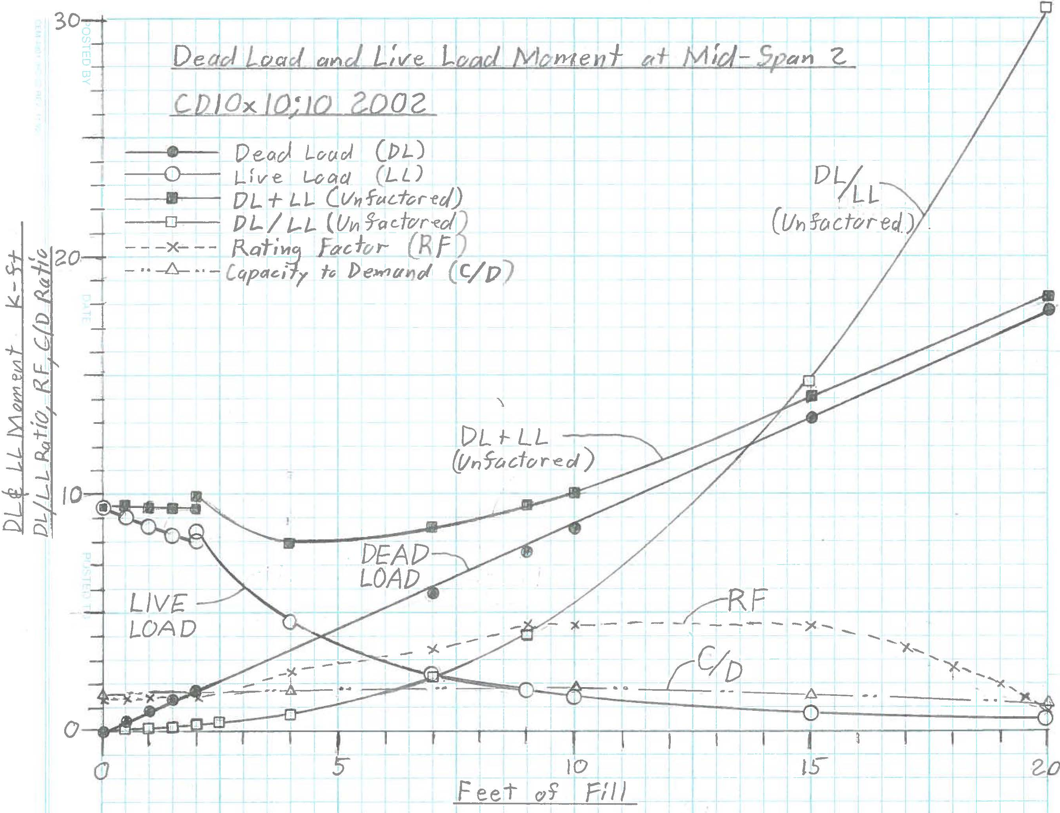
Dead Load & Live Load vs. Fill
EXAMPLE: CD10x10;10 2002 Deck Moment at Mid-Span:
Notes:
Example comparing the significance of dead load and live load versus fill height.
Live Load (LL) decreases and Dead Load (DL) increases with fill height. The combined effects are fairly constant up to 10’ fill, with a slight sag in the curve between 2’ and 10’.
The Dead Load/Live Load (DL/LL) ratio increases exponentially with fill height.
Rating Factor (RF) tends to increase slightly with fill height, and then drops off markedly as the capacity is reached.
Capacity/Demand (C/D) ratio is greater than 1.0 for RF>1 and is not as sensitive to change in fill height.
The interaction of RF, C/D, and DL/LL need further investigation.

Slide 46
RC Box Culvert Bridge is Robust
Triple 13.5’ W x 6’ H Built 1915, Widened 1937
Notes:
Good condition of older culverts is not uncommon. Not all culverts look this good. But typically the observed field condition is inconsistent with the low calculated rating results.

Slide 47
RC Box Culvert Bridge
Defects: Soffit Spalling and Exposed Rebar
near Widening Joint
Notes:
This spall with exposed rebar is near the widening joint, at what was previously the entrance to an older culvert.

Slide 48
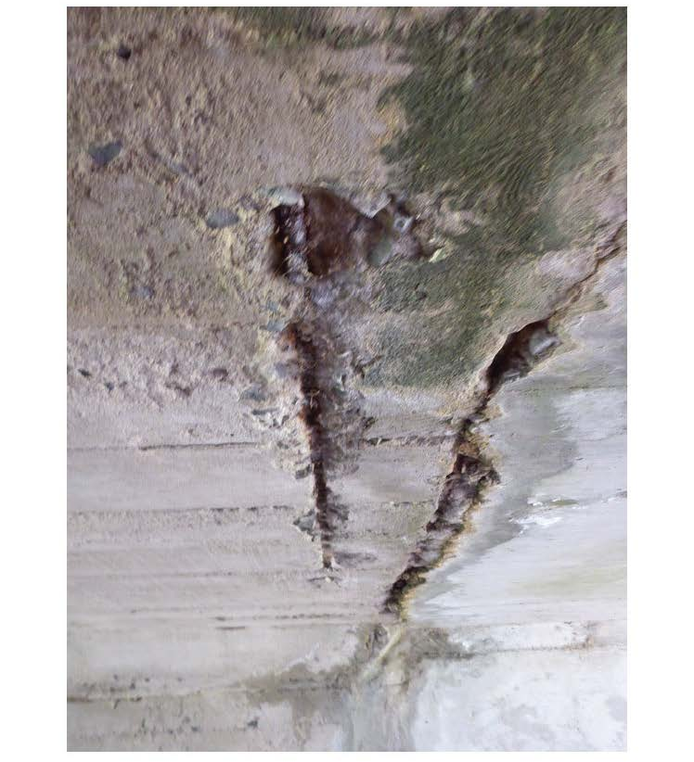
RC Box Culvert Bridge
Defects: Soffit Spalling and Exposed Rebar
at 1918/1967 joint
Notes:
Spalls and exposed rebar near joints is not uncommon. But it is usually localized. The steel seen at the right may be a small I-Beam used in the standard extension detail.

Slide 49
RC Box Culvert Bridge
Defects: Soffit Spalling and Exposed Rebar
at 1918/1967 joint; Overall OK
Notes:
Same joint viewed from farther back. The overall walls and soffit look good.

Slide 50
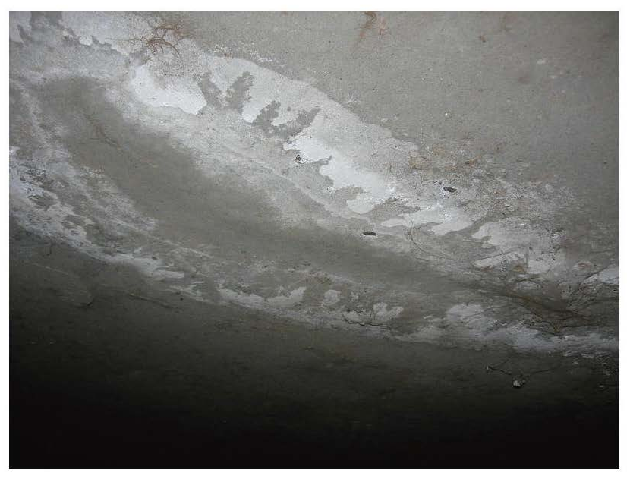
RC Box Culvert Bridge
Defects: Patched Soffit Spall
[Find a photo of patched spalling]
Notes:
A randomly located soffit spall which has been patched. It shows no signs of splitting out from deck loading.

Slide 51
RC Box Culvert Bridge
Defects: Transverse Cracking and Efflorescence
[Find a photo of cracking and efflorescence]
Notes:
Cracking and efflorescence in an older culvert.
Cracking is typically transverse to the culvert centerline. This means that it is not a flexural crack induced by live load.

Slide 52
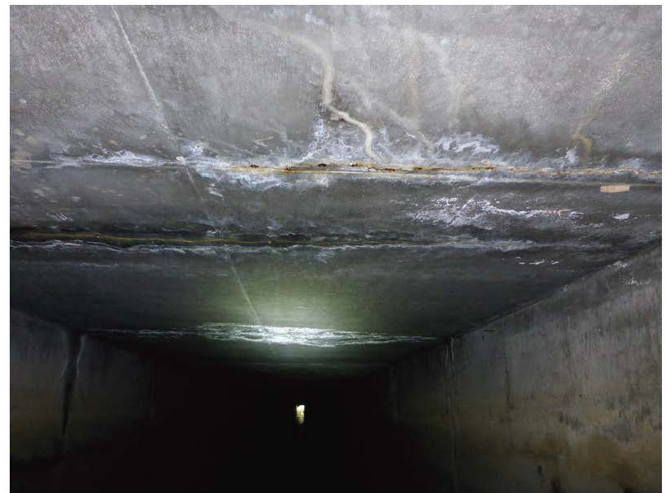
RC Box Culvert Bridge
Defects: Transverse Cracking and Efflorescence
[Find a photo of cracking and efflorescence]
Notes:
Cracking and efflorescence in a newer culvert. Cracking is typically transverse to the culvert centerline.

Slide 53
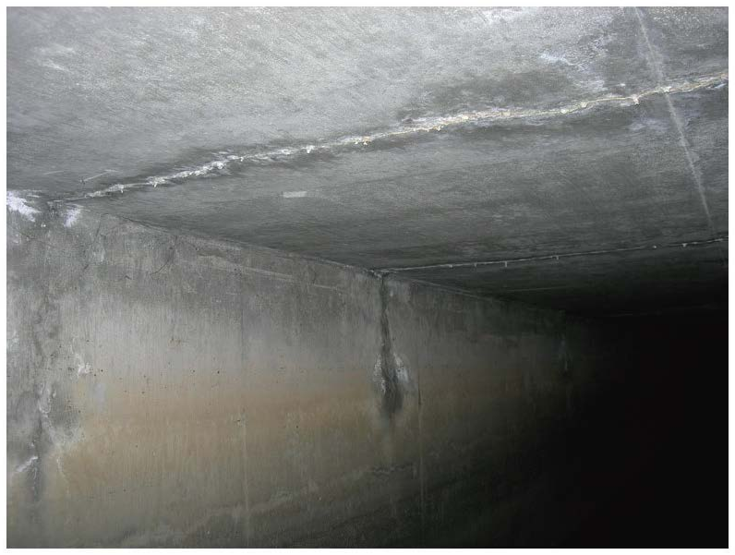
RC Box Culvert Bridge
Defects: Transverse Cracking and Efflorescence
[Find a photo of cracking and efflorescence]
Notes:
Cracking and efflorescence in a newer culvert. Cracking is typically transverse to the culvert centerline and vertical in the walls.
OVERALL: We are not seeing serious longitudinal cracking in the soffit, or soffit sagging, which would indicate flexural overloading from live load. We are not seeing longitudinal cracking or inward bulging of the exterior walls, indicating excessive lateral soil loads.

Slide 54
RC Box Culvert Bridge
Defects: Abrasion
[Find a photo Abrasion. 35 0017
Same bridge as cracking and efflorescence]
Notes:
Abrasion along the lower walls. Walls and soffit show no serious cracking.
OVERALL: We are not seeing serious longitudinal cracking in the soffit, or soffit sagging, which would indicate flexural overloading from live load. We are not seeing longitudinal cracking or inward bulging of the exterior walls, indicating excessive lateral soil loads.

Slide 55
Thoughts on Source of Low Ratings
The reason for low calculated ratings must be something basic.
Culverts have been working fine for years.
Walls are not actually loaded per theory.
Loads spread along the length of culvert.
Deck live loads spread over interior walls.
Confinement helps strengthen the structure.
Soil distributes and dissipates loads.
Load Factors? ASD & LFD design; and LRFR Rating
Notes:
Some general thoughts on the source of the low calculated ratings.

Slide 56
Box Culvert Rating Efforts on HOLD
Pending results of NCHRP 15-54 Culvert Study
Notes:
We are hoping that the NCHRP 15-54 study will be able to address the basic issues and provide realistic rating guidelines.
We are encouraged by the fact that the BrR developers are involved in the study. They are in a position to modify BrR as needed, and to extract the specific results data needed for evaluation. (For example; obtaining the RF for all elements, not just the governing element.)

Slide 57
Realities of Rating RC Box Culverts
Fine tuning an analysis is fruitless when the basic parameters are uncertain.
We do not have as-built plans for most culverts
We do not know the actual soil parameters
Soil parameters could vary with season
We do not know the exact fill depth
We do not know the exact pavement thickness
The live load distribution is approximate
Notes:
Fine tuning the analysis when the basic parameters are uncertain is fruitless. We typically do not have as-built plan information for most of our culverts. If we have As-Builts, or if we use Standard Plans for the model, there are still many uncertain rating parameters. Agreement needs to be reached on the basic parameters first.

Slide 58
Possible Options for Rating RC Box Culverts
Full Calculated Rating
Assigned Rating
Modified Assigned Rating for Culverts
Simple Span, Moment calculations
Continuous Span: Back Calculated moment capacity using BrR, based on Design and Legal Trucks. Rate all other trucks using BrR.
Rate the deck slab only
Notes:
When we have sufficient information, we can do a full calculated rating analysis.
However, it seems clear that some form of Assigned Rating process must be developed since we often do not have enough information to do a full calculated analysis.
We are considering a general concept; but it is NOT fully developed:
The Design Load would be estimated based on the year built and design agency.
The Design Load would be applied to a simple span model using the actual culvert span. The capacity would be assumed to be equal to the applied load.
Other truck loadings could be applied and rated based on the assumed capacity, to give realistic relative rating factors.
Simple spans could be assumed, and deck moments at mid span could be used.
Alternatively, it seems that a basic BrR model could be made. The ratings would be based on total capacity of key elements at critical points.
A similar approach using BrR could be taken by rating the deck slab only.

Slide 59
Modified Assigned Rating -1
Relative Rating Factors CONCEPT:
Using Simple Span Moments
Model as one simple span.
Load with the Design Truck
Obtain the Design moment demand at center of span. Use this as the Live Load Capacity.
Obtain demands for the trucks to be rated; Legal, SHV, EV, Permit
Obtain relative ratings for all other trucks using the Live Load Capacity derived above.
RF =
Live Load Capacity
Demand of Rated Truck
Dead and earth loads are assumed unchanged, and therefore drop out of the RF calculation.
Notes:
This slide illustrates the concept of calculating relative ratings using simple span moments.

Slide 60
Modified Assigned Rating - 2
Alternative 1: Use BrR and a full frame model
Model the span, height, and design fill. Set reasonable wall & slab thicknesses.
Load with the Design Truck
Obtain demands in key elements at critical locations, using BrR.
Total Capacity is equal to the sum of all factored loads.
Set the Capacities of key elements at critical locations in BrR using points of interest (POI). [This feature would need to be added to BrR for culverts.]
Rate using BrR.
Alternative 2: Use BrR with a deck only model
Alternative 3: Use BrR with a single cell model
Notes:
Alternative 1: This slide illustrates the concept of assigning relative ratings based on a full frame culvert analysis using BrR.
A generic BrR model could be made with span, height, and number of cells. It could be loaded with dead load and design live load, and the total factored demand of key elements at critical locations could be determined using BrR.
The total factored capacities of key elements at critical locations would be assumed to be equal to the design demands.
If the capacities were locked into BrR as designated values at points of interest, then BrR could do the full relative rating analysis for other trucks.
Alternative 2: A similar approach using BrR could be taken in rating the deck slab only, if the walls and invert are considered to be substructure elements in good condition.
Alternative 3: A single cell BrR culvert model could be used. This would be much simpler to do. Since relative ratings are desired, this alternative may be just as meanigful as the more complicated methods.

Slide 61
What We Need from AASHTO
Revisions to the MBE that will result in realistic ratings
Standard rating parameters for a Calculated Analysis: Soil Load, Concrete Shear Capacity
An approved Modified Assigned Rating method
Investigate use of the C/D ratio in conjunction with, or instead of, the RF beyond certain DL/LL ratio limits.
Notes:
Incorporate realistic recommendations into the MBE from the NCHRP 15-54 culvert study that will result in realistic ratings for our culverts.
We need a standard set of parameters for consistent calculated ratings for use when we have enough information to perform a calculated rating. Soil Load 120 pcf V; 36 pcf H ? Concrete shear capacity Vc = 3.0 Sqrt (f’c)bd ? Hopefully the NCHRP 15-54 study will determine some realistic recommended values.
We need an approved modified assigned rating method also, since we typically do not have enough information to perform a full calculated rating.
The capacity to demand ratio (C/D) appears to be more meaningful than the Rating Factor (RF) for high fills, where the dead load to live load ratio (DL/LL) is high. Appropriate limits of DL/LL for use of the RF and C/D should be investigated. This is being reviewed in the NCHRP 15-54 study.

Slide 62
What We Need from AASHTOWare
Tailor BrR to accommodate either rating method:
- Full calculated analysis (It now does this)
- Modified assigned rating procedure
Create a BrR report that provides the rating information for each of the culvert components separately
Notes:
BrR can perform consistent calculated ratings if we have a standard set of parameters and enough information to perform a calculated rating.
BrR could and should also be tailored to perform a rating by an approved modified assigned rating method, since we typically do not have enough information to perform a full calculated rating. The necessary changes to BrR will be determined as the specifics of the procedure are developed.
It would be helpful if the rating data for each culvert component could be viewed separately in BrR. For example; if the deck rating is adequate and the walls and invert show no distress, the bridge rating might be considered adequate even if the calculated rating for the wall is less than one, but reasonable.

Slide 63
Useful AASHTOWare Improvements
Allow interior and exterior wall end fixity conditions to be set independently.
Define interior and exterior haunches separately.
Allow for a user defined spread/depth ratio of Live Load through the cover soil.
Provide an option for a user defined shear Beta (β) value.
Provide the option for BrR to analyze and rate the culvert components separately.
Ignore rating results at designated points of interest (POI).
Provide a report of total factored Demand at designated POI.
Provide the ability to SET the Capacity at designated POI.
Report the C/D value when the DL/LL ratio reaches a certain limit (determined by AASHTO).
Notes:
Allow interior and exterior wall end fixity conditions to be set independently. Many culverts have pinned interior wall ends, but rigid exterior wall to slab connections.
Define interior and exterior haunches separately. Early culverts had different haunches at interior and exterior walls.
Allow for a user defined spread/depth ratio of Live Load through the soil. LRFD gives 1:1 or 1.15:1 spread from the tire patch. This seems too conservative. LFD gives 1.75:1 from a point.
Provide an option for a user defined shear Beta (β) value. This would allow for rating results with a single analysis if a user defined concrete shear capacity is to be considered when using the simplified method.
Provide the option for BrR to analyze and rate the culvert components separately. Rating the deck only could take much less analysis time. Rating the invert or walls separately would add flexibility.
Ignore rating results at designated points of interest (POI). This would allow negative moment to be ignored in continuous slabs with no negative reinforcing.
Provide a report of total factored Demand at designated POI. The demands of key elements at critical points could be used in a modified assigned rating procedure.
Provide the ability to SET the Capacity at designated POI. This would allow for setting the capacity at critical points of key elements for a modified assigned rating procedure.
Report the Capacity/Demand (C/D) value when the Dead Load/Live Load ratio (DL/LL) reaches a certain limit (determined by AASHTO).

Slide 64
AASHTOWare - BrR
BrR is good software for rating culverts.
It is simple to use.
Modeling is intuitive and the data input format is similar to that for bridges.
It can be adapted as needed when the rating issues are resolved.
Let’s put our heads together and make it work.
Let’s put our heads together and make it work.

