Slide 1

Rating of Steel Swing Bridges
Tony Zhang, P.E.
California Department of Transportation
07/30/2019

Slide 2
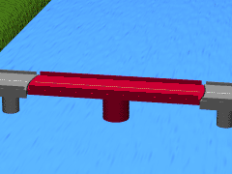
Swing Bridge

Slide 3
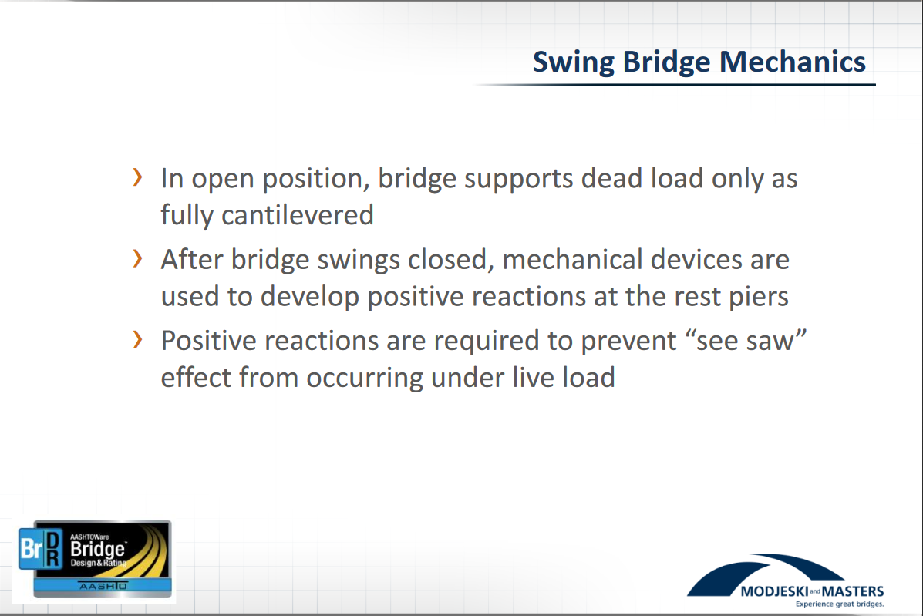

From “Analysis of Truss Swing Bridges in BrR” on 2018 BRDBUG Meeting, Jason Miles

Slide 4
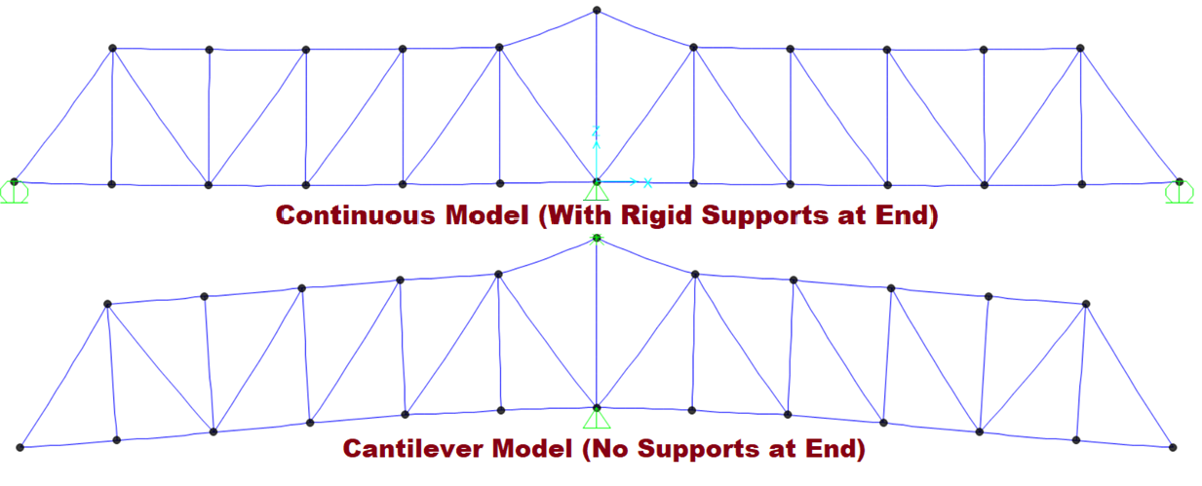
Benefit of End Jacking for Swing Bridges
Deflection Due to Dead Load:

Slide 5
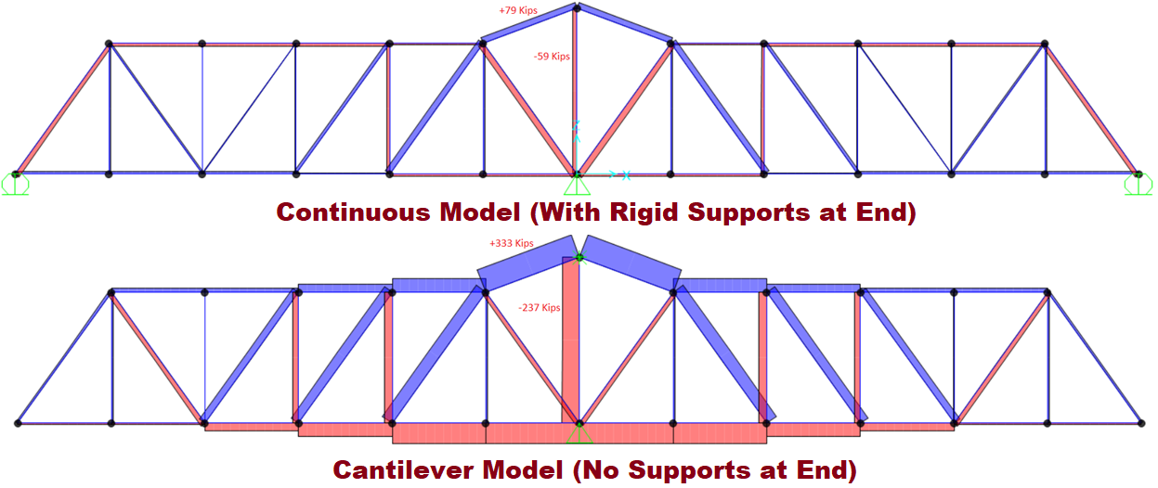
Benefit of End Jacking for Swing Bridges (Cont.)
Axial Force in Truss Members Due to Dead Load
End jacking increases the rating factors by reducing the forces in critical member due to dead loads.

Slide 6
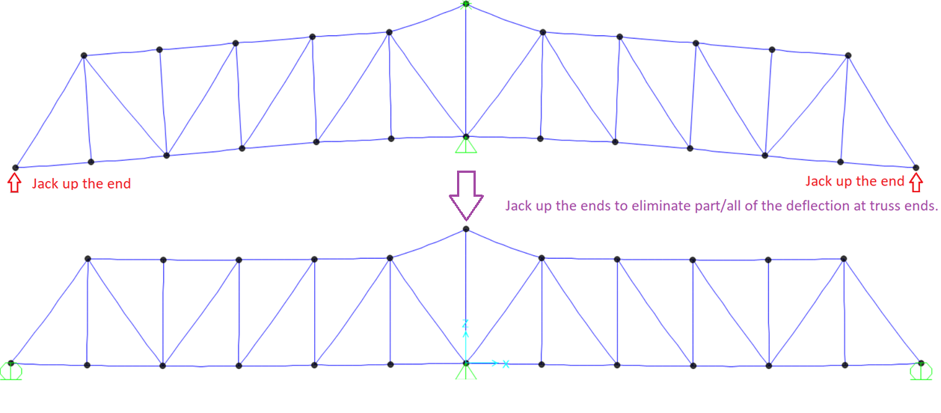
End Jacking Application

Slide 7
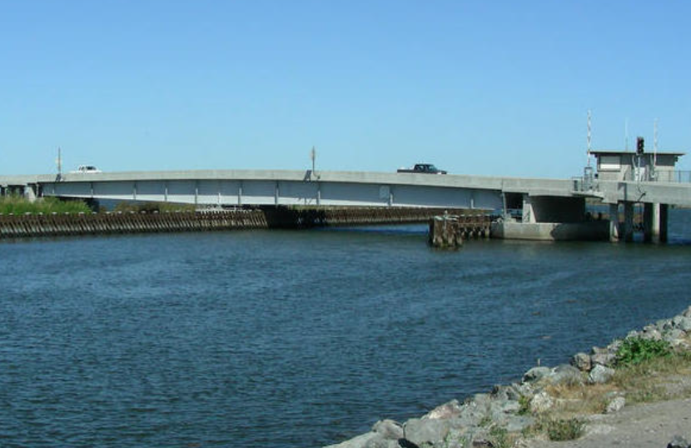
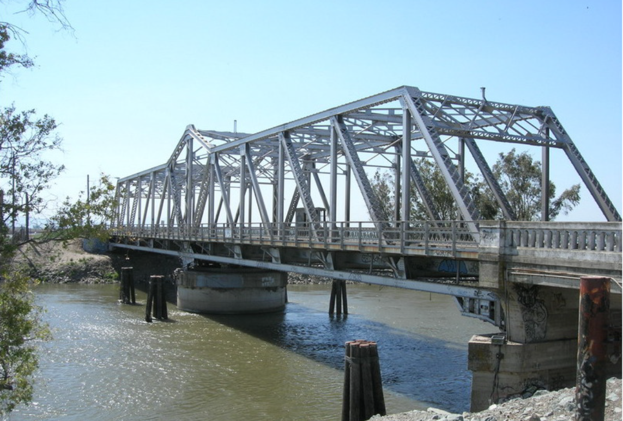
Typical Steel Swing Bridges in California
Steel Plate Girder Bridge | Steel Truss Bridge
● Steel Plate Girder Bridges
● Steel Truss Bridges

Slide 8
Swing Bridge with Partial End Jacking
(Steel Plate Girder Bridge)
Bacon Island Road Bridge at Middle River
(Br 29C0108)

Slide 9
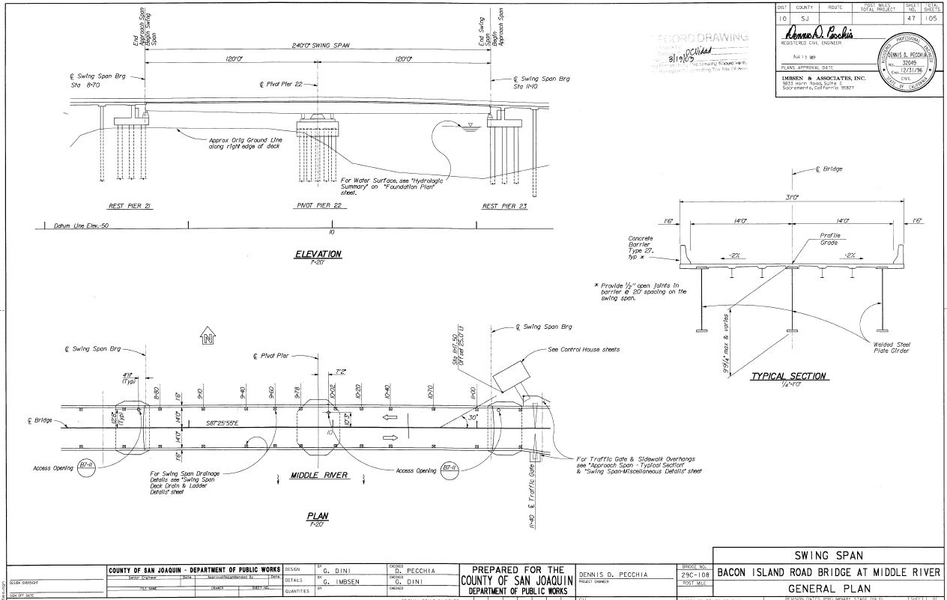
As-Built Plans, Bacon Island Road Bridge

Slide 10
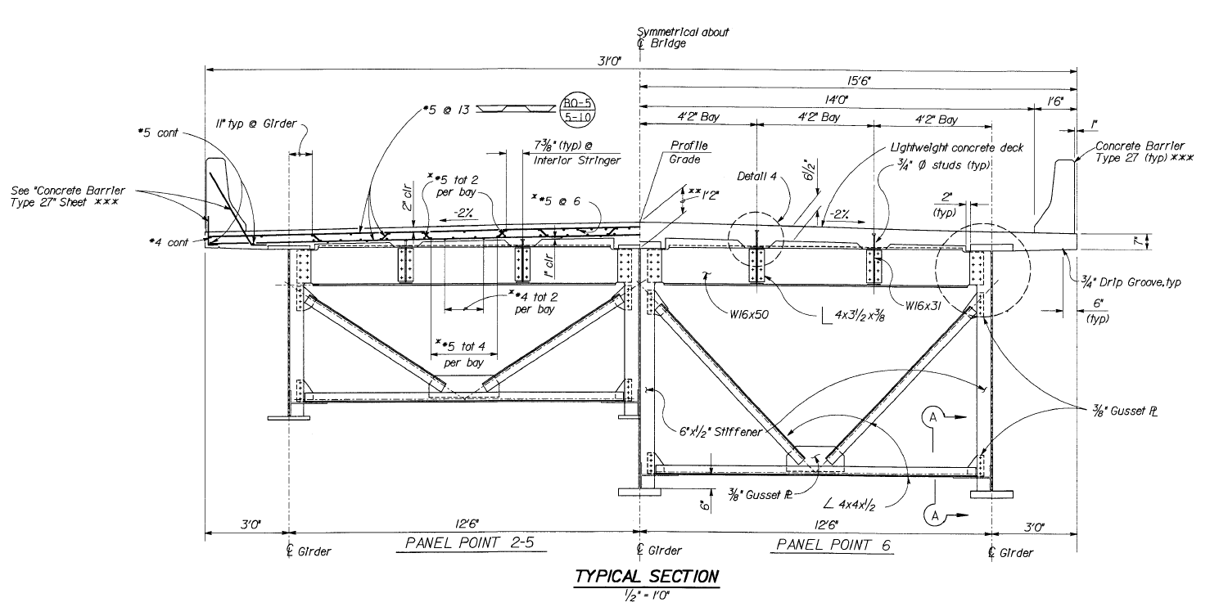
Typical Sections

Slide 11
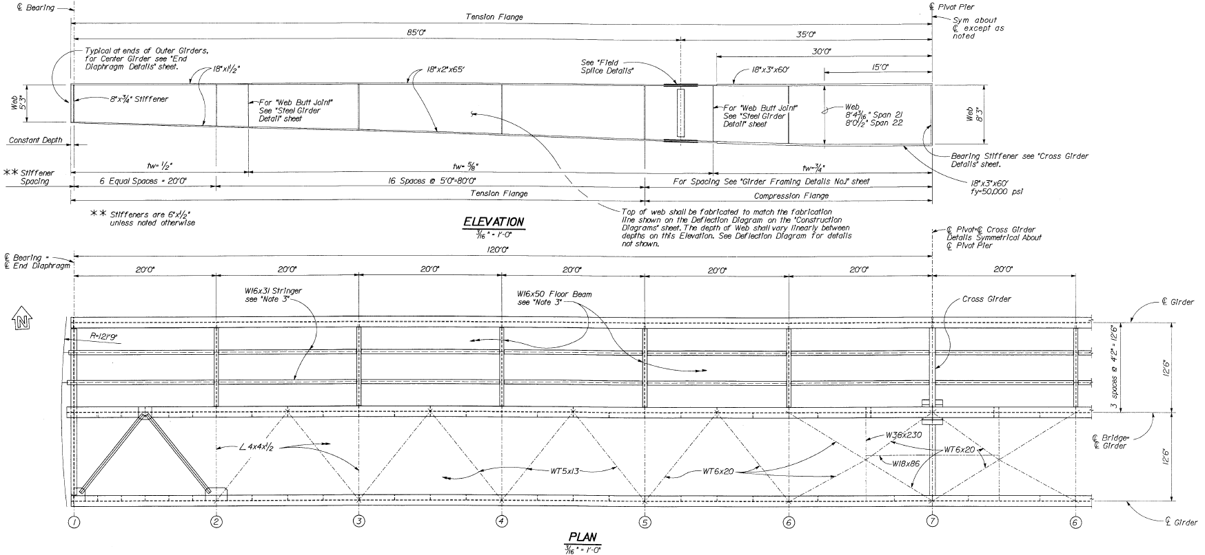
Girder Elevation and Framing Plan

Slide 12
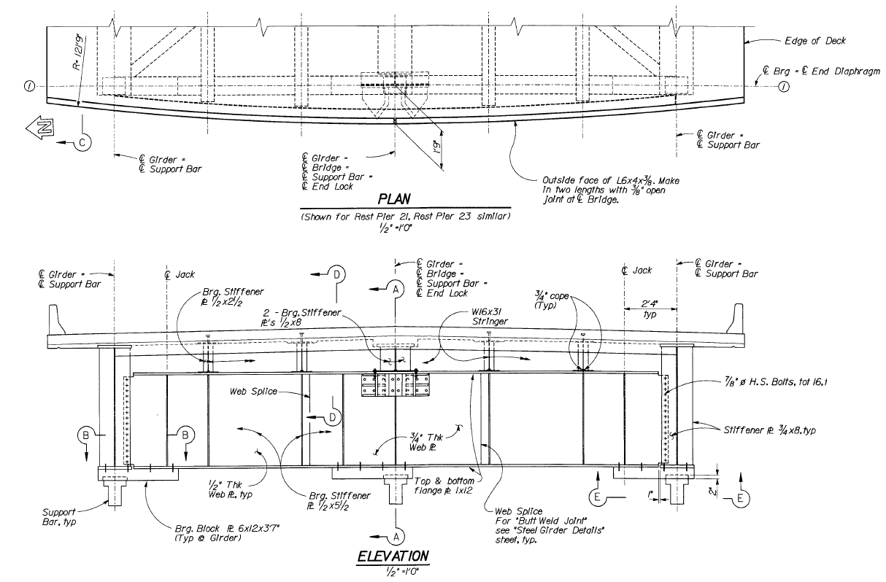
Jacking Point Details

Slide 13
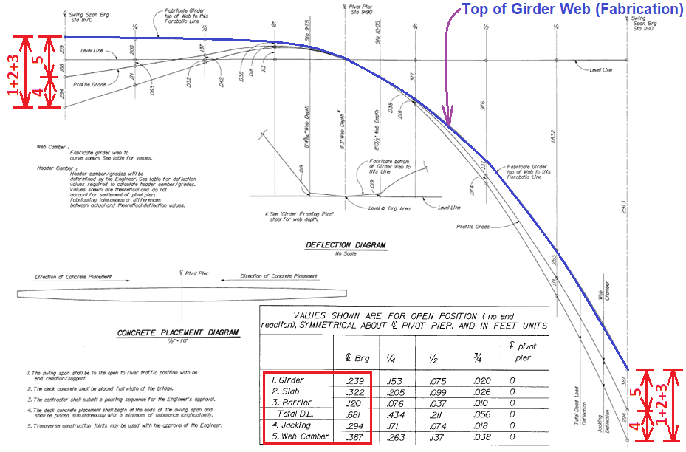
Deflection Diagram
Note: Jacking is supposed to recover a portion of the cantilever movement.

Slide 14
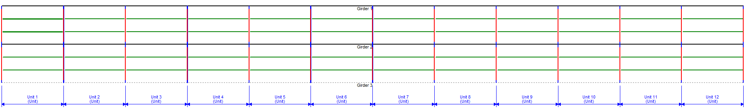
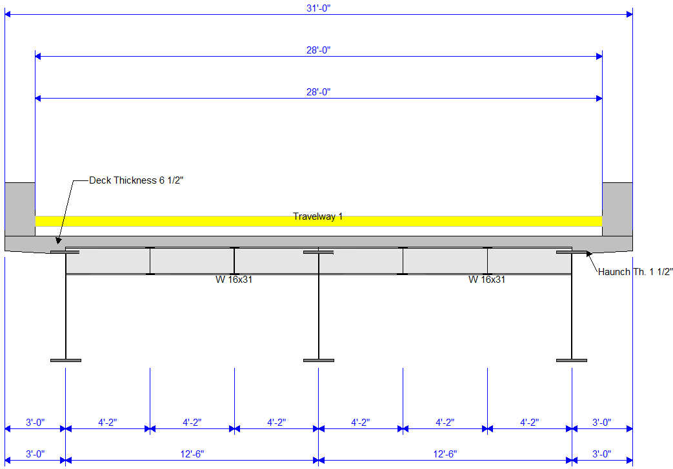
BrR Girder-Floorbeam-Stringer System Model

Slide 15
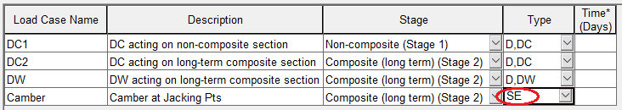
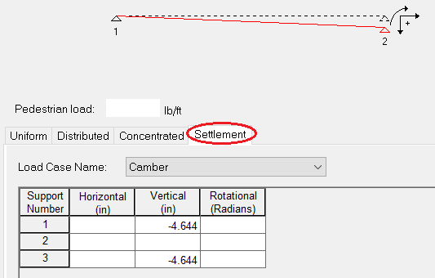
Girder End Settlement for End Jacking in BrR Model

Slide 16
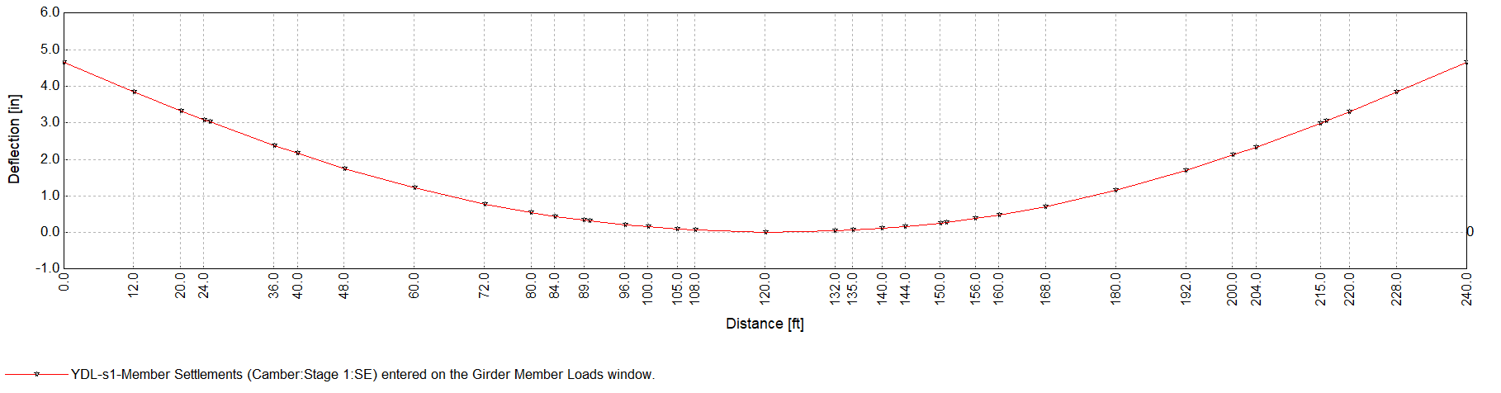
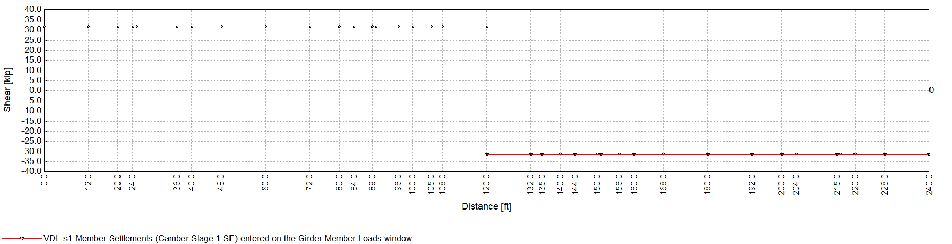
Main Girder Displacement and Shear Diaphragm

Slide 17
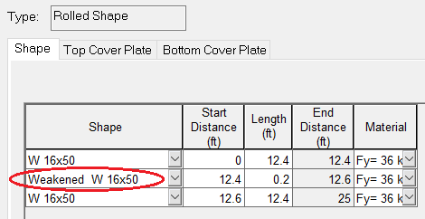
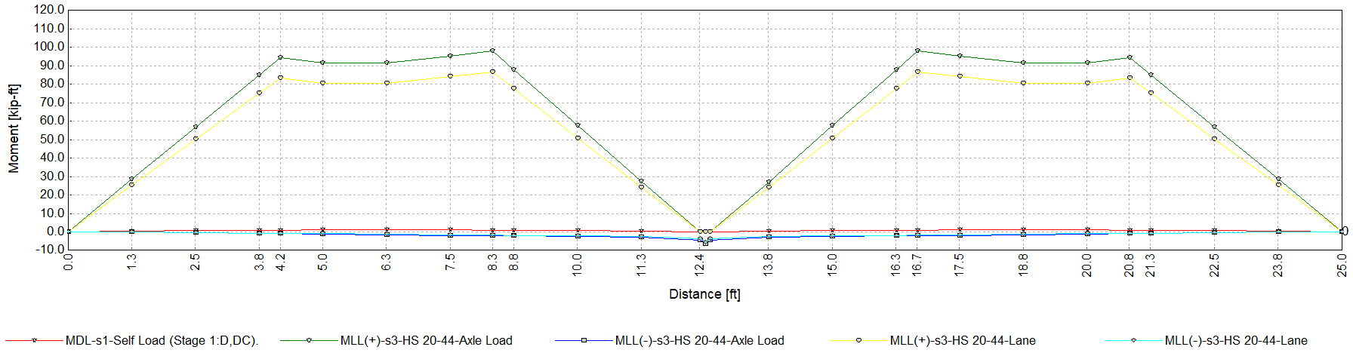
Hinge in Middle & Bending Moment of FloorBeam

Slide 18
Swing Bridge with Full End Jacking
(Steel Plate Girder Bridge)
Bishop Canal Bridge
(Br 29C0114)

Slide 19
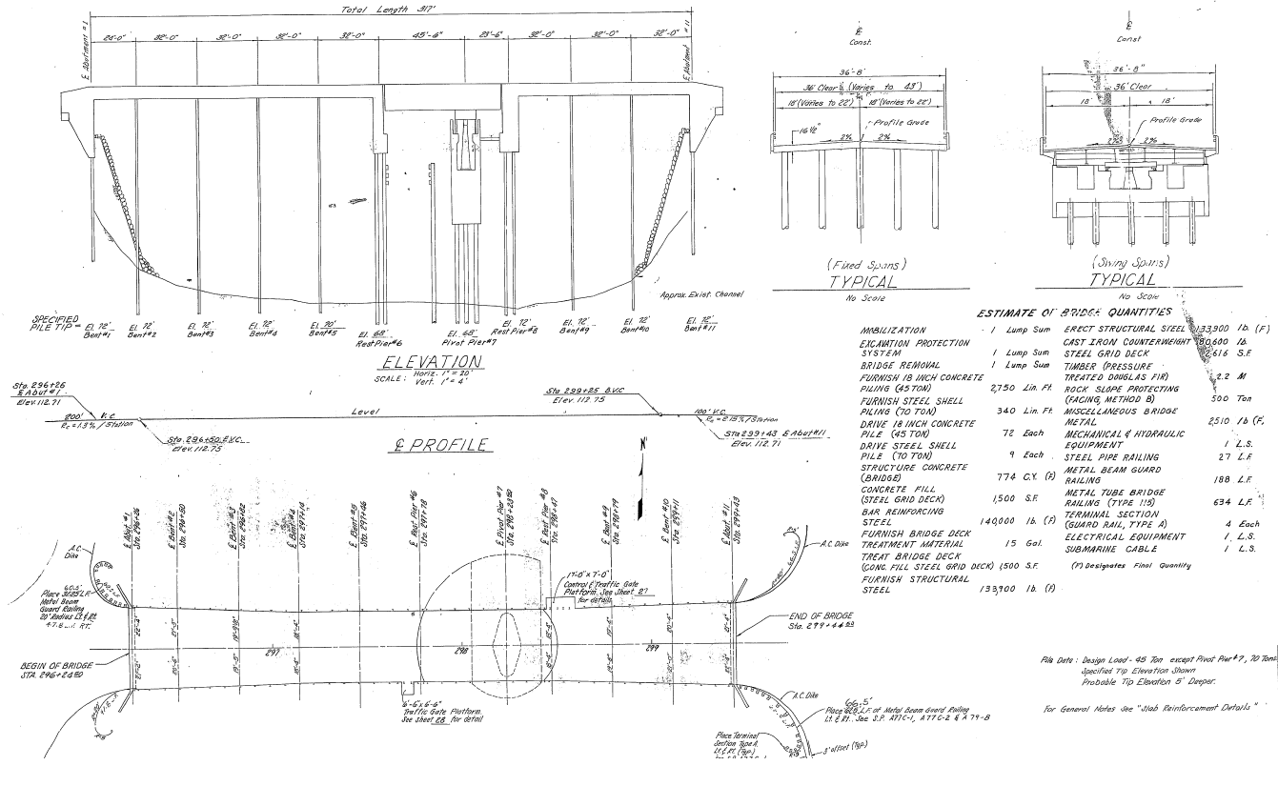
As-Built Plans, Bishop Canal Bridge

Slide 20
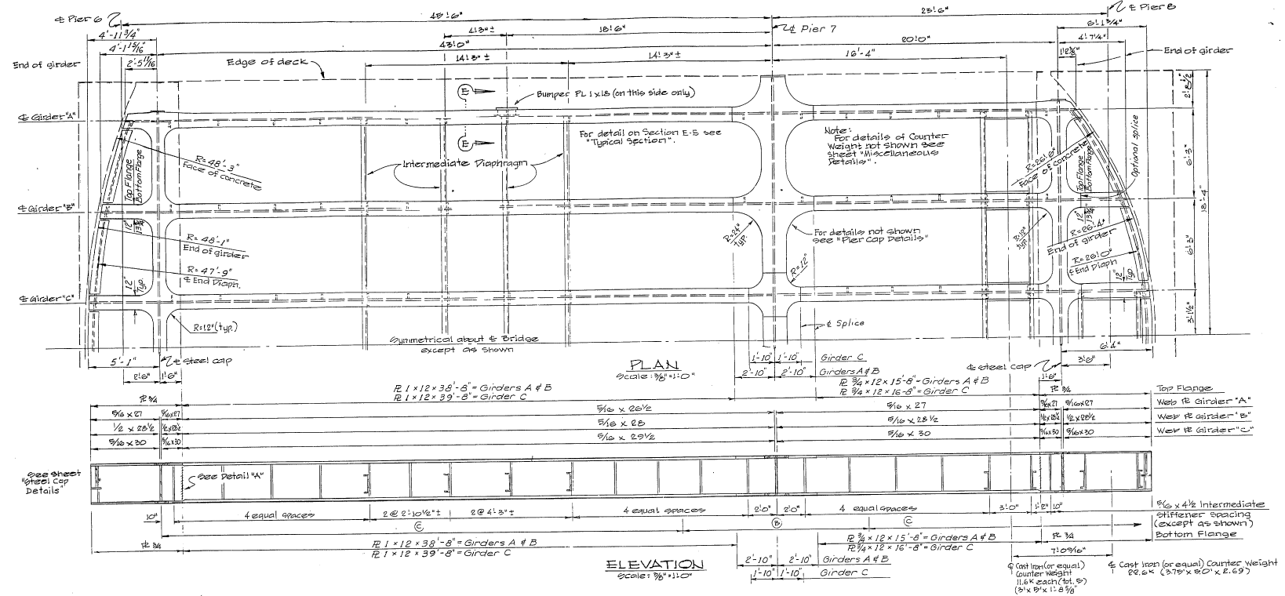
Bishop Canal Bridge
(Swing Spans 45.5’ + 23.5’ As-Builts)

Slide 21
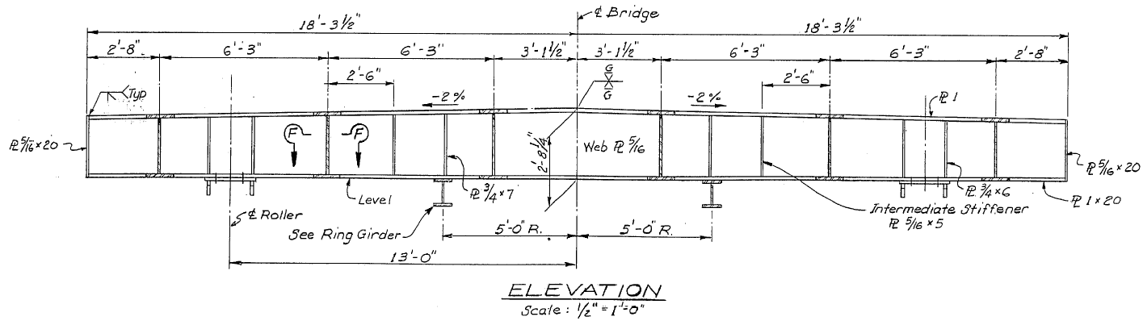
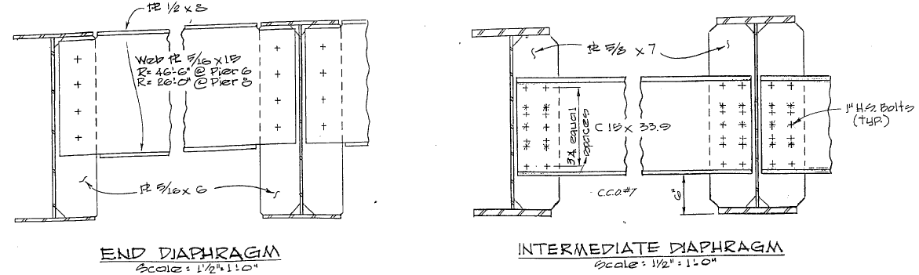
Details of Support at Pier 7 (Pivotal Pier) & Diaphragm

Slide 22
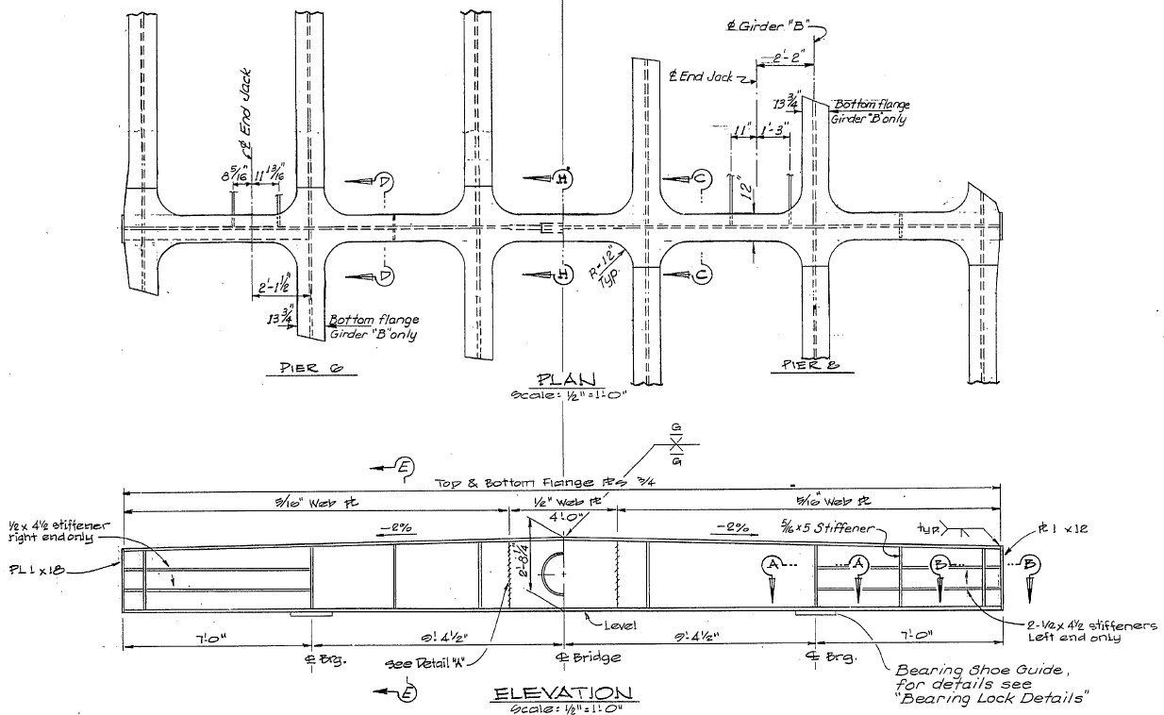
Jacking/Support Locations at Pier 6 and Pier 8

Slide 23
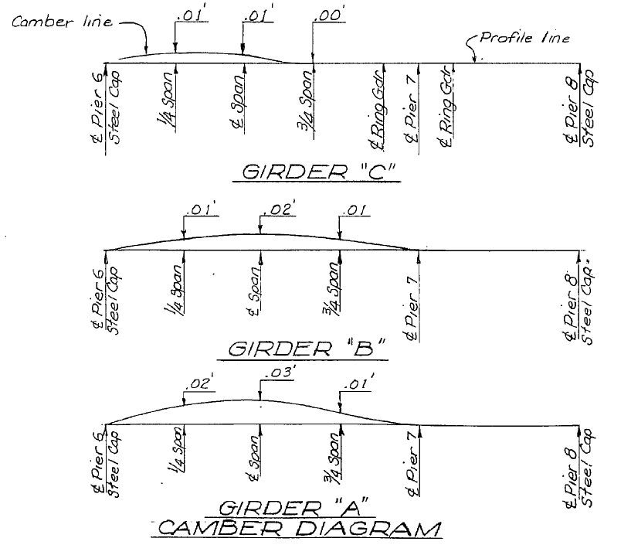
Camber Diagram of Swing Spans
Note: Jacking is supposed to recover all the cantilever movement.

Slide 24
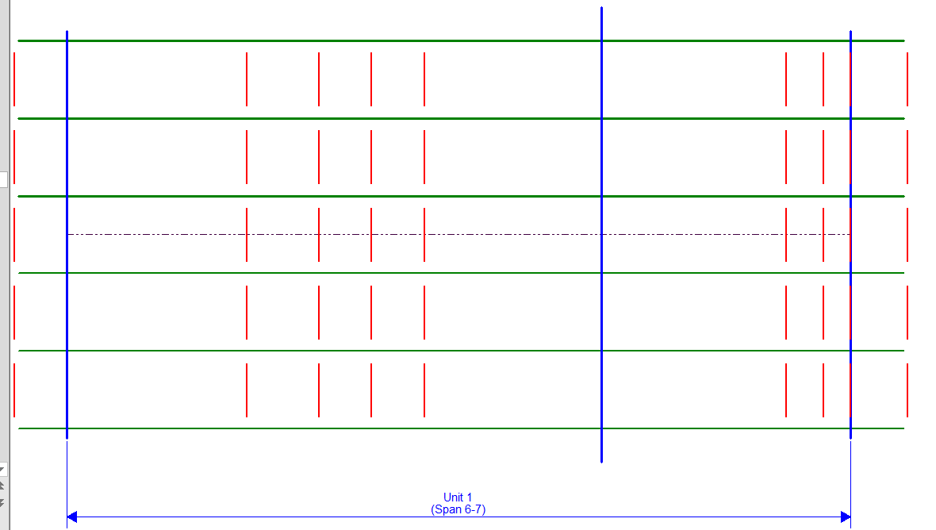
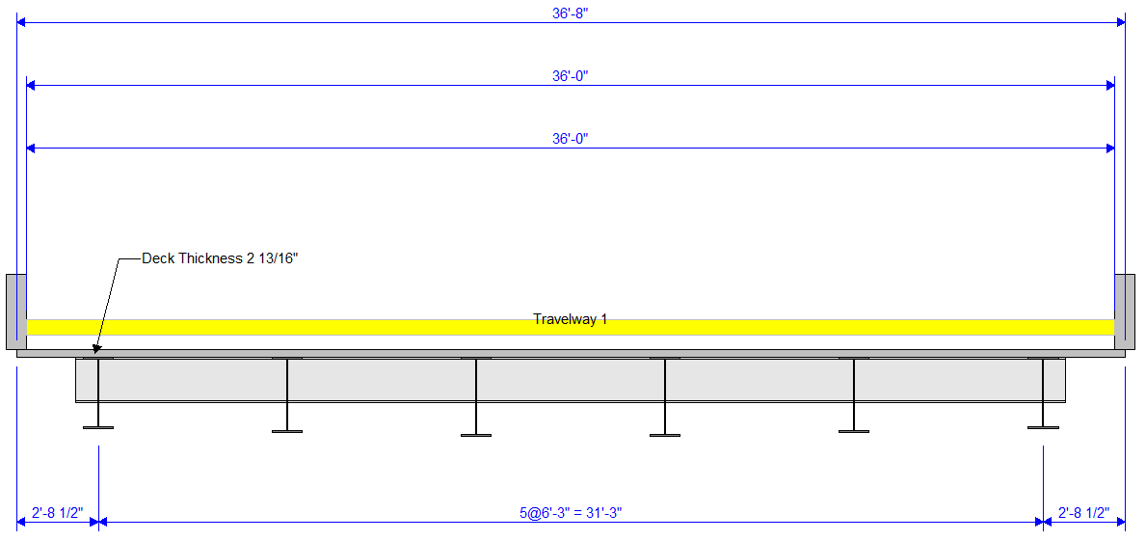
BrR Floorbeam-Stringer System Model (For Bent Cap)

Slide 25
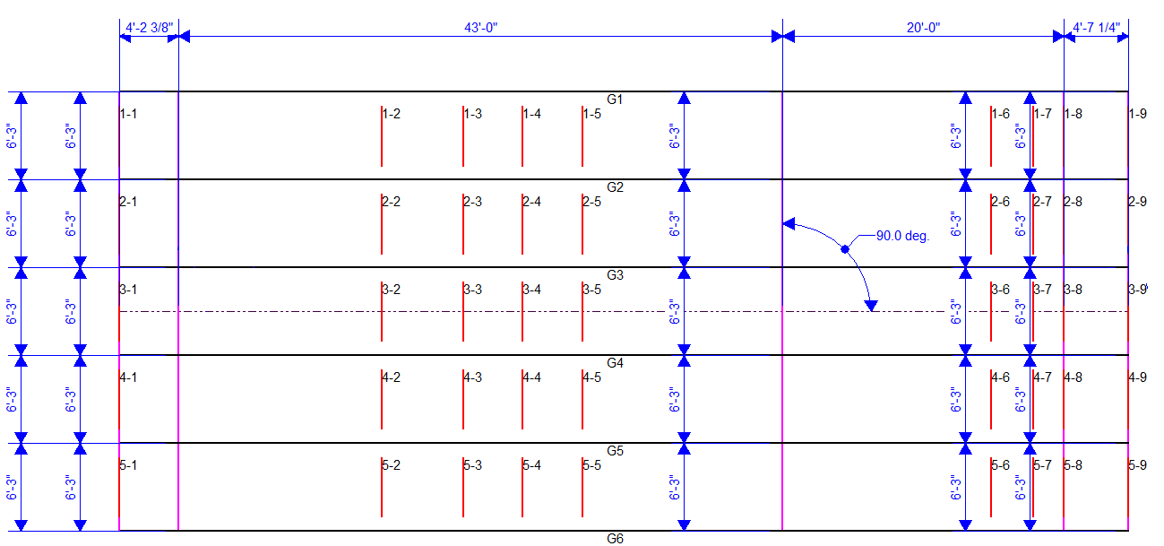
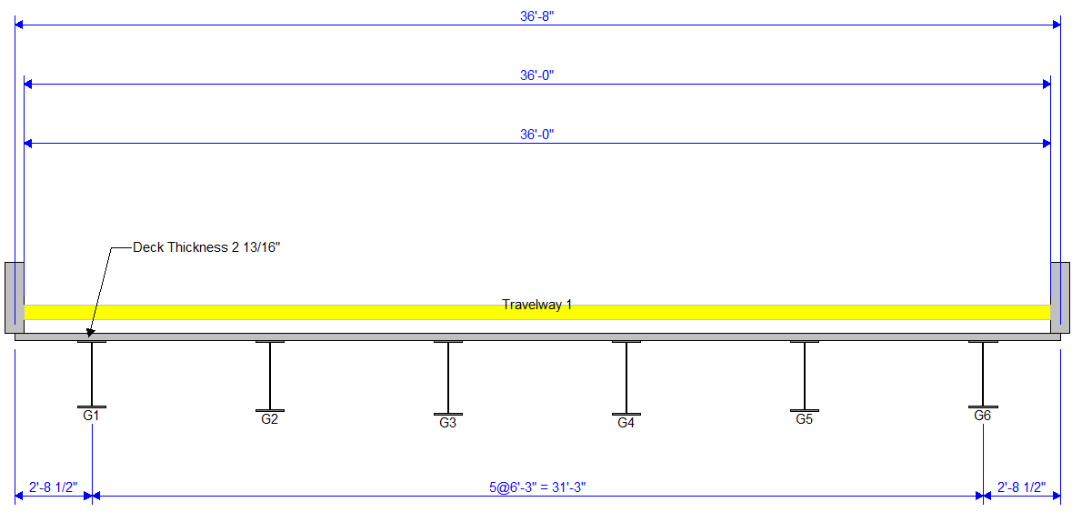
BrR Girder System Model (For Girders)

Slide 26
Full End Jacking for this Swing Bridge
The jacking movement compensates the whole cantilever displacement and girder ends.
The swing bridge can be rated as a fixed bridge.

Slide 27
End Jacking for Swing Truss Bridges in BrR Truss Module

Slide 28
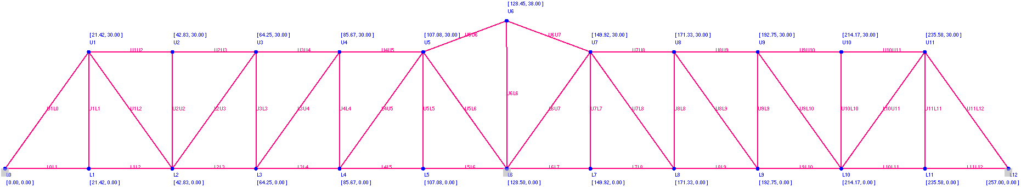
Limitation in BrR Truss Module
In Current BrR Program, no commands can directly simulate the support settlement or jacking movement at truss ends in BrR Truss Module!

Slide 29
Methods for Rating Swing Truss Bridges
FE modeling by using CSI Bridge (or other FEM software) and Hand Calculations;
FE Modeling and BrR Truss Module, from Jason Miles’ Presentation “Analysis of Truss Swing Bridges in BrR” on 2018 BRDBUG Meeting.
Proposed Dummy Spring Method in BrR Truss Module only.

Slide 30
FEM Shortcomings by Using CSI Bridge or other software
1. Time consuming;
2. Both rater and checker need to be familiar with CSI Bridge (or other FEM software);
3. Hard to maintain the FEM files due to the program updating in the future.

Slide 31
Proposed Method:
Dummy Spring Method

Slide 32
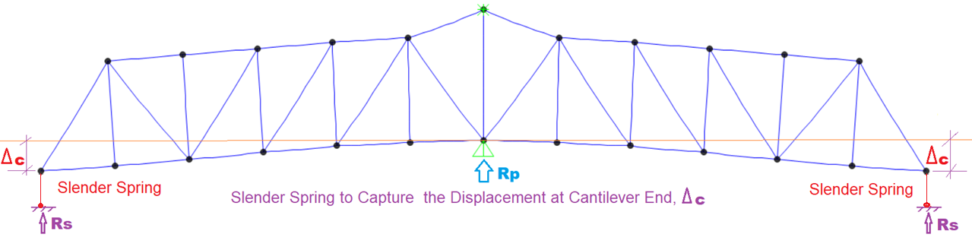
Step 1. Capture Displacement at Cantilever Ends
(Cantilever Model)
Note: Rs should be less than 2% of Rp. (The selected stiffness of the spring is supposed much smaller than the stiffness of the cantilever truss system, thus, the force in springs shall be small compared with the truss reactions.)

Slide 33
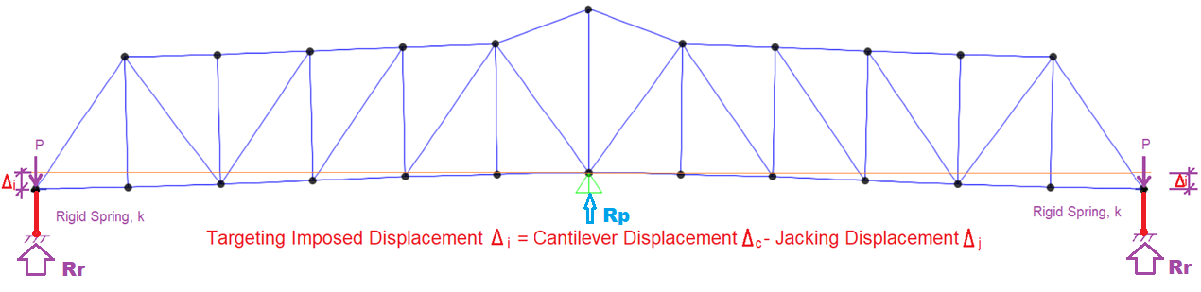
Step 2. Impose Huge Force at Truss Ends for Targeting Displacement
(Continuous Span Model)
Note: Rp should be less than 2% of Rr. The rigid spring with a selected stiffness can only deform at inch level under the imposed big force (much large than forces due to dead loads and live loads on bridges), whereas, the deformation due to dead loads and live load on the bridge is negligible.

Slide 34
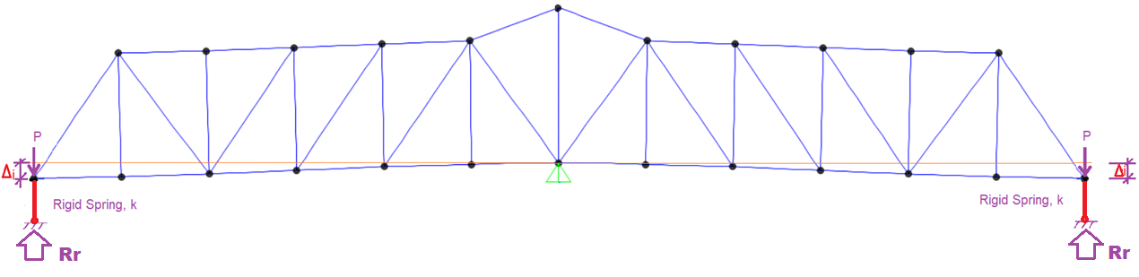
Step 3. Rate the Bridge as a Typical Truss Bridge
(Continuous Span Model)

Slide 35
Example of Dummy Spring Method in BrR Truss Module
Old River Bridge
(Br 29 0045)

Slide 36
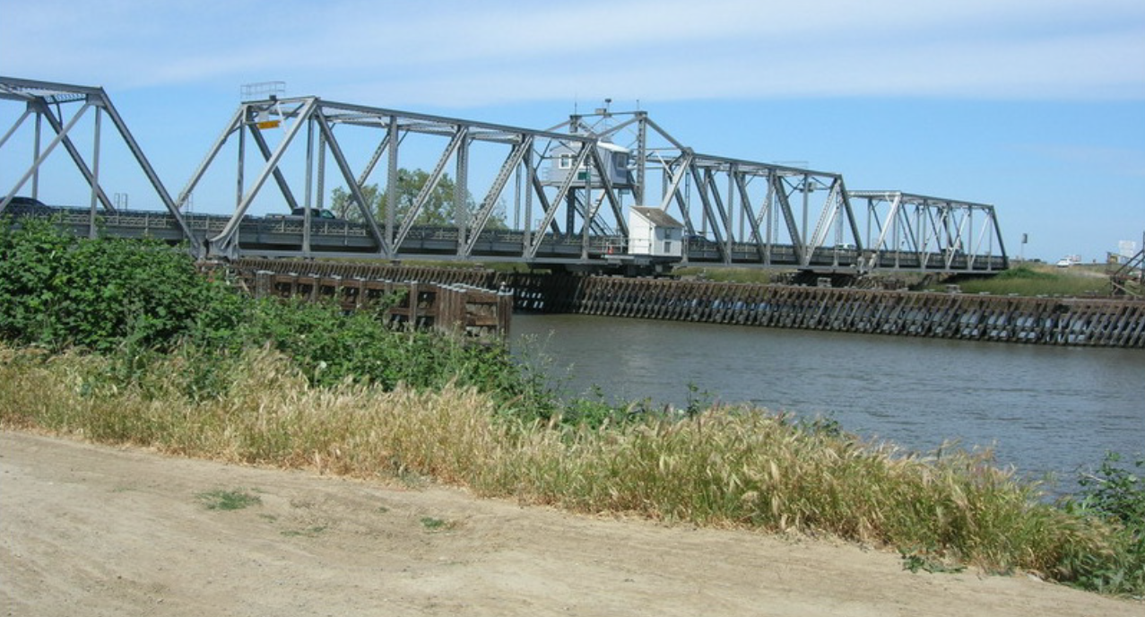
Old River Bridge, Swing Span 128’-0” + 128’-0”

Slide 37
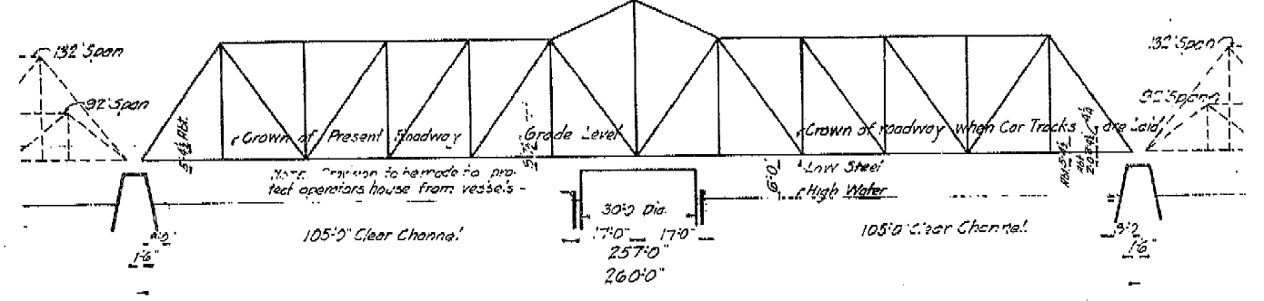
Elevation View from As-Built Plans

Slide 38
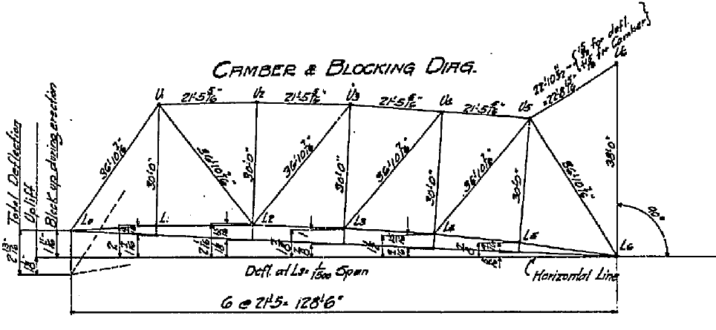
Design Camber Diagram

Slide 39
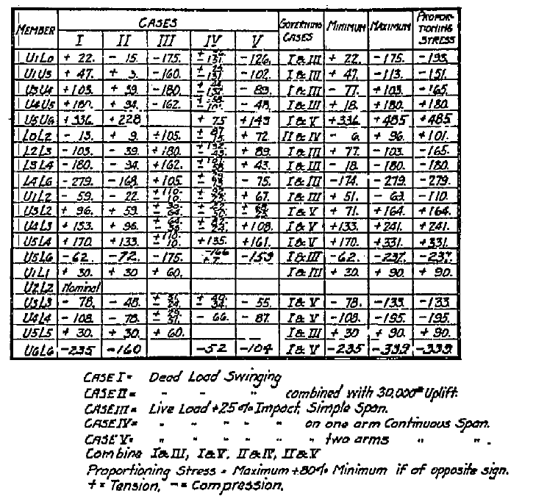
Design Force in Truss Members

Slide 40
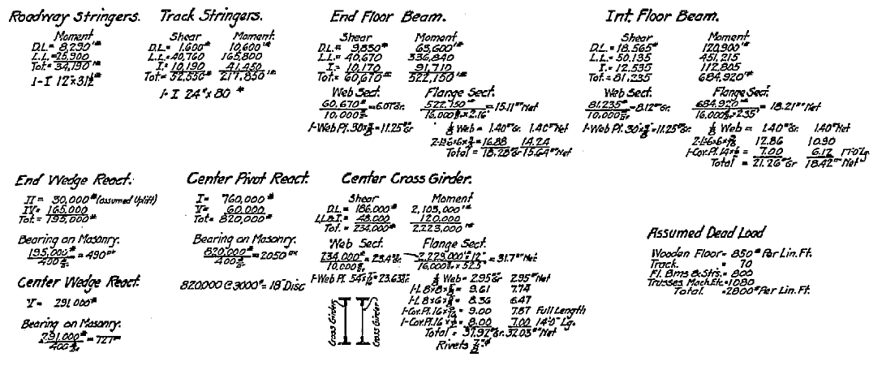
Design Forces and Wedge Reactions from Shop Plans

Slide 41
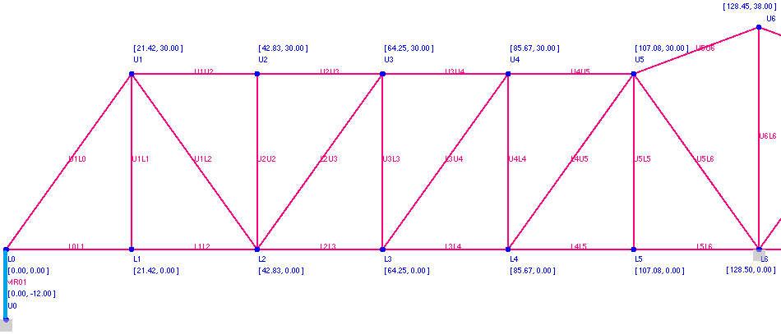
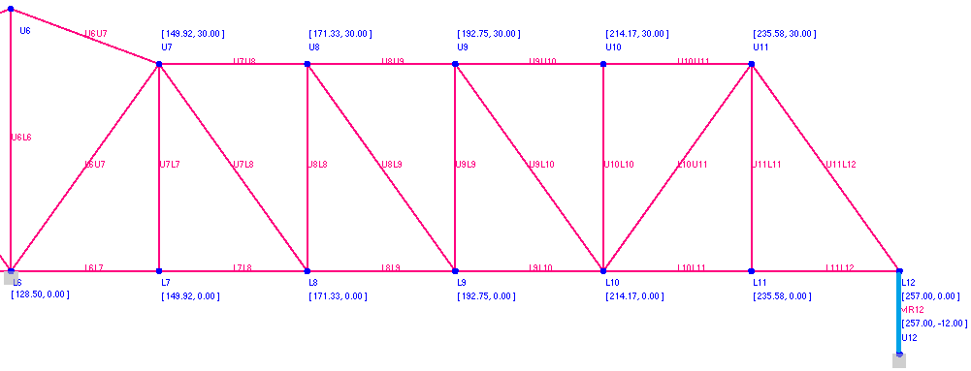
Member ID Map
Note: the rigid dummy members will not control rating results, since the rigid dummy members are intentionally selected to take much larger loads than DLs/LLs to get the targeting jacking/wedging movements.

Slide 42
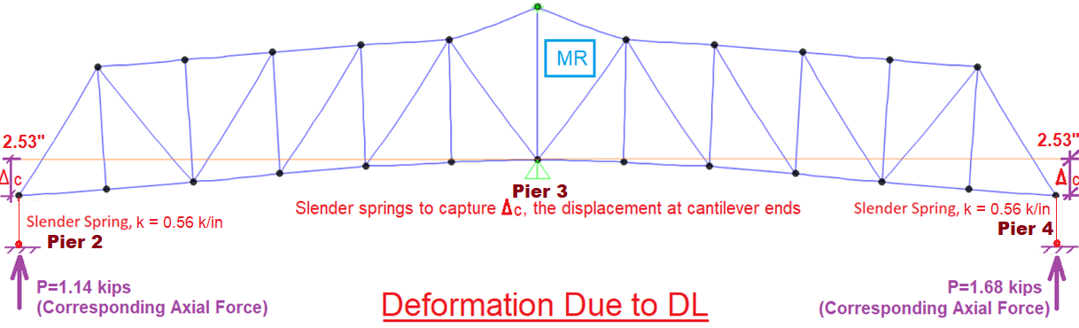
Δc, Deflection at Cantilever Ends (Cantilever Model)
Support Reaction Verification
Load Case | Rp, kips
Appurtenance | 48
Deck | 170
Stringers | 38
Floor Beams | 26
Truss Self Weight | 94
Super DC | 27
All DL Summary | 403
Max Spring Reaction | 1.68
Spring Member |  |  | Pier 2 | Pier 4
Member Length | L |  | 3 | 3 | ft
Member Area | A |  | 1 | 1 | in^2
Modulus of Elasticity | E |  | 20 | 20 | ksi
Axial Force | P |  | 1.14 | 1.68 | kips
Member Elongation | Δ | P*L/A/E | 2.05 | 3.02 | in
Average Elongation | Δc |  | 2.53 |  | in

Slide 43
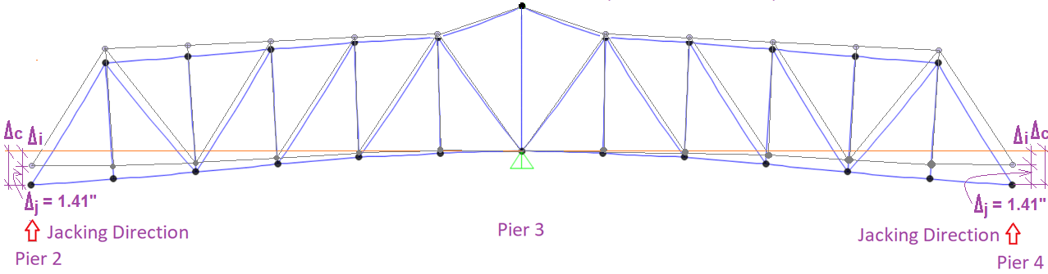
Δj, Jacking Distance at End Supports
(Field Measurement)
 | Pier 2 (on Deck) |  |  | Pier 4 ( on Deck)
Unit: inch | Left | Center | Right | Left | Center | Right
Jacking Movement | 1.38” | 1.53” | 1.44” | 1.44” | 1.75” | 0.91”
Average, Each Pier | 1.45” |  |  | 1.36”
Average, Whole Bridge | 1.41”

Slide 44
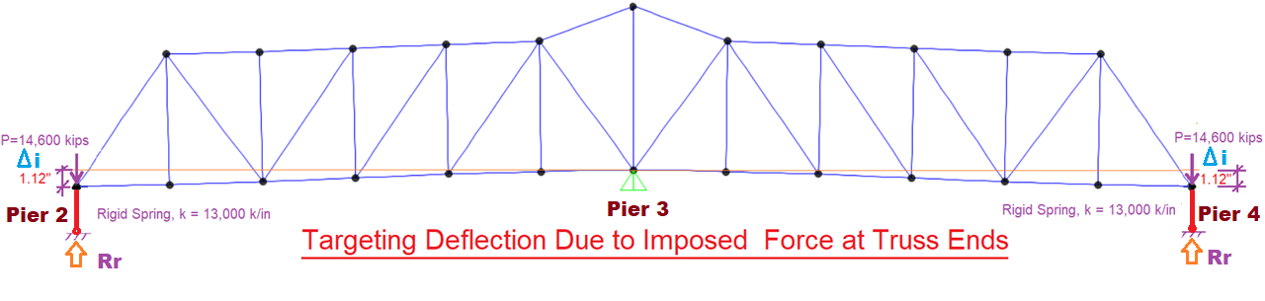
Δi, Targeting Deflection at Truss Ends (Continuous Spans)
Truss Tip Deflection (Recalled) | Δc |  | 2.53 | in
Jacking Distance (Recalled) | Δj |  | 1.41 | in
Targeting Imposed Movement | Δi | Δc - Δj | 1.12 | in
Spring Length | L |  | 3 | ft
Spring Area | A |  | 1.618 | in^2
Spring Modulus of Elasticity | E |  | 290,000 | ksi
Imposed Force at Truss Tip | P | E*A/L*Δi | 14,600 | kips
Spring Axial Force from BrR Model | P’ |  | 14,655 | kips
Ratio of P vs P’ | % | P’/P | 100.39%
Spring Deformation (BrR Model Verification) | Δv | P’*L/A/E | 1.12 | in
Truss End Reaction Verification
Load Case | Rr, kips | Unit
All DL Summary | 98 | kips
HS20 | 52 | kips
EV3 | 68 | kips
P13 | 161 | kips
Max LL Reaction | 161 | kips
Rigid Spring Constant | 13000 | kips/in
Max LL Displacement | 0.012 | in

Slide 45
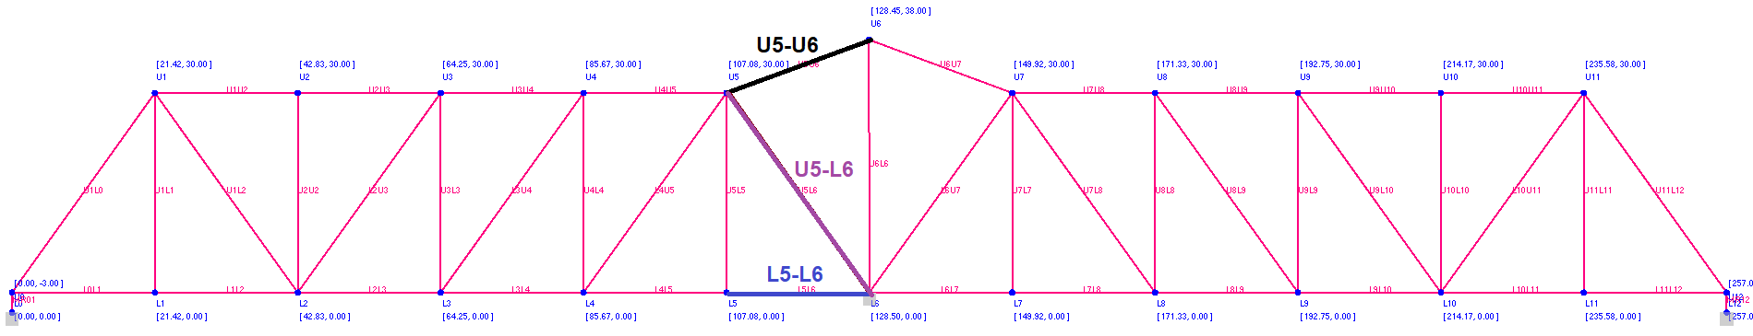
DL Truss Force Verification (BrR v.s. CSI Bridge)
Member Force Comparison, Truss End Movement ONLY
 | Force in Mem U5-U6 | Force in Mem U5-L6 | Force in Mem L5-L6 | Cantilever End Movement
 | Kips | Kips | Kips | In
BrR | 108.15 | 9.88 | -109.35 | 1.120
CSI Bridge | 108.93 | 9.78 | -107.73 | 1.120

Slide 46
LL Truss Force Verification (BrR v.s. CSI Bridge)
Member Force Comparison, One Lane of HS20 Truck, No Impact
 | Force in Mem U5-U6 | Force in Mem U5-L6 | Force in Mem L5-L6
 | Kips | Kips | Kips
BrR | 27.49 | -65.26 | -27.18
CSI Bridge | 27.49 | -65.18 | -27.19

Slide 47
Rating Summary
Swing Truss Members Only
 | Rating Factor |  | Critical Locations
Design Loading |  | Ton
Inventory | 2.06 | 74.07 | U7L7
Operating | 3.44 | 123.70 | U7L7
Legal Rating |  | Posting US Tons
Type 3 (25T) | 4.42 | 110.59 | U5L5
Type 3S2 (36T) | 4.78 | 172.04 | U5L5
Type 3-3 (40T) | 5.35 | 214.13 | U5L5
NRL | 2.85 | 113.87 | U5L5
SU4 | 3.80 | 102.54 | U5L5
SU5 | 3.56 | 110.36 | U5L5
SU6 | 3.20 | 111.31 | U5L5
SU7 | 2.99 | 115.84 | U5L5
EV2 | 3.87 | 111.32 | U5L5
EV3 | 2.49 | 106.86 | U5L5
Permit Rating
5 Axle Truck | 2.40 | 146.43 | U5L5
7 Axle Truck | 2.30 | 195.77 | U7L7
9 Axle Truck | 2.30 | 251.04 | U7L7
11 Axle Truck | 2.16 | 287.38 | L6U7
13 Axle Truck | 2.06 | 324.10 | L6U7

Slide 48
Benefit of Dummy Spring Method
1. It may directly generate BrR load rating summary table for the whole bridge on SQL server;
2. No any time-consuming FE modeling is necessary;
3. The method is straight forward and easy to use;

Slide 49
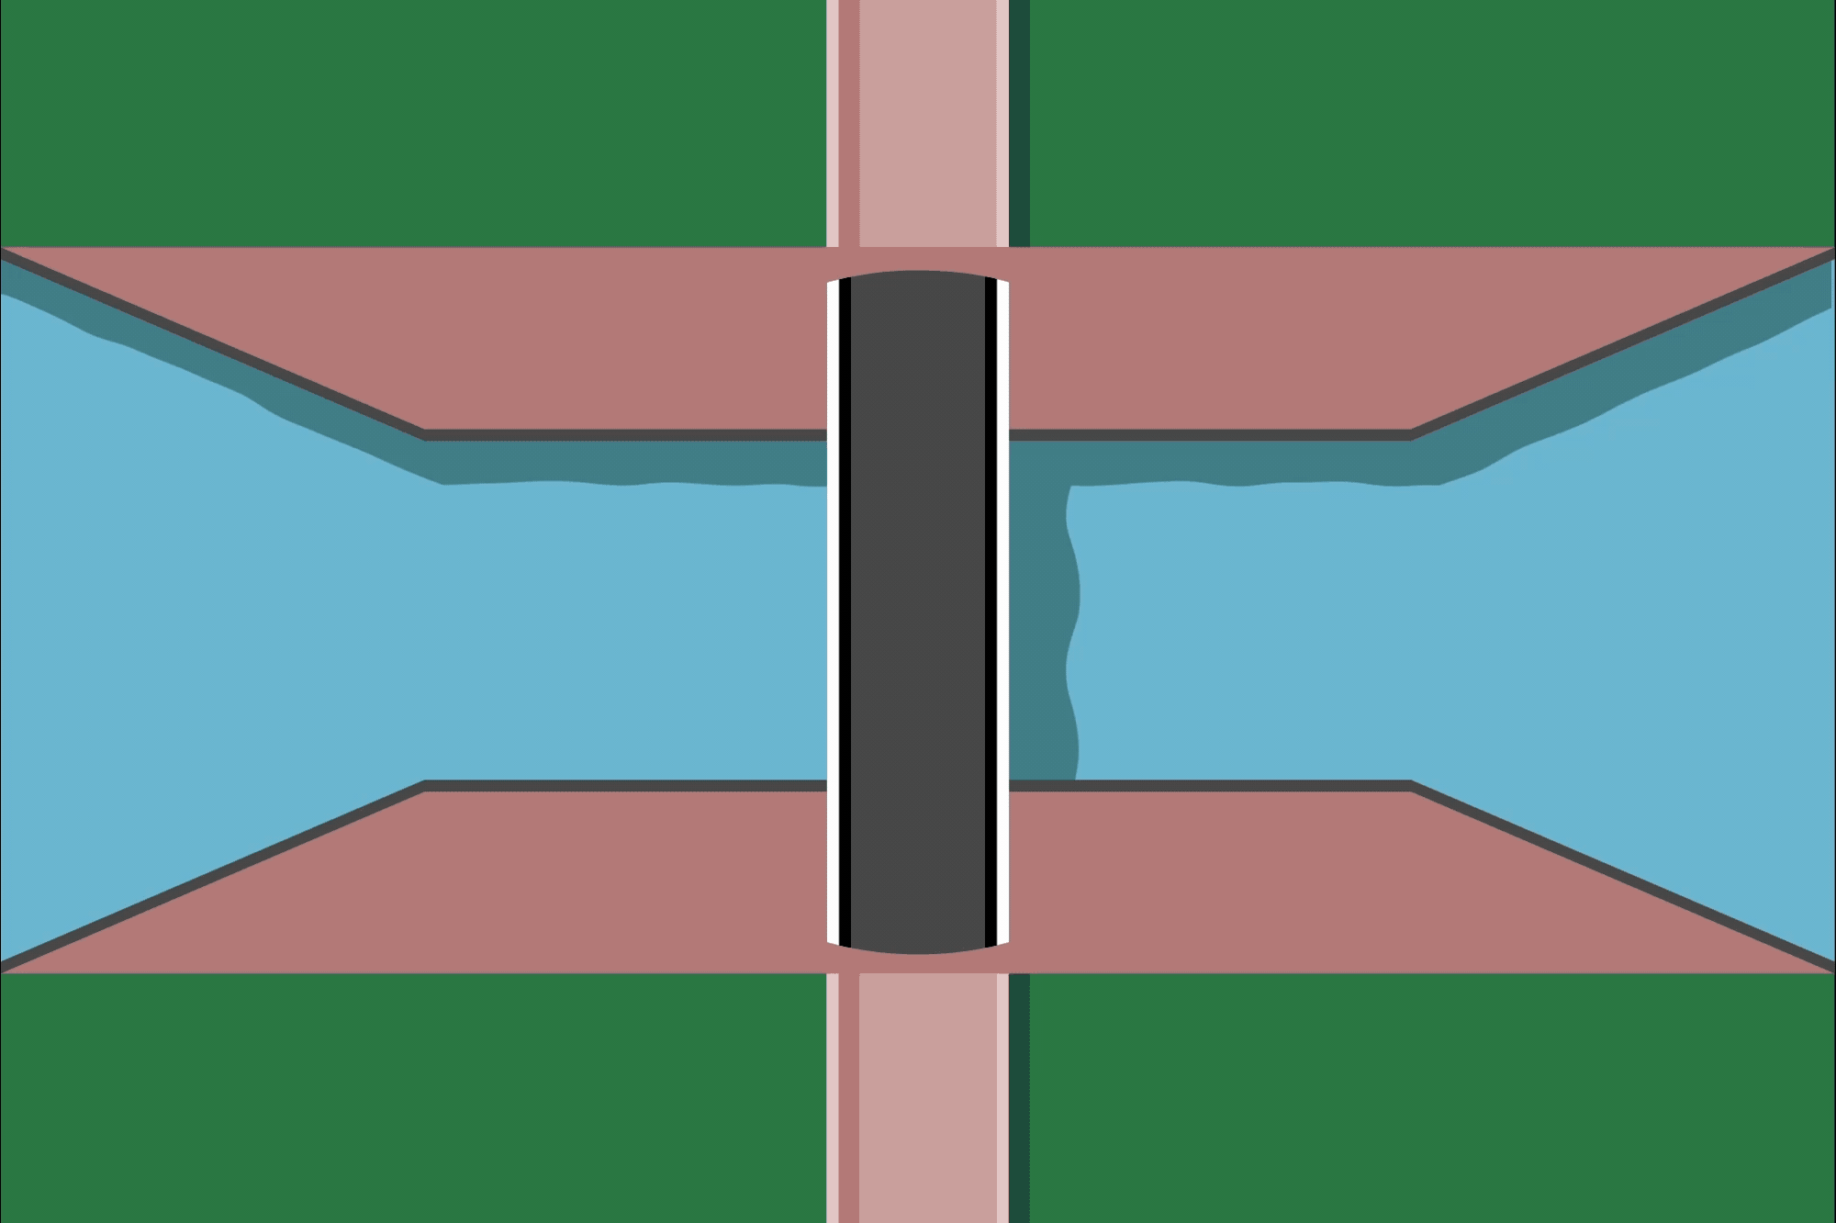
Thanks!
Any Questions?

