Slide 1



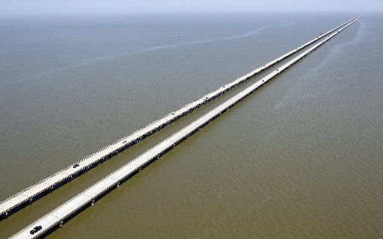
AASHTOWare Bridge
Task Force Update
2022 RADBUG Meeting
Todd Thompson, P.E., Bridge Task Force Chair

Slide 2
Agenda
BrDR releases
TAG Updates
RADBUG Officers
FY22 BrDR licensees
Task Force members

Slide 3
BrDR Legacy System reached end-of-life
After almost 5 years from the first announcement, the BrDR legacy system was sunset at the end June 2022
Version 6.8.4 was the last release of the legacy system
Maintenance, specification updates, and technical support of the legacy system ended effective June 30, 2022

Slide 4
BrDR Modernized System releases
7.0 – January 2021
7.1 – September 2021
7.2 – February 2022
7.3 – September 2022

Slide 5
BrDR 7.1 and 7.2 releases
Packed more than 20 unique new features and enhancements requested by state agencies
Major new features and enhancements
  Advanced concrete members modeling and analysis
  BrM web service integration
  New Analysis Results Comparison Tool
  Prestressed Concrete Design Tool enhancements
  New Steel Plate Girder Design Tool
  Load Rating Tool LRFR
  Data exchange via IFC 4.3 data standard

Slide 6
BrDR 7.3 release
Major new features and enhancements
  New AASHTO Timber Engine for ASR and LRFR
    Sawn and glulam timber beams, and sawn timber deck
  New AASHTO Metal Culvert Engine for LFR and LRFR
    Metal pipe, pipe arch, arch, and structural plate pipe structures
    Long-span structural plate pipe structures
    Structural plate box structures
  Manual for Bridge Evaluation updates (3rd Edition, 2021 Interim Revisions)

Slide 7
BrDR 7.3 release
Include Flange Lateral Bending in Analysis
  NYSDOT funded enhancement – Thanks!
System Default Analysis Engine Settings
BrDR Migration Wizard Phase 2
BrDR WiX Installer
Modernize Bridge Copy Utility
Improve Data Precision in BrDR Databases
Internal Release Utility Version 3

Slide 8
Additional FY 2022 activities
Mockups of curved multi-cell RC box bridges
Mockups of substructure pier cap load rating
Mockups of generic component load rating
3D analysis performance improvements planning
New Report Tool UI design
Redesign Analysis Settings window
Redesign specification checking architecture
.NET 6 upgrade planning

Slide 9
BrDR 7.4 release
Working on that plan – under consideration
  Advanced Concrete Multi-Cell Box Superstructure LFR and LRFR
  Next Generation of Report Tool Phase 1
  Consistent Rating Method Naming with MBE
  Support Copy and Paste Functionality for All UI Grids
  Enhance License Mechanism and Cryptographically Secure Bridge Data
  BrDR Database Maintenance and Usability Improvements
  BrDR WiX Installer Phase 2
  Update Tutorials for BrDR Modernized System
  User Group Enhancement Requests
  Additional maintenance tasks

Slide 10
TAGS
Beta Testing TAG
Culvert TAG
Design Tool TAG
Reports TAG
JIRA Backlog TAG
Analysis/Specs TAG - NEW

Slide 11
Beta Testing TAG
Mike Johnson, ID TD – Chair
Jeff Ruby, KS DOT - Vice-Chair
38 numerous volunteers currently serve on this standing TAG
Really has been one of the reasons for the success of the product

Slide 12
Culvert TAG
Mike Johnson, ID TD – Chair
Vinacs Vinayagamoorthy, CA DOT - Vice-Chair
11 numerous volunteers currently serve on this standing TAG
Working on adding metal pipes into Bridge Rating

Slide 13
Design Tool TAG
Jeff Ruby – KS DOT – Chair
Mark Bucci – LA DOTD – Vice-Chair
11 numerous volunteers currently serve on this standing TAG
Working on Design efforts

Slide 14
Reports TAG
Vinacs Vinayagamoorthy, CA DOT – Chair
Mark Bucci – LA DOTD – Vice-Chair
12 numerous volunteers currently serve on this standing TAG
Working on making the Reports and output much better and consistent

Slide 15
JIRA Backlog TAG
Mark Bucci, LA DOTD – Chair
Jeff Ruby, KSDOT – Vice-Chair
12 numerous volunteers currently serve on this standing TAG
Reviewing the list of backlog items and making recommendations

Slide 16
Analysis/Specs TAG
Vinacs Vinayagamoorthy, CA DOT – Chair
Mike Johnson, ID TD – Vice-Chair
Soliciting new members
Interpretation of AASHTO Spec can vary from state to state
  Provide Pro-Miles guidance
  Work with COBS Technical committee to resolve conflicts/questions

Slide 17
TAG
Interested in participating?
Reach out to me or anyone on the task force.
  We will consider requests

Slide 18
RADBUG Officers
Billy Metcalf – President (BrR)
Kelly Tomjanovich – Vice-President (BrR)
Julianne Fuda – Vice-President (BrD)
Amjad Waheed - Secretary

Slide 19
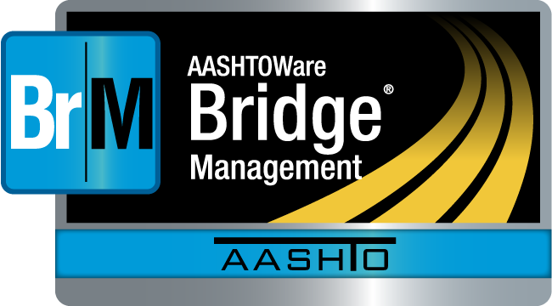
Bridge Rating Licensees (FY22)

Slide 20
Bridge Design Licensees (FY22)

Slide 21
Task Force members
Chair | Todd Thompson | South Dakota
Vice Chair | Eric Christie | Alabama
Member – BrM | Beckie Curtis | Michigan
Member – BrM | Craig Nazareth | Rhode Island
Member – BrM | Kent Miller | Nebraska
Member – BrM | David Hedeen | Minnesota
FHWA Liaison – BrM | Derek Constable | FHWA
Member – BrD | Jeff Ruby | Kansas
Member – BrD | Mark Bucci | Louisiana
Member – BrR | Vinacs Vinayagamoorthy | California
Member – BrR | Mike Johnson | Idaho
FHWA Liaison – BrDR | Tom Saad | FHWA

Slide 22
Save the Date
2023 RADBUG
August 8-9, 2023
Madison, WI

Slide 23
Thank You!
Any Questions?
  Contact –
    Todd Thompson – todd.Thompson@state.sd.us

