Slide 1
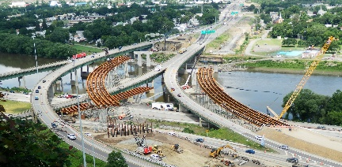
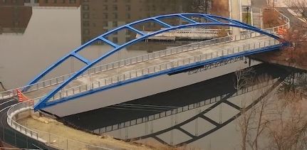

Office of Structures
Using BrD as a Design Tool for Digital Delivery
East 138th Street over Major Deegan Expressway
Julianne M. Fuda, P.E.
Assistant Director, Structure Design Bureau
BrDR User Group Meeting (RADBUG)
August 2nd, 2022

Slide 2
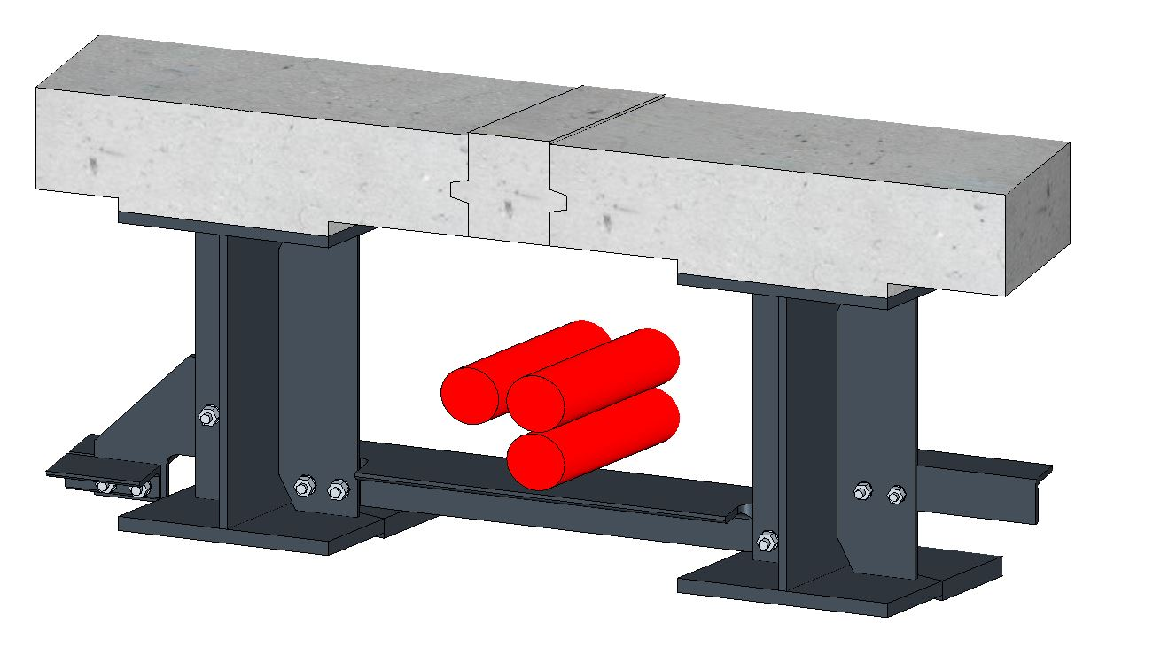

Presentation Topics
Using BrDR as a Design Tool
Digital Delivery at NYSDOT
East 138th Street Bridge over Major Deegan Expressway
Future of Information Exchange
Question & Answer

Slide 3
BrDR as a Design Tool
Bridge Configurations and Capabilities |  | AASHTO LRFD Design Review | AASHTO LRFR, LFR, ASR Rating
Superstructures | Reinforced concrete tee beams, slabs, I-beams, and multi-cell box beams | X | X
 | Reinforced concrete box culverts | X | X
 | Prestressed concrete box, I, tee, and U-beams (precast, pretensioned, continuity for live load, harped strands, and de-bonded strands) | X | X
 | Steel rolled beams (including cover plates) | X | X
 | Steel built-up plate I-girders | X | X
 | Steel welded plate I-girders (including hybrid) | X | X
 | Steel trusses and floor systems |  | X
 | Timber beams and decks |  | X
 | Corrugated metal decks |  | X
 | Simple spans, continuous spans, hinges (steel and reinforced concrete) | X | X
 | Parallel and flared girder configurations | X | X
 | Parallel, tapered, parabolic, and circular webs | X | X
 | Transverse and longitudinal stiffened | X | X
 | Frame structure simplified definition | X | X
Girder-line and 3D-FEM¹ | 3-D analysis of steel and concrete multi-girder superstructures | X | X
 | 3-D analysis of curved steel multi-girder superstructures | X | X
Substructures | Bridge piers including wall, hammerhead and multi-column pier bents | X
 | Single drilled shaft for substructure | X
Load Rating Features | Girder-floor beam-stringer configurations |  | X
 | Truss-floor beam-stringer and floor-truss configurations |  | X
 | Timber and corrugated metal decks |  | X
 | Gusset-plate connections² and splice connections |  | X

Slide 4
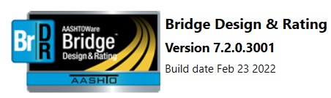
BrDR as a Design Tool
Tip and Tricks to Run 3D FEM Analysis and Curved Girders in BrDR
Hardware Recommendations
Machine: Intel Core i7 processor or equivalent
Memory: 32 GB or more
Hard Disk: Solid State Drive
Factor that Influence 3D Analysis Speed
Number of degrees of freedom (slower and more accurate vs. faster and less accurate)
Number of live load vehicles (more vehicles mean more analysis and slower speed)
Live loading increments (smaller increments means more analysis and slower speed)
Analysis output location (choose a local folder, writing to a network folder will slow it down)
Analysis output selection (choose what is necessary, LL influence line report for FE actions will generate an influence surface for each unit load application and bog down the analysis)

Slide 5
BrDR as a Design Tool
Tips for Successful Analysis
Fine tune the model while running the DL option only
Review the DL model with the Model Viewer
Run courser meshes initially, checking the moments graph for reasonableness, then fine tune the model
Do initial live load analysis for a single vehicle only
Do the first spec check for a single girder only
Do not select diaphragms for spec checking until satisfied with the girder models
Troubleshoot common analysis irregularities (Non-zero moments at end supports, Incorrect number of nodes, etc)
To prevent a “time-out” during the lengthy analysis, recommend clicking back and forth between the Bridge Explorer and Bridge Workspace to keep the database and library connections active

Slide 6
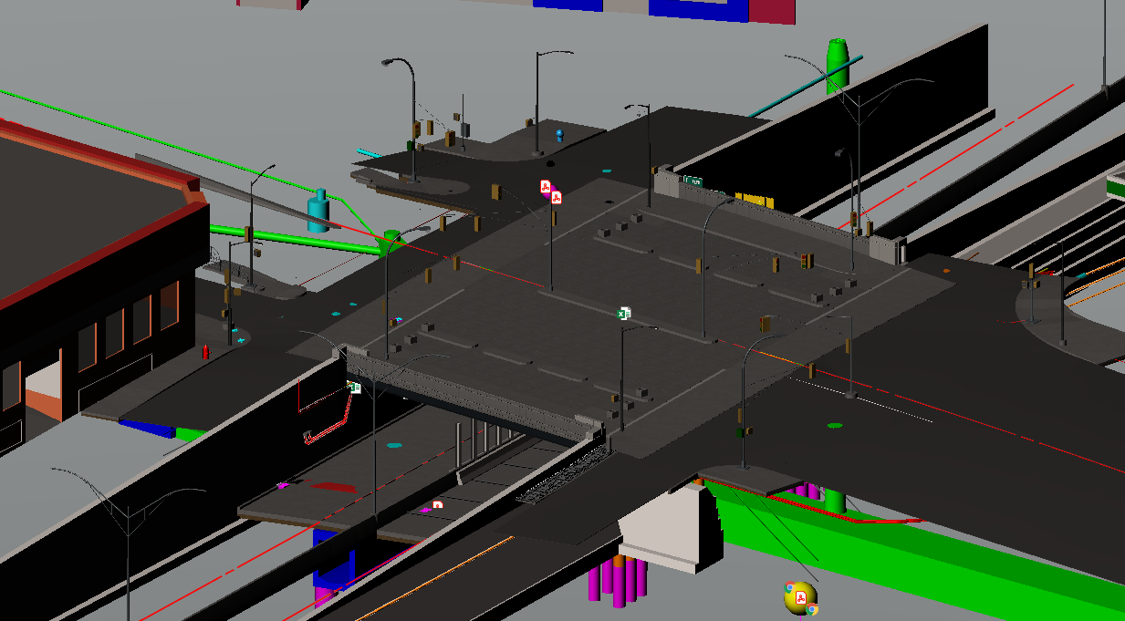
Digital Delivery at NYSDOT
East 138th Street Bridge Replacement over the Major Deegan Expressway

Slide 7
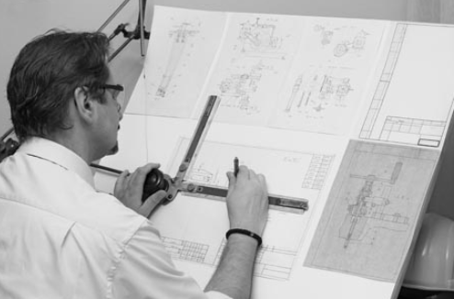
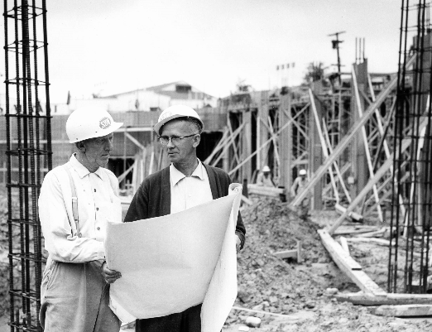

Digital Delivery at NYSDOT

Slide 8
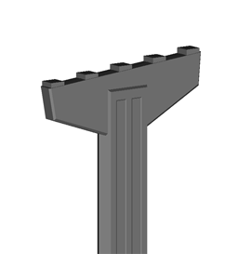
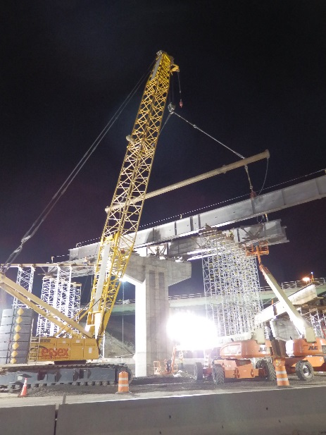
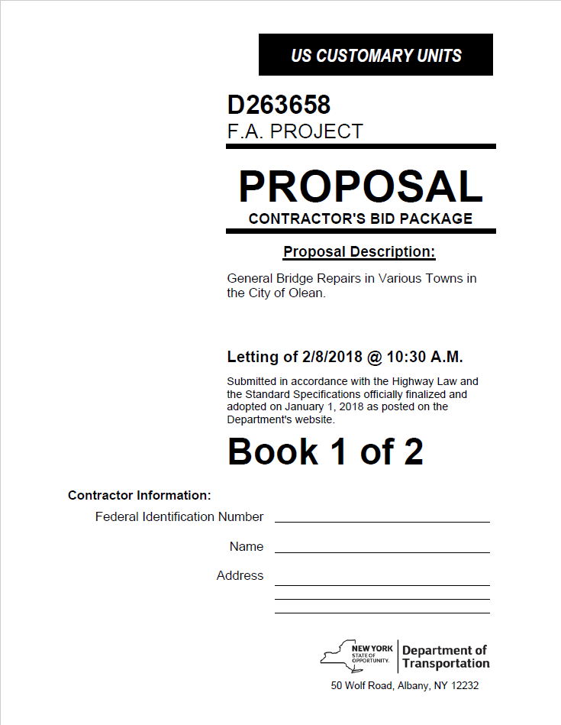
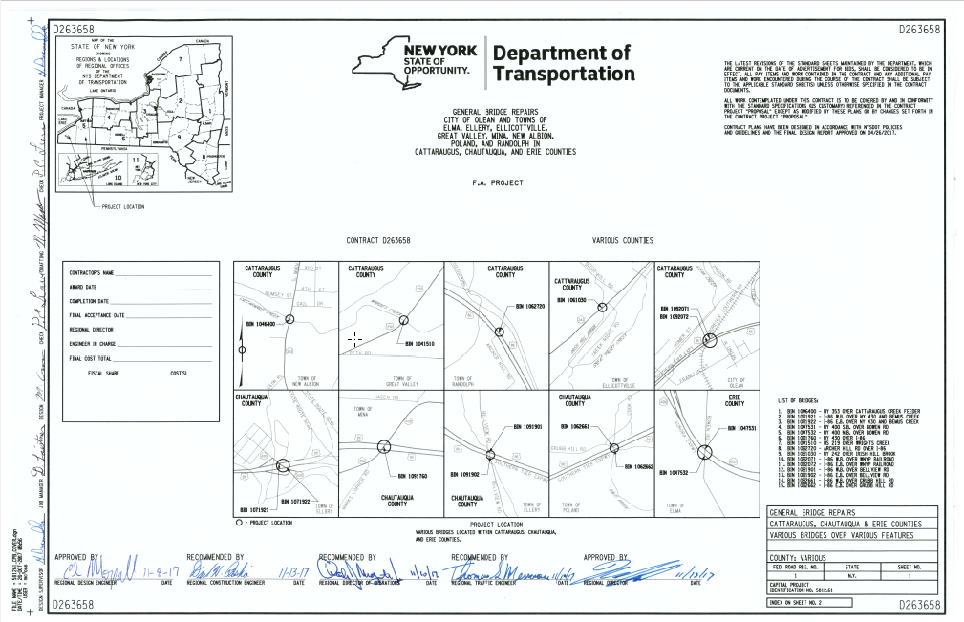
What is Model Based Contracting?
Specifying contractual work with a variety of relevant electronic files (CAD, XLS, ALG, XLM, etc.)
Reduce or eliminate corresponding 2D plans
By providing all the information that is traditionally contained in the 2D plans with 3D models, the 2D plans become unnecessary

Slide 9
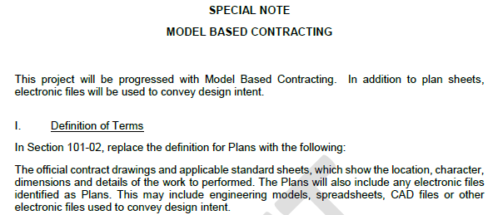
Model Based Contracting

Slide 10
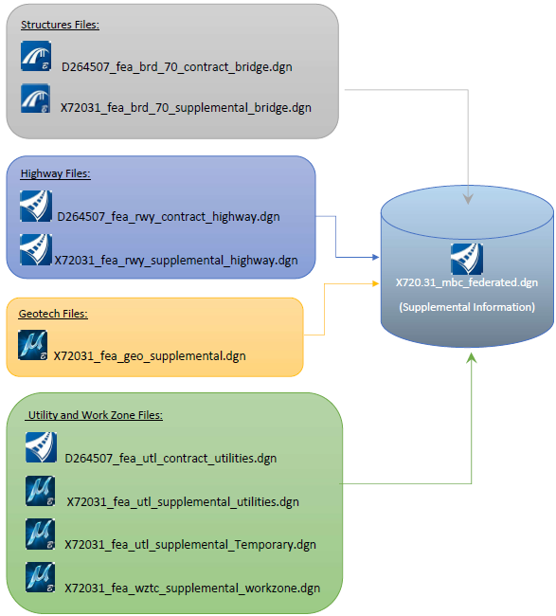

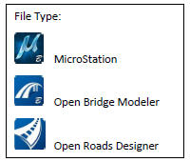
Overview of Files – Model Based Contracting Special Note
The MBC special note provides a detailed breakdown of electronic file content and file organizational structure.

Slide 11
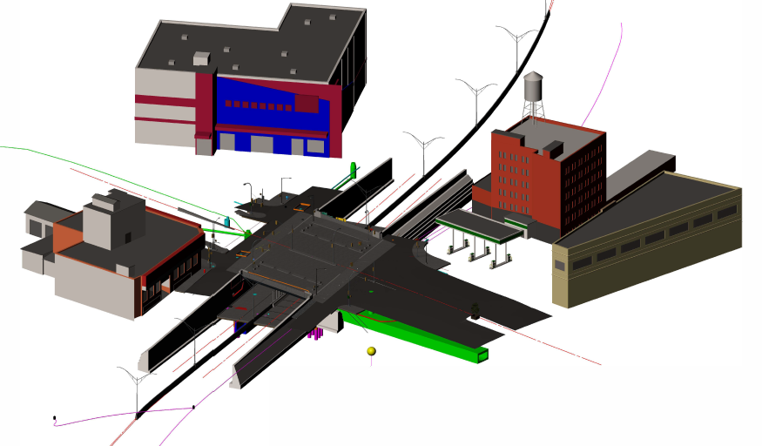
Overview of Files – Federated File

Slide 12
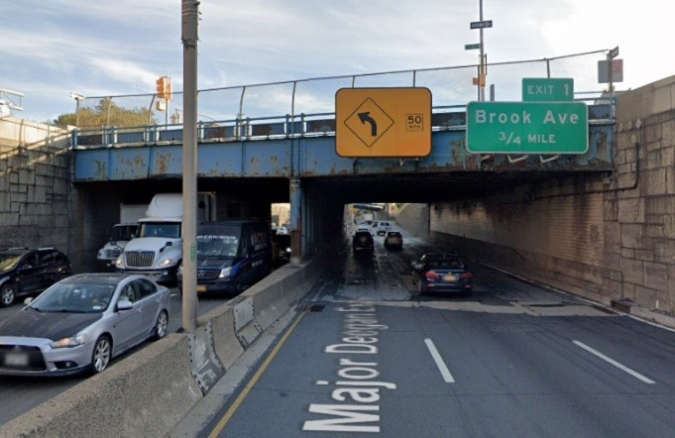
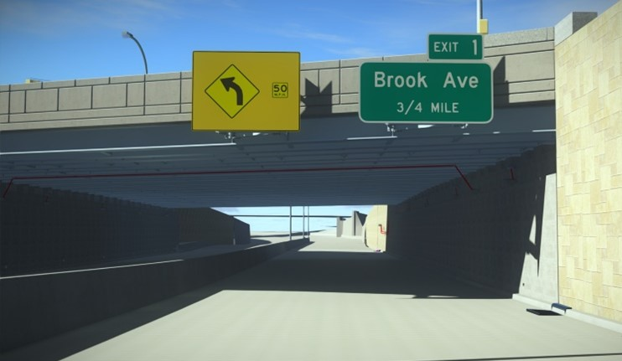
East 138th Street over Major Deegan Expressway
Existing Bridge Proposed Bridge

Slide 13
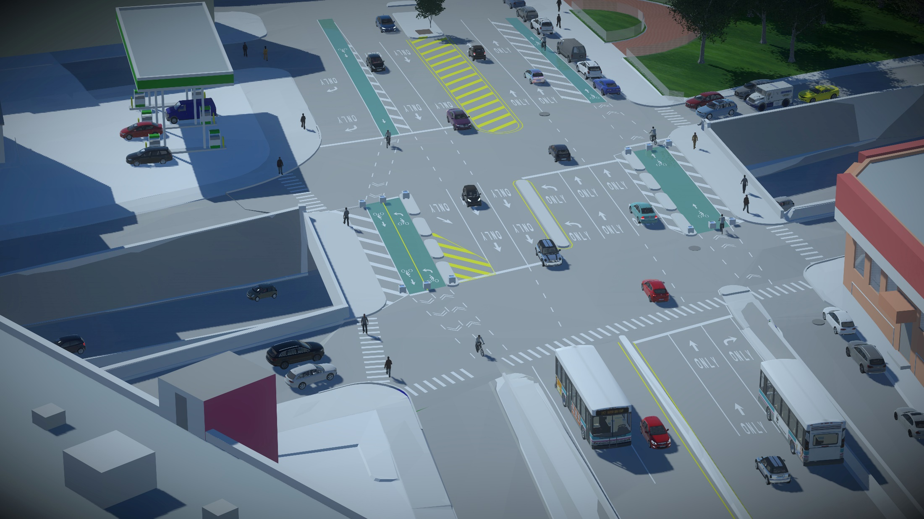
East 138th Street over Major Deegan Expressway
N

Slide 14
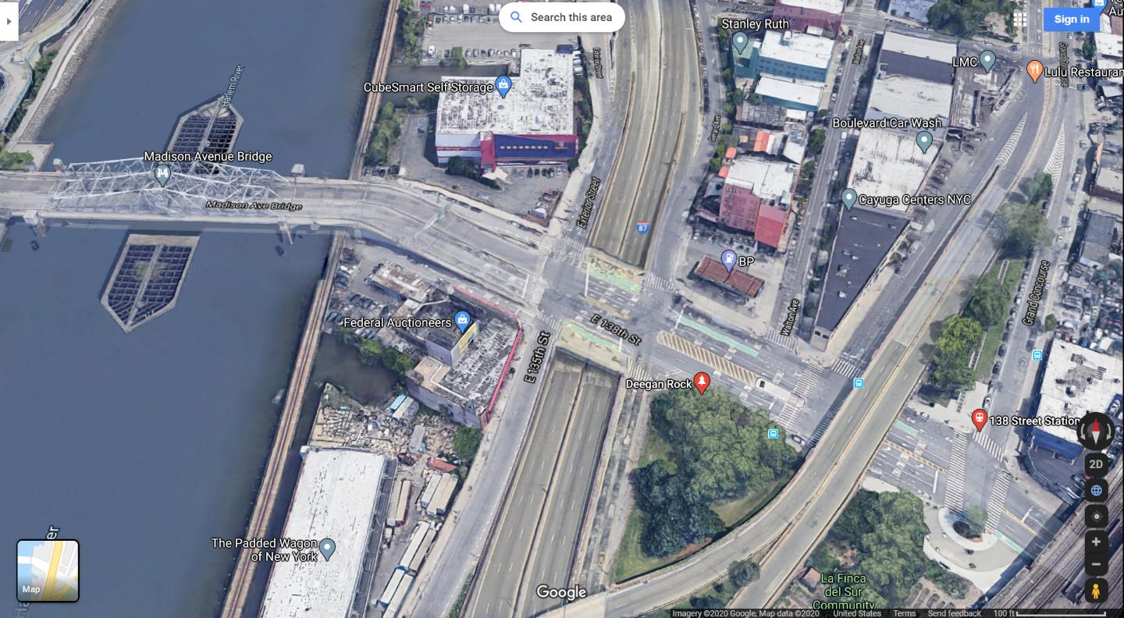
Project Overview
N
Madison Avenue Bridge
East 138th Street
Major Deegan Expressway (I-87)

Slide 15
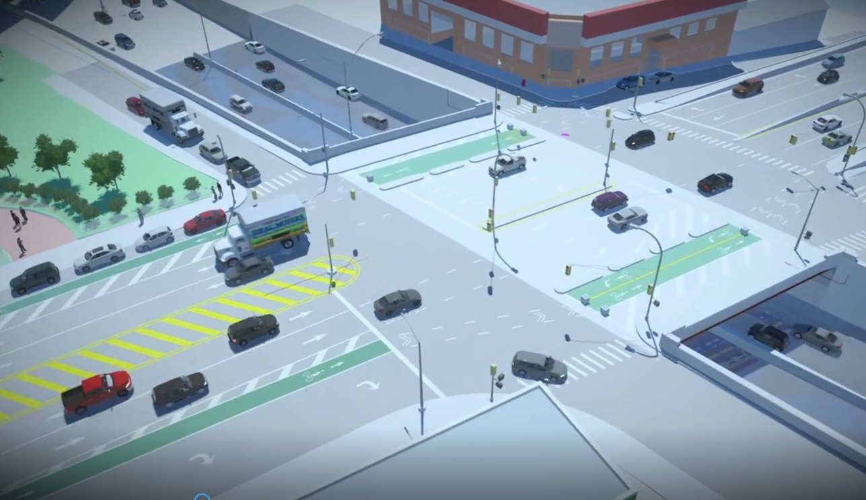

Slide 16
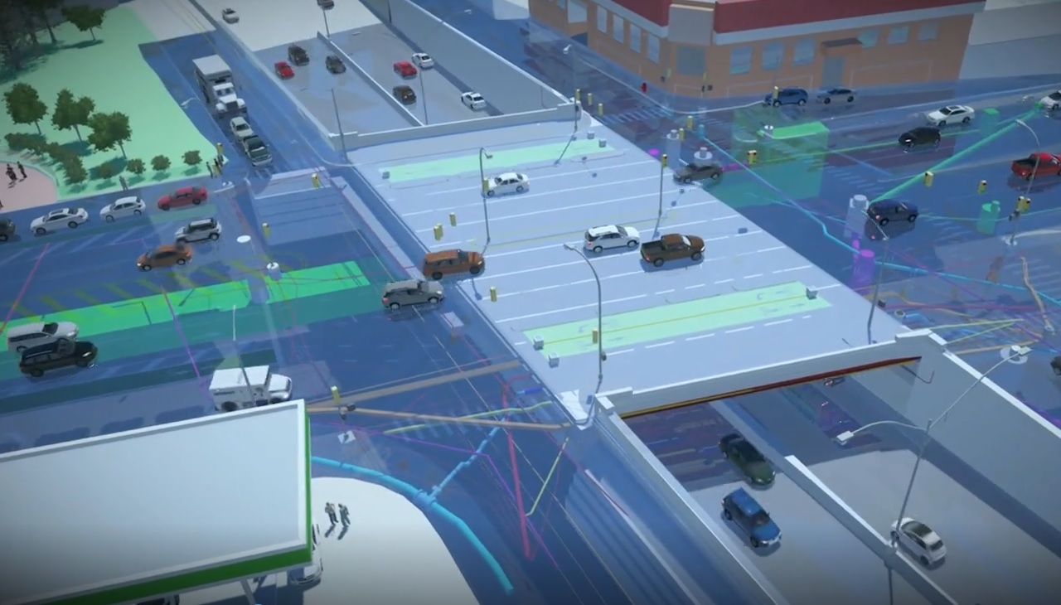

Slide 17
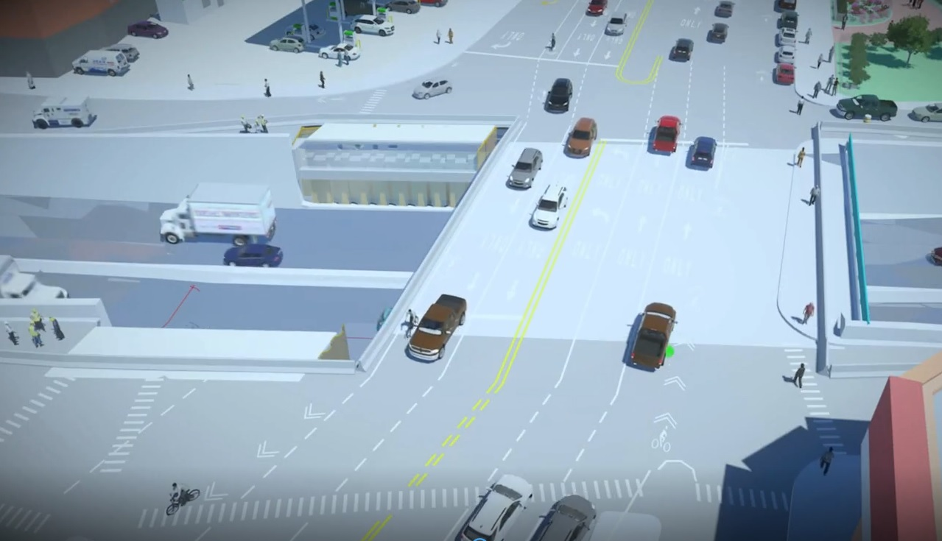

Slide 18
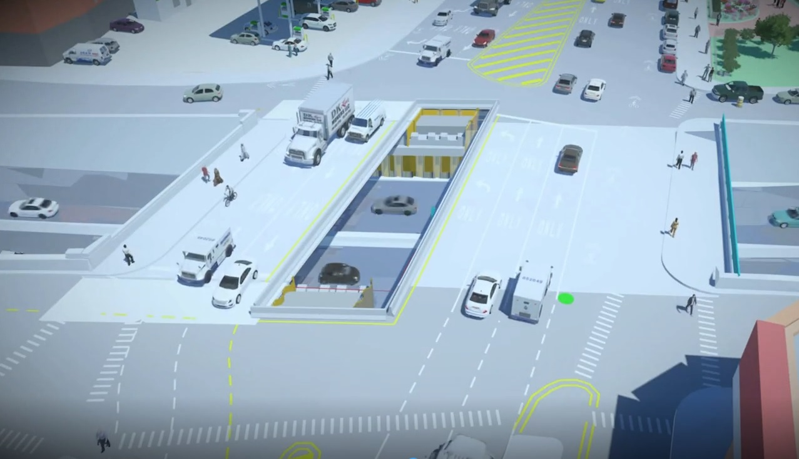

Slide 19
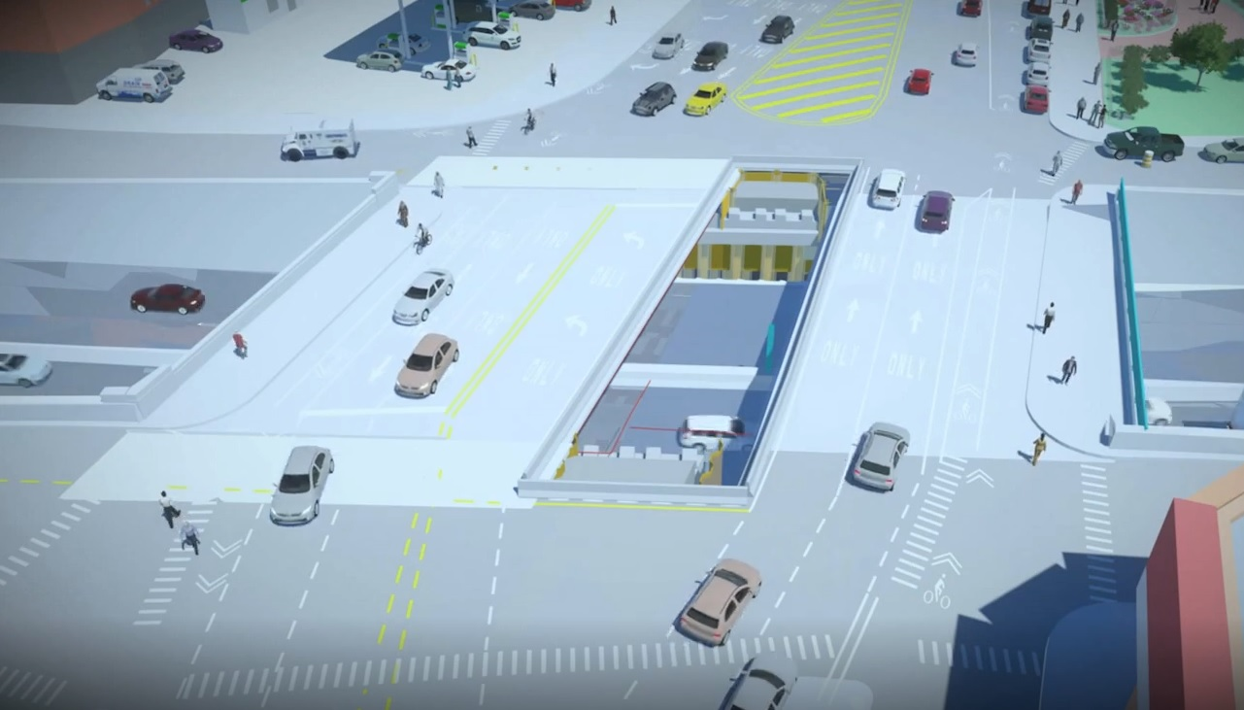

Slide 20
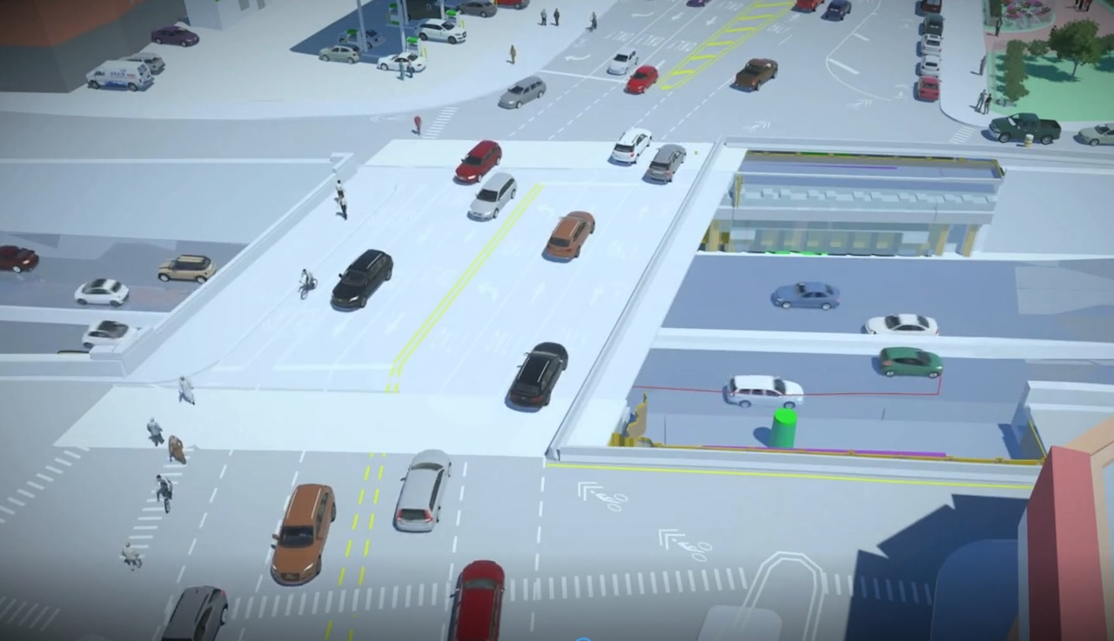

Slide 21
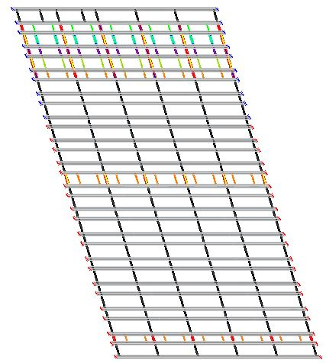
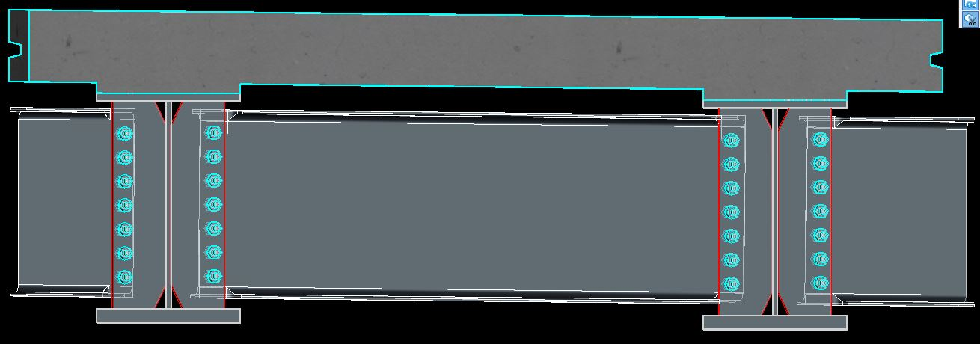
Bridge Superstructure
Superstructure Information:
Single span bridge constructed in 4 stages
Superstructure is comprised of prefabricated bridge units
Stage 2
Stage 3
2 steel girders with precast deck, connected with UHPC closure pours
Stage 4
Stage 5
Framing Plan

Slide 22
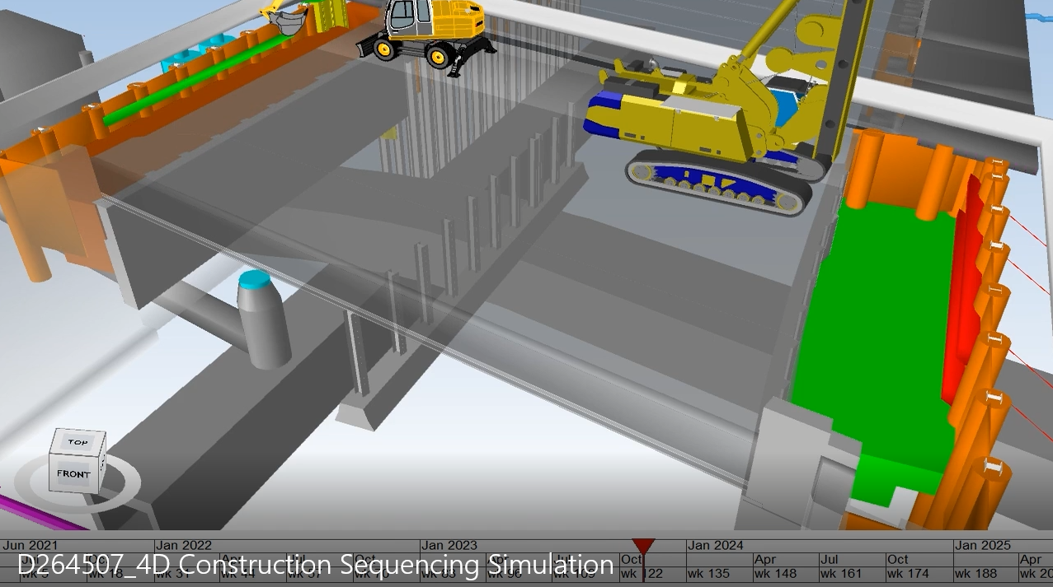
Bridge Substructure
Substructure Information:
Substructure will be constructed in 4 stages from the existing bridge
Suggested sequence for existing bridge removal:
  Install temporary supports along right most lane of each bound on MDE
  Cut existing superstructure to make room to build proposed abutments
  Install proposed foundations and abutments from the work area on the existing bridge (supported by existing pier and temporary supports)
Work Zone on the existing bridge during abutment construction

Slide 23
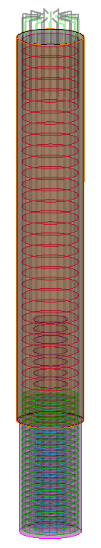


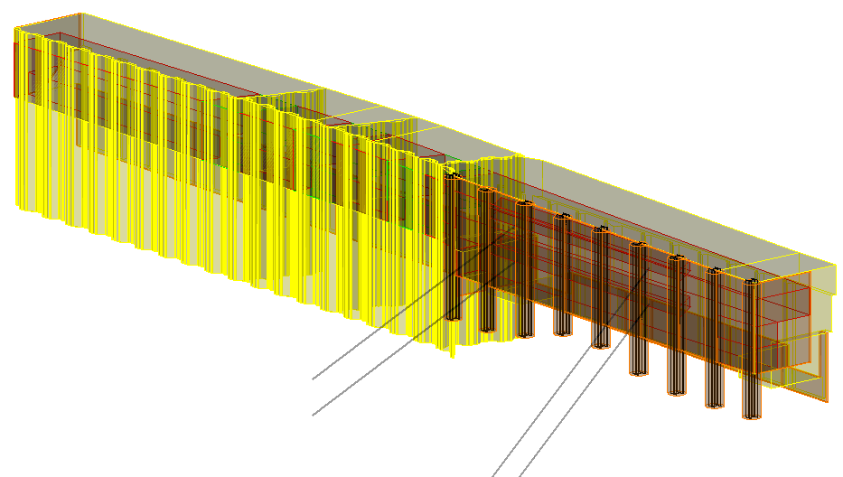
Bridge Substructure
Substructure Information:
Both abutments supported on deep foundations
  Driven H-piles
  Drilled shafts reinforced with an H-pile
  Drilled shafts with permanent casing and rebar cages
Abutments will be constructed with excavation support systems
  Driven cantilever sheeting
  Soldier pile and lagging wall with grouted tie backs/walers
  GRSS wall

Slide 24
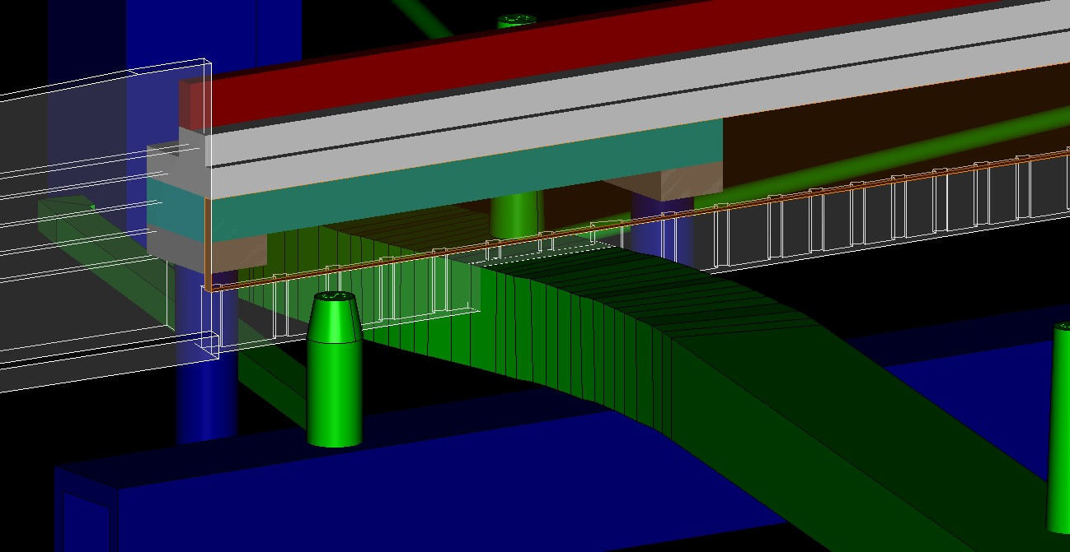
The “Carry Beam System”
  30ft wide existing DEP sewer structure that cannot be impacted during construction
  Future widening of DEP sewer required the abutments to span an area of 60ft, while still supporting the bridge overhead
  Steel carry beam system to span over sewer and support abutment footing overhead
HISTORIC
RETAINING
WALL
FOOTING
24” SEWER
CARRY BEAM
BRANCH
INTERCEPTOR
SHAFT
MANHOLE
COMBINED
SEWER
INTERCEPTOR
SEWER

Slide 25
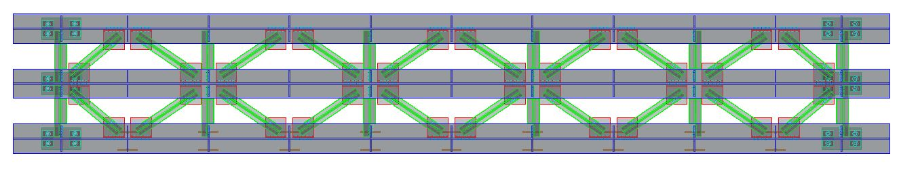
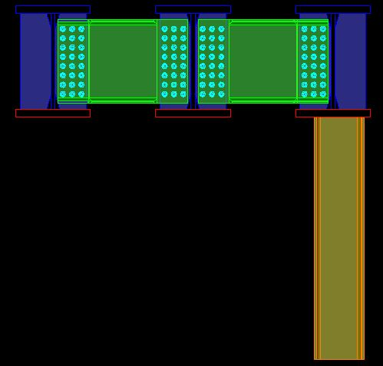
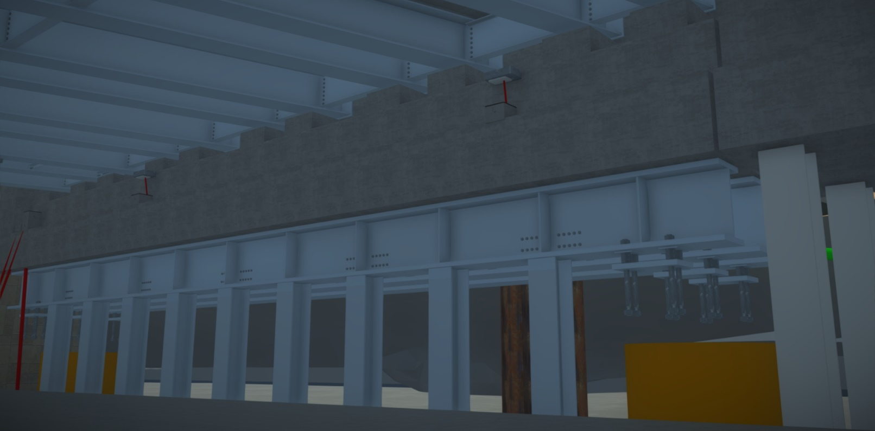
Bridge Work – Substructure
Substructure Information:
Items of special interest
  Carry beam system to span over the existing DEP combined sewer
  System includes beams, diaphragms, lateral bracing, anchorage, lagging piles
PLAN
SECTION
Abutment
Anchorage
Carry Beam System
Lagging piles to support toe wall
Drilled Shaft

Slide 26
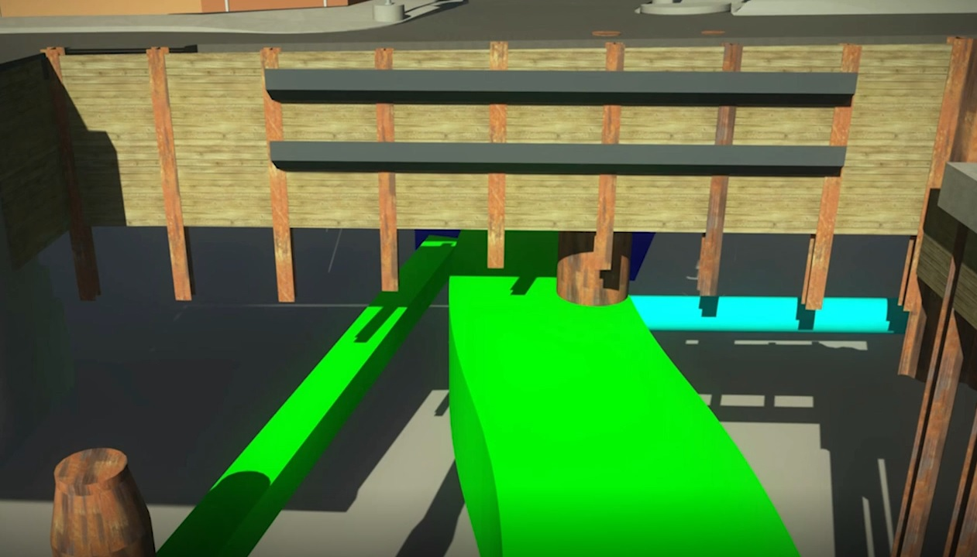

Slide 27
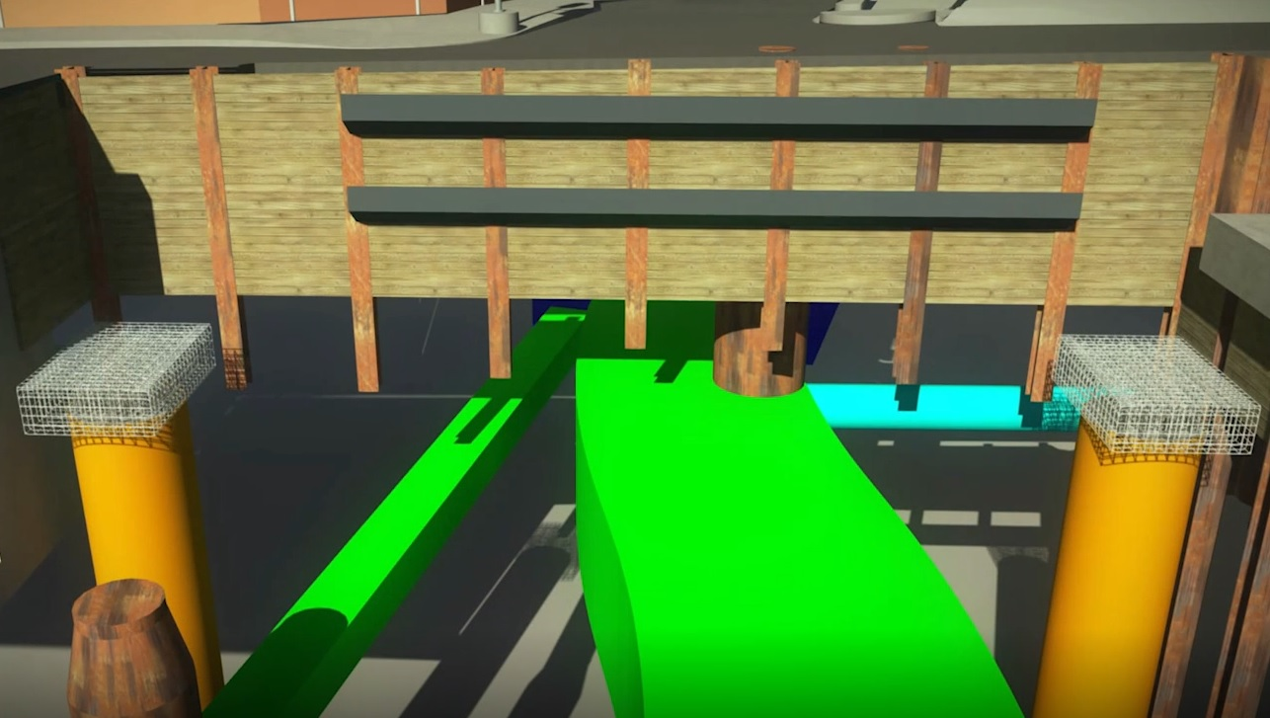

Slide 28
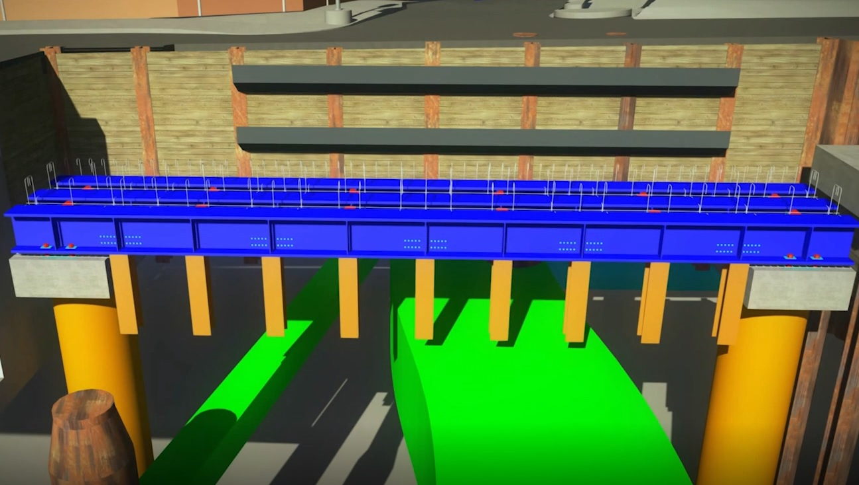

Slide 29
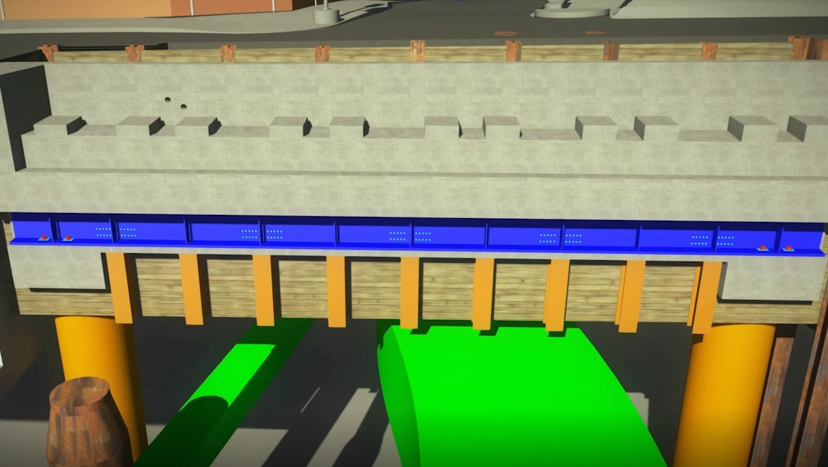

Slide 30
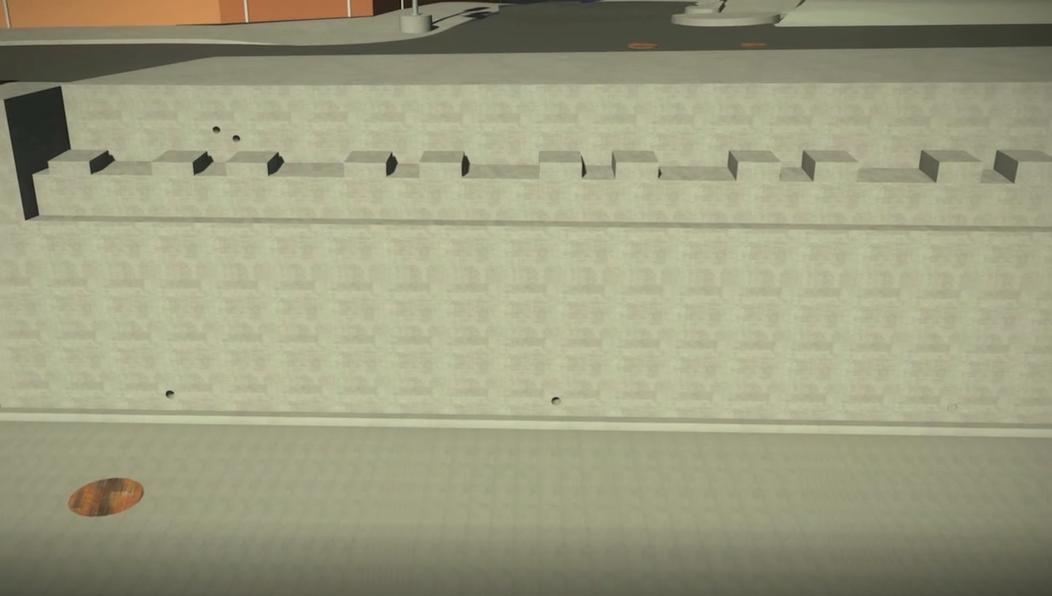

Slide 31
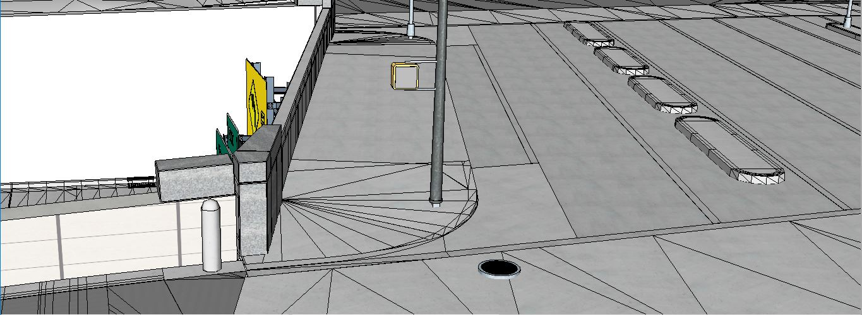

Slide 32
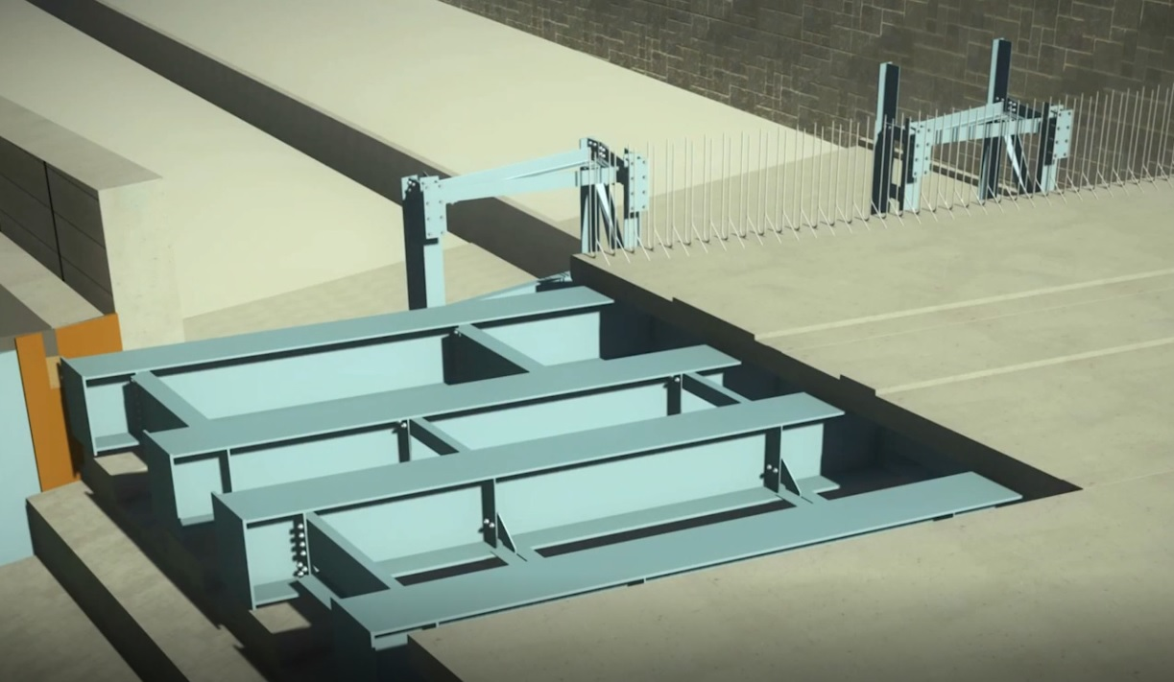

Slide 33
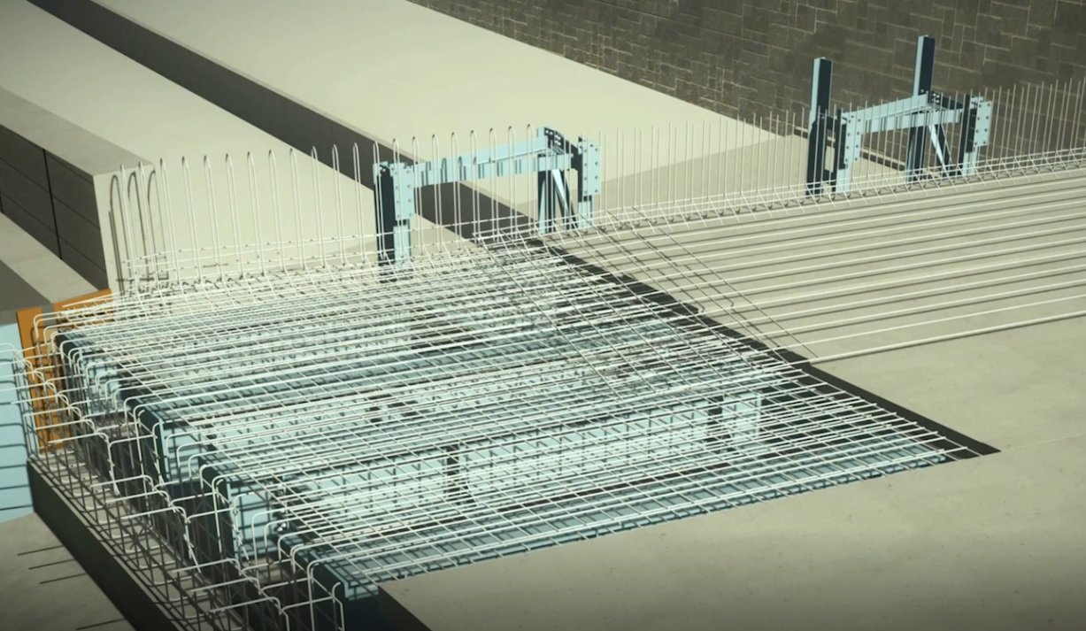

Slide 34
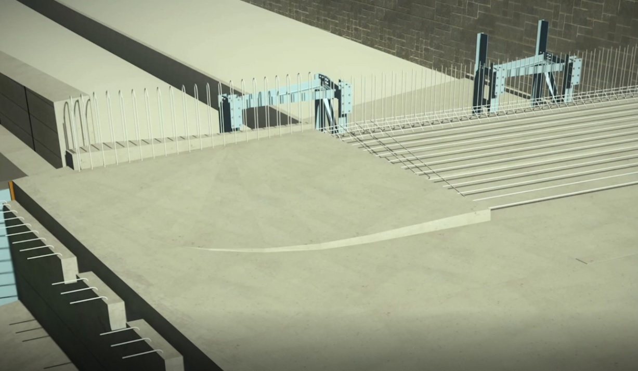

Slide 35
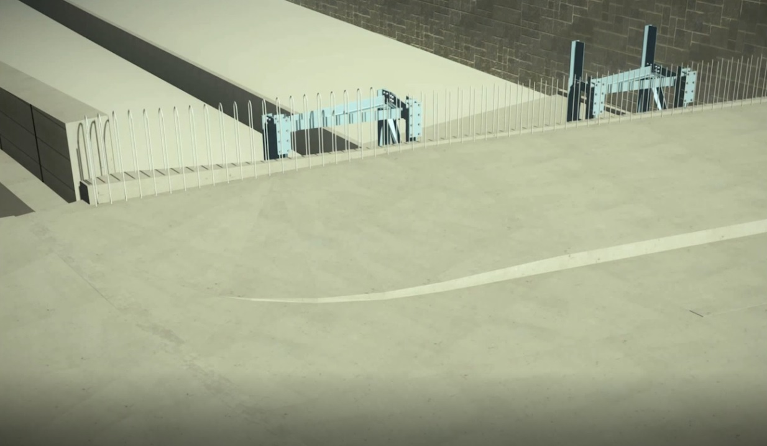

Slide 36
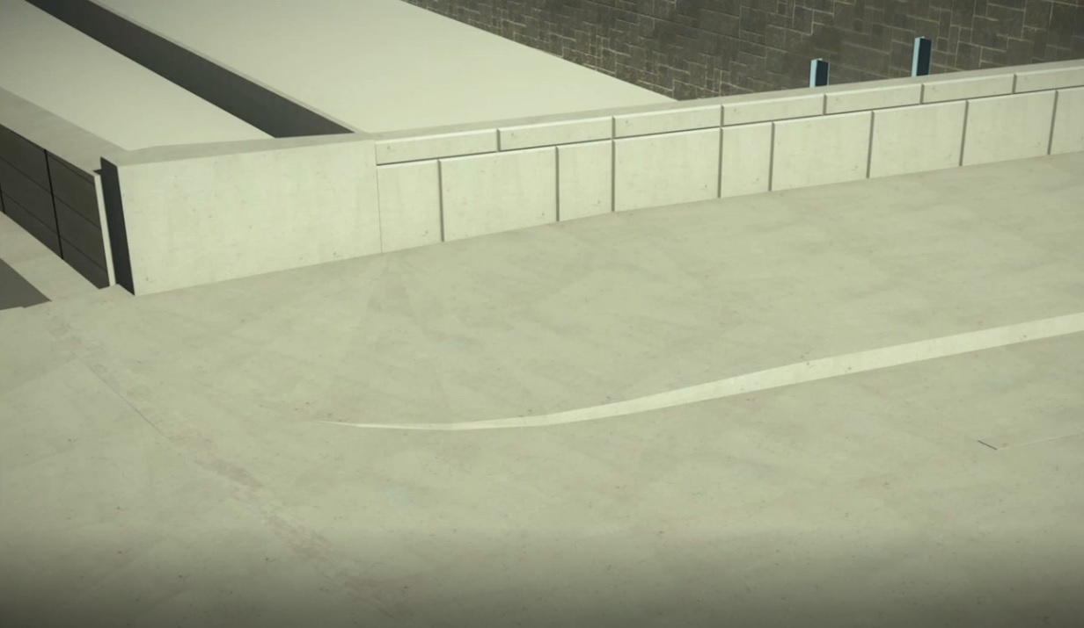

Slide 37
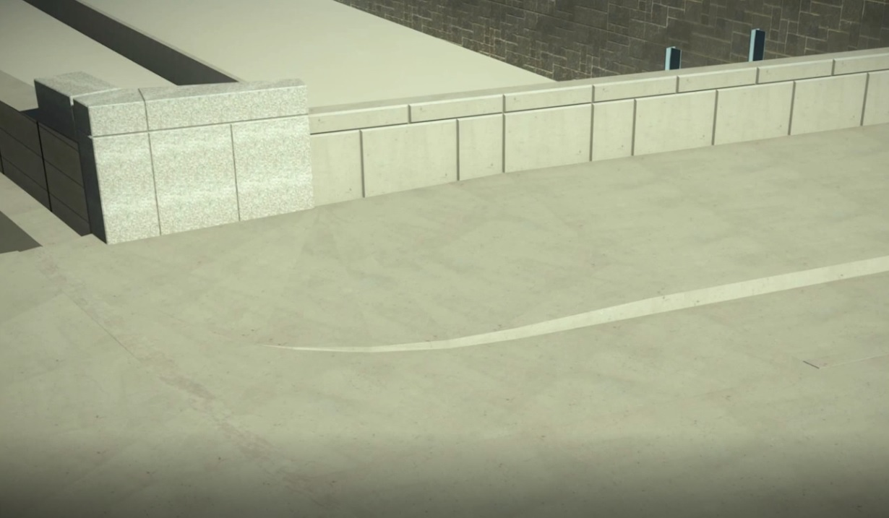

Slide 38
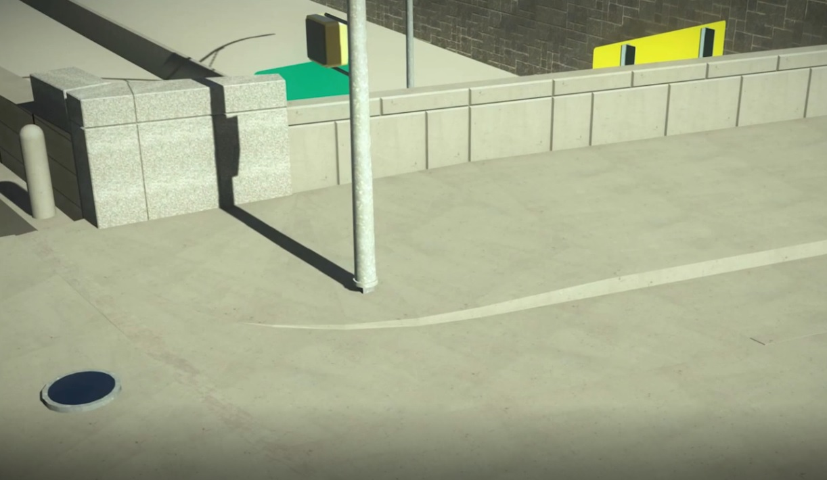

Slide 39
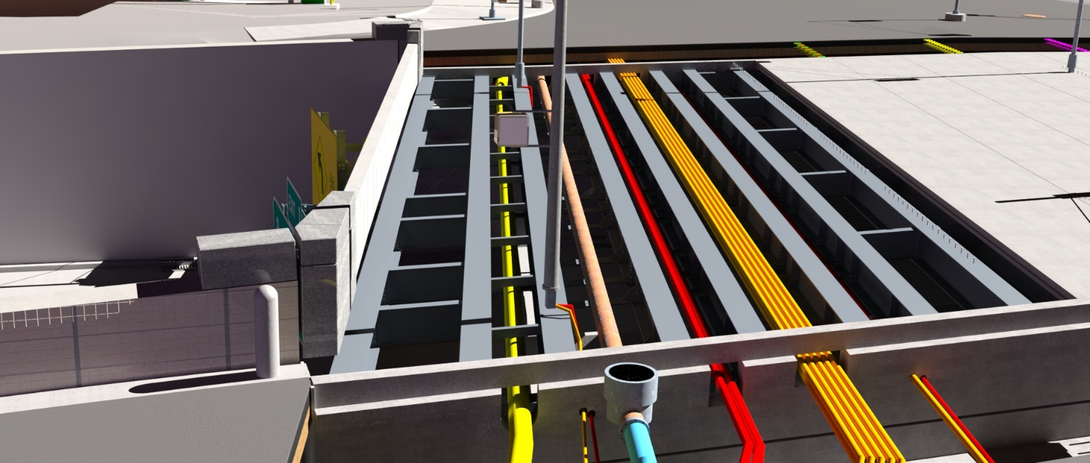
Using BrD as a Design Tool

Slide 40
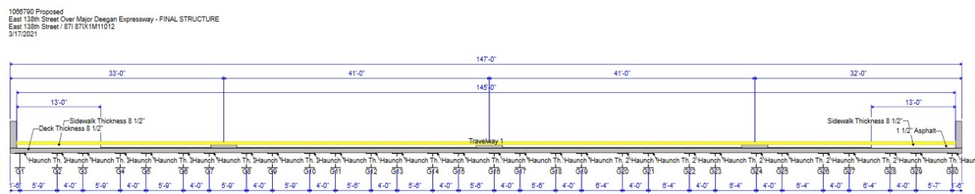
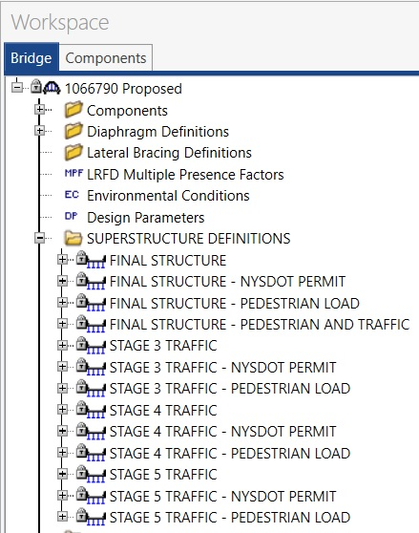



Superstructure Definitions in BrD
Final
Stage 3
Stage 4
Stage 5

Slide 41

Beam Definition in BrD

Slide 42








Diaphragms

Slide 43


Superstructure Components

Slide 44



IFC File Compatibility
An IFC file is a model file created in the Industry Foundation Classes (IFC) format, which is an open file format used by Building Information Modeling (BIM) programs. It contains a model of a building or facility, including spatial elements, materials, and shapes.

Slide 45



Future of Information Exchange

Slide 46

NYSDOT Recognized at
Bentley’s International Year in Infrastructure Conference
Receives Going Digital Award in Bridge Category

Slide 47
Office of Structures
Thank You!
Julianne Fuda, P.E.
Assistant Director, Structures Design Bureau
Julianne.Fuda@dot.ny.gov
(518) 457-0704

