Slide 1
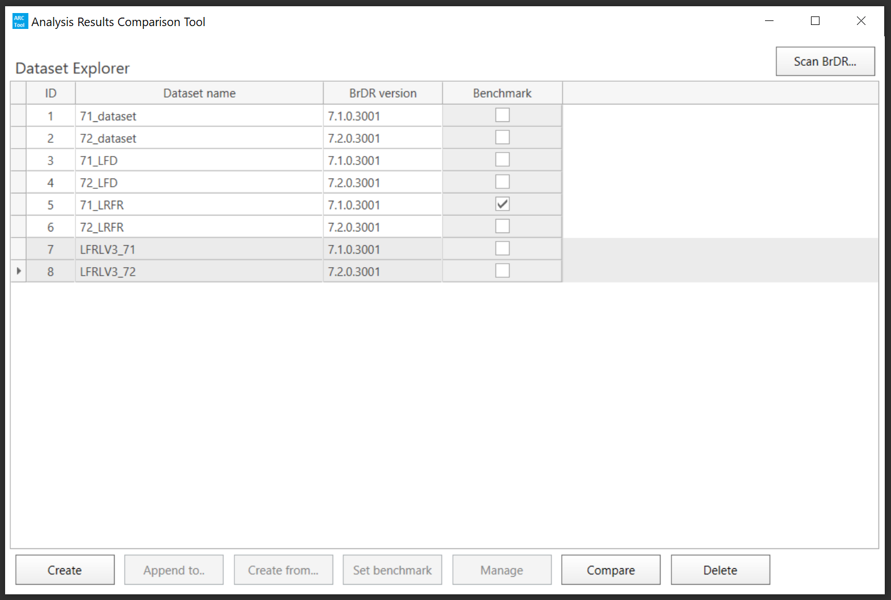
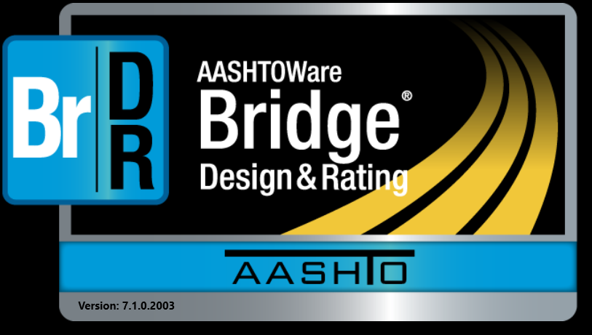

BrDR 7.2
Testing BrDR 7.2 Using the ARC Tool in Idaho
BrDR 7.1
Mike Johnson, P.E.
Idaho Transportation Department

Slide 2
Testing BrDR 7.2 Using the ARC Tool in Idaho
Why Test Upgrades?

Slide 3
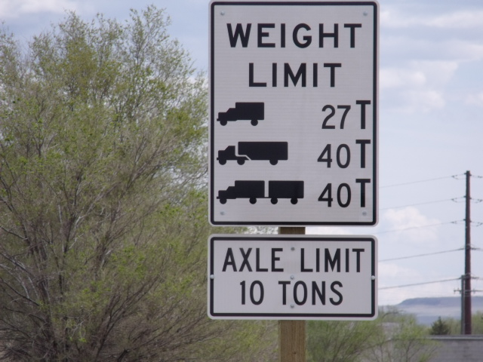
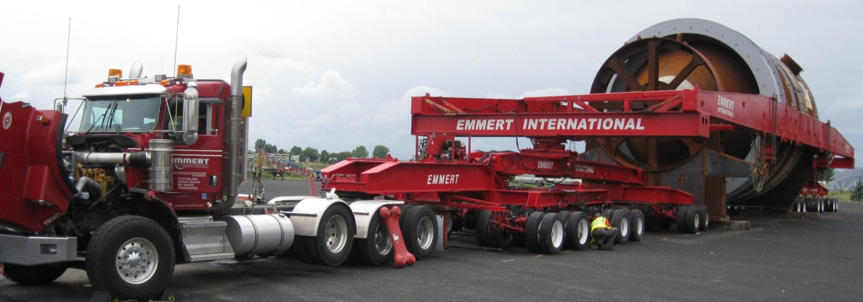
Testing BrDR 7.2 Using the ARC Tool in Idaho
Why Test Upgrades?
Agencies Conduct Different Levels Of Testing Of New Releases
Objective - Identify How New Versions Impact Ratings
  Need To Explain Decrease / Increase In Route Capacity

Slide 4
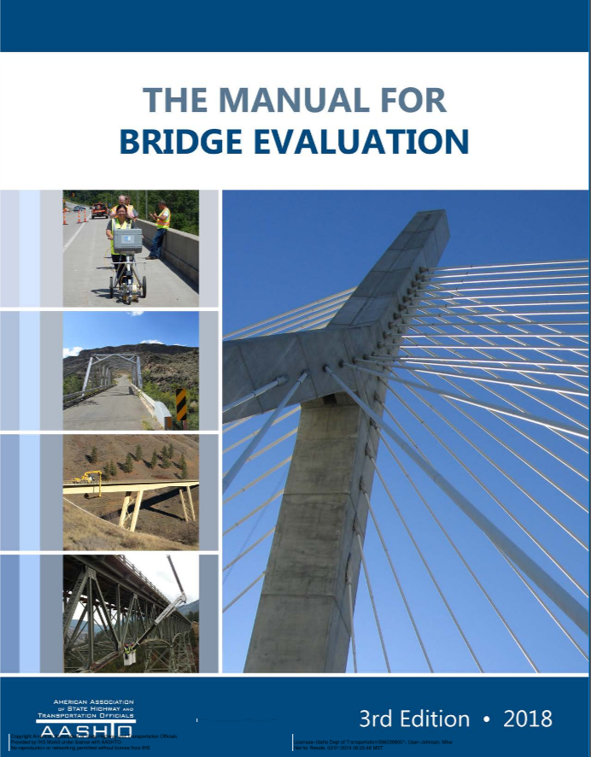
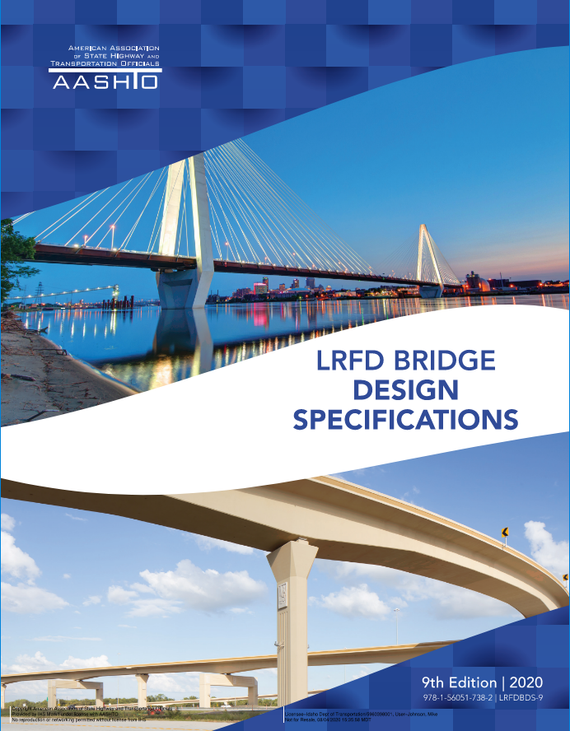
Testing BrDR 7.2 Using the ARC Tool in Idaho
Why Test Upgrades?
Reasons Behind Rating Changes
    Change In AASHTO Codes
    Bug Fixed From Previous Version
    New Bug / Issue
    Model Change (Condition/Loading)
      Change in Bridge Condition/Loading
      Accidental Model Change

Slide 5
Testing BrDR 7.2 Using the ARC Tool in Idaho
Idaho’s History of Testing

Slide 6
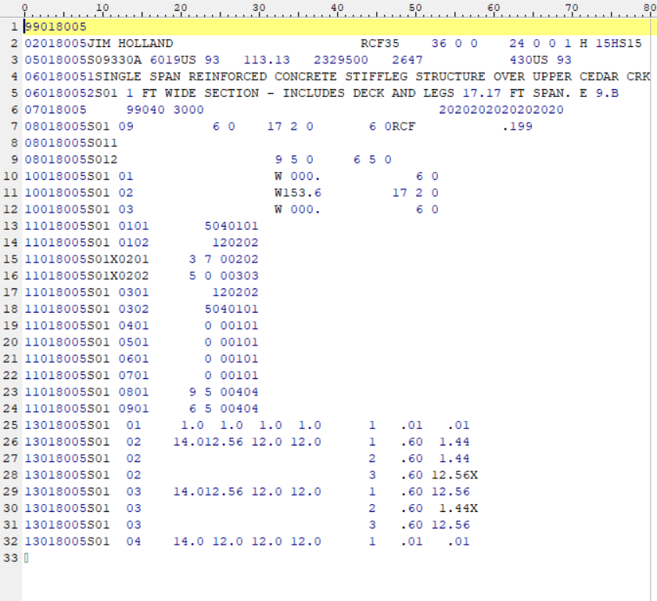
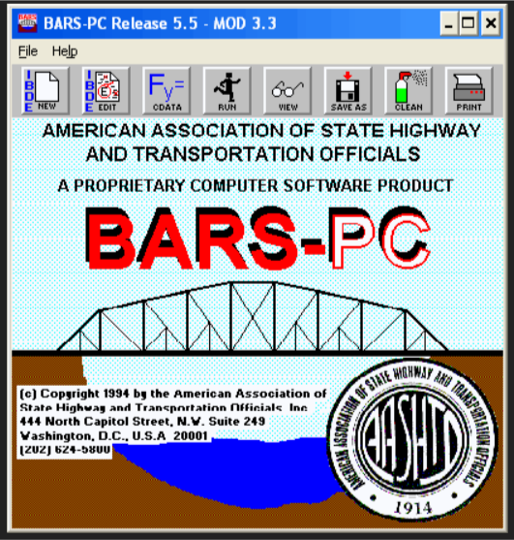


Testing BrDR 7.2 Using the ARC Tool in Idaho
Idaho’s History of Testing
BARS to Virtis (Now BrR) – 2004
  Compared 30 Bridges
  Results Were Different
  ITD Verified Virtis
ITD Started Inputting Bridge Virtis - 2008
  Testing Comprised Mainly Of Program Function

Slide 7
Testing BrDR 7.2 Using the ARC Tool in Idaho
Idaho’s History of Testing
Idaho Expanded Testing – 2011
  Began Modeling More Complicated Bridges With Virtis
  Tested Program Functions
  Tested Results of 30 Bridges of Various Types
  Started Seeing Some Differences Between Versions

Slide 8

Testing BrDR 7.2 Using the ARC Tool in Idaho
Idaho’s History of Testing
ITD Used Internal Resources – 2012 to 2016
  Compared Results Of All Bridges In Database
  In-Depth Review Of A Representative Sample
  All Testing Was Completed After The Release
Joined The Beta Testing TAG
  Able To Find Issues Before New Version Releases
  Still Completed Same Review Process Prior To Upgrading

Slide 9
Testing BrDR 7.2 Using the ARC Tool in Idaho
Idaho’s History of Testing
ITD Used Internal Resources – 2012 to 2016
  Compared Results Of All Bridges In Database
  In-Depth Review Of A Representative Sample
  All Testing Was Completed After The Release
Joined The Beta Testing TAG
  Able To Find Issues Before New Version Releases
  Still Completed Same Review Process Prior To Upgrading

Slide 10
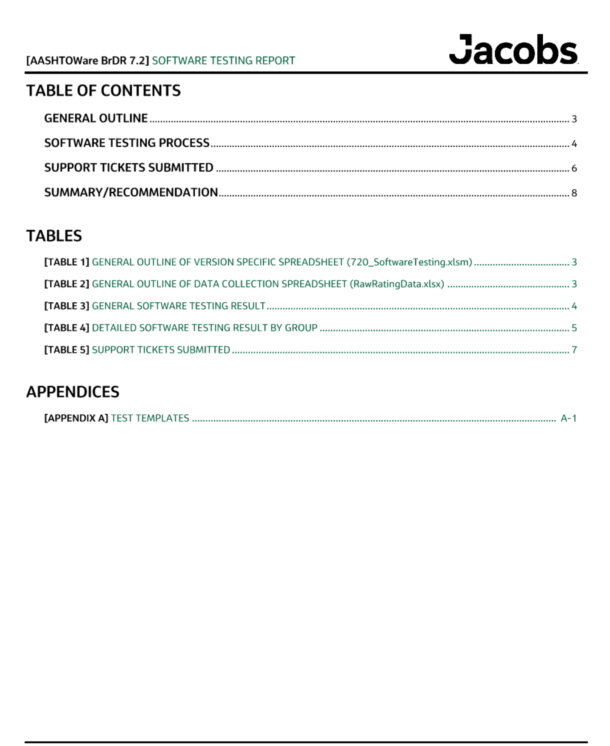
Testing BrDR 7.2 Using the ARC Tool in Idaho
Idaho’s History of Testing
ITD Hired Jacobs For Testing – 2017
  Database Had Over 2000 Bridges
  Compared The Controlling Ratings Of All Bridges
    Compared Results of Multiple Vehicles
  Developed Procedures For
    Testing
    Upgrading
    Documenting Results

Slide 11
Testing BrDR 7.2 Using the ARC Tool in Idaho
ITD’s Testing Prior To ARC Tool

Slide 12
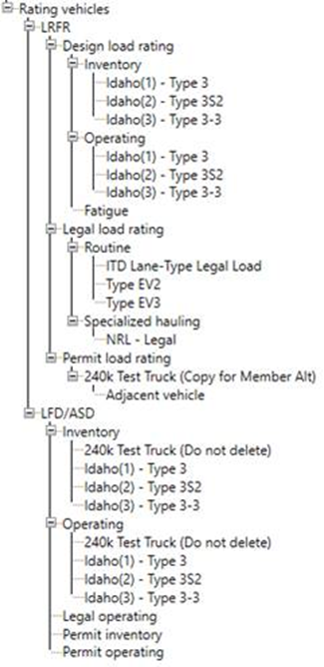
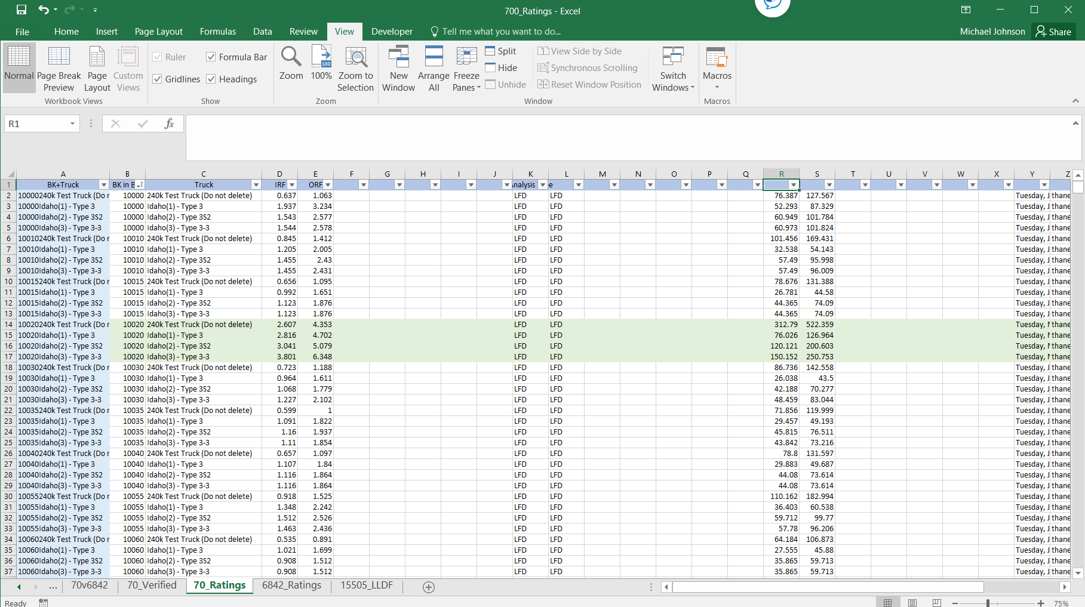
Testing BrDR 7.2 Using the ARC Tool in Idaho
ITD’s Testing Prior To ARC Tool
Run All The Completely Defined Bridges
Results Copied Into MS Excel

Slide 13
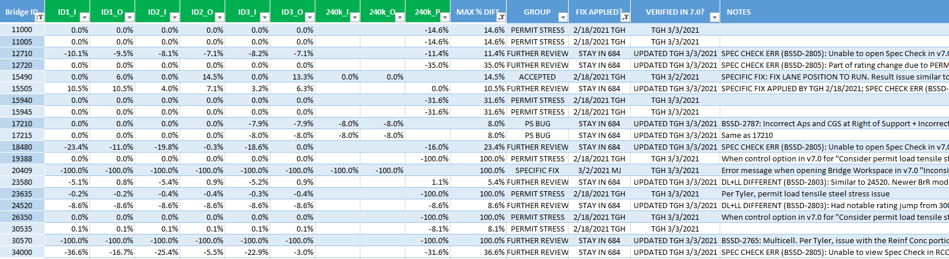
Testing BrDR 7.2 Using the ARC Tool in Idaho
ITD’s Testing Prior To ARC Tool
Compare Overall Controlling Ratings For Each Bridge
Flag / Review Models With ≥ 5% Difference

Slide 14
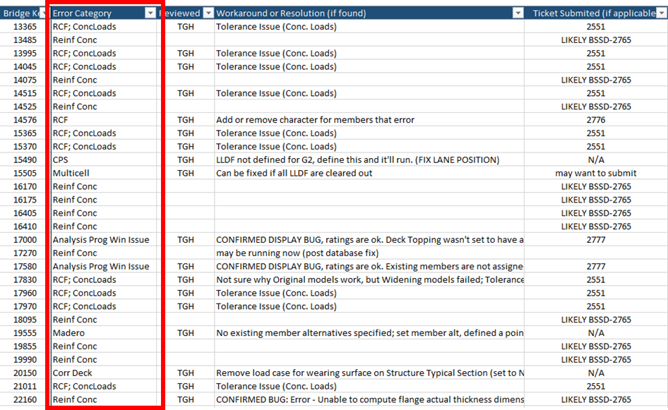
Testing BrDR 7.2 Using the ARC Tool in Idaho
ITD’s Testing Prior To ARC Tool
Identify Groupings For Flagged Bridges
  Similar Bridge Types / Errors

Slide 15
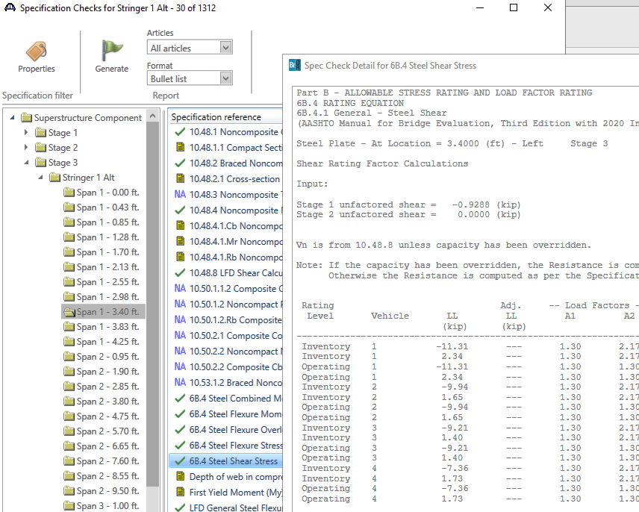
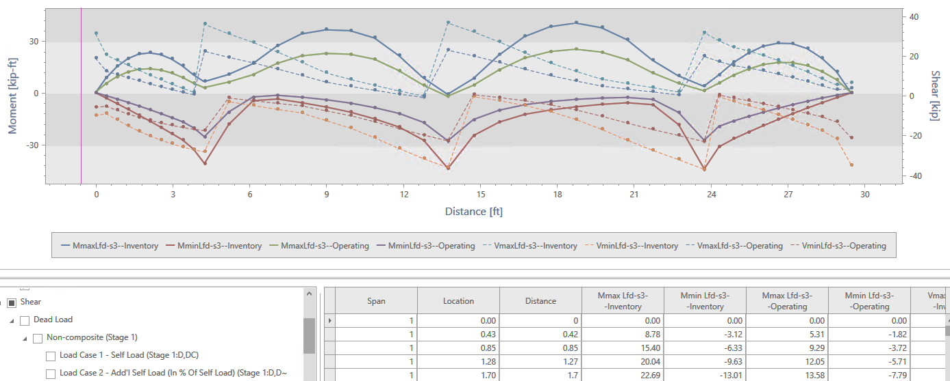
Testing BrDR 7.2 Using the ARC Tool in Idaho
ITD’s Testing Prior To ARC Tool
Run Bridges In Both Versions and Compare
  Controlling Location and Limit State
  Dead Loads and Live Loads
  Review The Specification Checks

Slide 16
Testing BrDR 7.2 Using the ARC Tool in Idaho
Procedure With ARC Tool

Slide 17
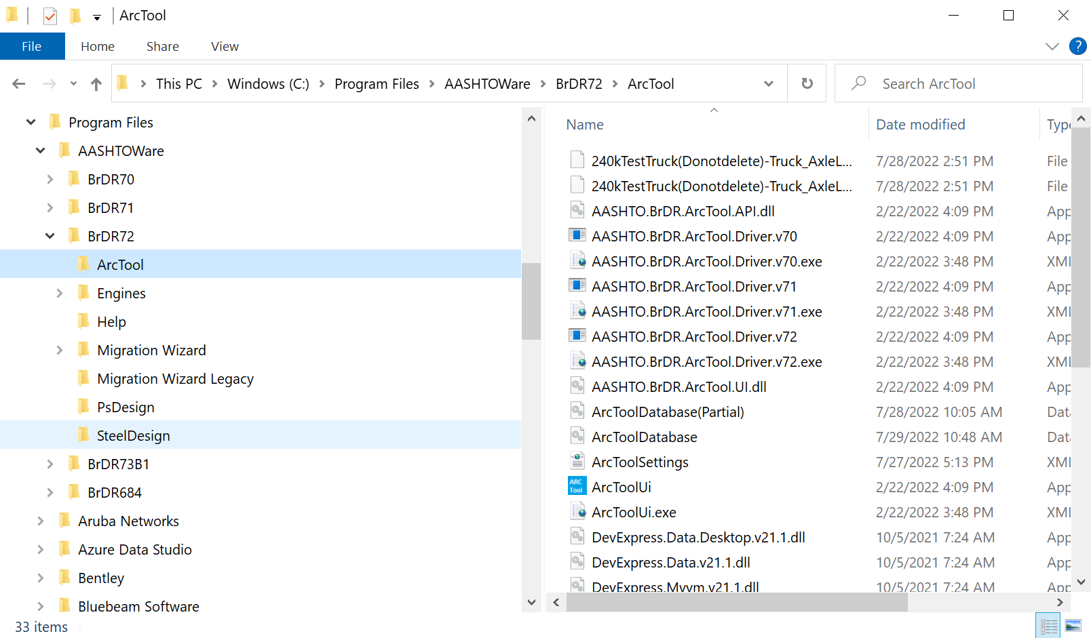
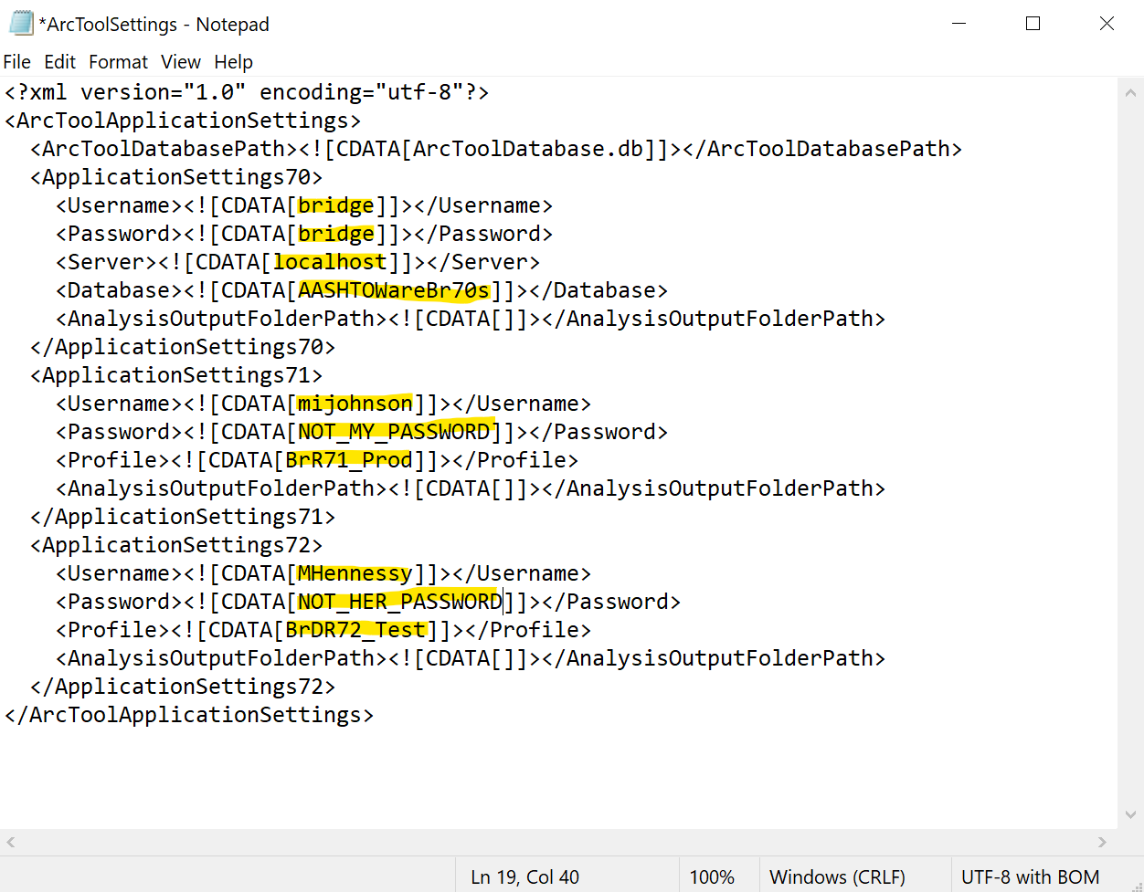
Testing BrDR 7.2 Using the ARC Tool in Idaho
Procedure With ARC Tool
Similar Approach Will Be Used
  Results Stored and Organized In ARC Tool Database
Set Up The ARC Tool Settings

Slide 18
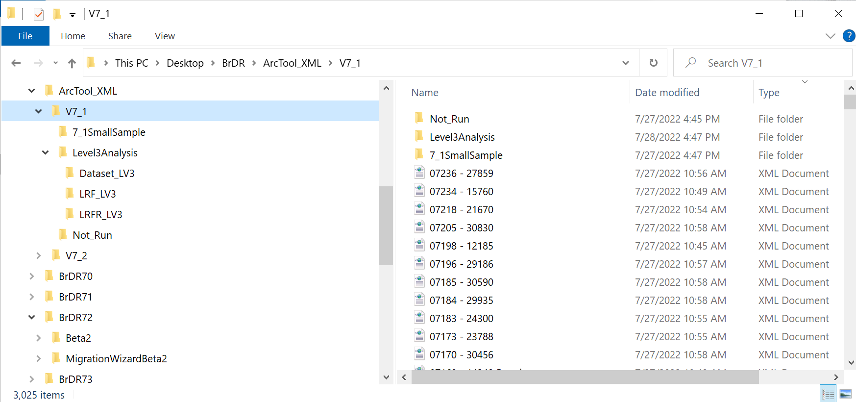
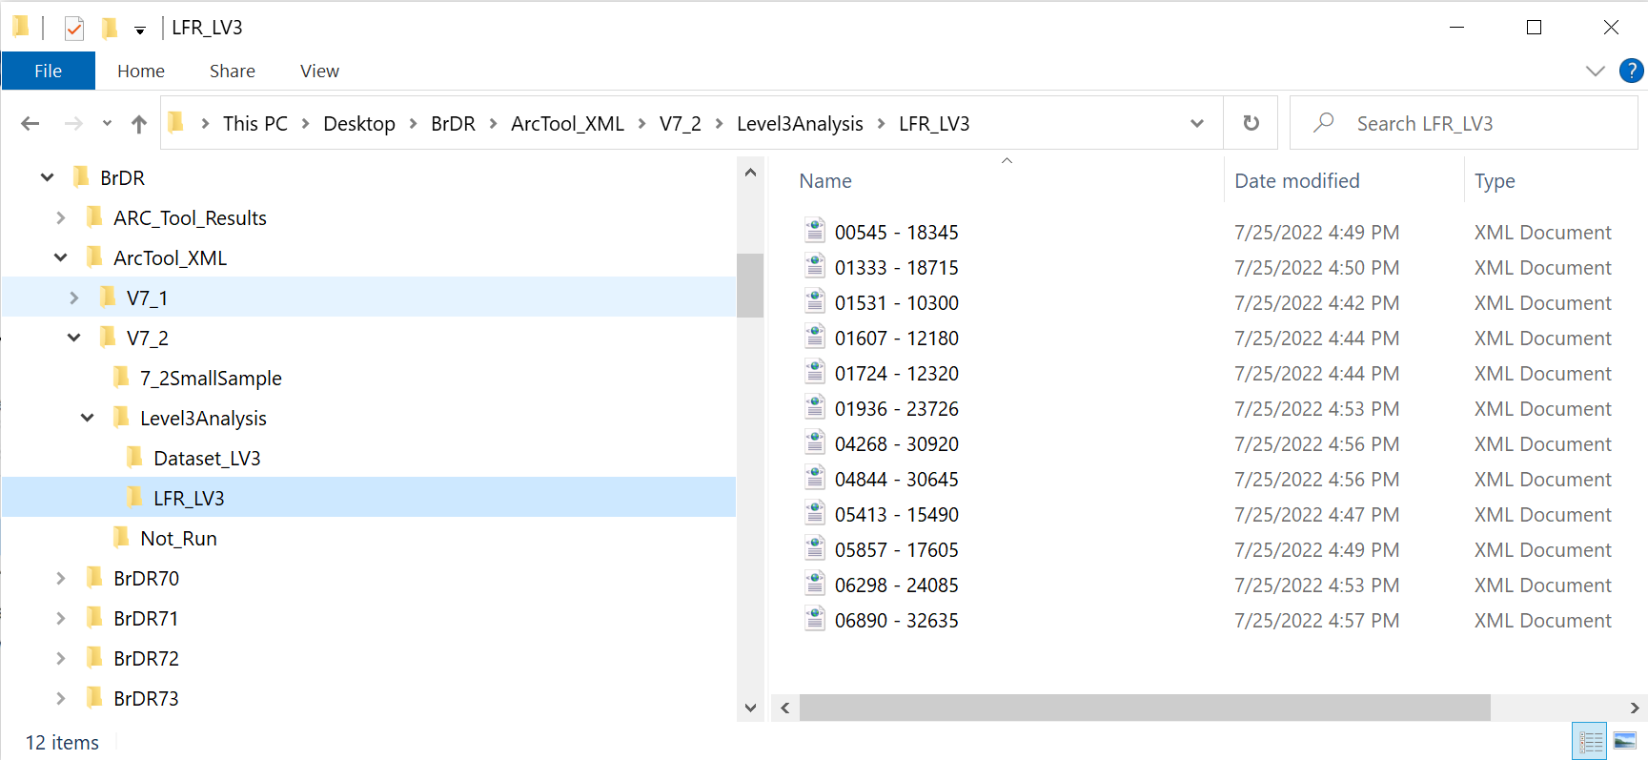
Testing BrDR 7.2 Using the ARC Tool in Idaho
Procedure With ARC Tool
Copying Bridge .xml Files
  Work From Separate Group Of .xml Files or Same
    If Use Same Group, Use Older Version Files
    Can Make Different Sets To Run from Old And New Versions

Slide 19
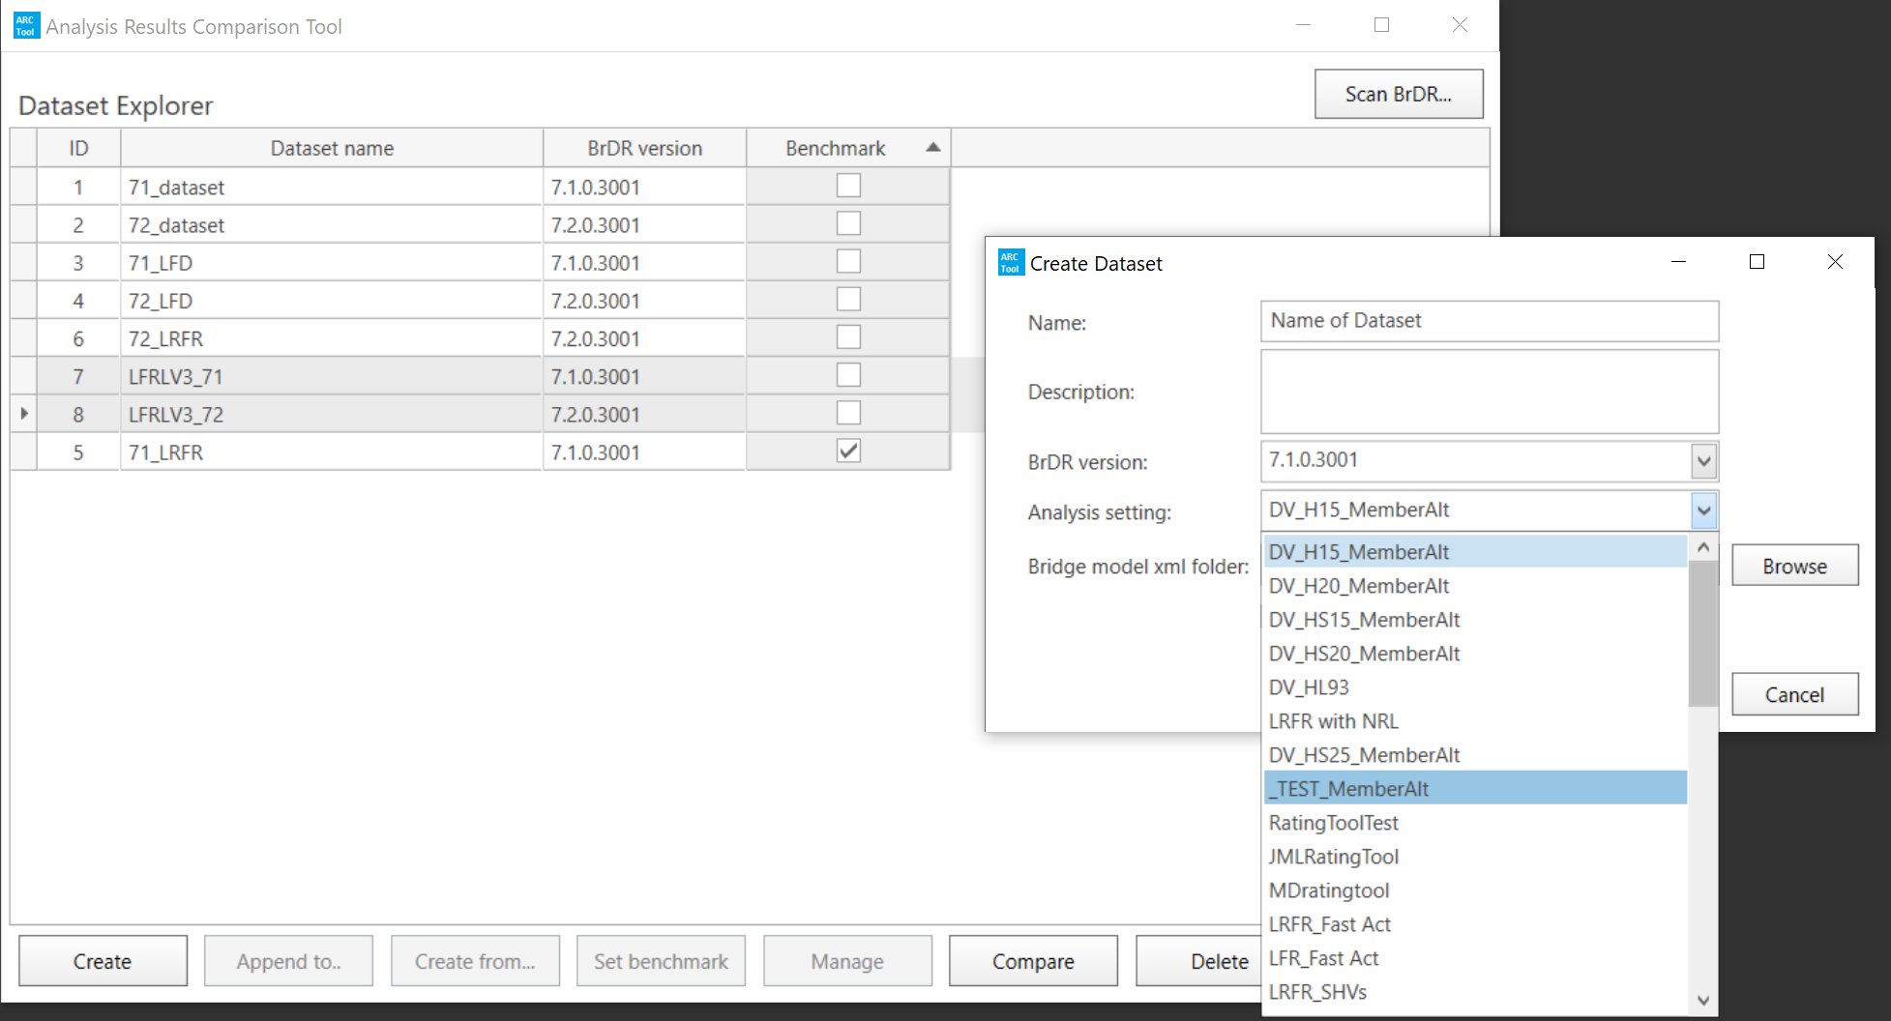
Testing BrDR 7.2 Using the ARC Tool in Idaho
Procedure With ARC Tool
Create Result File In ARC Tool For Both Versions
  Make Sure Same Template Is Selected

Slide 20
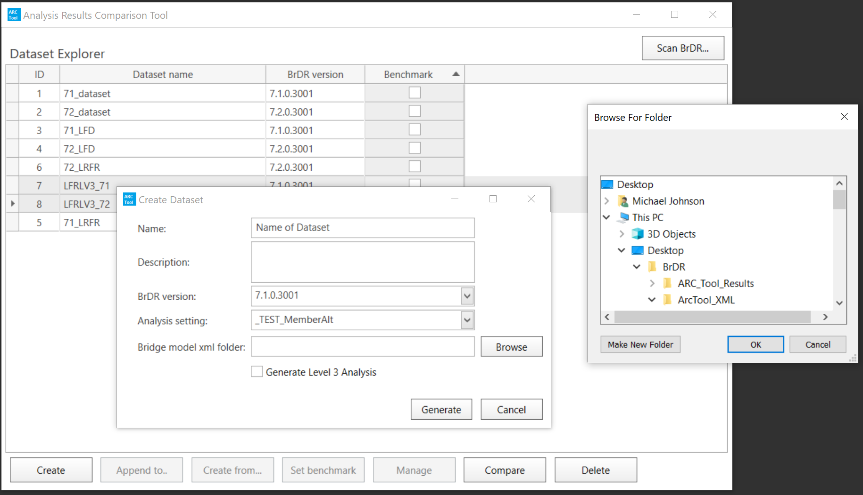
Testing BrDR 7.2 Using the ARC Tool in Idaho
Procedure With ARC Tool
Create Result File In ARC Tool For Both Versions
  Make Sure Same Template Is Selected

Slide 21
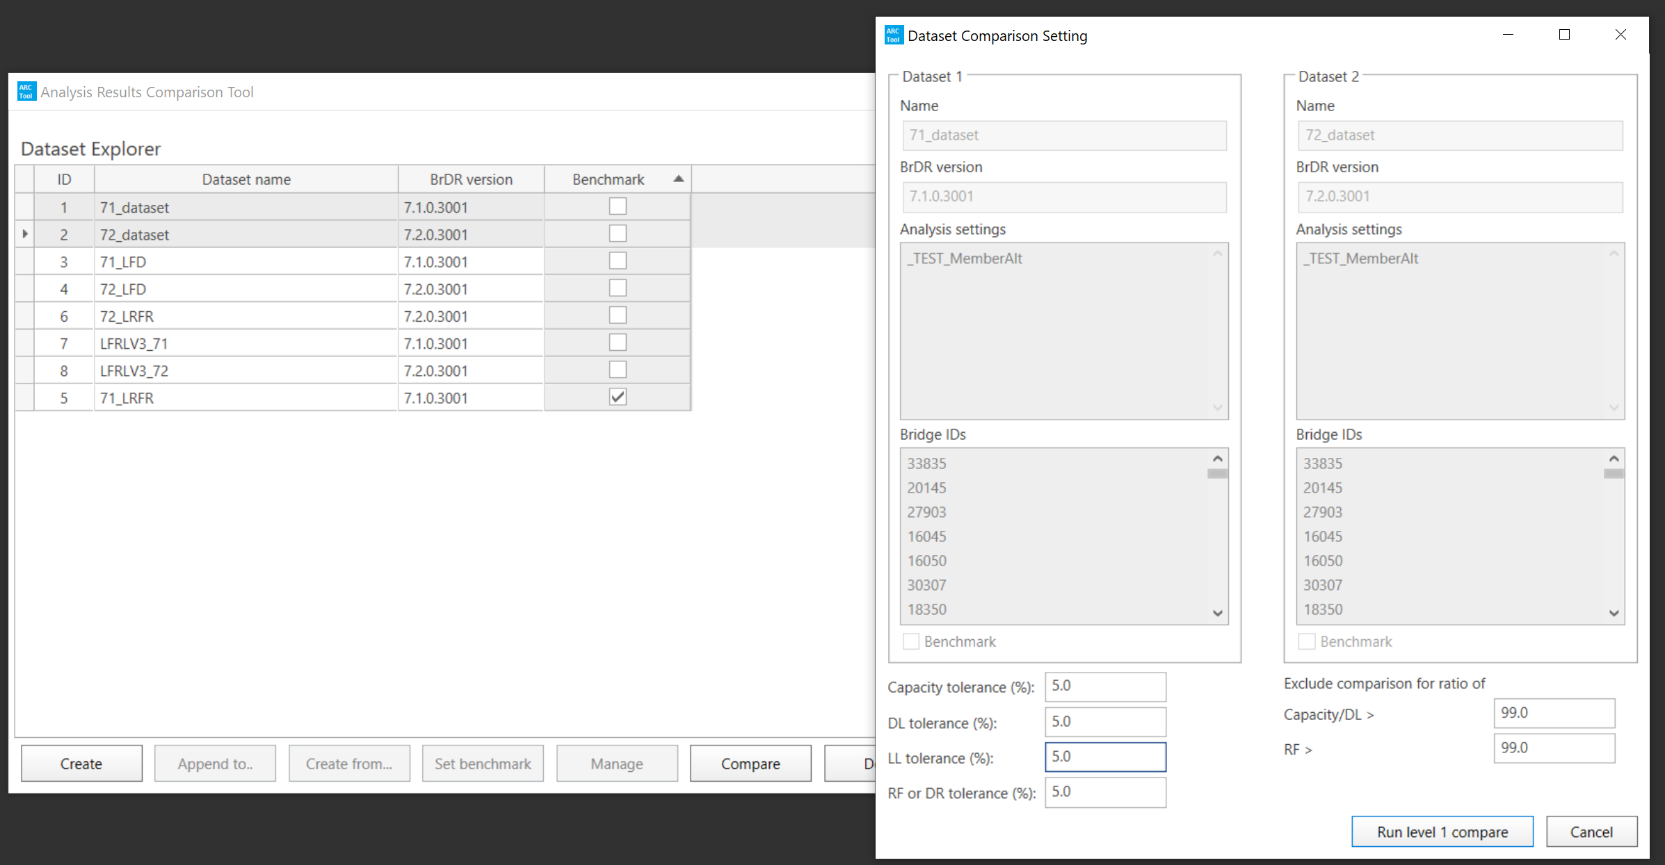
Testing BrDR 7.2 Using the ARC Tool in Idaho
Procedure With ARC Tool
Select Datasets To Compare
  Verify Analysis Settings Are The Same
  Set Desired Tolerance

Slide 22
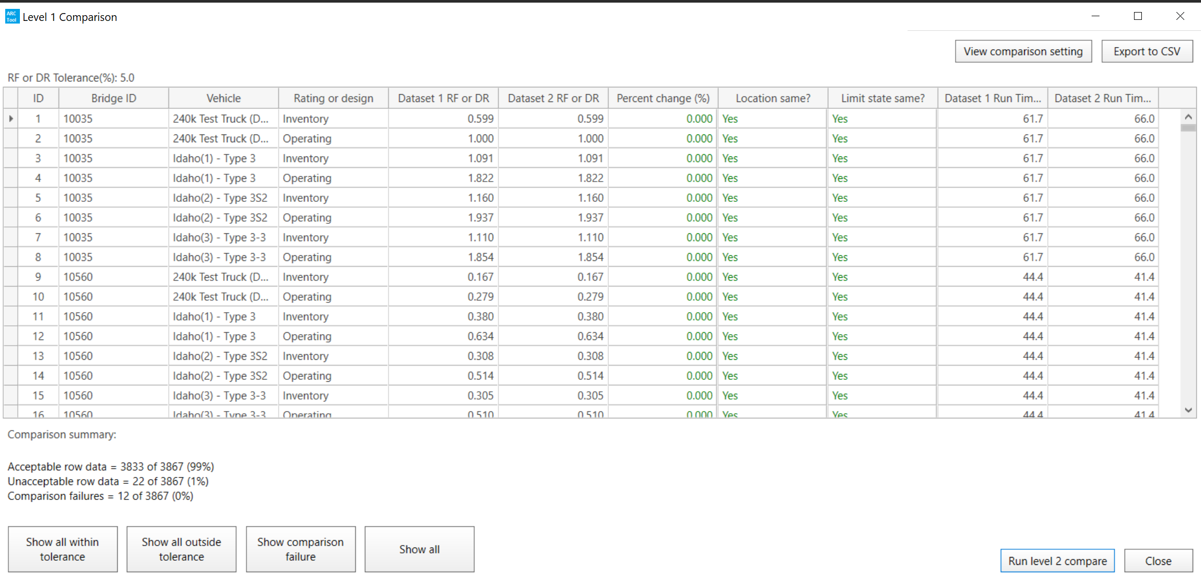
Testing BrDR 7.2 Using the ARC Tool in Idaho
Procedure With ARC Tool
Level 1
  Overall Bridge Controlling Load Rating

Slide 23
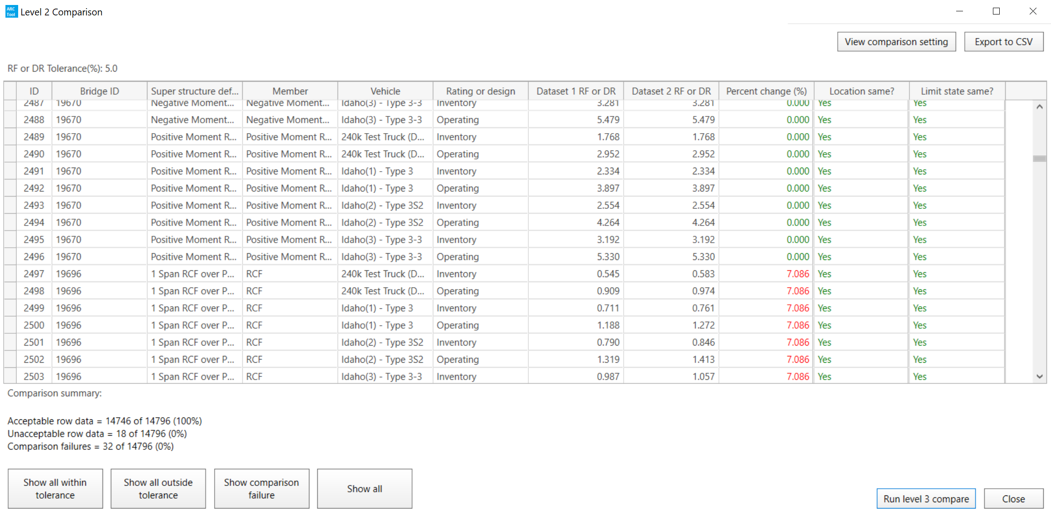
Testing BrDR 7.2 Using the ARC Tool in Idaho
Procedure With ARC Tool
Level 2
  Bridge Member Controlling Load Rating

Slide 24
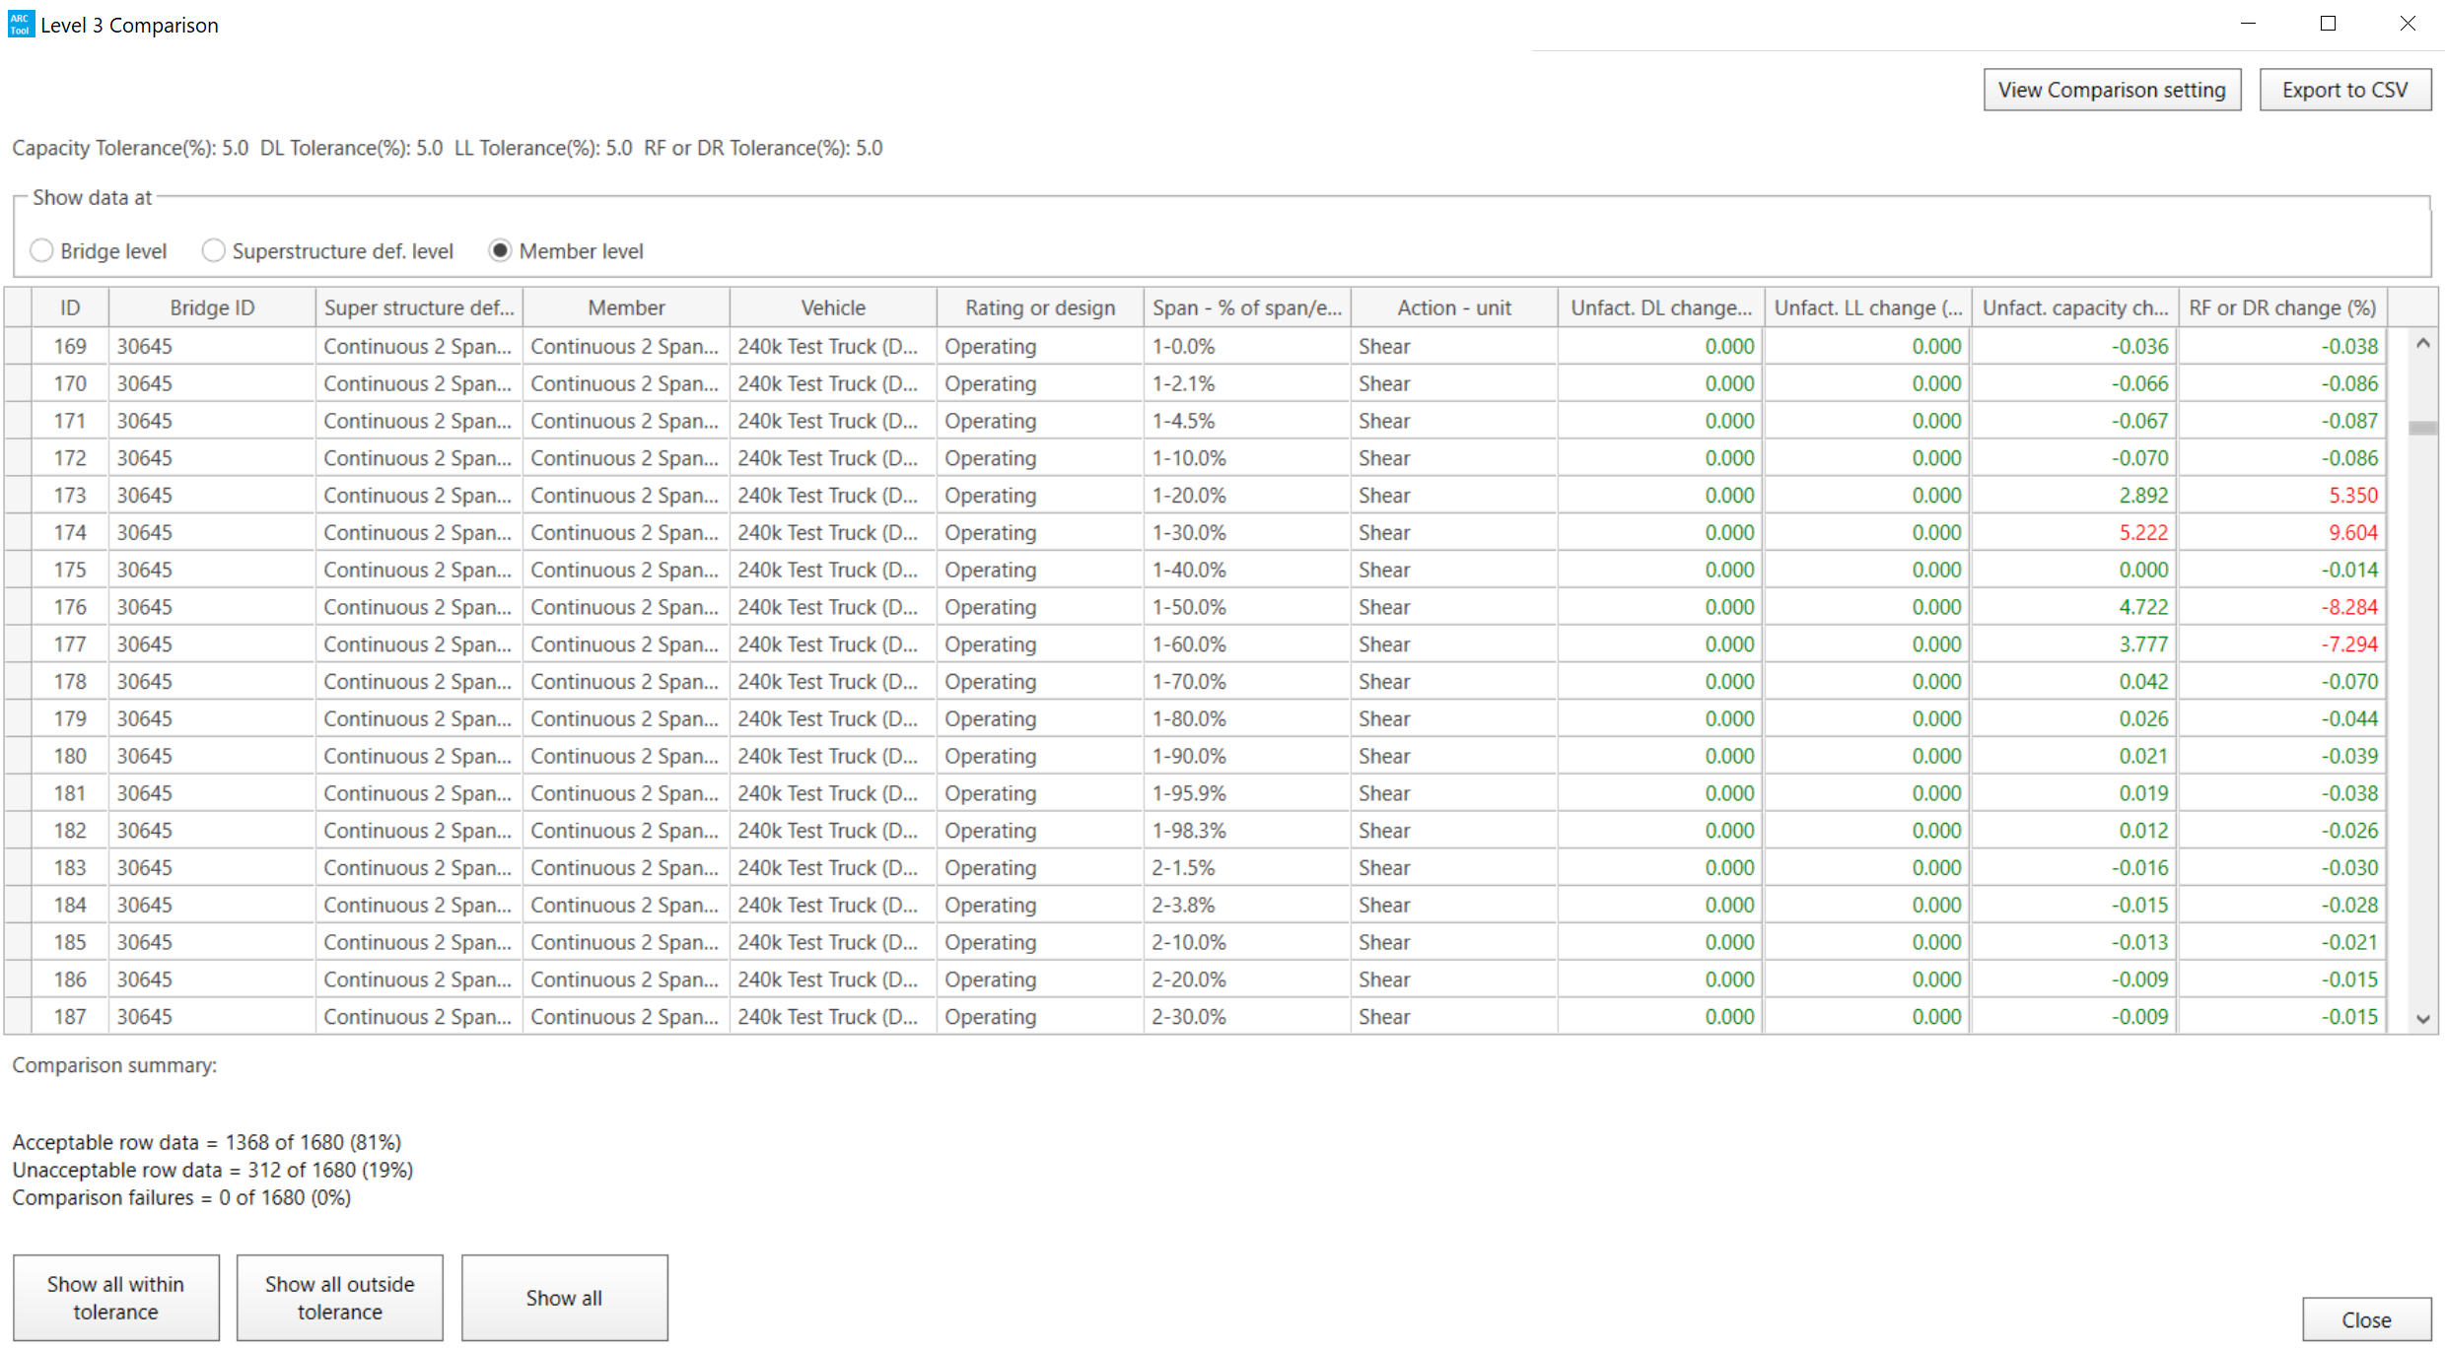
Testing BrDR 7.2 Using the ARC Tool in Idaho
Procedure With ARC Tool
Level 3
  Deadload, Liveload, and Capacity Comparison
  Used To Help Identify The Cause Of Difference

Slide 25
Testing BrDR 7.2 Using the ARC Tool in Idaho
How Will The ARC Tool Help?

Slide 26
Testing BrDR 7.2 Using the ARC Tool in Idaho
How Will The ARC Tool Help?
Reduce Time In Collecting / Sorting Data
Reduce Potential Human Error In Copying Data
Provides More Than Level 1 Results
  Level 1 – Overall Controlling Bridge Load Rating
  Level 2 – Controlling Member Load Ratings
  Level 3 – Deadload, Liveload, and Capacity Comparison
Easier To Find Issues That Don’t Impact Overall Load Rating
Assists In Finding Location And Reason For Difference
Decreased Time To Test = Upgrade Sooner

Slide 27
Testing BrDR 7.2 Using the ARC Tool in Idaho
ARC Tool – Things To Know

Slide 28
Testing BrDR 7.2 Using the ARC Tool in Idaho
ARC Tool – Things To Know
First Version – Refine Based On User Input
Must Use Same Dataset When Comparing
  Templates Created In BrDR
ARC Tool Creates Large Amount Of Temporary Files
  May Fill Up Hard Drive And Cause Analysis To Stop

Slide 29
Testing BrDR 7.2 Using the ARC Tool in Idaho
ARC Tool – Things To Know
Member Alternative Names Do Matter
  Certain Characters Cause File To Not Run
  Must Remove File – Restart through “Append To..”
Level 3 Analysis Not Intended For All Bridges
  Only Bridges Needing Further Investigation

Slide 30
Testing BrDR 7.2 Using the ARC Tool in Idaho
ARC Tool – Things To Know
Does Not Do All Bridge Types
  Timber (Coming BrDR 7.3)
  3D FEM Structures / Special Structures
  Bridge in Legacy Engine

Slide 31
Testing BrDR 7.2 Using the ARC Tool in Idaho
ARC Tool – What Is To Come?

Slide 32
Testing BrDR 7.2 Using the ARC Tool in Idaho
ARC Tool – What Is To Come?
ARC 2.0 And Beyond
List of 30 Enhancements
  Added Girder Types
  Set-up / Preference
  Handling Temporary Files
  Processing
    Multiple Computers
    Multiple Databases
  Compare Different Analysis Types
  Others
    Input from Users

Slide 33
Testing BrDR 7.2 Using the ARC Tool in Idaho
Results BrDR 7.2

Slide 34
Testing BrDR 7.2 Using the ARC Tool in Idaho
Results BrDR 7.2
Used Both Methods – Manual and ARC Tool
  Results Were Consistent
    Differences Due To Version Of v7.1 Used (7.1.0 vs. 7.1.1)
  ARC Tool Does Not Do Timber and FEM Bridges
  Need To Remove Bridge With Naming Conflicts

Slide 35
Testing BrDR 7.2 Using the ARC Tool in Idaho
Results BrDR 7.2
Tested 3116 Bridges
  2980 Results Matched
  123 ARC Tool Not Able To Run
  5 Shear POI Location Changed
  4 Permit Stress Rating Differences
  2 POI Added @ Debonded Strand Locations
  1 Difference in Calculation of Simultaneous Vu
  1 Change in Steel Flexure Overload

Slide 36
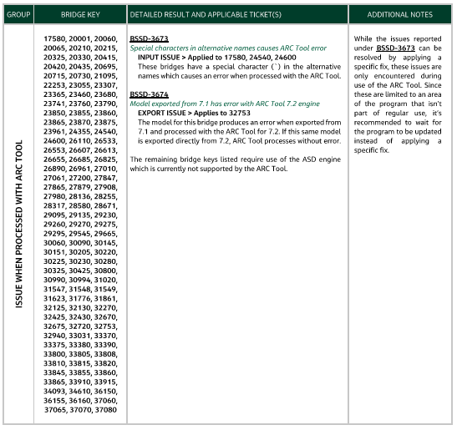
Testing BrDR 7.2 Using the ARC Tool in Idaho
Results BrDR 7.2
ARC Tool Not Able To Run (123 Total)
  Special Character In Alternative Name (3)
  Need To Run v7.2 Exported .xml (1)
  Timber Bridges (119)

Slide 37
Testing BrDR 7.2 Using the ARC Tool in Idaho
Results BrDR 7.2
ARC Tool Not Able To Run (123 Total)
  Special Character In Alternative Name (3)
  Need To Run v7.2 Exported .xml (1)
  Timber Bridges (119)
    Matched When Ran Manually

Slide 38
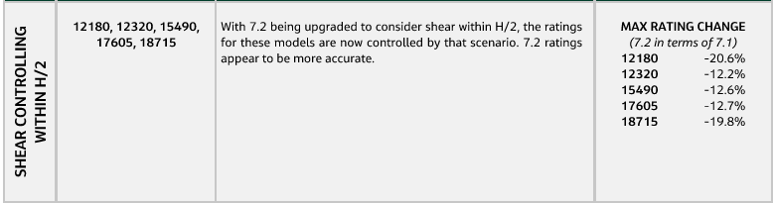
Testing BrDR 7.2 Using the ARC Tool in Idaho
Results BrDR 7.2
Shear POI Location (5 Total)
  v7.2 Added A POI For Shear At H/2

Slide 39
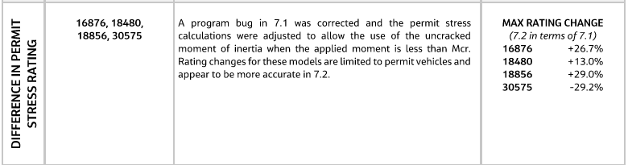
Testing BrDR 7.2 Using the ARC Tool in Idaho
Results BrDR 7.2
Permit Stress Rating Differences (4 Total)
  v7.2 Allows Use Of Uncracked MOI when Applied M < Mcr

Slide 40
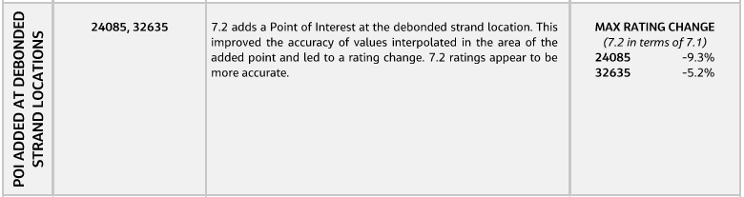
Testing BrDR 7.2 Using the ARC Tool in Idaho
Results BrDR 7.2
POI At Debonded Strand Locations (2 Total)
  v7.2 Added A POI

Slide 41
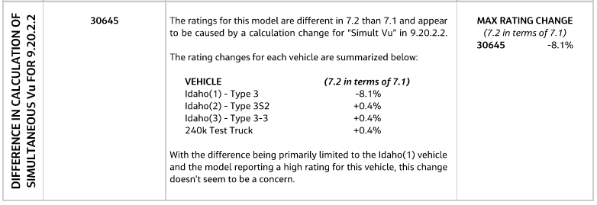
Testing BrDR 7.2 Using the ARC Tool in Idaho
Results BrDR 7.2
Difference in Calculation of Simultaneous Vu (1 Total)
  v7.2 Change How Simultaneous Vu Is Calculated

Slide 42
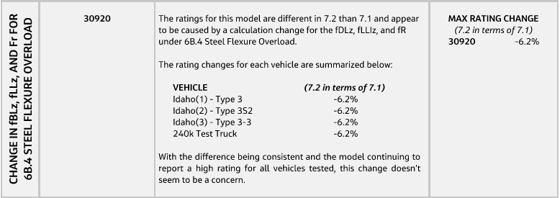
Testing BrDR 7.2 Using the ARC Tool in Idaho
Results BrDR 7.2
Change in Steel Flexure Overload (1 Total)
  v7.2 Change How Several Variables Used For Steel Flexure Overload Are Calculated

Slide 43
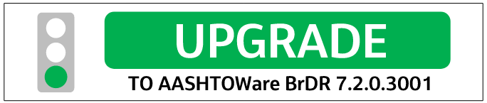
Testing BrDR 7.2 Using the ARC Tool in Idaho
Results BrDR 7.2
ITD Will Be Upgrading To v7.2 Next Week

Slide 44
Testing BrDR 7.2 Using the ARC Tool in Idaho
Thank You

