Slide 1
FHWA Update -
AASHTOWare RADBUG Meeting
Traverse City, MI
August 12-13, 2013
Thomas Saad, P.E.
Senior Structural Engineer
Federal Highway Administration
Phone: (708)283-3521
E-mail: thomas.saad@dot.gov

Slide 2
Presentation Outline
Legislative and Organizational Updates
Rulemaking Updates
Products to Aid Bridge Design and Analysis Engineers
Findings from Northeast States Load Rating and Permitting Peer Exchange

Slide 3
Highway Funding and FHWA and Organizational Updates
Highway Trust Fund – Law to fund Trust Fund through May, 2015 ($11B) signed last week.
GROW AMERICA Act – Administration’s proposal: 4 year bill – $300B
Dr. Joey Hartmann is FHWA’s new Director of Office of Bridges and Structures
Bill Bergeson – HIBS Tunnel Engineer
Derek Constable – HIBS Bridge Management Engineer

Slide 4

National Tunnel Inspection Standards (NTIS)
2010 NPRM
2013 SNPRM
Current expected publication date: Nov. 19, 2014
TOMIE Manual and Specification for the National Tunnel Inventory (coding guide) will be published concurrent with the NTIS
Inspector training expected to be available through NHI by end of 2014

Slide 5
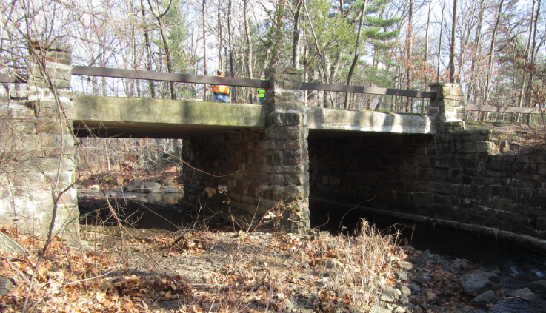
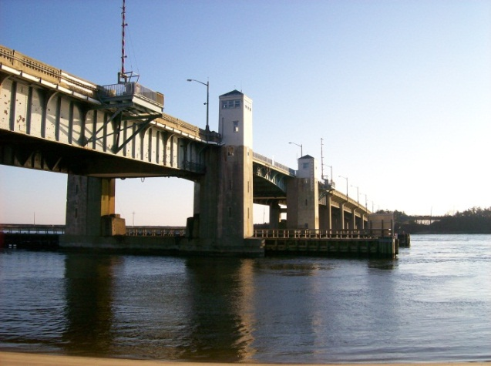
NBIS Regulations Update and Coding Guide
Mandated by MAP-21
  Methodology, training, and qualifications for inspectors
  Risk-based, data-driven procedure
Anticipate NPRM to be published in the Federal Register in December along with Coding Guide

Slide 6
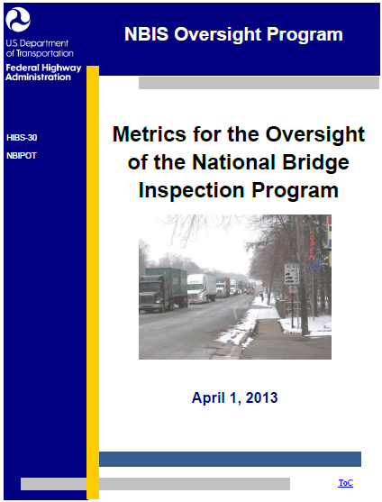
NBIS Compliance Update
FHWA/AASHTO Task Force in 2011
Issued latest version of metrics on 4/1/13 (15 of 23 metrics revised)
Compliance Oversight and Penalty Procedures
  NPRM in 2013
  Final Notice published in Federal Register in May 2014
Notes:
Metrics for PY 2014 (upcoming review year)
15 of 23 metrics were revised and sent out to Divisions on 4/1/2013

Slide 7
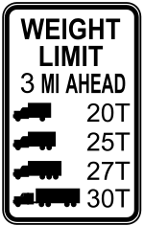
FHWA LRFR Webinar Series http://www.fhwa.dot.gov/bridge/loadrating/
  Topic No. 1: Implementation of the Load and Resistance Factor Rating Method, October 5, 2011
  Topic No. 2: LRFD/LRFR Design and Load Rating of Culverts, November 17, 2011
  Topic No. 3: LRFR Load Rating of Segmental Concrete Bridges, January 19, 2012
  Topic No. 4: State-Specific LRFR Load Rating Guidelines, April 19, 2012
  Topic No. 5: Application of Load Testing in Bridge Load Rating (1), September 20, 2012
  Topic No. 6: Application of Load Testing in Bridge Load Rating (2), December 6, 2012

Slide 8
FHWA LRFR Webinar Series http://www.fhwa.dot.gov/bridge/loadrating/
  Topic No. 7: Application of Computer Software in Bridge Load Rating (1), February 28, 2013
  Topic No. 8: Application of Computer Software in Bridge Load Rating (2), April 25, 2013
  Topic No. 9: Load Rating of Steel Truss Bridges (1), September 12, 2013
  Topic No. 10: Load Rating of Steel Truss Bridges (2), December 17, 2013
  Topic No. 11: Load Rating and Posting for SHVs, March 14, 2014
  Topic No. 12: A Comparison of AASHTO Bridge Load Rating Methods, May 29, 2014

Slide 9
FHWA/NHI Bridge Design and Analysis Courses (www.nhi.fhwa.dot.gov)
NHI Course 130081: LRFD for Bridge Superstructures
NHI Course 130092: LRFR for Highway Bridges
NHI Course 130093: LRFD Seismic Analysis and Design of Bridges
NHI Course 130094: LRFD Seismic Analysis and Design of Tunnels, Walls and other Geotechnical Features
NHI Course 130095: LRFD: Design and Analysis of Skewed and Horizontally Curved Steel Bridges

Slide 10
FHWA Seismic Retrofit Seminar
1 ½ day seminar (9 PDH)
Overview of FHWA Seismic Retrofit Manual
Develop design response spectrum identically to current LRFD
Delivered in IN, IL, NY, NJ, GA, MA, TN, UT
Thomas.saad@dot.gov

Slide 11
FHWA Seismic Design Seminar
¾ day seminar (6 PDH)
Introduction to LRFD seismic design provisions
Understand concepts behind force based and displacement based methods
Delivered in AR, ME, AL, NH
Thomas.saad@dot.gov

Slide 12
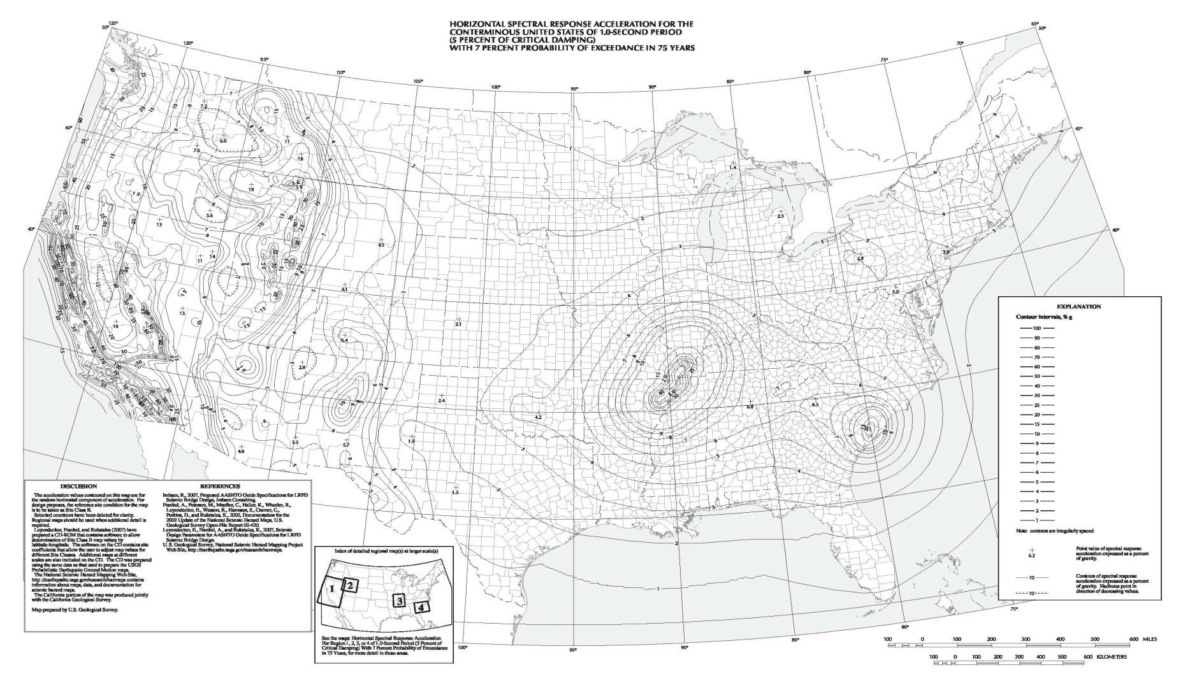
Seismic Design Category (zone)
(1000 Year Return Period)
Zone 1-SDC “A”
Zone 2-SDC “B”
Zone 3-SDC “C”
Zone 4-SDC “D”
SITE CLASS “B”

Slide 13

Seismic Design Category (zone)
(1000 Year Return Period)
Zone 1-SDC “A”
Zone 2-SDC “B”
Zone 3-SDC “C”
Zone 4-SDC “D”
SITE CLASS “E”

Slide 14
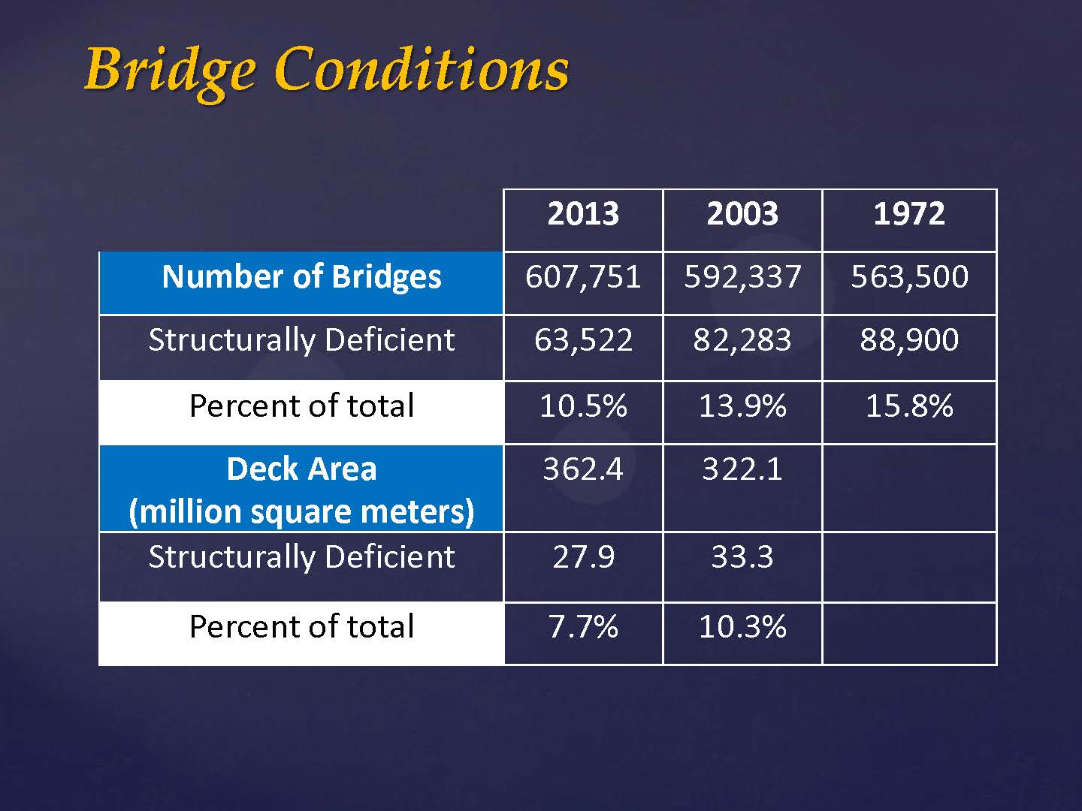

Slide 15
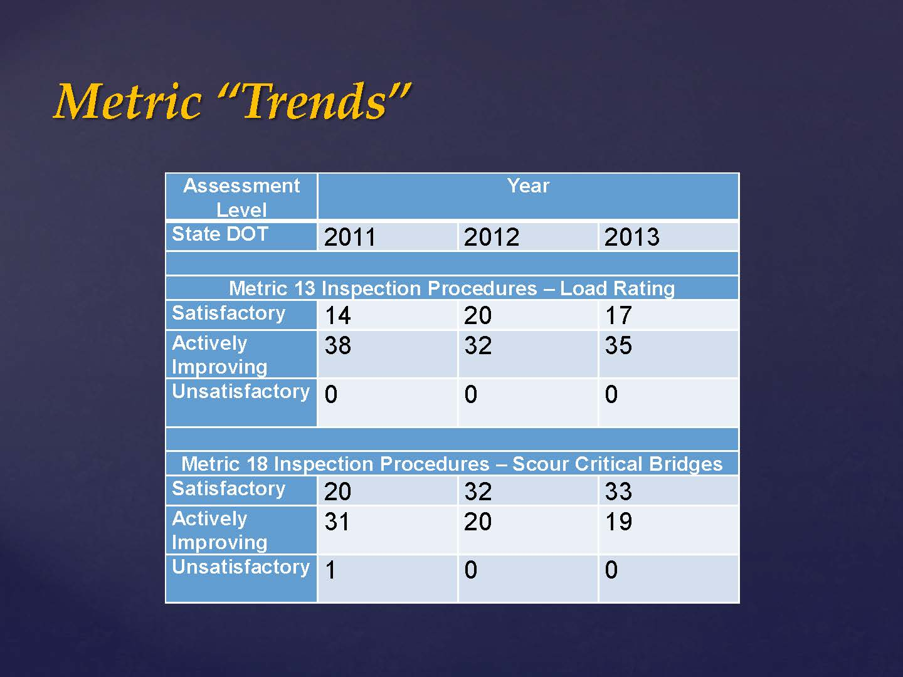

Slide 16
Northeast States Load Rating and Permitting Peer Exchange
Nine (9) Northeast States discussed ‘best practices‘ and program challenges
CT, ME, MA, NH, NJ, NY, PA, RI, and VT
Face-to-face meeting last week (Aug. 4-6)
Future videoconferences to continue dialogue

Slide 17
NESLRPPE High Priority Issues
LRFR vs. LRF
Load Testing
Load Rating Practices and Procedures
Rating for SHVs
Rating for Overloads and Other unique vehicles
Bridge Posting and Closure Procedures
QC/QA
Truss Bridge and Gusset Plate Evaluation
Policy interpretation – ‘Assigned Ratings’ and ‘Engineering Judgment’

Slide 18
LRFR vs. LRF
Operationally, what are the effects of LRFR evaluations versus LFR evaluations?
Do we need to post more bridges if we use LRFR?
Are we more restrictive in issuing permits with one method versus the other?
Developing and maintaining two sets of State-specific guidelines

Slide 19
Load Testing
Many States interested in determining if load testing is viable solution to avoid load posting
Share load test reports and activities with participating States

Slide 20
Specific Load Rating Practices and Procedures
Dynamic load allowance
Composite action of non-composite steel beams
When to use refined analysis
Need: Expanded guidance for use of refined analysis to improve load ratings
Best Practices: MA Load Rating Request Form and Color-coded Rating Reports, and ME procedure to ‘Close-the-loop’ with the bridge inspector

Slide 21
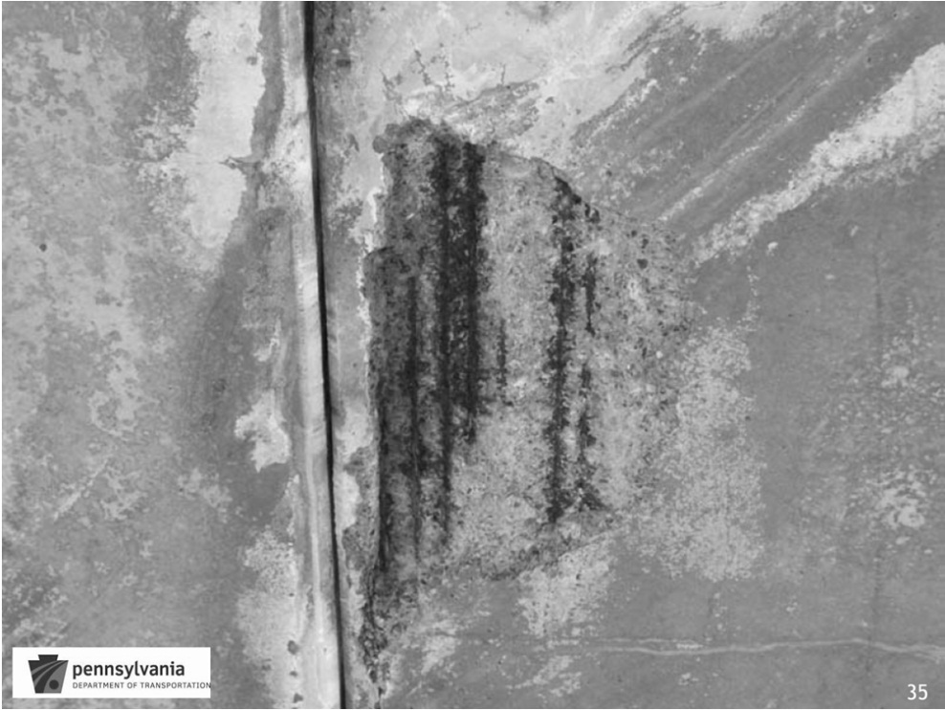
PA Procedure to Evaluate Bridges with Corroded Prestressing Strands

Slide 22
Rating for SHVs and Overloads
A number of States conducting parametric studies to evaluate the effects of SHVs
Several States indicate mobile cranes are larger and are not properly acquiring permits
Material Transfer Vehicles operating within construction zones
Permits often handled by separate office that may not coordinate routinely with load rating staff

Slide 23
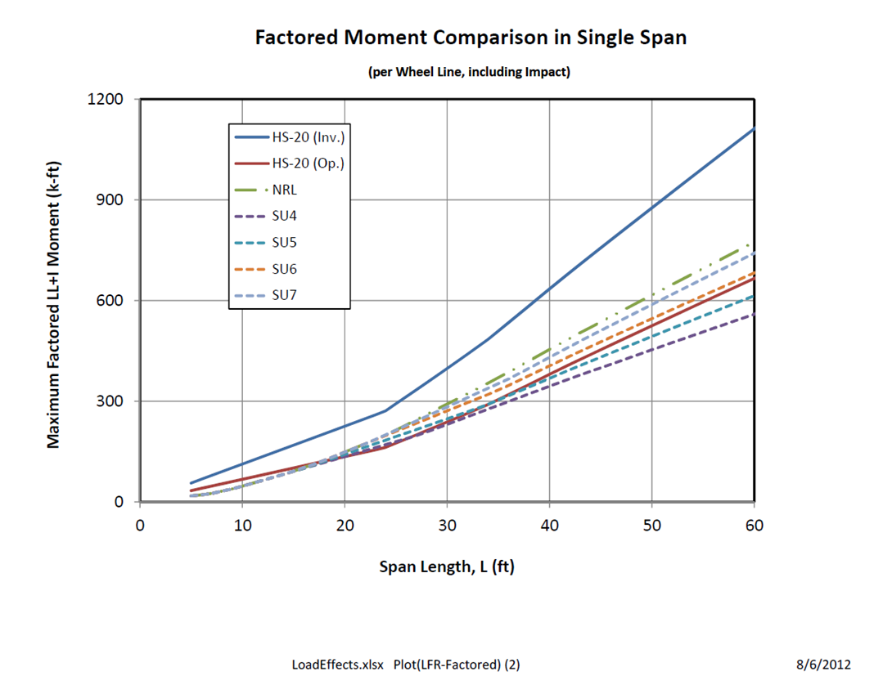
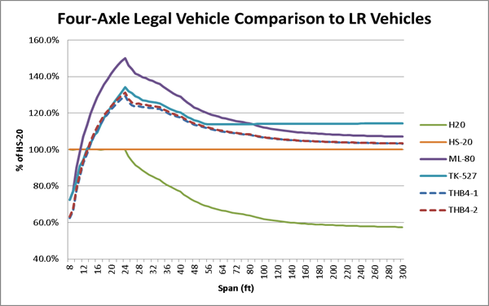
Parametric Studies

Slide 24

Mobile Cranes up to 160,000 lbs.

Slide 25
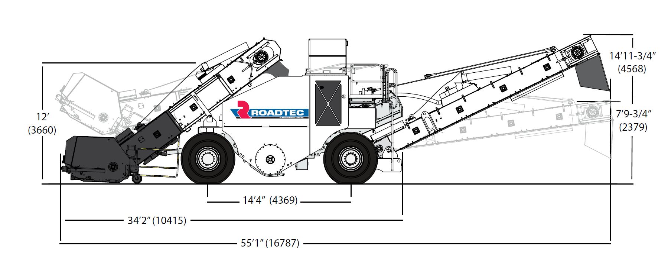
Material Transfer Vehicles
(62 kip axles when loaded with asphalt)

Slide 26
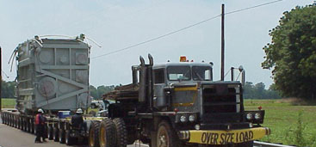
Increase in Number of Superloads/Routing Analyses

Slide 27
Bridge Posting and Closure Process
Best Practice: Bridge closure procedure in NH
  Timelines
  Coordination among numerous offices
  Public notice
  Method to close bridge
Best Practice: Bridge Posting Committee in ME
  Involve load rating, design and operation engineers to develop posting/closing decision
  Agree on safe load posting capacity

Slide 28
Share Procedures among Northeast States in Other Priority Areas
QC/QA
  NY has ‘newly’ established comprehensive procedure
Load Rating of truss bridges and gusset plates
State-specific load rating guidelines

Slide 29
Follow-up to the Peer Exchange
Regularly scheduled videoconferences and webinars to continue dialogue among Peers
Proactive effort to share questions and challenges with colleagues
Maintain SharePoint site to collect and distribute procedures, practices and research

Slide 30

Thank you!

