Slide 1
Bridge Design-Rating 2014 Administrative Overview
RADBUG Meeting
Traverse City, MI
Judy B. Skeen, P.E.

Slide 2
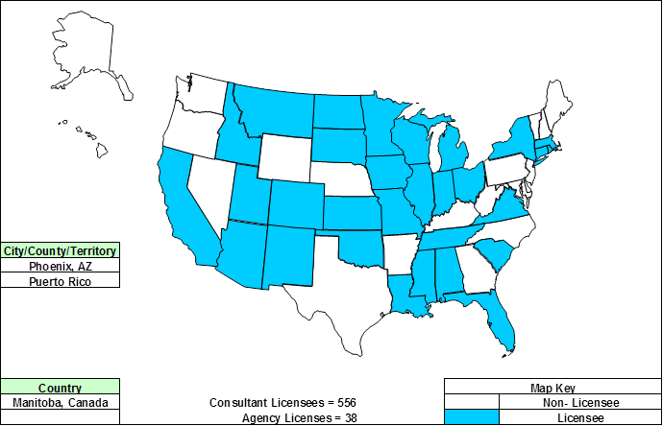
Bridge Rating Licensees

Slide 3
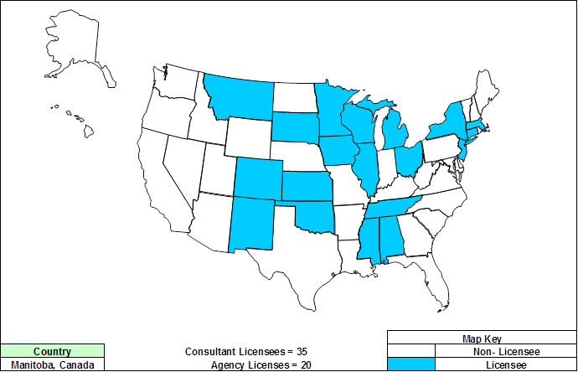
Bridge Design Licensees

Slide 4
FY2013 Bridge Design-Rating Revenue

Slide 5
FY2013 Bridge Design-Rating Revenue

Slide 6
FY2013 Expenditures

Slide 7
FY2014 Expenditures

Slide 8
AASHTO Administrative Overhead
AASHTO Administration & Overhead
Staff salaries, benefits, and overhead
Contracted Project Manager
Proportional share of SCOJD, T&AA and indirect costs
Legal Services
Technical and Applications Architecture Task Force
Technical resource for SCOJD and product task forces
Develop and maintain software standards and perform QA Reviews

Slide 9
Why Use AASHTOWare?
Incorporates “best practices”
Users share solutions and costs
License fees cover overall expenses ensure software products are kept current with technology and functional requirements
Each product is self-supporting
Non-profit operation
Management and oversight by agency (DOT) personnel
AASHTO staff project management/assistance
Notes:
The AASHTOWare Program offers member agencies a number of unique advantages over custom or commercially available solutions including:
The incorporation of best practices; both thru the design and development of software based on AASHTO specifications and the fact that task force direction comes about through the formation of consensus
Because the program is operated on not-for-profit basis, our sole focus is on satisfying the membership’s needs and priorities
– there is no other motivation for operating the program–
license fees are set to cover expenses– and products are supported, maintained and enhanced to keep products current with functional requirements and technology– as long as their is

Slide 10
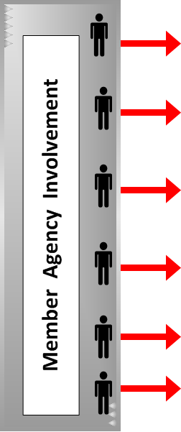
AASHTOWare Program Management
Notes:
Board of Directors & Executive Committee Meet Twice a Year… Establishes and revises policies governing the Cooperative Computer Development Program as called for within and consistent with this Administrative Resolution and AASHTO's Governing Documents.
Approves the creation of projects and products and the revenue and expenditure budgets of the activities within this Program as part of its overall budget approval role. Approves the appointment by the AASHTO President of the members of the Special Committee on Joint Development.
Special Committee on Joint Development provides management oversight of AASHTOWare Program & Products. The SCOJD studies all policy issues and topics with respect to the AASHTOWare program in consultation with all active product and project task forces and brings recommendations before the AASHTO Board of Directors and Executive Committee for action, as appropriate.
They review and approve all procedural documents, manuals and other guidelines pertaining to the process and management of the AASHTOWare program
Include in their charge is the approval of appointments [and removal] of Product and Project Task Force members as necessary and the designation of chairpersons. They review project proposals and authorize solicitation of membership for participation and funding for AASHTOWare projects; and, establish advisory and user groups when appropriate on the recommendation of the product and/or project task forces
A full-time AASHTOWare Project Manager is retained to coordinate product/project activities, and fulfill contract administration and project management functions.
As authorized by the executive director, the project manager leads/participates in contract negotiations and revisions; oversees invoices, payments, and other financial transactions; coordinates software development activities with other AASHTO committees; promotes awareness of the product capabilities and gathers potential enhancements for the products; and assists the task force in related matters as needed.
The Task Force provides the day to day management of the product. They guide software support and development services performed by contractors, determine the functionality to be included in enhancements; they oversee the development and execution of the annual work plans, including the associated budget, for the product and work with SCOJD to improve the overall AASHTOWare program.
The task force typically are comprised of 7 to 9 representatives from the agencies and serve on a rotating basis; they represent expertise in functional areas as well as IT. Included with their many duties, the task forces are responsible for (1) long range product direction, (2) annual consultant contracts, (3) quality assurance and control, and (4) responding to questions from users. The task force also determines the appropriate software platforms needed to meet the overall needs of the participating agencies and review and approve product releases. A typical member is a long-term or high-level administrator or user and has been active in the User Group for several years.
The Task Forces are oftentimes assisted by Technical Advisory Groups which provide subject matter expertise in defining functionality and software requirements and fulfill a variety of other roles; the TAG’s also oftentimes perform detailed reviews of beta code and make recommendations to the task force on approval of deliverables and product releases.
The Technical Advisory Group(s)s are appointed by the Task Force and assist the Task Force in working with contractor in development of new product/enhancement(s). Their composition and the number of members setting on the TAG are based upon need; the members are users familiar with the product/functions and are usually from agencies contributing funding. Their duties/business is generally conducted by e-mail, conference calls, and [sometimes] face-to-face meeting as required; typically, the TAG is chaired by a Task Force member.
User Groups are independent organizations with their own Constitution and/or Bylaws. The User Group represents member department’s interest in the product, and provides advice and recommendations on the product’s (1) effectiveness, (2) deficiencies, and (3) any needed product enhancements.
The User Group also recommends product training and support needs, details and recommends prioritized maintenance, enhancement, and support needs. The outcomes of the User Group are submitted to the Task Force as recommendations and helps for the basis for the upcoming fiscal year’s work plan.

Slide 11
AASHTOWare Capitalization
5% of Revenues
Governed and controlled by AASHTO Executive Committee
Covers risks associate with software development
Seed money for new projects
Legal expenses associated with patenting and third-party testing
National Transportation Marketing Campaign (Federal Transportation Bill)
AASHTOWare Rebranding / Marketing
Research

Slide 12
AASHTOWare Branding and TradeMarks

Slide 13
Brand Identity
AASHTOWare Branding and Trademark Guidelines ensure the strength of our brand
Internal Communication –
Task Force Meeting discussion
Task Force / Licensee Emails
SharePoint workspace folders and files
Internal presentations at Task Force and User Group Meetings
User Group websites, etc.

Slide 14
Brand Identity
External Communication – communication to groups outside the AASHTOWare community, including other AASHTO committees, AASHTO member agencies and the public
Presentations
Advertisements
Product Brochures
Product Newsletters
AASHTOWare Websites, etc.

Slide 15
Brand Identity - Naming
Full Name (External)
AASHTOWare Bridge Design & RatingTM
Abbreviated Name (Internal only)
BrDR
If the product name is used repeatedly, the full name should be presented every time.

Slide 16
AASHTOWare Service Units
A Brief Overview

Slide 17
AASHTOWare Service Units
Agencies can gain convenient access to services provided by the AASHTOWare contractor via service units.
AASHTO serves as facilitator by accepting the commitment for contractor-provided services, invoicing and receiving payment from the agency and forwarding the order to the contractor for the appropriate number of service units.
AASHTO makes payment for services rendered to the contractor following agency approval of the invoice.
Service units remaining at the conclusion of a fiscal year are carried forward into the next fiscal year.

Slide 18
AASHTOWare Service Units
Service units are intended to provide consultation and support to incorporate functional enhancements or to assist the licensee in the implementation of AASHTOWare products.

Slide 19
Service Unit – Example Activities
Service Unit work by the contractor may include the following types of activities:
Adding new agency-specific features to the system
Developing custom reports
Providing specialized training in the use of AASHTOWare products
Updating prior releases of product databases

Slide 20
Service Unit – Example Activities
Supporting common software enhancements unfunded through product licensing fees that will become part of the code base and will be supported by Maintenance, Support and Enhancement (MSE) costs
Incorporating analytical or specification engines into AASHTOWare products
Funding software development projects / solicitations

Slide 21
Use of Service Units
The example activities outlined previously may require more than one Service Unit each, depending on the specific agency requirements.
Service Units may not be used to provide reimbursement for travel expenses by agency personnel.
Service Units should not be used for work involving major new software development by member agencies.
Service Units may be converted to provide additional enhancement funding under the guidance of the Task Force.

Slide 22
Fee for Service Units
Service Units can be ordered in unit increments of $11,600 (this fee includes AASHTO administrative costs).
Service Units must be paid upon receipt of the invoice.
Each service unit provides $10,000 in routine contractor services.

Slide 23
Service Units Fee Distribution
86.2 |  | the percentage directly allocated to the software service provider
8.8 |  | the used to offset AASHTO internal administrative costs staff salaries, benefits, and overhead contracted project manager proportional share of SCOJD, T&AA and indirect costs legal services
5.0 |  | the percentage dedicated to support the Cooperative Development Capitalization Fund as required by governing policy approved by the Board of Directors covers risks associate with software development provides seed money for new projects funds expenses associated with patenting and third-party testing supports product branding / marketing initiatives

Slide 24
Service Unit Process
Partnership between requesting agency, Task Force and contractor.
Task Force ‘weighs in’ and approves, ensuring contractor resources are available with no detrimental impact to software development efforts.
Analyze opportunities for collaboration between agencies and Task Force product work plans.

Slide 25
Thank You
Questions?

