Slide 1
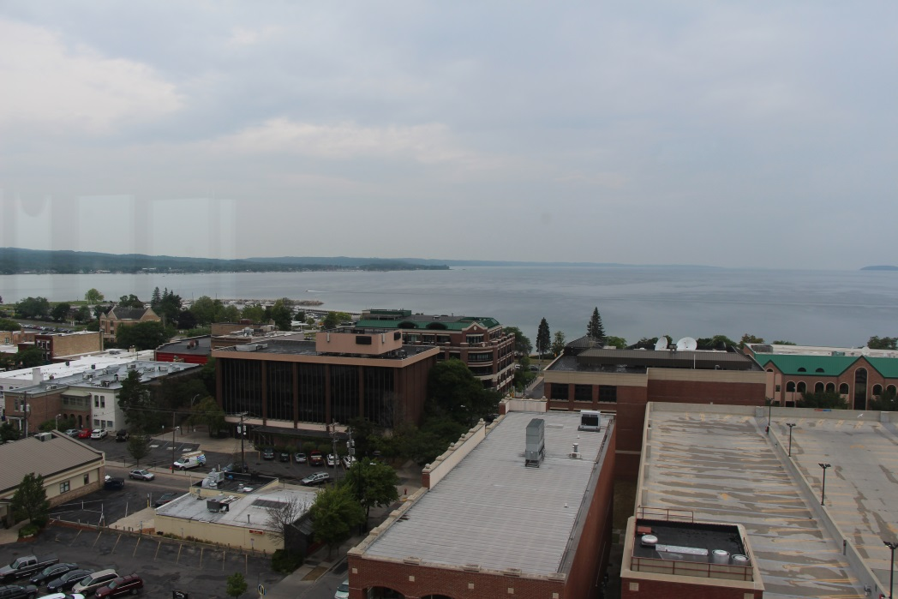
AASHTOWare Bridge Technical Update
AASHTOWare Bridge Rating/Design
User Group Training Meeting
Traverse City – August 2014

Slide 2
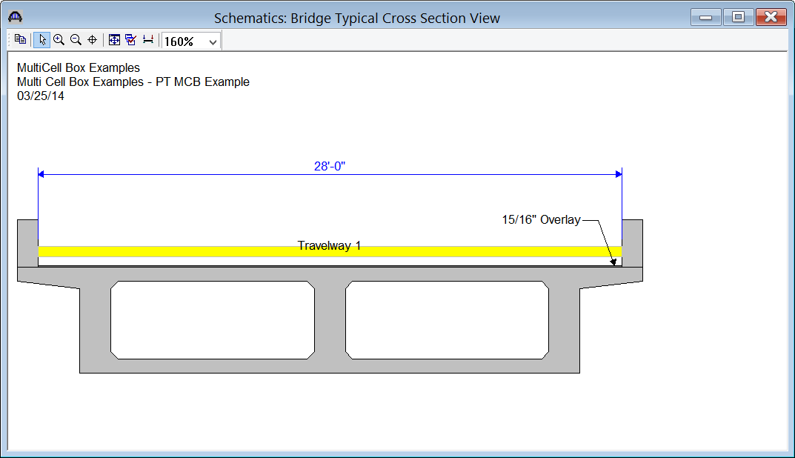
6.6 New Feature – Multi-cell Boxes
Post-tensioned and Reinforced Concrete Multi-cell Box LRFR Rating

Slide 3
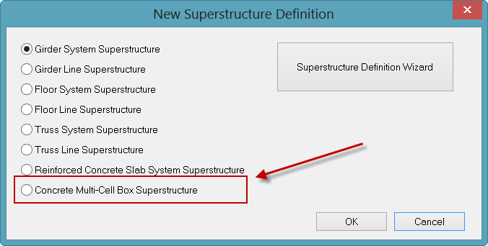
Multi-cell Boxes
Implemented as one new superstructure definition

Slide 4
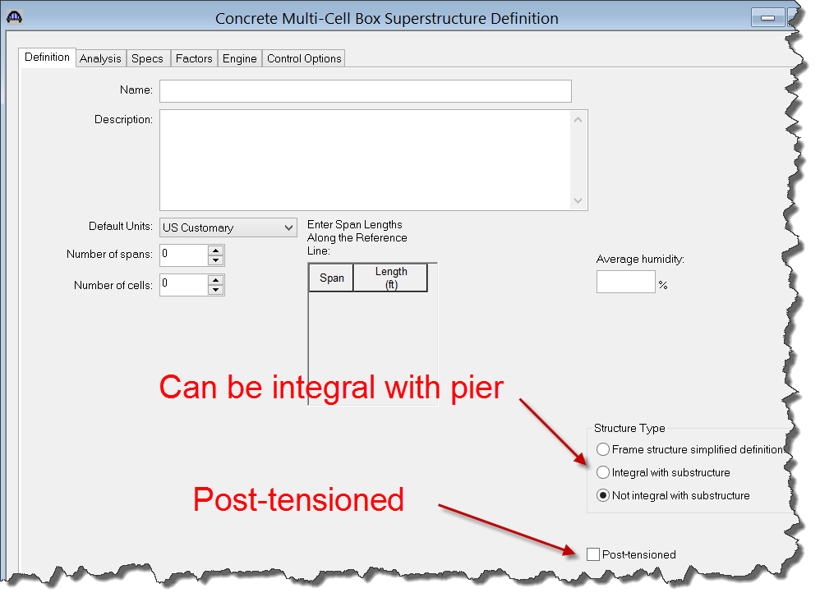
Multi-cell Boxes
Specify integral and post-tensioned

Slide 5
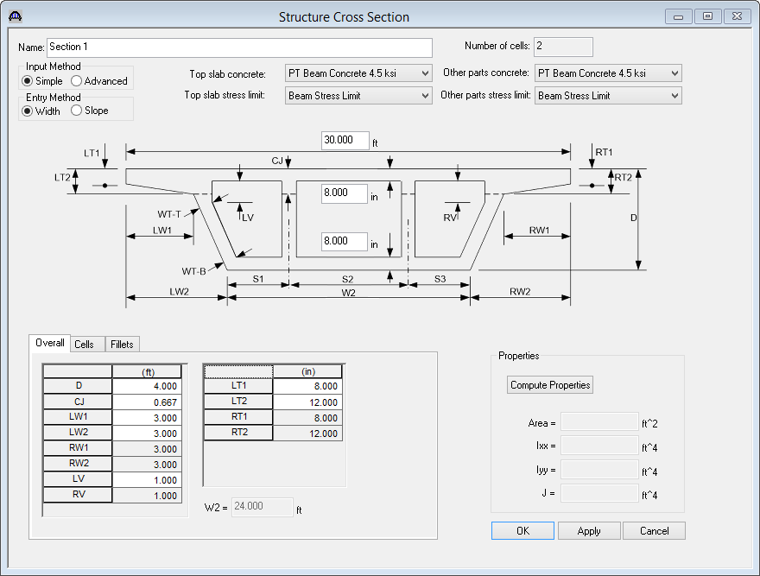
Multi-cell Boxes
Cross Section Based Dimensions

Slide 6
Multi-cell Boxes
Cross Section Flexibility

Slide 7
Multi-cell Boxes
Cross Section Flexibility

Slide 8
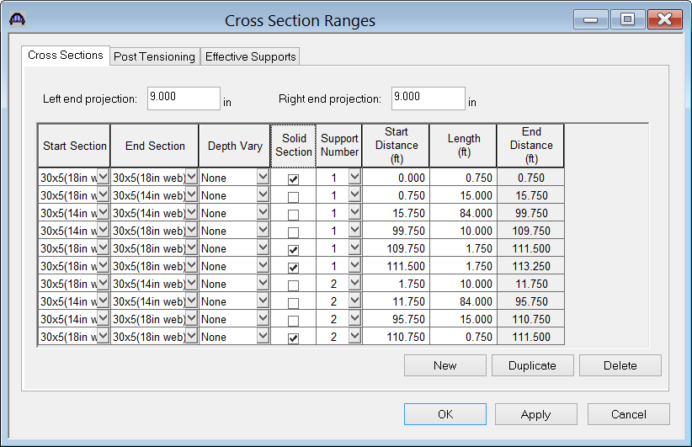
Multi-cell Boxes
Cross Section Ranges

Slide 9
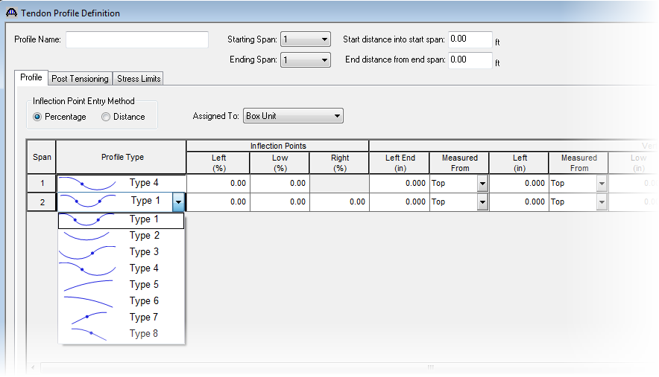
Multi-cell Boxes
Schedule-Based Tendon Profile
Select profile types for each segment

Slide 10
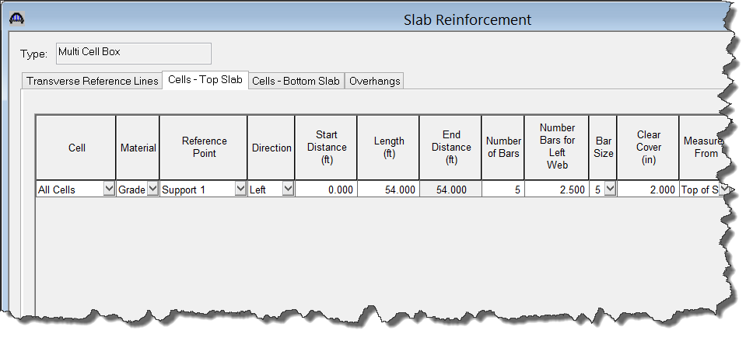
Multi-cell Boxes
Longitudinal Reinforcement - Schedule-based
Relative to a support line or mid-span
Relative to a user-defined transverse reference line

Slide 11
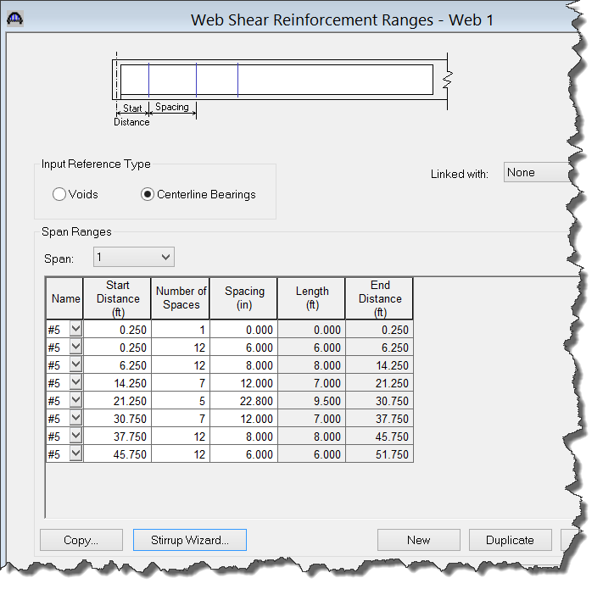
Multi-cell Boxes
Shear Reinforcement - Schedule-based

Slide 12
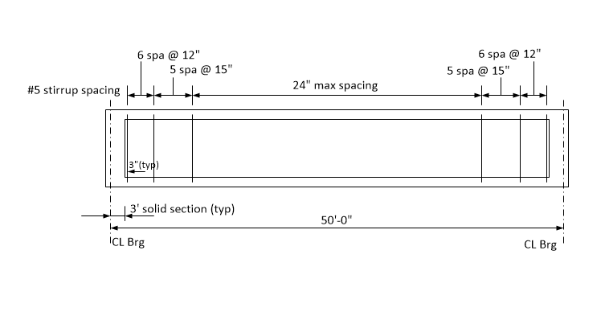
Multi-cell Boxes
Shear Reinforcement Wizard

Slide 13
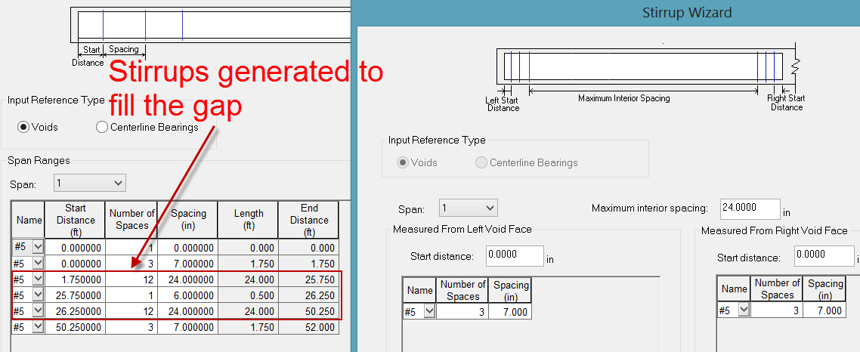
Multi-cell Boxes
Shear Reinforcement Wizard

Slide 14
Multi-cell Boxes
Data Input Method Summary:
Beam cross section - Cross-section based with sections applied to ranges
Tendon profile - Schedule-based
Longitudinal Reinforcement - Schedule-based
Shear reinforcement - Schedule-based

Slide 15
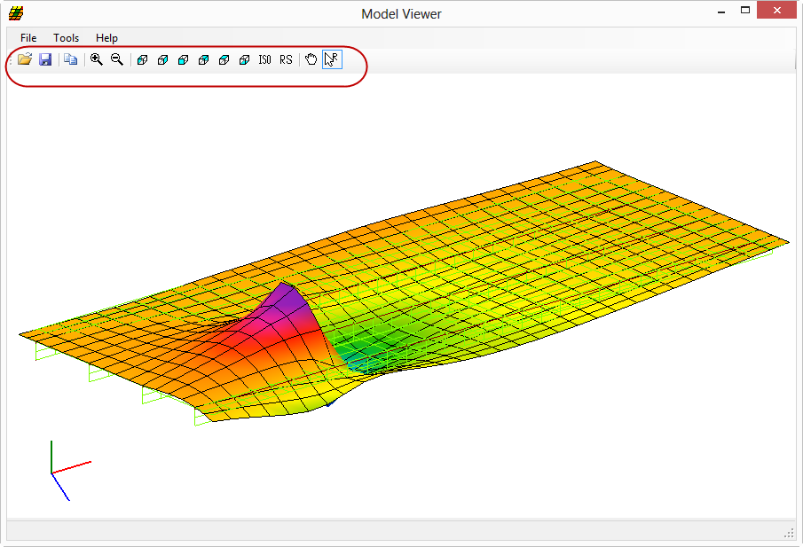
6.6 New Feature – Adjacent Vehicle
Permit Analysis with Adjacent Lane Traffic
Distribution factor approach
Multi-girder system
Truss
3D analysis
Straight multi-girder system

Slide 16
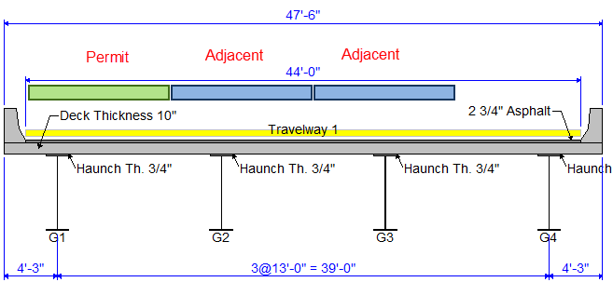
Adjacent Vehicle
Permit Analysis with Adjacent Lane Traffic
DFadjacent = DFmulti-lane - DFsingle-lane
DFpermit = DFsingle-lane
RF = (C – DL – LLadj) / LLpermit
Live load distribution factor approach in LRFD Article 4.6.2.2.5

Slide 17
Adjacent Vehicle
Permit Analysis with Adjacent Lane Traffic
3D Analysis Option (Multi-girder system only)
Load one lane with permit vehicle
Load other lanes with the adjacent vehicle
Evaluate all combinations of lane placements

Slide 18
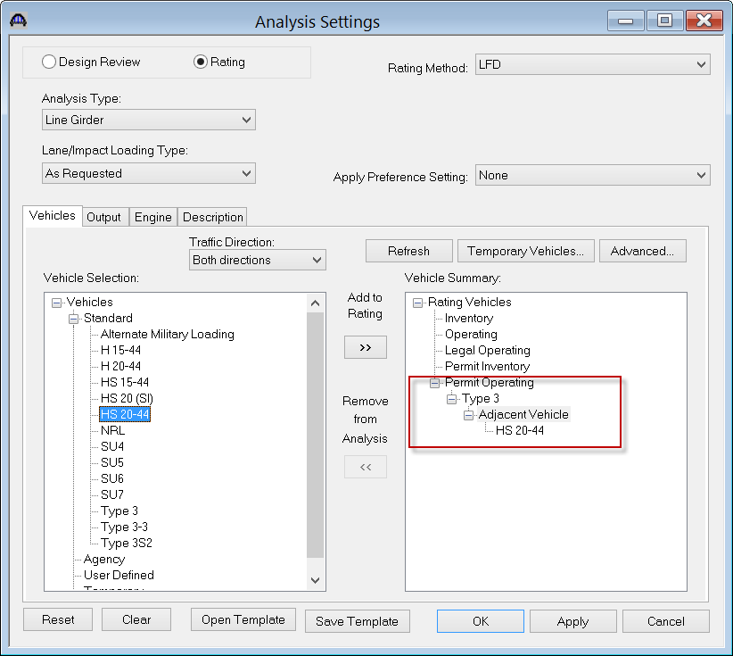
Adjacent Vehicle
Permit Analysis with Adjacent Lane Traffic
Select a Line Girder analysis
Select a permit vehicle and the adjacent vehicle

Slide 19
6.6 New Feature – Cont. for LL
Steel Girder Superstructure Continuous for Live Load Rating

Slide 20
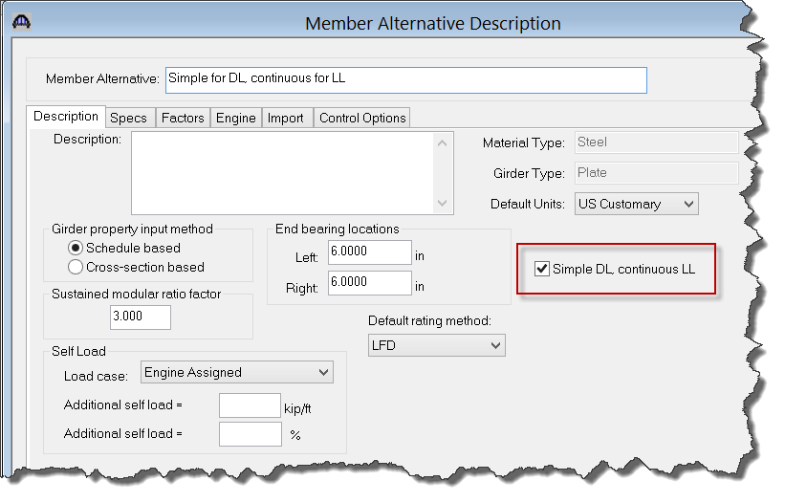
Continuous for Live Load
Steel Girder Superstructure Continuous for Live Load Rating

Slide 21
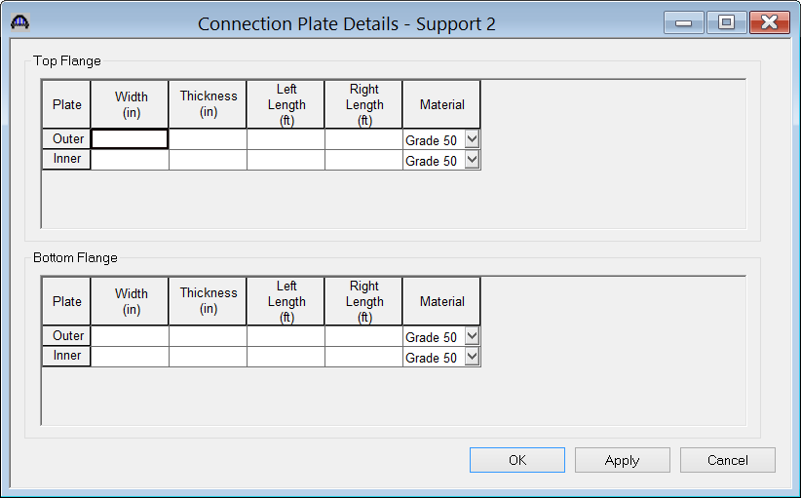
Continuous for Live Load
Steel Girder Superstructure Continuous for Live Load Rating

Slide 22
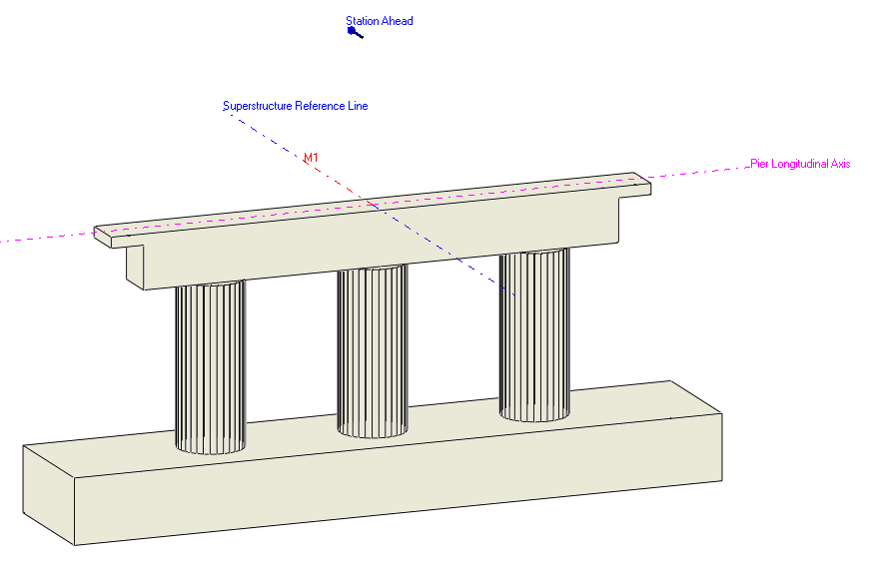
6.6 New Feature – Integral Pier
Integral Pier is implemented for:
Concrete Multi-cell Boxes
R/C Slab Systems

Slide 23
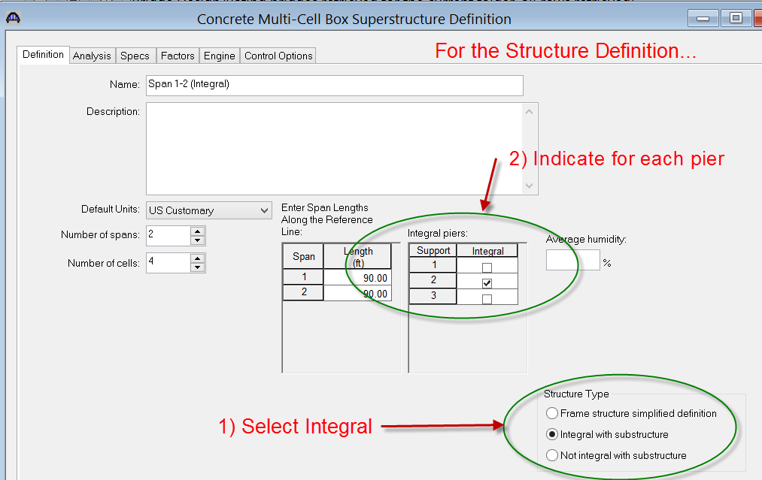
Integral Pier

Slide 24
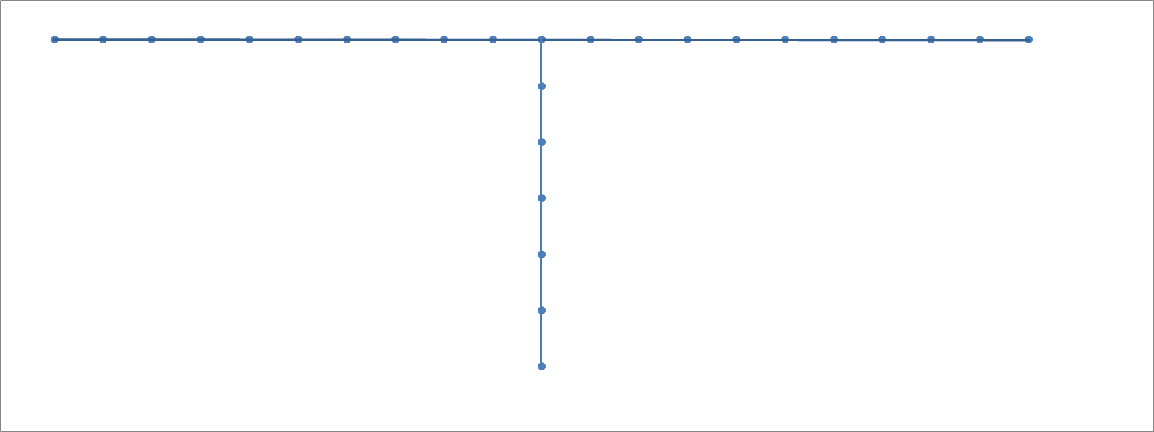
Integral Pier
The piers are modeled with beam elements that account for the stiffness of the pier

Slide 25
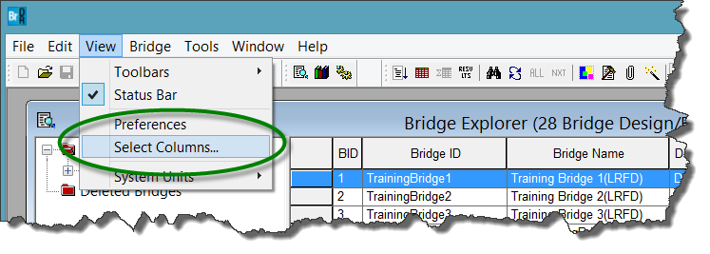
6.6 New Feature – Bridge Explorer
Bridge Explorer Customization
Add user-defined fields
Enable/Disable columns
Specify the order of columns

Slide 26
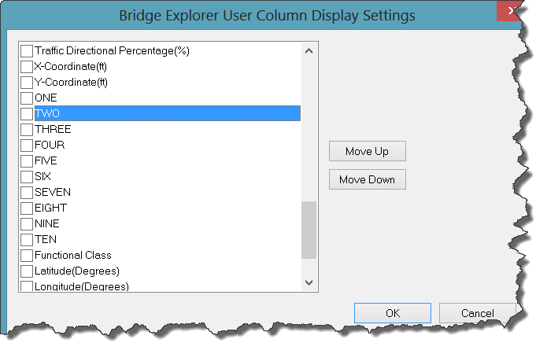
Bridge Explorer Customization

Slide 27
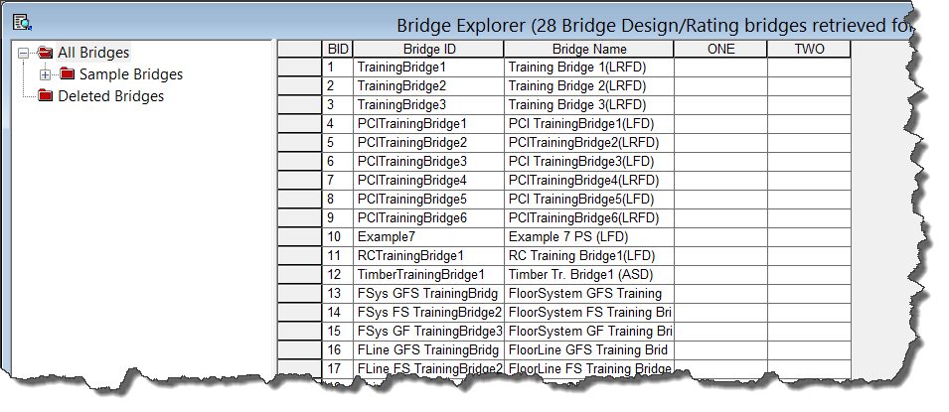
Bridge Explorer Customization

Slide 28
6.6 New Feature – Reuse FE Results
3D FE Analysis Results
Dead Load Analysis Results
Influence surfaces
If the model hasn’t changed since the previous analysis the results are reused.

Slide 29
Recent Significant Enhancements
Selection of Specification Version
3D Analysis, Spec-checking and Rating
R/C Culvert
Steel Curved Girder Analysis, Spec-checking and Rating
Multi-cell Box Rating

Slide 30
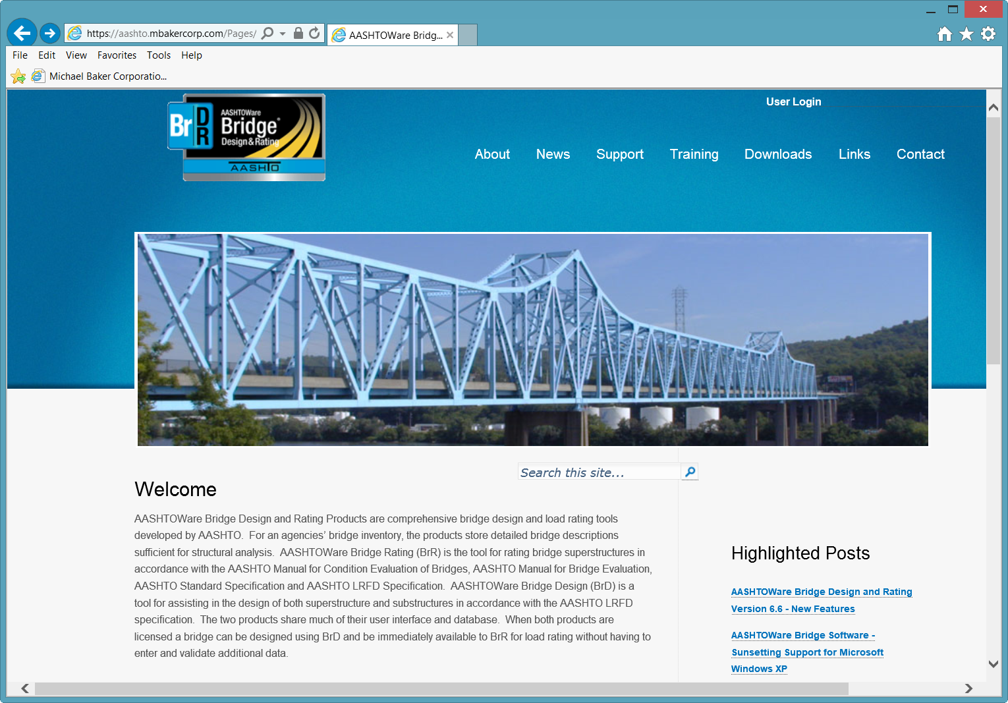
Support Site - aashto.mbakercorp.com

Slide 31
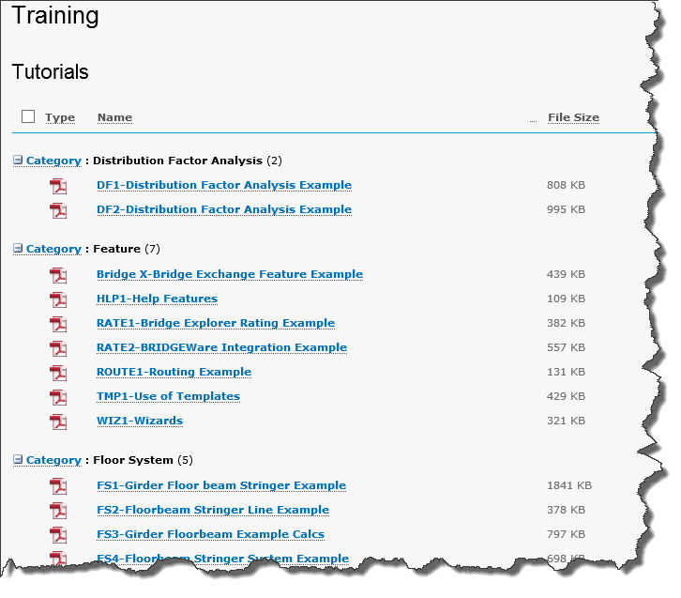
Support Site - aashto.mbakercorp.com
More than 50 tutorials

Slide 32
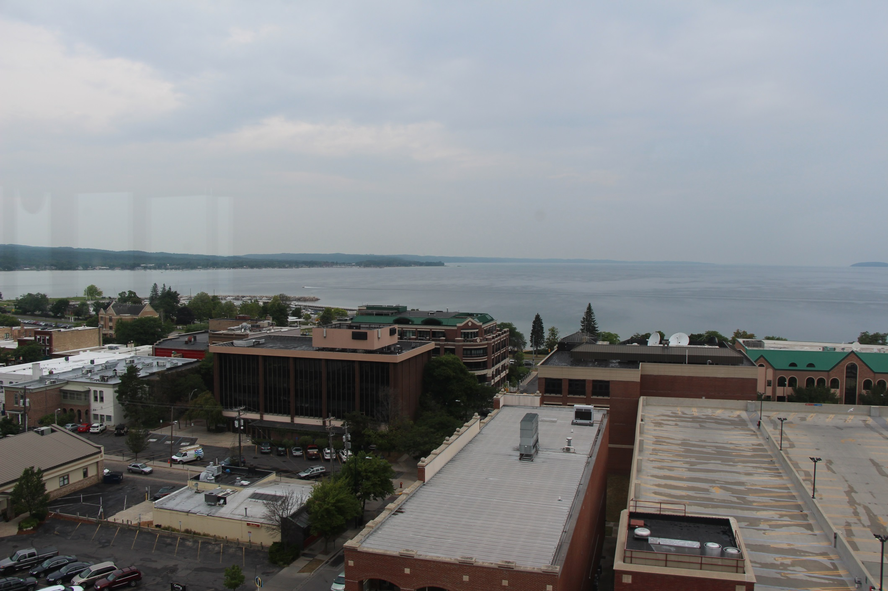
Thank you

Slide 33
AASHTOWare Bridge Technical Update
AASHTOWare Bridge Rating/Design
User Group Training Meeting
Traverse City – August 2014

