Slide 1
Michigan Load Rating Assistance Program
Helping Local Agencies Meet Their Load Rating Requirements

Slide 2
Speakers
Creightyn McMunn, P.E.
MDOT – Load Rating Program Manager
Chris Gilbertson, Ph.D., P.E.
CTT – Senior Research Engineer

Slide 3
MDOT Load Rating Program
  2009 FHWA Audit, Final Report March 2010
    US DOT OIG audit 2006
    FHWA division Offices directed to perform in-depth reviews of state load rating and posting practices

Slide 4
MDOT Load Rating Program
  Findings – Conditional Compliance
    “generally in compliance with NBIS and AASHTO requirements”
    Many MDOT bridges in the database “may not be load rated in compliance with NBIS” and “as many as 2,900 bridge load ratings must be revised”
    Many local agency bridges in the database may not be in compliance with NBIS “as many as 4,100 or more” bridge load ratings may need to be revised
    “MDOT’s oversight of local agency load rating practices is not sufficient…”

Slide 5

Load rating Prioritization List
Tier 1 – No Rating – 2012
  Nulls in load rating values
Tier 2 – Poor Condition –2014
  Deck, superstructure, substructure OR culvert ratings equal to 4 or less AND
  Deterioration indicator equals “No”

Slide 6
Load rating Prioritization List
Tier 3 – Other Irregularities – 2016
    Built after 1993 AND ASR
    Built after 2010 AND not LRFR
    NHS bridge AND ASR
    Fed Operating is greater than 3X Fed Inventory

Slide 7
Local Agency Bridges
Tier 1 – 1666 bridges
Tier 2 – 820 bridges
Tier 3 – 471 bridges

Slide 8
MDOT Load Rating Program
  Additional action
    Bridge Advisories
    Load Rating Dashboard
    AASHTOWare Bridge Rating® Super Site License
    Michigan Tech Center for Technology & Training (CTT) Contract

Slide 9
MTU-CTT Contract
  Administered in conjunction with LTAP
  Initiated in October 2011
  AASHTOWare Bridge Rating and load rating training and technical support for local agencies and consultants
  Policy issues are addressed by MDOT

Slide 10

Bridge Load Rating Program
Helping local agencies and their consultants meet their load rating requirements
Sponsored by:
Notes:
Provides training, technical support for Virtis, and engineering technical assistance
Facilitates procurement of Virtis software
Call Center open during business hours to provide one-on-one technical assistance

Slide 11
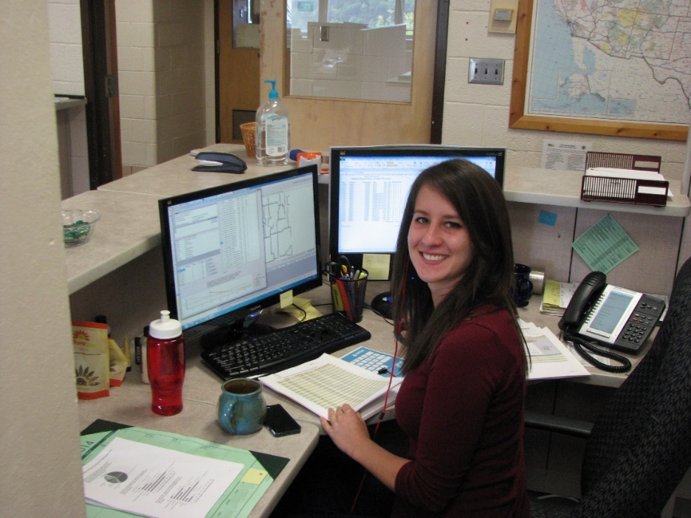
CTT History
Center for Technology
and Training at
Michigan Tech University
  Staff of Engineers, Computer Programmers, Technical Writers
  Local Technical Assistance Program (LTAP)
  Long History of Successful Training Programs for Local Agencies

Slide 12
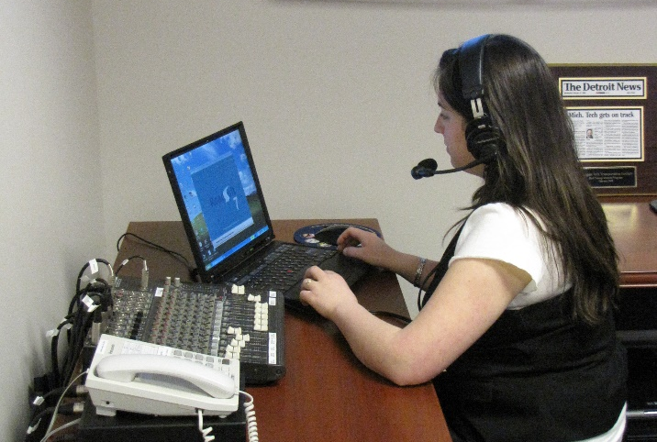
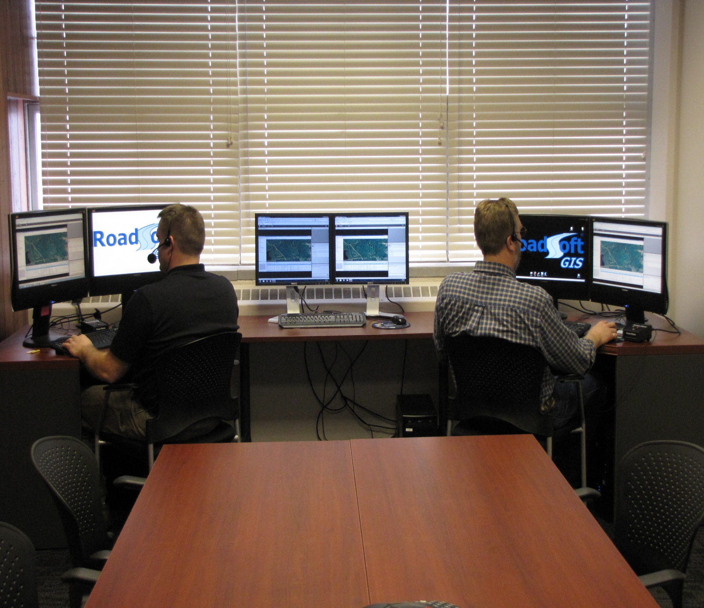
CTT Resources
Training
Professional Engineer Database
Dedicated Webinar Room
Added Structural Engineer as Additional LTAP Resource

Slide 13
Bridge load rating program
MDOT schedule prioritizes load rating into three tiers
The CTT assists local agencies with evaluating their bridges
The CTT provides software and technical support for
AASHTOWare Bridge Rating®
Support includes training webinars and classroom sessions

Slide 14
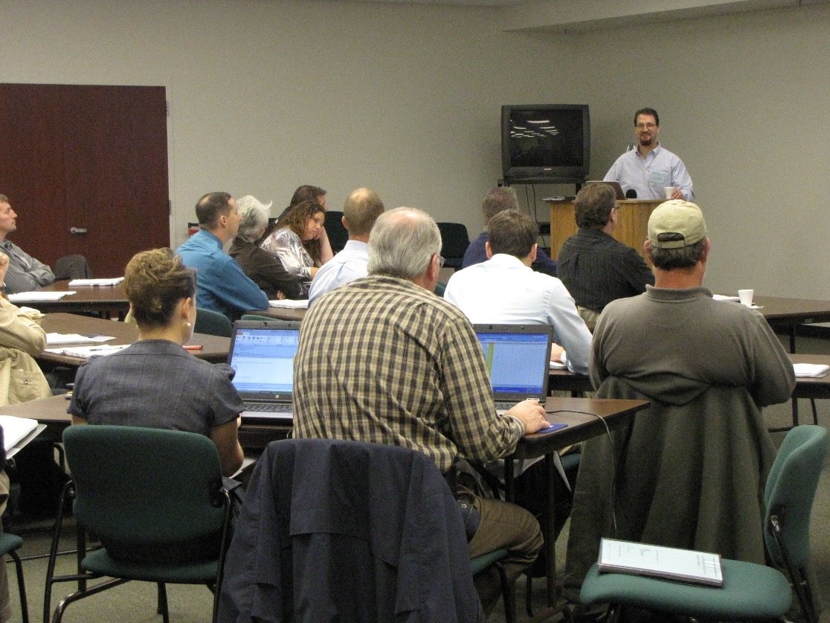
Local Agencies in Michigan
83 Counties
635 Local Agencies
Many Responsibilities
Few Resources

Slide 15
Annual license renewals
Software available through MDOT super site license
The CTT handles requests for AASHTOWare Bridge Rating®
Software is provided to local Michigan agencies and consultants for use on Michigan bridges
End Users represent 49 organizations

Slide 16
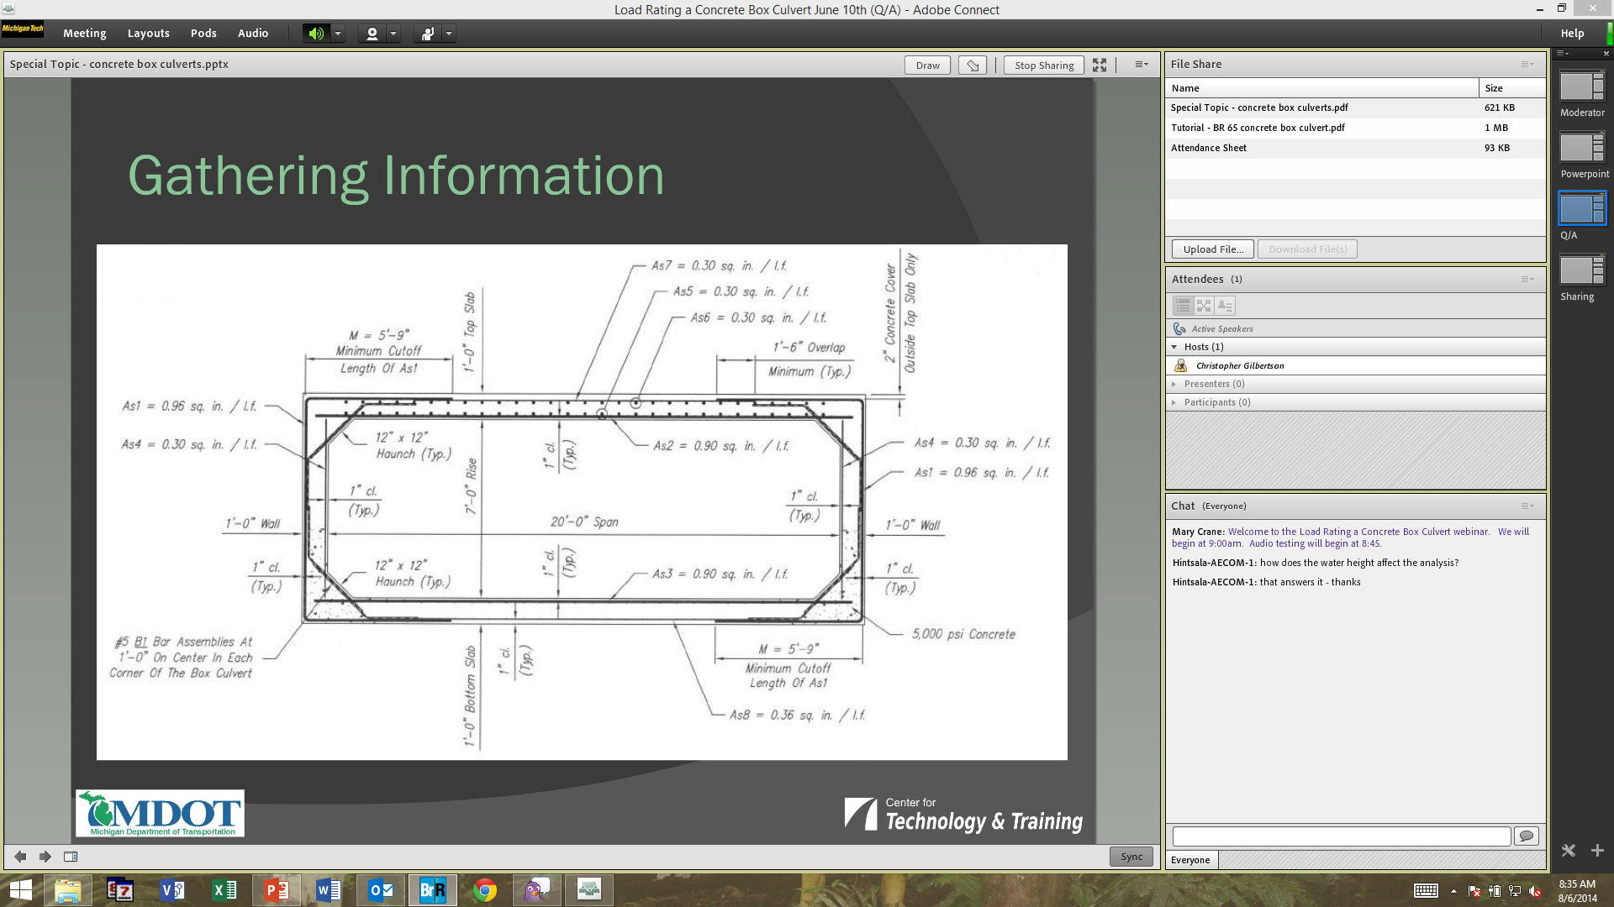
Webinars
1 to 2 hours
Typical Topics
  The Basics – From Plans to Load Rating
  Load Rating Theory & Policy
  AASHTOWare Bridge Rating Output Reports
  Load Rating a Concrete Box Culvert Webinar

Slide 17
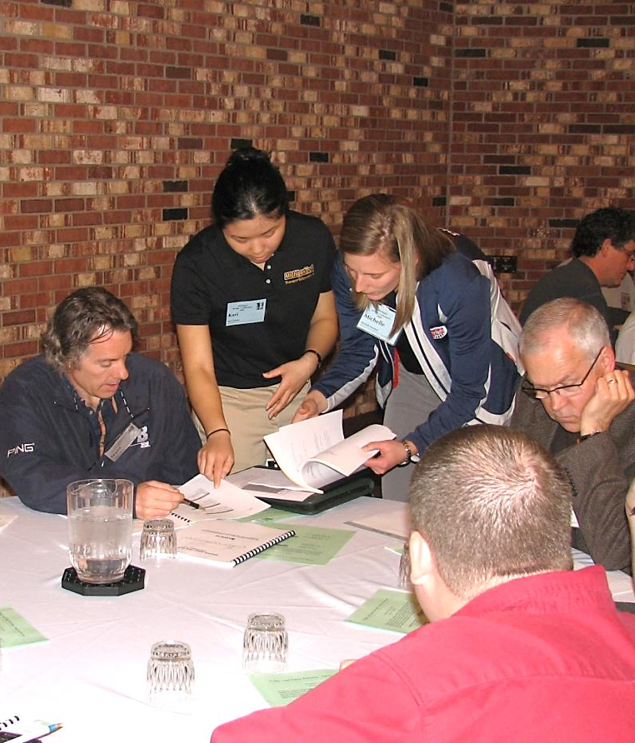
Classroom Workshop Sessions
Guided tutorials
Hands-on activities
Seating limited to 20 participants
IT assistance available
8 hours of bridge inspector recurrent training

Slide 18
Typical Workshop Agenda
Morning
  Registration and Computer Setup
  Adjacent Prestressed Box-Beam Tutorial
  Prestressed I-Beam Tutorial
Afternoon
  LFR/LRFR Rolled Steel Tutorial
  Select from Several Advanced Tutorials
    4-Span Prestressed I-Beam
    Concrete Box Culvert
    Camelback Bridge

Slide 19
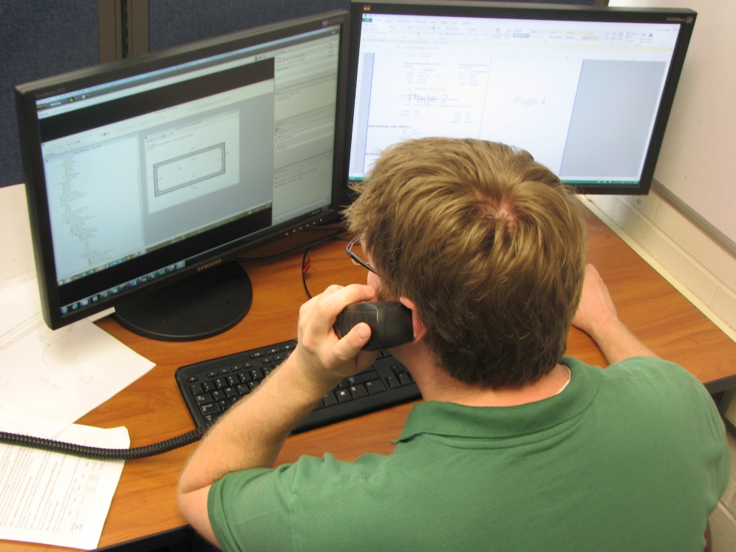
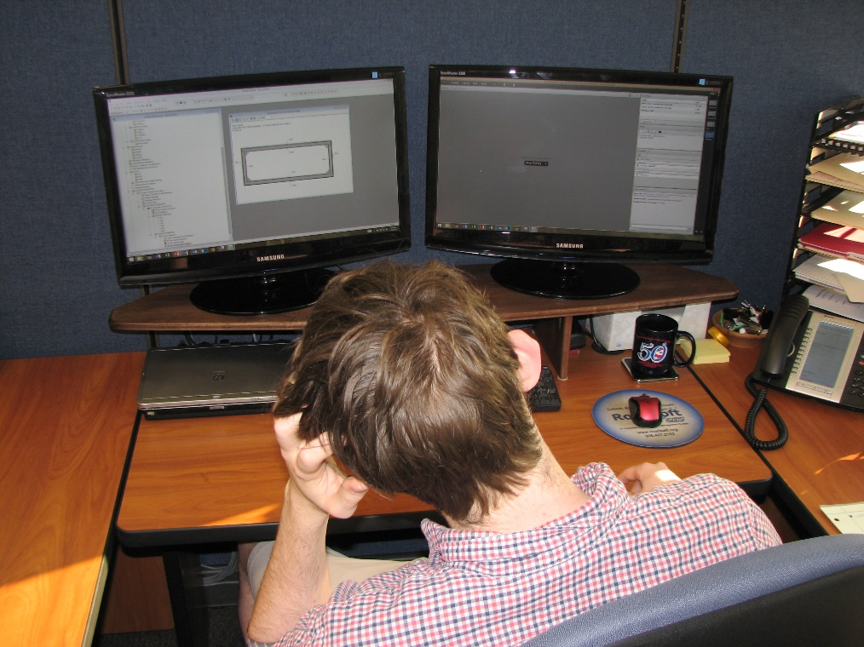
Tech Support
Help is available during business hours
  Phone
  Email
  Live using screen share

Slide 20
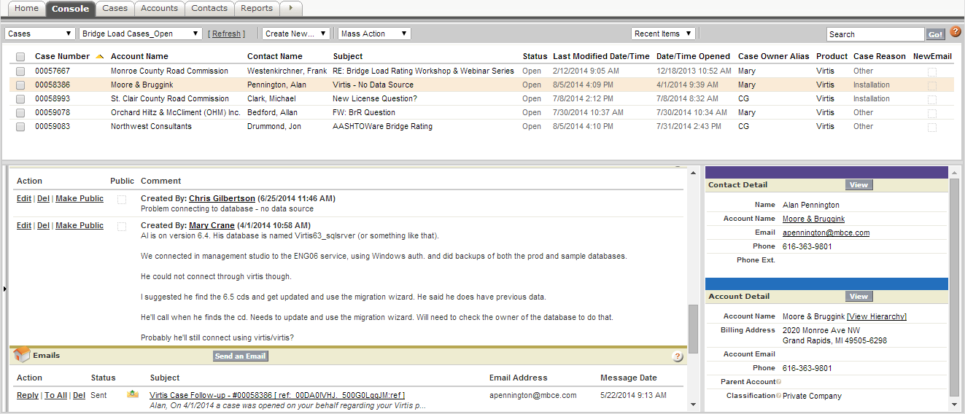
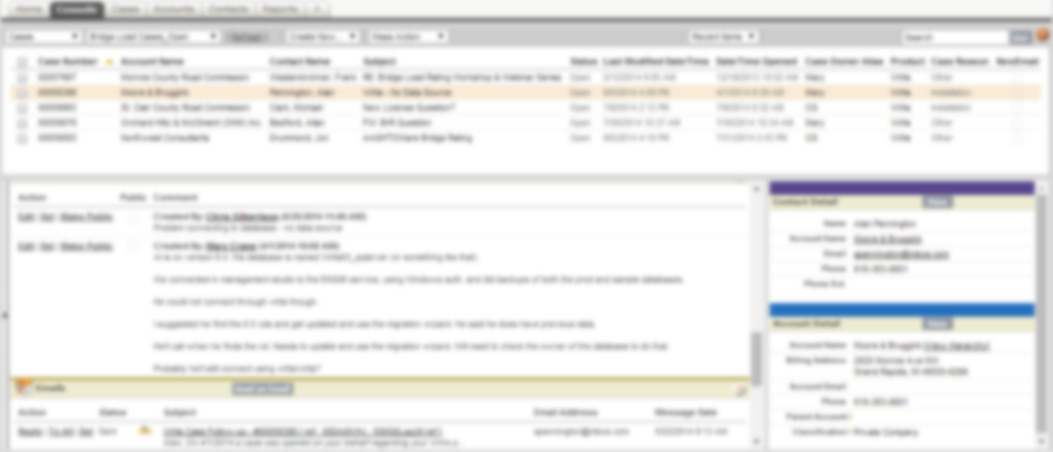

Managing tech assist cases

Slide 21
Tech Support

Slide 22
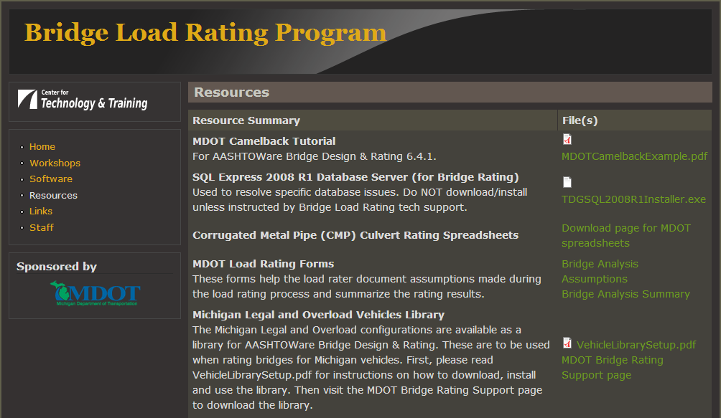
Bridge Load Rating Program Website

Slide 23
Local Bridges requiring ratings

Slide 24
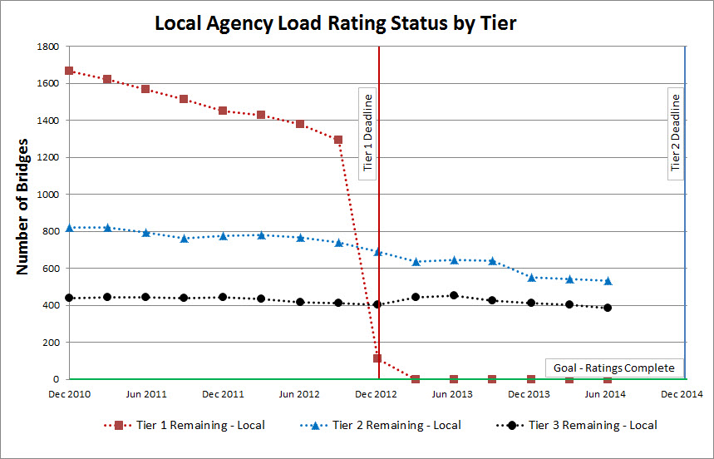
Load rating progress by local agencies

Slide 25
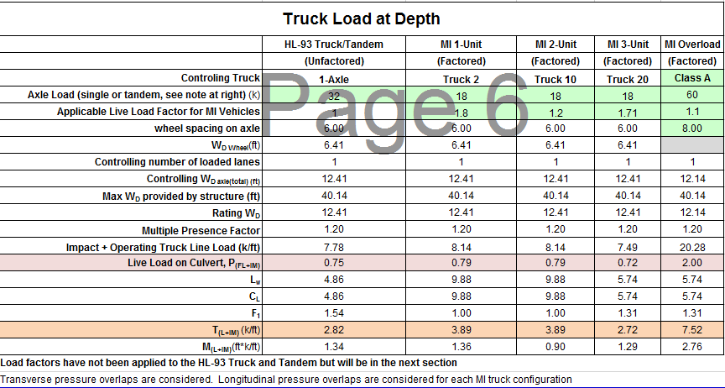
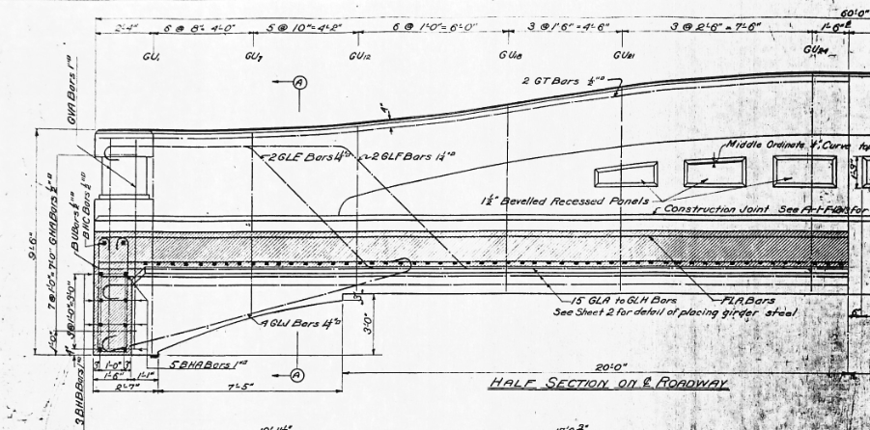
What do we do when the phone isn’t ringing?
CMP Spreadsheet
SHV Analysis
Camelback Bridge Rating Tutorial
Web Deterioration
Pin and Hanger Check
Box-Culvert Loading
H-15 Slab Analysis

