Slide 1

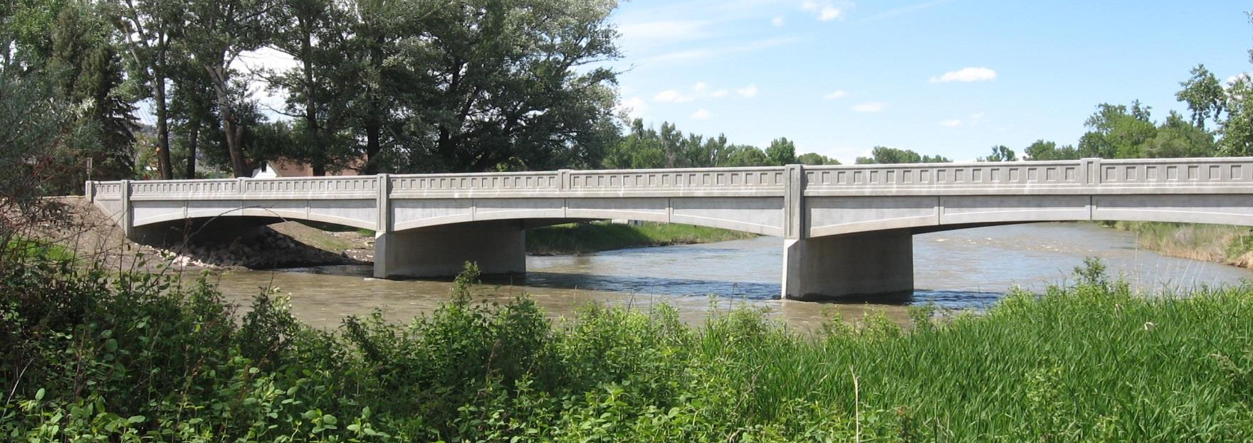
Bridge Design Implementation
Jeff Olsen, PE – MT DOT
AASHTOWare Bridge Task Force
jolsen@mt.gov

Slide 2
Montana’s Design Implementation
Previously used “In-House” programs
  Constantly updating to current AASHTO code
  Outdate language
What are our software needs?
  Prestressed Beams
  Reinforced Concrete Slabs
  Steel I-Girders
Looked at multiple programs
  PS-Beam, Conspan
  Merlin Dash, MDX
  AASHTOWare Bridge

Slide 3
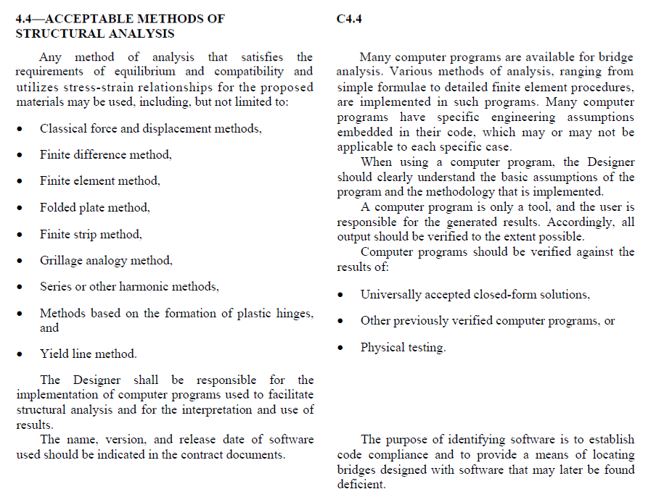
AASHTO LRFD 4.4 -
Acceptable Method of Structural Analysis

Slide 4
Advantages of AASHTOWare Bridge Design
One program is able to model majority of our new bridge types
AASHTO Spec-Checker and Spec Check Summary
Designer can select the spec version – updated yearly
Can build multiple alternates
3D Analysis and Steel Curved Girder
Ability to provide load rating with the same model
Bridge model is passed on to Bridge Management Section
State owned software
  We have a voice in the development
  Can add state specific features thru service units
New upcoming design tools

Slide 5
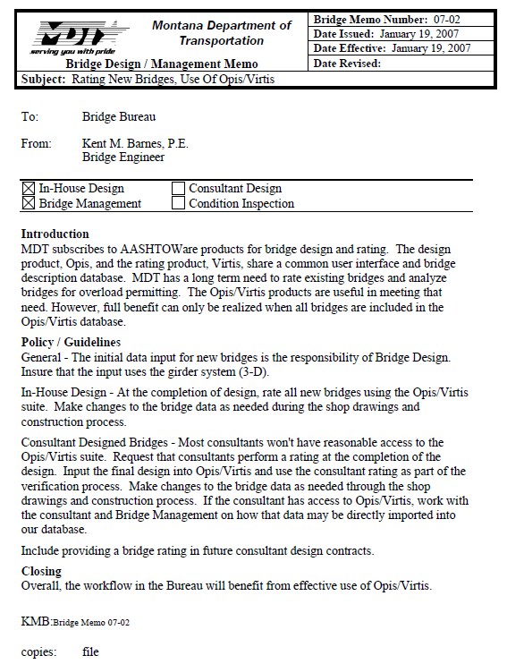


Design Policy

Slide 6
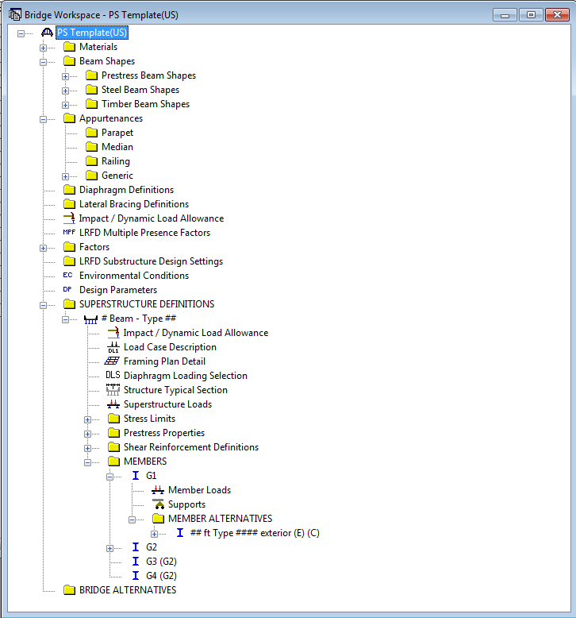
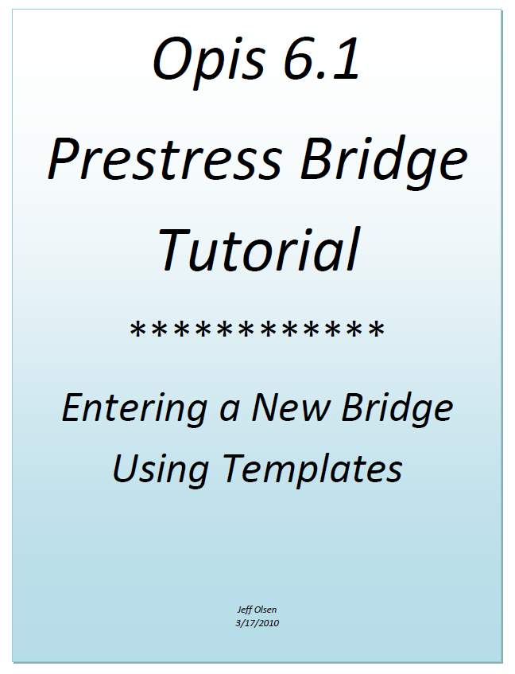
Helpers
Prestress Design Templates and Tutorial

Slide 7
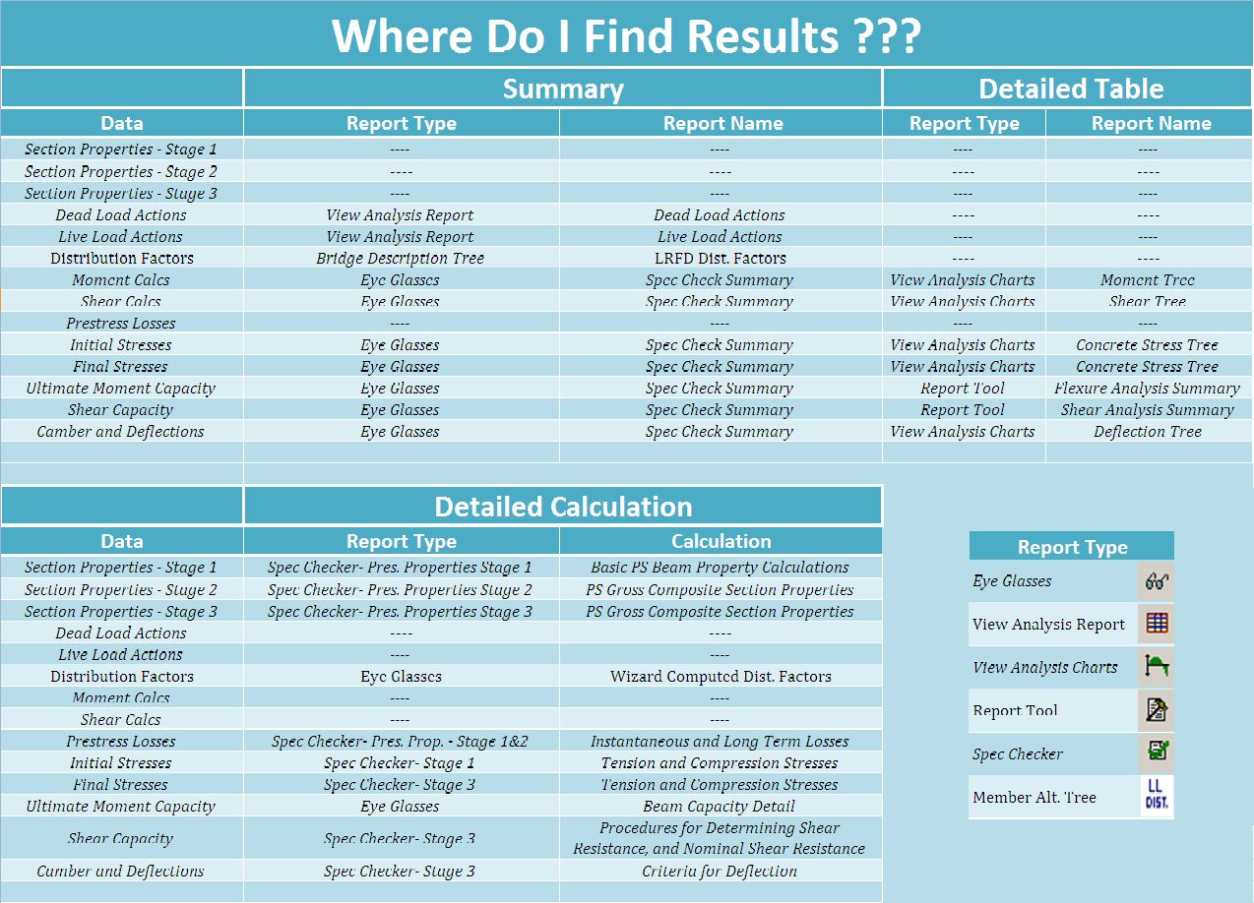
Helpers Report Location Summary

Slide 8
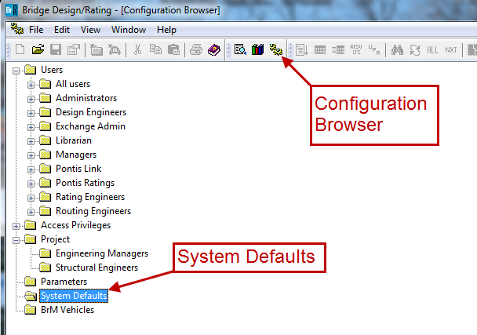
Customizing Bridge Explorer

Slide 9
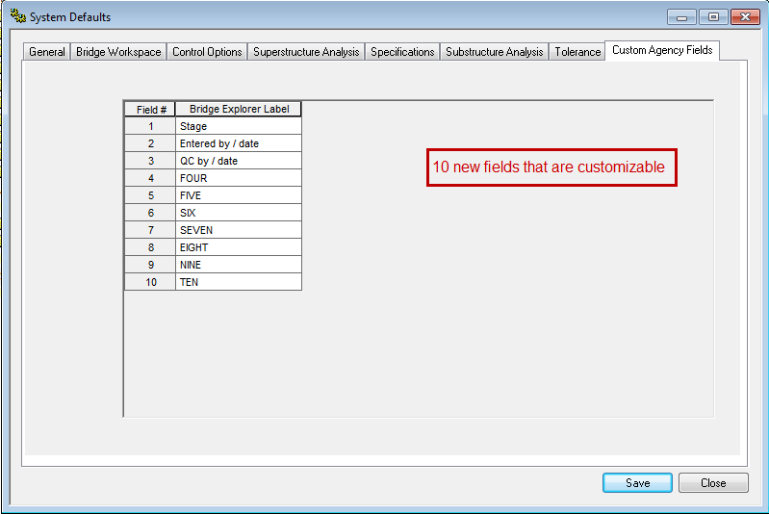
Customizing Bridge Explorer

Slide 10
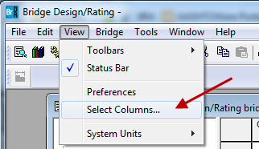
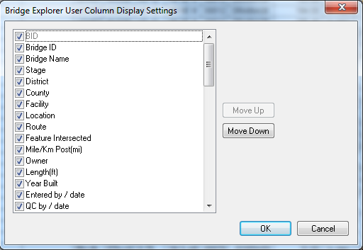
Customizing Bridge Explorer

Slide 11
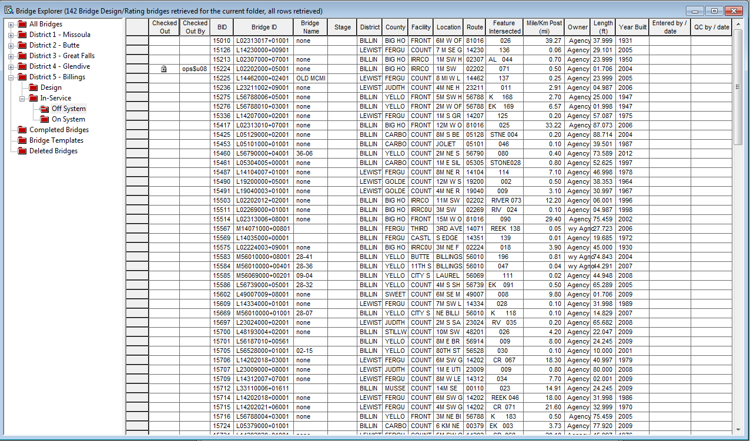
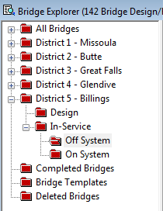
Customizing Bridge Explorer

Slide 12
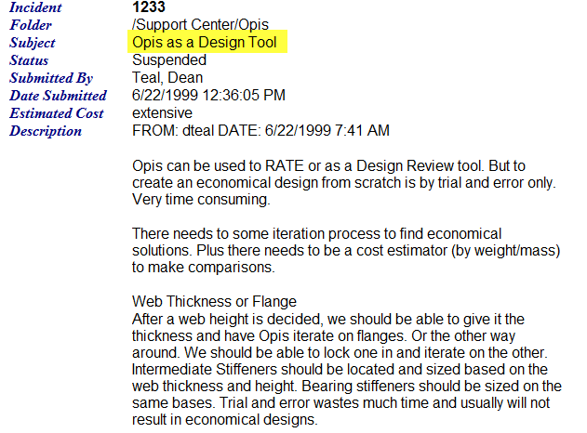

OPIS as a Design Tool
Enhancement # 1233

Slide 13
OPIS as a Design Tool
Task Force Created a Design Tool – Technical Advisory Group
Prestress Design Tool
  Currently Under Development – released as soon as ready
Steel Design Tool
  Design Phase – 2015
  Implementation – 2016
Steel Girder – Splice Analysis (New York Enhancement) – 2015
Future Design Tools
  Timber Design and Rating Application – BRDRSUP-228
  ???? (Insert your design tool idea here)

Slide 14
Design Tool TAG
Jeff Olsen – Montana, Chair
Dean Teal – Kansas, Co-Chair
Berhanu Woldemichael – Alabama
Mahmood (Mac) Hasan – Colorado
Nicholas Barnett – Illinois
Elizabeth Befikadu – AI Engineers
Arielle Ehrlich – Minnesota
Bethany Kappes – Montana
Brenda Crudele – New York
Jeff Ruby – Kansas

Slide 15
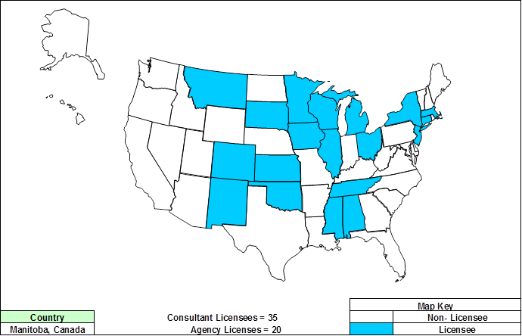
States that License BrDR

Slide 16

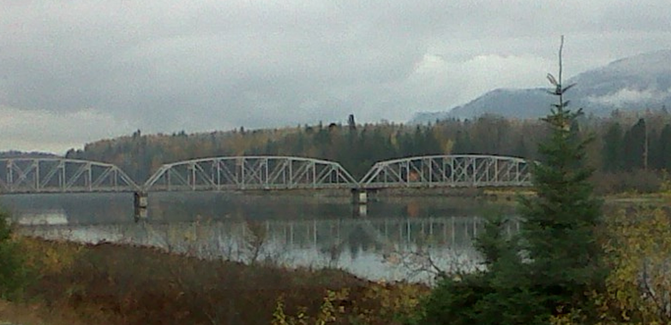
Questions……
Thank You

