Slide 1
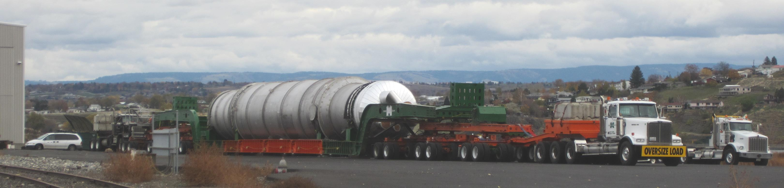
Scan 12-01 Advances in State DOT Superload Permit Processes and Practices

Slide 2
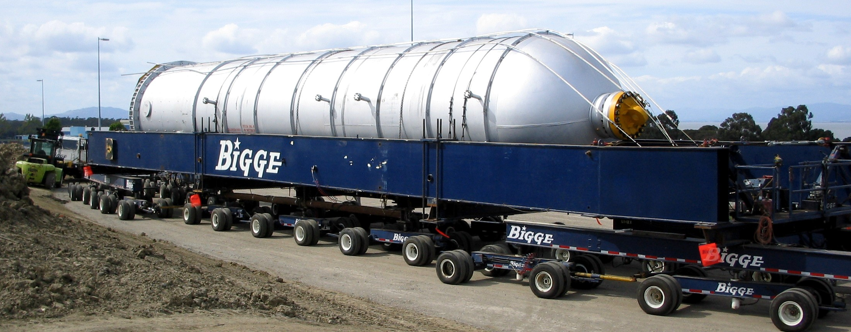
Purpose
Scan 12-01 Advances in State DOT Superload Permit Processes and Practices
There is a need to better understand the current State-of-Practice for “Superload” permitting as practiced by the States. This scan aims to gather and identify best practices, not only to become more efficient individually, but perhaps to improve the safety, mobility, and uniformity in transporting these large loads amongst all the States.

Slide 3
12-01Panel
Matt Farrar, P.E. Idaho Transportation Dept. Chair | Lubin Gao,P.E. Ph.D. FHWA
Scott Becker, P.E. Wisconsin DOT | Randy Braden Alabama DOT
Jeff Honefanger Ohio DOT | Kevin Keady, P.E. Caltrans
Jonathan Mallard, P.E. Virginia DOT | Michael Wight, P.E. Maine DOT
Hani Nassif, P.E.Ph.D. Report Facilitator
SCAN MANAGEMENT
Arora and Associates, P. C.
Lawrenceville, NJ

Slide 4
Introduction
Scan Approach (3 Stages)
Stage 1: Desk scan.
  Detailed literature review regarding the superload permitting practices and new development.
  Multiple DOTs were surveyed to collect information regarding legal and superload limits and representative States were selected for further investigation.
  18 states were selected: Florida, New York, California, Illinois, Indiana, Michigan, Ohio, Pennsylvania, Texas, Wisconsin, Washington, Idaho, Virginia, Louisiana, Maine, Minnesota, South Dakota, and Alabama.

Slide 5
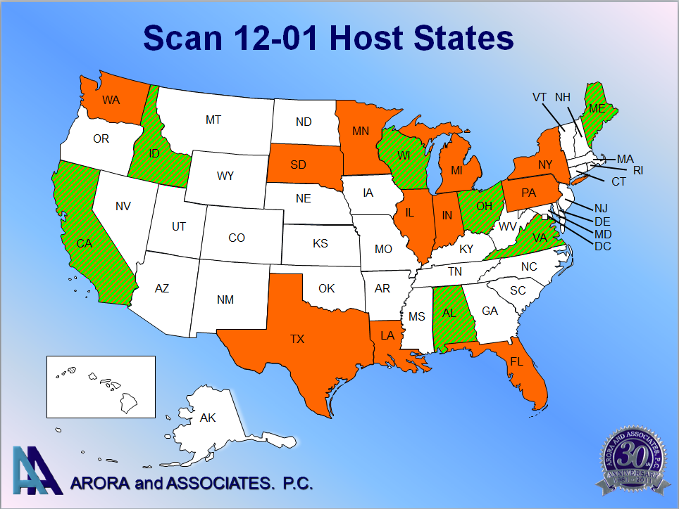
Introduction

Slide 6
Introduction
Scan Approach (3 Stages)
Stage 2: Comprehensive questionnaire with amplifying questions was distributed to the selected states and the current practices were collected:
Topic 1. Current State-of-Practice of OW/OS permit process.
Topic 2. Current State-of-Practice of OW/OS permit monitoring, data analyzing and compliances.
Topic 3. Current practices with regard to bridge analysis and rating for OW/OS vehicles.
Topic 4. Current practices with regard to better uniformity in OW/OS permitting.
Topic 5. Permit Questions.

Slide 7
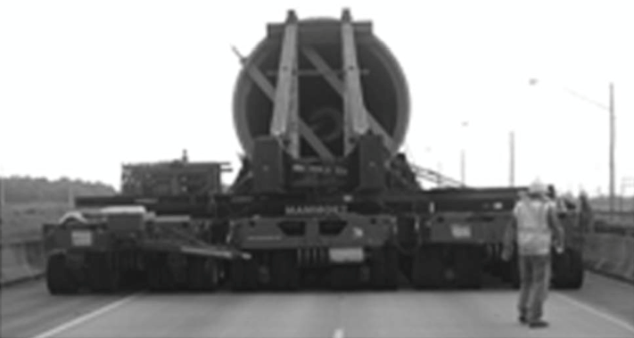
Introduction
Scan Approach (3 Stages)
Stage 3: Establish a workshop with DOT representative and oversize/overweight load permitting offices from various States.
    A workshop was held to identify the best practices and propose the implementation plan and recommendations for the future.

Slide 8
Introduction
State | Legal Weight Limits (Interstate)
 | GVW (kips) | Steering Axle (kips) | Axle (kips) | Tandem (kips) | Tridem (kips)
Florida | 80 | 22 | 22 | 44 | 66
New York | 80 | 22.4 | 22.4 | 36 | 42
California | 80 | 20 | 20 | 34 min and up. Depends on axle spacings | 34 min and up. Depends on axle spacings
Illinois | 80 | 20 | 20 | 34 | 42.5
Indiana | 80 | 12 | 20 | 34 | -
Michigan | 164* | 12 | 20 | 34 | 39
Ohio | 80 | 20 | 20 | 34 | 42.5
Pennsylvania | 80 | 20 | 20/22.4** | 34/36*** | 42.5
Texas | 80 | - | 20 | 34 | 42
Wisconsin | 80 | 20 | 20 | 34 | 42
Washington | 105.5 | 20 | 20 | 34 | Federal Bridge Formula
Idaho | 80 | 0.6 kips/in.width of tire | 20 | 34 | 42
Virginia | 80 | 20 | 20 | 34 | Federal Bridge Formula
Louisiana | 83.4 | 20 | 20 | 34 | 42
Maine | 100 | - | 22 | 34 | Federal Bridge Formula
Minnesota | 80 | 20 | 20 | 34 | 42
South Dakota | 80 | 20 | 20 | 34 | 42
Alabama | 80 | 12 | 20 | 34 | 42
* | There is an indirect limit caused by a combination of the maximum legal length of vehicles, maximum legal axle loads, axle spacing and total number of axles allowed.
** | 20 kips for GVW > 73.28 kips and 22.4 kips for GVW of 73.28 kips or under
*** | 34 kips for GVW > 73.28 kips and 36 kips for GVW of 73.28 kips or under

Slide 9
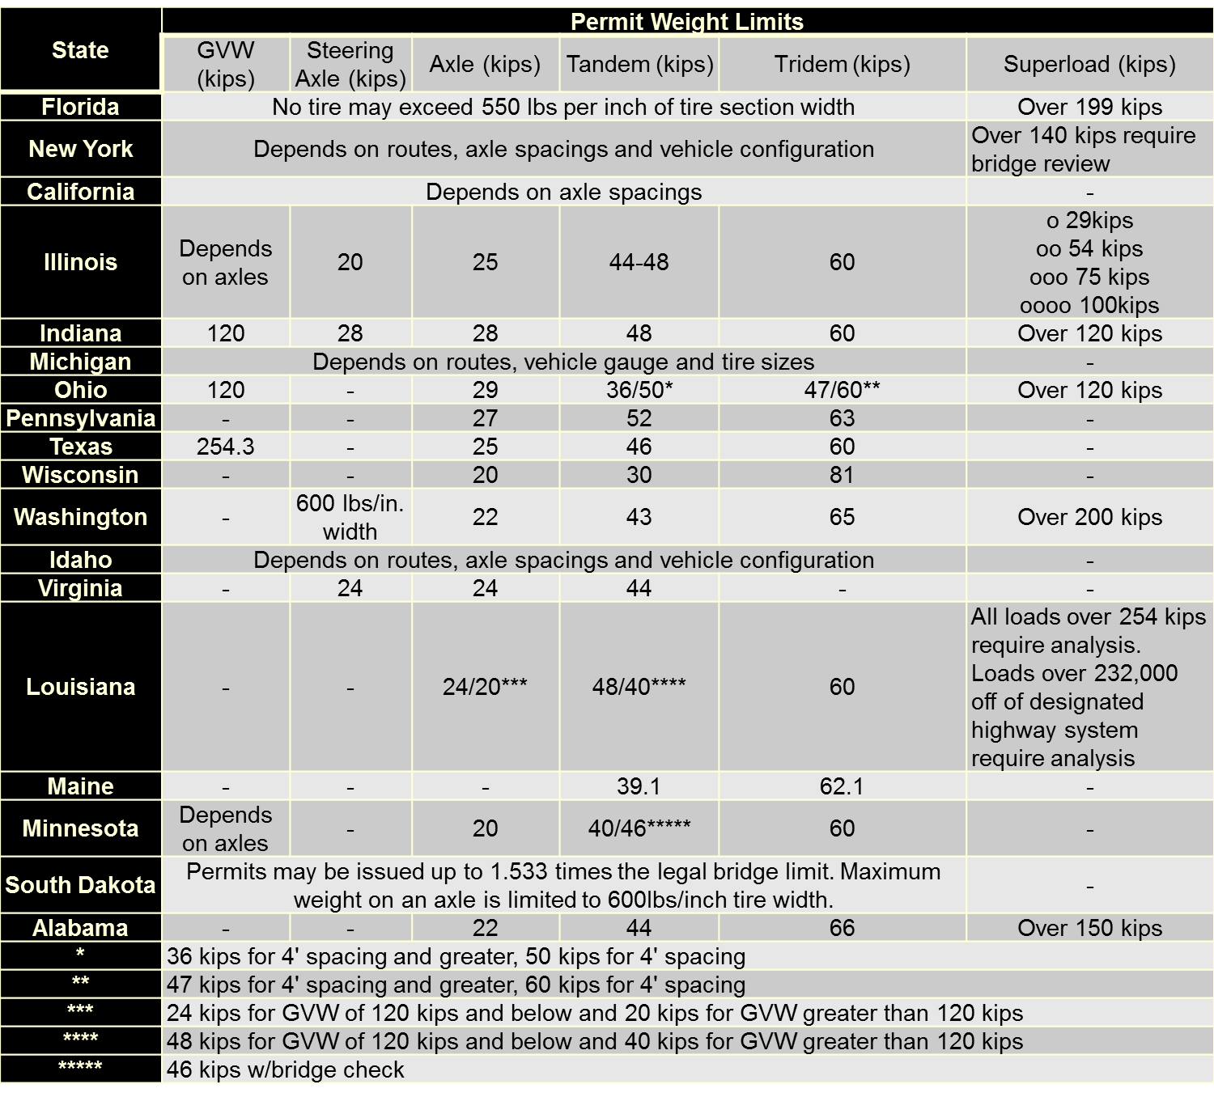
Introduction

Slide 10
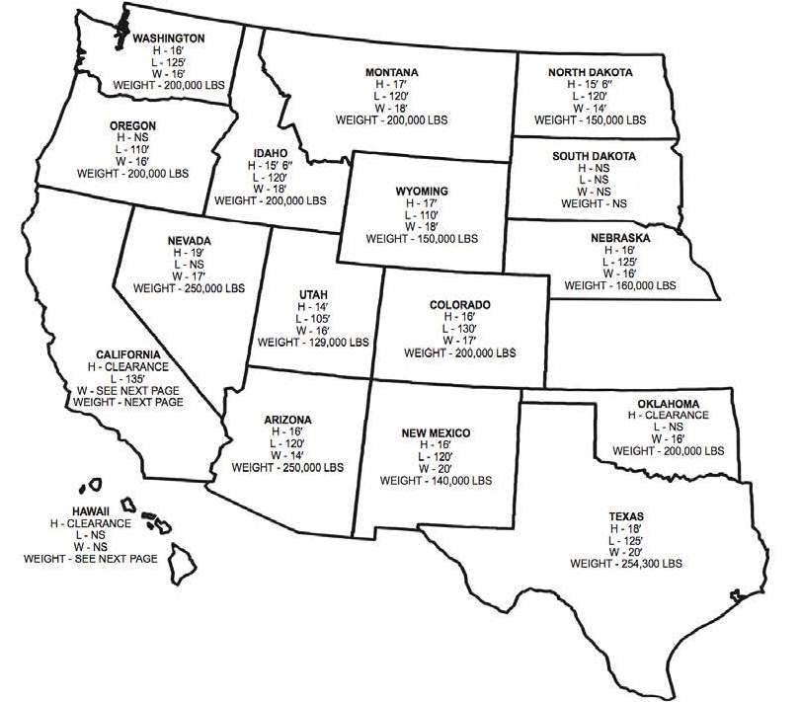
“Superload” WASHTO (2009)

Slide 11
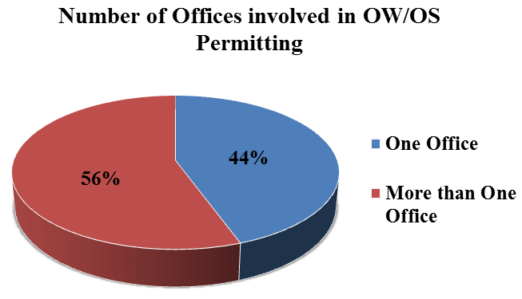
Findings and Observations
Findings and Observations based on Responses to Amplifying Questions and Discussions during Workshop
Permitting offices and staffs:
- About half the States centralize thier permitting functions. States such as Alabama, California, Illinois, Michigan, Minnesota, Ohio, Texas, Virginia.
- While the other participating States decentralize and have more than one office to handle permits

Slide 12
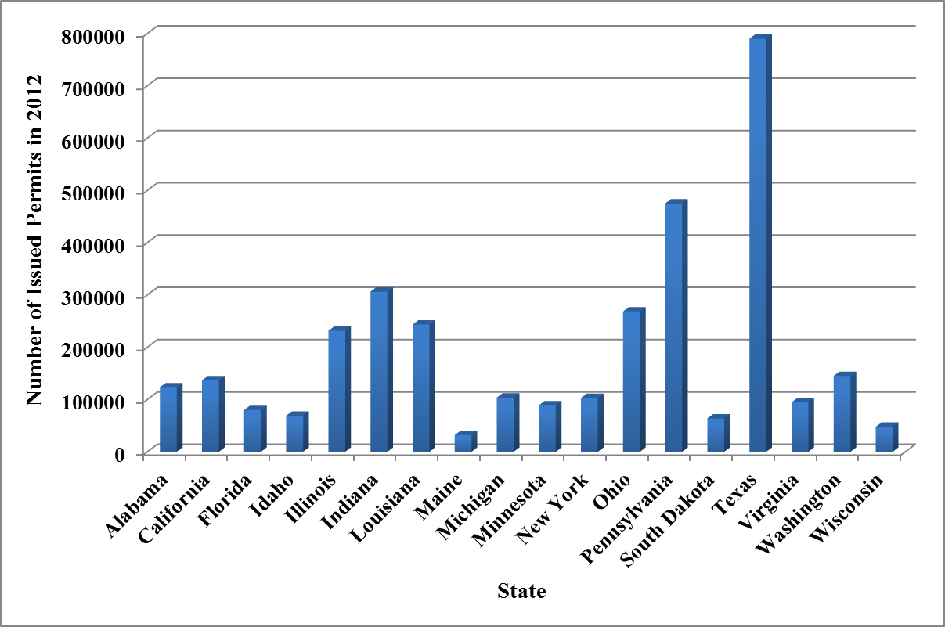
Findings and Observations
Number of permits issued every year
- The number of permits issued every year varies significantly from State to State . For example, Texas has 741,079 permits issued for the year of 2012.
- All the States issued permits with some permits being automated and self-issued, while some permits require special analysis.

Slide 13
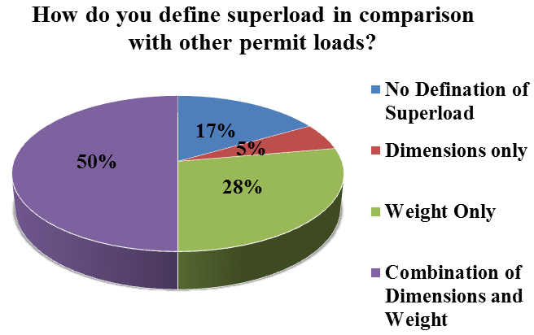
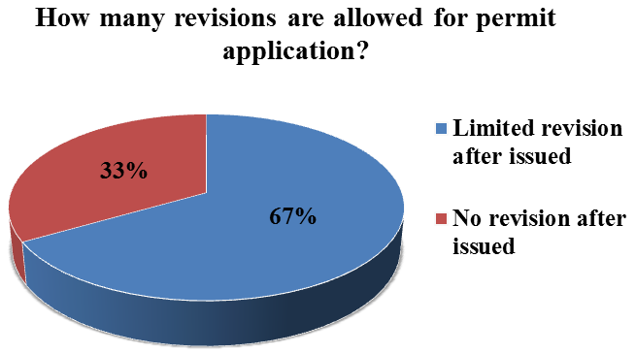
Findings and Observations
Definition of superload
The definition of superload varies amongst participating scan States. Some have no definition, some define based on the dimensions only (e.g. Michigan) or weight only (e.g. Florida), or a combination of both dimensions and gross vehicle weight (e.g. New York).
Number of revisions allowed
A number of the states allows unlimited revisions till the permit is issued (e.g., Alabama) while other states only allow a limited number of revisions (e.g., Illinois). Moreover, 33% of the participated states do not allow revisions on the permit once the permit is issued (e.g., Wisconsin).

Slide 14
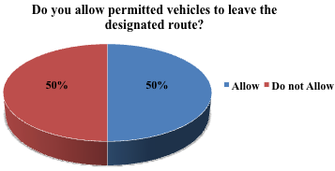
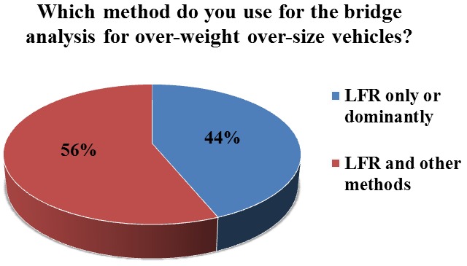
Findings and Observations
Permitted vehicles allowed to leave the designated route
Bridge analysis methods
44% of participating States use LFR only or dominantly, while 56% of selected States also use other methods (i.e. LFR, LRFR, or ASR)

Slide 15
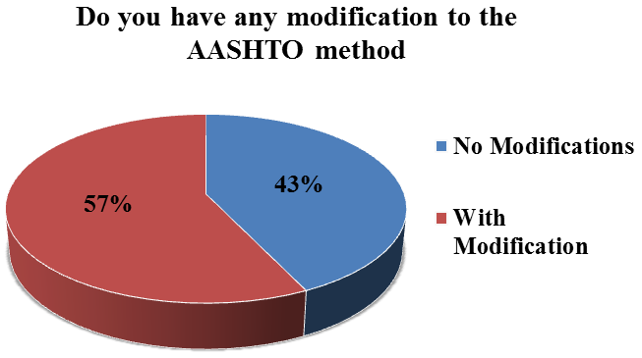
Findings and Observations
Speed and traffic restriction on permits
Most of states use speed and traffic restriction on permits. Some of the states occupy two lanes and/or speed limits for superloads (e.g., Minnesota) while some of the states even have more severe restrictions. For instance, the State of Maine restricted the speed to 5 mph and only allow one vehicle along centerline of the bridge for severe conditions.
Modifications to AASHTO Method
43% of participating States have no modification to AASHTO load rating method:
- 57% of participating States have modification to AASHTO load rating method: California Idaho, Louisiana, Michigan, New York State, Virginia, Washington State.

Slide 16
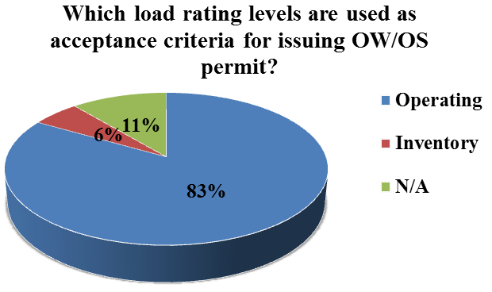
Findings and Observations
Load rating level for acceptance criteria
most of the states (83% of participating States) use operating level as acceptance criteria except Maine (usually inventory level) and Texas (do not use a load rating level when considering a superload).
Refined analysis for OS/OW rating
Most of the participating states use refined analysis for certain conditions (e.g. Maine use refined analysis for the bridge in poor condition and no other routes are available). AASHTOWare is the most popular software for refined analysis.
Computer software for OS/OW rating
Most of the states use AASHTOWare for OS/OW rating while some of the states use in-house software for OS/OW rating (e.g. Maine and Virginia).

Slide 17
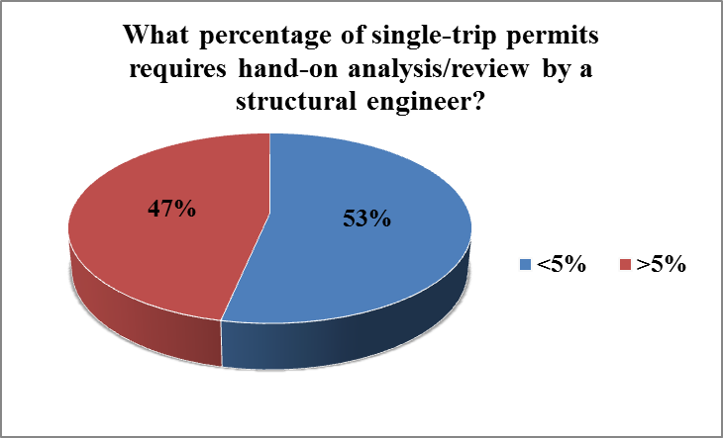
Findings and Observations
Joint State coalitions for better uniformity
Most of the states already are or are willing to be a members of State coalitions that aim at improving permitting.
Hands-on analysis/review for permits
Nearly all the States have developed screening systems to facilitate permit review or automated on-line systems.
About half of the participating States report that more than 5% of single-trip permits issued require hands on analysis/review. About half report that less than 5% of permits issued require hands on analysis.

Slide 18
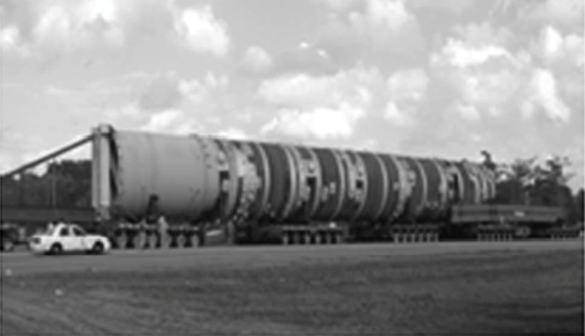
Select Best Practices from DOTs
Many States have established a Superload weight threshold for screening purposes, but there is no single definition.
Many States weigh Superload permit vehicles to verify axle loads, some States inspect permit vehicles to verify rigging, vehicle maintenance and good working order.
Many States have an automated system for issuing permits.
Many States have embraced Automation, but require rigorous QA/QC for reliable and verifiable bridge information

Slide 19
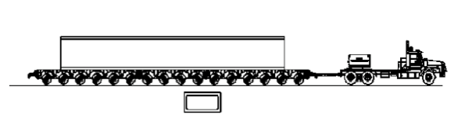
More Select Best Practices from DOTs
Washington - offers training on permit policies and statues to State police, load raters and others.
Virginia - for complex bridges, if consultants are hired because of specific knowledge, have them run several large weight permit trucks nationally for future comparisons.
New York - requires heavy haulers to hire consultants for Superload analysis.
Pennsylvania – developed a P3 to fund an automated permitting system.
Florida- Customer is responsible for horizontal and vertical clearance checks, reduces risk on the State .
Indiana - 200,000 lbs or greater and/or over 17 feet wide requires police escort.

Slide 20
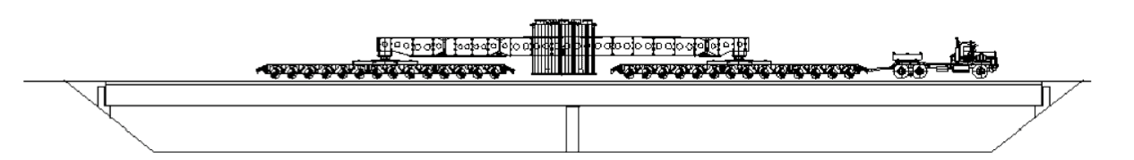
Recommendations
Recommendations for harmonization:
Collectively consider developing a National Permit Map with Heavy Haul Corridors among different States with industry participation.
Collectively consider developing a national or regional “Superload” permit vehicle with industry participation.
Encourage cross-cultural meetings and regional collaboration for routine and annual permits to ensure harmonization.
Educate, collaborate and assist local jurisdictions with permits.

Slide 21
Recommendations
Future Trends:
Geofencing
Virtual routes.
Crowdsourcing.
WIM for enforcement of permit weights and routes.
New Information Sharing Technologies

Slide 22
Recommendations to Ensure Safety
Consider-
Establishing route surveys.
Performing vehicle inspections.
Verify vehicle/axle weights prior to moves.
Requiring submittal of detailed shop drawings of the hauled weight.
Performing pre- and post-move surveys for bridges to establish what kind of damage could be or was caused by the move.
Consider training and education for local jurisdictions regarding overweight permits and superloads.
Consider certification for truck operators regarding truck leveling and load distribution systems including certification for escort services.

Slide 23
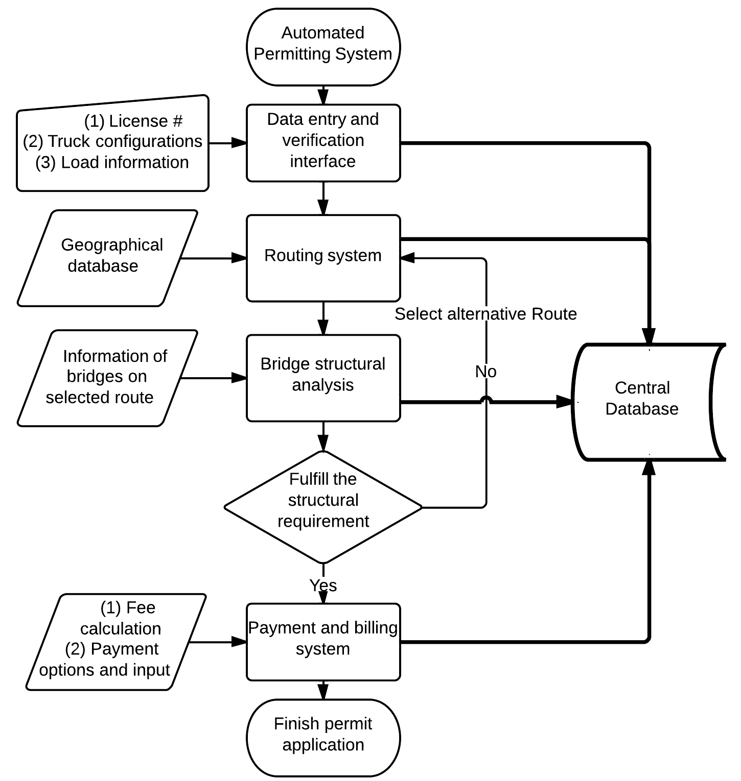
Recommendations for Automation Process for Self Issuance Permitting
(1) Central database
(2) Data entry and verification interface (Graphical User Interface (GUI))
(3) Routing system module with geographical database.
(4) Bridge structural analysis module with Application Program Interface (API)
(5) Payment and billing system with user interface

Slide 24
Recommendations
Recommendations to AASHTOWare BrR:
Develop a rapid route capacity analysis module for AASHTOware BrR to facilitate on-line self-issuance permitting.

Slide 25
Recommendations for Future Research
Research or information sharing is needed to confirm the assumptions made regarding lift/drop axles, self-propelled cranes, platform trailers and other loading mechanisms. (e.g., Self-leveling suspension, etc.).
Further research for bridge load testing and “Smart Bridge” technology is necessary to verify assumptions.
There is a need for funding to develop advanced sensing technology in regards to fatigue and fracture.
Further advances in refined analysis techniques and guidance with examples highlighting when refined analysis can be beneficial.
Develop criteria or guidance for load raters when analyzing or permitting “Superloads” over 1,000,000 pounds.

Slide 26
Acknowledgements
National Cooperative Highway Research Program (NCHRP).
Thanks to technical project panel for the guidance, Matt Farrar – chair, and Dr. Nassif for all their hard work.
Thanks to Harry Capers and Arora and Associates for Scan Management responsibilities.
U.S. Federal Highway Administration and other agencies.
AASHTOWare Taskforce and RADBUG

Slide 27
Thank you !

