Slide 1
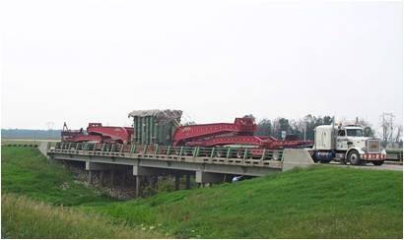
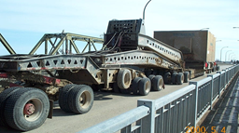
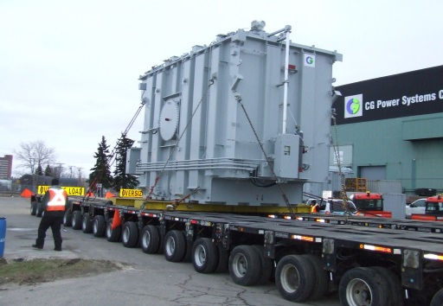
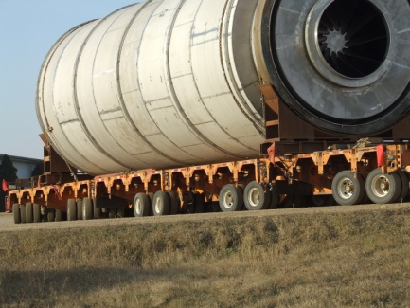
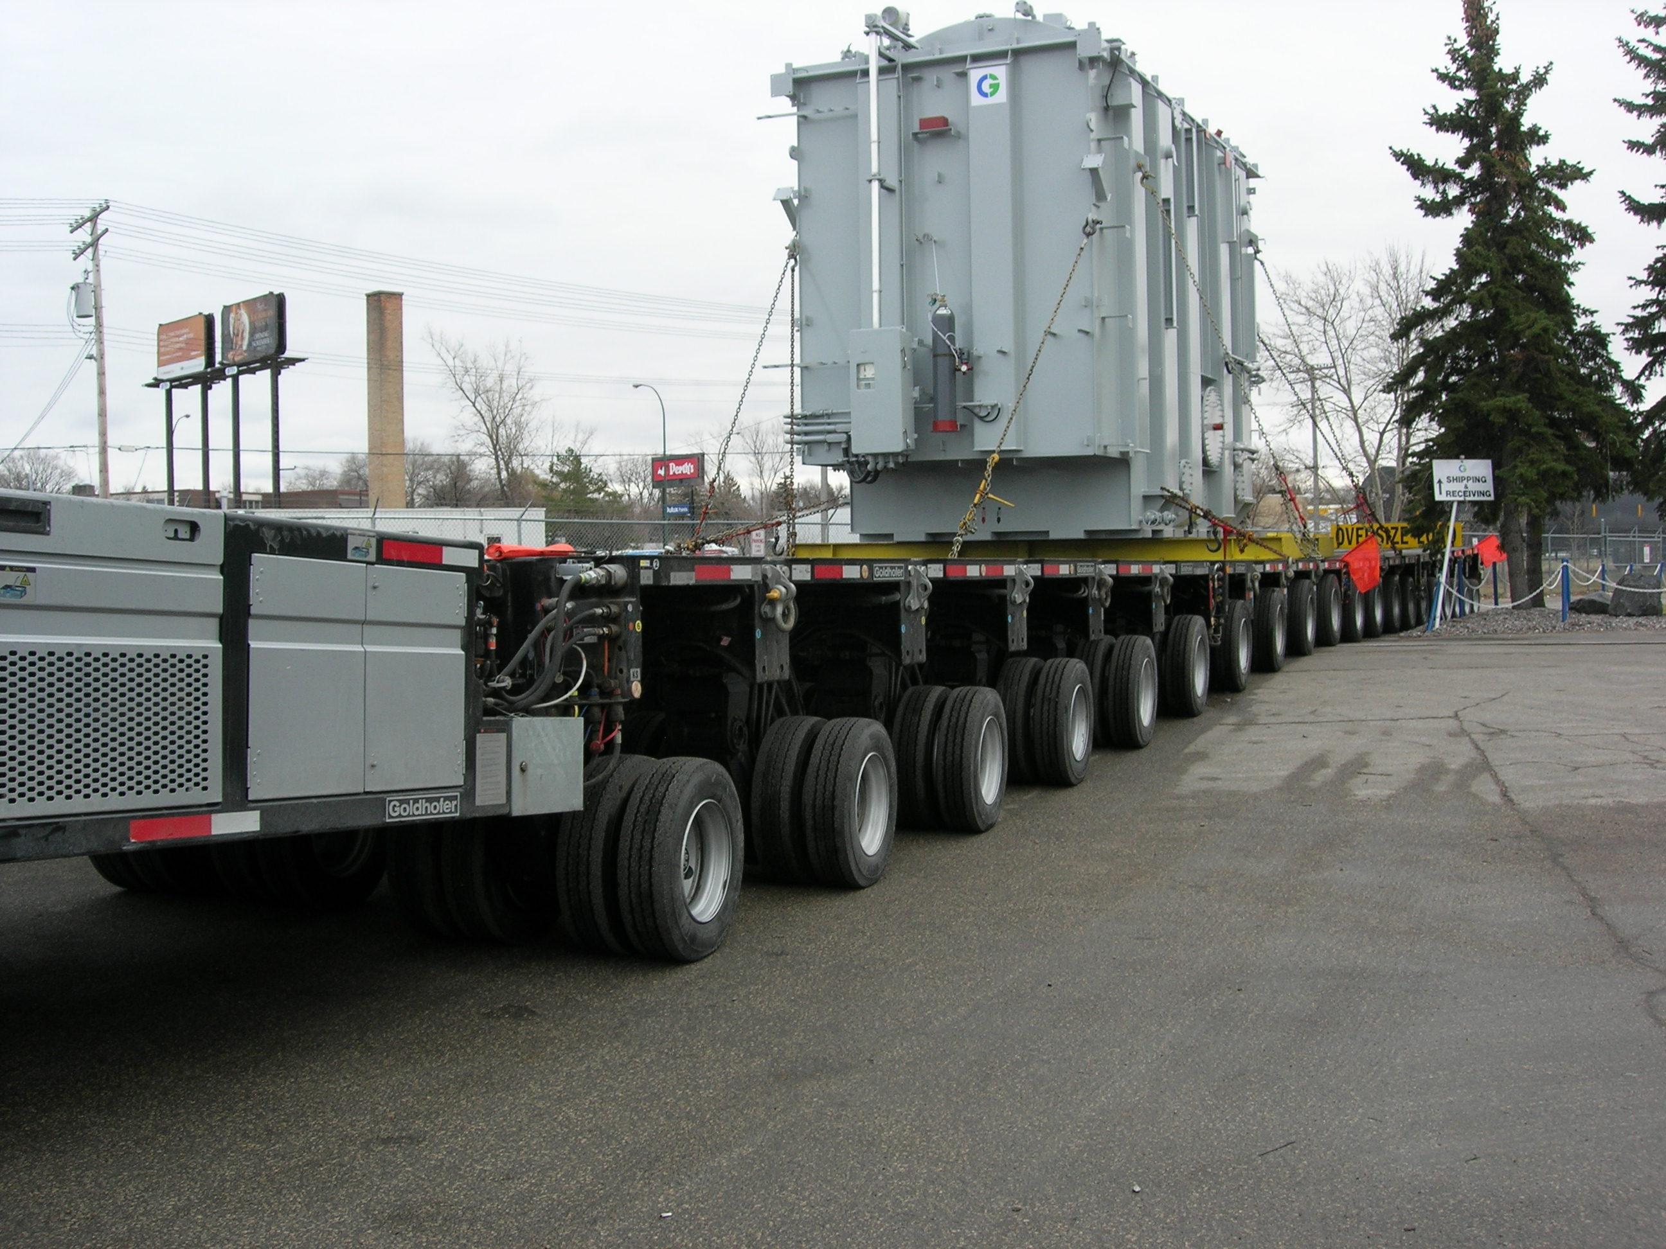

Manitoba Infrastructure and Transportation RADBUG - August 2014
Water Management and Structures

Slide 2
Innovative Overload Permitting in Manitoba
Allowing a 363 250 Kg (800,830 LB) G.V.M. “Superload”
Presented by:
Geoffrey C. Oramasionwu, M.Eng., P.Eng.
Manitoba Infrastructure and Transportation RADBUG - August 2014
Water Management and Structures

Slide 3
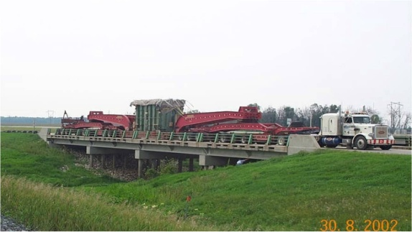
INTRODUCTION
  Increased demand to haul heavier loads
Many structures nearing the end of their Service Life
Increasing number of overload permit applications
MIT uses the AASHTO LRFD and LRFR Specifications for Design and Load Rating
AASHTOware Bridge Rating Program uses a refined
rating method
This AASHTOWare Bridge Rating enabled MIT to review and approve a 363, 250 Kg (800830 LB) overload
Manitoba Infrastructure and Transportation RADBUG - August 2014
Water Management and Structures

Slide 4
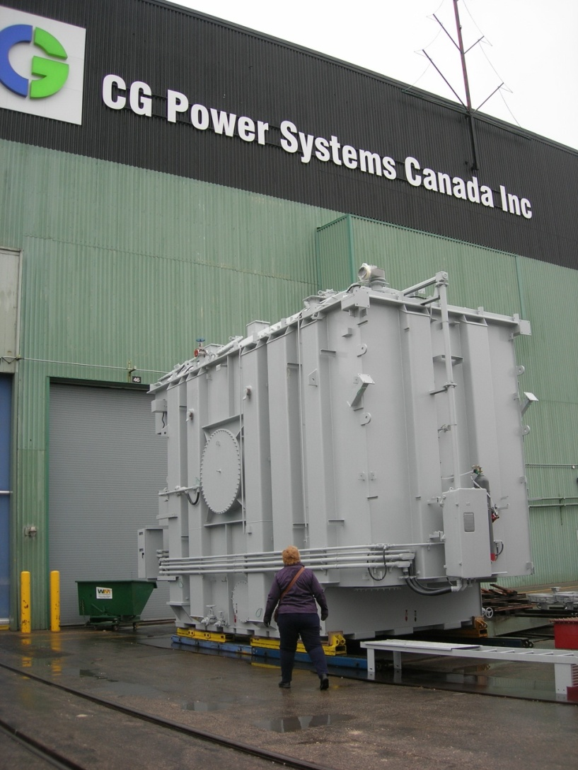

The Overload Permit
THREE TRANSFORMERS, EACH WEIGHED IN AT GVM =175,450 kg (386,800 lbs)
Manitoba Infrastructure and Transportation RADBUG - August 2014
Water Management and Structures

Slide 5
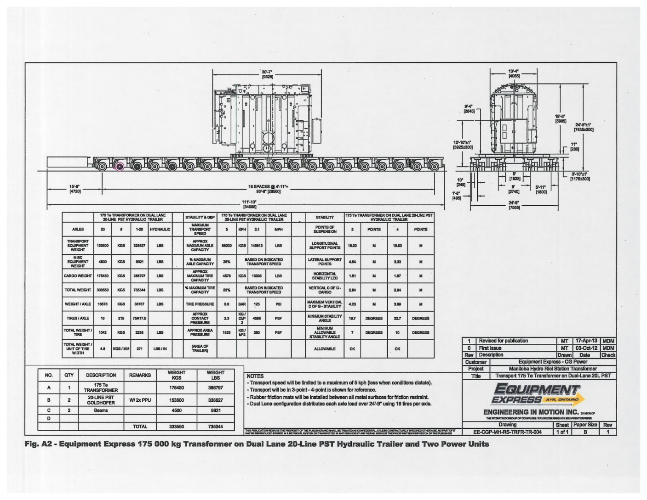
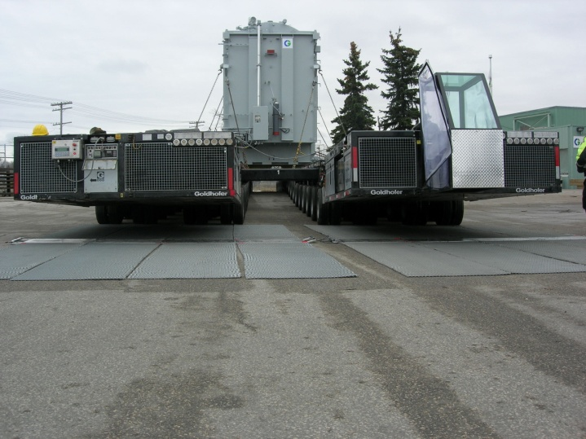
Two self propelled units
Dual 20-line hydraulic trailer units
16 tires per axle
GVM = 363,250 kg (800,830 lbs)
Total length = 34 m (110ft Approx.)
Total height = 7.435 m (24ft)
Total width = 7.55 m (24.77ft)
Manitoba Infrastructure and Transportation RADBUG - August 2014
Water Management and Structures

Slide 6
ROUTE OPTIONS
Water Management and Structures reviewed three different truck configurations and three different routes before approving the permit application.
Manitoba Infrastructure and Transportation RADBUG - August 2014
Water Management and Structures

Slide 7
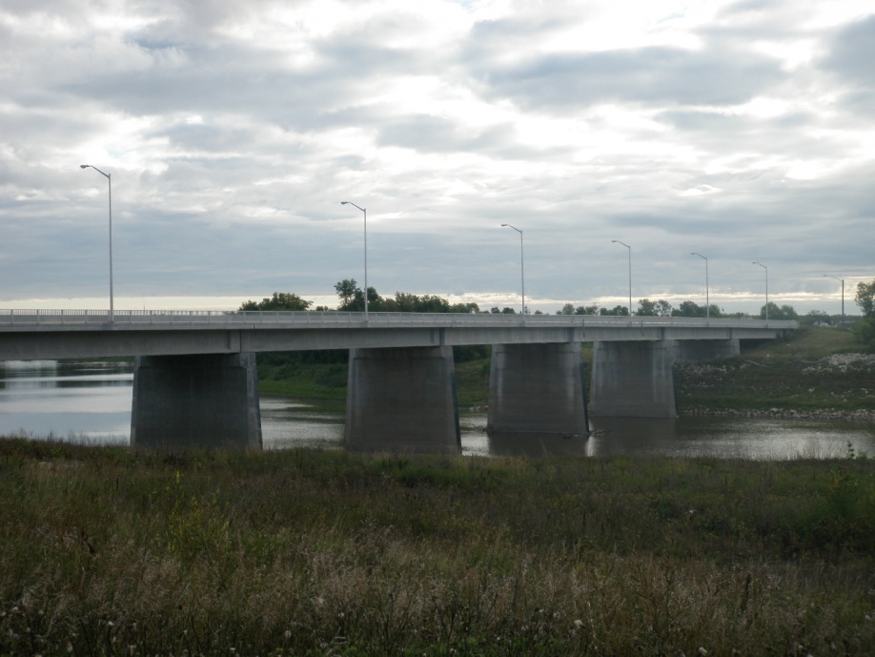
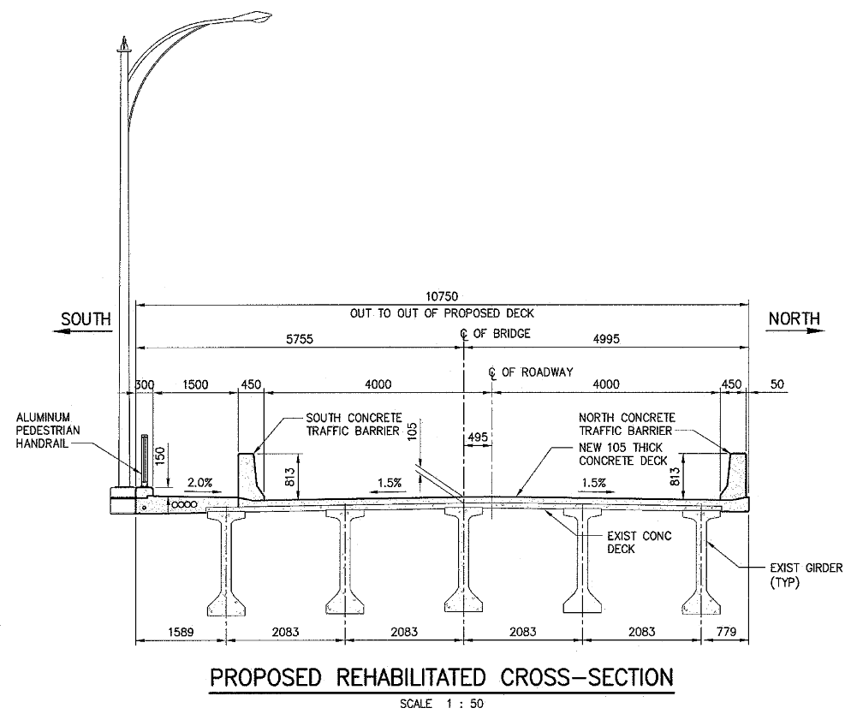
Red River Bridge
Precast Prestressed Concrete I Girder
Designed and built id 1975 for AASHTO HS25 Truck Live Load
In composite action with a 200 mm (8 in) reinforced concrete deck
Seven simply supported spans. Span length = 36.576 m (120 ft)
Manitoba Infrastructure and Transportation RADBUG - August 2014
Water Management and Structures

Slide 8
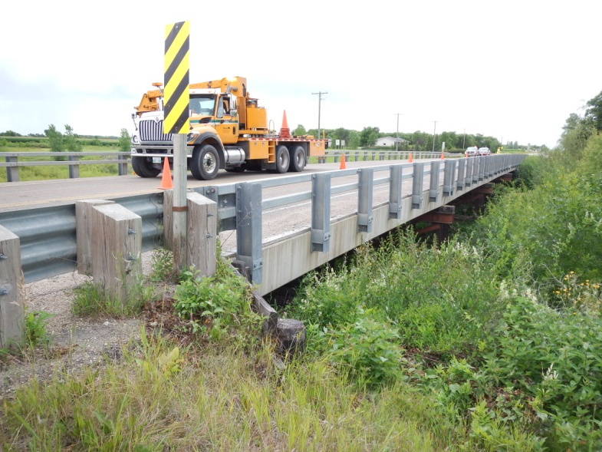
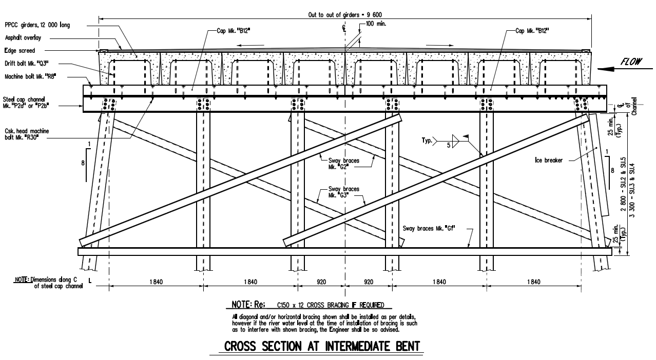
ST ADOLPHE COULEE BRIDGE
12 m (40 ft) Precast Pre stressed Concrete Channel Girder
100 mm (4 in) thick asphalt overlay wearing surface
Five simply supported spans. Span length = 11.8 m (38.74 ft)
Manitoba Infrastructure and Transportation RADBUG - August 2014
Water Management and Structures

Slide 9
BRIDGE LOAD RATING
Manitoba Infrastructure and Transportation RADBUG - August 2014
Water Management and Structures

Slide 10
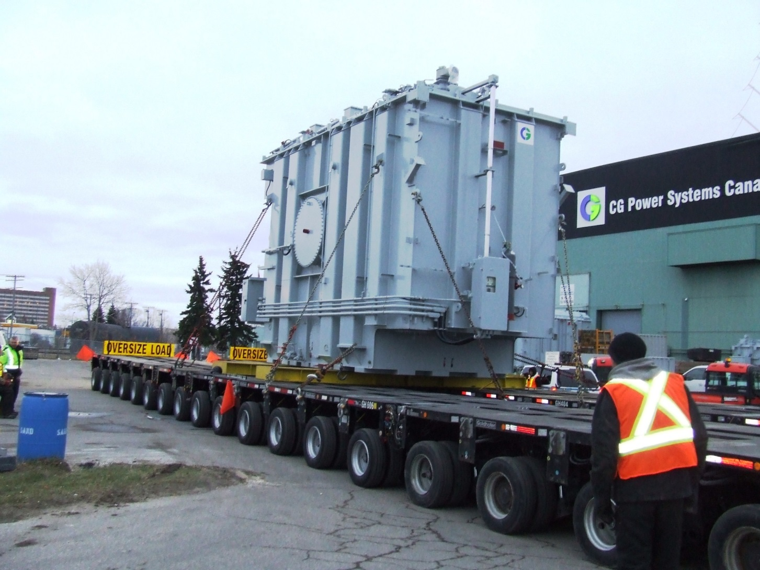
LONGITUDINAL CONFIGURATION DEFINITION
NUMBER OF AXLES = 20
AXLE SPACING = 1.5 m
Manitoba Infrastructure and Transportation RADBUG - August 2014
Water Management and Structures

Slide 11
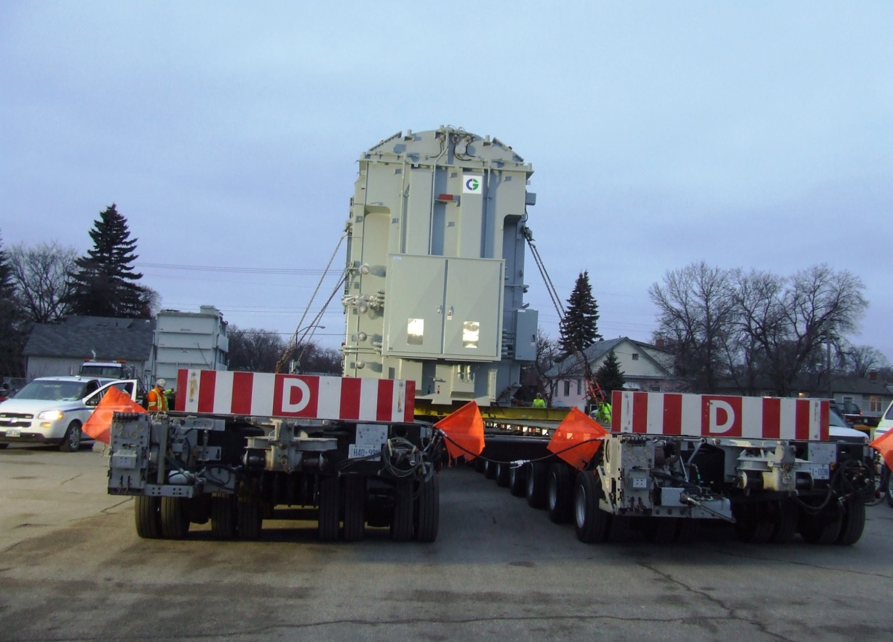
TRANSVERSE CONFIGURATION OF A NON-STANDARD GAGE
8 WHEELS PER AXLE
VARIABLE WHEEL SPACING
Manitoba Infrastructure and Transportation RADBUG - August 2014
Water Management and Structures

Slide 12
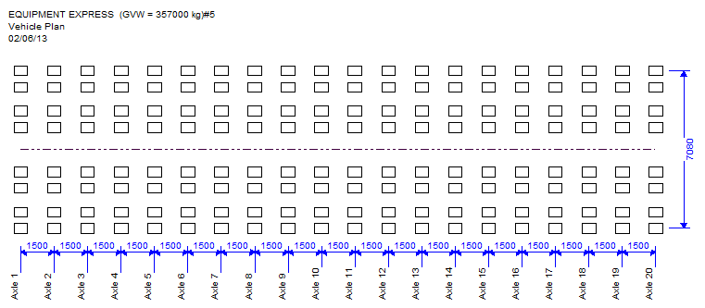
OUTPUT OF VEHICLE PLAN
LONGITUDINAL FOOTPRINT OF TRUCK
Manitoba Infrastructure and Transportation RADBUG - August 2014
Water Management and Structures

Slide 13
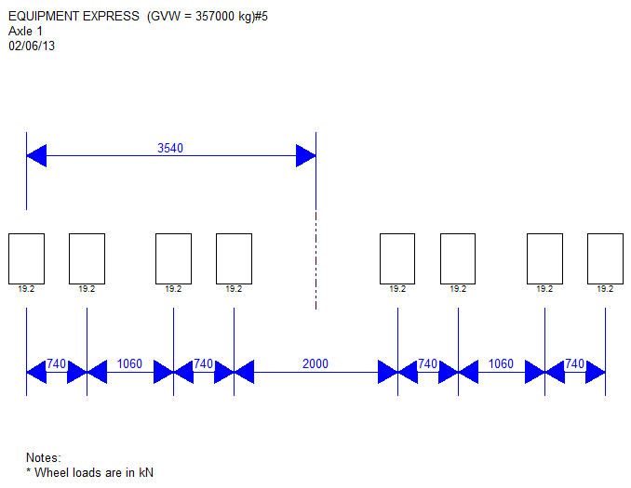
OUTPUT OF VEHICLE AXLE PLAN (AXLE 1)
Manitoba Infrastructure and Transportation RADBUG - August 2014
Water Management and Structures

Slide 14
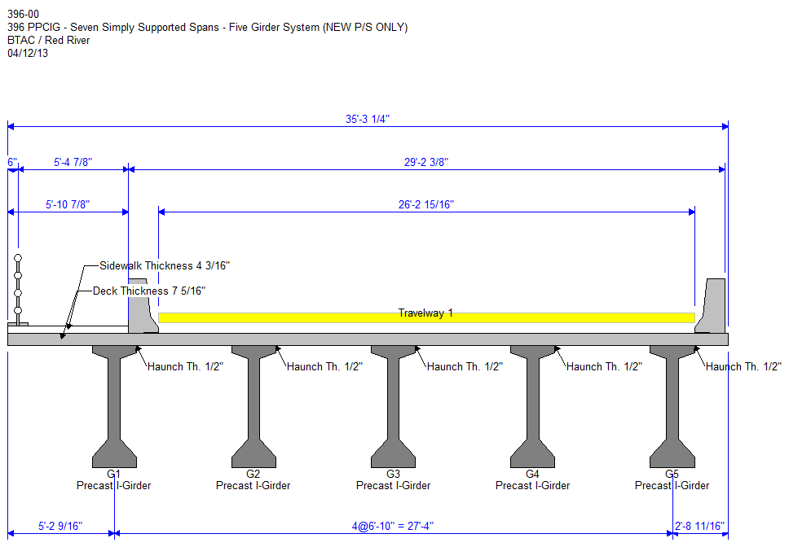
ACTUAL CROSS-SECTION OF THE BRIDGE
BRIDGE DECK IS MODELED AS SHELL ELEMENTS WITH MATERIAL PROPERTIES BEING THE SAME AS THE BRIDGE DECK
Manitoba Infrastructure and Transportation RADBUG - August 2014
Water Management and Structures

Slide 15
FINITE ELEMENT MODELING
CORE ELEMENT DATA CREATED IN “BrRAT” BRIDGE WORKSPACE WERE EXPORTED TO THE STAAD ENGINE
STAAD USES THE INFORMATION TO CREATE THE FINITE ELEMENT MODEL FOR THAT STRUCTURE
DECK SLAB → SHELL ELEMENTS
BEAM → INFINETELY STIFF MEMBERS
Manitoba Infrastructure and Transportation RADBUG - August 2014
Water Management and Structures

Slide 16
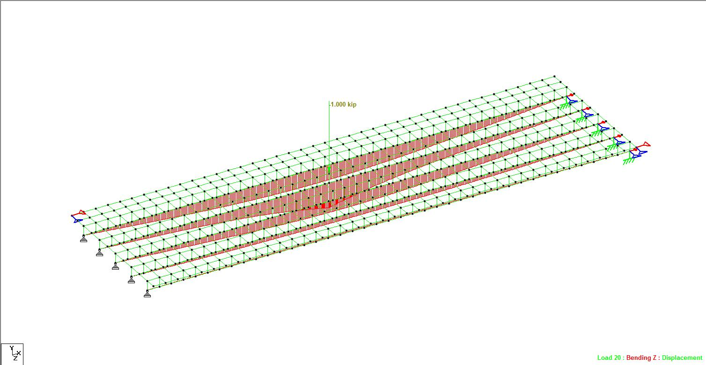
STAAD THREE DIMENTIONAL VIEW OF THE MODEL
Bending Moment, Shear Force and
Displacement Envelopes are generated for the Unit Load placed on at each element nodes.
A UNIT LOAD IS APPLIED AT EACH NODE OF THE SHELL ELEMENTS
Manitoba Infrastructure and Transportation RADBUG - August 2014
Water Management and Structures

Slide 17
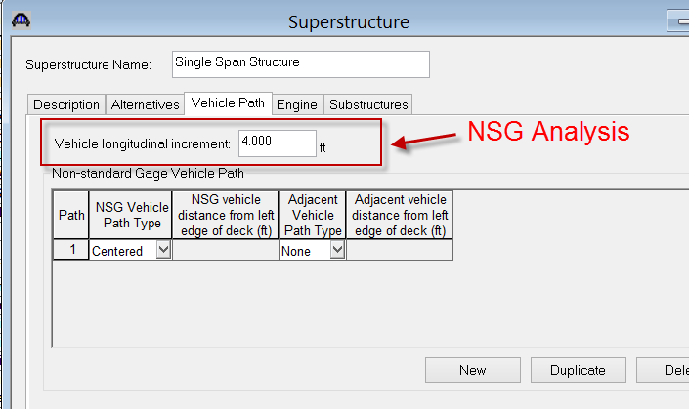
Manitoba Infrastructure and Transportation RADBUG - August 2014
Water Management and Structures

Slide 18
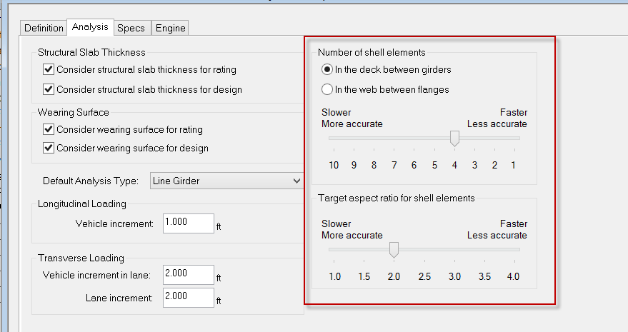
Manitoba Infrastructure and Transportation RADBUG - August 2014
Water Management and Structures

Slide 19
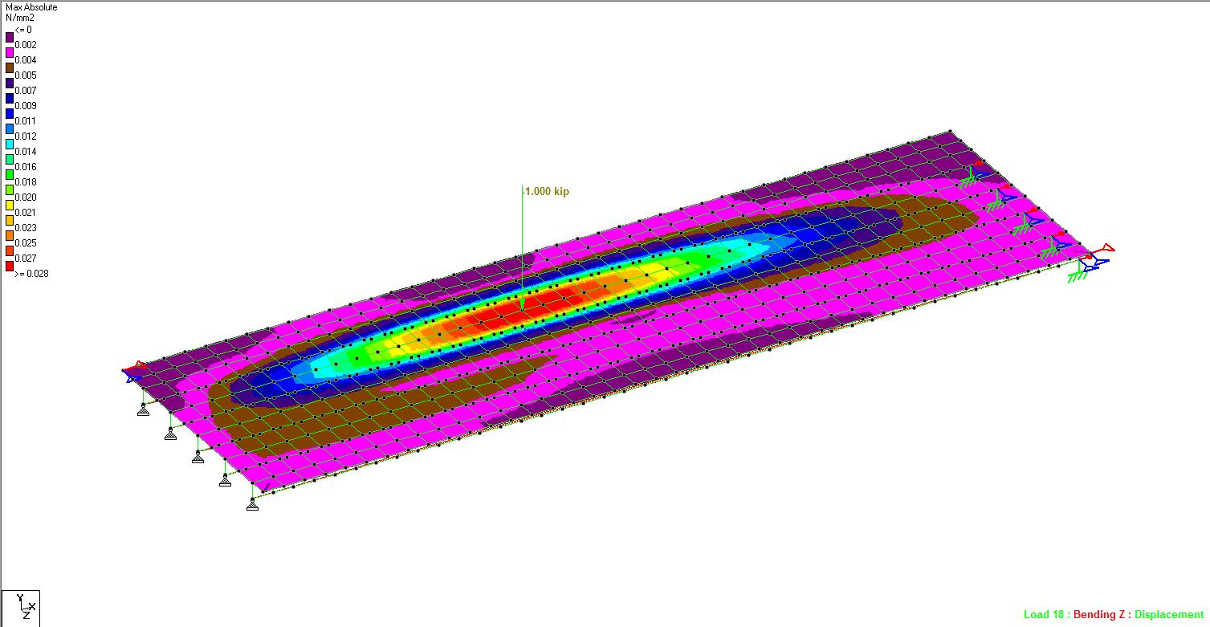
3D Stress Influence Surface for the unit Load Case No. 12, Placed at a Shell Node.
Manitoba Infrastructure and Transportation RADBUG - August 2014
Water Management and Structures

Slide 20
Manitoba Infrastructure and Transportation RADBUG - August 2014
Water Management and Structures

Slide 21
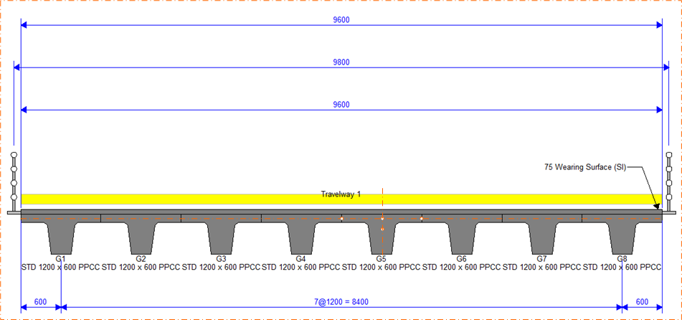
Manitoba Infrastructure and Transportation RADBUG - August 2014
Water Management and Structures

Slide 22
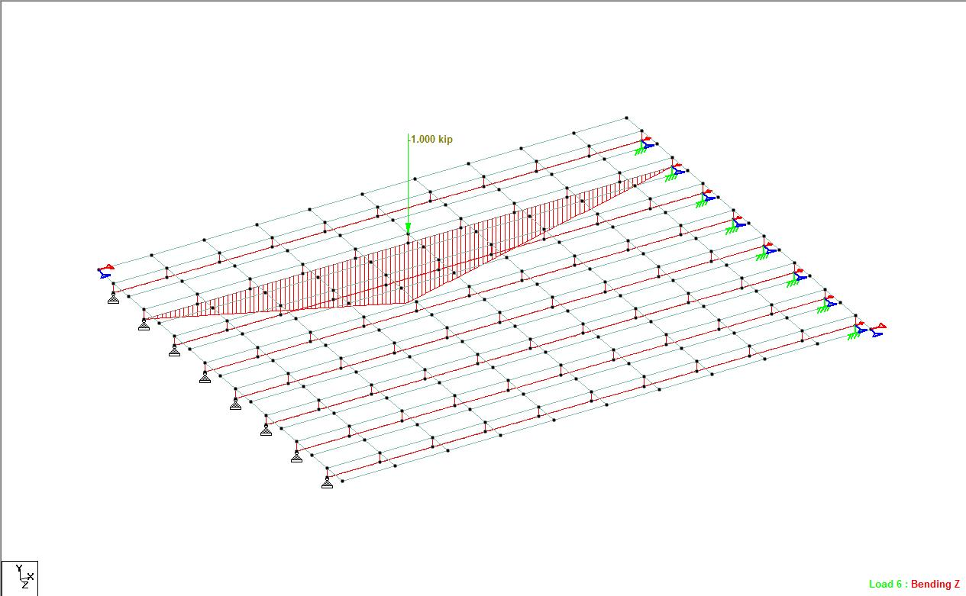
STAAD THREE DIMENTIONAL VIEW OF THE MODEL
Manitoba Infrastructure and Transportation RADBUG - August 2014
Water Management and Structures

Slide 23
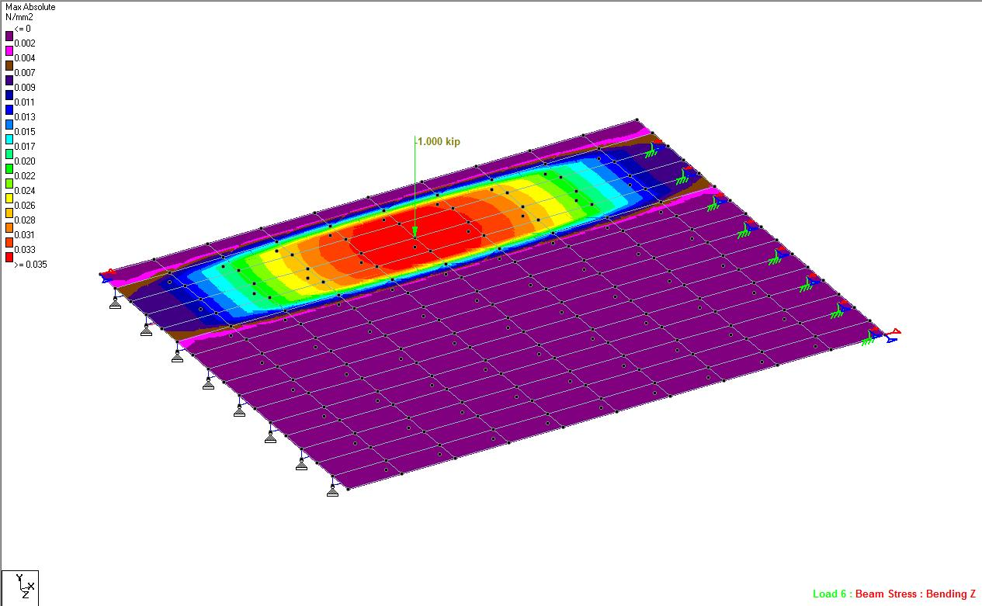
3D Stress Influence Surface for the unit Load Case No. 6, Placed at a Shell Node.
Manitoba Infrastructure and Transportation RADBUG - August 2014
Water Management and Structures

Slide 24
 | RED RIVER BRIDGE RATING FACTORS
 | GIRDER | LIMIT STATE | CHBDC | AASHTO STANDARD Single/two or more Lanes | AASHTO LRFD Single/Multi-Lanes | FINITE ELEMENT MODEL
 | 1 | Shear | 0.614 | 0.390/0.390 | 0.468/0.429 | 0.131
 |  | Moment | 0.567 | 0.390/0.390 | 0.468/0.429 | 0.131
 | 2 | Shear | 0.614 | 0.98/1.24 | 0.633/0.731 | 0.207
 |  | Moment | 0.525 | 0.98/1.24 | 0.436/0.622 | 0.207
 | 3 | Shear | 0.614 | 0.98/1.24 | 0.633/0.731 | 0.221
 |  | Moment | 0.525 | 0.98/1.24 | 0.436/0.622 | 0.221
 | 4 | Shear | 0.614 | 0.98/1.24 | 0.633/0.731 | 0.231
 |  | Moment | 0.525 | 0.98/1.24 | 0.436/0.622 | 0.231
 | 5 | Shear | 0.614 | 0.85/0.85 | 0.582/0.619 | 0.223
 |  | Moment | 0.567 | 0.85/0.85 | 0.582/0.619 | 0.223
Manitoba Infrastructure and Transportation RADBUG - August 2014
Water Management and Structures

Slide 25
ST. ADOLPHE COULEE BRIDGE RATING FACTORS
GIRDER | LIMIT STATE | CHBDC | AASHTO STANDARD Single/two or more Lanes | AASHTO LRFD Single/Multi-Lanes | FINITE ELEMENT MODEL
1 | Shear | 0.400 | 1.00/1.00 | 0.60/0.60 | 0.055
 | Moment | 0.339 | 1.00/1.00 | 0.60/0.60 | 0.055
2 | Shear | 0.400 | 0.56/0.72 | 0.60/0.60 | 0.172
 | Moment | 0.345 | 0.56/0.72 | 0.325/0.325 | 0.172
3 | Shear | 0.400 | 0.56/0.72 | 0.60/0.60 | 0.180
 | Moment | 0.345 | 0.56/0.72 | 0.325/0.325 | 0.180
4 | Shear | 0.400 | 0.56/0.72 | 0.60/0.60 | 0.089
 | Moment | 0.345 | 0.56/0.72 | 0.325/0.325 | 0.089
5 | Shear | 0.400 | 0.56/0.72 | 0.60/0.60 | 0.089
 | Moment | 0.345 | 0.56/0.72 | 0.325/.0325 | 0.089
6 | Shear | 0.400 | 0.56/0.72 | 0.60/0.60 | 0.180
 | Moment | 0.345 | 0.56/0.72 | 0.325/.0325 | 0.180
7 | Shear | 0.400 | 0.56/0.72 | 0.60/0.60 | 0.172
 | Moment | 0.345 | 0.56/0.72 | 0.325/.0325 | 0.172
8 | Shear | 0.400 | 1.00/1.00 | 0.60/0.60 | 0.055
 | Moment | 0.339 | 1.00/1.00 | 0.60/0.60 | 0.055
Manitoba Infrastructure and Transportation RADBUG - August 2014
Water Management and Structures

Slide 26
RATING FACTORS FROM DIFFERENT CODES
Manitoba Infrastructure and Transportation RADBUG - August 2014
Water Management and Structures

Slide 27
RATING FACTORS FROM DIFFERENT CODES
Manitoba Infrastructure and Transportation RADBUG - August 2014
Water Management and Structures

Slide 28
RATING FACTORS FROM DIFFERENT CODES
LOAD RATING IS CARRIED OUT USING THE CONVENTIONAL BRIDGE RATING PROCEEDURES AS DESCRIBED EARIER
IT CAN BE SEEN THAT THIS SUPERLOAD WOULD NOT HAVE BEEN APPROVED IF WE HAD USED THE CONVENTIONAL DISTRIBUTION FACTOR CALCULATION METHOD.
Manitoba Infrastructure and Transportation RADBUG - August 2014
Water Management and Structures

Slide 29
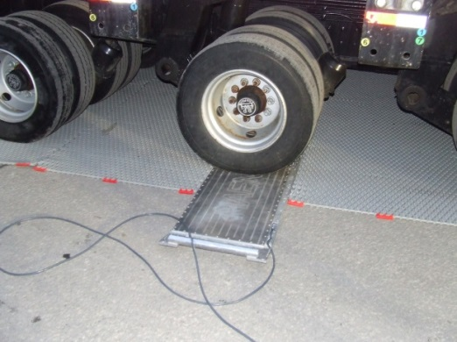
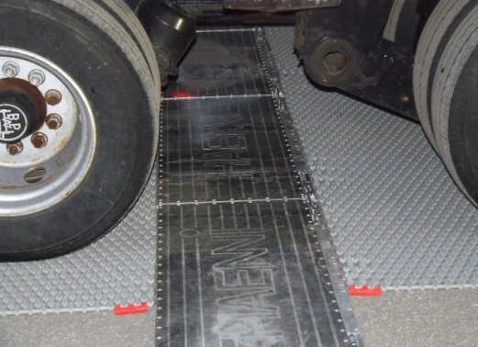
RATING FACTORS FROM DIFFERENT CODES
WE ALSO NEEDED TO VERIFY THAT OUR MODEL IS CORRECT BY DOING SOME MEASUREMENTS DURING ONE OF MOVES.
PORTABLE SCALES
Manitoba Infrastructure and Transportation RADBUG - August 2014
Water Management and Structures

Slide 30
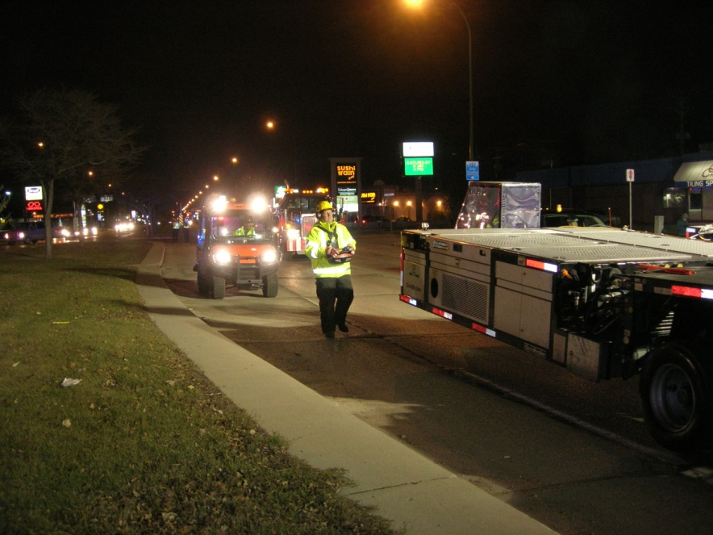
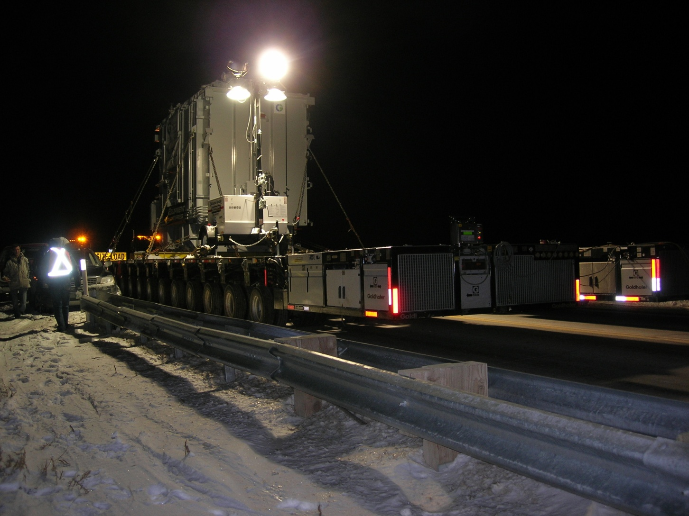
Permit Conditions
Travel from 8:00 pm – 6:00 am
10 km/h maximum speed
Traveling on centreline of bridge
Police escort inside the city limits and Manitoba
Compliance Officers for traffic control.
Total move – three nights
Manitoba Infrastructure and Transportation RADBUG - August 2014
Water Management and Structures

Slide 31
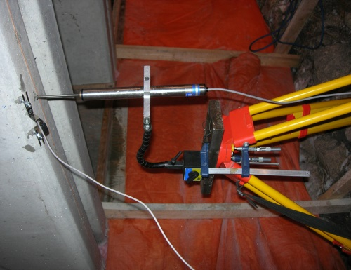
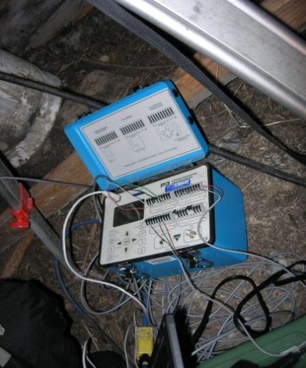
Instrumentation and Data Collection
Manitoba Infrastructure and Transportation RADBUG - August 2014
Water Management and Structures
Notes:
Due to accessibility reasons, the focus for the instrumentation was the PPCC structure.
As can be seen from the distribution factors from the previous slides and the transverse wheel spacing shown here; we note that girder lines G2 and G7 experienced more of the live load.
Instrumentation Placement
A telescopic measuring pole was used to manually verify the deflection in order to ensure the accuracy of the LVDT measurements
Data collection and storage was facilitated by 2 Model P3 Strain Indicator and Recorder Units with two separate laptops.

Slide 32
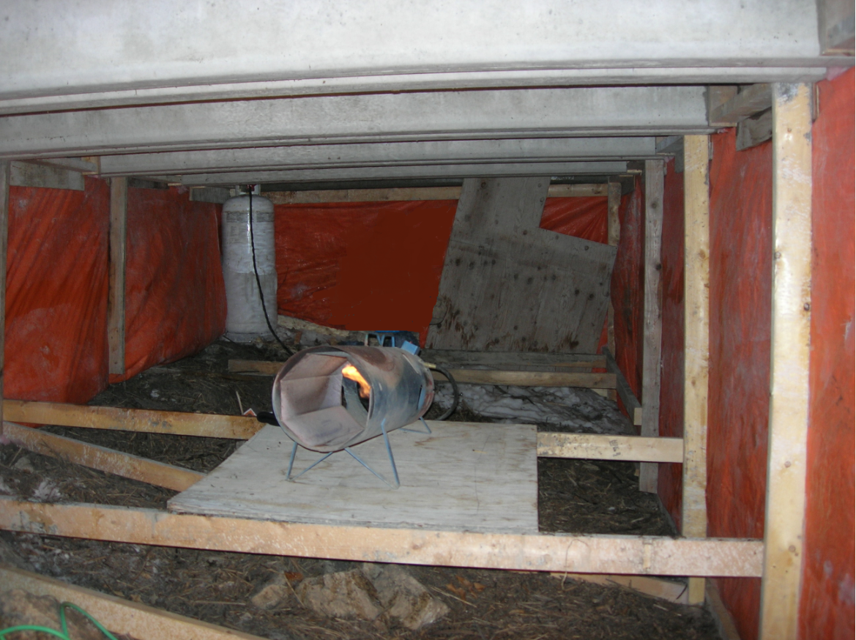
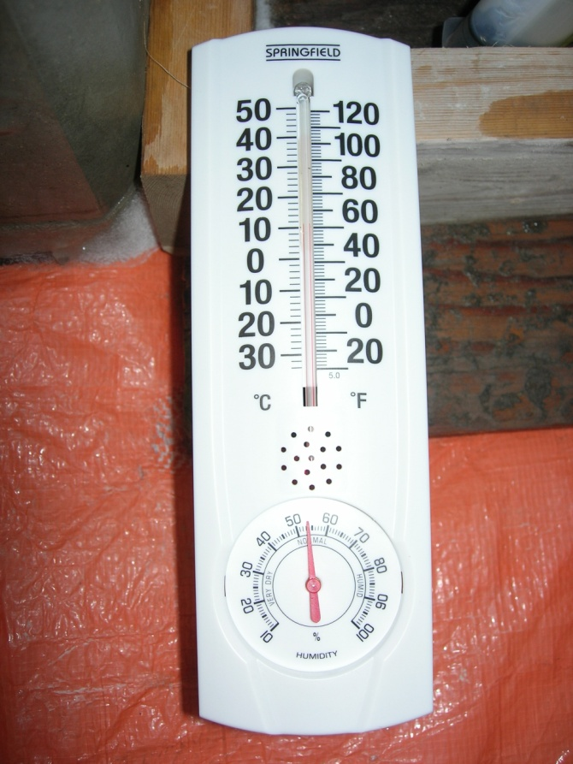
Instrumentation and Data Collection
Manitoba Infrastructure and Transportation RADBUG - August 2014
Water Management and Structures
Notes:
As this was undertaken during a typical MB winter, there were numerous environmental and climatic challenges to overcome.
Hoarding was constructed for the full width of the structure, beneath the mid-span of Span 1 and heat was provided.
Both the ambient air temp. and the girder concrete temperature were monitored during the installation of the instrumentation and the move. The temperatures remained relatively constant and within the allowable operating temperature of the instruments.

Slide 33
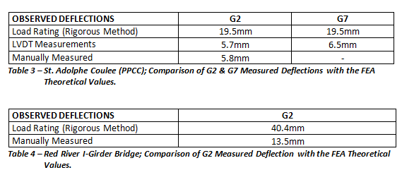
Instrumentation and Data Collection
Manitoba Infrastructure and Transportation September 2013
Water Management and Structures
Notes:
From Table 3 & 4 it is evident that the measured deflections are considerably less than those calculated from the analysis. In fact, for both structures the actual deflections represent approximately 1/3 of the theoretical deflections.
Although further testing would be required to ensure the accuracy of the measured data, you may note that the values obtained by both the LVDTs and the telescopic measuring pole do coincide.
The differences in deflection values can partially be due to subtle differences in the theoretical model versus the actual structure, such as in-situ material properties versus the design properties utilized for the load rating model. Understandably so, the load rating model also incorporates a certain level of conservatism due to material and load resistance factors to ensure an adequate amount of reserve capacity is available in the structure.
IN CONCLUSION, when NSG trucks are used for large moves, the Rigorous Method could be used to more accurately determine the effects of the load on the structure and permit a load otherwise unable to be permitted using conventional methods..

Slide 34
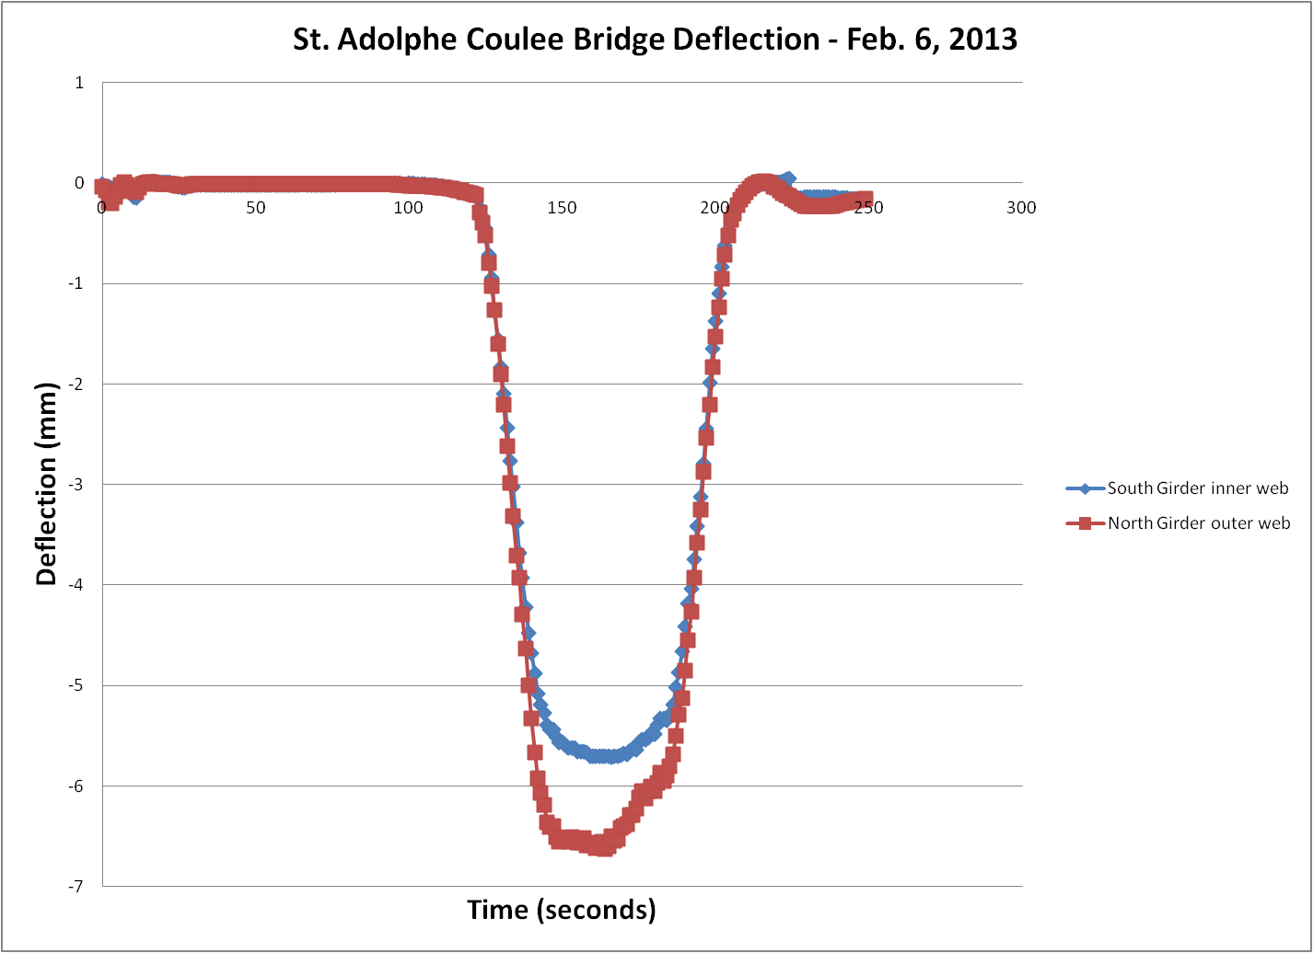
Instrumentation and Data Collection
Manitoba Infrastructure and Transportation RADBUG - August 2014
Water Management and Structures

