Slide 1


AASHTOWare BrR
Workarounds
2019 Rating and Design Bridge User Group (RADBUG) Meeting
July 30 – 31, 2019
South Lake Tahoe, CA
California Department of Transportation
David Ward, P.E.

Slide 2
Workarounds we’ll discuss
PS/PT Box Girder Shear Capacity near Inflection Points
RC Slab Bridges with Rigid Frame Abutments
Range of Applicability and The Lever Rule
Notes:
Rigid frame abutments also known as “3 sided buried structures”

Slide 3
PS/PT Box Girder Bridges
Shear Capacity near Inflection Points

Slide 4
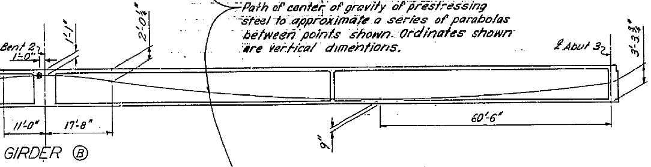
PS/PT Box Girder Bridges
Shear Capacity near Inflection Points
If the POI near the inflection point of the moment diagram is controlled by a low shear rating, the reason may be that the prestressing steel ends up slightly on the flexural compression side and does not contribute to the strain calculation in MCFT.
Notes:
Inflection points are typically seen as low risk areas, not common to see shear OR moment cracks in this location.
We, in CA also don’t have a lot of our prestress shop drawings available so have to utilize one total cable path coupled with the total design force minus losses. This same method also has to be used with our PC/PS I girders so a similar problem could show up in the analysis of those girder types as well.
Although cable paths typically rise into the compression zone in negative moment areas over continuous supports we did have 1 case where tendons from a simply supported PC/PS girder were above and caused a similar issue.

Slide 5
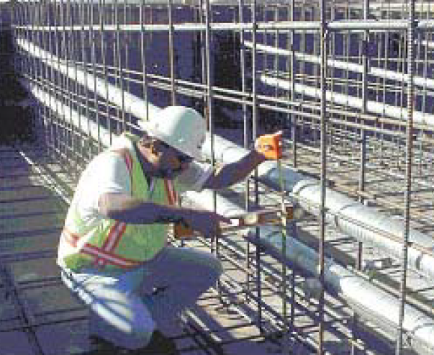
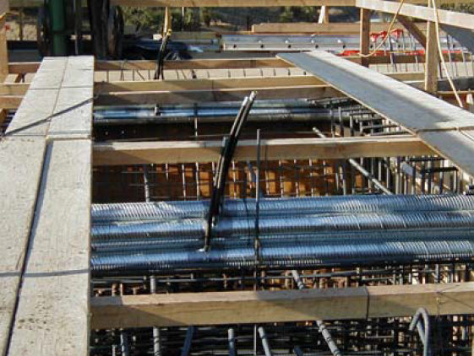
Shear Capacity near Inflection Points cont.
  Most Multi-Cell Box girders have multiple ducts within each web and all have different cable paths.
Notes:
For multicell box girders the software is limited to inputting the centroid of the prestressing steel.

Slide 6
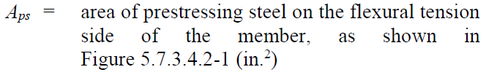
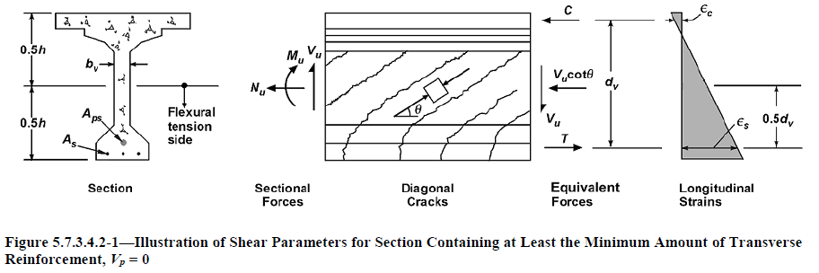
Shear Capacity near Inflection Points cont.

Slide 7
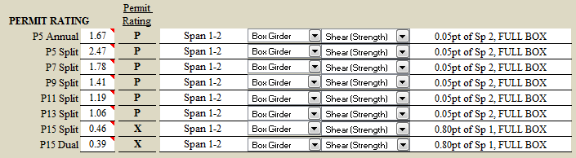
Shear Capacity near Inflection Points cont.
Notice the sharp drop in rating factor between P13 and P15 vehicles. This is an indication that moment changes sign and we have the issue with MCFT completely ignoring the effects of the prestressing force.
Notes:
We brought the issue up at the national level a few years back and the response from the researchers was to ignore the analysis point.
Brief description of our “Permit Trucks”

Slide 8
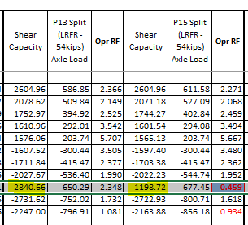
Shear Capacity near Inflection Points cont.
From the summary spreadsheet for the 0.8pt of Span 1 you can see that the demand does not increase much between the P13 and P15 but capacity drops significantly.

Slide 9
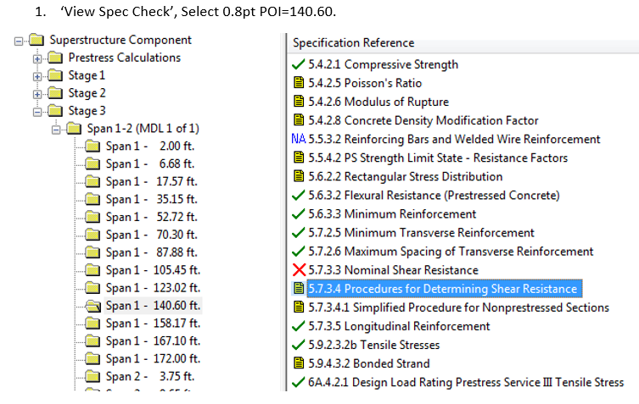
Shear Capacity near Inflection Points cont.
To confirm our suspicions:

Slide 10
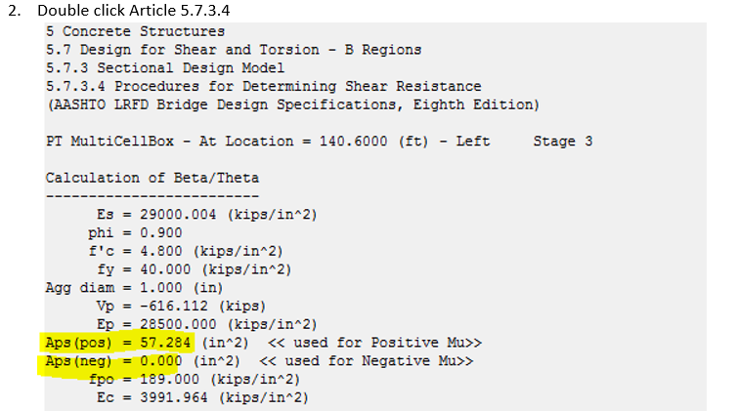

Shear Capacity near Inflection Points cont.

Slide 11
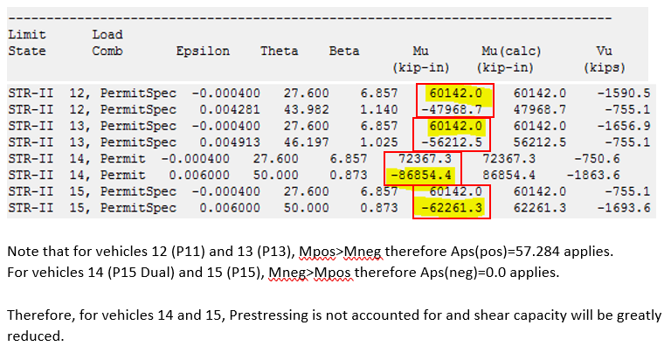
Shear Capacity near Inflection Points cont.

Slide 12
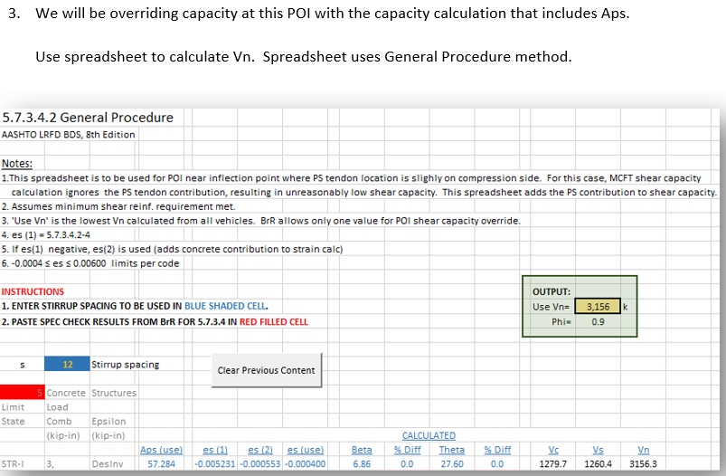
Shear Capacity near Inflection Points cont.

Slide 13
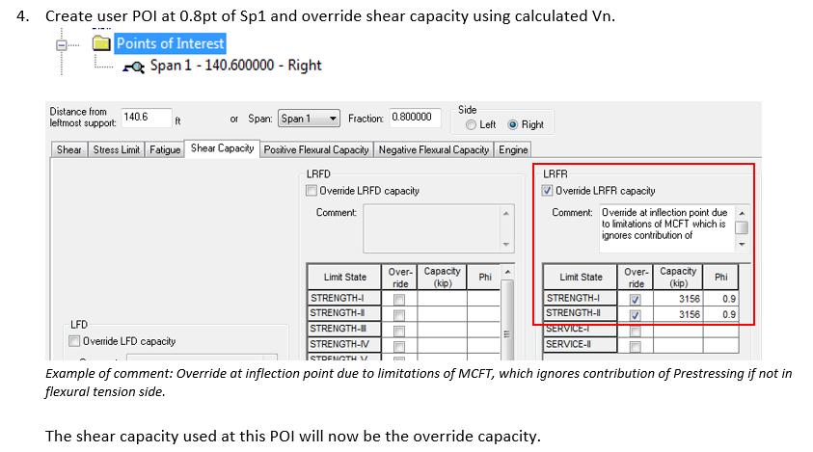
Shear Capacity near Inflection Points cont.

Slide 14
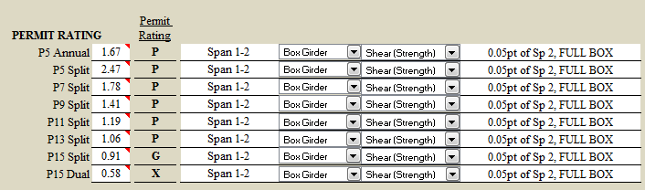
Shear Capacity near Inflection Points cont.
Results after override of shear capacity.

Slide 15
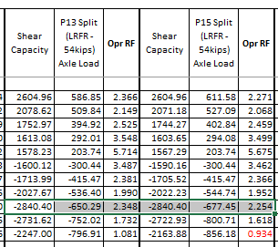
Shear Capacity near Inflection Points cont.
0.8 pt Sp1
Vr=0.9*Vn=0.9*3156=2840
Notes:
Note that 0.8pt POI no longer controls P15 Split and P15 Dual and instead, dv from Face of Support is now the controlling location.
Add ‘workaround’ agency code

Slide 16
Modeling a Rigid Framed RC Slab Bridge

Slide 17
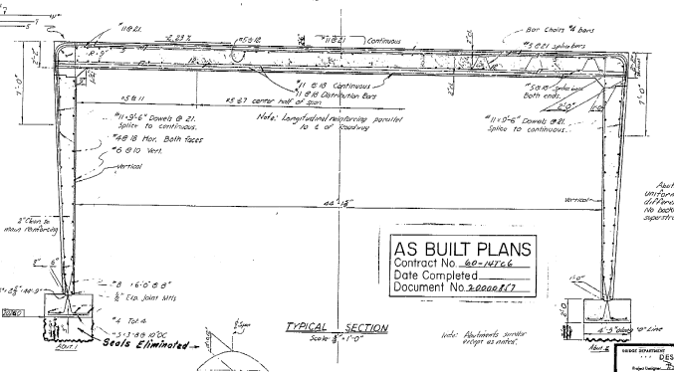
Modeling a Rigid Framed RC Slab Bridge
1959 –Rigid Pinned support at bottom
Notes:
The varying section thickness of our typical framed abutment makes it difficult o come up with fixed end moments. Constant thickness sections can be done by hand.

Slide 18
Modeling a Rigid Framed RC Slab cont.
The abutment walls of Rigid Frame Structures will have Horizontal Earth Pressure (EH) and therefore, its effect on the structure needs to be considered.
LRFD specifications include min and max load factors for EH, BrR includes only max.
BrR is not currently capable of applying horizontal forces on vertical members (excluding Culvert module).
BrR does not allow “integral” substructure at Abutment. The option that is available for rigid frame structures is to use the Frame Structure Simplified definition.
Notes:
EH: see Page 3-15 of 2016 AASHTO LRFD Bridge Design Specification - 7th Edition; Incorporates 2016 Interim Revisions
L:\Unit 3488 (Old 626)\Rating Analysis Branch\Analysis Reference\AASHTO_LRFD_7th

Slide 19
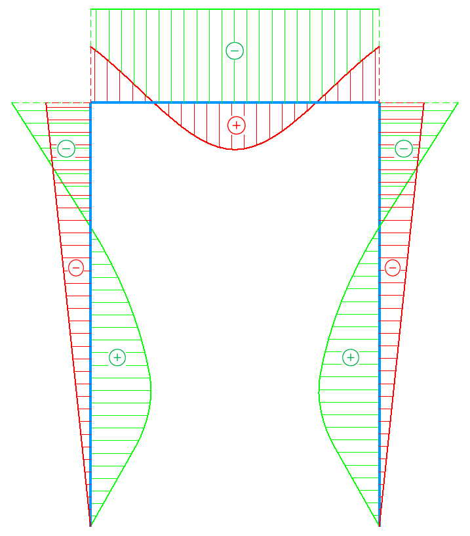
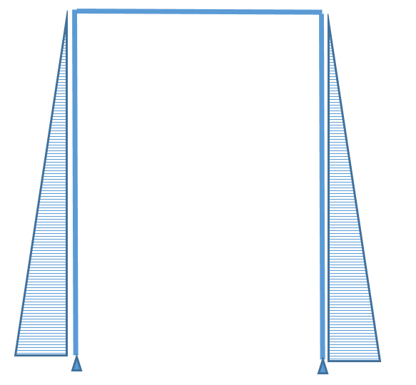
Modeling a Rigid Framed RC Slab cont.
Earth pressure counters the DLM
in the positive moment regions but
adds to the dead load demand in
the negative moment region.
Red = Dead Load Moment
on superstructure
Green = Moment due to
Earth Pressure

Slide 20
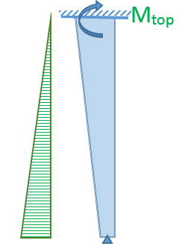
Modeling a Rigid Framed RC Slab cont.
Establish the Fixed
End Moment (FEM) at the top of abutment wall for EH loading separately. This approach uses the “Moment Distribution” approach and assumes that side sway at superstructure level will not occur.

Slide 21

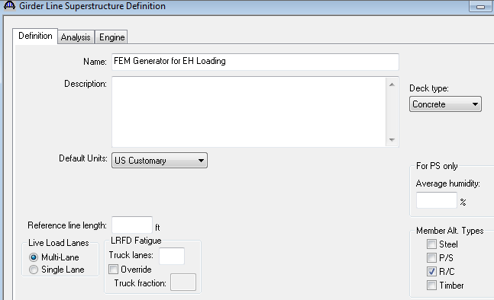
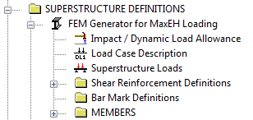
Modeling a Rigid Framed RC Slab cont.
  Use BrR to calculate FEM at top of abutment
  Generate a Girder Line Structure
Actual
Mathematical Model within BrR

Slide 22
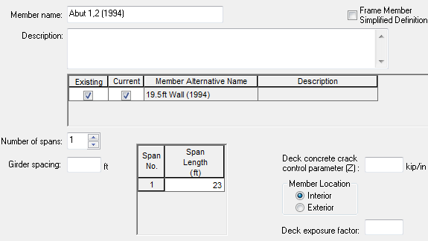
Modeling a Rigid Framed RC Slab cont.
  Create a RC Slab member.
  Length of the beam element equals the height of the abutment.
  Width and depth of the beam element will be set equal to the width and thickness of abutment wall.

Slide 23
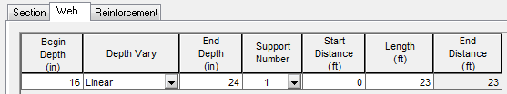
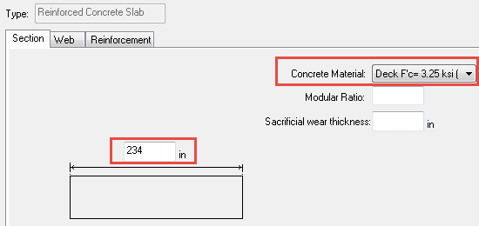
Modeling a Rigid Framed RC Slab cont.
  Enter the Slab Profile only
    Width of the section equals width of Abut Wall (19.5’ wide wall = 234” input).
    Thickness of wall equals “depth” (thickness varies from 16” to 24”).
    No need to enter any other details.
Notes:
Make sure the correct Concrete Material is selected

Slide 24

Modeling a Rigid Framed RC Slab cont.
  Adjust the support condition to match the boundary condition of the wall.
Wall is pinned at bottom (support 1) and fixed at top (support 2).
Notes:
Make sure the correct Concrete Material is selected

Slide 25


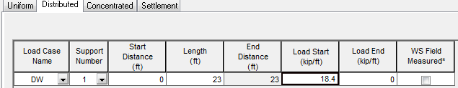
Modeling a Rigid Framed RC Slab cont.
  Enter the EH load as a Distributed Member Load, Load Case DW.
Notes:
Make sure to pick the correct Dead Load Case → Select “Member Dist’d Loads”, NOT the default “Self Load”
Slide #102: Case 1: 0.9 x 45.0 ≈ 41.0 psf for Maximum demand [using DW load case]

Slide 26

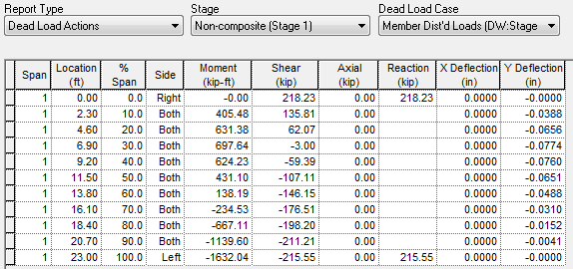
Modeling a Rigid Framed RC Slab cont.
  Run the “DL Only” analysis on this member and get the moment demand for Member Distributed Load at Right end of the member (that represents the top of the wall). Result is 1632 kip-ft
Notes:
Make sure to pick the correct Dead Load Case → Select “Member Dist’d Loads”, NOT the default “Self Load”
Slide #102: Case 1: 0.9 x 45.0 ≈ 41.0 psf for Maximum demand [using DW load case]

Slide 27
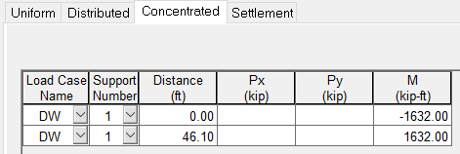
Modeling a Rigid Framed RC Slab cont.
Enter the FEM established at top of the abutment walls as a “concentrated” moment on the superstructure.
Be careful with sign of the EH moment demand
Run full live load analysis on slab model and capture results
Repeat for additional load cases
Notes:
Case 1: (1.35/1.50) x 45 = 0.9 x 45 ≈ 41.0 psf for Maximum demand [using DW load case]
Case 2: (0.5/1.50) x 45 ≈ 0.333 x 45 = 15.0 psf for Minimum demand [using DW load case]

Slide 28
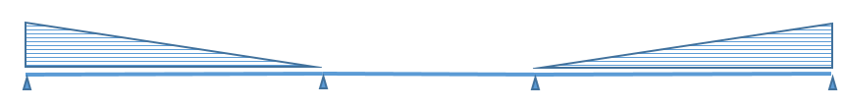

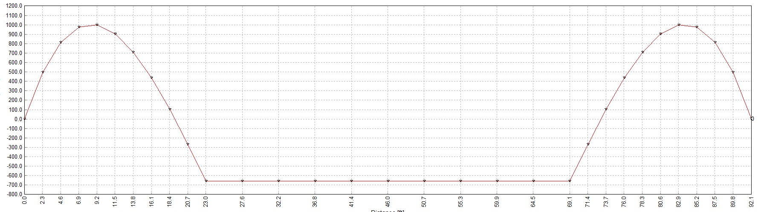
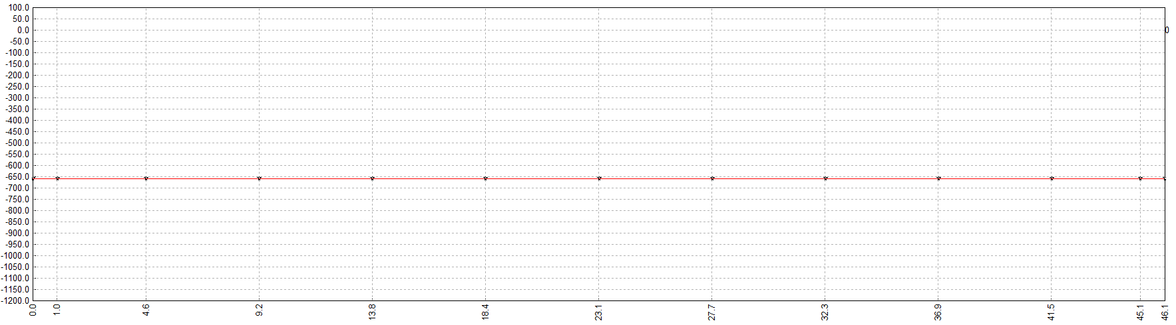
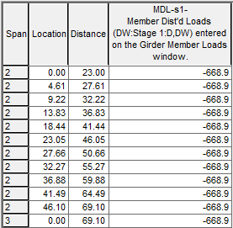
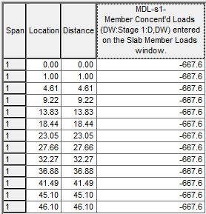
Modeling a Rigid Framed RC Slab cont.
Two approaches were compared to validate the demand from EH loading.
Comparison is shown below:
Abutment rotational spring
(column stiffness from Framing Plan)

Slide 29
Range of Applicability Overwrite
&
The Lever Rule

Slide 30
Range of Applicability Overwrite
AASHTO LRFD simplified LLDF equations were developed by creating finite element models generated for “typical” bridge configurations.
Ranges of applicability for the simplified equations were established based on the limits of the research (span length, girder spacing, deck thickness, longitudinal stiffness).
AASHTO Specification recommends to use “refined analysis” to design bridge when the bridge geometry falls outside of the range of applicability.
AASHTOWare BrR uses the most conservative “Lever Rule” method to establish the LLDF whenever the range of applicability is violated.

Slide 31
Range of Applicability Overwrite cont.
Use of Lever Rule to establish the LLDF is often conservative.
  Bridges that fall outside a range of applicability may not rate well when LLDFs are generated using the Lever Rule method.
Instead of extending the “range of applicability” to all structures and for all variables, Caltrans practice is to overwrite applicability rules based on comparisons of LLDF values generated by the simplified equations and Lever Rule at both range extents.

Slide 32
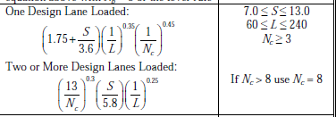
Range of Applicability Overwrite cont.
  Whenever variable of the LLDF is in the numerator and actual value is smaller than the lowest range of applicability, the lowest range value is used in the expression to establish the LLDF.
  Only S is in the numerator in these expressions.
  So, if the actual girder spacing falls below 7 (say 6.9ft), LLDF will be developed using the value of 7.

Slide 33
Range of Applicability Overwrite cont.
  Whenever variable of the LLDF is in the numerator and actual value is larger than the largest range of applicability, LLDF will be established using “LEVER RULE”.
  Only S is in numerator in these expressions
  So, if the actual girder spacing exceed the largest range of 13ft (say 14ft), LLDF will be developed using LEVER RULE
  As S increases, the deck will become more flexible and may eventually not be stiff enough to distribute the loads to other girders so the “Lever Rule” method will be appropriate.

Slide 34
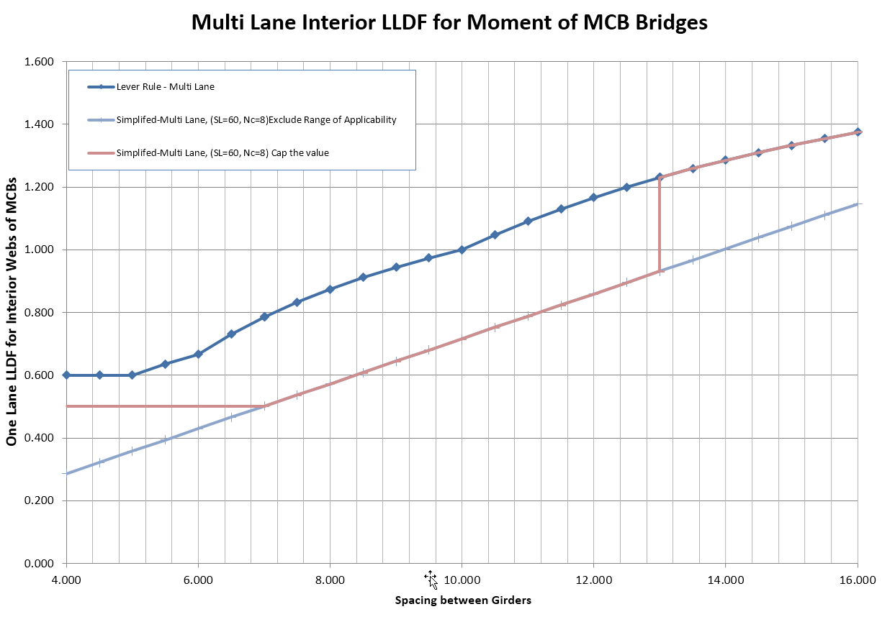
Range of Applicability Overwrite cont.
  Using the lowest range given in the expression to establish the LLDF at min value and Lever Rule at max.

Slide 35
Range of Applicability Overwrite cont.
  Whenever variable of the LLDF is in the denominator and actual value is larger than the largest range of applicability, the largest range given in the expression will be used to establish the LLDF.
  In this expression Span Length L and number of Cells N_{c} are in the denominator.
  So, if the actual span length is greater than 240ft (say 260ft), LLDF will be developed using the value of 240ft instead of the Lever Rule.

Slide 36
Range of Applicability Overwrite cont.
  Whenever variable of the LLDF is in the denominator and actual value is smaller than the smallest range of applicability, LLDF will be established using “LEVER RULE”.
  In this expression Span Length L and number of Cells are in the denominator.
  So, if the actual span length is less than 60ft (say 59ft), LLDF will be developed using Lever Rule.

Slide 37
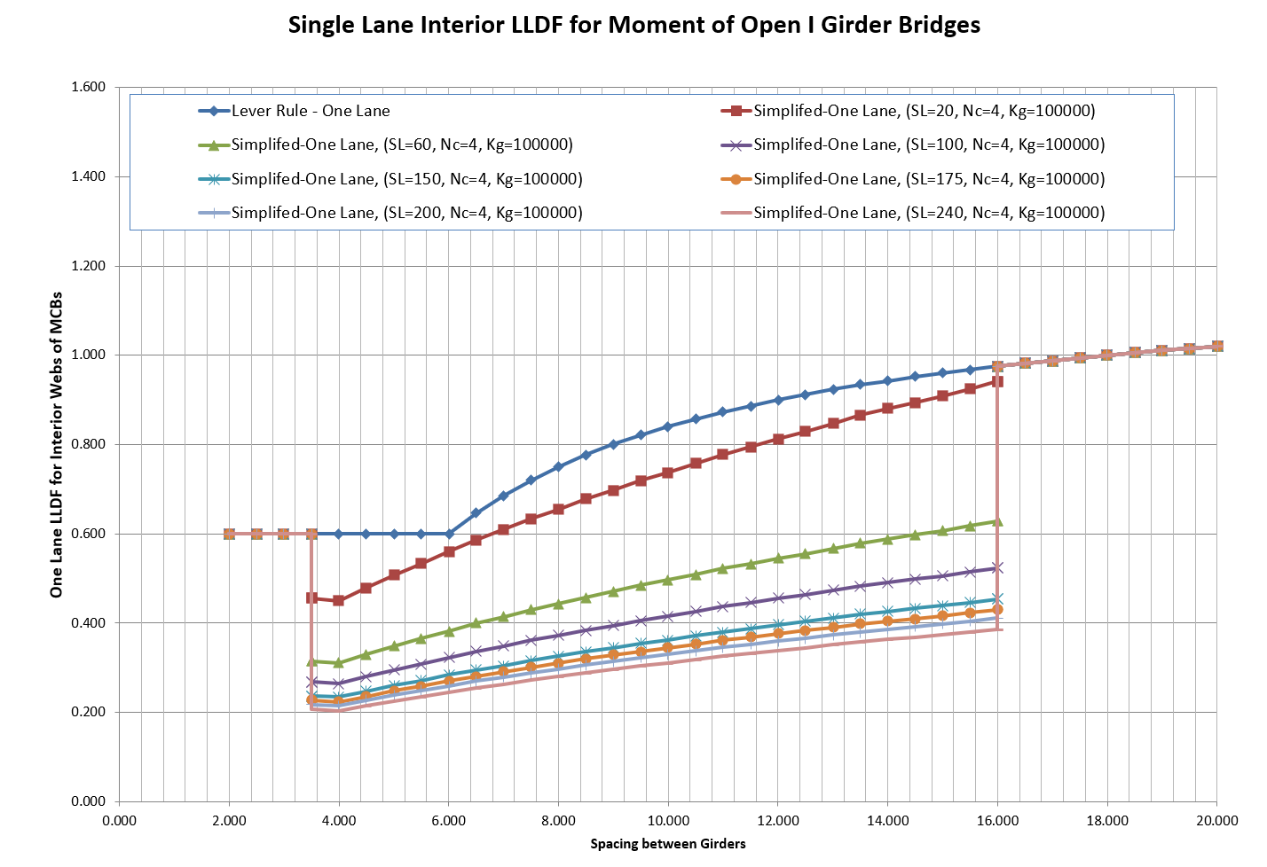
Range of Applicability Overwrite cont.
  In this example, as the span length increases the Lever Rule becomes increasingly conservative (3.5’≤S≤16.0’).

Slide 38
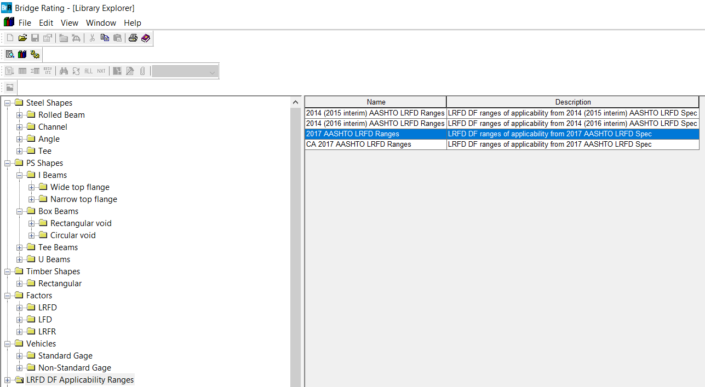
Range of Applicability Overwrite cont.
How can a Range of Applicability be overwritten in the BrR software?

Slide 39
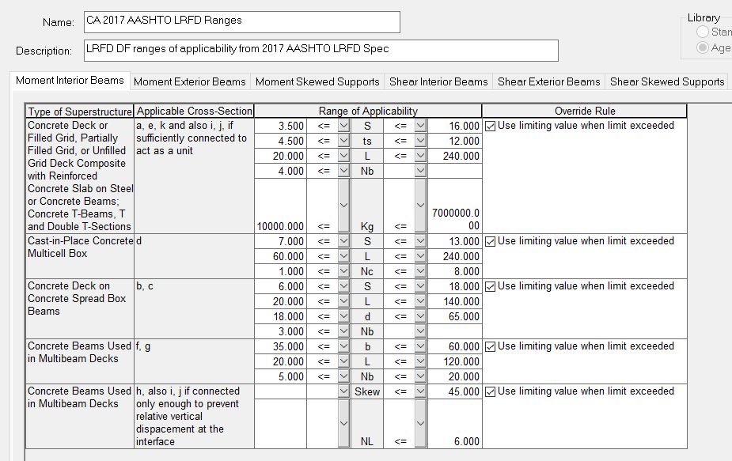
Range of Applicability Overwrite cont.

Slide 40
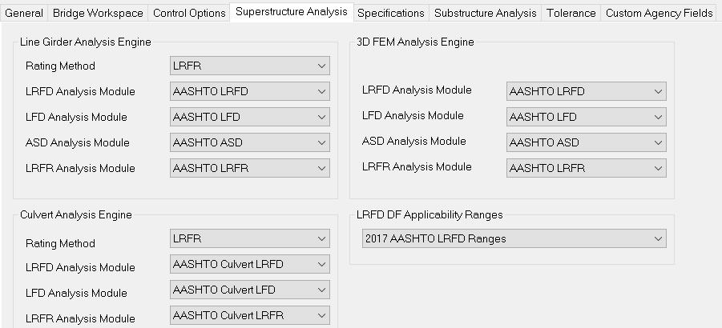

Range of Applicability Overwrite cont.
Go to Configuration Browser/System Defaults/Superstructure Analysis Tab
Change the LRFD DF Applicability Ranges to newly created CA 2017AASHTO LRFD Range

Slide 41

Questions?
Notes:
MEYDAN VIP BRIDGE, DUBAI, UAE
LED lighting welcomes VIP guests visiting Dubai on the Meydan Bridge: Every year, Royal family members and other A-list guests use the bridge to access the racetrack for the Dubai World cup.

