Slide 1








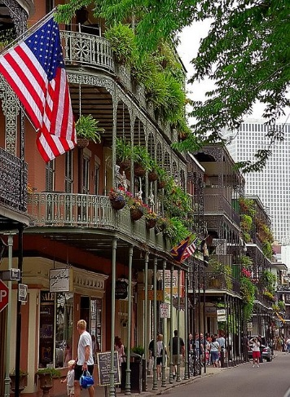


Welcome to Louisiana

Slide 2
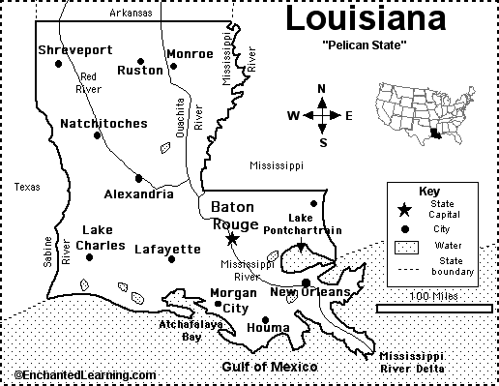
13,000 bridges (22nd)
180 million SF deck (3rd)
(~666 superdomes)
18 of top 20 longest bridges
141 movable bridges (2nd)
40% 50+ years old
15% posted bridges, 10% scour critical bridges
70% concrete, 4% steel, 5% timber, 20% culvert
51% good, 40% fair, 9% poor

Slide 3
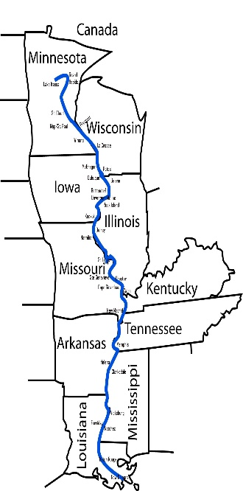
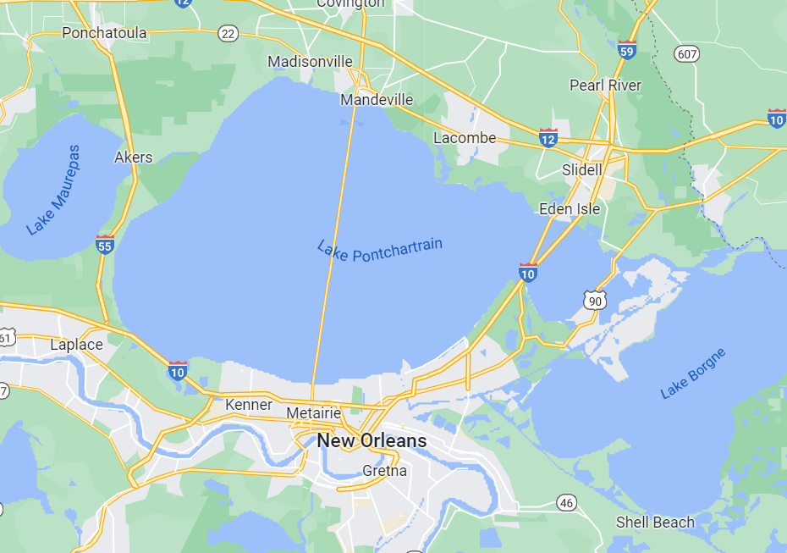
Bridges Across Lake Pontchartrain
2340
136
11
Bridges Across Mississippi River

Slide 4
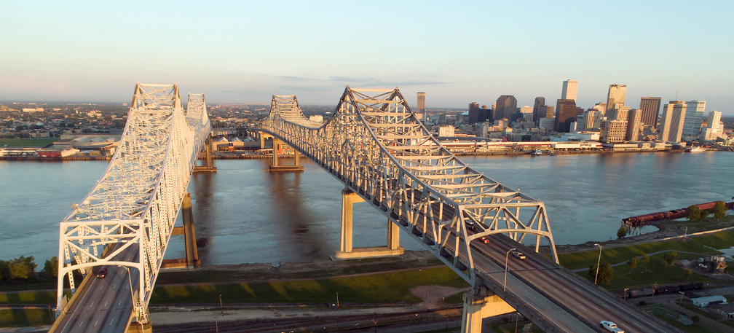
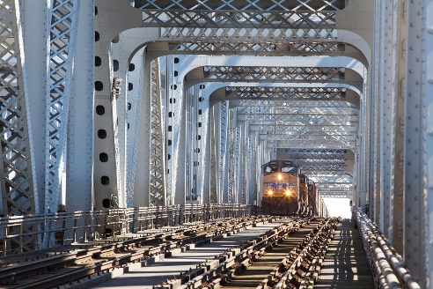
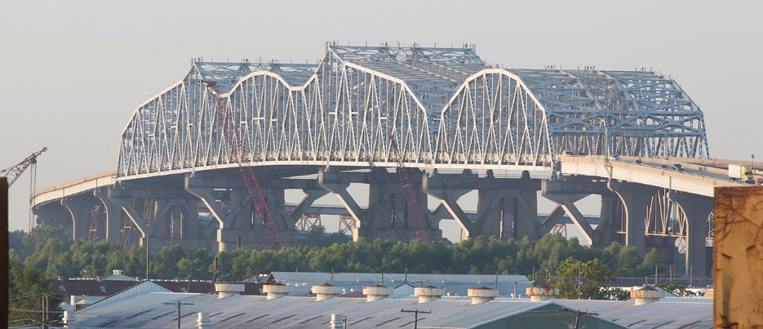
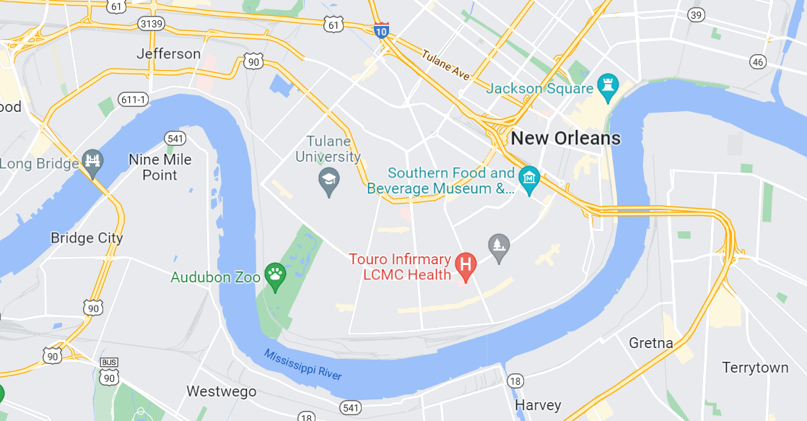
Last Two Bridges Across “The Father of Waters” Before Reaching Gulf of Mexico
US 90 Crescent City Connection
1958EB 1988WB 2.5 miles
US 90 Huey P. Long Bridge
1935 2013 1.5 miles

Slide 5
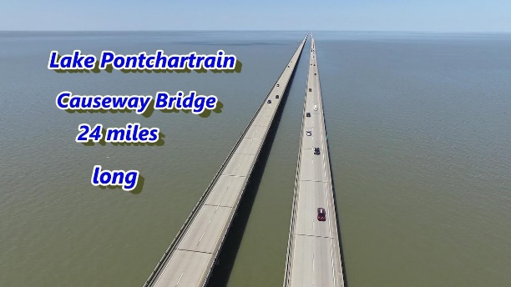

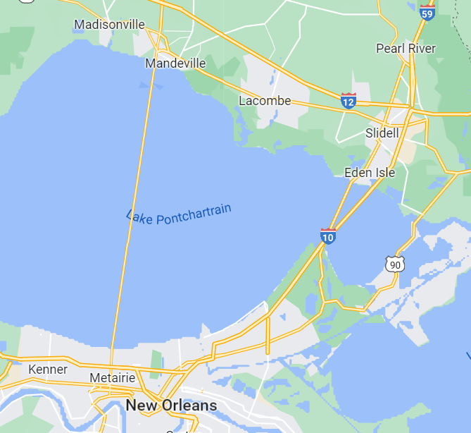
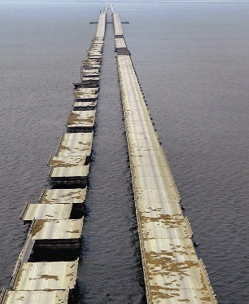
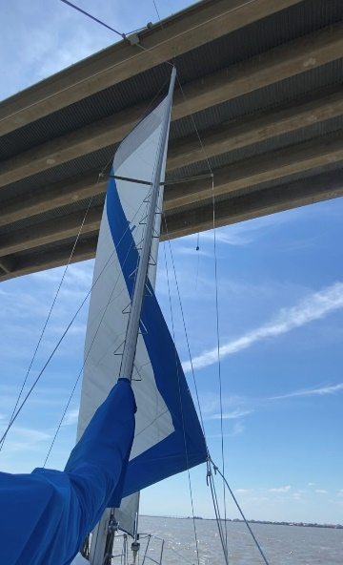
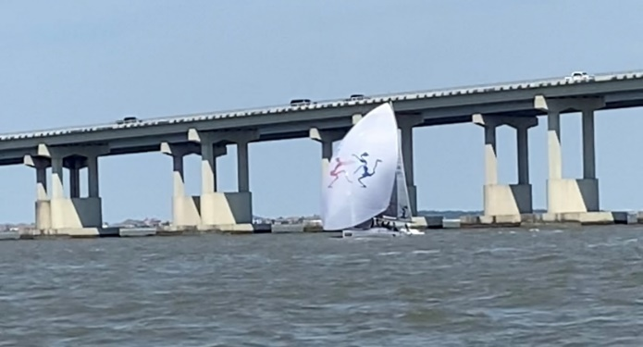
Bridges Across Lake Pontchartrain
I-10 Twin Span Bridges – 5.4 miles
8/29/2005 Destroyed by Katrina
2011 Rebuilt – Designed by DOTD Bridge Design In-House Staff in 9 Months

Slide 6
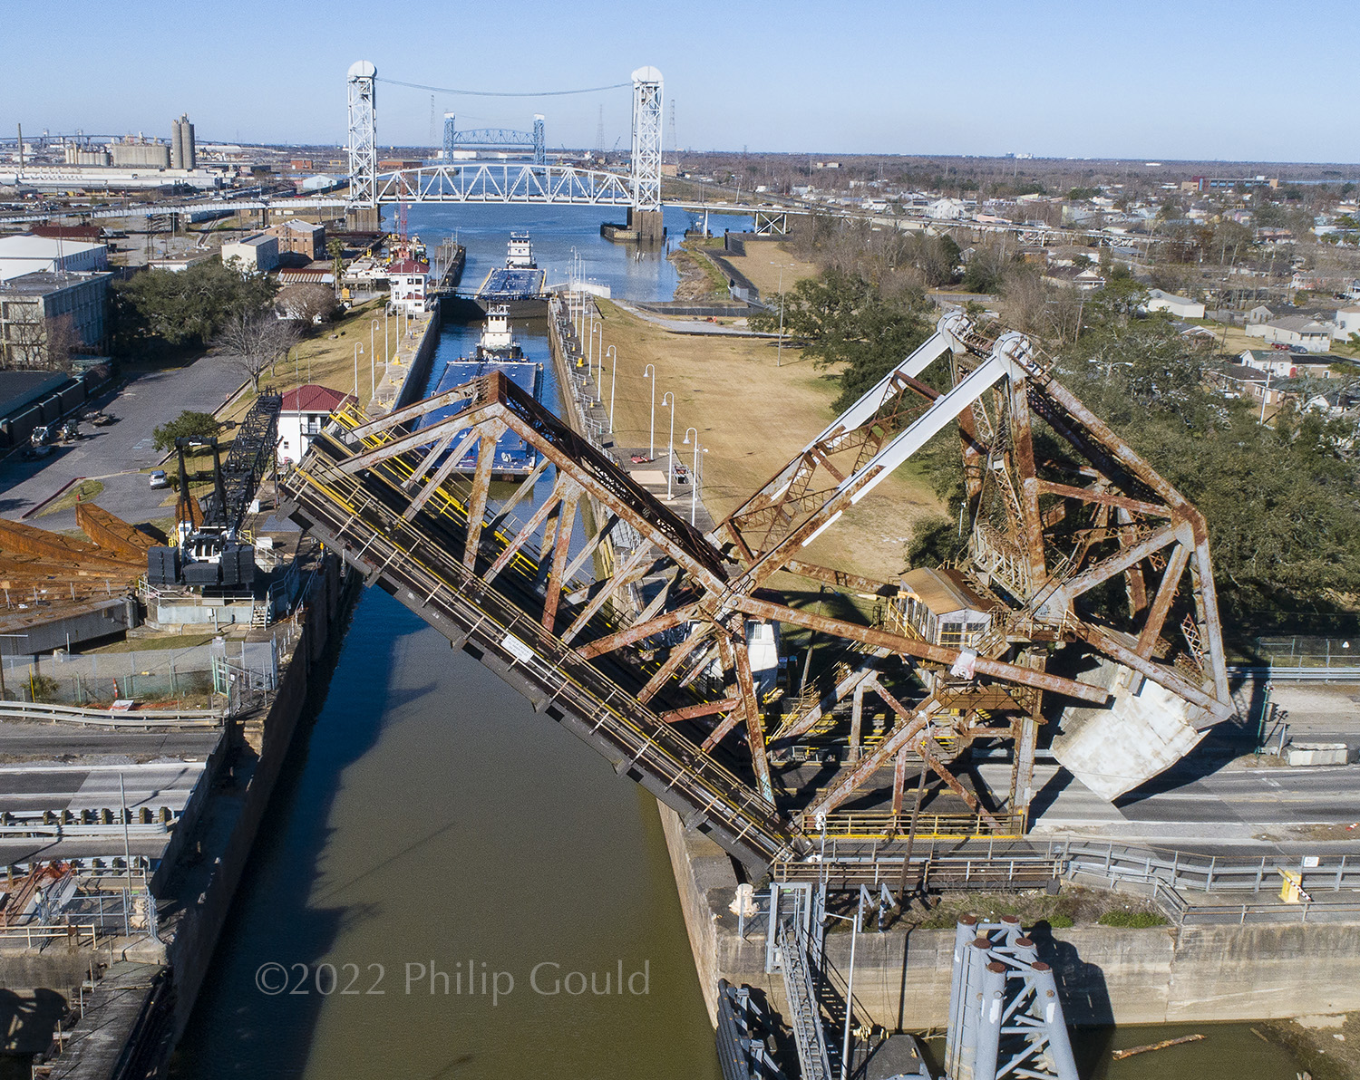

Slide 7
LADOTD Bridge Design Staff
Load Rating Unit
In-House Design Unit
Manuals/Standards/Spec./Consultant Management Unit
Highway Safety/Emergency Project Unit
Movable Bridges/Facilities/Interstate Lighting Unit
Bridge Program and Project Management Unit
  On-System Bridge Program $270M/year (with IIJA)
  Off-System Bridge Program $70M/year (with IIJA)
  70 positions (down by 10)
  Very difficult to recruit engineers

Slide 8
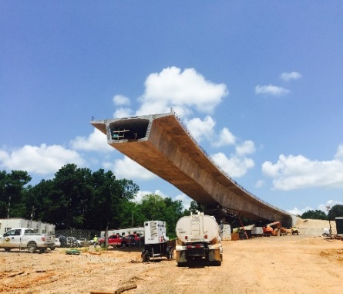
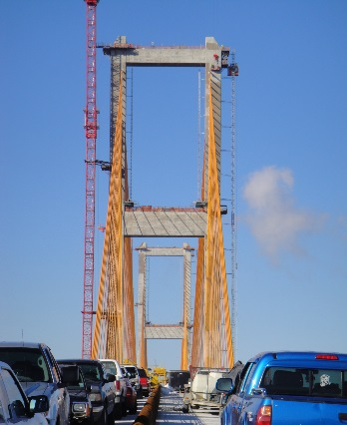
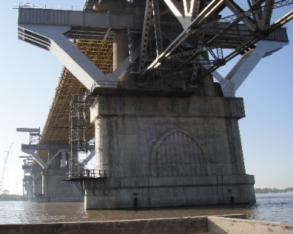
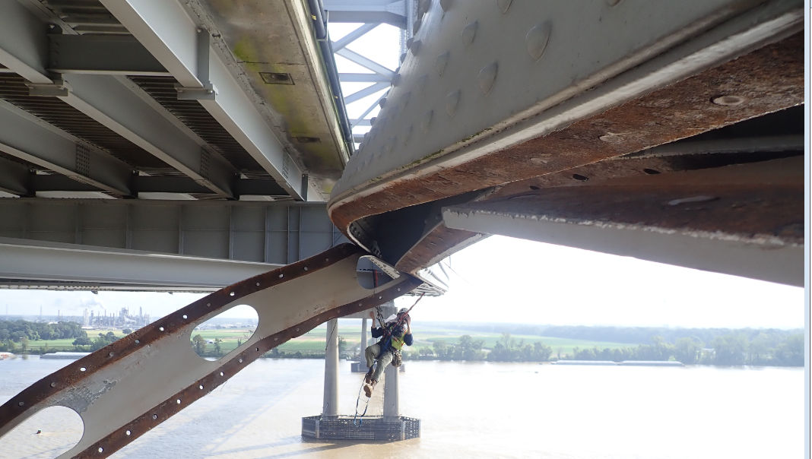
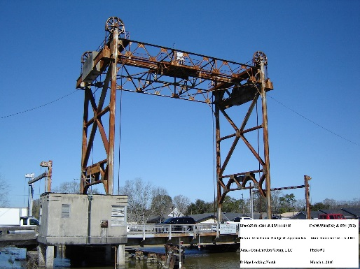
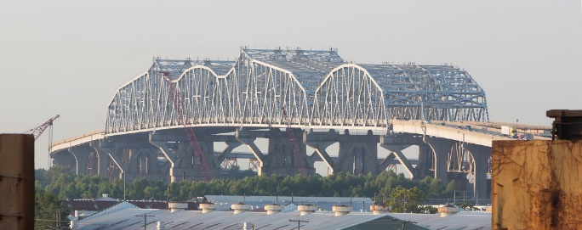
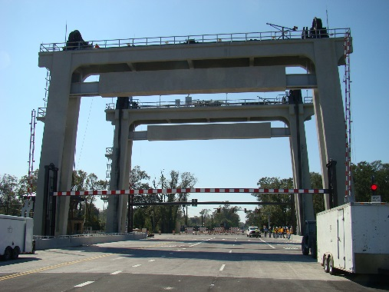
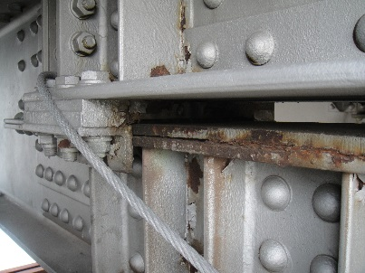
350+ projects in development
150+ projects under construction
New bridges
Replacing exist. bridges
Widening exist. bridges
Rehabilitation/Repair
Emergency Projects

