Slide 1
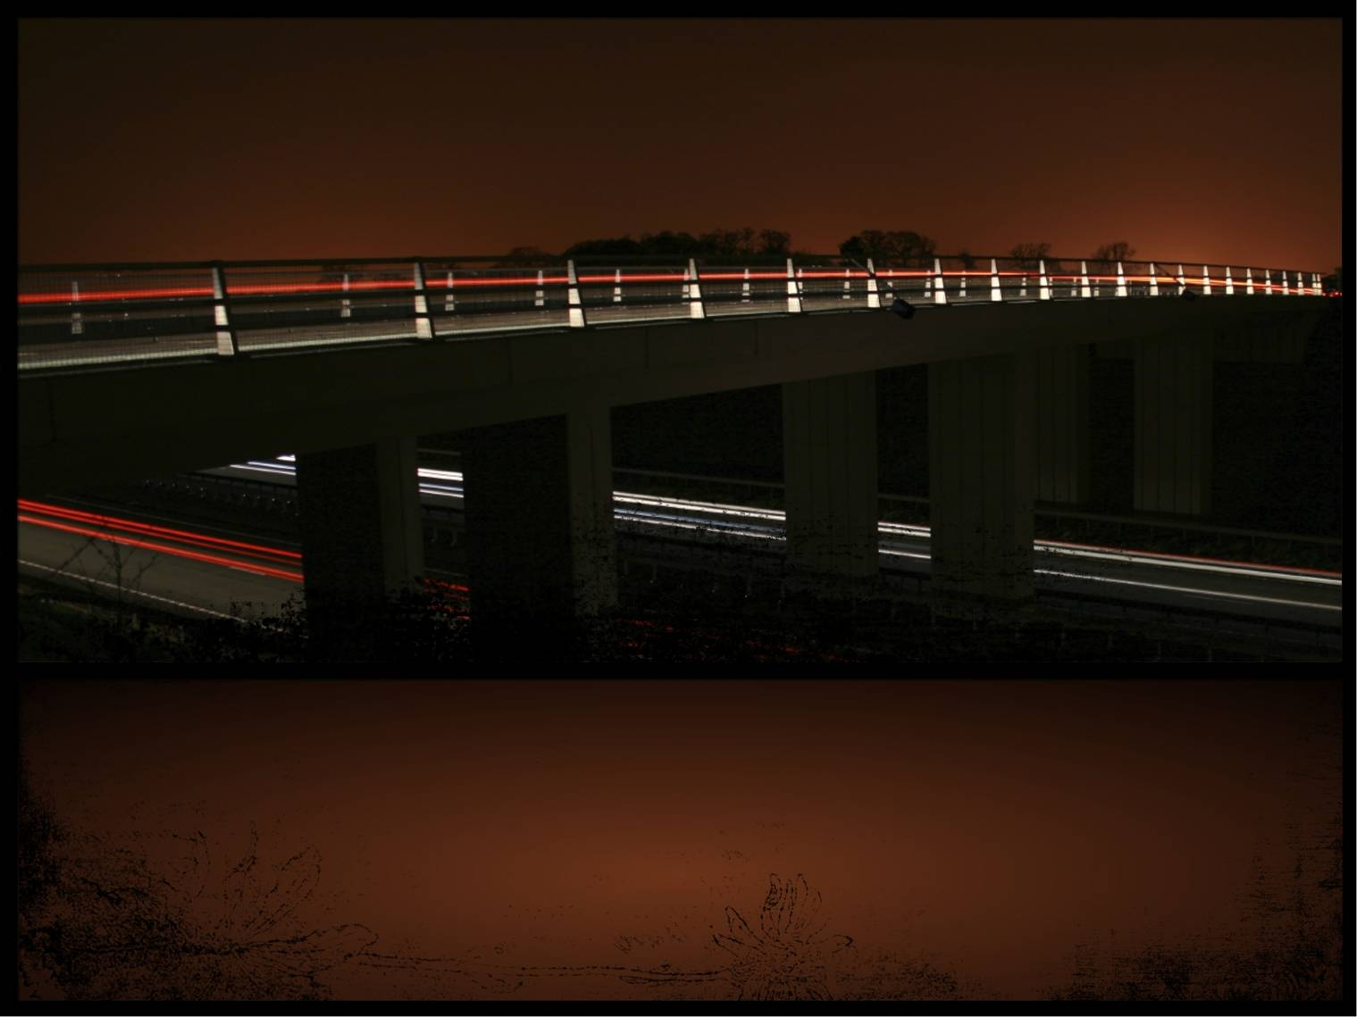
AASHTOWare BRIDGEWare Satisfaction Survey Results
FY 2010
Wendy L. Gagnier, P.E.
BRIDGEWare Project Manager

Slide 2
BRIDGEWare Task Force Members
Wendy Gagnier, P.E. - AASHTO BRIDGEWare Project Manager
Virtis/Opis
Pontis
Tim Armbrecht – IL DOT & BW Chair
Dean Teal – KS DOT
Rebecca Curtis – MI DOT
Bryan Silvis – VA DOT
Vacancy -
Tom Saad – FHWA & Virtis/Opis Liaison
Mike Johnson – Caltrans & Vice-Chair
Paul Jensen – MT DOT
Francois Ghanem – NYS DOT
Scot Becker – WI DOS
Wade Casey – FHWA & Pontis Liaison

Slide 3
Background
The AASHTOWare Annual Strategic Plan Requires Each Product to Conduct a User/Customer Satisfaction Survey
  To Promote and Improve Customer Satisfaction
  To Establish Issues of Importance to Product Users, and
  To Establish How to Measure Issues for Prioritization and Incorporation

Slide 4
Background
Two Surveys Were Issued in FY 2010 for BRIDGEWare Products
  One to Member Agencies
  One to Consultants and Non-Member Agencies
Difference in Content of Survey Topics
  Survey for Consultants and Non-Member Agencies Did Not Include Questions on Interaction With BRIDGEWare Task Force

Slide 5
Background
The FY2010 Survey Was Issued on January 08, 2010
All Results Were Received by January 25, 2010
  Member Agencies = 52 Respondents
  Consultants and Non-Member Agencies = 31 Respondents

Slide 6
Survey’s Formats
Questions Were Asked in the Following Areas:
  Satisfaction With the Products
  Satisfaction With the Contractor
  Satisfaction With the Product Documentation
  Satisfaction With the BRIDGEWare Task Force

Slide 7
Survey Results
The Surveys Were Reviewed and Analyzed
Pivotal Questions Were Extracted and Used in the Executive Summaries to Provide an Overall Look at the Response to the Main Topics

Slide 8
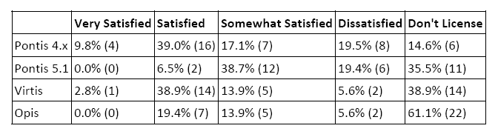
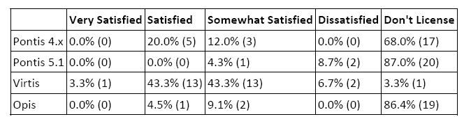
Survey Results
Overall Satisfaction With the BW Products
  Member Agencies Response
  Consultants/Non-Member Agencies Response

Slide 9
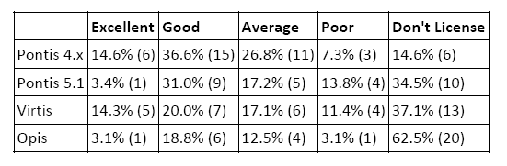
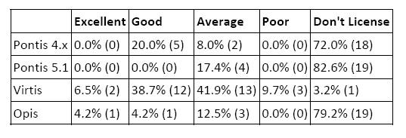
Survey Results
Ranking of Contractor Support for Products
  Member Agencies Response
  Consultants/Non-Member Agencies Response

Slide 10
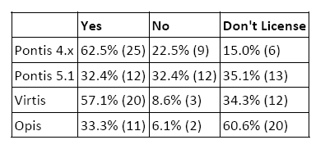
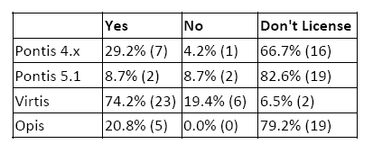
Survey Results
Would the Users Confidently Recommend BW Products to Others
  Member Agencies Response
  Consultants/Non-Member Agencies Response

Slide 11
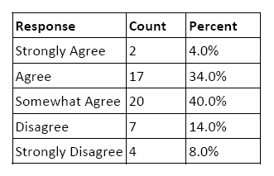
Survey Results
Does the Task Force Understand the Service Needs of the Agency/Organization
  Member Agencies Response
  Consultants/Non-Member Agencies Response
    NA

Slide 12
Additional Comments
Some of the Questions Provided an Opportunity for the Respondent to Offer Additional Comments
The Task Force Has Reviewed These Comments
In an Effort to Effectively Provide Reponses, They Have Grouped the Comments Based on a Topic Area

Slide 13
Additional Comments
Virtis/Opis Help Manual, Tutorial or Documentation and General Program Usability:
“The Task Force is to include a dedicated user manual as an option for user prioritization during extensive enhancement voting. Additionally, the Task Force will compile the existing tutorials and highlight what is currently available at the upcoming User Group Meeting.”

Slide 14
Additional Comments
Task Force Not Responsive to V/O User Group Requests:
“The Task Force recently distributed a detailed explanation of the user requested enhancements that have been added to the current work plan. A long term plan identifying a schedule for significant program enhancements will be presented at the User Group Meeting. Additionally, the Task Force will allow for the users to vote on extensive enhancements (part of strategy for a long term plan) separately from minor enhancements (added to each release).”

Slide 15
Additional Comments
Task Force Communication Issues :
“The V/O Task Force takes user communication issues seriously, and has recently increased its efforts in this area. Specifically, meeting minutes for all Task Force meetings are sent to the User Group officers for distribution to the user groups. The Task Force also recently distributed a detailed explanation of the user requested enhancements that have been added to the current work plan. Additionally, a long term plan identifying a schedule for significant program enhancements will be presented at the User Group Meeting.”

Slide 16
Additional Comments
Structural Accuracy and Bugs With the Virtis/Opis Products:
“The Task Force has set aside a funding source in the work plan in order to get the AASHTO Design Specifications and MBE updates into the program during the same year. The Task Force has also undertaken the task to clarify the bug policy that will clarify which issues are bugs, which are maintenance items and which are enhancements. This bug policy will require additional communication between the contractor and the users regarding any bugs found in current versions of the software. Finally, bug resolution has been included in the performance goals for the products set by the Task Force and enforced by SCOJD.”

Slide 17
Additional Comments
Products’ Output and Reporting:
“A tutorial will be developed for locating and interpreting output.”

Slide 18
Additional Comments
Product Enhancements:
“The Task Force has developed a long term plan to incorporate the extensive user requested enhancements. This plan will be presented to the users at the User Group Meeting.”

Slide 19
Additional Comments
Opis as a Design Tool:
“Improving Opis as a design tool has been added to the long term plan.”

Slide 20
Questions?

