Slide 1
BrDR 7.1 and 7.2
New Features and Enhancements
Krisha Kennelly, P.E. krisha@promiles.com
Subhadeep Ghosh, P.E. subhadeep@promiles.com
AASHTOWare RADBUG Meeting
August 2-3, 2022
New Orleans, LA

Slide 2
What’s new in BrDR in the last year?
BrDR 7.1.0 released September 2021
BrDR 7.1.1 released November 2021
BrDR 7.2.0 released February 2022

Slide 3
BrDR 7.1.0 September 2021
Advanced concrete members
Live load distribution factors for one or two cell box girder bridges
User-defined load distribution to multi-cell box webs
Ability to specify LRFD resistance factors for tension-controlled post-tensioned concrete sections with bonded strands or tendons
Ability to specify if the exterior web in a multi-cell box bridge should be considered as an interior web when computing live load distribution factors to accommodate widened structures
Four LRFD live load distribution factor applicability ranges enhancements
3D analysis for reinforced concrete and steel superstructures with in-span hinges
Ability to specify Load Rating Tool’s permit analysis settings
Load Rating Tool – Addition of slab system LFR
Simplified Analysis API for LRFR permit load analysis
BrM web service integration
Analysis Results Comparison Tool
Support Active Directory authentication
Support Oracle container database architecture
API license mechanism

Slide 4
BrDR 7.1.0 September 2021
Advanced concrete members
  Wide variety of cross sections can be modeled including non-symmetric and precast shapes
  Regions of post-tensioning and regions of reinforced concrete within the same member
  Overlapping post-tensioning tendons apply at different construction stages
  Hinges can be present in select construction stages
Notes:
Krisha will present this new feature after this presentation.
New “Advanced Concrete” member alternative for Girder System and Girder Line Structure Definitions.
Member alternative can be RC or PT

Slide 5
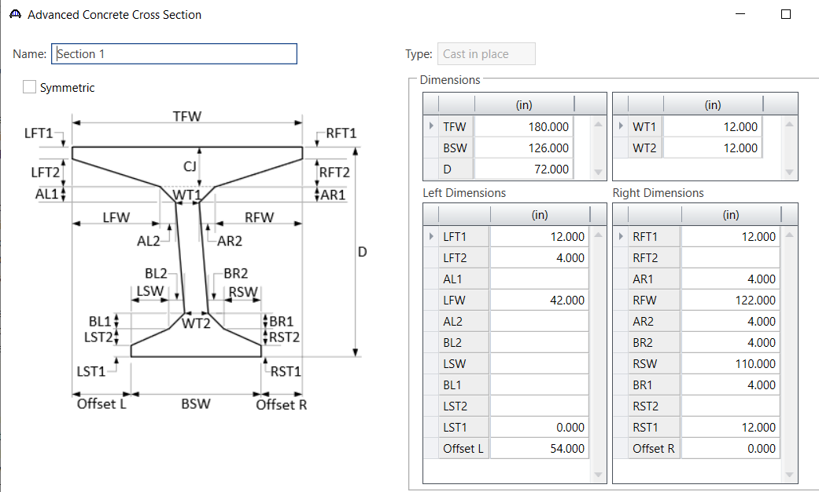
BrDR 7.1.0 September 2021
Advanced concrete members
Notes:
Krisha will present this new feature after this presentation.
New “Advanced Concrete” member alternative for Girder System and Girder Line Structure Definitions.
Member alternative can be RC or PT

Slide 6
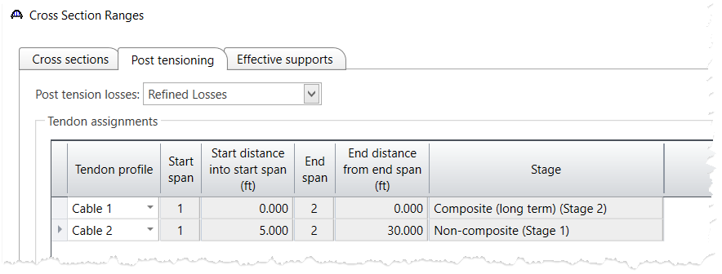
BrDR 7.1.0 September 2021
Advanced concrete members
Notes:
Krisha will present this new feature after this presentation.
New “Advanced Concrete” member alternative for Girder System and Girder Line Structure Definitions.
Member alternative can be RC or PT

Slide 7
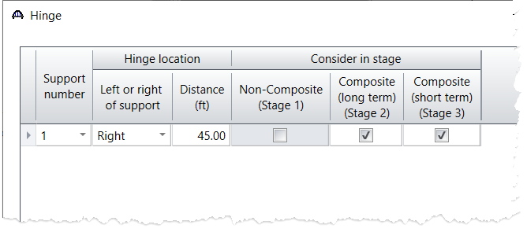
BrDR 7.1.0 September 2021
Advanced concrete members
Notes:
Krisha will present this new feature after this presentation.
New “Advanced Concrete” member alternative for Girder System and Girder Line Structure Definitions.
Member alternative can be RC or PT

Slide 8
BrDR 7.1.0 September 2021
Live load distribution factors for one or two cell box girder bridges
  One or two cell standalone structure, not connected to an adjacent structure
  One or two cell structure, where the top flange/deck is connected to an adjacent structure and both layers of deck reinforcement are spliced
Notes:
Allows user to specify if MCB structure definition is attached to an adjacent MCB structure definition and compute LLDF accordingly.

Slide 9
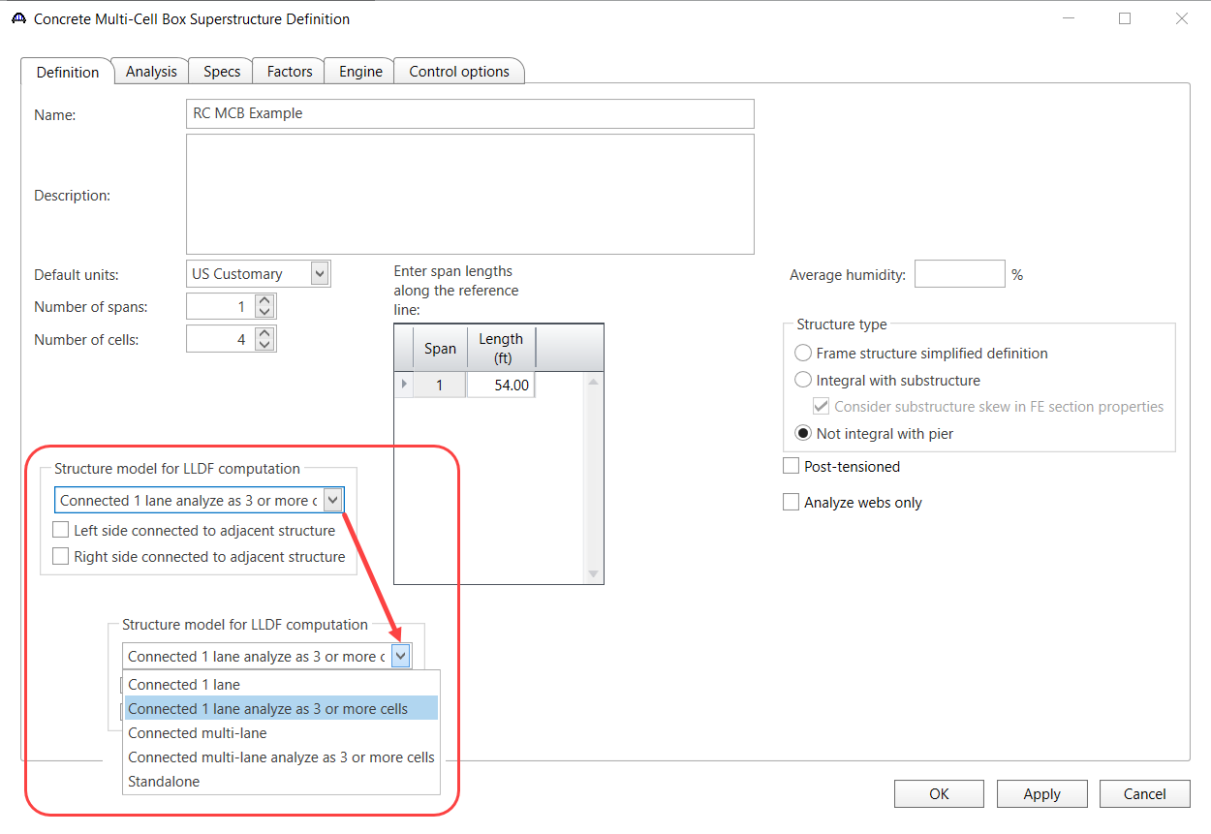
Notes:
Default is “Standalone”, migration of existing data sets to “Standalone”.

Slide 10
BrDR 7.1.0 September 2021
User-defined load distribution to multi-cell box webs
  Ability to distribute post-tensioning forces to individual webs by percentages
  Ability to specify percent of dead load flexure and shear for individual webs

Slide 11
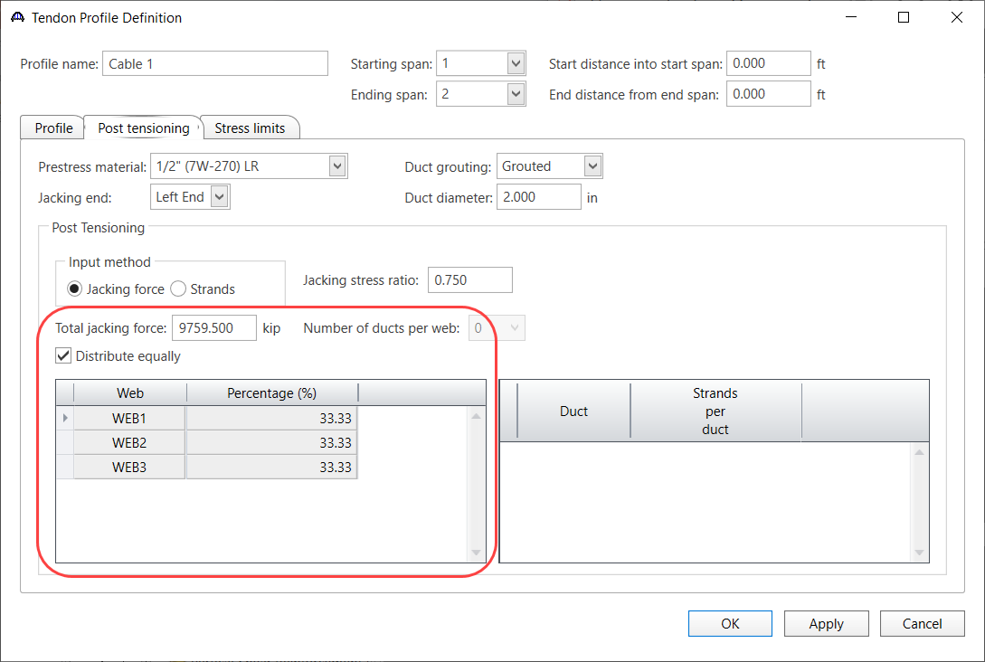

Slide 12
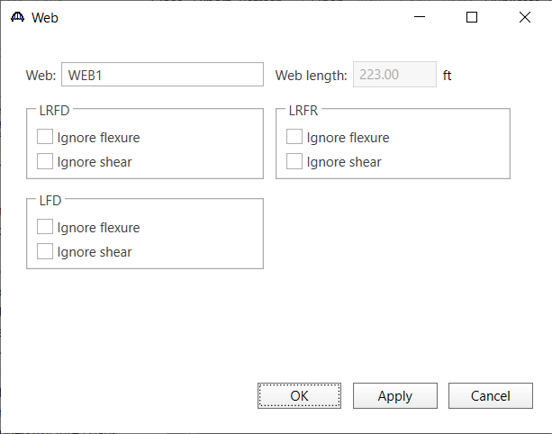
Notes:
New Web window.

Slide 13
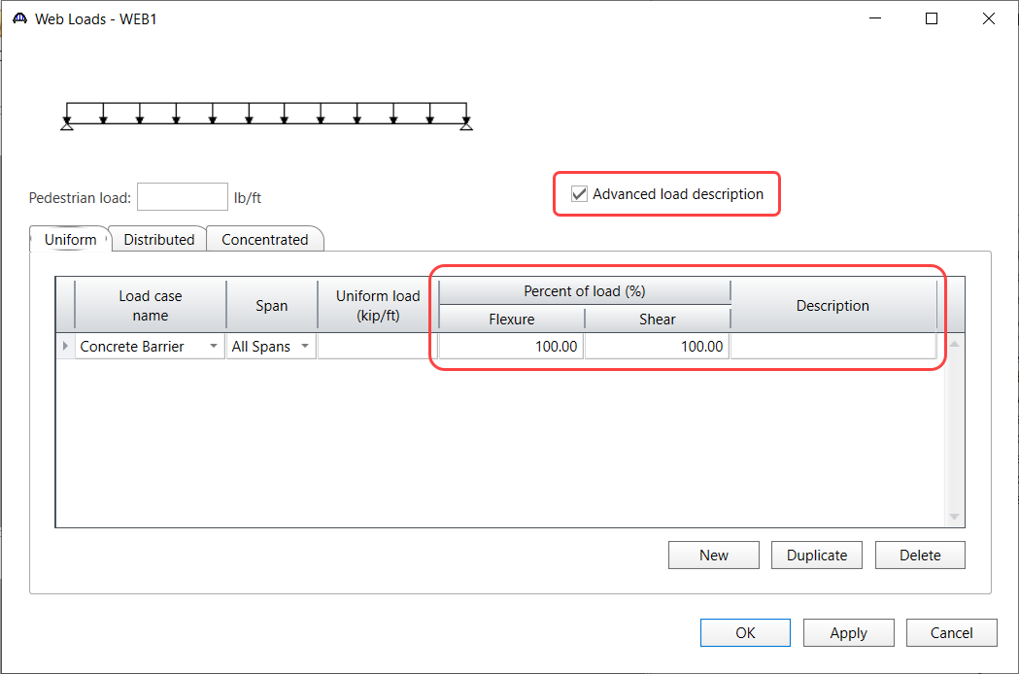
Notes:
New Web Loads window.

Slide 14
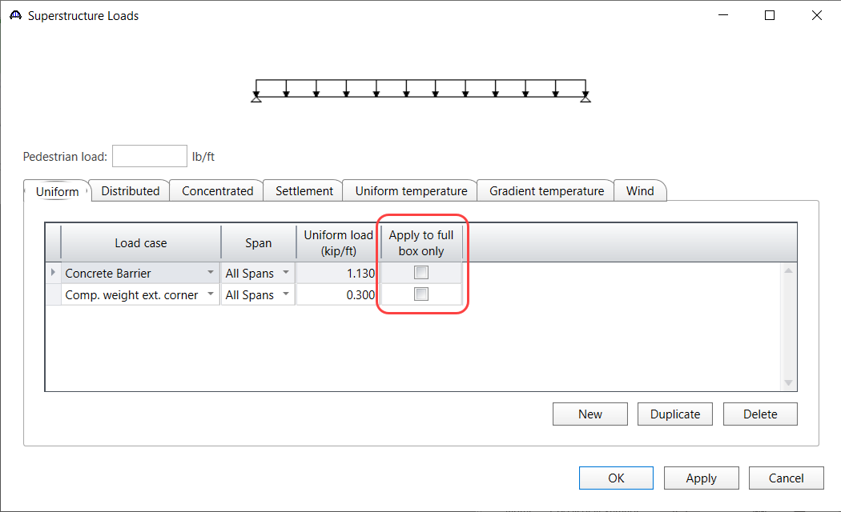
Notes:
MCB Superstructure Loads window change.

Slide 15
BrDR 7.1.0 September 2021
Ability to specify LRFD resistance factors for tension-controlled post-tensioned concrete sections with bonded strands or tendons
  AASHTO LRFD Bridge Design Specifications only provides resistance factors for unbonded strands or tendons

Slide 16
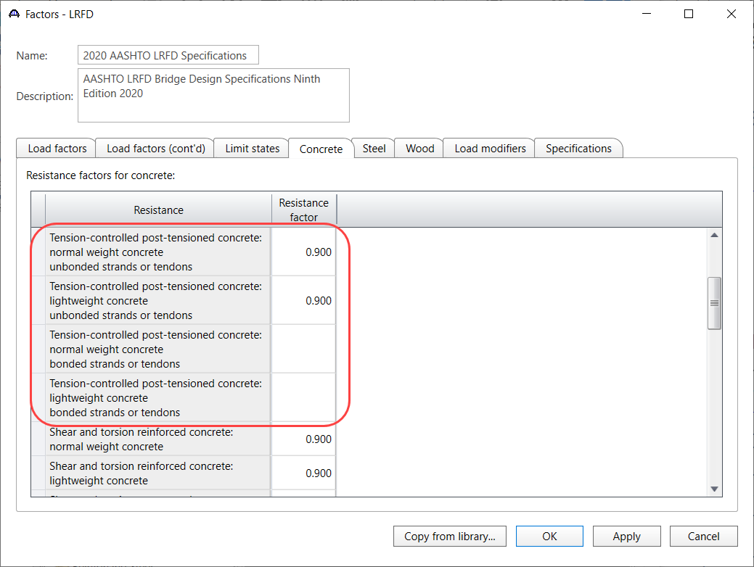
Notes:
Bonded resistance factors are left blank since they not specified by AASHTO.
If bonded and unbonded tendons used at a location, the smaller resistance factor is used.

Slide 17
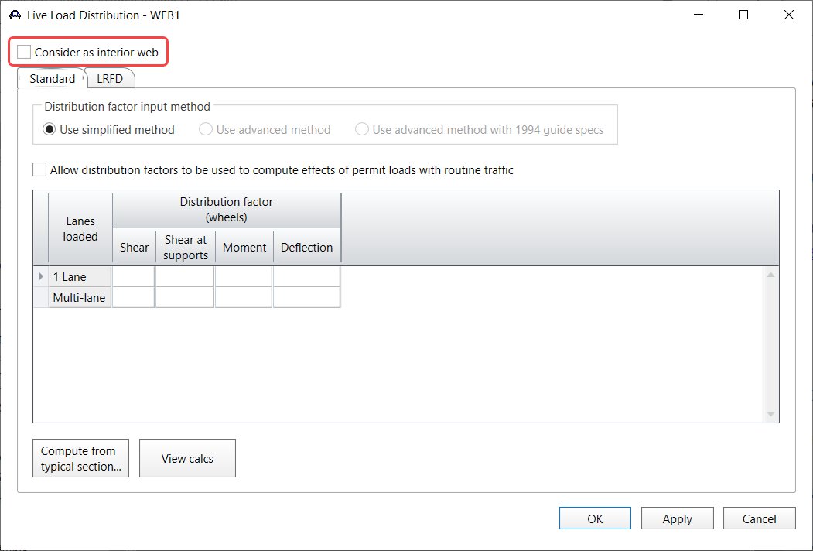
BrDR 7.1.0 September 2021
Ability to specify if the exterior web in a multi-cell box bridge should be considered as an interior web when computing live load distribution factors to accommodate widened structures

Slide 18
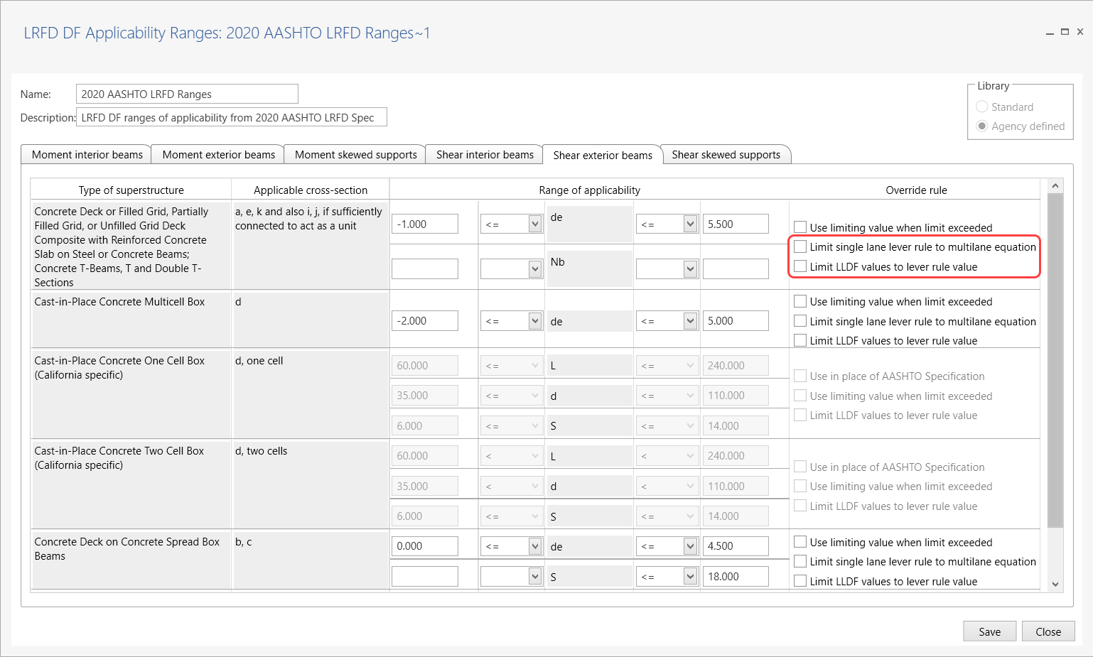
BrDR 7.1.0 September 2021
6a. LRFD live load distribution factor applicability ranges – Limit single lane lever rule to multi-lane equation
6b. LRFD live load distribution factor applicability ranges – Limit live load distribution factor values to lever rule value
Notes:
Additional override rules.
#6 is available for exterior beams only.
#6 When Specifications require moment or shear one-lane LLDF on exterior girder to be computed by lever rule and the computed factor is greater than the corresponding multi-lane LLDF computed with the simplified equation, use the multi-lane LLDF in place of the one-lane LLDF.
#7 When the range of applicability is extended, the value established by the AASHTO equation sometimes exceeds the value established by the Lever Rule. Use the lowest of the value established by Lever Rule or the AASHTO equation.

Slide 19
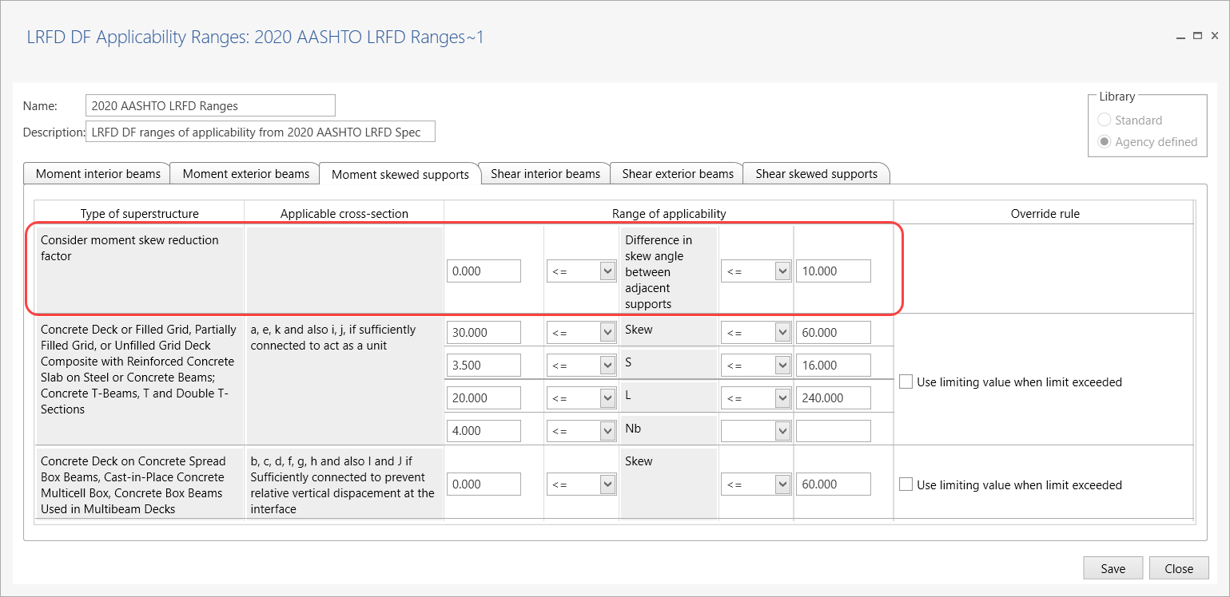
BrDR 7.1.0 September 2021
6c. LRFD live load distribution factor applicability ranges – Difference in skew angle between adjacent supports override
Notes:
Adjust the range of skew angles considered in LRFD 4.6.2.2.2e to determine when to consider the moment LLDF skew reduction factor.
If the difference in skew angle between adjacent supports is outside the range specified here, the moment reduction factors specified in LRFD Table 4.6.2.2.2e-1 will not be used.

Slide 20
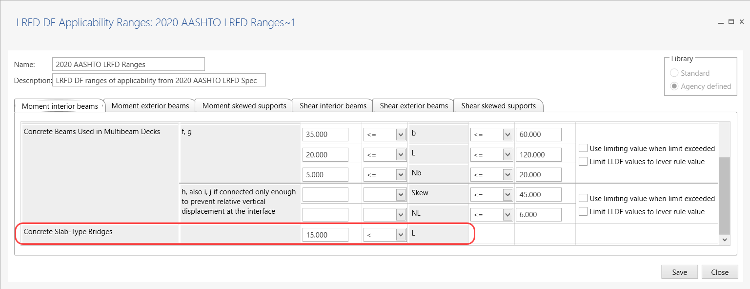
BrDR 7.1.0 September 2021
6d. LRFD live load distribution factor applicability ranges – Range of applicability for slabs
Notes:
This new row specifies the rule for the span length to determine when LRFD 4.6.2.3 is used. Previous versions used LRFD 4.6.2.3 for all slab span lengths.
If the span length violates the rule, LRFD 4.6.2.1.3 will be used.

Slide 21
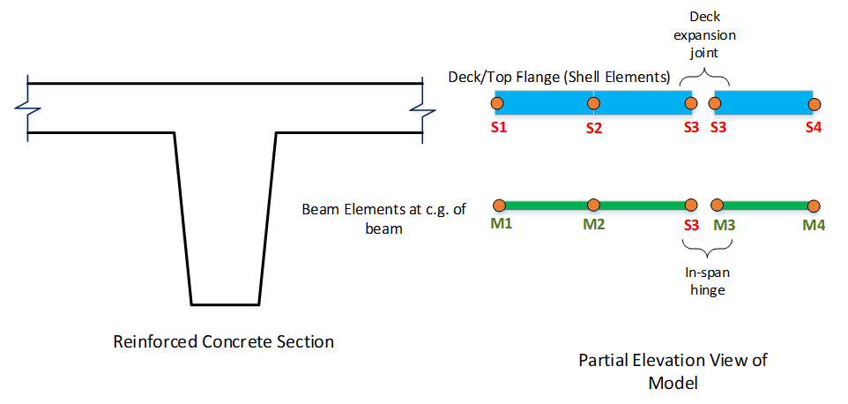
BrDR 7.1.0 September 2021
3D analysis for reinforced concrete and steel superstructures with in-span hinges

Slide 22
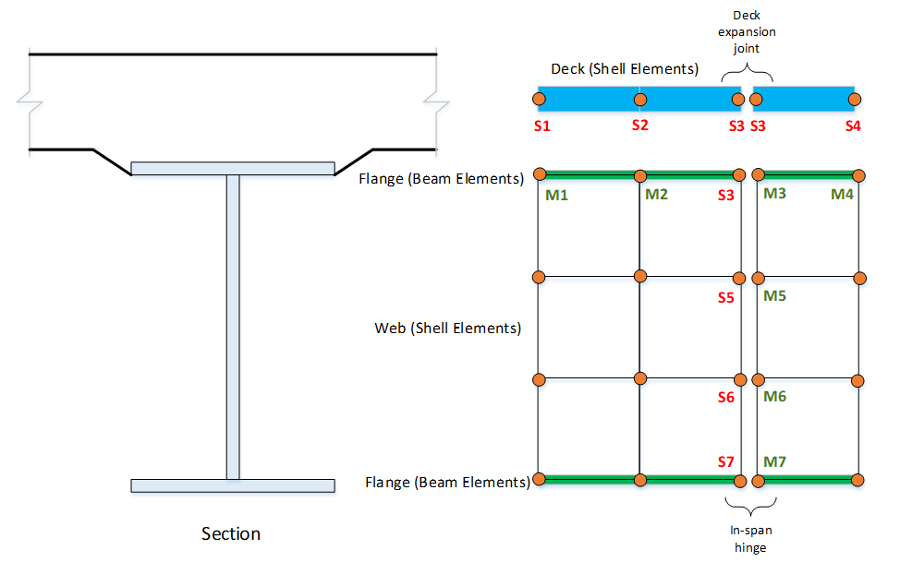
BrDR 7.1.0 September 2021

Slide 23
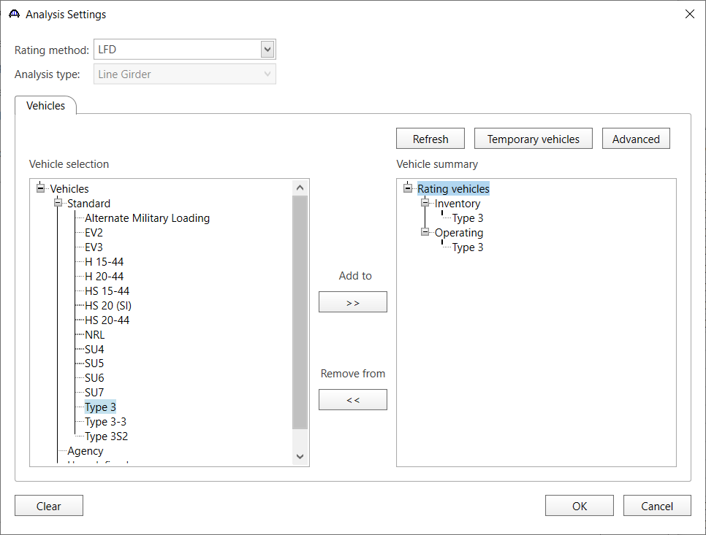
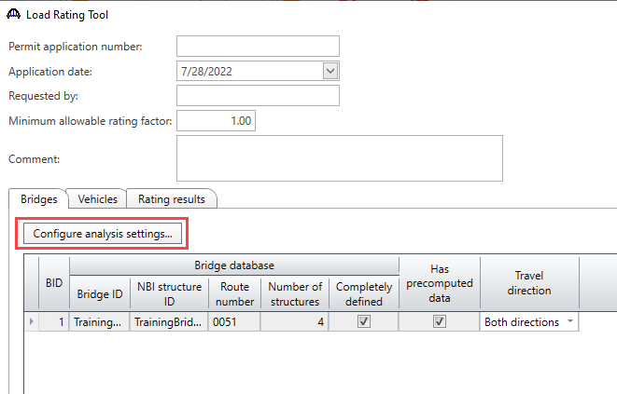
BrDR 7.1.0 September 2021
Ability to specify Load Rating Tool’s permit analysis settings

Slide 24
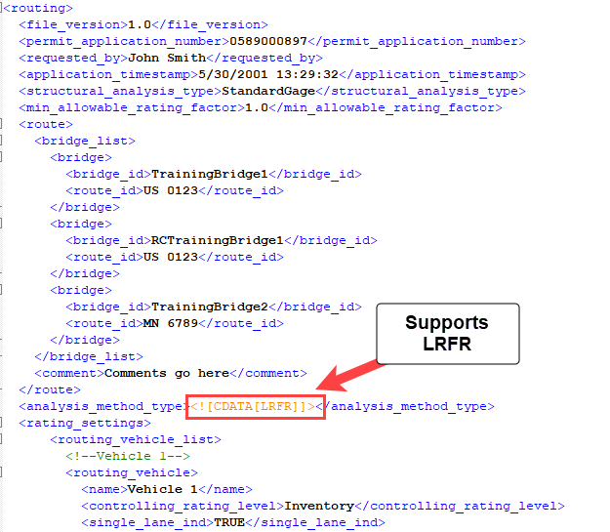
BrDR 7.1.0 September 2021
Load Rating Tool – Addition of slab system LFR
Simplified Analysis API for LRFR permit load analysis
Notes:
Domain API, Engine API, and Analysis API.

Slide 25
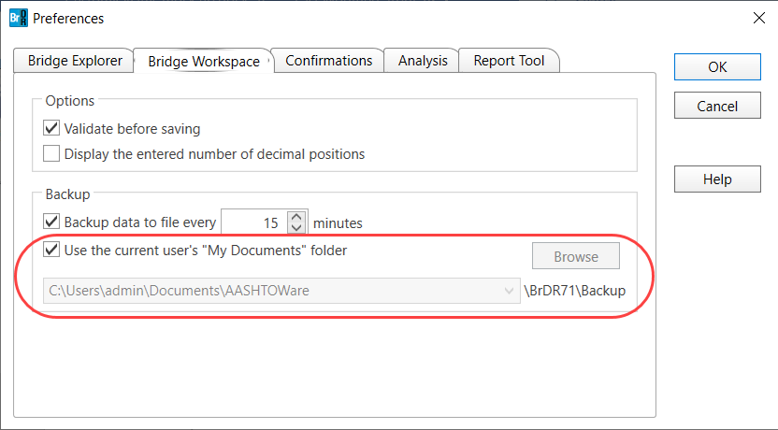
BrDR 7.1.0 September 2021
Ability to specify file paths for various output

Slide 26
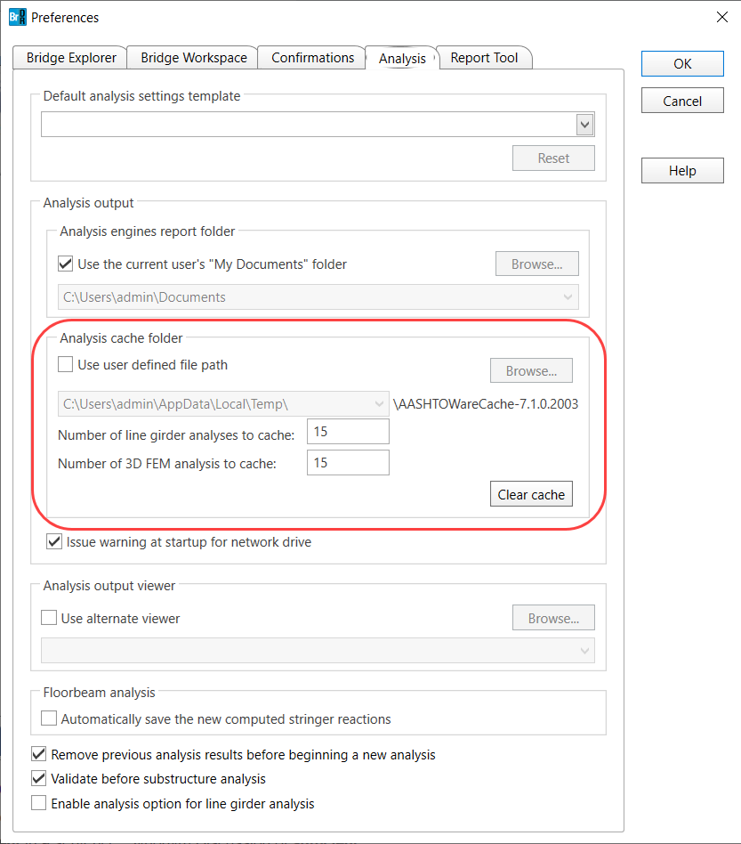

Slide 27
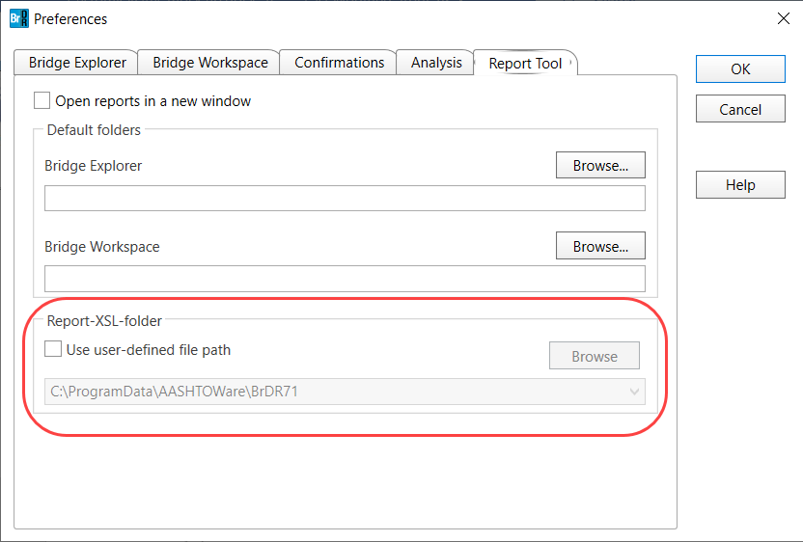
BrDR 7.1.0 September 2021

Slide 28
BrDR 7.1.0 September 2021
BrM web service integration
  Provides a Representational State Transfer (REST) client within BrDR to consume the REST web services provided by BrM 6
  All previous AASHTOWare Bridge Integration use cases in the legacy system are supported
  No longer required to integrate BrDR and BrM databases
Notes:
Lindsey will present this new feature later in this session.

Slide 29
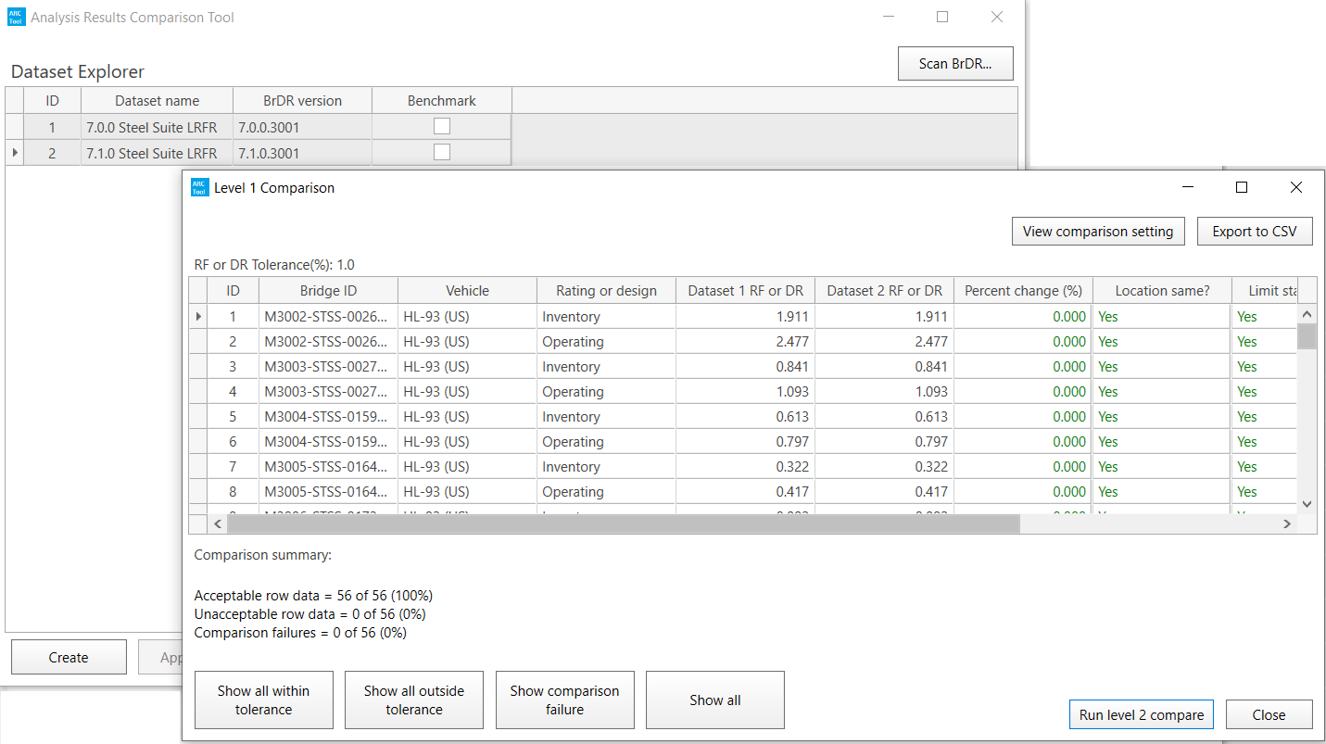
BrDR 7.1.0 September 2021
Analysis Results Comparison Tool

Slide 30
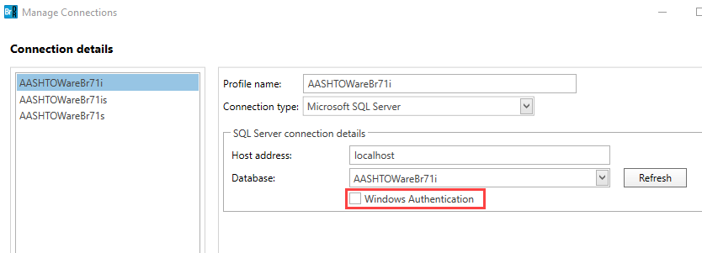
BrDR 7.1.0 September 2021
Support Active Directory authentication
Support Oracle container database
API license mechanism
Notes:
#15 The multitenant architecture enables an Oracle database to function as a multitenant container database (CDB). All Oracle databases before Oracle Database 12c were non-CDBs.
#16 Improve the BrDR license enforcement mechanism. Move licensing mechanism from the UI to the BrDR API. To prevent use of the BrDR API after the license has expired.

Slide 31
BrDR 7.1.1 November 2021
Critical bug fixes

Slide 32
BrDR 7.2.0 February 2022
Prestressed Concrete Design Tool – Phase 2 Enhancements
Steel Plate Girder Design Tool
Load Rating Tool – LRFR multi-girder superstructures, multi-cell box, slab system
Data exchange via IFC Bridge data standard

Slide 33
BrDR 7.2.0 February 2022
Prestressed Concrete Design Tool – Phase 2 Enhancements
  1a. Girder system and girder line entry
  1b. Schematics
  1c. Prestress Tee Beams
  1d. Additional strand configurations
  1e. Stability checks for transport

Slide 34
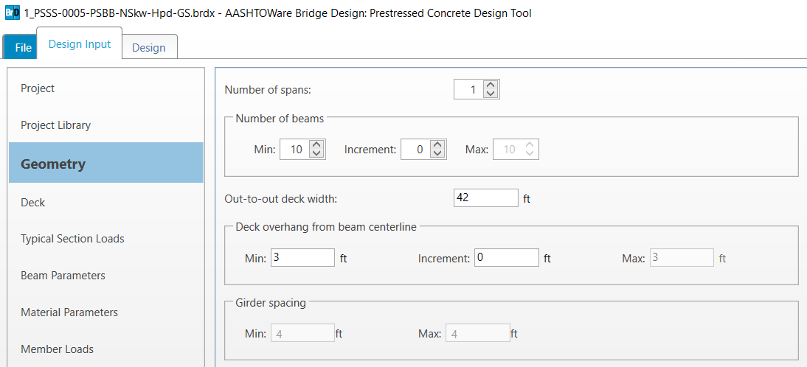
BrDR 7.2.0 February 2022
1a. Girder system entry

Slide 35
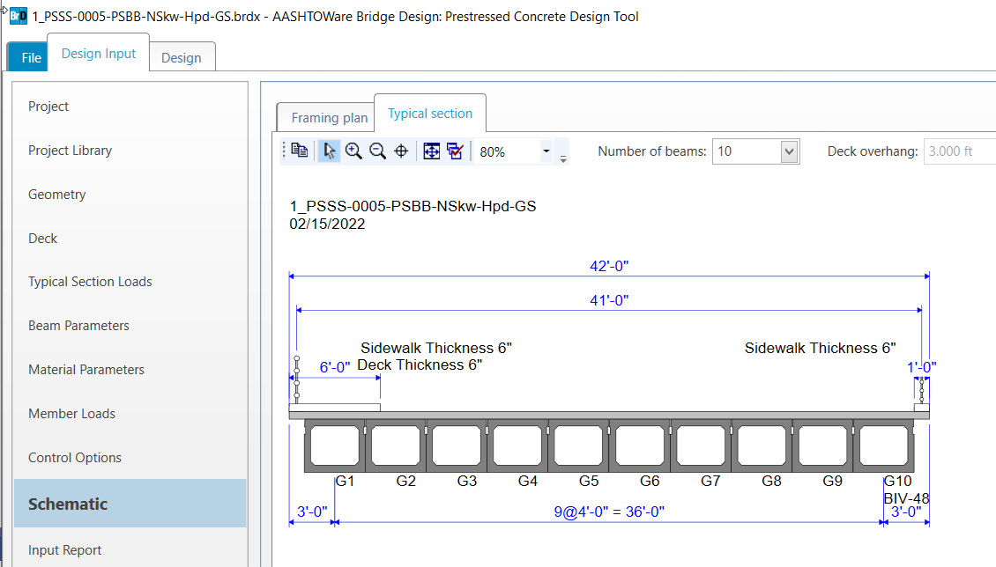
BrDR 7.2.0 February 2022
1b. Schematics

Slide 36
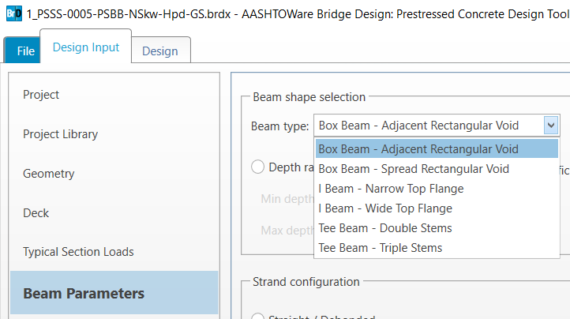
BrDR 7.2.0 February 2022
1c. Prestress Tee Beams

Slide 37
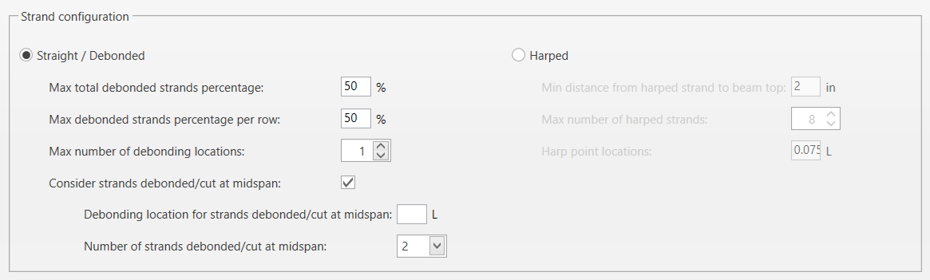
BrDR 7.2.0 February 2022
1d. Additional strand configurations

Slide 38
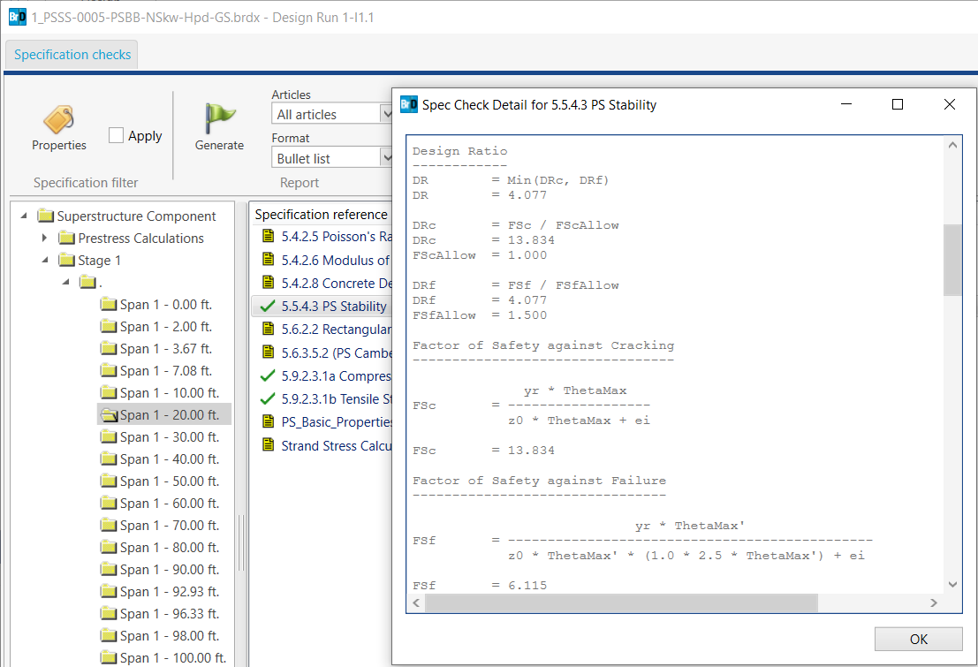
BrDR 7.2.0 February 2022
1e. Stability checks for transport

Slide 39
BrDR 7.2.0 February 2022
Steel Plate Girder Design Tool
2a. Steel plate girders, hybrid girders
2b. Control options
2c. Shear connector design
2d. Final design specification checking report
2e. Beam profile schematic

Slide 40
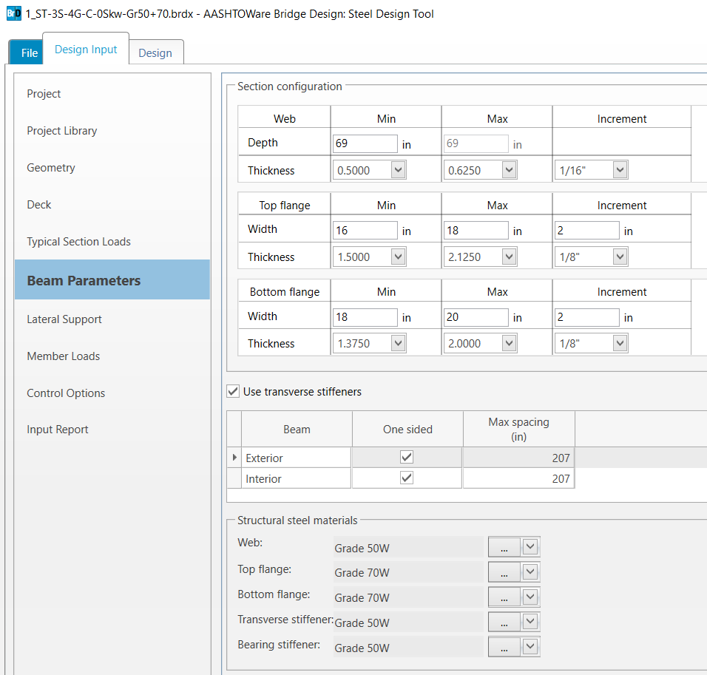
BrDR 7.2.0 February 2022
2a. Steel plate girders, hybrid girders

Slide 41
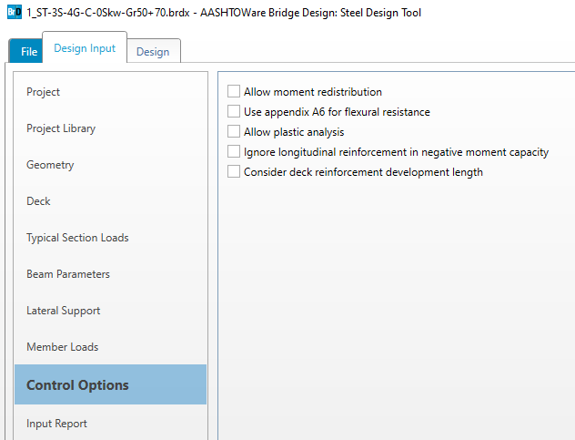
BrDR 7.2.0 February 2022
2b. Control options

Slide 42
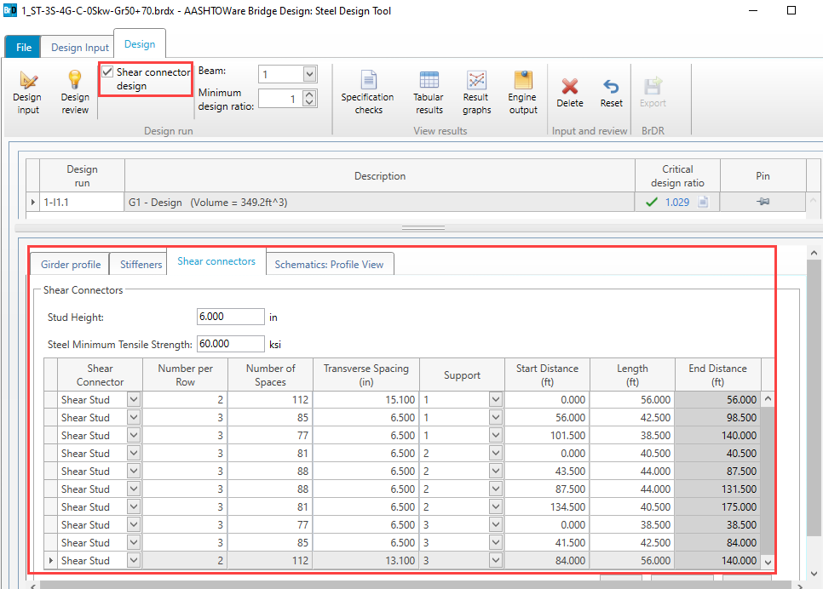
BrDR 7.2.0 February 2022
2c. Shear connector design

Slide 43
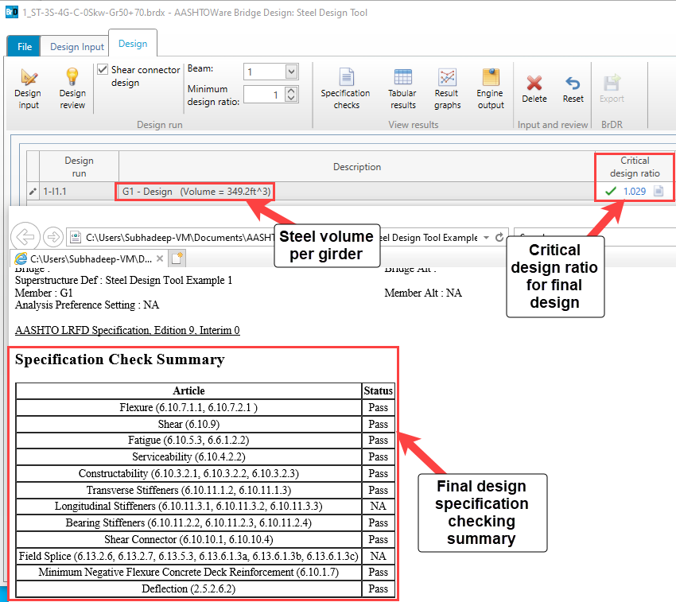
BrDR 7.2.0 February 2022
2d. Detailed final design specification checking report

Slide 44
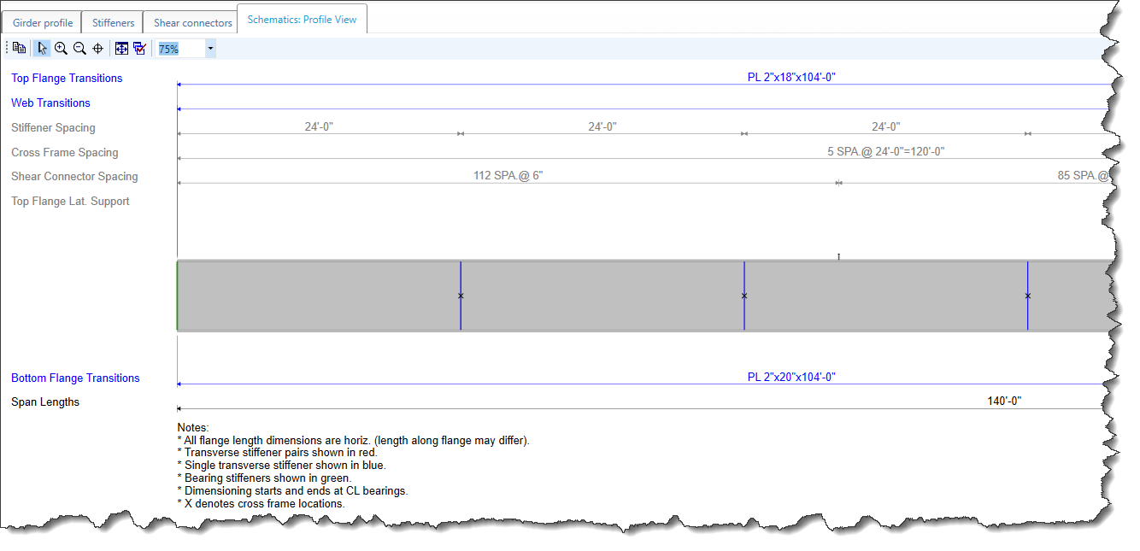
BrDR 7.2.0 February 2022
2e. Beam profile schematic

Slide 45
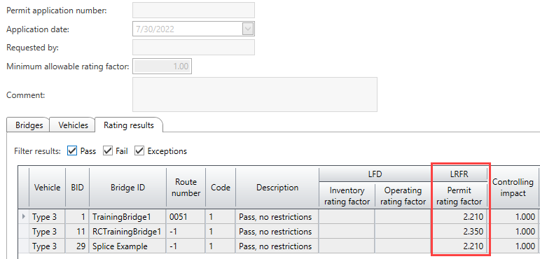
BrDR 7.2.0 February 2022
Load Rating Tool – LRFR multi-girder superstructures, multi-cell box, slab system

Slide 46
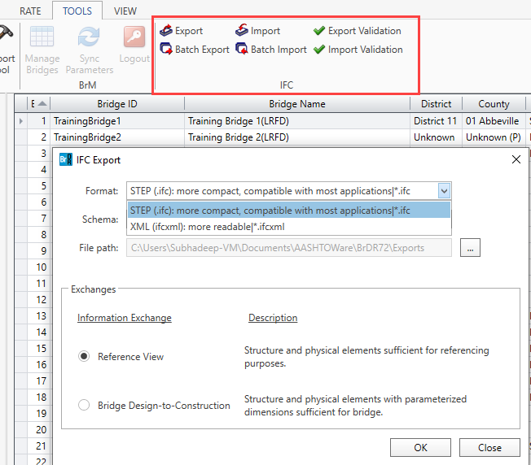
BrDR 7.2.0 February 2022
Data exchange via IFC Bridge data standard
Notes:
AASHTO Administrative Resolution AR-1-19 Title: “Adoption of Industry Foundation Classes (IFC) Schema as the Standard Data Schema for the Exchange of Electronic Engineering Data”.

Slide 47
Questions?

