Slide 1
BrDR 7.3 Preview
New Features and Enhancements
Herman Lee, P.E. herman@promiles.com
AASHTOWare RADBUG ANNUAL Meeting
August 2-3, 2022
New Orleans, LA

Slide 2
What’s new in BrDR since 7.0?
7.0 – January 2021
7.1 – September 2021
7.2 – February 2022
7.3 – September 2022
Notes:
BrDR Legacy System – After almost 5 years from the first announcement, the BrDR legacy system was end-of-life on June 30th.
BrDR 7.1 and 7.2 releases – Packed more than 20 unique new features and enhancements requested by state agencies

Slide 3
BrDR 7.3 Preview
New AASHTO Timber Engine for ASR and LRFR
  Sawn and glulam timber beams, and sawn timber deck
Material & Member type | BrR with Madero Engine | AASHTO Timber Engine
 | ASR | ASR | LRFR
Sawn beam | ✓ | ✓ | ✓
Sawn deck | ✓ | ✓ | ✓
Glulam beam | ✗ | ✓ | ✓

Slide 4
BrDR 7.3 Preview
  Madero vs AASHTO Timber Engine comparison
  Madero dead load distribution is always by tributary area.
  Madero adjusts dead load shear for points within depth of the beam “d” with shear at “d”. Madero computes shear at “d” using interpolation if it is not a tenth point. AASHTO Timber Engine will behave the same but will add a FE node to get shear at “d”.
  Madero adjusts live load shear for points within minimum of “3d” and “L/4” with shear at minimum of “3d” and “L/4”. AASHTO Timber Engine will behave the same but will add a FE node to get shear at minimum of “3d” and “L/4”.

Slide 5
BrDR 7.3 Preview
  Madero vs AASHTO Timber Engine comparison
  Madero applies shear at support based on shear LLDF and not shear at support LLDF. AASHTO Timber Engine will behave the same.
  Madero tabular live load results do not include LLDF. AASHTO Timber Engine tabular live load results include LLDF to be consistent with other AASHTO line girder engines.

Slide 6
BrDR 7.3 Preview
New AASHTO Metal Culvert Engine for LFR and LRFR
  Metal pipe, pipe arch, arch, and structural plate pipe structures
  Long-span structural plate pipe structures
  Structural plate box structures
  Steel or aluminum material
  Analysis follows the empirical procedures in the AASHTO Standard and LRFD specifications
  Optional Duncan & Drawsky plastic moment rating for pipe culverts
  Deflection and deterioration are considered
Notes:
Supported structure types include:
Features include:

Slide 7
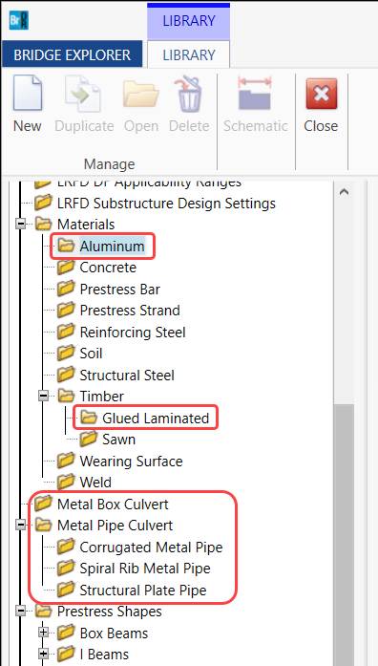
BrDR 7.3 Preview
Notes:
Supported structure types include:
Features include:

Slide 8
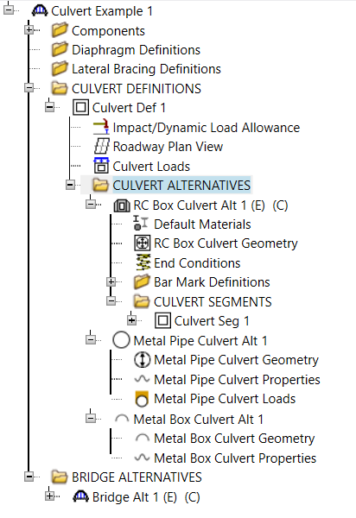
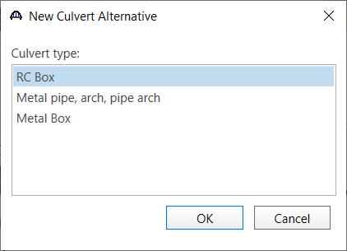
BrDR 7.3 Preview
Notes:
Supported structure types include:
Features include:

Slide 9
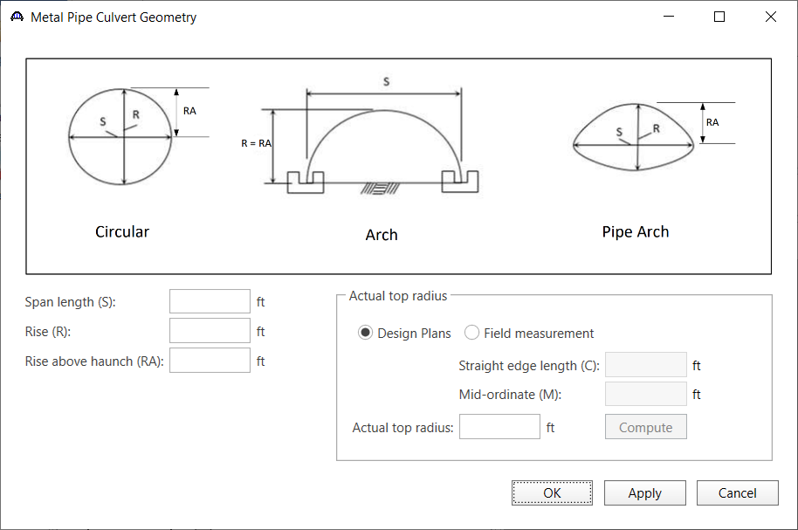
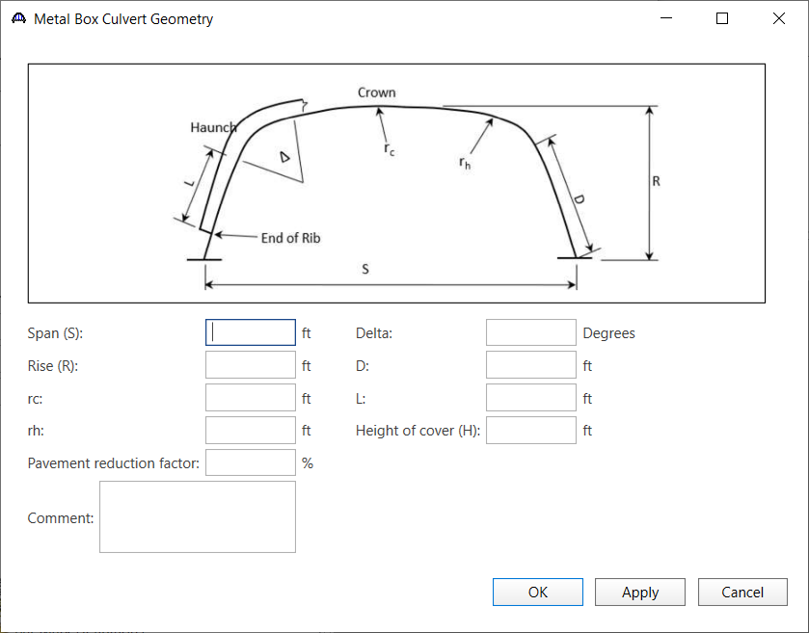
BrDR 7.3 Preview
Notes:
Supported structure types include:
Features include:

Slide 10
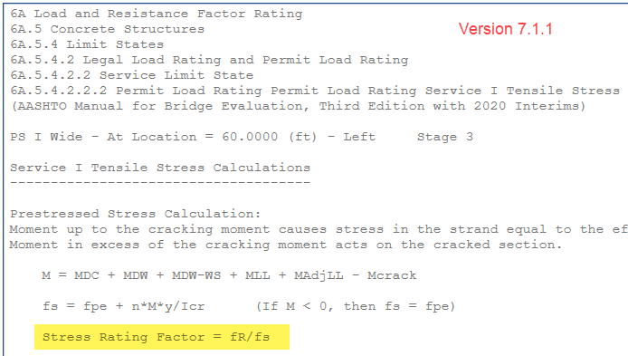
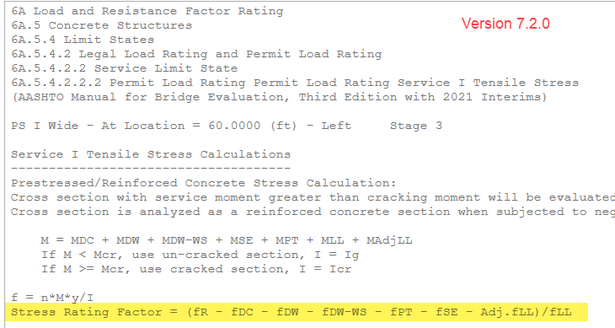
BrDR 7.3 Preview
Manual for Bridge Evaluation updates – 3rd Edition, 2021 Interim Revisions
  Appendix A, Example A3 – Modify Article 6A.5.4.2.2b rating factor equation for PS members
Notes:
6A.5.4.2.2b—Permit Load Rating, Service I Limit State

Slide 11
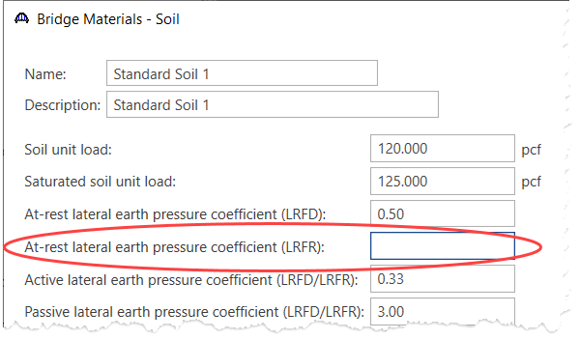
BrDR 7.3 Preview
  6A.10 Culvert load rating changes
    6A.10.10.2b LRFR at-rest lateral earth pressure coefficient
Notes:
The remaining spec updates for the 2021 interims deal with changes to load rating of culverts.

Slide 12
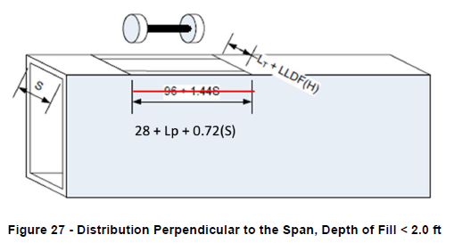
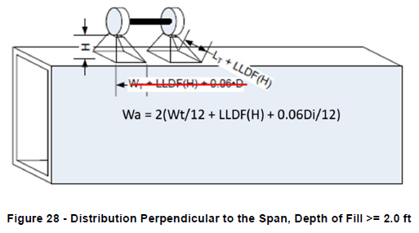
BrDR 7.3 Preview
  6A.10 Culvert load rating changes
    6A.10.10.3a Live load distribution changes

Slide 13
BrDR 7.3 Preview
  6A.10 Culvert load rating changes
    6A.10.10.3a Negligible live load effects

Slide 14
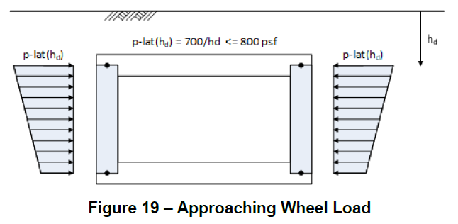
BrDR 7.3 Preview
  6A.10 Culvert load rating changes
    6A.10.10.3c Approaching Wheel Load (AW)
      Replaces Live Load Surcharge (LS)
      Applied for <= 2’ of cover

Slide 15
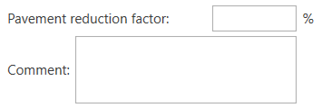
BrDR 7.3 Preview
  6A.10 Culvert load rating changes
    6A.10.10.3d Pavement Reduction Factor

Slide 16
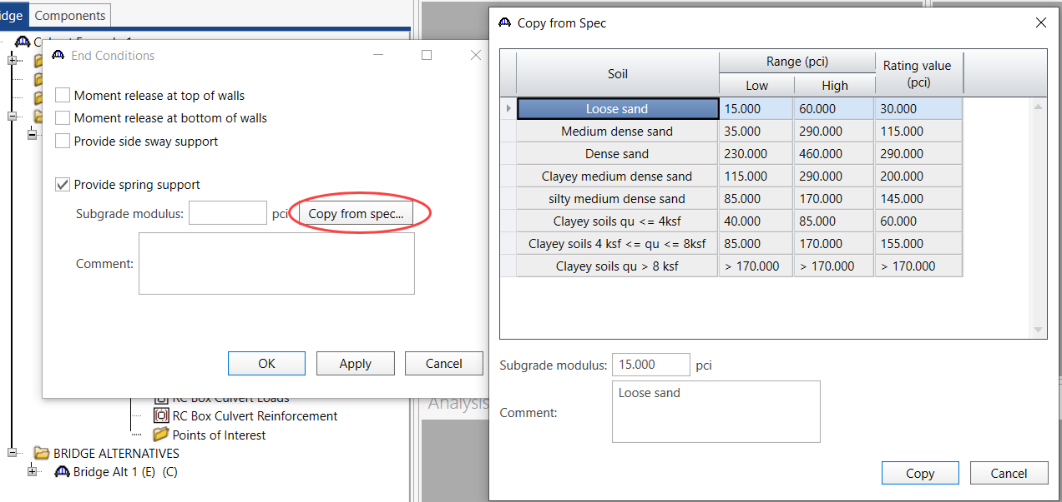
BrDR 7.3 Preview
  6A.10 Culvert load rating changes
    6A.10.3.1 Subgrade Modulus

Slide 17
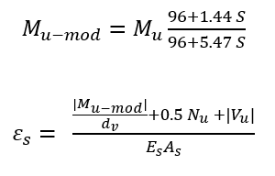
BrDR 7.3 Preview
  6A.10 Culvert load rating changes
    6A.10.11.1 Modified Shear Strain Capacity
      General shear method
      Modified negative moment in top slab under less than 2’ fill

Slide 18
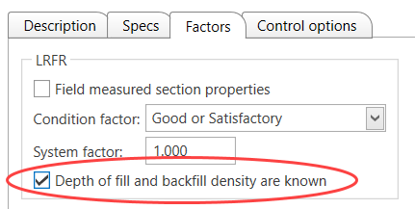
BrDR 7.3 Preview
  6A.10 Culvert load rating changes
    Table 6A.10.5.1 Limit States and Load Factors
      If depth of fill & backfill density are known, maximum EV load factor may be taken as average of 1.0 and EV factor from table

Slide 19
BrDR 7.3 Preview
Include Flange Lateral Bending in Analysis
  NYSDOT Service Unit work
  Allow flange lateral bending stresses to be specified for the design and rating of skewed steel I-girder bridges
  Required by the AASHTO LRFD Bridge Design Specifications and supported by NCHRP Report 725 and FDOT Report BE535
  Default flange lateral bending stresses based on LRFD Article 6.10.1

Slide 20
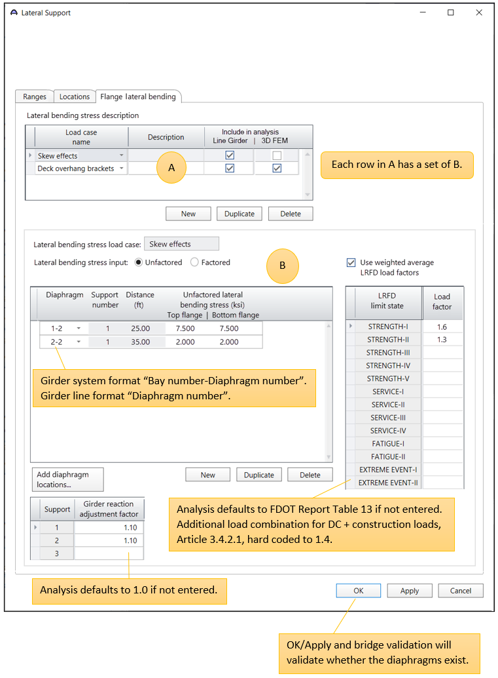
BrDR 7.3 Preview

Slide 21
BrDR 7.3 Preview
System Default Analysis Engine Settings
  Ability to specify system default analysis engines based on member types
  Ability to specify truss and multi-cell concrete box default rating methods
  More granular control over the Analysis Engine used for an analysis

Slide 22
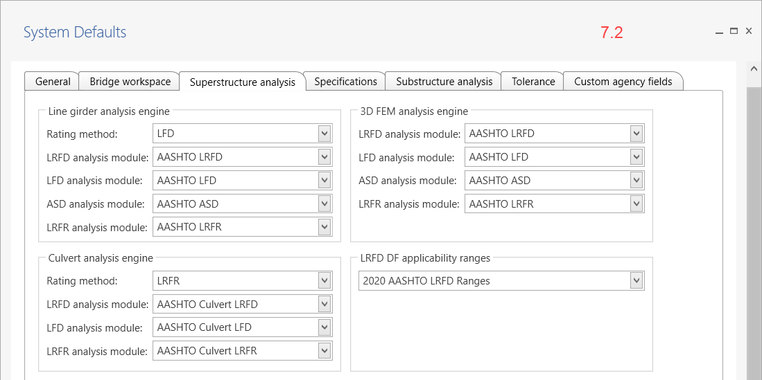
BrDR 7.3 Preview

Slide 23
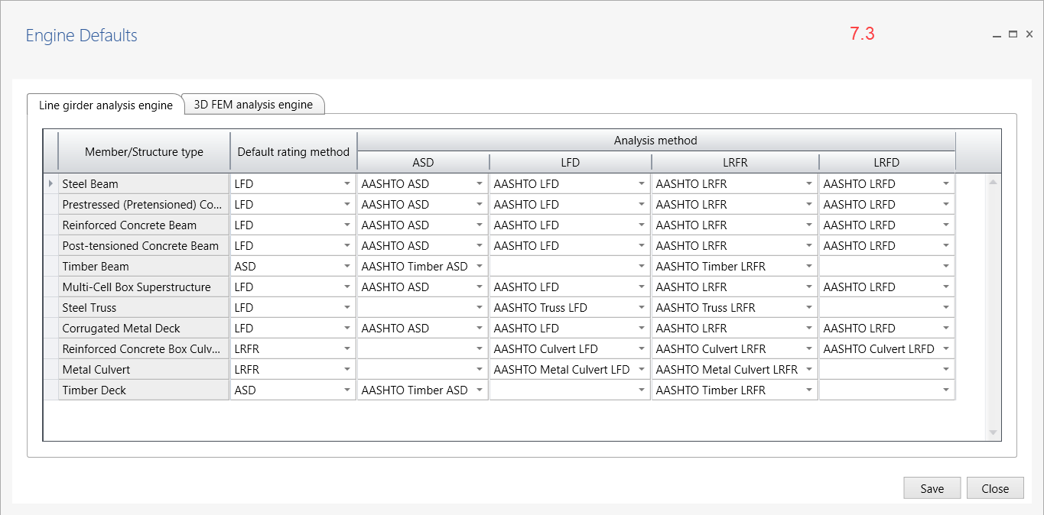
BrDR 7.3 Preview

Slide 24
BrDR 7.3 Preview
BrDR Migration Wizard Phase 2
  UX improvements
  BrDR Database Repair Script Generator
BrDR WiX Installer
  Streamline BrDR installation and improve consistency
  Provide better support for headless installations
Modernize Bridge Copy Utility
  Upgrade from .NET Framework to .NET 6
Notes:
Oracle public synonym progress bar; Validation progress
Compare database schema snapshots and generate basic database repair scripts
BrDR Bridge Copy Utility allows users to copy a bridge from one database to another database, delete a bridge from one database, or replace a bridge in one database with a bridge from another database

Slide 25
BrDR 7.3 Preview
Improve Data Precision in BrDR Databases
  Improve accuracy of floating point arithmetic operations
  Avoid loss of precision, overflow, and underflow error conditions
  Changing float to double, smallint to int, also date/time data type
Internal Release Utility Version 3
  Facilitate rapid and agile develop-build-test cycles
  Embrace “Test Early and Test Often” for Alpha and Beta testing

Slide 26
Thank You!

