Slide 1
BrDR Service Desk Overview Tips and Tricks, FAQs Mark Mlynarski, P.E. mmlynarski@promiles.com
AASHTOWare RADBUG Meeting
August 1-3, 2022
New Orleans, LA

Slide 2
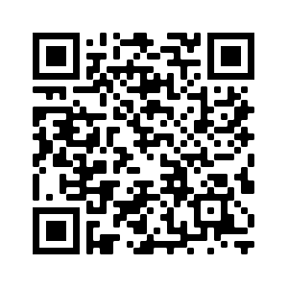
https://bridgeware.atlassian.net/servicedesk/customer/portals
Notes:
After login

Slide 3
BrDR Support Service Desk (BSSD)
For BrDR licensing options that include technical support
Unlimited Option and Single Workstation Option
Tracks technical support requests, enhancement requests, maintenance issues, and bug issues
Login users can search for and access their own or any service request in BSSD
Notes:
Can search for BRDRSUP issues.

Slide 4
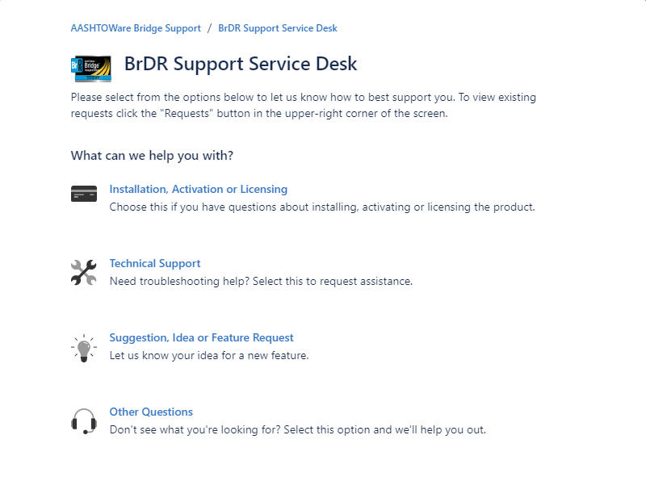
BrDR Support Service Desk (BSSD)

Slide 5
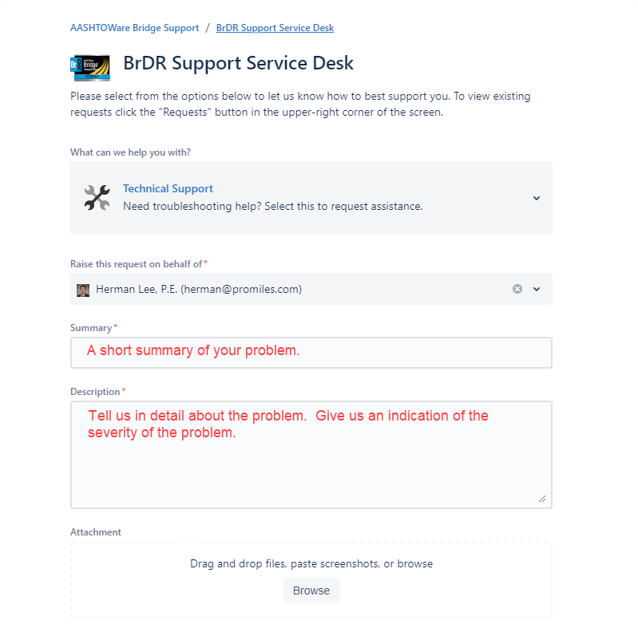
BrDR Support Service Desk (BSSD)

Slide 6
BrDR Support Service Desk (BSSD)
Specify the state and environment in which the problem occurred
Include the steps to the reproduce the problem
Provide the expected outcomes vs. actual outcomes
Remember to attach screenshots, videos, and supporting documents
Remember-we’re trying to reproduce it so we can fix it
Notes:
What is it that you disagree with.

Slide 7
BrDR Support Service Desk (BSSD)
Do not enter multiple different issues in one service request
Do not “reuse” service requests, open or closed
Keep an eye on “Need More Information” email notifications
When an issue in the “Client Review” status has been resolved satisfactorily, please make a comment to that effect in the Comments section.

Slide 8
BrDR Email Service Desk (BESD)
For any BrDR user sending an email to BrDR@promiles.com
Do not send new service requests to jira@bridgeware.atlassian.net
BESD will pick up the email, create a service request, and reply to the email

Slide 9
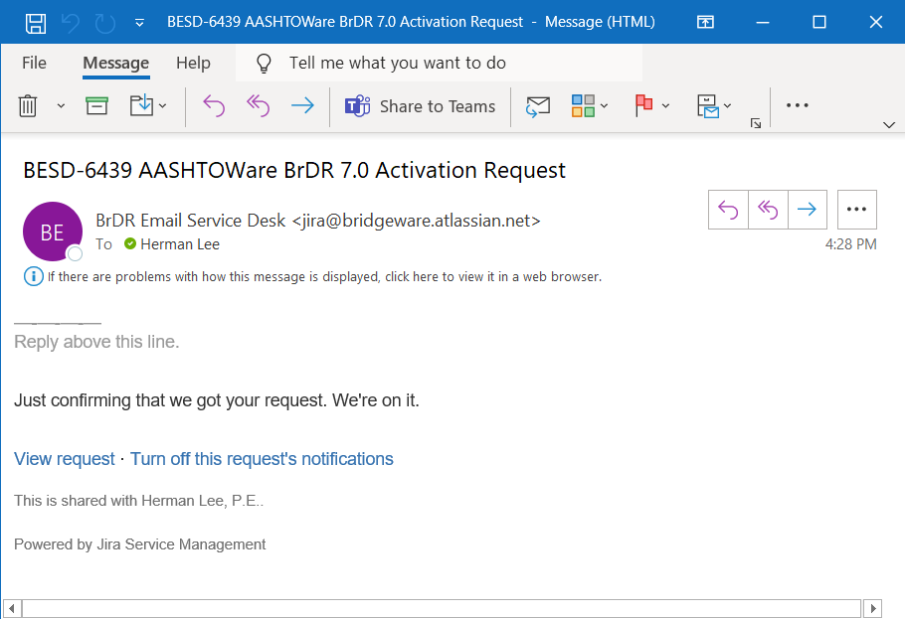
BrDR Email Service Desk (BESD)

Slide 10
BrDR Email Service Desk (BESD)
Specify the state and environment in which the problem occurred
Include the steps to the reproduce the problem
Provide the expected outcomes vs. actual outcomes
Remember to attach screenshots, videos, and supporting documents
Remember-we’re trying to reproduce it so we can fix it
Notes:
If this slide looks familiar – it’s because it’s the same as BSSD – Tell us the issue.

Slide 11
BrDR Email Service Desk (BESD)
Service request communication is handled via the jira@bridgeware.atlassian.net email address
Enhancement requests, maintenance issues, and bug issues will be moved to BSSD

Slide 12
Confluence Articles
Articles that provide common solutions
Part of Jira
Not everyone has access, but we can make them public to share
Similar to FAQ list
Organized by Tags

Slide 13
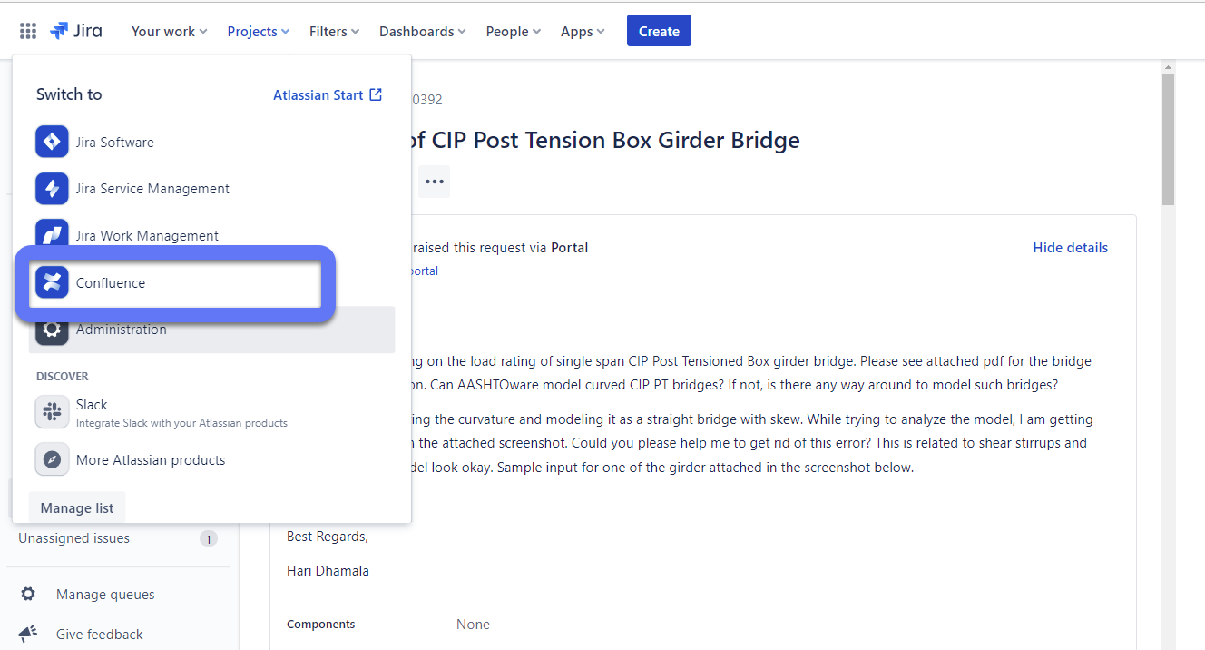
Confluence Articles

Slide 14
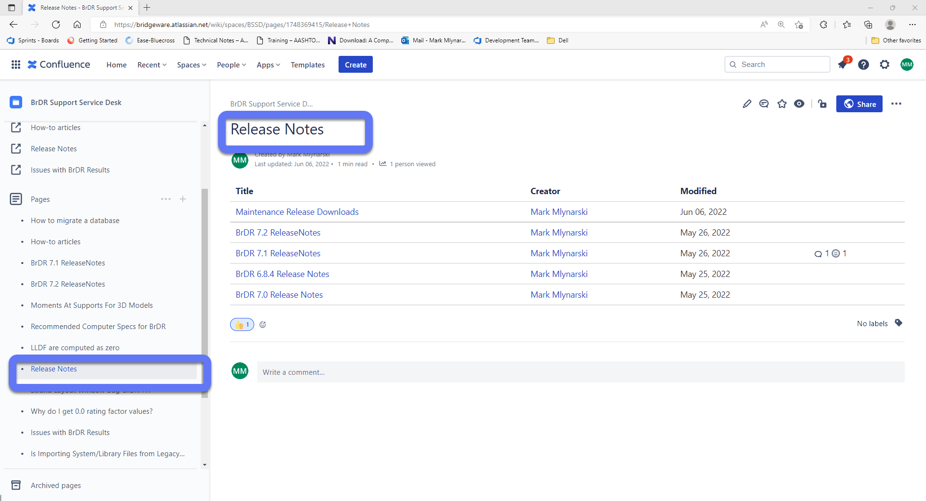
Confluence Articles

Slide 15
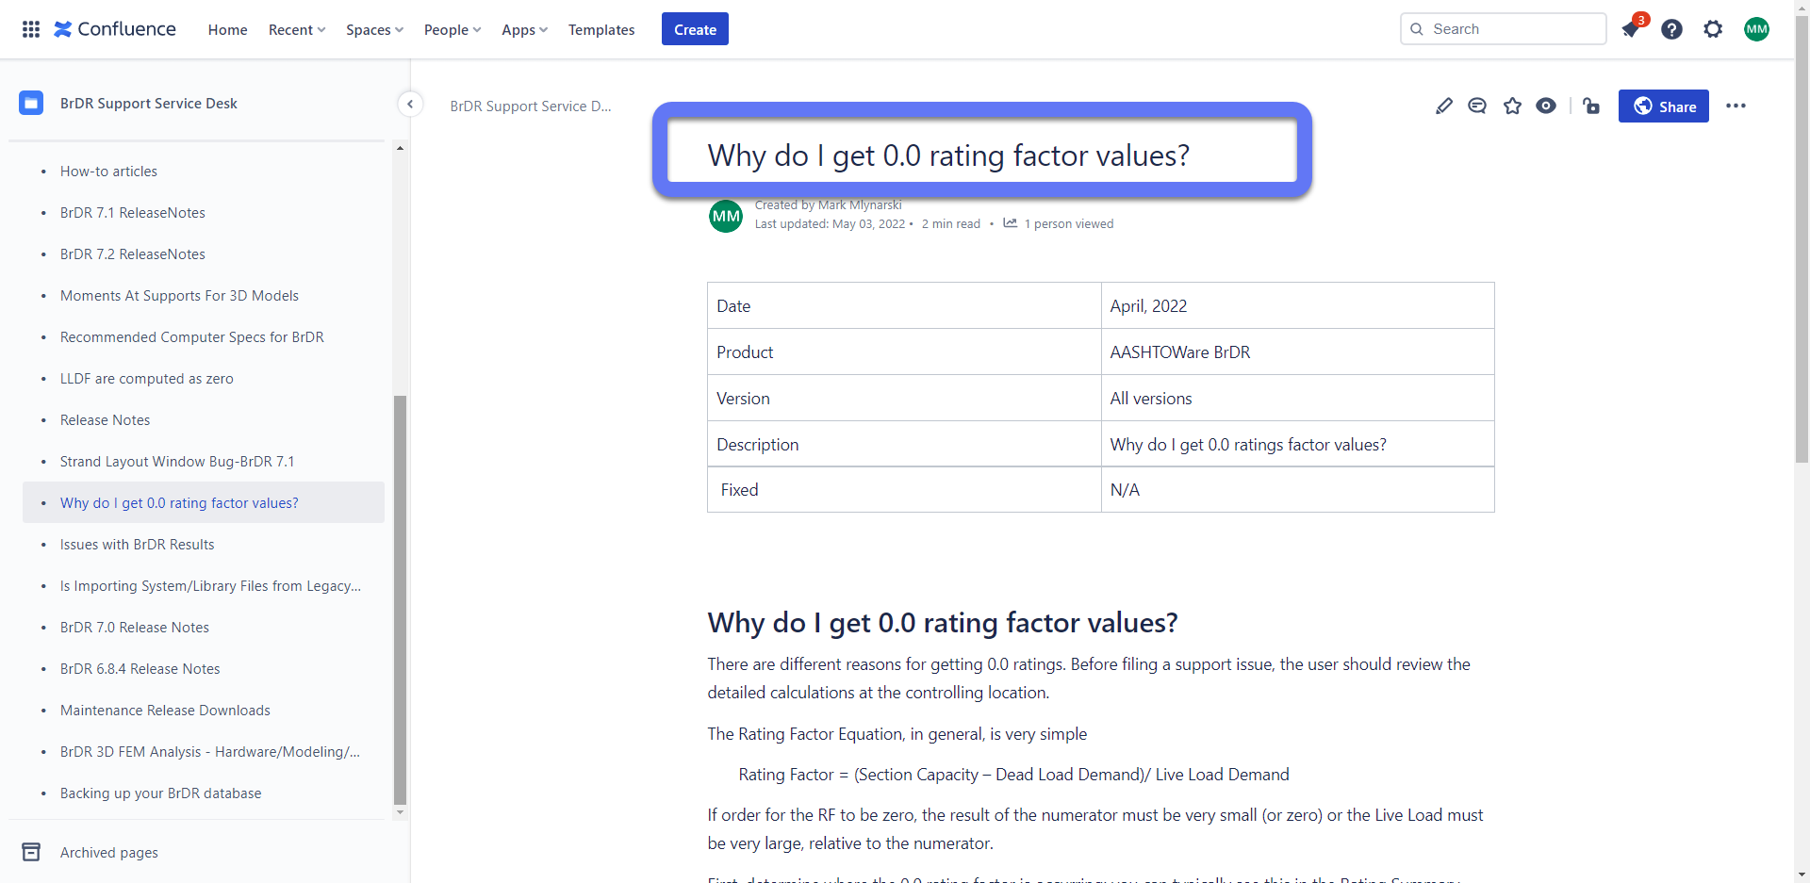
Confluence Articles

Slide 16
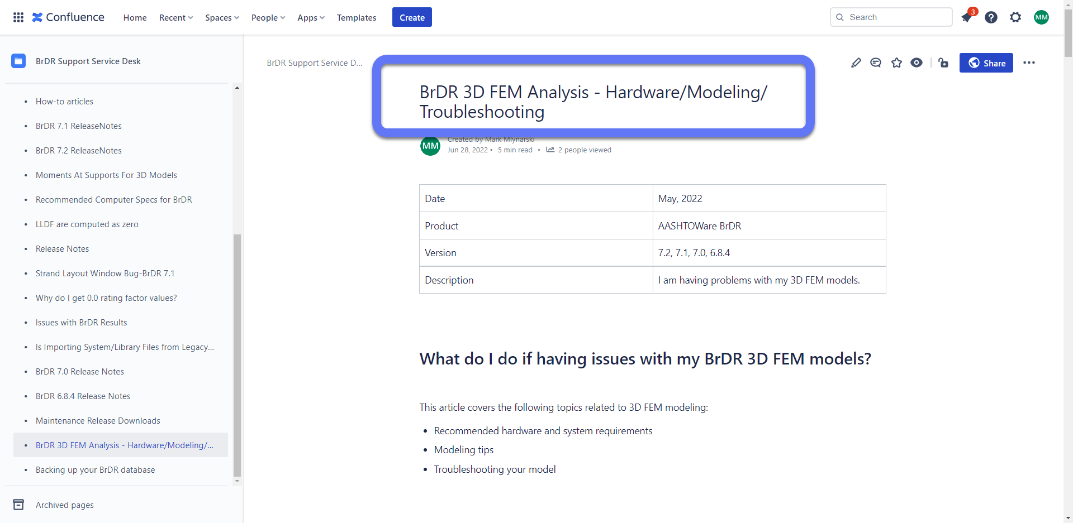
Confluence Articles

Slide 17
Confluence Articles
Ideas for an Article?
Let me know
mmlynarski@promiles.com
Or submit to the Support board
Submit ideas as a Word document

Slide 18
Questions?

