Slide 1
BrDR Database
Everything NEW You Need to Know
Kyle Plummer
Kyle@promiles.com
AASHTOWare RADBUG Meeting
August 2-3, 2022
New Orleans, LA
Notes:
Introduce myself – name, company, title
Going to discuss over next 15 minutes
Last year reviewed basics
Best Practices, etc.
Love to hear from you about your process/setup
Someone other than me next year!
Briefly review what’s now supported
Look at the new BrDR Migration Wizard 2.0
Looking forward
Questions

Slide 2




What’s Now Supported
Software Requirements
Operating System | Windows® 10
Oracle Version | 12.2c, 18.3c, 19.3c
Microsoft SQL Server Version | 2019
Microsoft SQL Server Express Version | 2019
Microsoft Azure SQL | Azure cloud managed
PostgreSQL | Hosted only
AASHTOWare RADBUG Meeting
August 2-3, 2022
New Orleans, LA
Notes:
BrDR stores most data – all bridge data – in a SQL database
Currently support Microsoft SQL Server, Oracle Database, Azure SQL, Postgres - hosted
Versions - from startup guide
Oracle – since 7.2 – support container databases, BrDR as pluggable database
Azure SQL – love to hear your feedback. Please send us thoughts, experience, feedback, suggestions for anything more usable
Official support – tested against
Use other DB – still provide support, doesn’t violate any support agreement
May be unknown bugs or issues
Oracle 21c innovation release available – may work with BrDR, not thorough testing

Slide 3
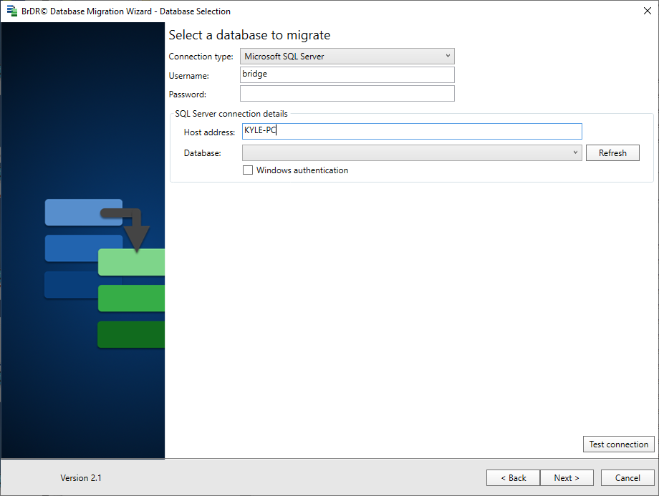
BrDR Migration Wizard 2.0
New Connection Screen
ODBC No Longer Supported
AASHTOWare RADBUG Meeting
August 2-3, 2022
New Orleans, LA
Notes:
New BrDR Migration Wizard 2.0
Major facelift, modernized UI/UX
New Connection screen – similar to BrDR connection profile and login
ODBC No longer supported
When connecting: SQL Server now only need db_owner role – no longer required owner of DB
Oracle still need to be owner of the schema
PostgreSQL – hosted only – contact us more details
Backup Database before beginning!! No way to reverse process.

Slide 4
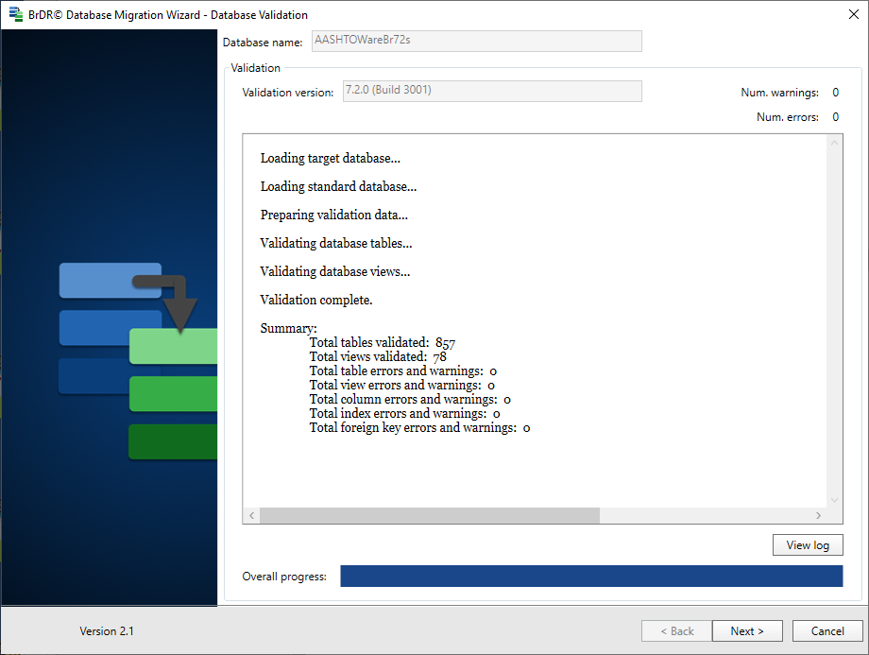
BrDR Migration Wizard 2.0
New Database Validation
Please contact us with any errors!
Log file and Schema Validation file
.log and .dvx
brdr@promiles.com
AASHTOWare RADBUG Meeting
August 2-3, 2022
New Orleans, LA
Notes:
New Database Validation component
Previous validation very basic
New validation much more thorough – try to prevent issues before they happen
Validate tables and views
Column names and order
Primary keys and indexes
Foreign keys – “integrity” constraints
If you have any warnings or errors or questions – Please stop and contact us!
brdr@promiles.com
Everything written out to log, schema validation file also saved
\Documents\AASHTOWare\MigrationWizardLogs

Slide 5


Looking Forward
Reconnecting after lost database connection
Encrypting data “in transit”
Additional Azure SQL connection methods
AASHTOWare RADBUG Meeting
August 2-3, 2022
New Orleans, LA
Notes:
Looking ahead to what’s coming in the near and not quire as near future
Reconnecting after database connection is lost
Especially frustrating during long-running analysis
Enhanced security – encrypting data between database and BrDR
Questions about supporting other Azure Sql authentication methods
Multi factor authentication
Already have hosted database option – Postgres
Full multi-tenant SAAS solution? Wait and see!

Slide 6
We’re Here to Help!
Questions?

