Slide 1
Culvert Top Slab Design Using Opis
VOBUG Conference
August 3rd, 2010
Nashville, Tennessee
Robert LeFevre, P.E.
Adam Price, P.E.
Tennessee Department of Transportation
Structures Division

Slide 2
Background
Before 2000, Tennessee’s cast-in-place reinforced concrete box and slab culverts were designed and built as frames.
Very thick top and bottom slabs under deep fill
Solution:
  Change culverts from frames (moment connections) to only shear connections at wall to slab interfaces.
  For fills greater than 10 feet, top bars in top slab and bottom bars in bottom slab are broken at interior walls to ensure simple span action.
Shear at interior supports is less for simple spans than for continuous spans
Greatly reduced top and bottom slab thicknesses

Slide 3
Assignment
The current culvert designs are according to the AASHTO Standard Specifications.
In order to receive federal funding, FHWA requires all culverts to be designed according to the AASHTO LRFD Specifications after October 2010.

Slide 4
Solution
Since Tennessee uses pinned connections to connect the culvert top and bottom slabs to the culvert walls, the top slab may be modeled in Opis as a slab bridge.
Excel spreadsheets were written to design the exterior walls, interior walls, and bottom slabs.

Slide 5
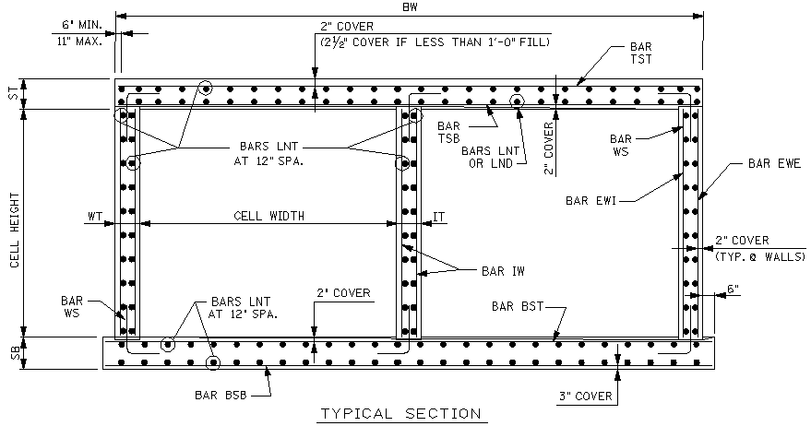
Box Culvert Cross-Section

Slide 6
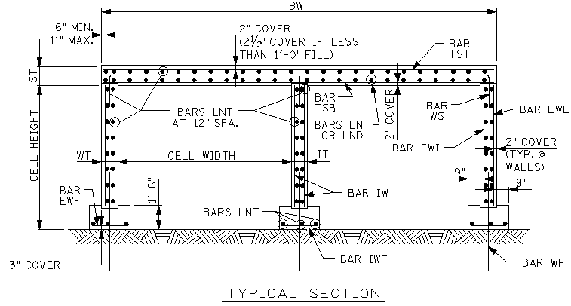
Slab Culvert Cross-Section

Slide 7
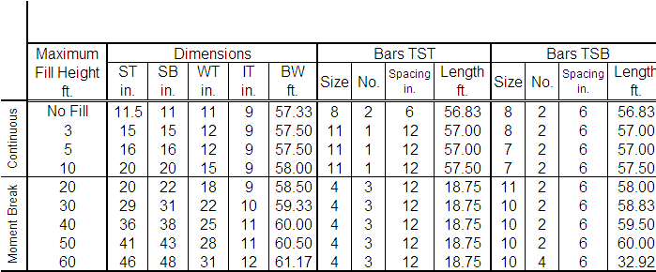
Culvert Table
3 @18x18 Box Culvert

Slide 8
Culvert Sizes
Culvert sizes covered by standard drawings (clear width x clear height):
  Smallest: 1 cell 6ft. X 3ft.
  Largest: 3 cells 18ft. X 18ft.

Slide 9
Live Load Distribution Factors (LLDFs)
For a 14’ cell width,
no fill,
single cell,
LLDF = 0.1240.

Slide 10
AASHTO LRFD 4.6.2.10
Equivalent Strip Widths for Box Culverts
“This Article shall be applied to box culverts with depth of fill less than 2.0 feet.”
“Design for depths of fill of 2.0 feet or greater are covered in Article 3.6.1.2.6.”

Slide 11
AASHTO LRFD 4.6.2.10
Equivalent Strip Widths for Box Culverts
TDOT’s culvert design is based on Case 1: Traffic Travels Parallel to Span.
The axle load is distributed perpendicularly to the span over a width ‘E’.

Slide 12
Calculating ‘E’
E = 96 + 1.44S
E = 96 + 1.44 x 14’
E = 116.16”
E = 9.68’

Slide 13
AASHTO LRFD 4.6.2.10
Equivalent Strip Widths for Box Culverts
“When traffic travels primarily parallel to the span, culverts shall be analyzed for a single loaded lane with the single lane multiple presence factor.”
From AASHTO LRFD 3.6.1.1.2, the single lane MPF = 1.2

Slide 14
Calculating the LLDF
LLDF = (1/E) x MPF
LLDF = (1/9.68’) x 1.2
LLDF = 0.1240 lanes

Slide 15
AASHTO LRFD 3.6.1.2.6
Distribution of Wheel Loads Through Earth Fills
“…where the depth of fill is 2.0 feet or greater, wheel loads may be considered to be uniformly distributed over a rectangular area with sides equal to the dimensions of the tire contact area… and increased by…the depth of the fill...”

Slide 16
AASHTO LRFD 3.6.1.2.5
Tire Contact Area
“The tire contact area...shall be assumed to be a single rectangle whose width is 20.0 inches and whose length is 10.0 inches.”

Slide 17
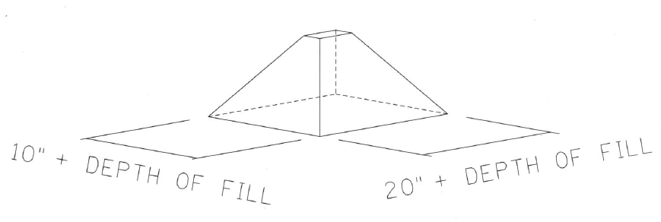
AASHTO LRFD 3.6.1.2.6
Distribution of Wheel Loads Through Earth Fills

Slide 18
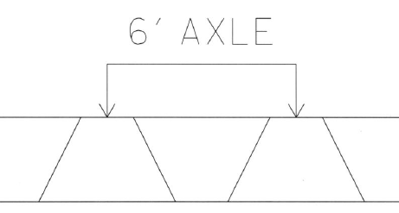
Live Load Distribution Width ‘E’

Slide 19
Live Load Distribution Width ‘E’
Cell width = 14’
Single cell
3’ fill case
E = (20” + 2’) x 2
E = 88”
E = 7.333’

Slide 20
Calculating the LLDF
LLDF = (1/E) x MPF
LLDF = (1/7.333’) x 1.2
LLDF = 0.1636 lanes

Slide 21
AASHTO LRFD 3.6.1.2.6
Distribution of Wheel Loads Through Earth Fill
“Where the live load and impact moment in concrete slabs, based on the distribution of the wheel load through earth fills, exceeds the live load and impact moment calculated according to Article 4.6.2.10, the latter moment shall be used.”

Slide 22
Calculating the LLDF
no fill case
LLDF = 0.1240 lanes
0.1240 < 0.1636
Therefore, LLDF = 0.1240

Slide 23
Live Load Distribution Width ‘E’
Cell width = 14’
Single cell
5’ fill case
E = (20” + 3’) x 2
E = 112”
E = 9.333’

Slide 24
Calculating the LLDF
LLDF = (1/E) x MPF
LLDF = (1/9.333’) x 1.2
LLDF = 0.1286 lanes

Slide 25
Calculating the LLDF
no fill case
LLDF = 0.1240 lanes
0.1240 < 0.1286
Therefore, LLDF = 0.1240

Slide 26
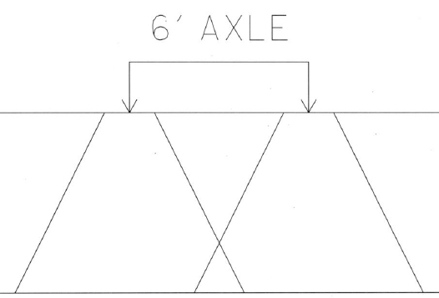
Live Load Distribution Width ‘E’

Slide 27
Live Load Distribution Width ‘E’
Cell width = 14’
Single cell
10’ fill case
E = 6’ + 20” + 5’
E = 152”
E = 12.667’

Slide 28
Calculating the LLDF
LLDF = (1/E) x MPF
LLDF = (1/12.67’) x 1.2
LLDF = 0.0947 lanes

Slide 29
Calculating the LLDF
no fill case
LLDF = 0.1240 lanes
0.1240 > 0.0947
Therefore, LLDF = 0.0947

Slide 30
Live Load Distribution Width ‘E’
Cell width = 14’
Single cell
20’ fill case
E = 6’ + 20” + 10’
E = 212”
E = 17.67’

Slide 31
Calculating the LLDF
LLDF = (1/E) x MPF
LLDF = (1/17.67’) x 1.2
LLDF = 0.0679 lanes

Slide 32
Calculating the LLDF
no fill case
LLDF = 0.1240 lanes
0.1240 > 0.0679
Therefore, LLDF = 0.0679

Slide 33
Live Load Distribution Width ‘E’
Cell width = 14’
Single cell
30’ fill case
Neglect live load.

Slide 34
AASHTO LRFD 3.6.1.2.6
Distribution of Wheel Loads Through Earth Fill
“For single-span culverts, the effects of live load may be neglected where the depth of fill is more than 8.0 feet and exceeds the span length…”

Slide 35
AASHTO LRFD 3.6.1.2.6
Distribution of Wheel Loads Through Earth Fills
minimum fill depth = 20’
span length = cell width = 14’
{fill = 20’} > {8’}
{fill = 20’} > {span length = 14’}
Therefore, LL may be neglected.

Slide 36
AASHTO LRFD 3.6.1.2.6
Distribution of Wheel Loads Through Earth Fill
“For multiple span culverts, the effects of live load may be neglected where the depth of fill exceeds the distance between faces of end walls.”

Slide 37
Live Load Distribution Length ‘L’
cell width = 14’
single-cell
5-foot fill case
L = 10” + 3’
L = 46”
L = 3.833’

Slide 38
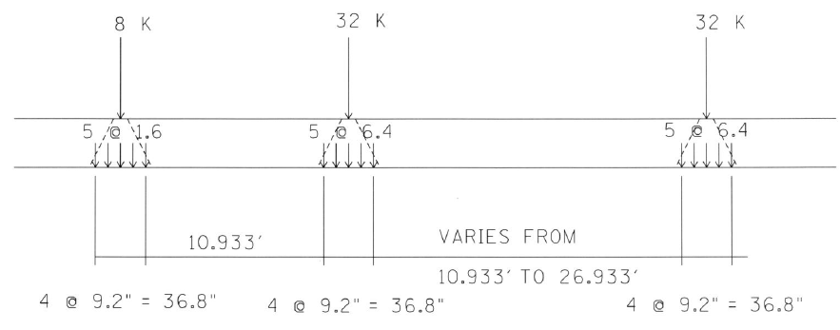
“Centipede” Truck

Slide 39
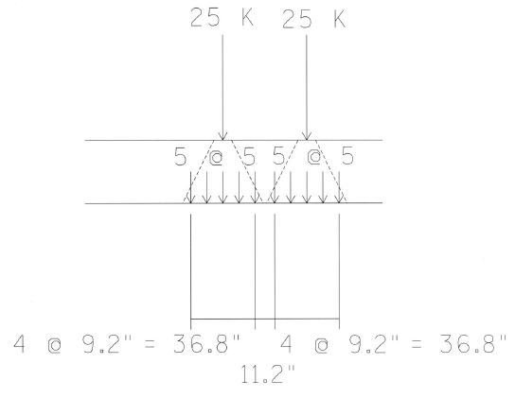
“Centipede” Tandem

Slide 40
Live Load Distribution Length ‘L’
cell width = 14’
single-cell
10-foot fill case
L = 10” + 5’
L = 46”
L = 5.833’

Slide 41
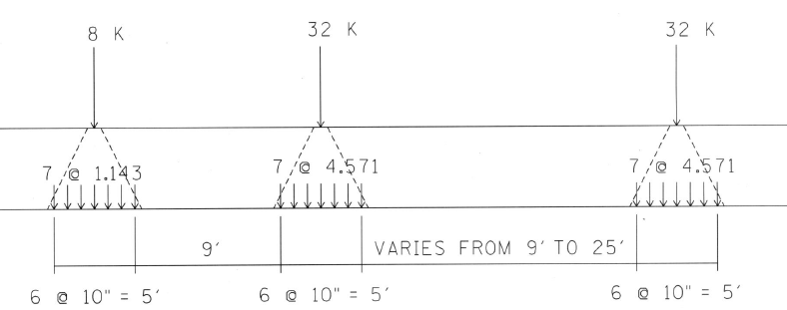
“Centipede” Truck

Slide 42
AASHTO LRFD 3.6.1.2.6
Distribution of Wheel Loads Through Earth Fill
Where…areas from several wheels overlap, the total load shall be uniformly distributed over the area.

Slide 43
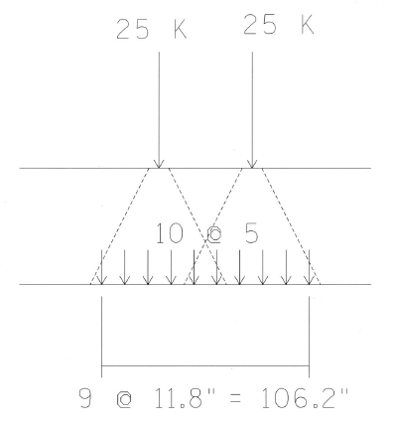
“Centipede” Tandem

Slide 44
Live Load Distribution Length ‘L’
cell width = 14’
single-cell
20-foot fill case
L = 10” + 10’
L = 130”
L = 10.833’

Slide 45
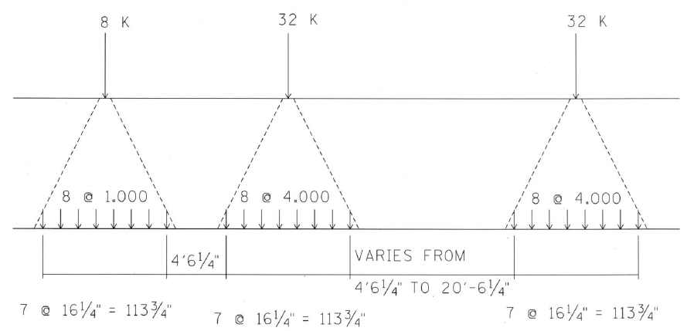
“Centipede” Truck

Slide 46
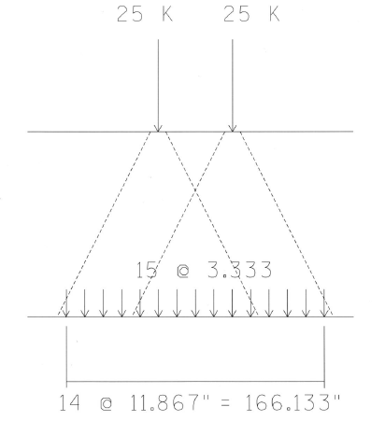
“Centipede” Tandem

Slide 47
Dynamic Load Allowance, IM
IM = 33% for Limit States other than the Fatigue and Fracture Limit State.

Slide 48
3.6.2 Dynamic Load Allowance: IM
3.6.2.2 Buried Components
The dynamic load allowance for culverts and other buried structures…shall be taken as:
IM = 33 x (1.0 – 0.125 x D_{E}) >= 0

Slide 49
For the three-foot fill case:
IM = 33 x (1.0 – 0.125 x D_{E})
IM = 33 x (1.0 – 0.125 x 0’)
IM = 33%

Slide 50
For the five-foot fill case:
IM = 33 x (1.0 – 0.125 x D_{E})
IM = 33 x (1.0 – 0.125 x 3’)
IM = 20.6%

Slide 51
For the ten-foot fill case:
IM = 33 x (1.0 – 0.125 x D_{E})
IM = 33 x (1.0 – 0.125 x 5’)
IM = 12.4%

Slide 52
For the twenty-foot fill case:
IM = 33 x (1.0 – 0.125 x D_{E})
IM = 33 x (1.0 – 0.125 x 10’)
IM = -8.3%
{IM = -8.3%} < 0
Therefore, IM = 0.

Slide 53
Materials
Concrete
  28-day Compressive strength: f’c = 3 ksi
Reinforcing Steel
  ASTM A615 Grade 60
    For culverts under less than 1’-0” of fill, bars in the top mat of the top slab are epoxy coated.

Slide 54
Bar Mark Definitions
For reinforced concrete slab bridges, the reinforcing steel must be defined under the bar mark definitions tab.
  Name
  Material (previously defined)
  Size
  Type (straight, hooked, etc.)
  Dimensions

Slide 55
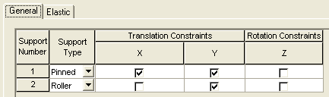
Supports
Wall-to-Slab connection is made by using #8 bars @ 1’-0”.
  Bars are in the center of members.
  Only shear capacity is provided.
  Pinned/Roller connection = default supports

Slide 56
Girder Profile - Section
12 inch strips were used for design.
Standard drawing tables are based on per foot quantities.

Slide 57
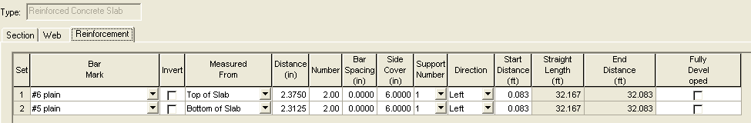
Girder Profile - Reinforcement
For culverts under less than 1’-0” of fill, the main flexural reinforcement in the top of the top slab is required to have 2 ½” of clear cover.
Otherwise, 2” of clear cover is required.

Slide 58
Girder Profile - Reinforcement
Bar spacing and side cover were always input as 0 inches and 6 inches, respectively.
This was done in order to manipulate the program to use the correct spacing modification factor (0.8) for the development length. The correct number of bars was always input.

Slide 59
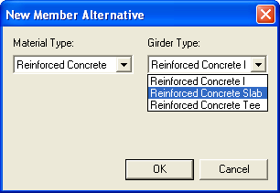
Member Alternatives
Material Type: Reinforced Concrete
Girder Type: Reinforced Concrete Slab

Slide 60
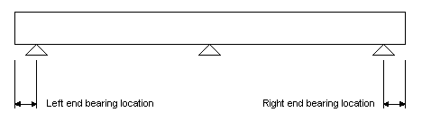
Member Alternative Description
Left and right end bearing locations were set to 4 inches for simplicity.
Interior walls thicker than 8 inches were only required for some culverts with fill depths of 20 feet or greater.
These culverts were designed as simple spans. Therefore the end bearing location of 4 inches was acceptable.

Slide 61
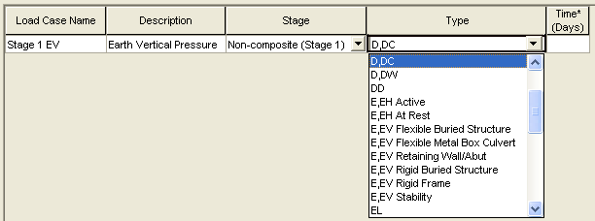
Load Case Description
Many options are available for earth fill loads.
“E,EV Rigid Buried Structure” was initially selected for the earth fill load type.

Slide 62
Load Case Description Problem
It was later discovered that none of the earth fill load types are used by Brass.
The earth fill load was not being applied to the model.
“D,DC” was used as the load case type for the earth fill.
The earth fill load as multiplied by 1.3/1.25 to account for the difference in load factors.

Slide 63
Load Case Description Problem
Incident 9523
Users should not have the option to input data not accepted by the engine running the analysis.
Since the load can be input, most people would assume that the program uses it properly.
Could lead to dangerous mistakes
Issue has been corrected in version 6.2

Slide 64
Shear
Opis uses AASHTO 5.8 for shear code check.
For culverts under 2.0 feet or more of fill, AASHTO 5.14.5.3 applies instead of 5.8.

Slide 65
Shear for Fill ≥ 2 ft.
Using AASHTO 5.8 instead of 5.14.5.3 is conservative.
When shear failures were indicated by Opis, shear was checked using 5.14.5.3.
Excel spreadsheet was written for this check.
Design ratios around 0.9 using AASHTO 5.8 were found to be over 1.0 when using 5.14.5.3.

Slide 66
Supplementary Check Points
In addition to checking tenth points for each span, other “points of interest” to check may be specified.
Needed in order to check critical sections for shear, taken as the greater of (AASHTO 5.8.3.2):
  0.5*d_{v}*cot(θ)
  d_{v}
d_{v} ≥ greater of (AASHTO 5.8.2.9):
  0.9*d_{e}
  0.72*h
Since h (slab thickness) was already known for each check, it was simple and conservative to take the critical section for shear as 0.72h from the face of the wall. If this greatly increased the slab thickness of the current Standard Specification designs, then 0.9d_{e} was used.
Adding shear checks points by default would be an excellent enhancement for OPIS.
  Incident 10172

Slide 67
Bridge Alternatives
Bridge alternatives are not required for slab bridges.

Slide 68
Culvert Top Slab Summary
In some cases, we found that the LRFD designs matched our existing AASHTO Standard Specification designs.
In other cases, additional reinforcing steel and/or thicker top slabs were required.
Primary reasons:
  Wheel loads spread through fill at a rate of 1.0*fill depth for LRFD versus 1.75*fill depth for Standard Specifications.
  Critical section for shear located closer to support for LRFD than for Standard Specifications.

Slide 69
Reference
American Concrete Pipe Association
  Very good comparison of the differences between the AASHTO Standard Specifications (17th Ed.) and the AASHTO LRFD Specifications (2008 Interim)
  http://www.concrete-pipe.org/pdf/Box-Cliff-Notes.pdf

Slide 70
Standard Drawings
TDOT culvert standard drawings can be found at:
http://www.tdot.state.tn.us/Chief_Engineer/engr_library/stddrlib.htm

Slide 71

Questions?

