Slide 1
FHWA Update
2019 AASHTO RADBUG Meeting
July 30 - 31, 2019
South Lake Tahoe, CA
Images Source: FHWA
Christopher Long, M.S., P.E.
Infrastructure Team Leader
California Division Office

Slide 2
Presentation Outline
Bridge program updates
Structural engineering updates
Bridge load rating updates
Notes:
Federal Highway Administration has been adapting to a performance based program over the past 7 years since in the enactment of MAP-21. There are more than 616,000 bridges in the country that State, local, Federal, and tribal agencies are managing.

Slide 3
Bridge Program Changes
Elimination of sufficiency rating (SR), functional obsolete (FO), structurally deficient (SD)
Fracture critical (FC)
Good, Fair, Poor
More...what else do we need to tell our story?
Risk-based, data driven
Risk…severity of consequence v. likelihood of occurrence
Notes:
Approved slide. Shay Burrows Ketnote presentation at International Bridge Conference, National Harbor, MD, June, 2019

Slide 4
The Language of the F-A Bridge Program
Sufficiency Rating
Functionally Obsolete
Structurally Deficient
Fracture Critical
Good/Fair/Poor
To avoid some of the same misuse or misinterpretation, illustrative language is needed.
Poor
National Bridge
Inspection Standards
(NBIS) Update?
Notes:
Approved slide. Shay Burrows Ketnote presentation at International Bridge Conference, National Harbor, MD, June, 2019

Slide 5
Structural Engineering Program
FHWA Office of Bridges and Structures provides key national leadership to advance the state of the practice in engineering.
Program areas include:
  Structural Steel
  Structural Concrete
  Load Rating
  Security
  Seismic
  Tunnels
Notes:
We have many efforts ongoing to provide national leadership, policy and guidance, research, and implementation of new tools and technology in structural engineering for highway bridges and structures. We work closely with AASHTO, TRB, industry, and DOTs to identify the high priority needs and use our resources to provide advancement
Approved slide. Shay Burrows Ketnote presentation at International Bridge Conference, National Harbor, MD, June, 2019

Slide 6
Improved Design and Evaluation
of Bridges with Refined Analysis
Refined Analysis refers to a more detailed, sophisticated approach to modeling the behavior of structures
Can provide more accurate assessment of load effects and resistance
In the national specifications, but somewhat undefined
“Manual for Refined Analysis in Bridge Design and Evaluation” published in May 2019
Notes:
FHWA has been very active in developing technical guidance on the use of refined analysis in bridge engineering.
Approved slide. Shay Burrows Ketnote presentation at International Bridge Conference, National Harbor, MD, June, 2019

Slide 7
Building Information Modeling (BIM)
for Bridges and Structures
BIM refers to modeling in a more holistic way, where the model becomes a shared, collaborative resource and communication tool
Provides a complete record of the bridge, and offers maximum value to the owner and stakeholders
The FHWA has been providing national leadership to establish technical guidelines and implementation
Notes:
Approved slide. Shay Burrows Ketnote presentation at International Bridge Conference, National Harbor, MD, June, 2019

Slide 8
Load Carrying Capacity Rating
Load rating of bridges continues to be a big challenge for our industry
It is critical to assuring safety of traveling public and providing mobility
FHWA has ongoing efforts to provide policy and guidance to assist the state DOTs
Notes:
Approved slide. Shay Burrows Ketnote presentation at International Bridge Conference, National Harbor, MD, June, 2019

Slide 9
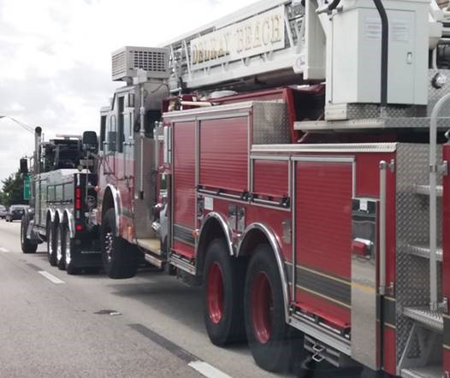
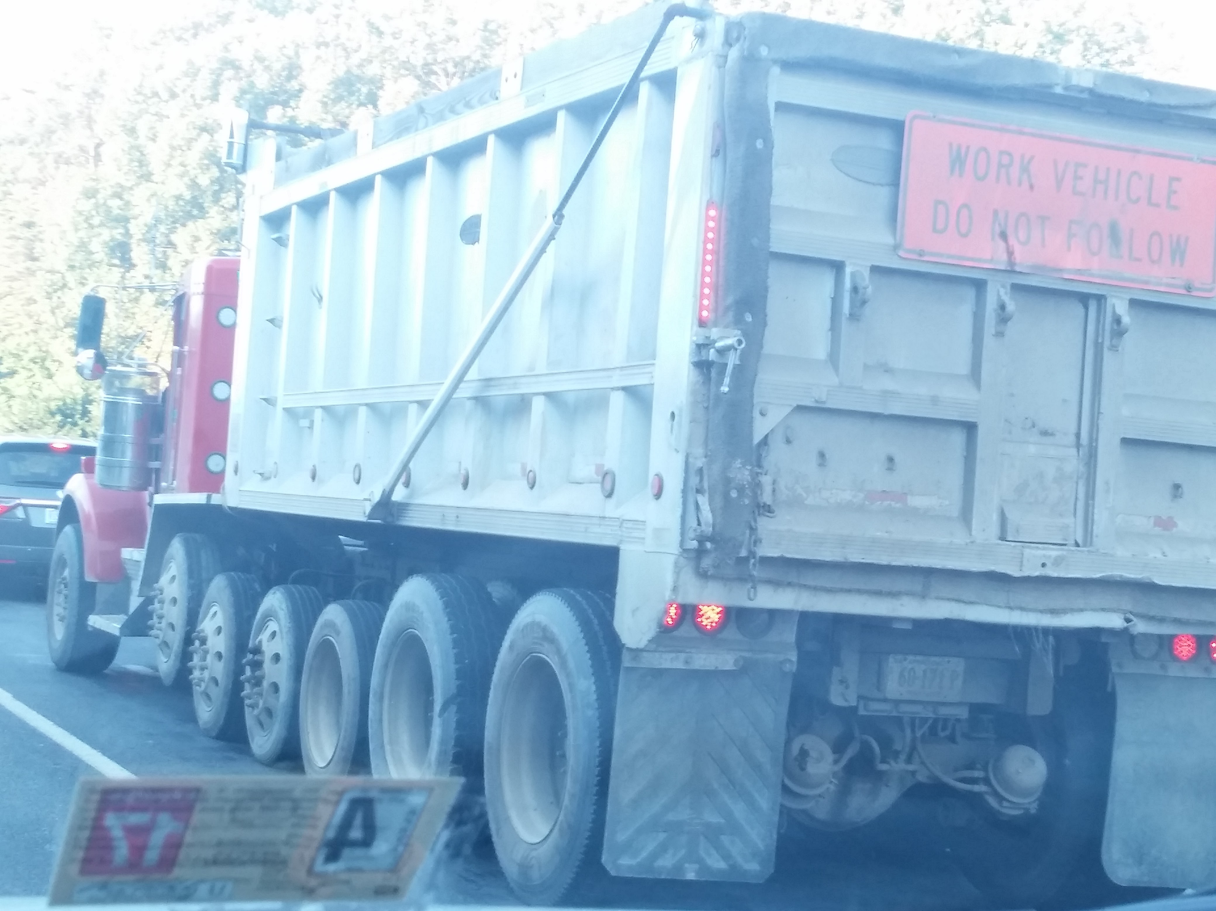
Changing Truck Weights
Special Hauling Vehicles
Emergency Vehicles
Heavy Duty Tow and Recovery Vehicles
Image Source: FHWA
Notes:
Source: Lubin Gao
Approved slide. Shay Burrows Ketnote presentation at International Bridge Conference, National Harbor, MD, June, 2019

Slide 10
Changing Truck Weights
Table 3-8. Trucks and Truck Miles by Average Weight: 1987, 1992, 1997, and 2002¹
Average weight (pounds) | 1987 |  | 1992 |  | 1997 |  | 2002 |  | Percent Change, 1987 to 2002
 | Number (thousands) | VMT (millions) | Number (thousands) | VMT (millions) | Number (thousands) | VMT (millions) | Number (thousands) | VMT (millions) | Number | VMT
Total | 3,624 | 89,972 | 4,008 | 104,987 | 4,701 | 147,876 | 5,415 | 145,624 | 49.4 | 61.9
Light-heavy | 1,030 | 10,768 | 1,259 | 14,012 | 1,436 | 19,815 | 1,914 | 26,256 | 85.9 | 143.8
10,001 to 14,000 | 525 | 5,440 | 694 | 8,000 | 819 | 11,502 | 1,142 | 15,186 | 117.6 | 179.2
14,001 to 16,000 | 242 | 2,738 | 282 | 2,977 | 316 | 3,951 | 396 | 5,908 | 63.6 | 115.8
16,001 to 19,500 | 263 | 2,590 | 282 | 3,035 | 301 | 4,362 | 376 | 5,161 | 43.2 | 99.3
Medium-heavy | 766 | 7,581 | 732 | 8,143 | 729 | 10,129 | 910 | 11,766 | 18.8 | 55.2
19,501 to 26,000 | 766 | 7,581 | 732 | 8,143 | 729 | 10,129 | 910 | 11,766 | 18.8 | 55.2
Heavy-heavy | 1,829 | 71,623 | 2,017 | 82,832 | 2,536 | 117,931 | 2,591 | 107,602 | 41.7 | 50.2
26,001 to 33,000 | 377 | 5,411 | 387 | 5,694 | 428 | 7,093 | 437 | 5,845 | 15.9 | 8.0
33,001 to 40,000 | 209 | 4,113 | 233 | 5,285 | 257 | 6,594 | 229 | 3,770 | 9.7 | -8.4
40,001 to 50,000 | 292 | 7,625 | 339 | 9,622 | 400 | 13,078 | 318 | 6,698 | 9.0 | -12.2
50,001 to 60,000 | 188 | 7,157 | 227 | 8,699 | 311 | 12,653 | 327 | 8,950 | 73.8 | 25.1
60,001 to 80,000 | 723 | 45,439 | 781 | 51,044 | 1,070 | 74,724 | 1,179 | 77,489 | 63.1 | 70.5
80,001 to 100,000 | 28 | 1,254 | 33 | 1,529 | 46 | 2,427 | 69 | 2,950 | 144.3 | 135.2
100,001 to 130,000 | 8 | 440 | 12 | 734 | 18 | 1,051 | 26 | 1,571 | 238.5 | 257.2
130,001 or more | 4 | 185 | 5 | 227 | 6 | 312 | 6 | 329 | 43.2 | 77.9
Image Source: FHWA
Notes:
Source: https://ops.fhwa.dot.gov/freight/freight_analysis/nat_freight_stats/docs/13factsfigures/table3_08.htm
The key area to focus on is the increase in number of trucks and vehicles miles traveled (VMT) for trucks over 80,000 pounds.
80,000-100,000 pounds: 144% increase in trucks and 135% increase in VMT
100,000-130,000 pounds: 238% increase in trucks and 257% increase in VMT
Approved slide. Shay Burrows Ketnote presentation at International Bridge Conference, National Harbor, MD, June, 2019
Also in approved slide. Lubin Gao’s presentation at 2019 Bridge and Tunnel Inspectors’ Conference, Portland, OR, April, 2019

Slide 11

Truck Platooning
Image Source: USDOT

Slide 12
IDIQ Contract Task Order
Truck Platooning Impacts on Bridges:
Phase I – Structural Safety
IDIQ Contract No.: DTFH6114D00048
TASK ORDER: 693JJ318F000250
Period of Performance: 08/13/2018 to 12/12/2020
Contractor: WSP USA Inc.
Subcontractor: Michael Baker, Auburn University
Notes:
Approved slide. Lubin Gao’s presentation to AASHTO T-5 Technical Committee Mid-Year Meeting
Atlanta, GA. October 25, 2018

Slide 13
Objective
“The objective of this task order is to produce a comprehensive report for FHWA that covers the technical aspects of truck platooning impacts on bridges with a focus on structural safety.”
The report shall include a brief discussion of:
The truck platooning technology
Identify most common, probable truck platooning scenarios
Document the research methodology and findings
Recommend load models for bridge evaluation
Propose design specification modifications
Recommendations for further research
Notes:
Approved slide. Lubin Gao’s presentation to AASHTO T-5 Technical Committee Mid-Year Meeting
Atlanta, GA. October 25, 2018

Slide 14
Project Schedule
Task/Deliverable | Schedule
Task 1 – Kick Off Meeting | September 13, 2018
Task 1 – Kick Off Meeting Minutes | September 18, 2018
Task 1 – Literature and Technology Review, Research Methodology and Workplan | November 13, 2018
Task 2 – Execute Tier 1 Parametric Analysis | May 13, 2019
Task 3 – Execute Tier 2 Sample Bridge Analysis | November 13, 2019
Task 4 – Proposed Load Rating Methodology | May 13, 2020
Task 5 – Investigate Potential Impacts of Platooning on Design | May 13, 2020
Task 6 – Draft Final Report | August 13, 2020
Task 6 – Final Deliverables | November 13, 2020
Project Schedule
Notes:
Approved slide. Lubin Gao’s presentation to AASHTO T-5 Technical Committee Mid-Year Meeting
Atlanta, GA. October 25, 2018

Slide 15
Shear Load Rating for Concrete Bridges
John Holt, Uriel Garcia, et al. (2018), Concrete Bridge Shear Load Rating, Synthesis Report, FHWA-HIF-18-061, Federal Highway Administration, November 2018. https://www.fhwa.dot.gov/bridge/loadrating/pubs/hif18061.pdf

Slide 16
IDIQ Contract Task Order
Development of a Synthesis Report on Concrete Bridge Shear Load Rating
IDIQ Contract No.: DTFH6114D00049
Period of Performance: 07/31/2017 to 1/30/2019
Contractor: HDR Inc.
Subcontractor: Dr. Oguzhan Bayrak, PE Structural Consultants

Slide 17
Project Deliverable
A critical review of relevant specifications, technical literature, and transportation agency and industry practices and experiences were performed for the synthesis report. The review investigated the specifications and provisions related to shear design and shear rating for concrete bridges specified in the current and previous editions of the AASHTO Manual for Bridge Evaluation (MBE) Standard Specifications and Load and Resistance Factor Design (LRFD) Specifications.
A survey of select State DOTs was conducted to help define challenges that need to be addressed in this review.

Slide 18
Major Findings
The report includes a history of changes in shear design provisions in AASHTO design specifications and the MBE. The report also provides a summary of States’ practices and identifies the issues that States are facing in rating existing concrete bridges using the MBE shear provisions. The final report was published in November 2018, and it is available at FHWA’s website.
Fifteen findings are identified and documented in the report. Some could be addressed through an AASHTO Agenda Item with modifications to the MBE or the LRFD.

Slide 19
IDIQ Contract Task Order
Development of Concrete Bridge Shear Load
Rating Guidance and Examples Using the Modified Compression Field Theory (MCFT)
IDIQ Contract No.: DTFH6114D00050
Task Order No.: 693JJ319F000201
Period of Performance: 07/01/2019 to 6/30/2021
Contractor: MCEER/University at Buffalo
Subcontractor: Modjeski and Masters, Inc.

Slide 20
Further Work from Previous Task Order
Finding 7: Estimation of the strain - correctly - for use in MCFT-based calculations is critical.
Finding 8: Using MCFT and the strain equations in LRFD when prestressing is on the compressive flexural side can provide incorrect and overly conservative shear strengths.
Finding 9: MCFT-based shear strength calculations are load dependent.
Finding 10: An existing girder not meeting minimum shear reinforcement requirements with MCFT may be have its shear strength unduly penalized.
Finding 12: Reinforcement detailing should be verified for adequacy when load-rating concrete bridges in shear.

Slide 21
Objective
Produce a guidance document with examples for FHWA that covers the technical aspects of concrete bridge shear load rating using the MCFT. A study shall be performed to develop methods for determining shear resistance for sections that do not meet minimum reinforcement requirements (either minimum longitudinal tension reinforcement or minimum shear reinforcement), based on the available shear test dataset that is in published literature.
The procedure shall include how to accurately compute strain, resistance, concurrent force effects and rating factor including the shear-moment interaction and the strain-force effect consistency in shear resistance determination. Minimum three (3) examples shall be developed to demonstrate the MCFT shear load rating procedure.

Slide 22
Major Tasks
Task 1 – Kick-off. (1 month from award)
Task 2 - Development of AASHTO agenda items, methodologies, content outlines and work plan. (3 months from award)
Task 3 - Development of technical procedures and validation against test data. (9 months from award)
Task 4 - Development of guidance with examples as approved in Task 2. (21 months from award)

Slide 23
Load Rating of Tunnel Structures

Slide 24
IDIQ Contract Task Order
Development of a Reference Guide for Load Rating of Tunnel Structures
IDIQ Contract No.: DTFH6114D00049
Period of Performance: 09/05/2017 to 07/28/2020
Contractor: HDR Inc.

Slide 25
Objective
Produce a reference guide for FHWA that covers the technical aspects of load rating of tunnel structures and provides practical, representative step-by-step examples.
This reference guide shall provide sufficient technical details and breadth appropriate for explaining the load rating specifications and guidelines governing U.S. highway tunnel structures.
A set of examples will help illustrate the requirements, procedures, and methods.
Conduct two workshops and to develop two validation examples.

Slide 26
Project Status
The guide is under final publication review.
It includes the contents and four examples.
It will be published in late summer 2019.
Two validation examples will be published separately after development.

Slide 27
Bridge Engineering Must Adapt
Refined Analysis and BIM-based process must be embraced to meet the challenges of the future
Increasing truck volumes, and new technology such as automated and connected vehicles requires our practice to change the way we do business
Safety and mobility depend on it
Notes:
Approved slide. Shay Burrows Ketnote presentation at International Bridge Conference, National Harbor, MD, June, 2019

Slide 28
Thank you!
Christopher Long
Christopher.long@dot.gov
916.498.5042
Lubin Gao, Ph.D., P.E.
Senior Bridge Engineer – Load Rating
Acting Team Leader
Structures Safety and Management
Office of Bridges & Structures
lubin.gao@dot.gov

