Slide 1
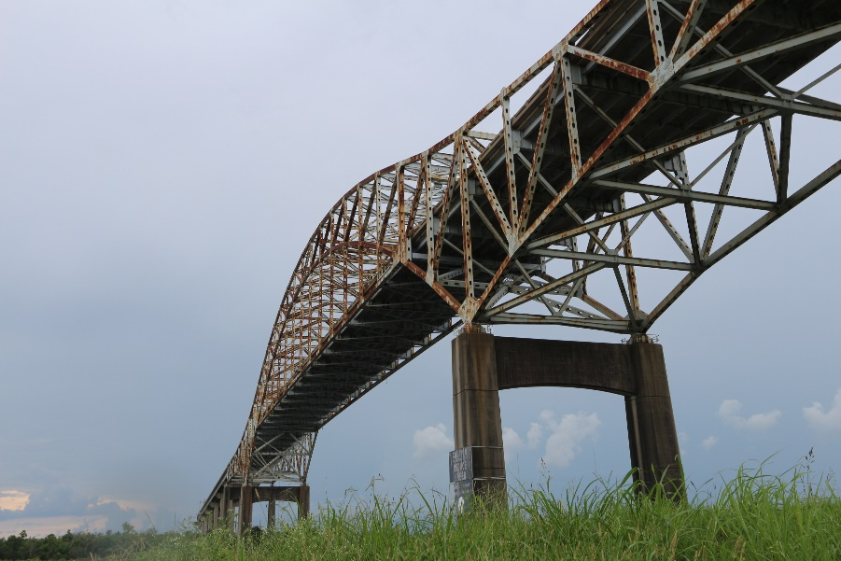



Load Rating of the LA 47 Bridge over Intracoastal Waterway gulf outlet
Presented by:
Durk H. Krone, PE, TRC
Xianzhi “Sage” Liu, PE, TRC

Slide 2
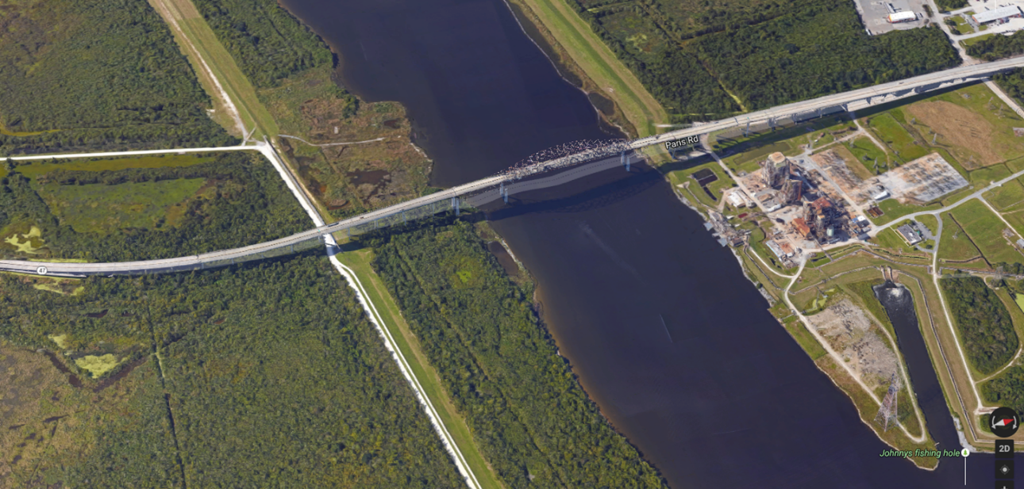
Outline
Project Background
Truss Modeling and Validation
Truss and Gusset Plate Load Rating
Approach Span Load Rating
Questions & Answers

Slide 3
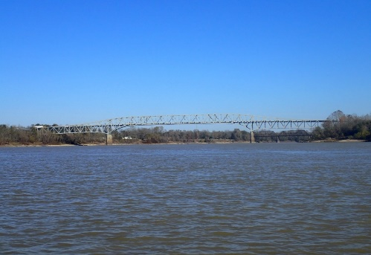
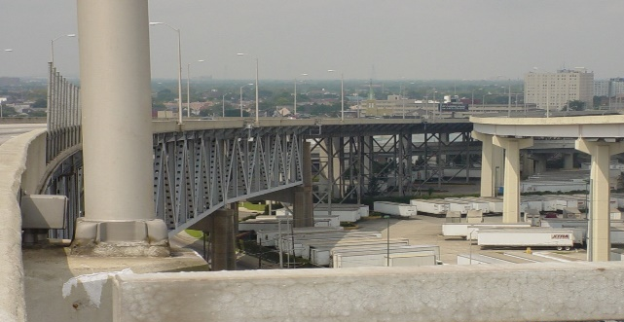
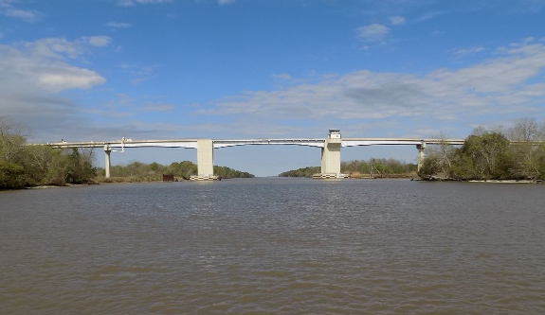
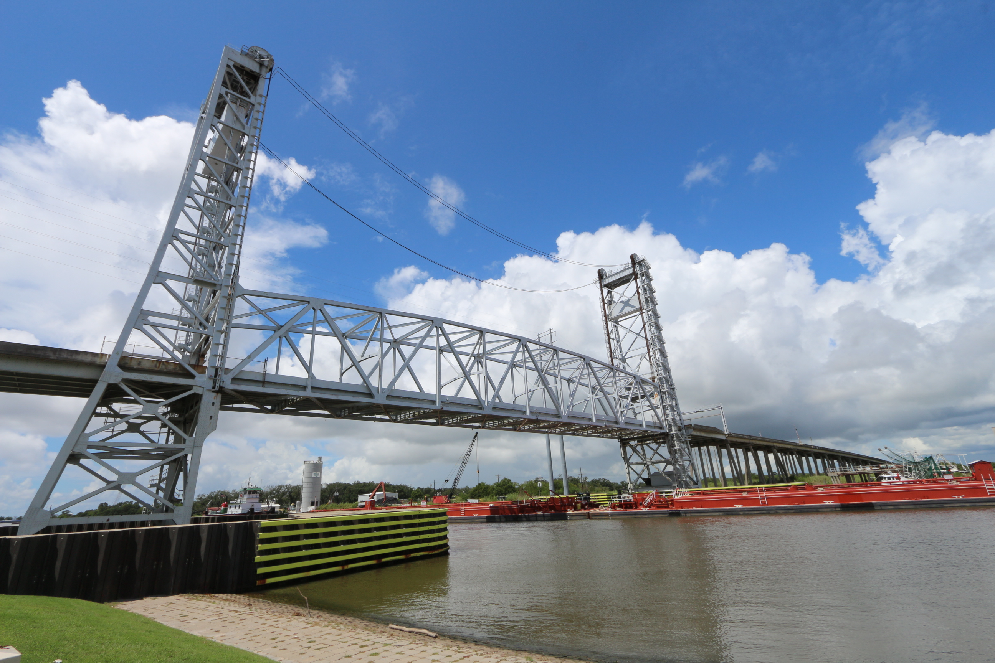
Project Background
Retainer Contract for Complex Bridge Load Rating for LA DOTD
Including Through-Truss, Vertical Lift Bridges, Bascule Bridges, etc.

Slide 4
Project Background
Project Goals/Tasks:
  Perform complete Load Rating for whole bridge
  AASHTOWare BrR has to be used whenever possible, to facilitate future permit load evaluation
  Perform load rating for structural components that can’t be included in BrR
  Provide Influence Lines for critical components/critical load effects that can’t be load rated in BrR, also to facilitate future permit load evaluation

Slide 5
Project Background
Required Live Loads for LRFR:
  Design Loads (HL-93)
  LADV-11 (only require for New Bridges)
  Legal Loads
  NRL and SU trucks
  EV: not implemented yet

Slide 6
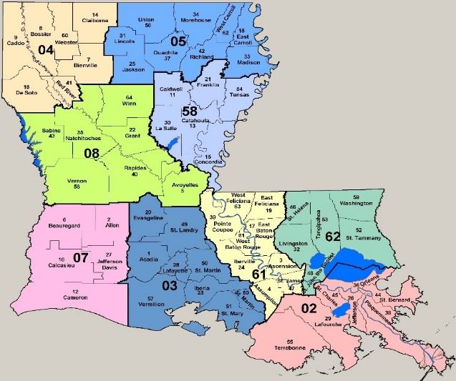
Project Background
Bridge Location: LA 47 Intracoastal Waterway Gulf Outlet, Orleans Parish, Louisiana
Built in 1962
Bridge was originally designed for HS-20
Total Length 6622 feet
69 Spans
North Approach spans were widened in 1987
PROJECT
LOCATION

Slide 7
Project Background
Superstructures:
  Slab Span
  PPC Girder Spans
  Steel Girder Spans
  Truss Spans
Substructures:
  Pile Bents
  Column Bents
  River Piers

Slide 8
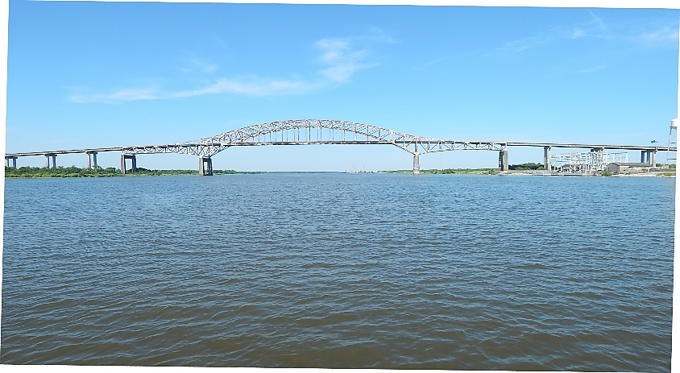
Project Background
Main Truss Span
  Anchor span
  Cantilever arm
  Suspended span takes form of tied-arch truss
  Span length: 273’-702’-273’
  Pin-hanger at U9-L9 and U9’-L9’

Slide 9
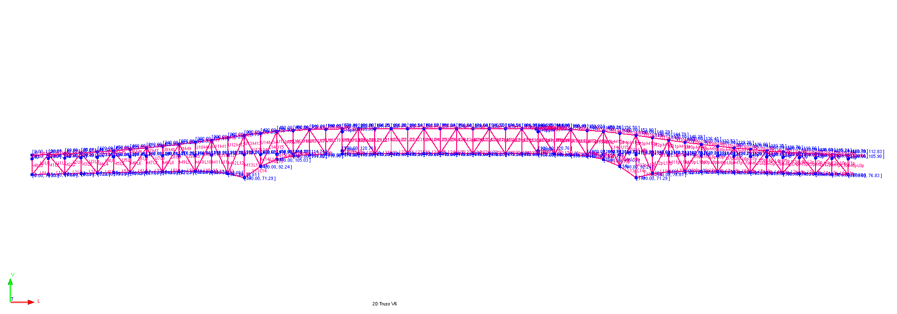
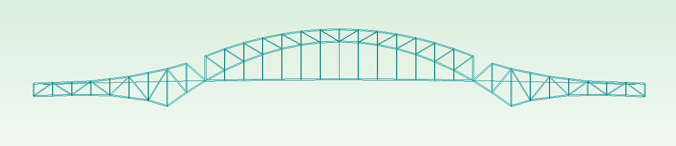
Truss Modeling and Validation
Required Load Rating Software:
  AASHTO BrR
Modeling Validation Software
  MIDAS Civil
BrR Model
MIDAS Model

Slide 10
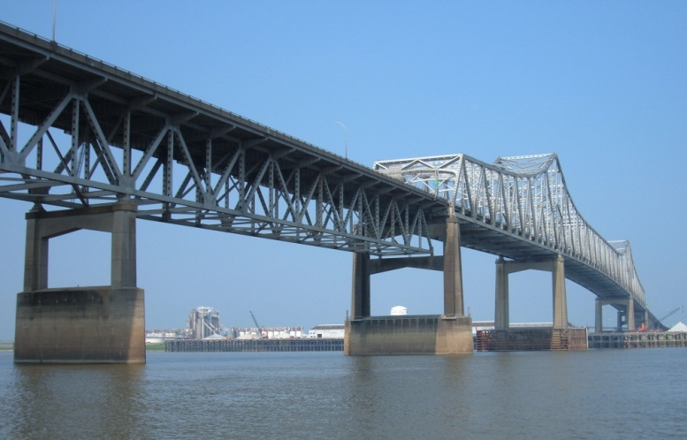
Truss Modeling and Validation
Available Truss Configurations Options for AASHTO BrR
  Deck: Live Loads on Upper Chord
  Through: Live Loads on Lower Chord
  Half-Deck: Deck Line Varies
Deck Line –Deck Truss
Deck Line –Through Truss

Slide 11
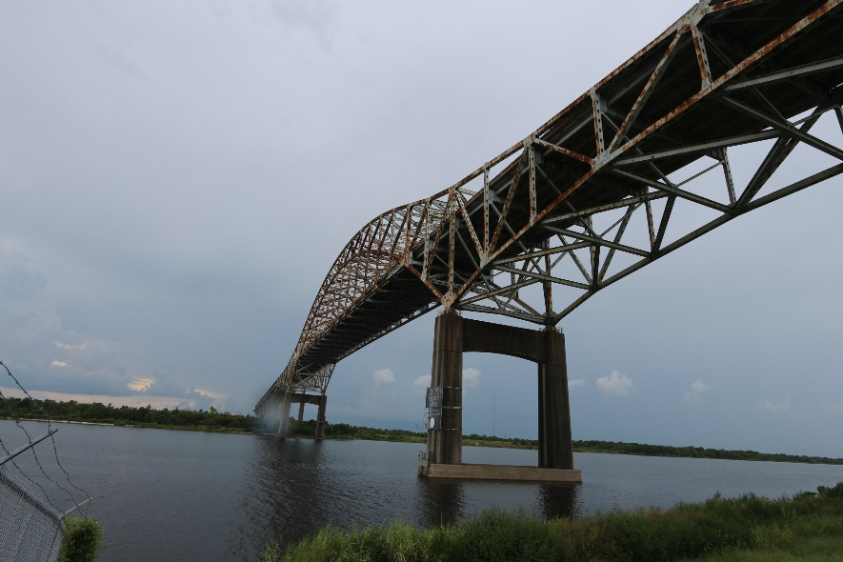
Truss Modeling and Validation
Half Deck Option
  New BrR Feature
  User-defined deck locations along truss for LL analysis
  Additional Panel Point Locations at deck level
Deck Line

Slide 12
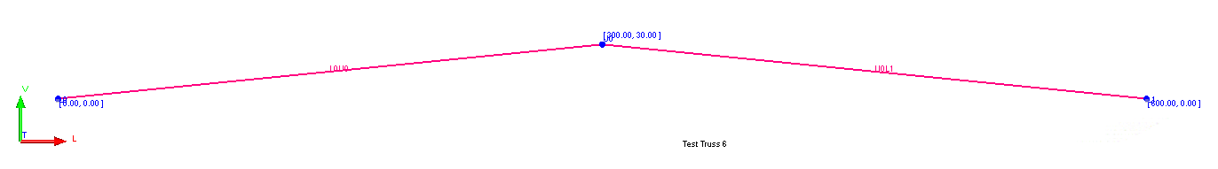
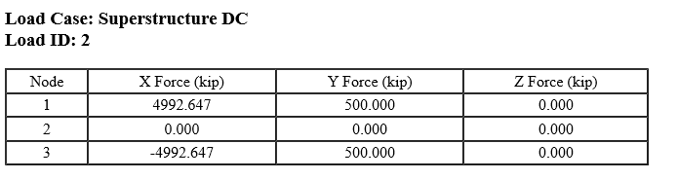
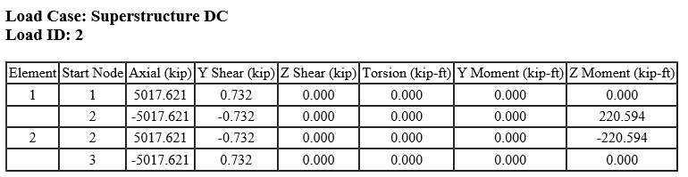
Truss Modeling and Validation
A test model
  Model 1: Deck Truss
  Model 2: Half Deck Truss
  Using Half Deck Option Showing shear and moment for truss members

Slide 13
Truss Modeling and Validation
Comparison
  Truss member forces are not identical
  Deck truss seems to behave like a truss
  Half deck truss has “Framing” effects
Member | Deck Truss Option | Half Deck Option
U0U1 | 0 | 13
U1U2 | 1673 | 1659
U2U3 | 1673 | 1667
U3U4 | 2660 | 2649
U4U5 | 2660 | 2647
U5U6 | 2368 | 2363
U6U7 | 2368 | 2360
U7U8 | 1330 | 1329
M10L10 | 100 | 102
M11L11 | 114 | 113
M12L12 | 100 | 103
M13L13 | 114 | 111
M14L14 | 100 | 100
M15L15 | 114 | 112
M16L16 | 100 | 95
U9L9S | 1411 | 1388
U10M10 | -604 | -595
U11M11 | -534 | -530
U12M12 | -451 | -436
U13M13 | -323 | -310
U14M14 | -179 | -167
U15M15 | -2 | 6
U16M16 | 84 | 89
Member | Deck Truss Option | Half Deck Option
L0L1 | -836 | -824
L1L2 | -836 | -833
L2L3 | -2344 | -2327
L3L4 | -2344 | -2330
L4L5 | -2549 | -2546
L5L6 | -2549 | -2546
L6L7 | -2093 | -2092
L7L8 | -2456 | -2453
L8L9C | -1509 | -1511
L9SL10 | 2669 | 2630
L10L11 | 2669 | 2645
L11L12 | 2669 | 2651
L12L13 | 2669 | 2660
L13L14 | 2669 | 2667
L14L15 | 2669 | 2671
L15L16 | 2669 | 2674
U9U10 | -518 | -539
U10U11 | -1085 | -1107
U11U12 | -1669 | -1689
U12U13 | -2245 | -2249
U13U14 | -2732 | -2721
U14U15 | -3075 | -3047
U15U16 | -3187 | -3147

Slide 14
Truss Modeling and Validation
A test model
  Model 1: Deck Truss
  Model 2: Half Deck Truss
  Truss Geometry for both truss models are identical
  Applied Loads are identical: 100kips on lower panel points of suspended span

Slide 15
Truss Modeling and Validation
Comparison
  For Anchor spans: Zero members showing minor member force for half-deck truss
Member | Deck Truss Option | Half Deck Option
U0L0 | 0 | 9
U1L1 | 0 | 4
U2L2 | 0 | 1
U3L3 | 0 | 4
U4L4 | 0 | -4
U5L5 | 0 | -5
U6L6 | 0 | -7
U7L7 | -471 | -482
U8L8 | -1516 | -1500

Slide 16
Truss Modeling and Validation
Comparison
  For suspended span: Member with 100 kips are slightly off too
Member | Deck Truss Option | Half Deck Option
M10L10 | 100 | 102
M12L12 | 100 | 103.37
M14L14 | 100 | 99.81
M16L16 | 100 | 94.95

Slide 17
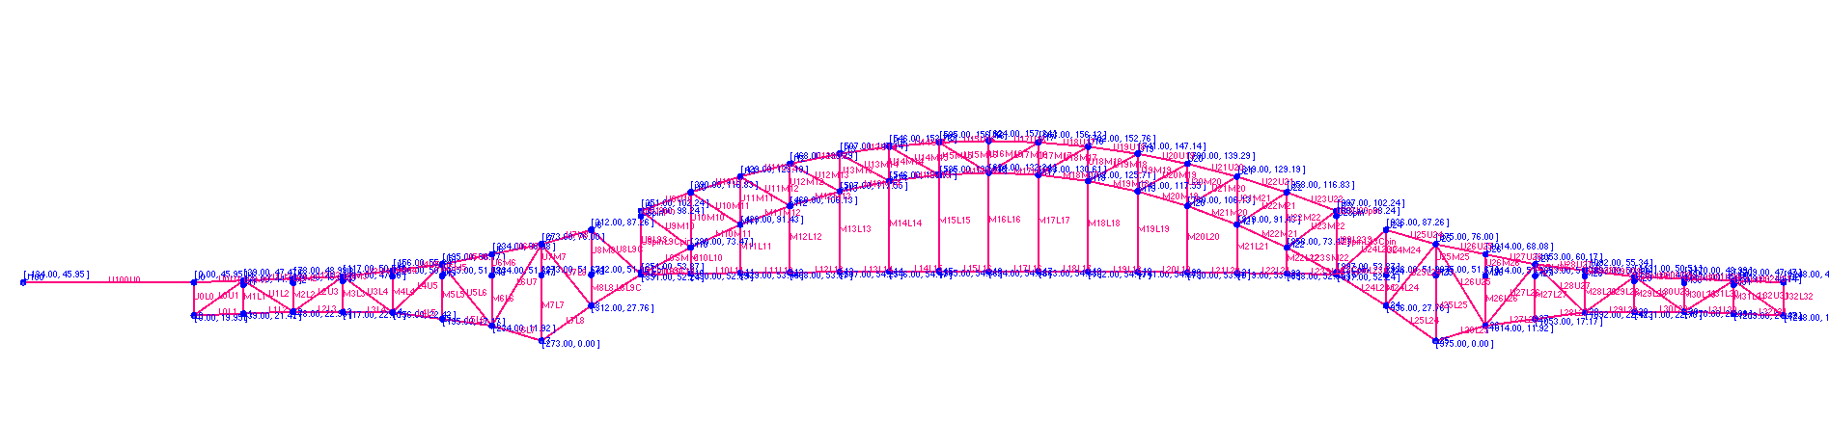
Truss Modeling and Validation
Half Deck Option Made Certain Truss Members Become Fixed connection
Comparison of BrR model and MIDAS model

Slide 18
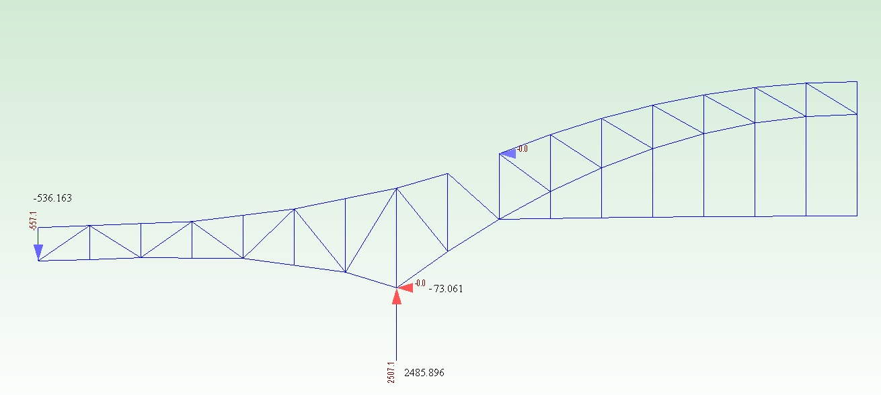
Truss Modeling and Validation
Comparison
  73kips of Horizontal Reaction at Pier 2

Slide 19
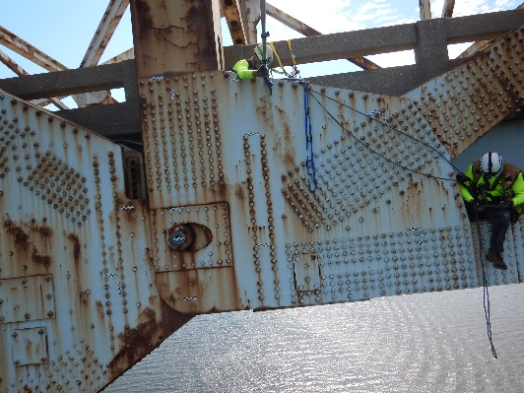
Truss Modeling and Validation
Member U9-L9:
  Two members coincide with each other
  U9-L9C inside of U9-L9S
  L9S can move horizontally for expansion (note the slotted hole for the pin)

Slide 20
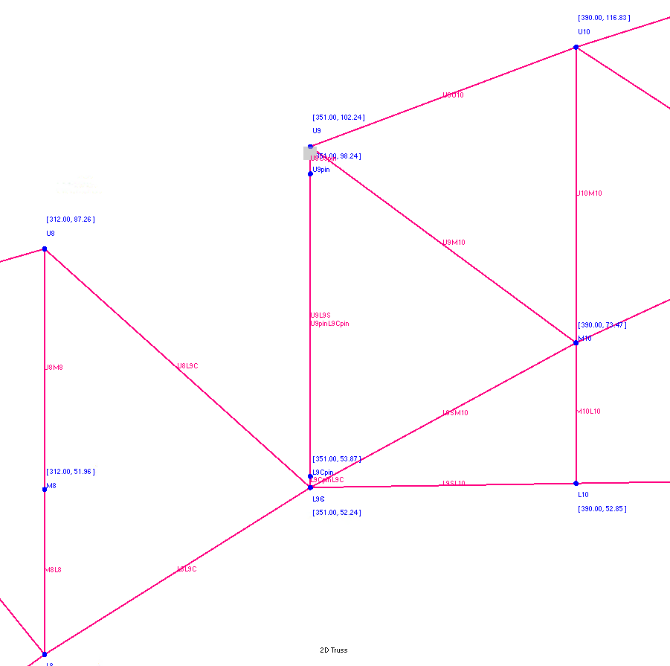
Truss Modeling and Validation
Solution:
  Make artificial pins with a short segment of weak section at hanger
False Beams for Pins

Slide 21
Truss Modeling and Validation
Comparison of BrR Model and MIDAS Model
  Lower Chord
Member | Location | DL Force (BrR) | DL Force (MIDAS Civil) | BrR/MIDAS Civil
 |  | (kips) | (kips)
L0L1 | Lower-Chord | 79 | 80 | 99%
L1L2 | Lower-Chord | 78 | 80 | 98%
L2L3 | Lower-Chord | -721 | -737 | 98%
L3L4 | Lower-Chord | -725 | -737 | 98%
L4L5 | Lower-Chord | -1871 | -1884 | 99%
L5L6 | Lower-Chord | -1872 | -1884 | 99%
L6L7 | Lower-Chord | -2459 | -2469 | 100%
L7L8 | Lower-Chord | -2894 | -2898 | 100%
L8L9C | Lower-Chord | -1658 | -1654 | 100%
L9SL10 | Lower-Chord | 2394 | 2431 | 98%
L10L11 | Lower-Chord | 2408 | 2431 | 99%
L11L12 | Lower-Chord | 2413 | 2431 | 99%
L12L13 | Lower-Chord | 2422 | 2431 | 100%
L13L14 | Lower-Chord | 2427 | 2431 | 100%
L14L15 | Lower-Chord | 2431 | 2431 | 100%
L15L16 | Lower-Chord | 2433 | 2431 | 100%

Slide 22
Truss Modeling and Validation
Comparison of BrR Model and MIDAS Model
  Upper Chord
Member | Location | DL Force (BrR) | DL Force (MIDAS Civil) | BrR/MIDAS Civil
 |  | (kips) | (kips)
U9U10 | Upper-Chord | -512 | -488 | 105%
U10U11 | Upper-Chord | -1034 | -1013 | 102%
U11U12 | Upper-Chord | -1559 | -1542 | 101%
U12U13 | Upper-Chord | -2059 | -2059 | 100%
U13U14 | Upper-Chord | -2477 | -2493 | 99%
U14U15 | Upper-Chord | -2762 | -2796 | 99%
U15U16 | Upper-Chord | -2842 | -2885 | 99%
U0U1 | Upper-Chord | -2 | 0
U1U2 | Upper-Chord | 177 | 181 | 98%
U2U3 | Upper-Chord | 182 | 181 | 100%
U3U4 | Upper-Chord | 1384 | 1397 | 99%
U4U5 | Upper-Chord | 1387 | 1397 | 99%
U5U6 | Upper-Chord | 2256 | 2265 | 100%
U6U7 | Upper-Chord | 2258 | 2265 | 100%
U7U8 | Upper-Chord | 1453 | 1458 | 100%

Slide 23
Truss Modeling and Validation
Comparison of BrR Model and MIDAS Model
  Verticals
Member | Location | DL Force (BrR) | DL Force (MIDAS Civil) | BrR/MIDAS Civil
 |  | (kips) | (kips)
M10L10 | Vertical | 206 | 204 | 101%
M11L11 | Vertical | 210 | 212 | 99%
M12L12 | Vertical | 200 | 197 | 102%
M13L13 | Vertical | 209 | 212 | 99%
M14L14 | Vertical | 198 | 197 | 100%
M15L15 | Vertical | 212 | 214 | 99%
M16L16 | Vertical | 197 | 200 | 98%
U9L9S | Vertical | 1404 | 1426 | 99%
U10M10 | Vertical | -491 | -504 | 98%
U11M11 | Vertical | -422 | -429 | 99%
U12M12 | Vertical | -335 | -349 | 96%
U13M13 | Vertical | -219 | -231 | 95%
U14M14 | Vertical | -90 | -102 | 88%
U15M15 | Vertical | 67 | 61 | 110%
U16M16 | Vertical | 152 | 149 | 102%
U0L0 | Vertical | -101 | -99 | 101%
U1M1 | Vertical | 202 | 205 | 99%
M1L1 | Vertical | 22 | 25 | 89%
U2M2 | Vertical | -7 | -13 | 56%
M2L2 | Vertical | -188 | -194 | 97%
U3M3 | Vertical | 215 | 212 | 101%
M3L3 | Vertical | 33 | 31 | 107%
U4M4 | Vertical | -12 | -18 | 69%
M4L4 | Vertical | -194 | -199 | 97%
U5M5 | Vertical | 219 | 218 | 100%
M5L5 | Vertical | 35 | 34 | 103%
U6M6 | Vertical | -12 | -18 | 65%
M6L6 | Vertical | -196 | -202 | 97%
U7M7 | Vertical | -1510 | -1518 | 99%
M7L7 | Vertical | -1712 | -1721 | 100%
U8M8 | Vertical | -1694 | -1718 | 99%
M8L8 | Vertical | -1893 | -1918 | 99%
U9pinL9Cpin | Vertical | -1978 | -1978 | 100%

Slide 24
Truss Modeling and Validation
Comparison of BrR Model and MIDAS Model
  Diagonals
Member | Location | DL Force (BrR) | DL Force (MIDAS Civil) | BrR/MIDAS Civil
 |  | (kips) | (kips)
L9SM10 | Diagonal | -2717 | -2768 | 98%
M10M11 | Diagonal | -2136 | -2173 | 98%
M11M12 | Diagonal | -1534 | -1566 | 98%
M12M13 | Diagonal | -960 | -977 | 98%
M13M14 | Diagonal | -425 | -421 | 101%
M14M15 | Diagonal | 15 | 37 | 39%
M15M16 | Diagonal | 313 | 355 | 88%
U9M10 | Diagonal | 575 | 568 | 101%
U10M11 | Diagonal | 601 | 607 | 99%
U11M12 | Diagonal | 604 | 612 | 99%
U12M13 | Diagonal | 581 | 602 | 96%
U13M14 | Diagonal | 491 | 512 | 96%
U14M15 | Diagonal | 342 | 366 | 93%
U15M16 | Diagonal | 101 | 115 | 88%
L0U1 | Diagonal | -94 | -97 | 97%
U1L2 | Diagonal | -301 | -308 | 98%
L2U3 | Diagonal | 661 | 680 | 97%
U3L4 | Diagonal | -800 | -800 | 100%
L4U5 | Diagonal | 665 | 669 | 99%
U5L6 | Diagonal | -566 | -561 | 101%
L6U7 | Diagonal | 264 | 272 | 97%
U7L8 | Diagonal | 1505 | 1527 | 99%
U8L9C | Diagonal | 1870 | 1883 | 99%

Slide 25
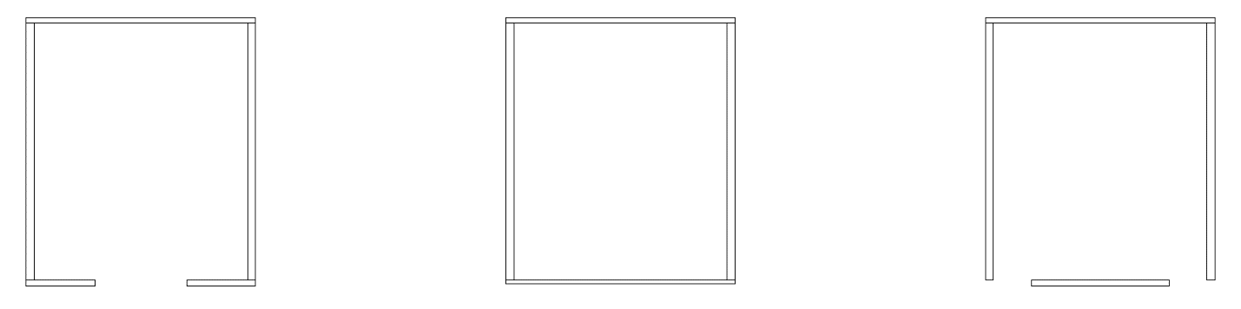
Truss Member Load Rating
Equivalent Section Definition
  LFR vs LRFR
  Detailed Description of Cross Section for Built-up members
  Keep Net Area the same
  Use reduced thickness to account for the holes
  Define Narrowed Plate with gap on side

Slide 26
Truss Member Load Rating
Equivalent Section Definition
  CS1 reduced thickness
  CS2 center plate with gap on the side
Original
Cross Section
Equivalent
CS2
Equivalent
CS1
Hand Holes in middle Thinner Plate Gaps on side
Member | Gross Area | Net Area | Izz | Rz | Iyy | Ry
 | (in²) | (in²) | (in⁴) | (in) | (in⁴) | (in)
Actual | 112 | 112 | 12170.70 | 10.42 | 12942.50 | 10.75
CS1 | 112 | 112 | 12114.17 | 10.4 | 12579.26 | 10.6
CS2 | 112 | 112 | 12185.86 | 10.43 | 12141.76 | 10.41

Slide 27
Truss Member Load Rating
Equivalent Section Definition
  For LFR, only equivalent area matters
  LRFR is sensitive to some checks of local buckling
Member | Capacity |  | Opr
 |  |  | RF
 | Comp. | Tens.
 | (kip) | (kip)
Actual | -8570.2 | 11200 | 8.38
CS1 | -8565.8 | 11200 | 8.38
CS2 | -8568 | 11200 | 8.38
Member | Capacity |  | Opr
 |  |  | RF
 | Comp. | Tens.
 | (kip) | (kip)
Actual
CS1 | 8265.5 | 9273.6 | 5.34
CS2 | 8517.5 | 9273.6 | 5.58

Slide 28
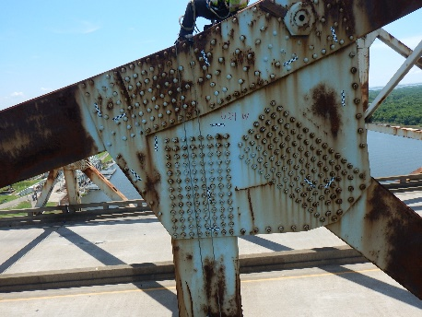
Gusset Plate Load Rating
Horizontal Shear
  Along Chord Direction
  True Horizontal Direction (BrR default to this when the chord is not defined as continuous)
  For sharply inclined chords, this approach may miss critical sections

Slide 29
Gusset Plate Load Rating
Horizontal Shear Comparison
  Horizontal shear is calculated along chord member to verify BrR results
  For locations with inclined chord members, BrR tends to generate higher RF than critical sections
Gusset Plate Horizontal Shear Load Rating Summary
Panel Point | RF (hand calc) | RF (BrR)
M10 | 12.12 | 1.11
M11 | 11.74 | 1.63
M12 | 4.45 | 99.00 *
M13 | 3.18 | 99.00 *
M14 | 2.78 | 1.57
M15 | 3.12 | 2.53
U5 | 5.34 | 5.78
U7 | 11.77 | 12.19
U10 | 1.89 | 2.23
U11 | 2.20 | 2.97
U12 | 4.87 | 7.33
U13 | 5.79 | 8.26
U14 | 8.50 | 11.76
U15 | 10.92 | 13.65
L4 | 5.67 | 6.09
L6 | 5.98 | 6.64
L8 | 10.61 | 16.15
Note: RF is for HL-93 inventory level.
* BrR can not calculate the horizontal shear
force correctly at M12 and M13. Dummy input
is used here to generate non-governing rating
factor results.

Slide 30
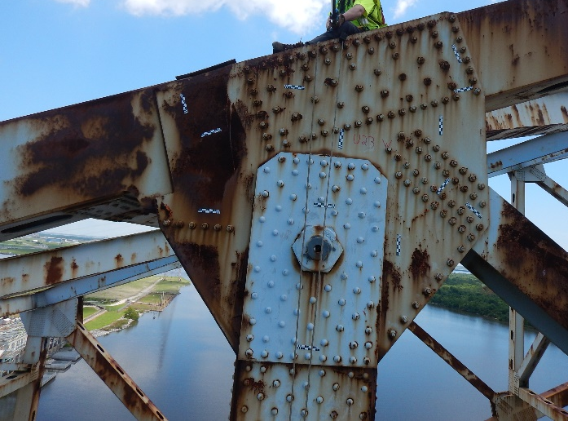
Gusset Plate Load Rating
Certain Cases Have to be Load Rated Outside of BrR
  Gusset Plate with Pins
  Horizontal Shear Gusset Plates with Sharp Incline of Chord members

Slide 31
Gusset Plate Load Rating
Certain Cases Have to be Load Rated Outside of BrR
  Link Plates on Member L15-L16

Slide 32
Load Rating of Approach Spans
Steel Girder Spans 37-40
  Tapered Geometry
  Unique Framing Configuration

Slide 33
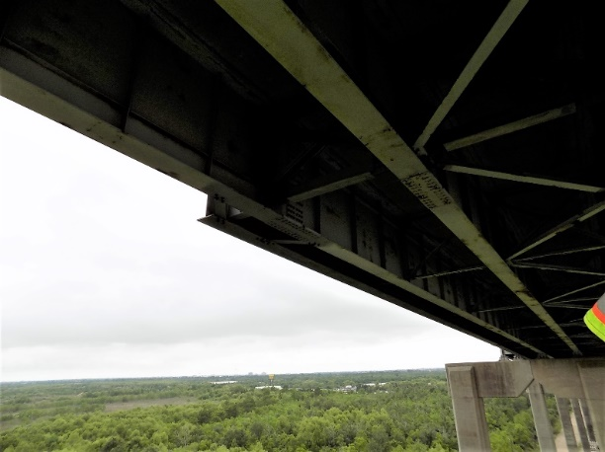
Load Rating of Approach Spans
Steel Girder Spans 37-40
  BrR can not load rate this configuration
  MIDAS FE was used to model and analyze load effects and perform load rating

Slide 34
Load Rating of Approach Spans
Steel Girder Spans 37-40
  4 span continuous unit
  Girder 5 ends mid-span and supported by Girder 4
  Girder 6 – only last two spans

Slide 35
Load Rating of Approach Spans
South Approach spans 27-31
  Kinked Girder line was used to incorporate horizontal curves
  Kinked angle is about 3 degrees

Slide 36
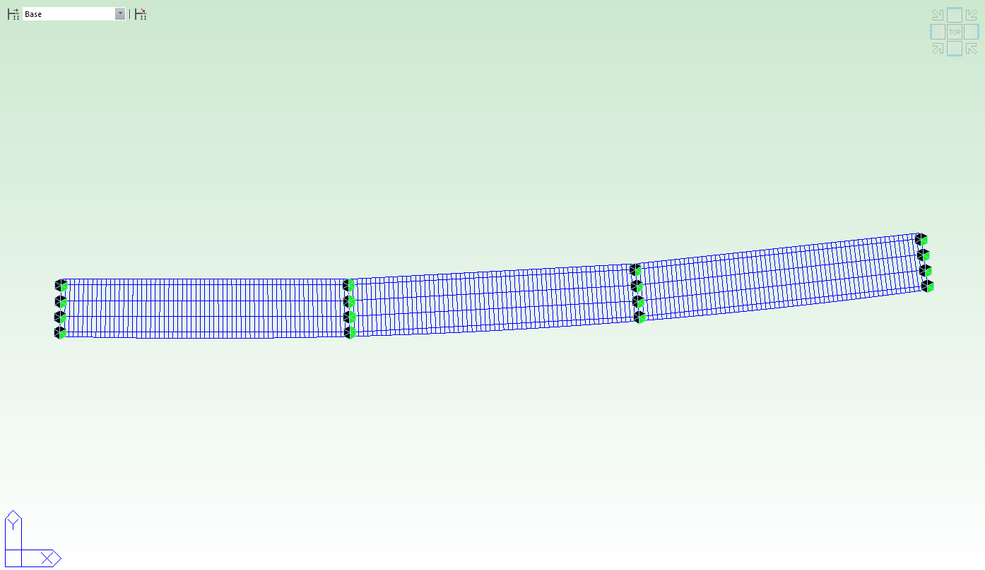
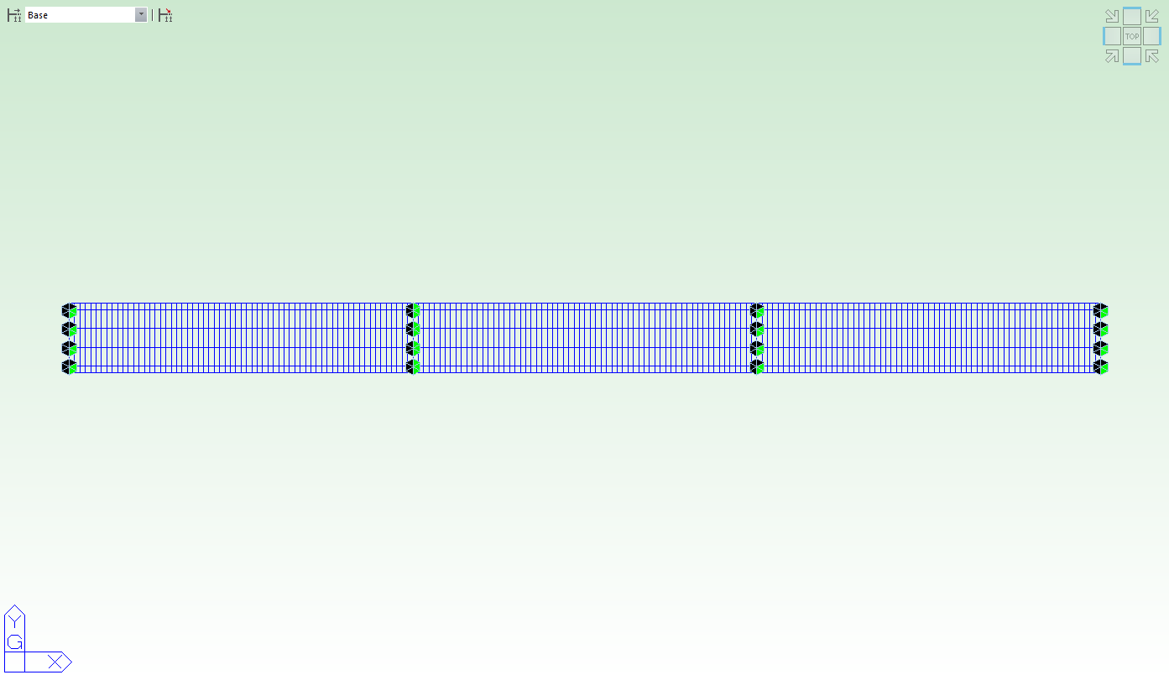
Load Rating of Approach Spans
South Approach spans 27-31
  BrR Can only model the girders in straight lines
  MIDAS FE was used to verify the difference

Slide 37
Load Rating of Approach Spans
Comparison of Kinked Girders and Straight Girders
  Moment difference is negligible
  Shear difference is up to 7% difference
  Critical load effect is moment for these spans. Thus BrR model can be relied on for load rating
Interior Girder
Exterior Girder
Force Effects / Model | Curved | Straight | Difference
Maximum Moment | 3524.3 | 3497.3 | -0.8%
Minimum Moment | -3430.4 | -3431.1 | 0.0%
Maximum Shear at Interior Support | 134.6 | 144.3 | 7.2%
End Shear at End Support | -121.4 | -127.6 | -5.1%
Force Effects / Model | Curved | Straight | Difference
Max Moment | 2794 | 2793.6 | 0.0%
Min Moment | -2661.8 | -2629.4 | 1.2%
Max Shear at Interior Support | 115.0 | 110.1 | -4.9%
End Shear at End Support | -85.2 | -84.0 | 1.4%

Slide 38
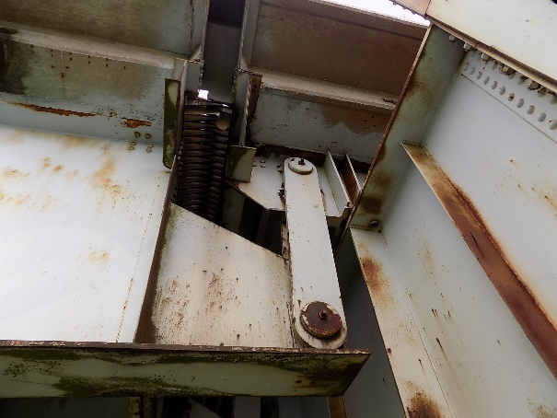
Other Non-standard Components
Pin-Hanger for steel girders
  Link plates
  Pins

Slide 39
Influence Lines
Influence Lines for Governing Girder
  An influence surface would be needed to accurately capture LL effects
  Influence Lines are required by the Client to evaluate future permit load applications

Slide 40
Influence Lines
Influence Lines for Governing Girder
  A multiple lane group approach is used to present IL for different Lanes
  Either Single Lane or Multiple Lanes can be checked for the corresponding permit load scenario

Slide 41
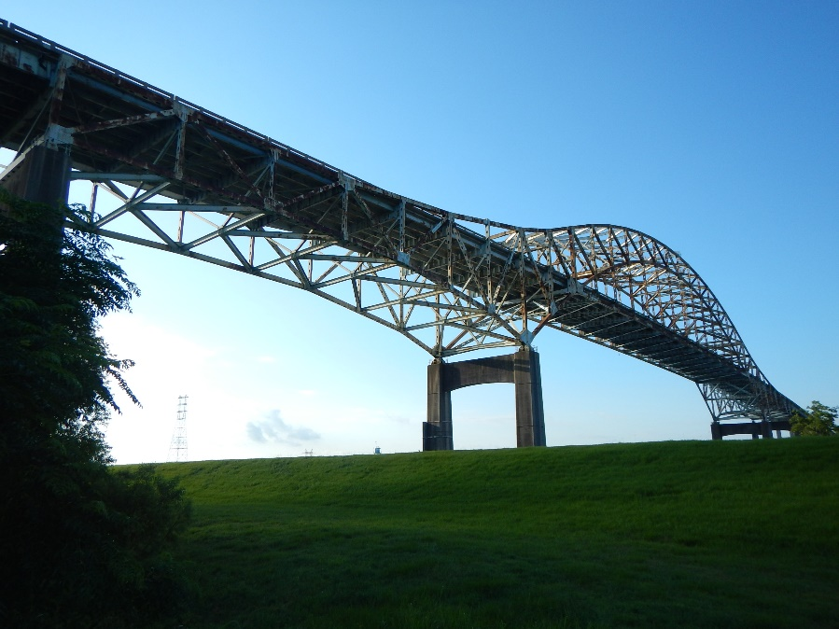
Questions and Answers?

