Slide 1
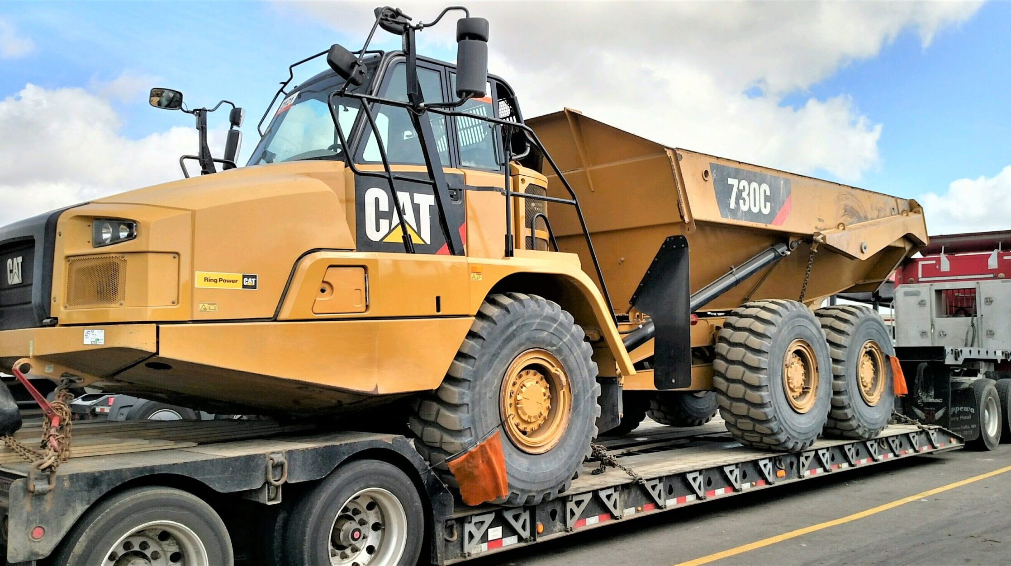
RADBUG 2022 – OSOW Program Development & the Load Rating Tool

Slide 2
Presentation Outline
Where we started with SCDOT’s OSOW
Comparing other DOT programs
Less “refined” options
Considerations
Load rating tool
Pros & cons moving forward

Slide 3
Evaluation of Other DOT OSOW Programs
AIE researched multiple other DOTs including CO, ID, KS, LA, MS, NC, OH, ND, GA, MA, & NY
Data collection
Available software companies
Department resources & capacity
Permit types & weight thresholds
Strengths vs. weaknesses for each approach
Where bottlenecks could occur
Evaluation of time vs. cost vs. value
Long-term goal: Mostly automated OW routing system utilizing LR data
Considered LRT but it wasn’t “ready” yet
Initially, we settled on a Moment and Shear approach

Slide 4
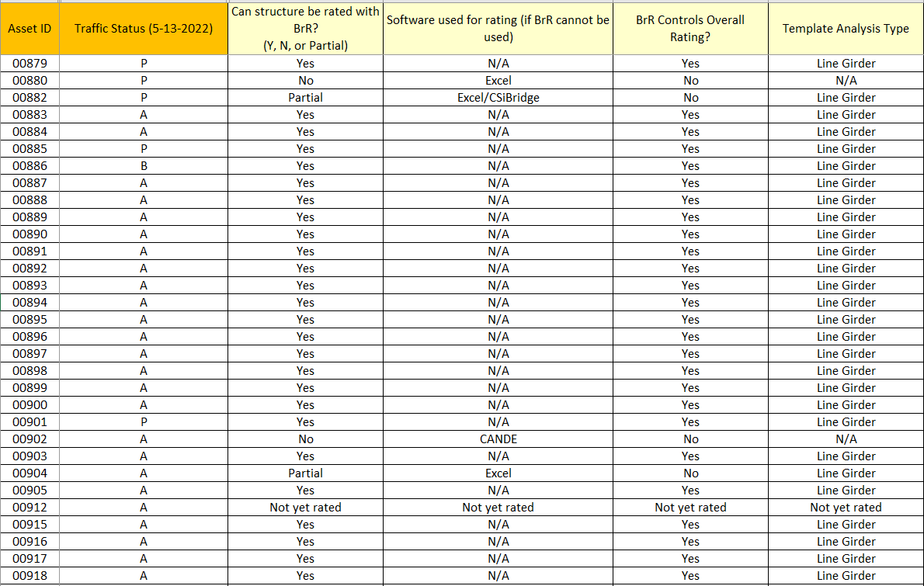
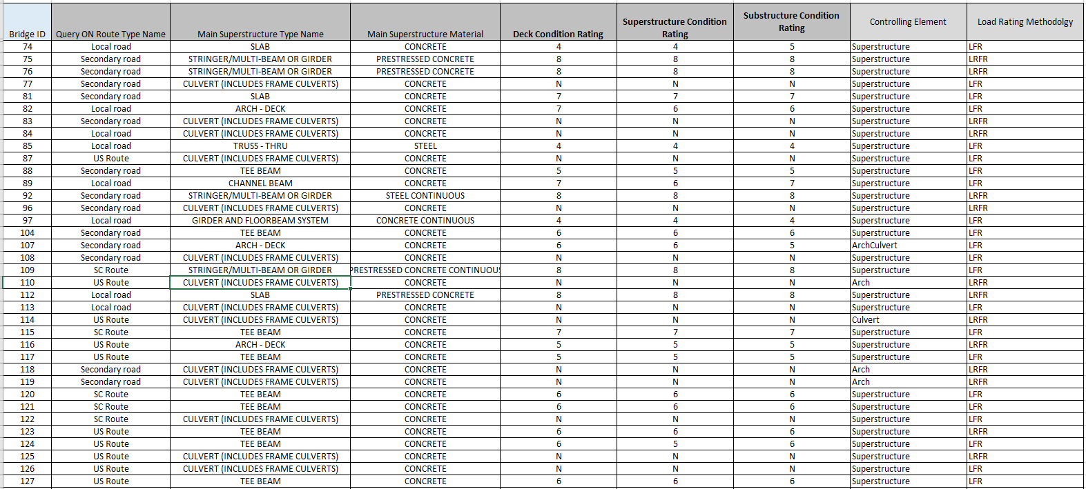
Initial Steps
Gather ALL the load ratings & start organizing
Identify bridges recommended for posting
Roadway classification (Interstate, Primary, Local, etc.)
Develop tools or spreadsheets to determine what software was used for each rating
Structure type
LR methodology
Sync data (NBI, LR, BMS)

Slide 5
Initial Steps
Identify bridges suitable for automated analysis (BrR)
Approximately 95% of the inventory
SCDOT’s existing service proposed to utilize proprietary analytical methods
AIE recommended supplementing with an alternate method that could reduce processing time
LRT
Moment and Shear

Slide 6
Initial Steps
Concurrently - Collect DMV data for permit applications
Develop Theoretical Permit Trucks (TPTs) based on actual high volume permit applications from 90k to 260k – we created 25 permit vehicles
Spreadsheets, spreadsheets, spreadsheets

Slide 7
Moment and Shear
Initial Concept:
Calculate Max. moments and shears on simple span for actual permit truck
Calculate equivalent HS20 rating capacity
Equivalent capacity = Max. permit moment/shear x 36 tons / AASHTO moment/shear
Compare equivalent HS20 rating capacity to HS20 operating capacity
Pass if HS20 operating capacity > equivalent HS20 capacity

Slide 8
Moment and Shear
Pros:
Existing framework was already available
Met or exceeded many of the other DOTs programs
Very quick in terms of results
Was applicable for “most” bridges
Cons:
Varying degrees of conservatism
Comparative vs. “true” analysis
Was applicable for “most” bridges
Required “rules” for N/A applicable bridges

Slide 9
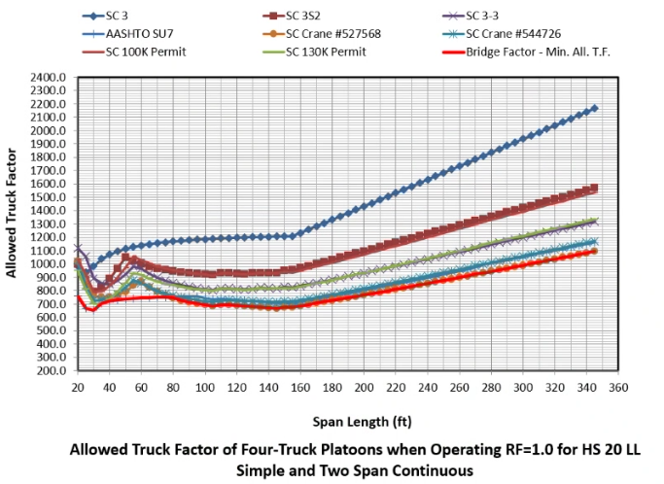
Moment and Shear
Not all bridges have limit states that are Moment and Shear:
Trusses, Culverts, Arches, Columns (substructures)
For certain bridge types, shear is a function of LL
Does not account for negative moment regions in continuous spans
Enveloping becomes difficult for long spans (over 140 ft) and heavy loads (over 180 kips)

Slide 10
Moment and Shear - Refinement
“Refined” Moment and Shear
Promiles had developed the framework for refinement for M and V analysis – it was ready for testing
Used precomputed BrR data and influence lines which led to more accurate moment results
Shear was still arbitrarily accurate as many bridges were PS
Processing time was only a few seconds per bridge
Huge Takeaway – the generation of influence lines was fast, accurate, and beneficial in many situations. We were getting closer!

Slide 11
Moment and Shear - Refinement

Slide 12
Moment and Shear - Refinement
“Refined” Moment and Shear Challenges:
Control Options – these could vary widely across ~10,000 ratings (9,000 BrR)
In addition to variance in Control Options, there were new Control Options added between the start of this project (6.8.3) and current (7.2).
Tension Field Action
Service I
BrR bugs in general – PS Service issues in 7.0
Limited to BrR line girder bridges
Timber bridges – no ASR support
Culverts not supported
Exclusively used LFR and many bridges rated only LRFR

Slide 13
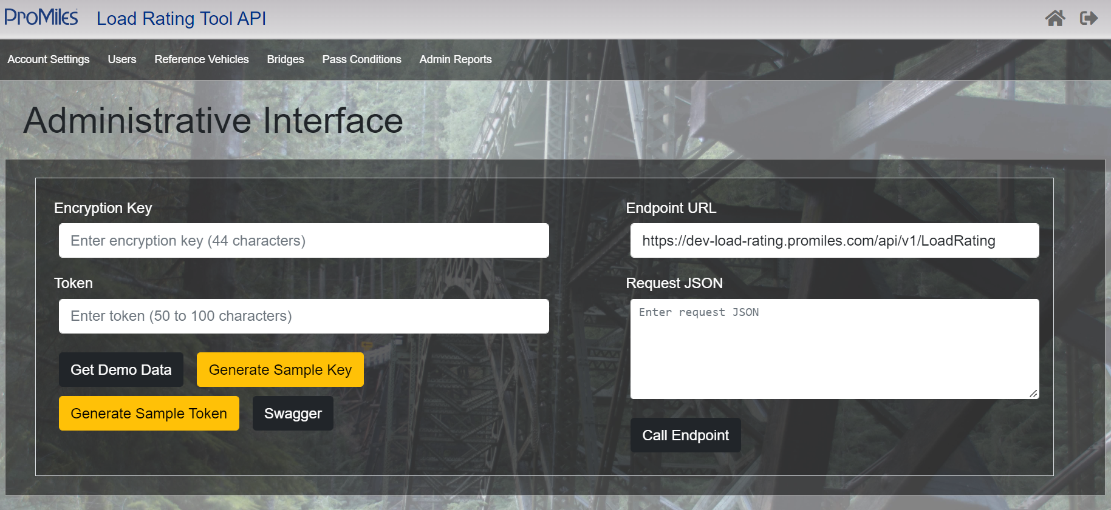
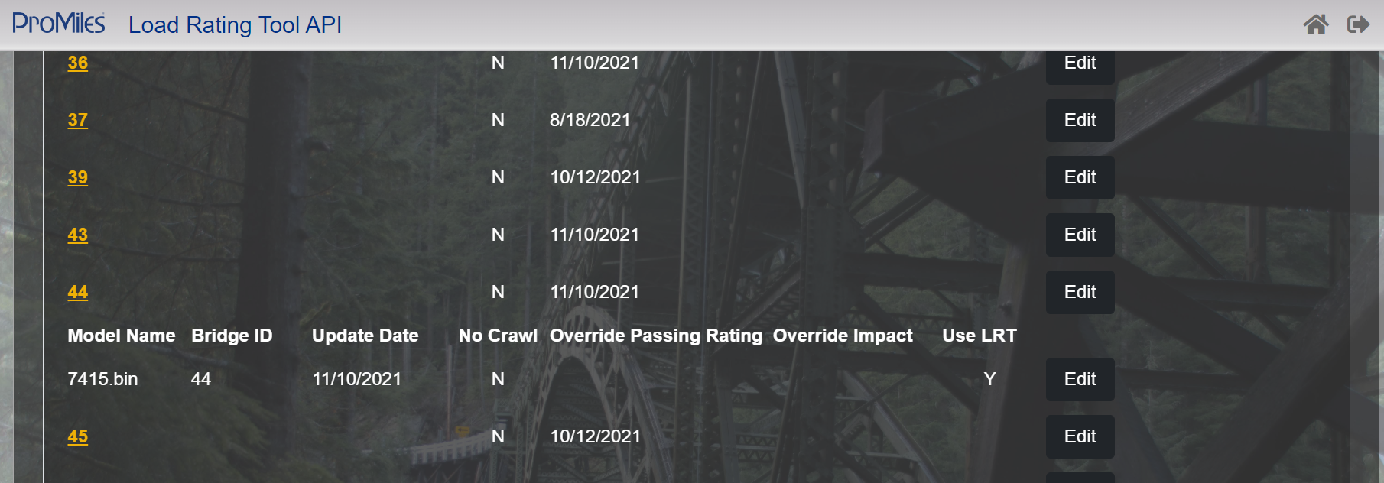
Load Rating Tool Testing
Fast Forward – The DOT is able to move to 7.1 and 7.2. LRT is now feasible
Concurrently the LRFR features of the LRT are now released
Additional structure types become available for LRT
Supports expedited load rating analysis
Uses data from precomputed data analysis
Actual “true” analysis vs. comparative analysis
Processing time similar to Moment and Shear
Will continue to be supported by future versions of AASHTOWare

Slide 14
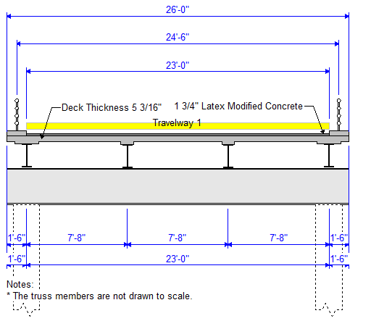
Load Rating Tool Testing
Findings of the LRT
First off – it is fantastic. Overwhelmingly better (and more accurate) than the alternatives for 80%+ of a given inventory
We used widescale testing of the SCDOT 130k truck in the LRT vs. actual BrR results and found approximately 94% to be spot on (LFR)
Issues/Discrepancies: occasional bugs – these are being worked on
“Stringer Units”: require “Check in/Check out” to analyze. Bridges cannot be “read-only” in the database. Solution: Disable check in/check out in the analysis database or add a BrR enhancement to check a bridge out during analysis. Any interest?
Notes:
Stringer Units in FB systems or trusses – the stringer unit data/reactions are always called back to the memory
Bridges with stringers (floor systems, trusses, etc. – has to have a stringer defined) have beam end vertical force reactions saved during analysis. Whether they are new reactions or old the program makes a call to the database. Bridges that are not checked out can’t make this call. Check out allows the call and if it isn’t checked out all functions of the bridge are read-only. The reactions need to be sent to the file (as opposed to floating in memory indefinitely) and the call needs to occur.
API analysis aborts/full crash instead of a bridge failure. This is because it is a “system failure” and not a bridge error or file error. “check in/check out”

Slide 15
Load Rating Tool

Slide 16
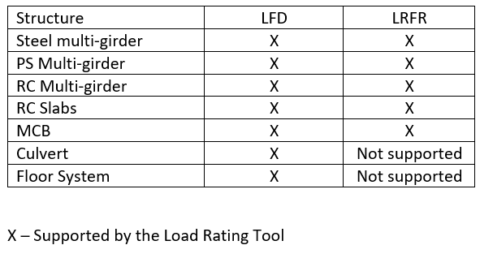
Load Rating Tool
Supported Structure Types:

Slide 17
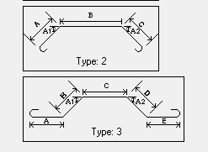
Load Rating Tool
Additional items to keep in mind:
BrR 7.x flags and catches more “errors” than 6.x. Bridges that used to run may not
Solution: Brute Force – run them in large batches, identify the bridges, determine what kind of error it is
Forensic Analysis of bridges that get “kicked back” – is the error “real”? Is it a bug? Is a simple check-box simply left unchecked?
Situationally, there are bridges with “Bridge Completely Defined” unchecked or Superstructure Definitions left unassigned (girder lines, substructures, models for force effects only)
Configured for single trip only for LRFR
Need to specify methodology (LFR or LRFR)
Bridges sent to Manual Review
Notes:
T-Beams – bar projection

Slide 18
Program Challenges
Files with blank LFR or LRFR fields:
LRFR passed all DOT-specific loads, no LFR rating is triggered. LFR-specific data fields are now empty. Can these be auto-computed?
Widenings, rehabilitations, structures that have manually calculated LLDF or other parameters intentionally.
Lever Rule
Structure “type” for LLDF calc
Identifying bugs and which bridges would be affected. Handful? Dozens? Hundreds?
Updating and maintaining data
Multiple data sources (NBI, LR, BRM)?
Culverts pass for legal loads – what about permit loads?

Slide 19
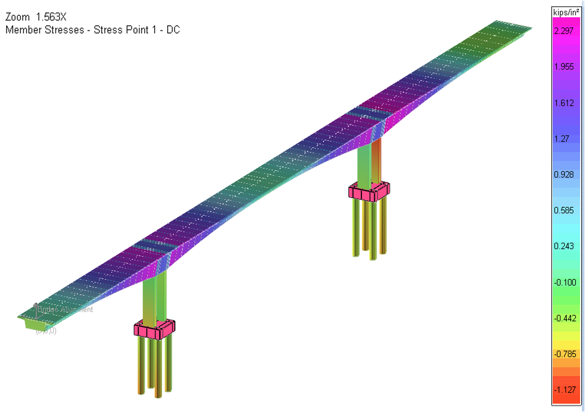
Program Challenges
Bridges that are non-BrR ratings:
Arches, Complex Geometry, Post-Tensioned bridges, buried structures, etc.
Bridges with both BrR and “other” software used
Separated into:
BrR Superstructure + “Other” substructure
BrR + “Other” software used for superstructure units
Approximately 5% of the bridge inventory
Bridges not applicable for the LRT:
3D FEM, curved
LRFR Culverts
Arches
Trusses
Flagging bridges with GCR = 4 or lower
Flagging bridges with timber substructures

Slide 20
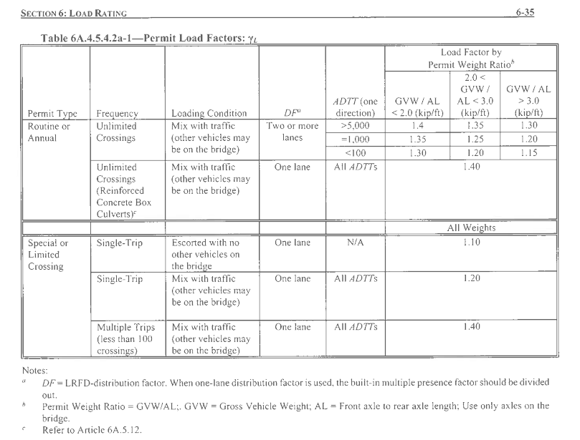
Program Challenges
LRFR Permit Analysis vs. Permit Applications
Single Trip vs. Multi Trip vs. Unlimited
Industry WILL figure out if certain applications are approved and others are not.
How are other states handling this?

Slide 21
Findings
5,152 bridges that were rated in both LRFR and LFR
17 permit vehicles were analyzed
92% of bridges (4,340) had a “better” methodology, 8% (812) were mixed
“Better” = 15 of 17 vehicles rated higher in one methodology vs. the other
Higher results:
LRFR: 2,778 bridges
LFR: 1,984
Cause: Traffic Count (ADTT)? Span length?

Slide 22
THANK YOU!

