Slide 1

Using Templates to Increase Efficiency
Jeff Olsen
Montana Department of Transportation
Helena, MT

Slide 2
Agenda Development
Meetings Consist of:
Task Force Updates
Technical Updates
User Training
State Presentations
Third Party Updates
Group Meetings

Slide 3
Agenda Development
State Presentations:
How are states using Virtis Opis?
Issues and solutions relating to product.
Other interesting happenings.
What does the user want to see???
Ideas for next years meeting???
Submit ideas to: jolsen@mt.gov

Slide 4
So How does Montana use Virtis / Opis?
Montana has licensed V/O for many years.
Using Virtis for rating
Opis was the “side-kick” - never got much action

Slide 5
MDT Policy on Virtis / Opis
Internal Designs
By completion of design, have bridge modeled in Opis
Rate bridge using Virtis.
Make necessary adjustments to design if required by rating.
Consultant Designs
Consultants are required provide a rating for with their final design.
MDT enters the bridge into V/O and compares rating.

Slide 6
What could I do to increase usage?
Problem
  Building model is cumbersome
  Reports are difficult to find data
  No standard procedures or guidelines
Goal
  Find a way to make input quicker and easier
  Some how take the sting out of reports

Slide 7
Solutions
Building Model
  Developed Standard Procedures
  Training (training alone proved unsuccessful)
  Create Templates
  Create Tutorials for using Templates
Reports
  Help handout on different report tools
  Report Summary – Where do I find it?

Slide 8
Current MDT Policy on Prestress
In most cases, MDT provides beam details and design stresses in the plan set.
Awarded fabricator designs strand pattern and required concrete strengths.
Shear steel is standardized for each beam type.
Shop drawings are submitted to MDT for approval.
MDT enters final strand pattern into Opis and checks design and rating.
Fabricator modifies and resubmits shop drawings as necessary .

Slide 9
Naming Procedures
Bridge ID box - Input the Structure Number, except replace the "+" with an underscore"_".
NBI Structure ID box - Input the Structure Number, except replace the "+" with an underscore"_".
Name box – Use this box to identify the stage your bridge is in.
  While you are entering the bridge, input “Draft Bridge” in this box.
  When the design is complete and you are satisfied with the design and rating, input “Design Complete” in this box.
  When the shop drawings come in and you have made the appropriate revisions, input “Shop Drawings Complete” in this box.
Description box – Use this box to identify any code or rating failures and explain any exception or justification for those failures.

Slide 10
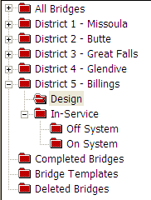
Montana’s Bridge Explorer

Slide 11
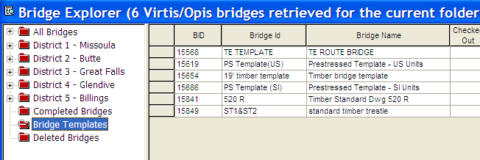
Templates Folder

Slide 12
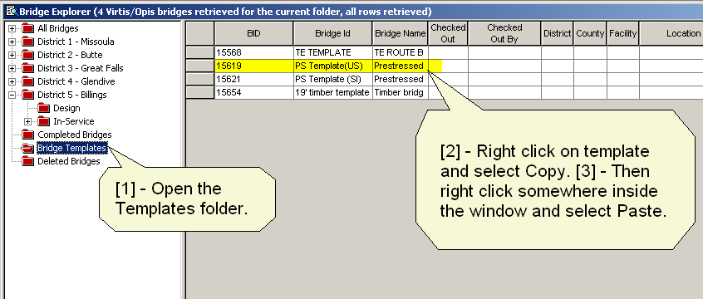
Beginning with a Template Bridge

Slide 13
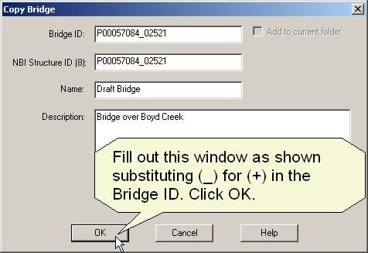
Naming Procedures

Slide 14
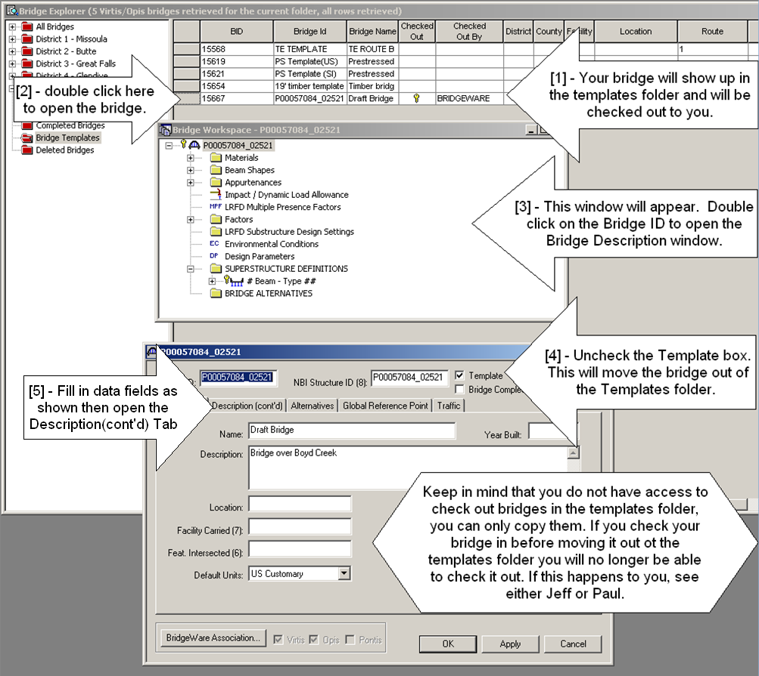
Bridge Description Window

Slide 15
Go to Opis

Slide 16
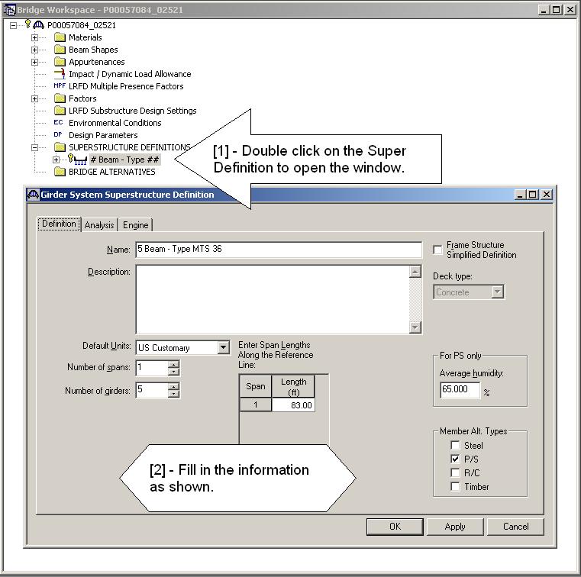

Slide 17
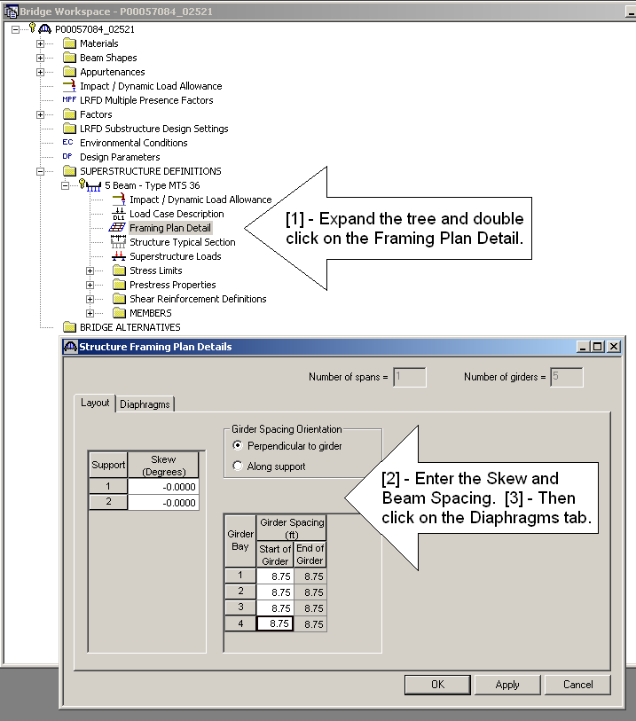

Slide 18
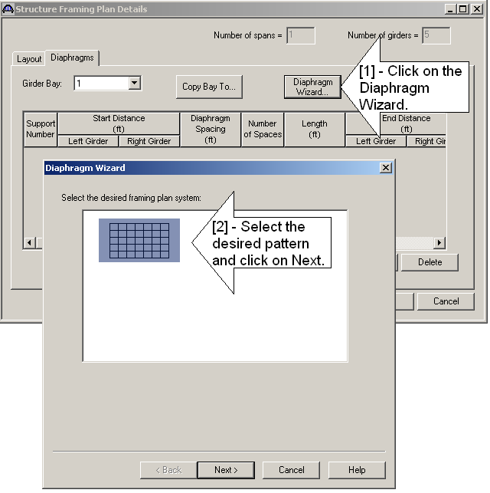

Slide 19
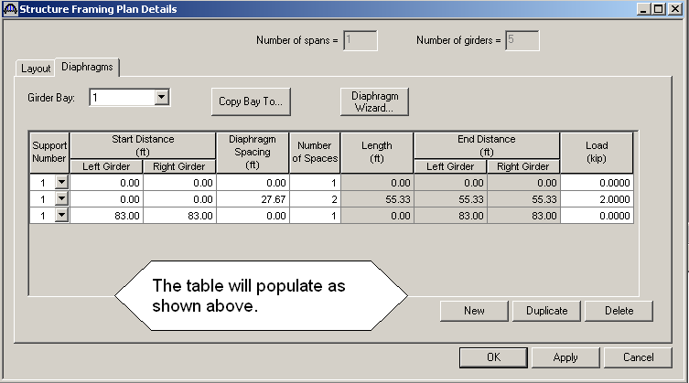

Slide 20
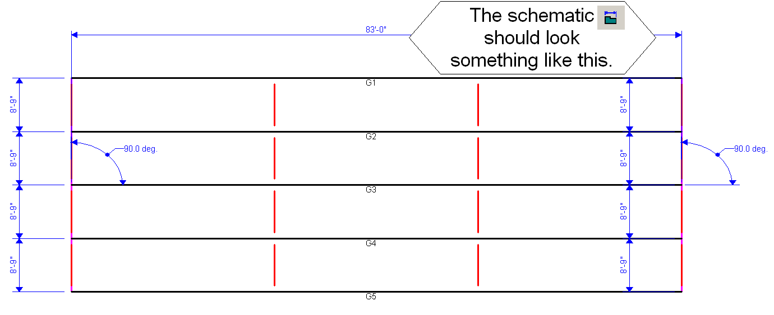

Slide 21
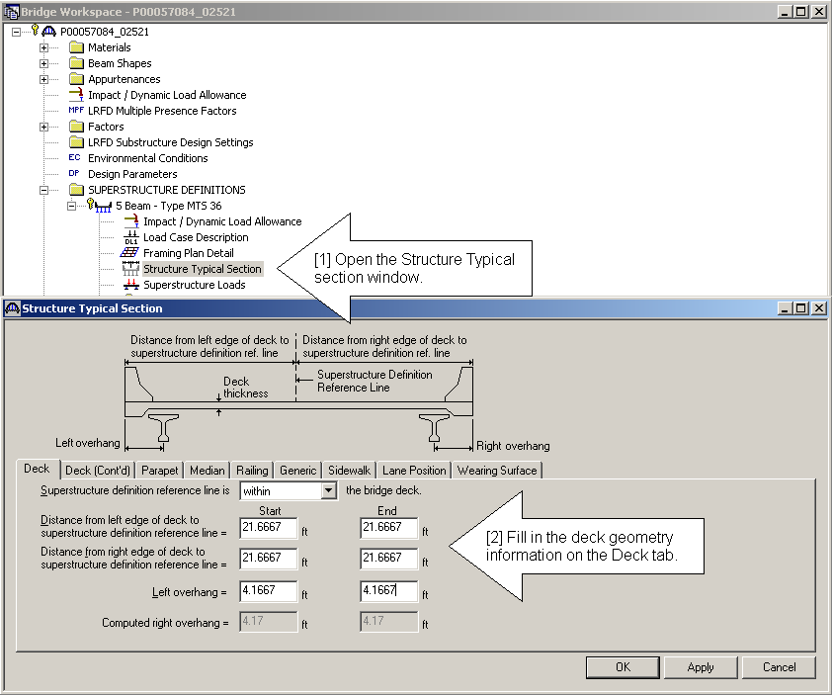

Slide 22
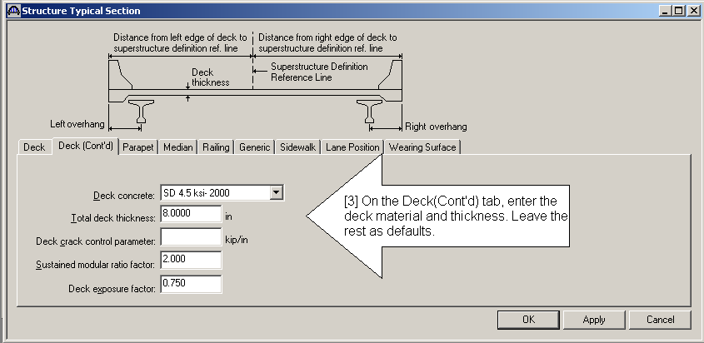

Slide 23
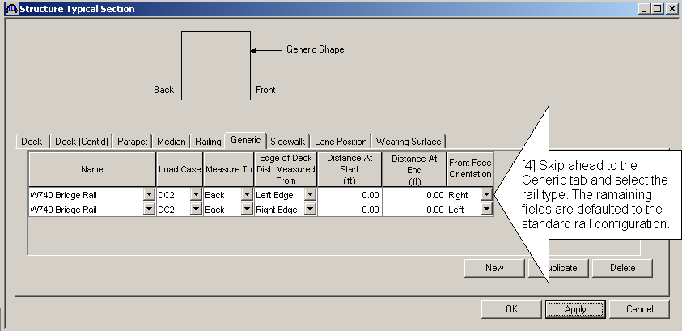

Slide 24
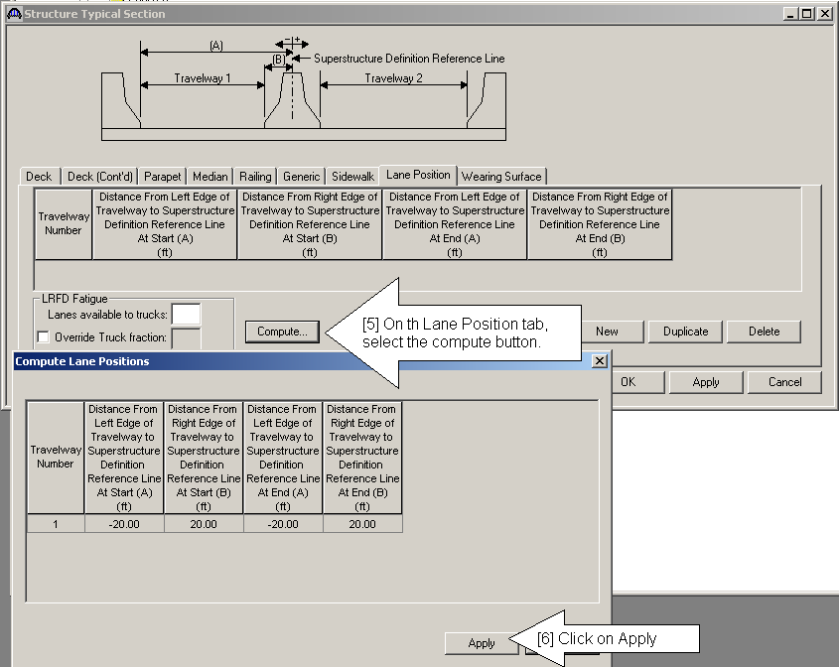

Slide 25
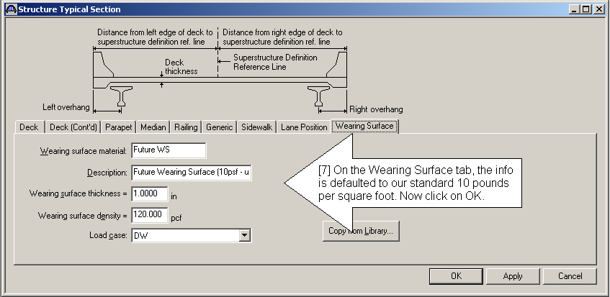

Slide 26
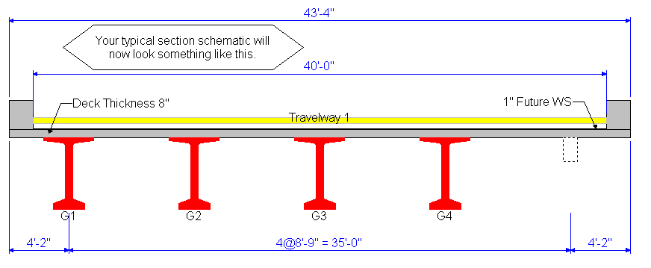

Slide 27
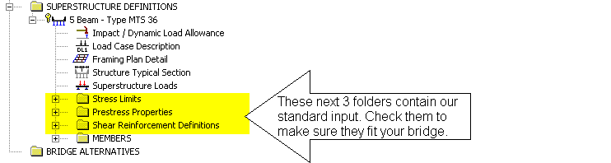

Slide 28
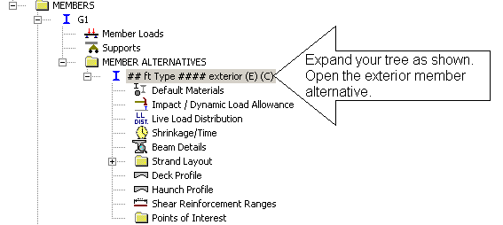
Now it’s time to define the members. For each step, enter the data for both the exterior beam and interior beam before moving on the next step.

Slide 29
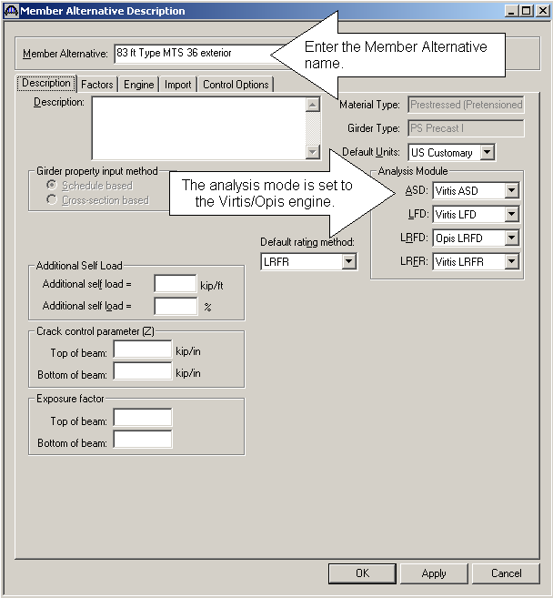

Slide 30
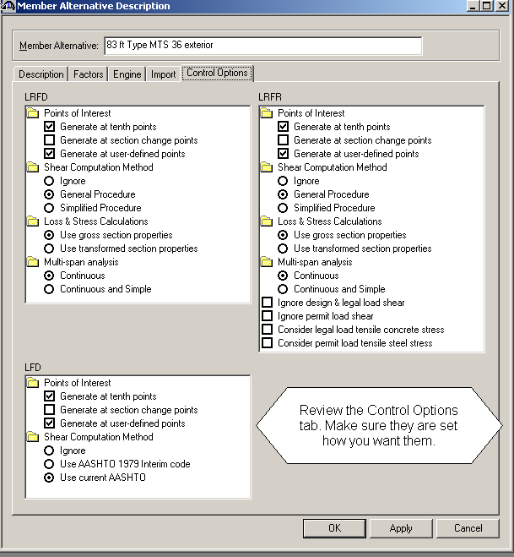

Slide 31
Control Options
I set up the control options to our state defaults.
The designer may alter them for special cases.
I included a discussion of all options in the tutorial.

Slide 32
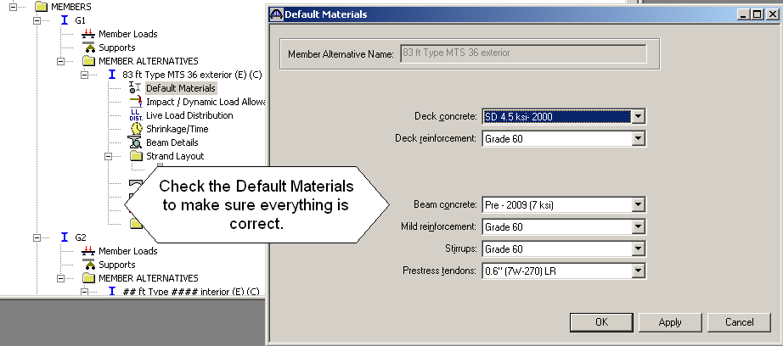

Slide 33
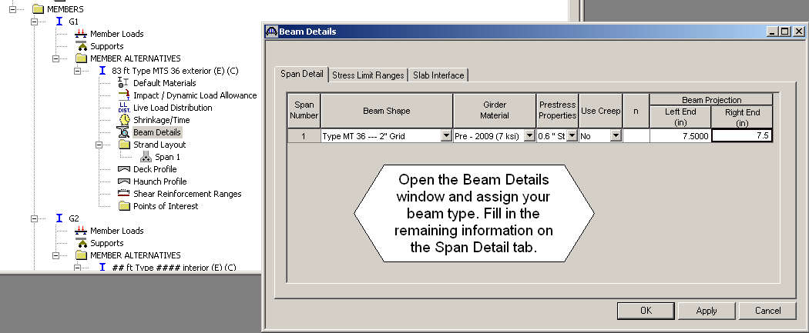
Enter Beam Details

Slide 34
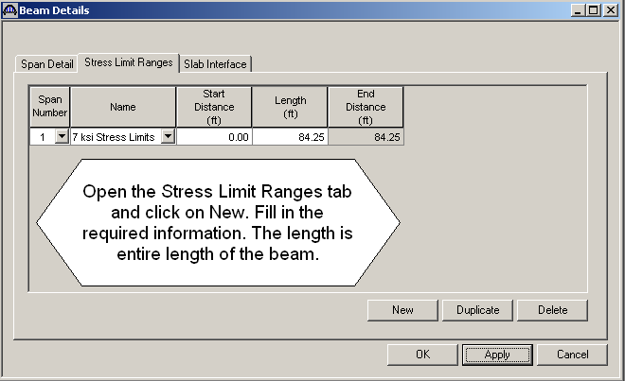

Slide 35
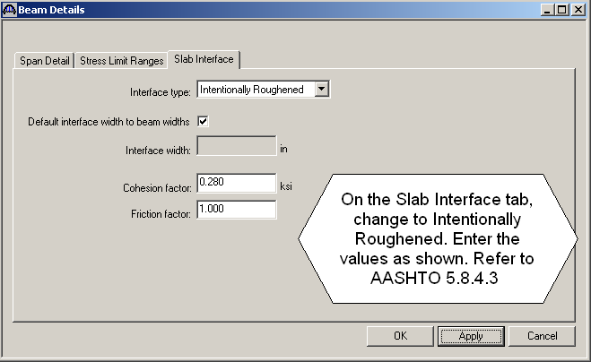

Slide 36
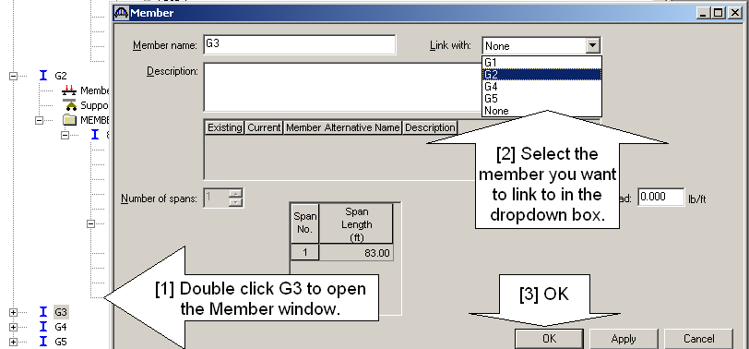
Link beams at this point.
Repeat process for interior beam.

Slide 37
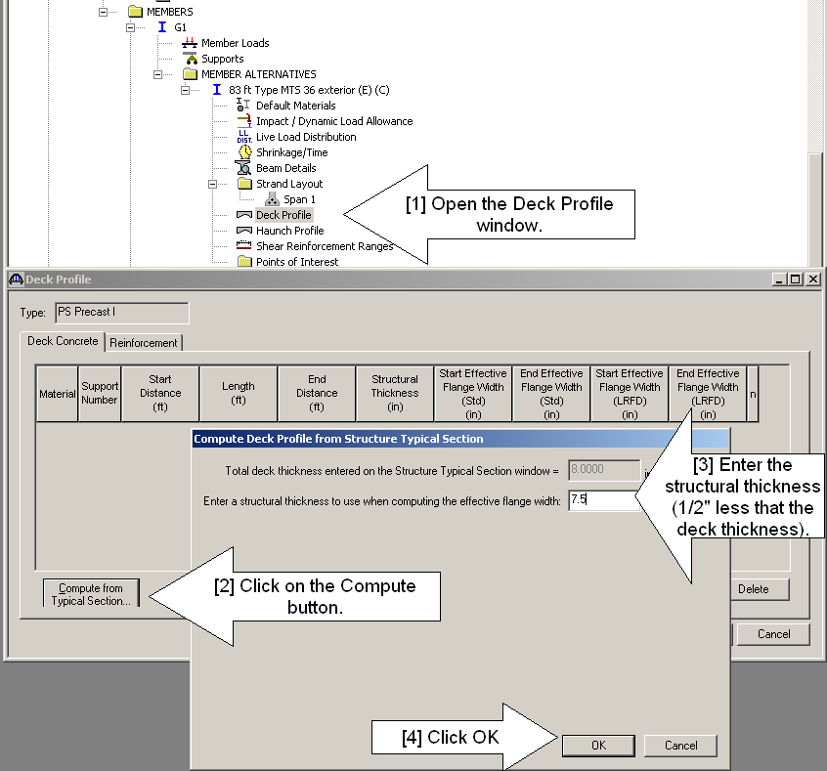
Enter Deck Details for G1 and G2.

Slide 38
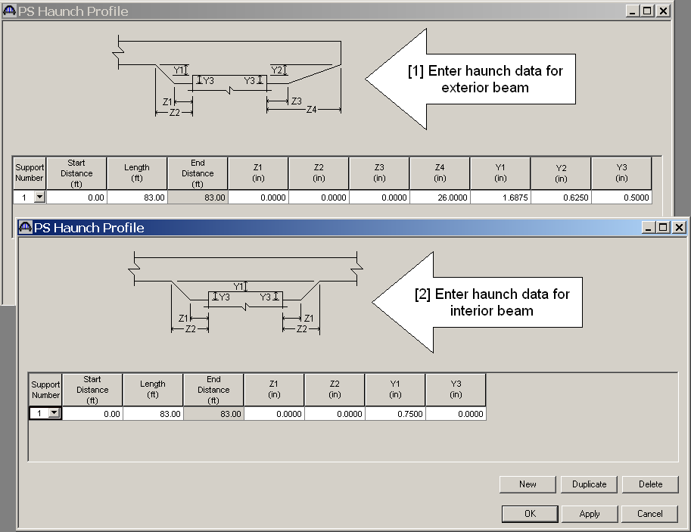
Enter Haunch Details for G1 and G2.

Slide 39
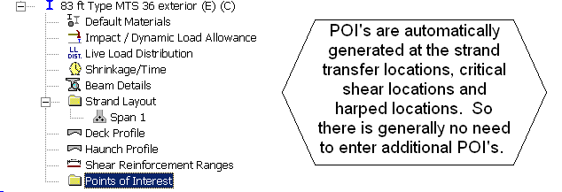
Points of Interest

Slide 40
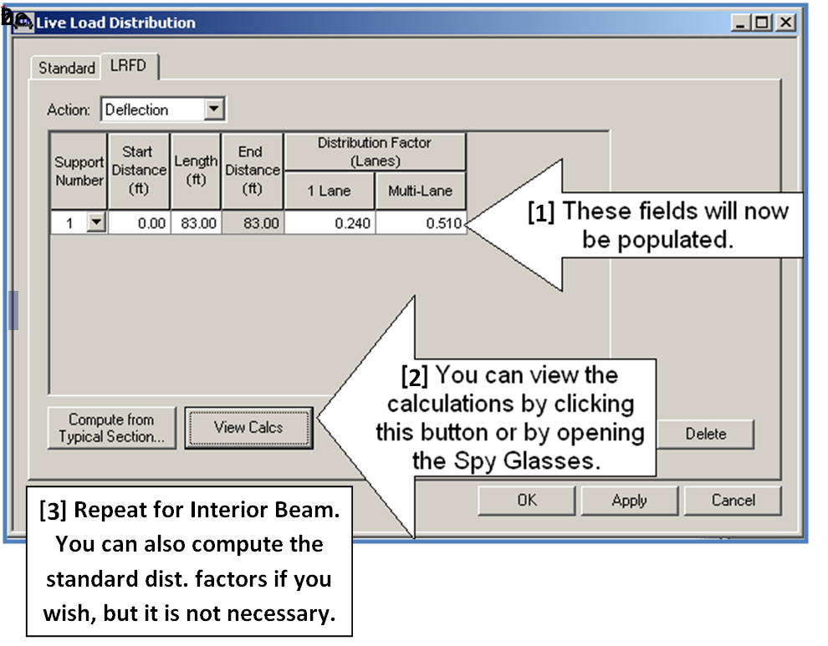
Compute Distribution Factors

Slide 41
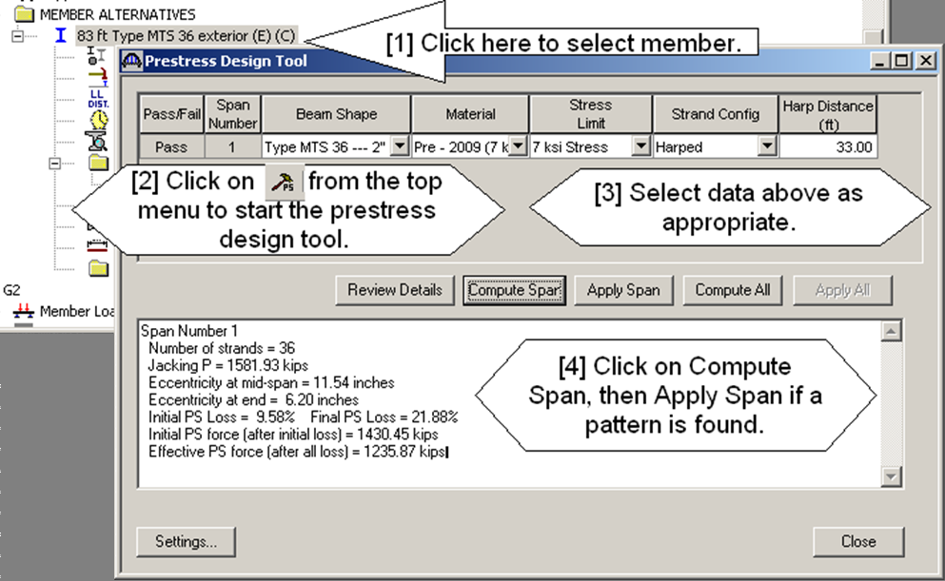
Enter Strand Pattern

Slide 42
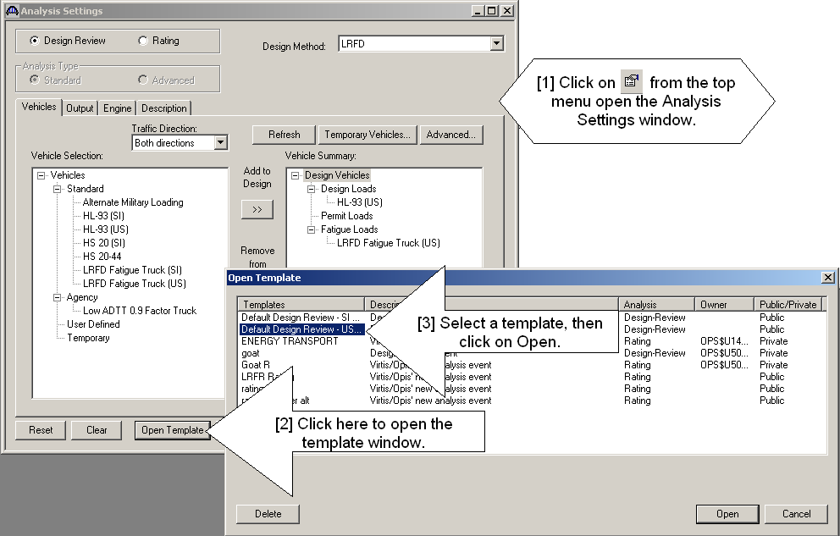
Select Analysis Settings

Slide 43
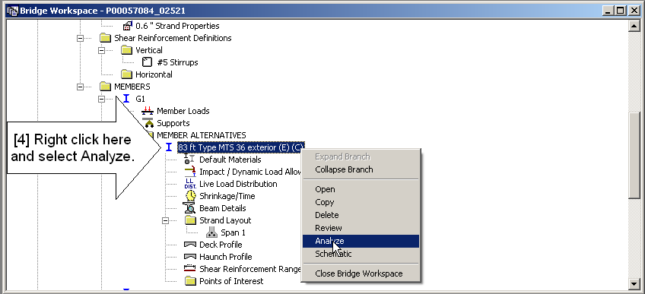
Analyze Beam

Slide 44
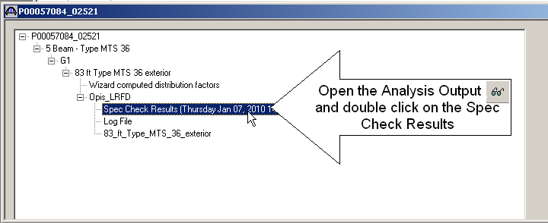
Check Results
Summary of the Specification Results and a table for each of the articles checked.

Slide 45
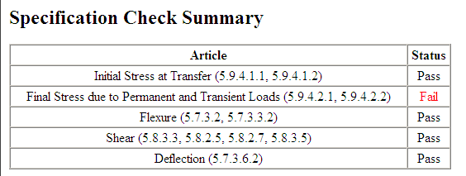

Slide 46
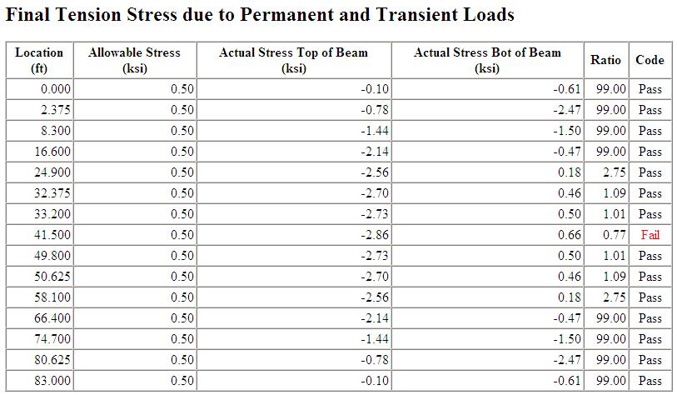
Modify Strands as Necessary - Tutorial offers guidelines

Slide 47
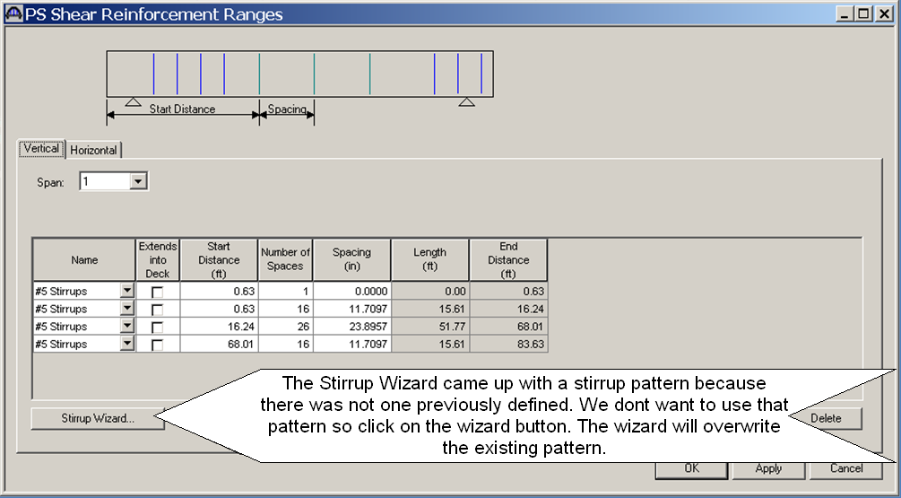
Add Shear Reinforcement and re-analyze as necessary

Slide 48
Bridge Rating
When you are satisfied with the design, check the rating.
Make any modifications necessary.

Slide 49
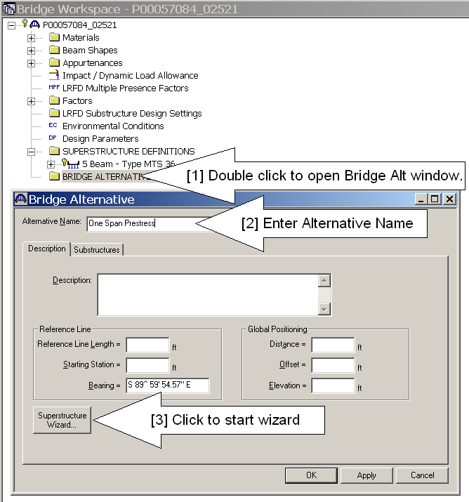
Build the Bridge Alternative Model using wizard

Slide 50
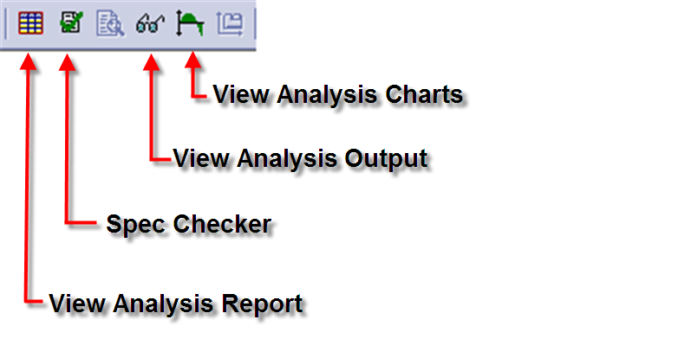
Tutorial APPENDIX A - Reports

Slide 51
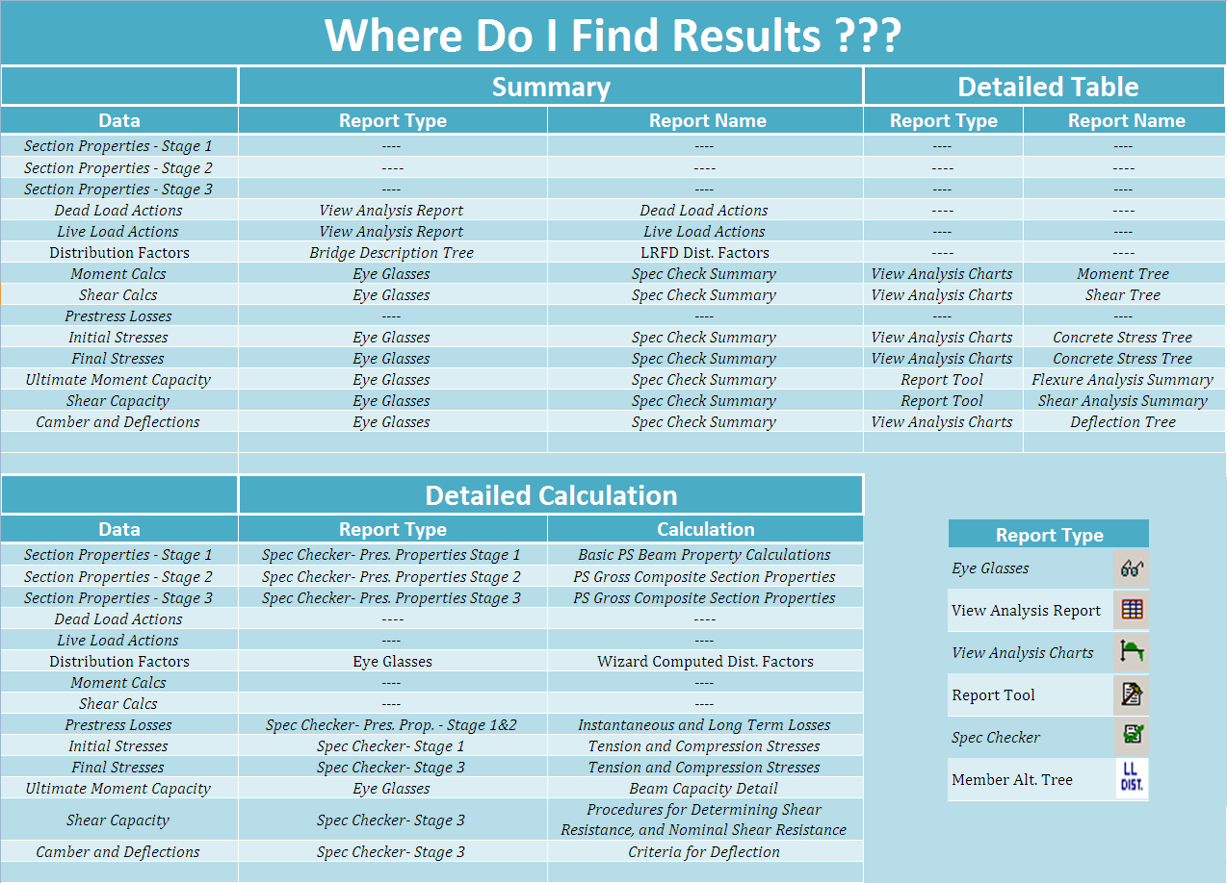

Slide 52
Questions

