Slide 1
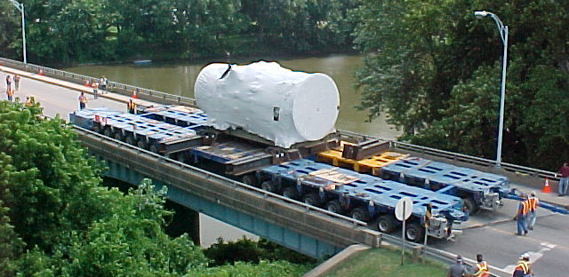



Development of Simplified Factors for Lateral Distribution
of Loads of Non-Standard Gauge (NSG) Axles – PID 114241
Presenter:
Travis Butz, PE

Slide 2
Research Team
Burgess and Niple:
Travis Butz, Olya Watts, Roger Kochman
ODOT Research:
Vicky Fout, Jennifer Spriggs
Technical Advisory Committee (ODOT):
Amjad Waheed Office of Structural Engineering
Alex Young Office of Structural Engineering
Brad Noll Office of Structural Engineering
Josh Thieman Permits
Mike Moreland Maintenance Administration

Slide 3

Problem Statement
The Ohio Hauling Permit System (OHPS) is an automated system used to evaluate more than 335,000 permit loads each year.
Many permits involve non-standard gauge (NSG) axle loads, meaning vehicles with gauge widths not equal to 6 feet.
NSG axle loads are evaluated by applying modifiers to AASHTO live load distribution factors prior to running the OHPS analysis process.
When results indicate that structures are incapable of carrying a load, ODOT engineers either apply restrictions on hauling or perform more rigorous and time-consuming evaluations of individual structures.
Modifiers used for the NSG axle loads are based on historical precedent and not supported by research.

Slide 4
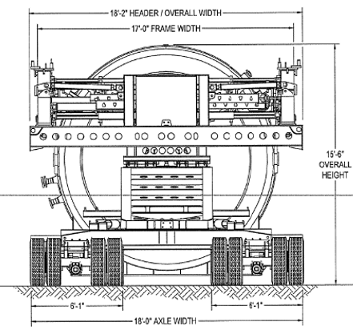
Goals and Objectives
Produce an accurate and simplified method that would improve ODOT’s process of analyzing NSG axle permit vehicles.
Develop a table or matrix of live load correction factors that could be applied to both AASHTO Load Factor Design (LFD) and Load and Resistance Factor Design (LRFD) distribution factors and incorporated into the OHPS.
Examined gauge widths ranged from 3.5 feet to 24 feet
The scope includes four structure types:
  Reinforced Concrete Slab Bridges
  Prestressed Concrete side-by-side box beam bridges
  Prestressed I-beam bridges
  Steel multi-beam bridges with a concrete deck

Slide 5

AASHTO Guidance
Distribution factors define the fraction of the live load assigned to a specific portion of the bridge. Distribution factors simplify analysis by assigning live load to individual bridge components.
Distribution factors are defined in both the AASHTO Standard Specifications and the AASHTO LRFD Bridge Design Specifications.
Distribution factor equations are derived for standard gauge axles. NSG axles are not addressed.
The AASHTO Manual for Bridge Evaluation, which provides guidance for evaluation of permit loads, includes commentary on NSG loading (C6A.3.2):
“AASHTO LRFD distribution factors were developed using . . . a standard 6-ft gauge width. Sensitivity studies . . . indicate that most parameters such as gross weight, number of axles, and axle spacings have only a small effect on the load distribution factor for flexure. It was found that the single most important parameter is gauge width. The distribution factor is generally lower for increased gauge widths.”

Slide 6
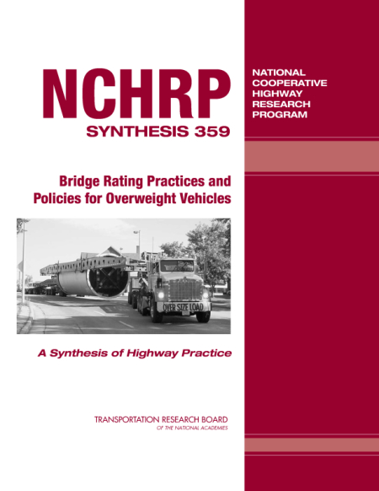
Past Research
NCHRP Synthesis 359, Bridge Rating Practices and Policies for Overweight Vehicles (2006)
Collected information from US States and Canadian Provinces concerning permit policies
For NSG axle vehicles, concluded that there is “no national specification for lateral distribution”
Noted that there was considerable disparity between states in how NSG axle loads were applied
Appendix includes a table summarizing how various states address NSG axle vehicles

Slide 7
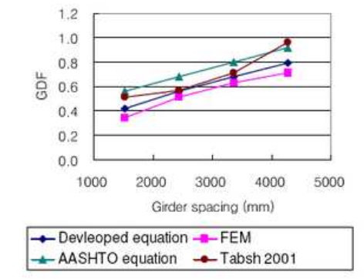

Past Research
Moment and Shear Load Distribution Factors for Multi-Girder Bridges Subjected to Overloads, Bae and Oliva (2012)
Developed distribution factor equations for multi-girder bridges for NSG axle vehicles
Considered span length, girder spacing, girder stiffness, gauge width, skew, and number of spans
FE analysis of 118 multi-girder bridges, 16 load cases
Distribution factor equations developed by curve fitting

Slide 8
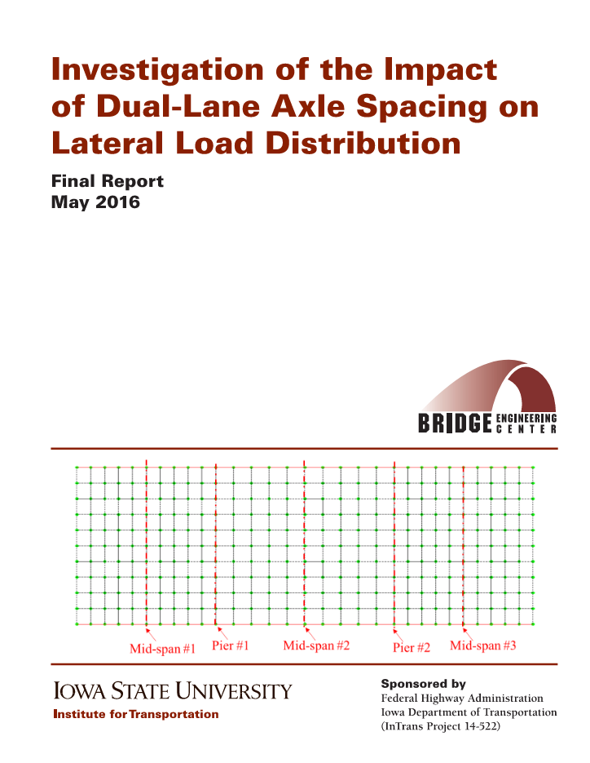
Past Research
Investigation of the Impact of Dual-Lane Axle Spacing on Lateral Load Distribution, Deng, Phares, and Lu (2016)
Investigated the impact of wheel line spacing for the Iowa Department of Transportation
FE analysis of 20 prestressed concrete, 20 steel, and 20 slab bridges randomly sampled from Iowa database
Loaded with 22 types of single-axle and four-wheel-line loads
Results were used to establish maximum allowable axle loads for NSG vehicles based on comparison to a baseline load

Slide 9
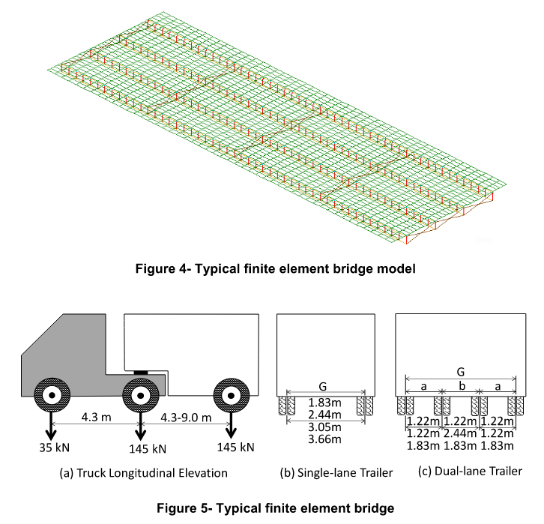
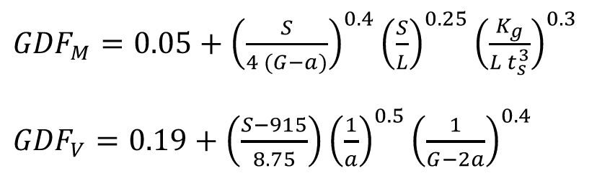
Past Research
Load Distribution in Short Bridges Subjected to Oversize Vehicles, Tabsh (2019)
Parametric study of nine composite steel girder bridges
Loaded using 2- and 4-wheel line vehicles with axle widths of 6, 8, 10 and 12 ft
Distribution factor equations were developed in a similar format to the AASHTO LRFD equations

Slide 10
Past Research Applicability
Past studies are not fully compatible with the project goals, data cannot be directly incorporated
Provide useful information regarding the impact of various parameters
Parameters from past studies were tabulated and considered for inclusion in the current project

Slide 11
ODOT OHPS Process
NSG axles are evaluated as standard gauge, with reduction factors applied based on a table provided by Kansas DOT.
The table references the research paper “Effective Width Method for Determining the Lateral Distribution of Wheel Loads for Non-AASHTO Axles” (McLelland) as the source of the reduction factors.
The research team examined the research paper and found no direct link to the values in the table.
Table of NSG axle reduction factors from Kansas DOT:
Gauge | Number of tires | Reduction factor
7 – 8 | 4 | .945
8 – 9 | 4 | .900
9 – 10 | 4 | .851
10 and over | 4 | .811
10 - 11 | 8 | .811
11 - 12 | 8 | .771
12 – 13 | 8 | .740
13 - 14 | 8 | .681
14 and over | 8 | .631

Slide 12
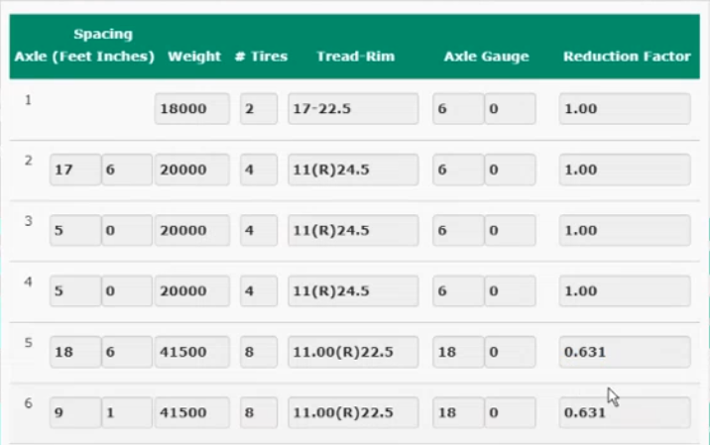
ODOT OHPS Process
Axle data and reduction factors are entered using the input screen shown.
The Promiles software system uses this data to evaluate all bridges on the proposed route.
Bridge specific data can not be considered in the determination of the reduction factor.
Promiles identifies bridges that do not pass the automated evaluation, and bridges that require manual analysis.
Input data for NSG vehicle in ODOT OHPS system:

Slide 13
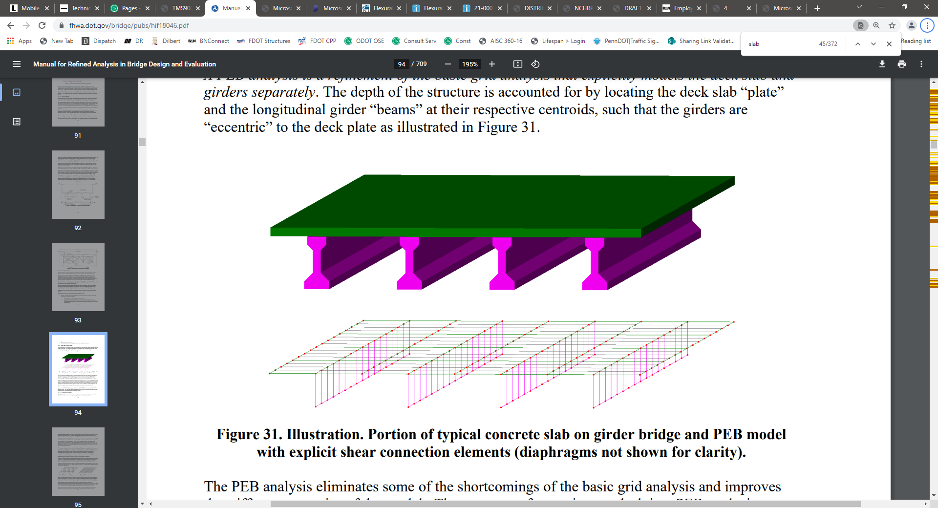
Parametric Study
A parametric study was designed and performed to generate data for development of correction matrix for NSG vehicles.
The study consisted of a series of finite element analyses that isolated various parameters that could potentially influence live load distribution.
A common set of vehicles was applied to each structure to evaluate the impact of axle gauge variations and variations in the number of wheel lines.
Bridge parameters and member sizes were based on a review of ODOT standard drawings and on existing plan sets for similar span configurations.
Parametric Study Data:
Number of Bridges: 168
Number of Bridge Types: 4
Number of Axle Configurations: 34
Modeling Software: Midas Civil

Slide 14
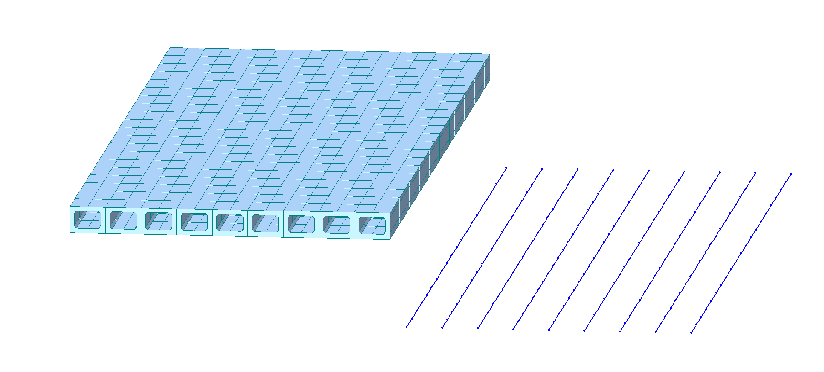
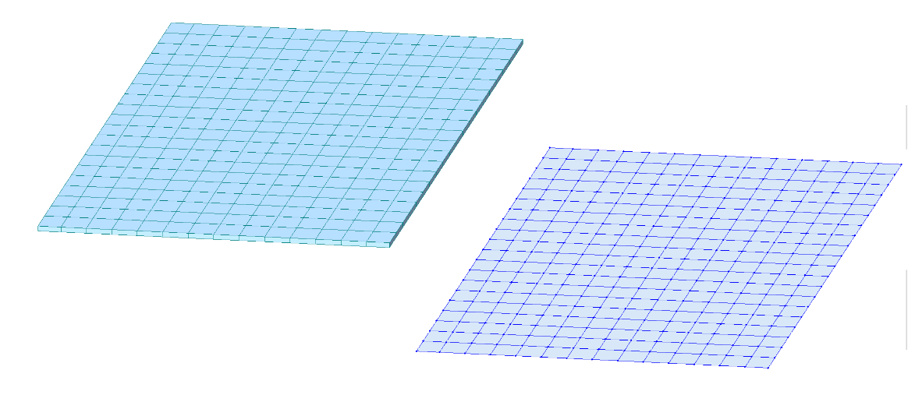
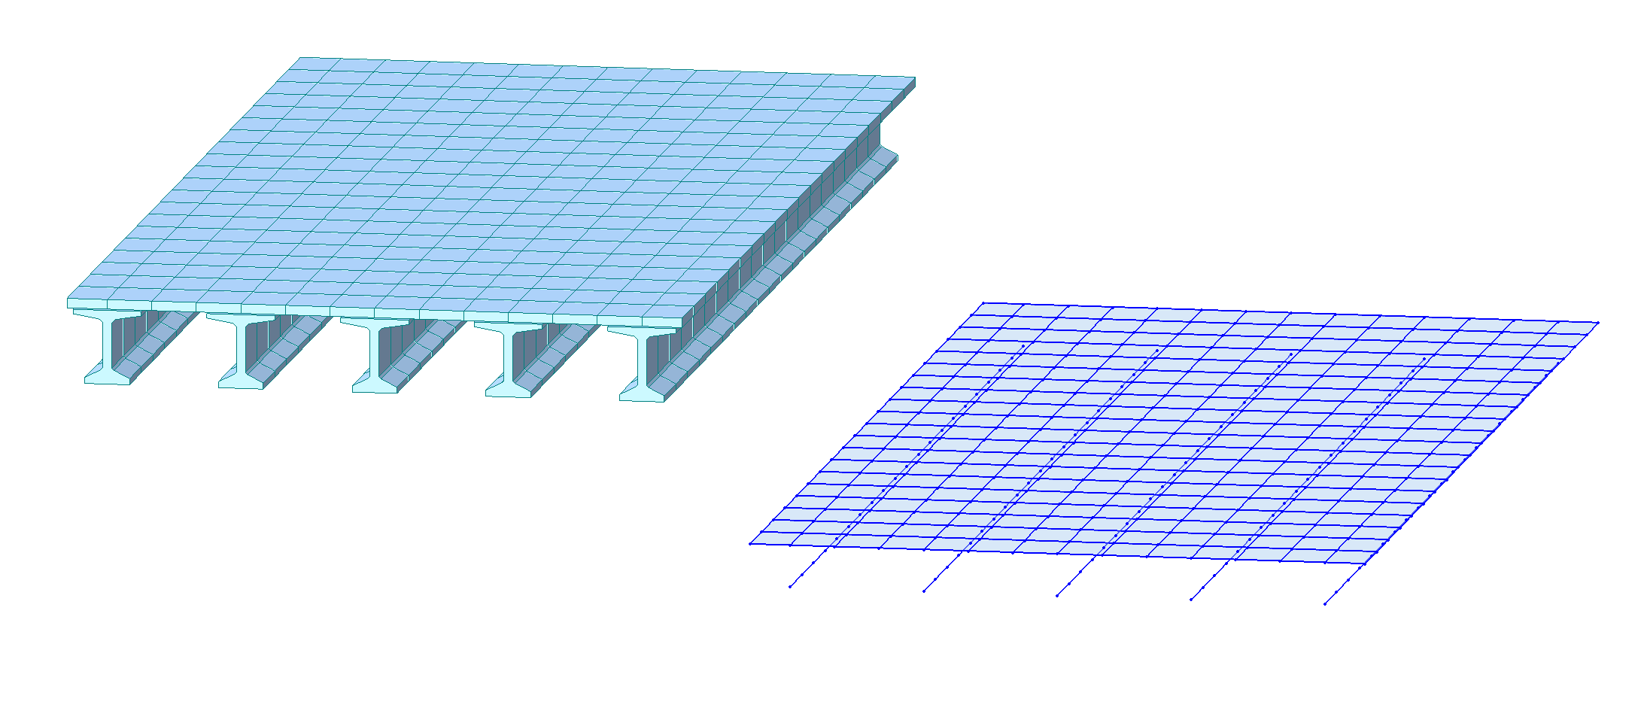
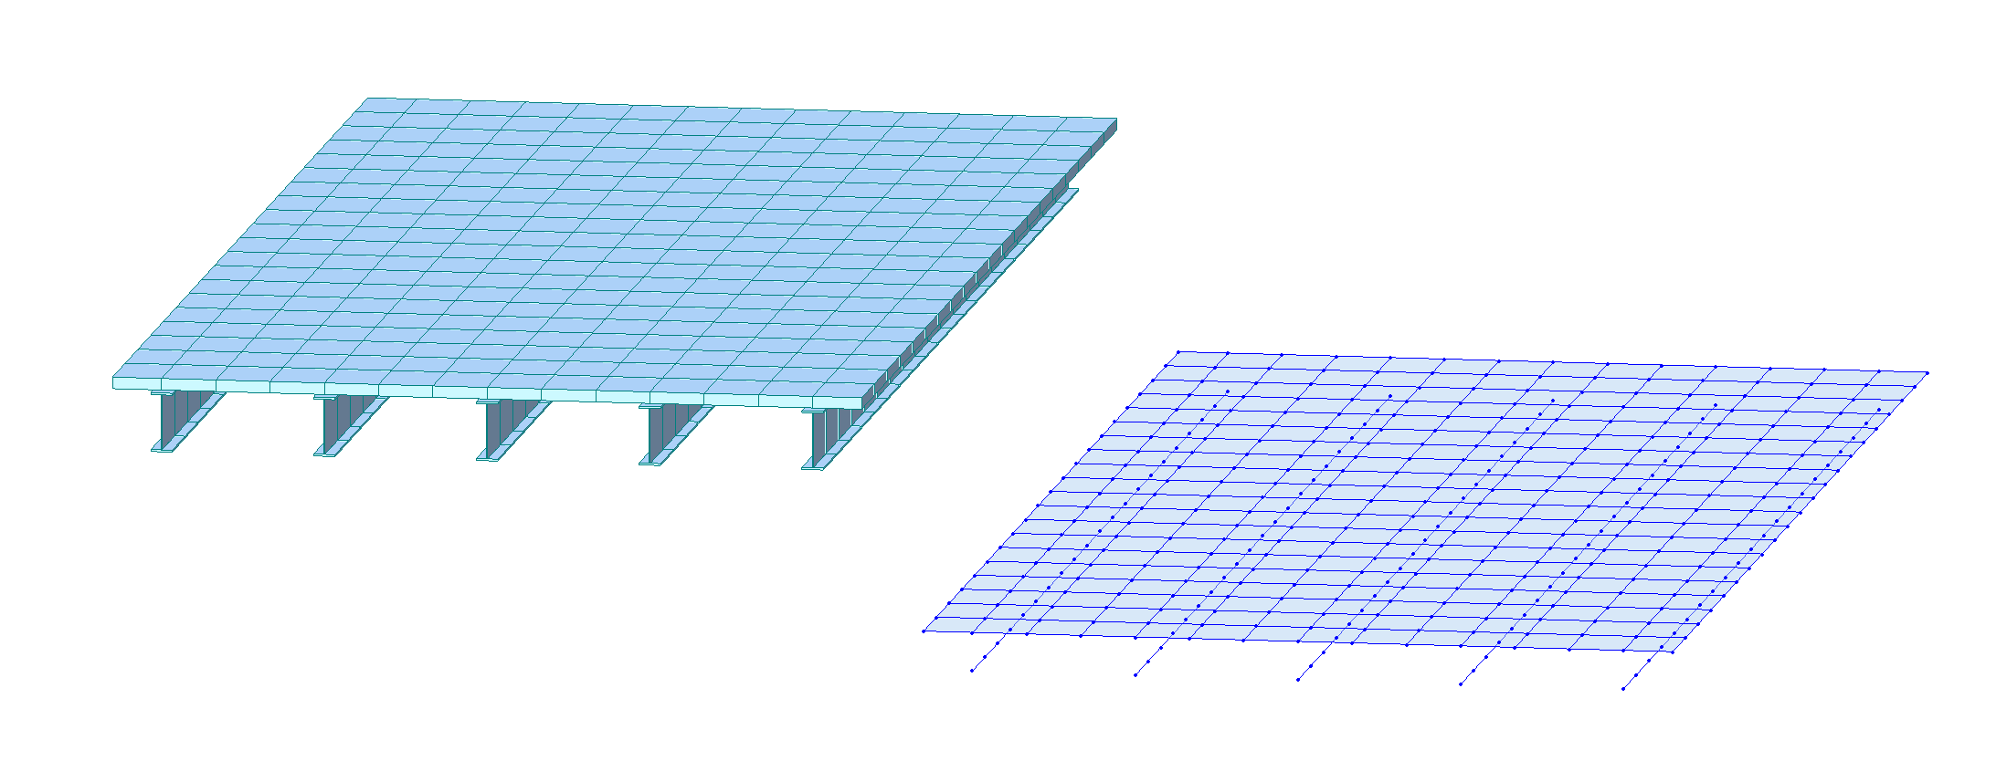
Parametric Study: Bridges
Bridge Types to be included:
Side-by-side prestressed concrete box beam
(composite and non-composite)
Concrete slab
(simple span and continuous)
Prestressed concrete I-beam
(simple span and continuous)
Steel multi-beam
(simple span and continuous)

Slide 15
Parametric Study: Bridges
Bridge Type | No. of Spans | No. of Bridges | Span Range | Beam Spacing
Non-Composite Box Beam | 1 | 6 | 33 ft - 100 ft | 4 ft
Composite Box Beam | 1 | 6 | 47 ft - 115 ft | 4 ft
Concrete Slab | 1 | 6 | 11 ft - 38 ft | -
Concrete Slab (continuous) | 3 | 6 | 17.5 ft - 57.5 ft | -
Concrete I-Beam | 1 | 36 | 50 ft - 140 ft | 7 ft, 9.5 ft, 12 ft
Concrete I-Beam (continuous) | 2 | 36 | 50 ft - 140 ft | 7 ft, 9.5 ft, 12 ft
Steel Multi-Beam | 1 | 36 | 50 ft - 180 ft | 7 ft, 9.5 ft, 12 ft
Steel Multi-Beam (continuous) | 2 | 36 | 50 ft - 180 ft | 7 ft, 9.5 ft, 12 ft

Slide 16
Parametric Study: Vehicles
A set of typical NSG axle permit loads was requested by the research team and provided by ODOT.
Based on the vehicles provided and discussions with ODOT, the range of axle gauges to be studied was set to vary from 3.5 ft to 24 ft.
Vehicles in the study would consist of single axle lines, rather than multi-axle configurations.
The study would include axles with 2, 4, 6, and 8 wheel lines.
NSG axle permit loads provided by ODOT:
Vehicle No. | Widest Axle Gauge (ft) | No. of Wheel Lines in Widest Axle | Vehicle Weight (kips)
1 | 7.25 | 2 | 148
2 | 9 | 2 | 151.5
3 | 7.08 | 2 | 100
4 | 8.33 | 2 | 132
5 | 6.82 | 2 | 76
6 | 6.82 | 2 | 70.13
7 | 14.5 | 4 | 334
8 | 14.58 | 6 | 900.8
9 | 24 | 8 | 673.6

Slide 17
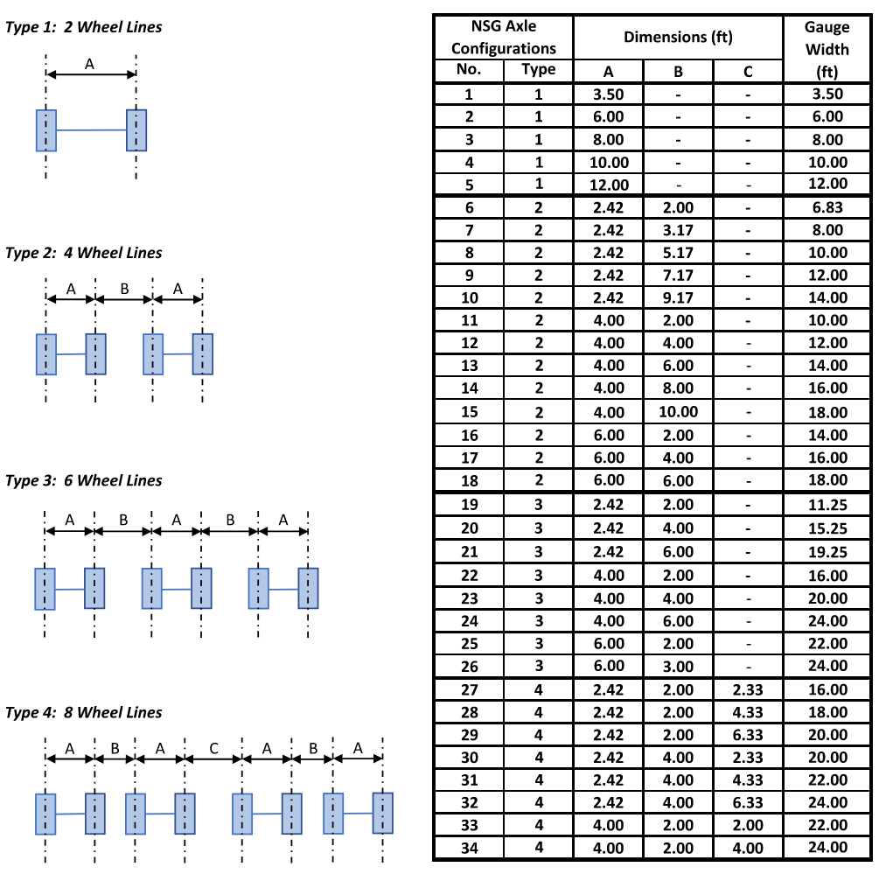
Parametric Study: Vehicles
Terminology
Axle – A line of transverse loads on a vehicle. Consists of multiple wheel lines.
Wheel Line – Load point on an axle. Can consist of a single tire or a set of dual tires.
Each “type” represents a single axle with a specified number of wheel lines.

Slide 18
Parametric Study: Analysis
Concrete Slab
Modeling methods for concrete slabs are well established
Two-dimensional shell elements, capable of modeling bi-axial bending effects, were used to model the concrete superstructure
Model refinement level was established based on FHWA guidance and a convergence analysis
1 ft to 2 ft mesh used for all structures
Rendered View
Wire-Frame View

Slide 19
Parametric Study: Analysis
Steel Multi-Beam & Prestressed I-Beam
Models followed recommendations from the FHWA Manual for Refined Analysis in Bridge Design and Evaluation
Plate and Eccentric Beam type models were used for these bridge types
Beam elements were used for the steel and concrete beams, two-dimensional shell elements were used for the concrete deck
Meshing was based on a minimum of 10 elements per span, a minimum of 2 deck elements between each beam line, maintaining an aspect ratio of 2:1 or less
Steel Multi-beam:
Rendered View
Wire-Frame View
Prestressed I-beam:
Rendered View
Wire-Frame View

Slide 20
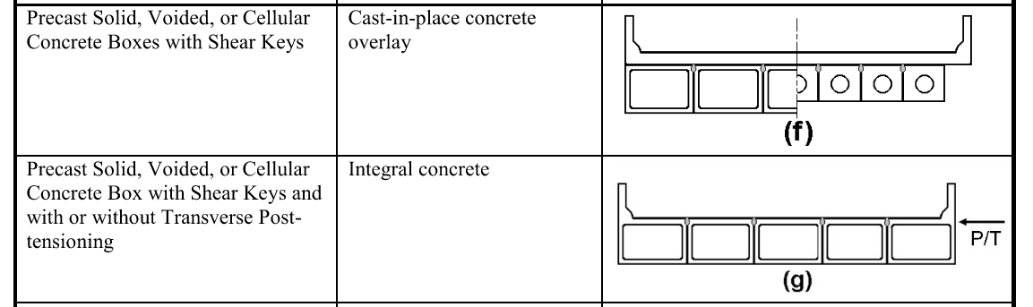
Parametric Study: Analysis
Prestressed Side-by-Side Box Beam
Distribution factors in AASHTO LRFD are based on NCHRP Report 12-26/1
Distribution factor equations assume the structure acts as a monolithic unit
No differentiation between composite and non-composite
Longitudinal beam elements transversely connected by rigid elastic links
Links released for moment to allow beams to rotate independently
Models showed good agreement with AASHTO single-lane distribution factor equations
AASHTO LRFD Table 4.6.2.2.1-1:
Beam lines connected with rigid elastic links
Rendered View
Wire-Frame View

Slide 21
Parametric Study: Results
Analysis Results
Correction factors for the various analyses by comparing peak section forces (moments/shears) between standard gauge and non-standard gauge vehicles.
Correction factor = (Section force due to NSG loading) / (Section force due to standard gauge loading)
Section Forces Collected
Composite / Non-Comp. Box Beam: Maximum Moment Maximum Shear
Concrete Slab: Maximum Unit Moment
Minimum Unit Moment
Concrete I-Beam / Steel Multi-Beam: Maximum Moment Minimum Moment Maximum Shear

Slide 22
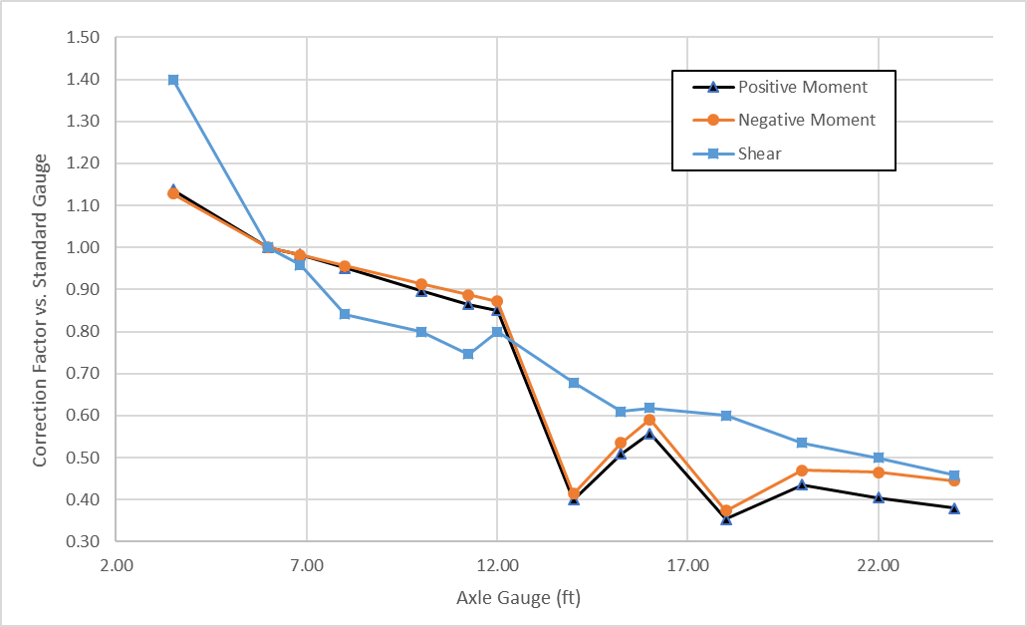
Parametric Study: Results
Prestressed I-Beam / Steel Multi-Beam Bridges:
Similar results were obtained for steel multi-beam and prestressed I-beam superstructures.
Steady reduction in moment correction factor as gauge width increases.
Shear correction factor is directly linked to the ratio of beam spacing to gauge width. (Sharp decline over 12 ft)
Correction factors do not differentiate between interior and exterior beam lines
Correction Factors for Steel Multi-Beam Bridges:

Slide 23
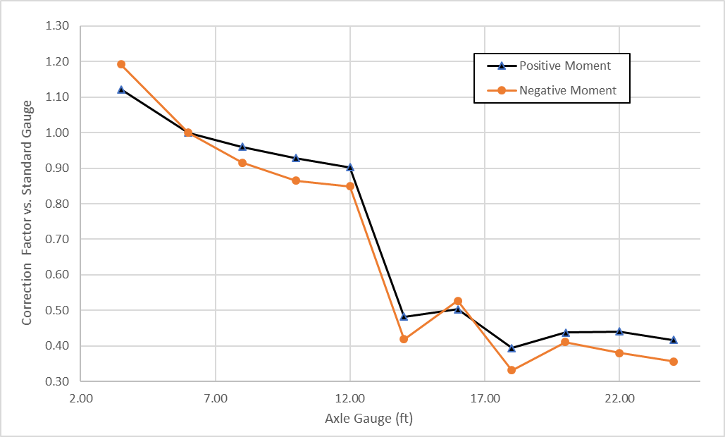
Parametric Study: Results
Concrete Slab Bridges:
Similar correction factors for negative and positive moment
Gradual decrease in correction factors for axles with 2 wheel lines up to 12 ft gauge
Significant reduction when additional wheel lines are added (gauge > 12 ft)
Correction Factors for Concrete Slab Bridges:

Slide 24
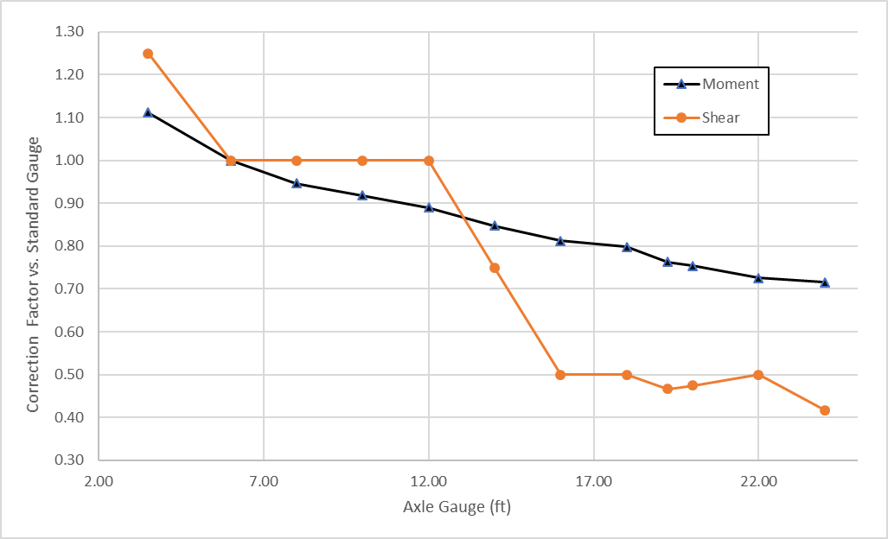
Parametric Study: Results
Side-by-Side Prestressed Box Beam Bridges:
Composite and Non-composite showed similar results
Very gradual reduction in moment as the axle gauge increases
Force reduction is small because side-by-side box beams provide a high level of load sharing under both standard gauge and NSG loading
Correction factors are significantly higher than for other bridge types
Correction Factors for Non-Composite Box Beam Bridges:

Slide 25
Parametric Study: Data Analysis
Pearson’s product-moment coefficient measures correlation on a scale from -1.0 to +1.0
-1.0 = perfect neg. correlation
+1.0 = perfect pos. correlation
0.0 = no correlation
Correction Factors for all structures show strong negative (inverse) correlation with gauge width and number of wheel lines
Box beam structures show weak positive correlation with span length and beam stiffness
Other bridge characteristics show little to no correlation with correction factors
Correction Factor Correlation Coefficients per Bridge Type:

Slide 26
Correction Matrix
A review of the results was conducted prior to development of the final correction factor matrix.
Study results showed that the Type 2 (4 wheel lines) correction factors were controlled by axle configurations with closely spaced wheel lines.
ODOT conducted a follow-up review of recent permit vehicles and determined that some of the axle configurations in the parametric study are rarely or never encountered in practice.
Based on this review, the vehicles shaded in red were not included in the final correction factor matrix.

Slide 27
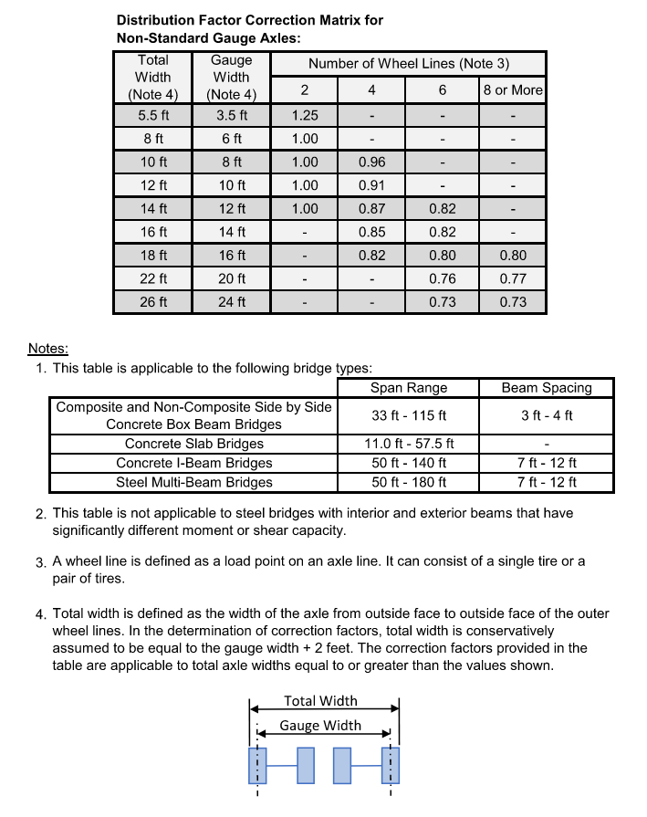
Correction Matrix
The correction factor matrix was developed based on the worst-case (highest) correction factors among the remaining vehicles.
Results were tabulated based on gauge width and the number of wheel lines per axle.
This matrix was largely controlled by correction factors for side-by-side prestressed box beams.

Slide 28
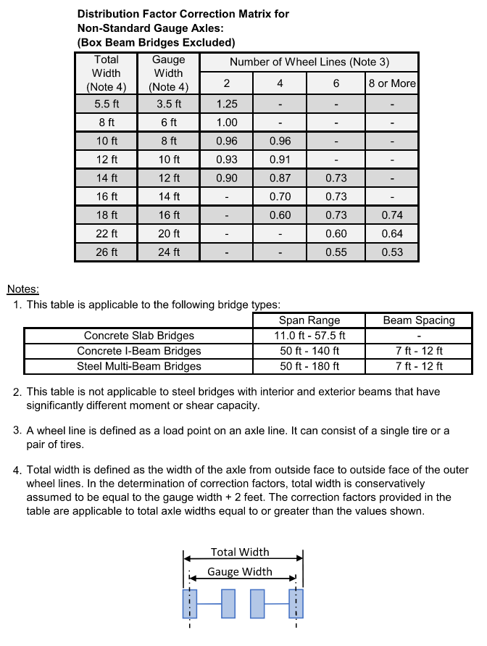
Correction Matrix
A second version of the matrix was developed with the side-by-side prestressed box beam results excluded.
This version of the matrix provides less conservative factors for use on the other bridge types when side-by-side prestressed box beam bridges will not be analyzed.

Slide 29
Matrix Comparison:

Slide 30
Correction Matrix
In addition to the overall matrix, correction factors for each axle type analyzed were tabulated by structure type and section force.
The factors in these tables can be applied to specific combinations of vehicles and structures to obtain less conservative results.
These tables are included in the Appendix of the final report.

Slide 31
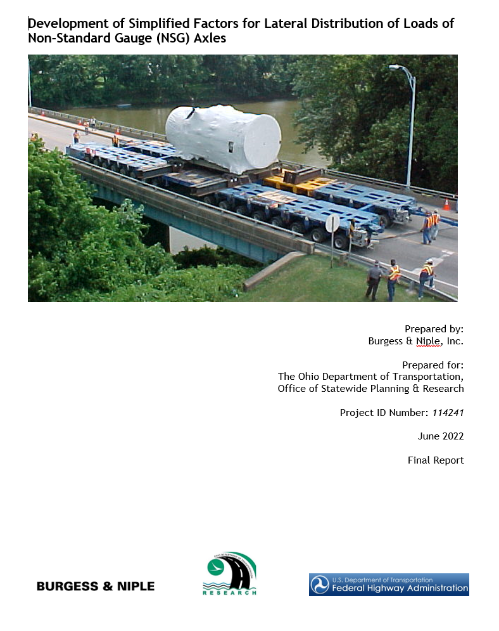
Questions?

