Slide 1

PGSuper2AASHTOWare
Bridge Data Translator
Richard Pickings, P.E.,
BridgeSight Inc.
Ron Pierce, S.E.
David Evans & Associates

Slide 2
What Is PGSuper?
Special Purpose Software For:
Precast-Prestressed Girder Superstructures
LRFD Girder Design and Analysis
LRFR Rating
Multi-Span, Continuous Structures
Bridge Geometry Modeling
Highly-Efficient Windows User Interface
Notes:
Targeted

Slide 3
Major Features
Comprehensive LRFD/LRFR Evaluation
  Straight, Harped, and Debonded Strands
  Automated Design Algorithm
  Lifting and Hauling Analysis
Complex Bridge Geometry Modeling
Highly Configurable
  Internet-Based Library and Template Configuration
Free !!

Slide 4
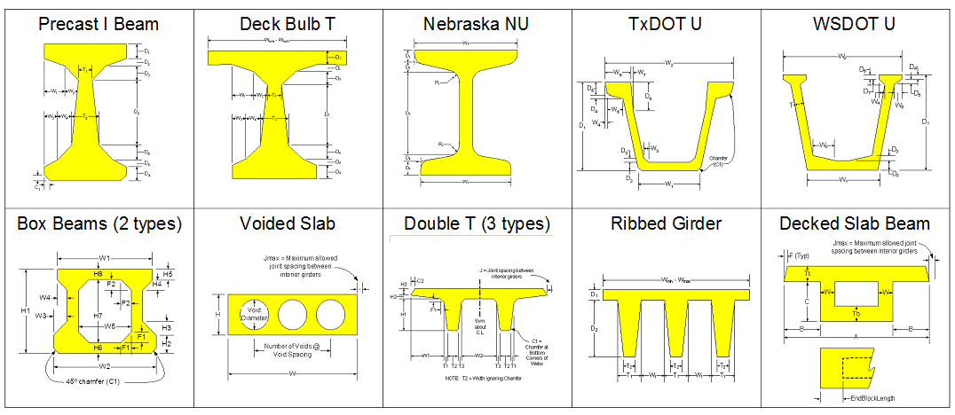
Parametric Sections
Adjacent and Spread Spacing

Slide 5
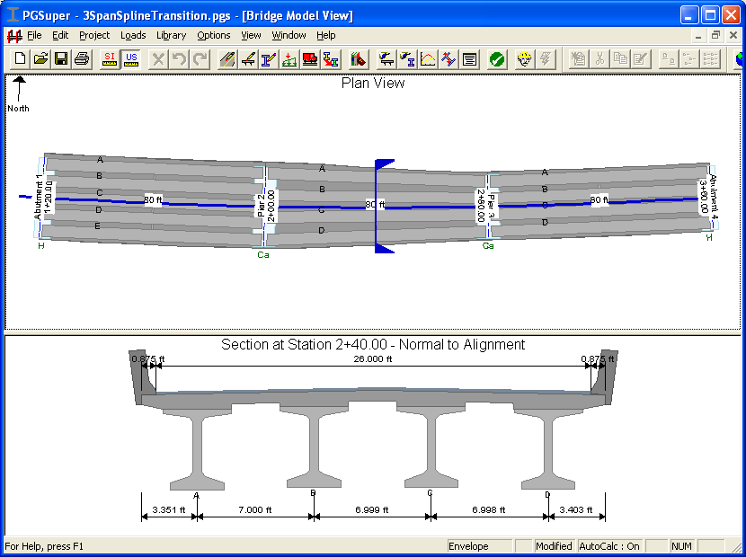
Enhanced Geometry

Slide 6
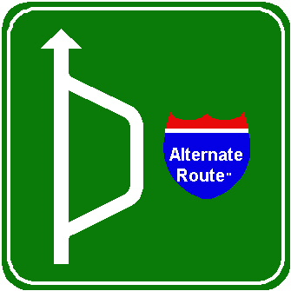
PGSuper History
Timeline
  1997 WSDOT/BridgeSight Begin Development
  1998 Open Source License (ARP)
  2000 Version 1.0
  2006 TxDOT Joins Development Effort
  2007 Multi-Span Continuous
  Aug, 2010 Version 2.4

Slide 7
Recent Developments
PGSuper 2.4
Engineering Functionality
  LRFR Load Rating (Version 2.3)
  Lightweight Concrete
  LRFD 5th Edition, 2010
  TxDOT Fabricator Optional Girder Analysis
Software Extensibility Architecture
  Add New Features and Applications to PGSuper
Notes:
T-19 Sacramento

Slide 8
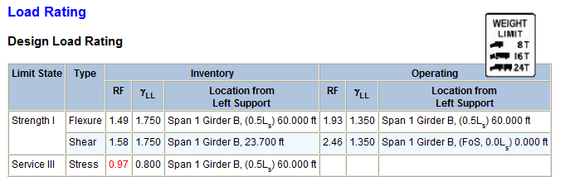
LRFR Load Rating
Section 6, Part A of the AASHTO Manual for Bridge Evaluation, First Edition, 2008
  Positive/Negative Moment, Shear, and Flexural Stress
  Standard or Custom Vehicles
For:
  Inventory
  Operating
  Legal Loads with Routine Commercial Traffic or Specialized Hauling Vehicles
  Permit Loads for Routine or Annual Permits
  Permit Loads for Special or Limited Crossing Permits

Slide 9
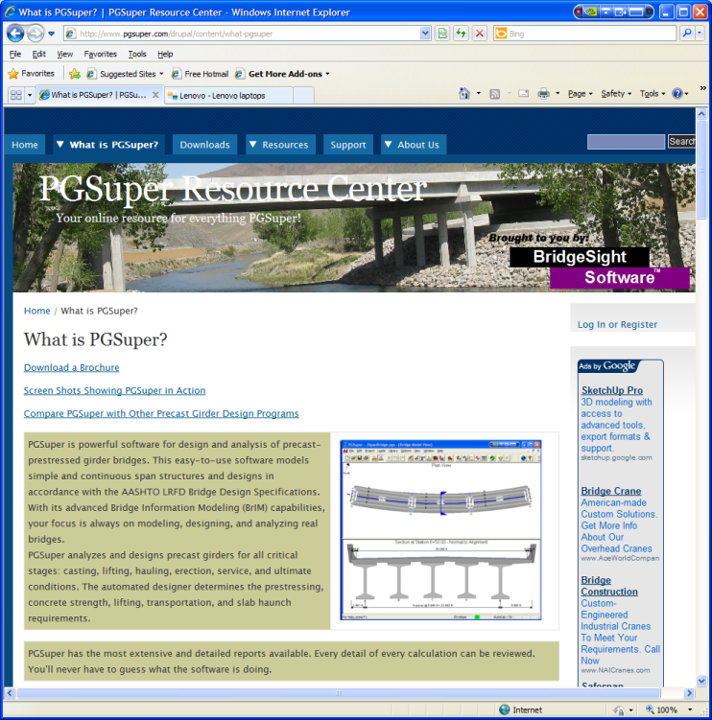
PGSuper Resource Center www.PGSuper.com
General Information
  Brochure
  Product Comparison
Free Training
Community-Based Support
Newsletter
DOT Configurations

Slide 10
Past
Misconceptions…

Slide 11
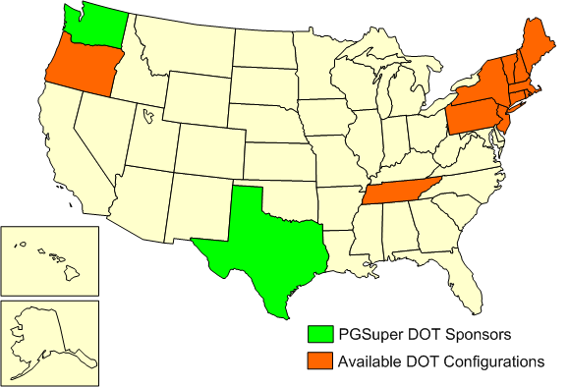
Pgsuper Can Be Used By Anyone!
New DOT Configurations at PGSuper.com

Slide 12

Software Extensibility Architecture
Four Types Of 3rd Party Extensions:
Plug-in Girder Types
    3rd parties can develop and plug-in new types of girders
    Requires C++/COM programming (BridgeSight can help with this)
Application Plug-ins
    Project Importers
    Data Importers
    Data Exporters (PGSuper2AASHTOWare, LandXML)
Extensions (3D Viewer, Custom Reports)
    More Challenging to Develop
    Unlimited Integration Within PGSuper’s User Interface
    Unconstrained Functionality
Applications (Library Editor, TxDOT Optional Girder Analysis)
    Most Challenging To Develop
    Provide Completely New Project Types
Notes:
Finicky clients

Slide 13
WSDOT/TxDOT Components
PGSuper is a general precast-prestressed girder bridge design, analysis and rating tool
WSDOT/TxDOT agency specific features have been moved into 3rd party extensions
These features are only available if installed

Slide 14
PGSuper2AASHTOWare
Export PGSuper Bridge Data to Virtis/Opis
PGSuper Data Exporter Plug-in

Slide 15
Benefits of Using PGSuper2AASHTOWare
Use PGSuper for Design
  Very Efficient Input UI
  Optimized Design Algorithm
  The Most Robust And Full Featured Prestressed Girder Software Available
Export Data to Opis/Virtis in Seconds!
  Nearly Complete Translation
  Secondary LRFD and LRFR Verification
  On To Virtis and Pontis for Rating and Bridge Management

Slide 16
PGSuper Pro™
Enhanced Version of Pgsuper From BridgeSight
Pgsuper Pro Enhancements
  Pgsuper2AASHTOWare Data Translation
  LandXML Import and Export
  Export Analysis Results to Excel
  Enhanced Reporting
  3D Visualization and Editing
Extended User Manual
Toll-Free Technical Support

Slide 17
Demo
PGSuper Pro™
  PGSuper2AASHTOWare Data Translator using a Utah DOT Design/Rating Example
  Data Exporters
  3D Viewers

Slide 18
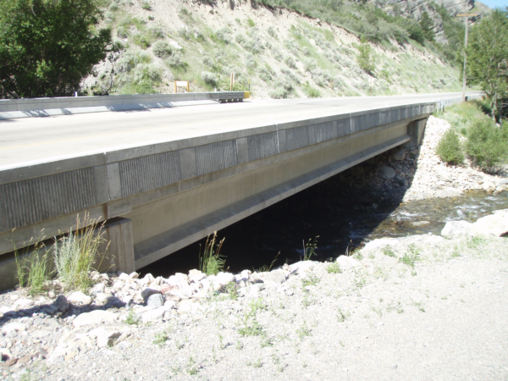
Demo Bridge

Slide 19
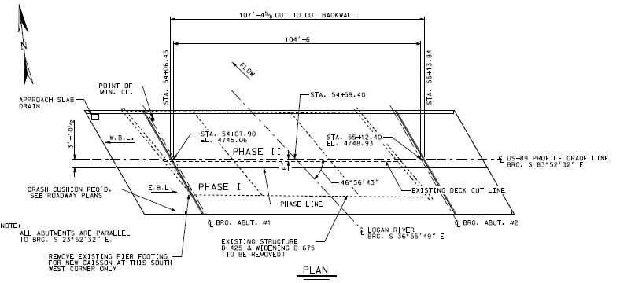
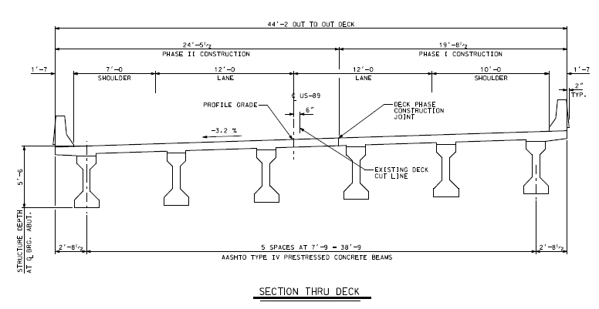
Bridge F-723, Cache County, UT
LRFR Inventory Rating
Single 104’-6” Simple Span
Six UDOT Type IV Girders @ 7’-9”
30° Skew
3.2% Superelevation
8.5” Deck
41’ Curb to Curb
Interior Diaphragms at 1/3 points
Special Barrier
Girder Design
48 Strands (38 Straight, 10 Harped)
f’ci = 6.4 ksi
f’c = 7.0 ksi
Prescribed Lump Sum Losses
Composite = 35.9 KSI
Final = 42.6 KSI

Slide 20
Rating Results
Interior Girders
Inventory RF | PGSuper | Virtis/BRASS | % Difference
Positive Moment | 2.12 | 2.04 | 3.8
Shear Capacity | 1.88 | 1.93 | -2.6
Stress, Service III | 1.68 | 1.69 | -0.6
Exterior Girders
Inventory RF | PGSuper | Virtis/BRASS | % Difference
Positive Moment | 1.99 | 1.93 | 3.1
Shear Capacity | 2.23 | 2.29 | -2.7
Stress, Service III | 1.75 | 1.74 | 0.6
Notes:
2.5% difference in PS force made big difference in Service iii

Slide 21
What’s Next?
Post-Tensioning
  Continuous Structures
  Spliced Girders
  Multiple Construction Scenarios

Slide 22
Get Involved
Join our Beta Test program
  Contact BridgeSight
Join Our Peer-to-peer Support Mailing List at PGSuper.com
Contribute DOT Configurations You’ve Created

Slide 23
BridgeSight Inc
Training
  Tutorials and White Papers at PGSuper.com
  On-site One day PGSuper Training Class
PGSuper Customization
  Customize PGSuper for Your Agency
    Design Policies, Girder Sections, etc
  Develop Plug-ins and Extensions
  Application Branding

Slide 24
Conclusions
PGSuper is a Very Powerful, FREE, Prestressed Girder Design Program
PGSuper2AASHTOWare Translator Brings Significant Benefits
Visit www.PGSuper.com for More Information
More DOT Configurations and Free Training To Come

Slide 25
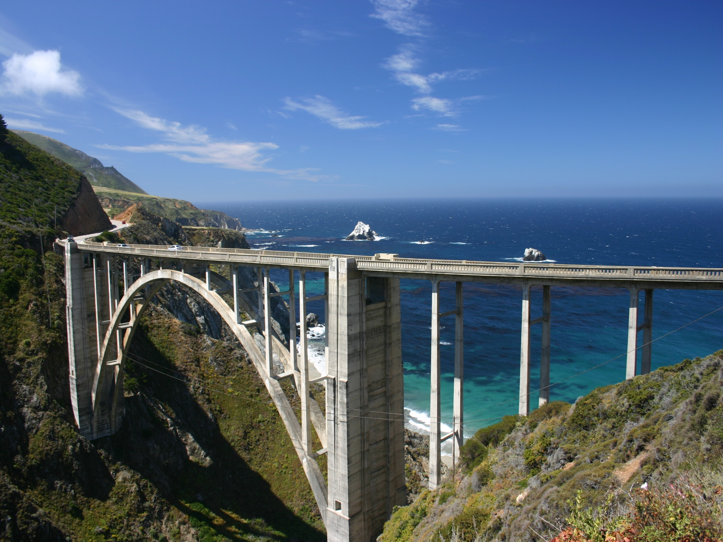
Thank You!!
Questions?
Special Thanks:
  Terry Leatherwood
  AASHTOWare Task Force

