Slide 1
Louisiana Load Rating
2022 RADBUG
Dana Feng, PhD, PE
LA State Bridge Load Rating Engineer

Slide 2
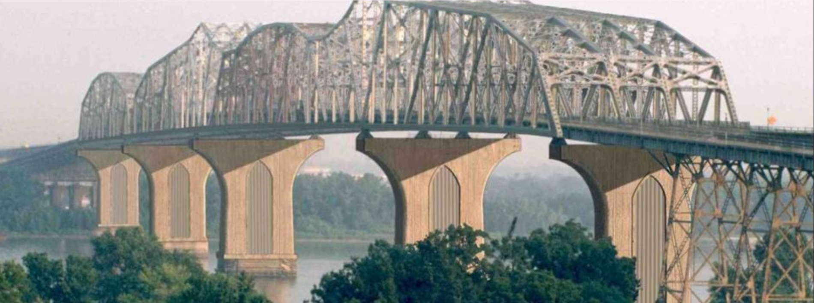
Load Rating Unit
Bridge Design Section / Bridge Rating Unit
  Kian, Billy, Danny, Suba, Dominic, Andy, Nathan, Teri
Bridge Maintenance Section
  Off-system load rating: Corey

Slide 3
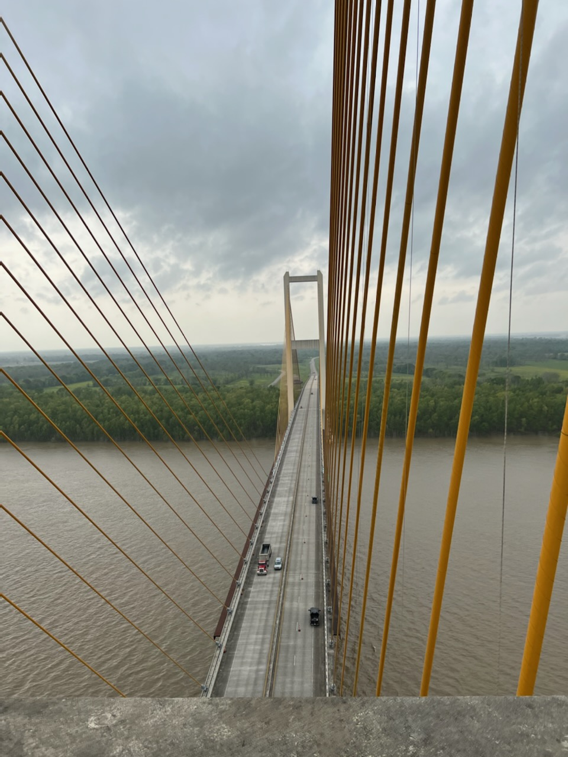
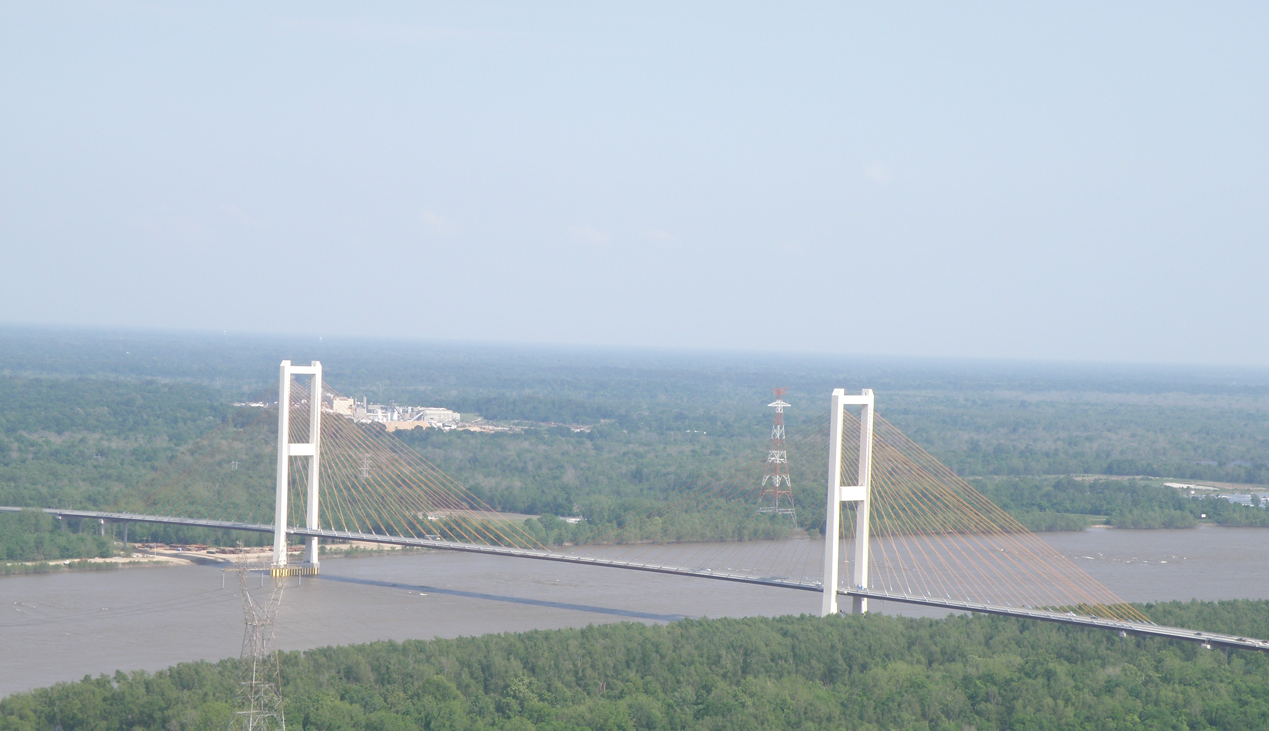
What do we do
Bridge Load Rating, Posting
Remove Posting and rehab
Overlay Review
Truck Permitting
NDT and Health Monitoring
Research
Notes:
Audubon Bridge on LA10 over Mississippi River built in 2011.

Slide 4
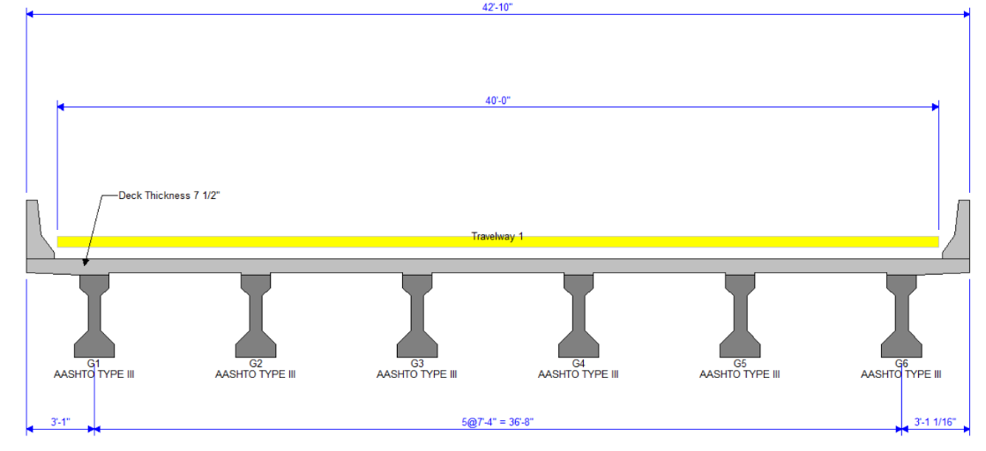
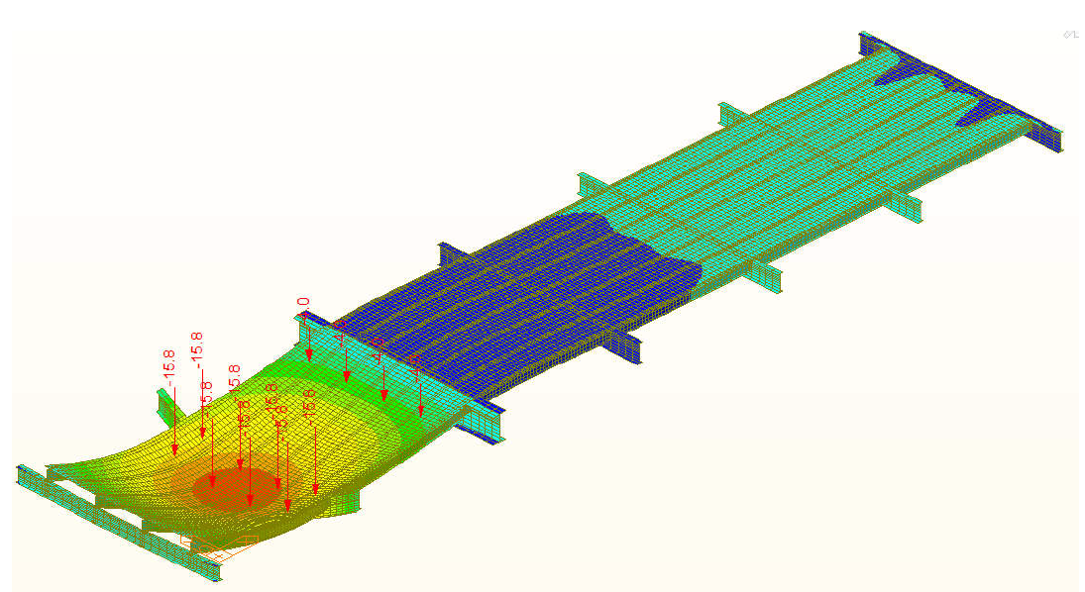
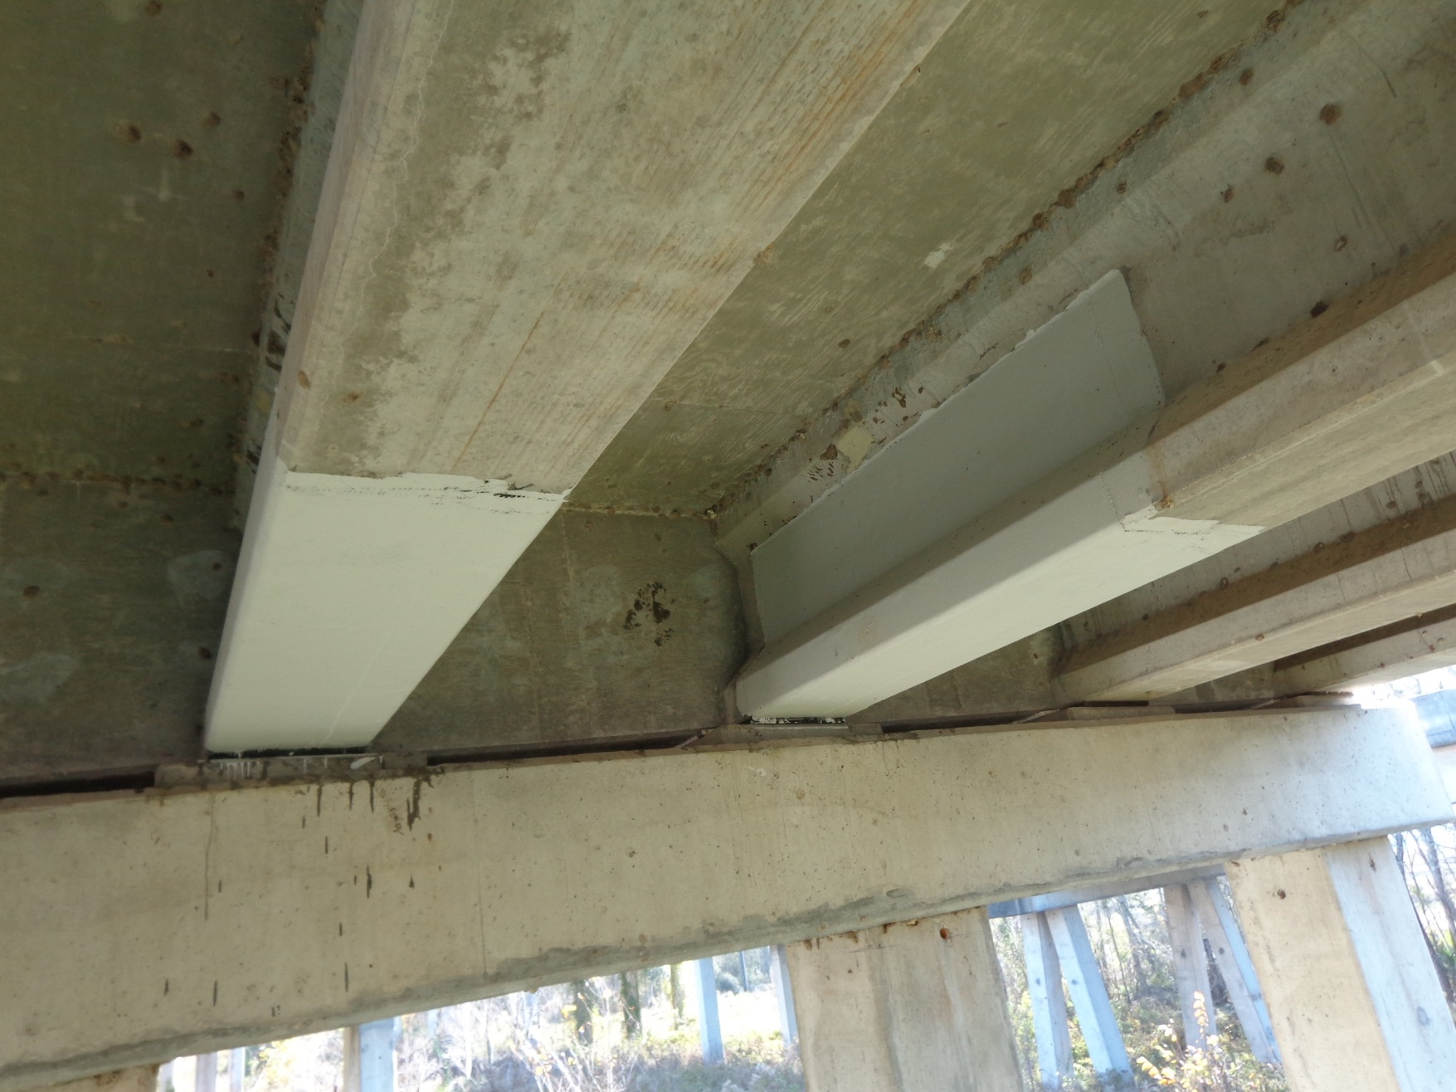
Load Rating Levels
BrR/BrD
Refined analysis
NDT/Health Monitoring
Rehab
Posting

Slide 5
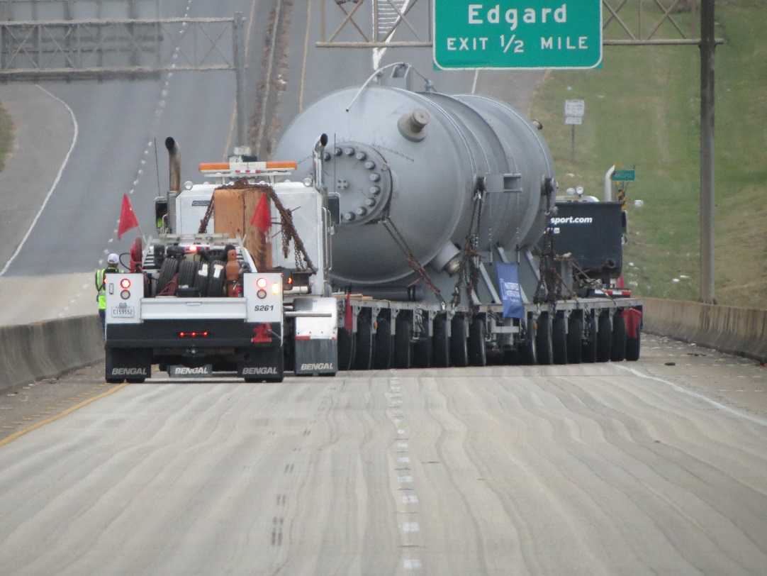
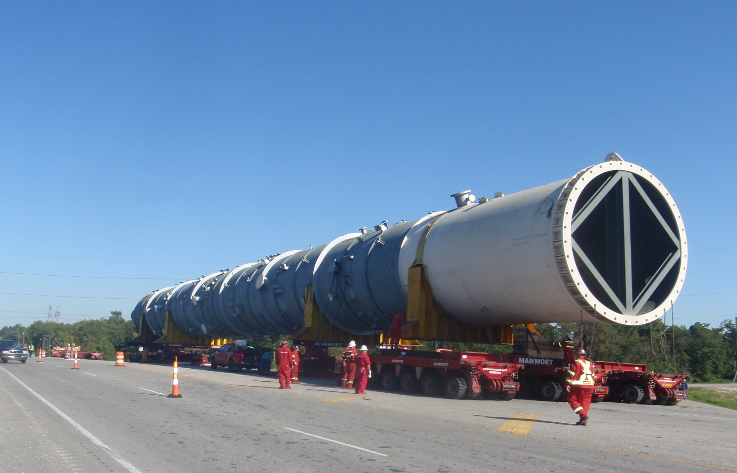
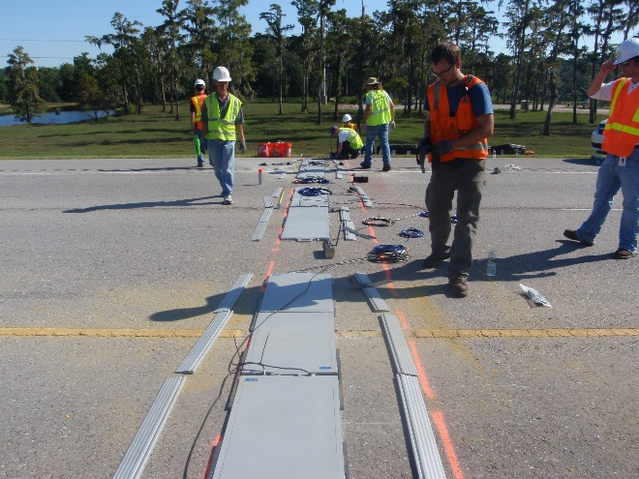
Permit/Overlay Review
2 Million pounds
Notes:
BrR will be the first round screening. Advance methods.

Slide 6
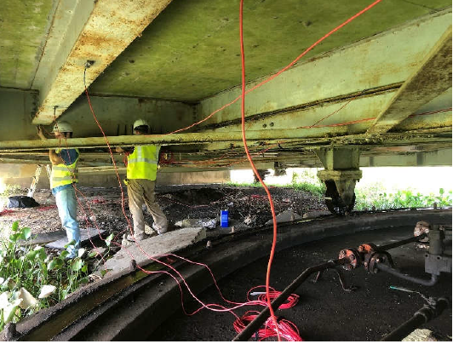
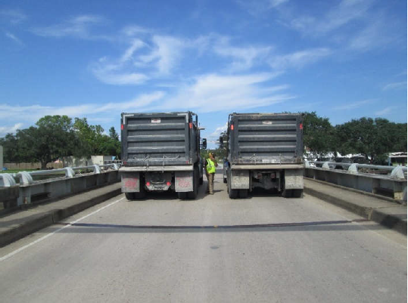
NDT/Health Monitoring
Notes:
No damage. Coring. Bridge rating has equipment to do some testing. Drone, monitor, gages, WIM

Slide 7
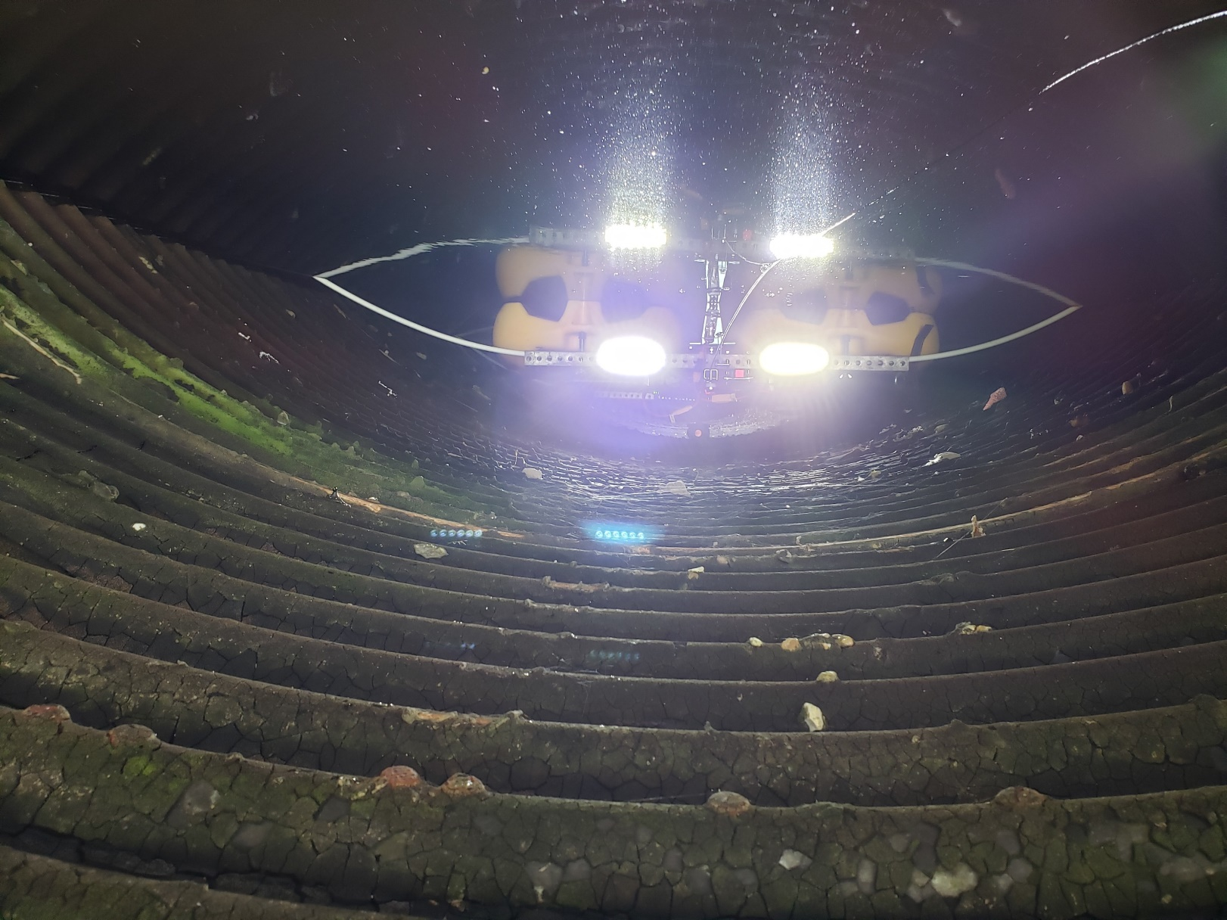
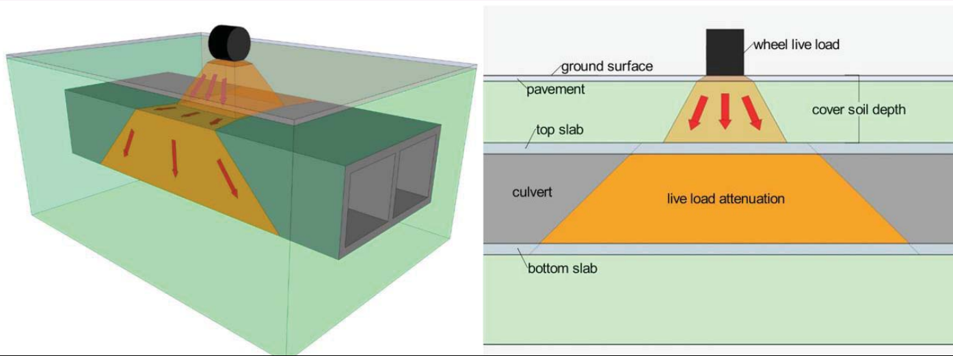
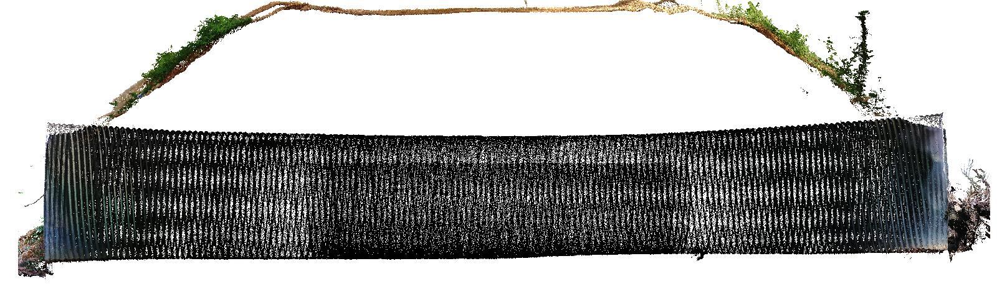
Research
LA CIP Concrete box culvert rating
Metal culvert measurement and rating
Continuous steel stringer rating

Slide 8

Enjoy!

