Slide 1
IMPROVED CONTINUOUS STRINGER RATINGS
William “Billy” METCALF, Jr. P.e.
Louisiana department of transportation and development

Slide 2
POST 2010 LADOTD STARTED HAVE MAJOR PROBLEMS WITH STEEL RATINGS
PROBLEMS WERE WITH MAJOR BRIDGES - ELEVATED INTERSTATE SECTIONS AND MISSISSIPPI RIVER CROSSINGS.
ALL PROBLEM BRIDGES WERE GIRDER/TRUSS STRINGER FLOORBEAM BRIDGES.
ISSUES WERE WITH CONTINUOUS STRINGER RATINGS.
SOME RATINGS CAME BACK VERY LOW OR EVEN “CLOSED”
ALL BRIDGES HAD BEEN IN SERVICE FOR DECADES IN GOOD CONDITION AND PERFORMING WELL.
ISSUE FIRST APPEARED IN LRFR RATINGS.

Slide 3
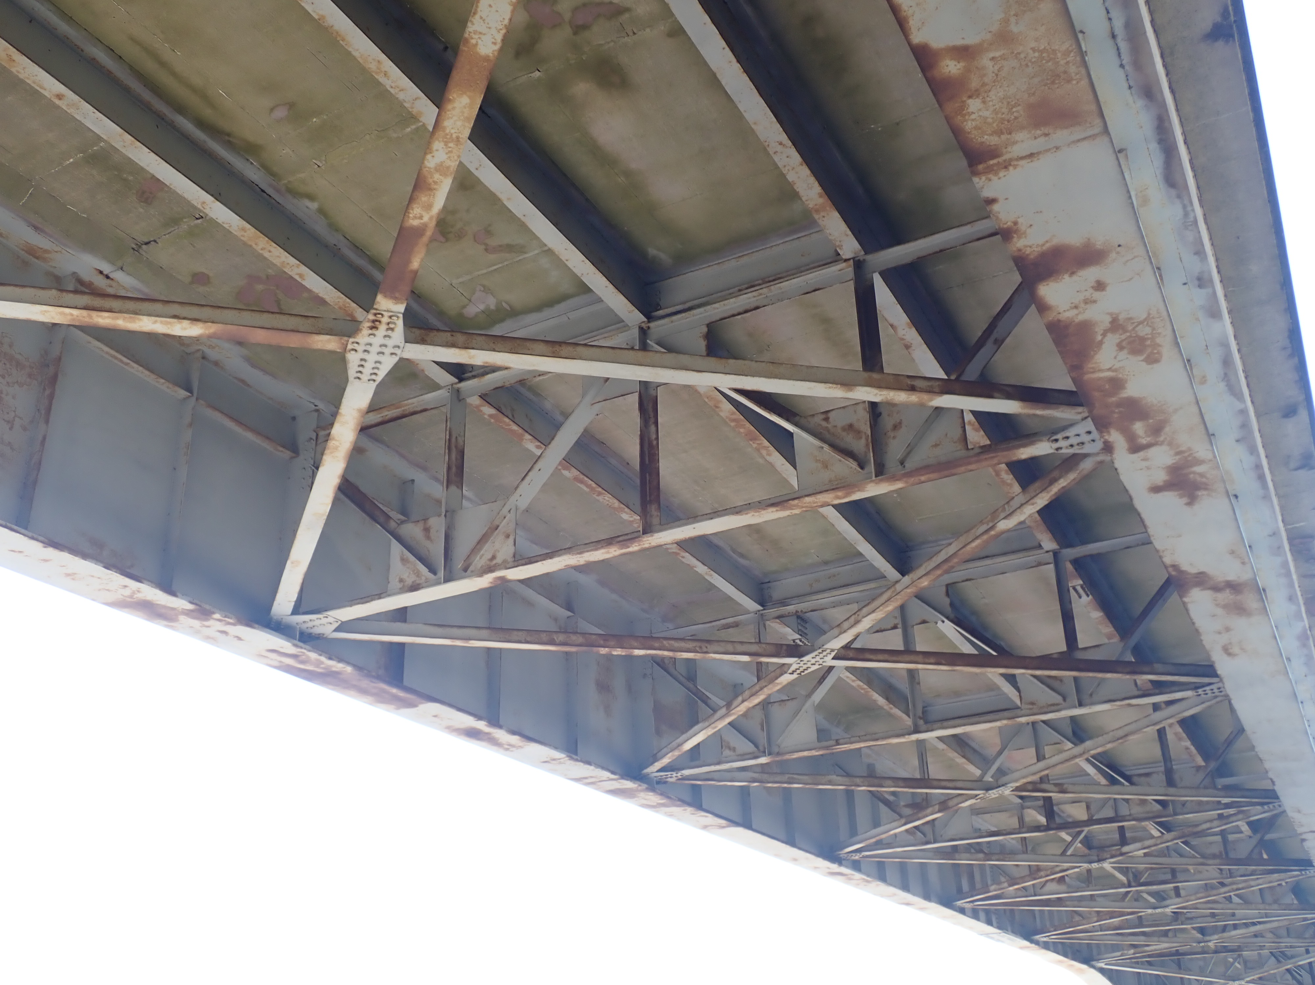
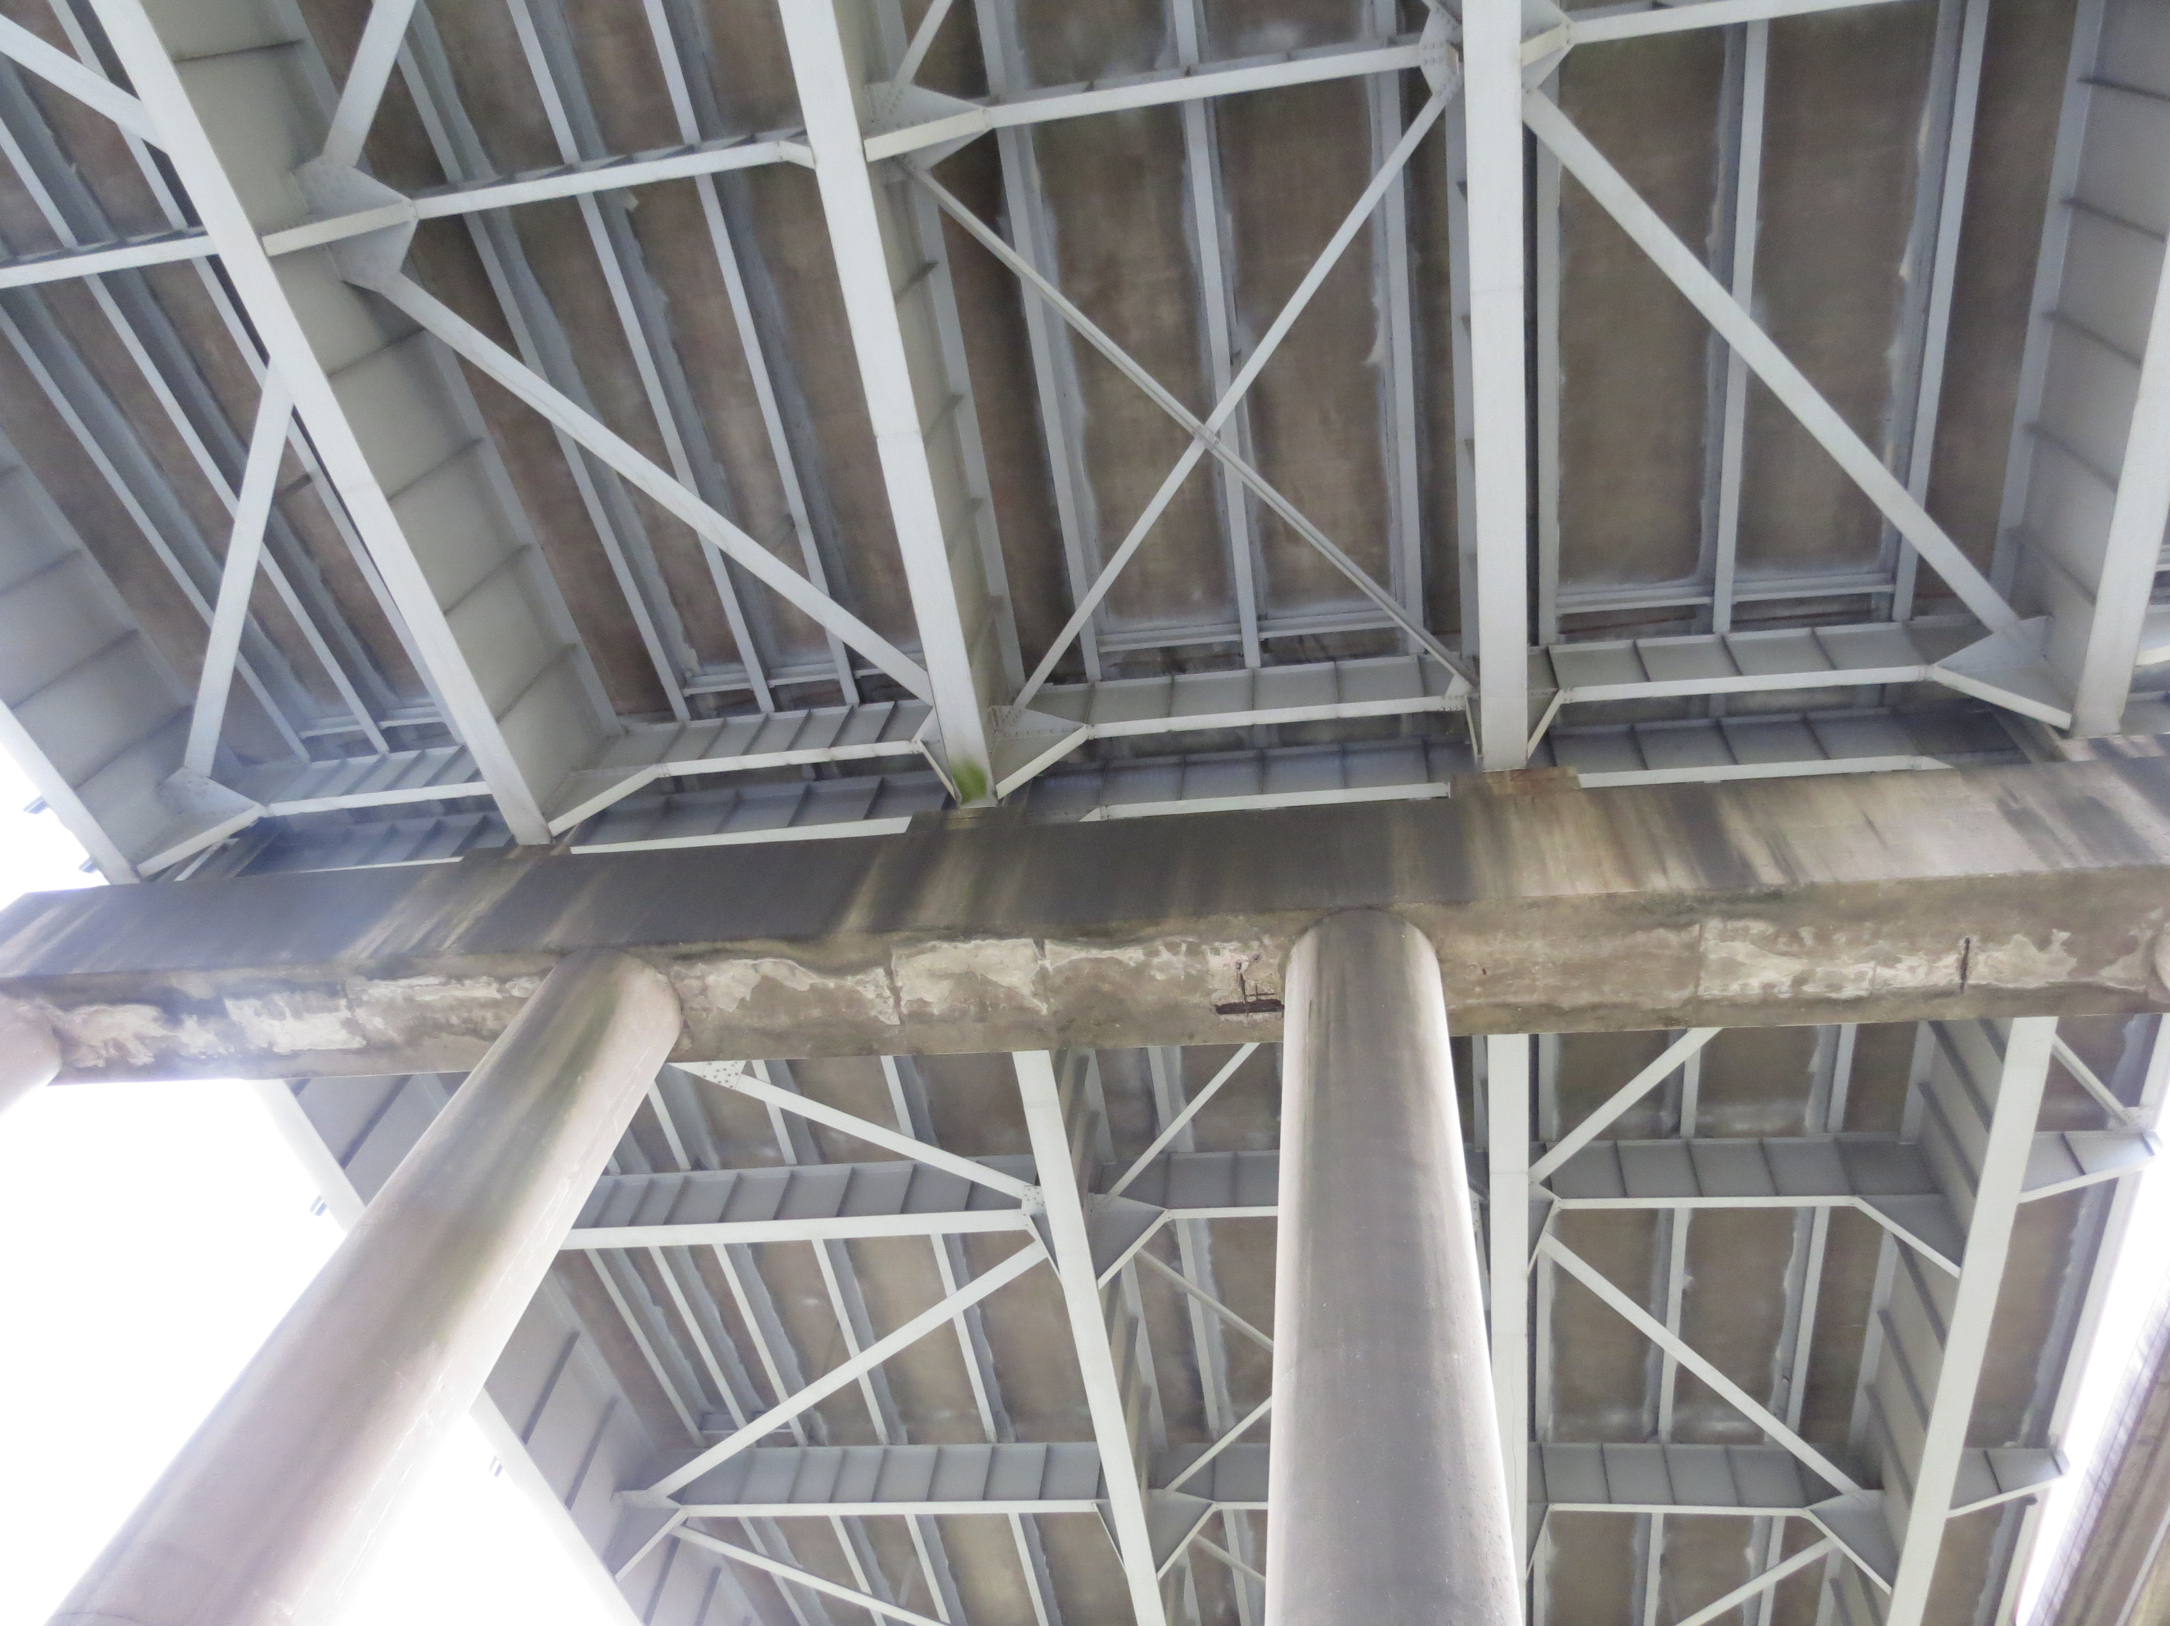
TYPICAL SECTIONS

Slide 4
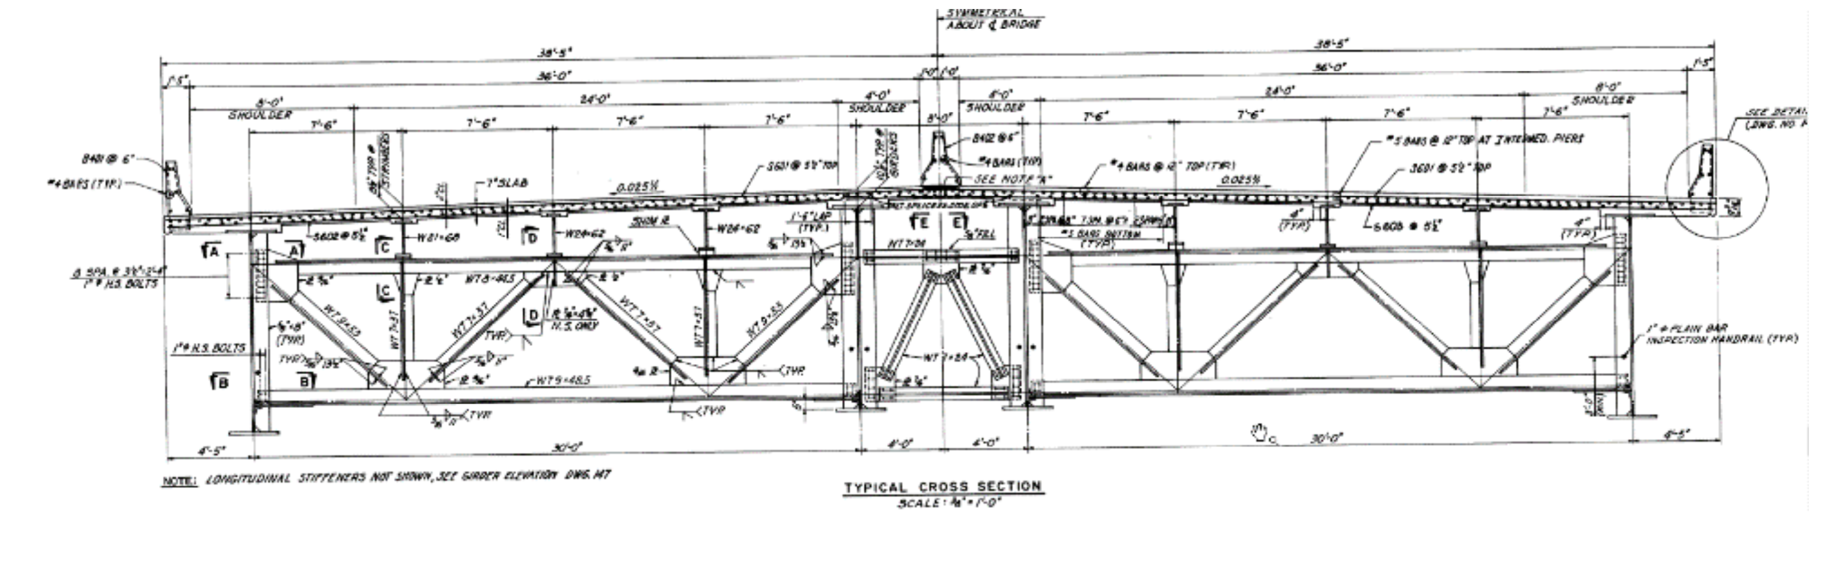
TYPICAL SECTIONS

Slide 5
“PERSON(S) OF INTEREST”
SOFTWARE ERROR OR OTHER CALCULATION ERRORS.
CHANGES IN RATING METHODOLOGY FROM LFR TO LRFR.
CODE CHANGES.
CONSERVATIVE PHILOSOPHY IN THE CODE SUITABLE FOR DESIGN BUT NOT RATING.
DESIGN ISSUES.

Slide 6
SOFTWARE OR CALCULATION ERROR
HAND CALCULATIONS WERE PERFORMED AND AGREED WITH BrR RESULTS.
REVIEW BY MULTIPLE PARTIES - LADOTD ENGINEERS, 2 CONSULTANTS, AND RESEARCHERS CONFIRMED THAT THE LOW RATINGS RESULT WERE “CORRECT” ACCORDING THE CODE (DESIGN).
BrR DETERMINED TO BE WORKING AS INTENDED AND OTHER CALCULATION ERRORS WERE NOT THE SOURCE OF THE PROBLEM.
BAD NEWS.

Slide 7
LATERAL TORSIONAL BUCKLING
Analysis of the low ratings determined the exact source of the low ratings was Lateral Torsional Buckling(LTB) checks.
“Lateral torsional buckling is a phenomenon which involves both lateral displacement as well as twisting of the member. This situation occurs in beams where the compression flange is free to move in a lateral direction as well as undergo rotation.”
LTB checks for these members are found in the in the LRFD code in section 6.10.8.

Slide 8
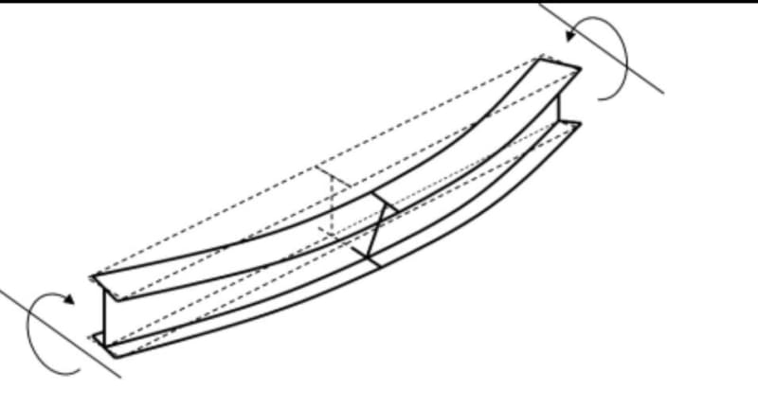
LATERAL TORSIONAL BUCKLING

Slide 9
LATERAL TORSIONAL BUCKLING
LTB CAPACITY DEPENDS ON UNBRACED LENGTH OF COMPRESSION FLANGE. THE DECK BRACES THE TOP FLANGE SO THE ISSUE ONLY ARISES IN THE NEGATIVE MOMENT SECTION OF CONTINUOUS STRINGERS.
BRACING OF THE BOTTOM FLANGE MAKES A HUGE DIFFERENCE IN CAPACITY. SUFFICIENTLY BRACED MEMBERS CAN DEVELOP FULL YIELD STRENGTH.
MEMBERS NOT FULLY BRACED MUST HAVE CAPACITY REDUCED. THIS CAPACITY IS EFFECTED BY THE MOMENT GRADIENT IN THE MEMBER. THIS IS ACCOUNTED FOR BY MOMENT GRADIENT FACTOR C_{b}.
DIFFERENT PHILOSOPHIES EXIST FOR CALCULATING C_{b}.

Slide 10
LFR vs LRFR
HAS AN EFFECT ON SOME MEMBERS.
LIMITING UNBRACED LENGTH CALCULATIONS FOR LFR ARE DIFFERENT.
DETAILS OF THE C_{b} EQUATIONS HAVE CHANGED FOR LRFR.
THE DIFFERENCE BETWEEN CODES EXPLAINS PART OF THE PROBLEM BUT NOT THE ENTIRE PROBLEM. FOR THE LOWEST RATED BRIDGE IT IS INSIGNIFICANT.

Slide 11
CODE CHANGES – DESIGN ISSUES
CHANGES IN LRFD SECTION 6.10.8.
FORMER DESIGN PRACTICES SEEM TO HAVE SOMETIMES ASSUMED MEMBERS TO BE BRACED AT CONTRAFLEXURE POINTS.
LRFR CALCULATIONS FOR LTB ARE MOST CONSERVATIVE OF ALL CODES CHECKED. APPROPRIATE FOR DESIGN BUT NOT SUITABLE FOR RATING.
LESS CONSERVATIVE METHODS FOR CALCULATING CAPACITY EXIST AND ARE REFERENCED IN THE CODE.

Slide 12
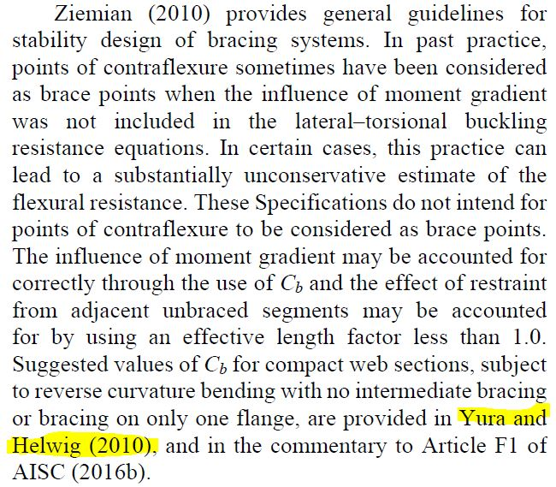
COMMENTARY FOR SECTION 6.10.8 LRFR CODE
RESEARCH HAS SHOWN THAT THIS PRACTICE SOMETIMES USED IN THE PAST IS NOT ACCEPTABLE. NOTICE HIGHLIGHTED PART IT WILL BE IMPORTANT.

Slide 13
CLASSIC RATING DILEMMA
BRIDES ARE HAVE BEEN IN SERVICE FOR DECADES. BRIDGES ARE IN GOOD CONDITION AND HAVE BEEN PERFORMING PERFECTLY.
RATING PERFORMED STRICTLY BY THE CODE IS NOT ACCEPTABLE AND WOULD RESULT IN CLOSURE OF SEVERAL SIGNIFICANT BRIDGES.
RESEARCH HAS SHOWN PAST ASSUMPTIONS USED TO MAKE THE DESIGN AND RATING OF THESE STRUCTURES WORK ARE NOT CONSERVATIVE AND CAN’T BE SAFELY USED.
LESS CONSERVATIVE METHODS FOR CALCULATING CAPACITY EXIST, BUT WE HAVE NO EXPERIENCE OR CONFIDENCE IN USING THEM.

Slide 14
SOLUTIONS?
CLOSE AND/OR RESTRICTIVELY POST MAJOR INTERSTATE BRIDGES AND MISSISSIPPI RIVER CROSSING BRIDGES. NOT FEASIBLE FOR OBVIOUS REASONS
RETRO FIT BRIDGES WITH ADDITIONAL BOTTOM FLANGE BRACING. THE SIZE AND LENGTH OF THESE BRIDGES MAKE THIS A MASSIVE UNDERTAKING THAT IS NOT FEASIBLE.
DEVELOP CONFIDENCE IN THE SAFE USE OF LESS CONSERVATIVE CAPACITY CALCULATION. THIS IS THE ONLY REASONABLE SOLUTION.

Slide 15
RESEARCH PROJECT
LADOTD DECIDED TO COMMISSION A RESEARCH PROJECT IN CONJUNCTION WITH THE LOUISIANA TRANSPORTATION RESEARCH CENTER (LTRC).
GOAL WAS TO FIND A METHODOLOGY FOR RATING THAT GAVE ACCURATE RATINGS, DID NOT SUFFICIENTLY INTERRUPT LOUISIANA'S TRANSPORTATION NETWORK, AND DID NOT ENDANGER SAFETY.
HELP TO ADD THE METHOD TO LADOTD EXISTING RATING WORKFLOW USING BrR RATING SOFTWARE.

Slide 16
Load Rating of Existing Continuous Stringers on Louisiana’s Bridges
LTRC PROJECT NO. 18-4ST.
RESEARCHERS: DR. C. SHAWN SUN, DR. JAY PUCKETT, DR. DANIEL G. LINZELL.
REVIEW RATINGS OF 5 LOUISIANA BRIDGES.

Slide 17
PROJECT METHODOLOGY
CURRENT RATING TECHNIQUES.
EXPERIMENTAL STUDY.
FINITE ELEMENT ANALYSIS.

Slide 18
CURRENT RATING TECHNIQUES
REVIEWED LADOTD RATING METHODOLOGY AND CHECKED BrR RATINGS.
REVIEWED CODE PROVISIONS.
REVIEWED EXISTING RESEARCH.
CHECKED RATINGS USING SEVERAL OTHER CODES INCLUDING AISC AND CODES USED IN OTHER COUNTRIES.
FOUND LADOTD AND BrR RATINGS WERE CORRECT.
DETERMINED AASHTO METHODOLOGY IS THE MOST CONSERVATIVE.
DETERMINED OTHER METHODOLOGY'S EXIST.

Slide 19
EXPERIMENTAL STUDY
EXPERIMENTAL STUDY OF THE LTB RESISTANCE OF A TWO-SPAN CONTINUOUS STEEL STRUCTURE, WHICH INCLUDED THREE LINES OF STRINGERS, STEEL DIAPHRAGMS AT END THE END SUPPORTS, AND A FLOORBEAM AS THE INTERIOR SUPPORT.
VARITY OF BRACING CONDITIONS WERE TESTED.
W16X31 SECTIONS WITH GRADE 50 STEEL WERE USED.
LTB RESISTANCE WAS MEASURED TO COMPARE TO CALCULATED VALUES.

Slide 20
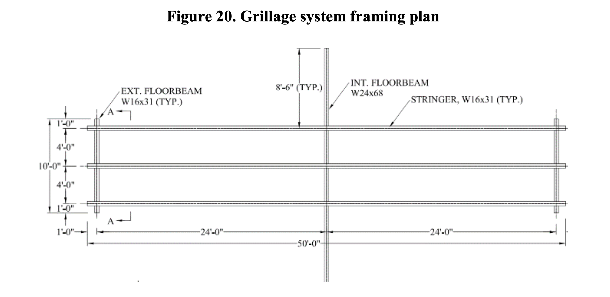
TEST FRAME

Slide 21
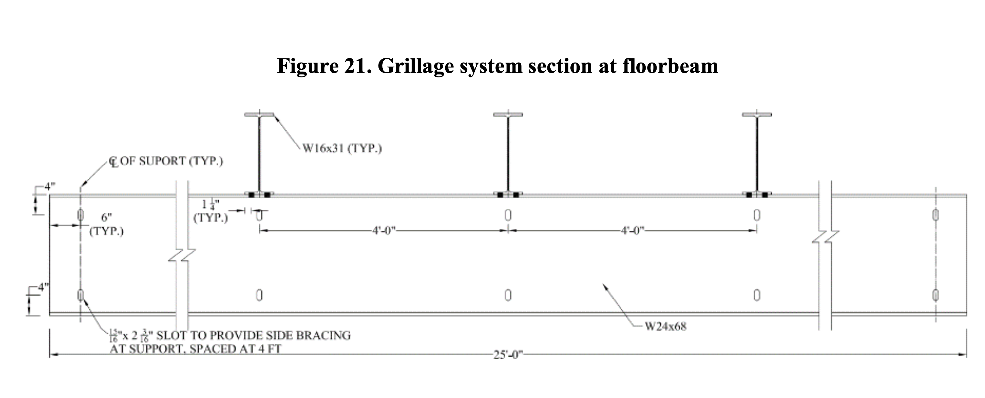
TEST FRAME

Slide 22
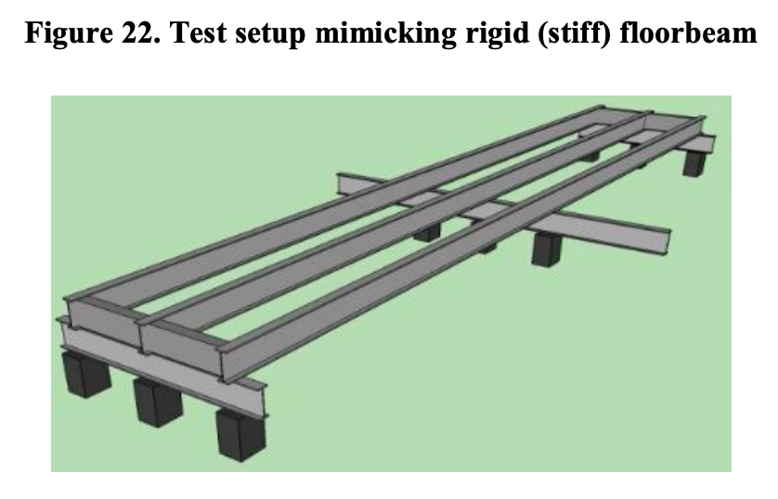
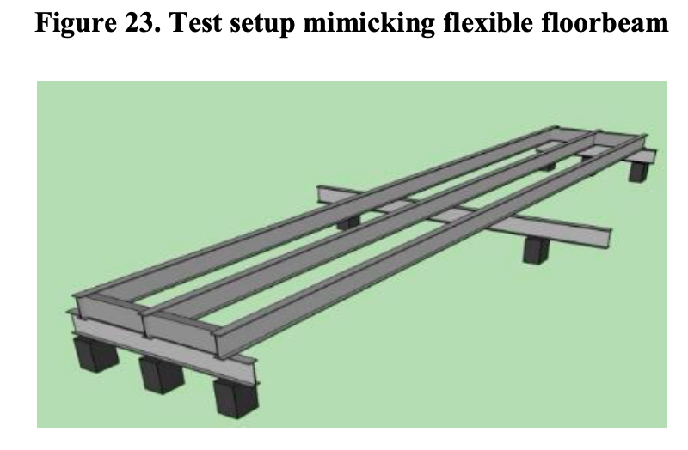
TEST FRAME

Slide 23
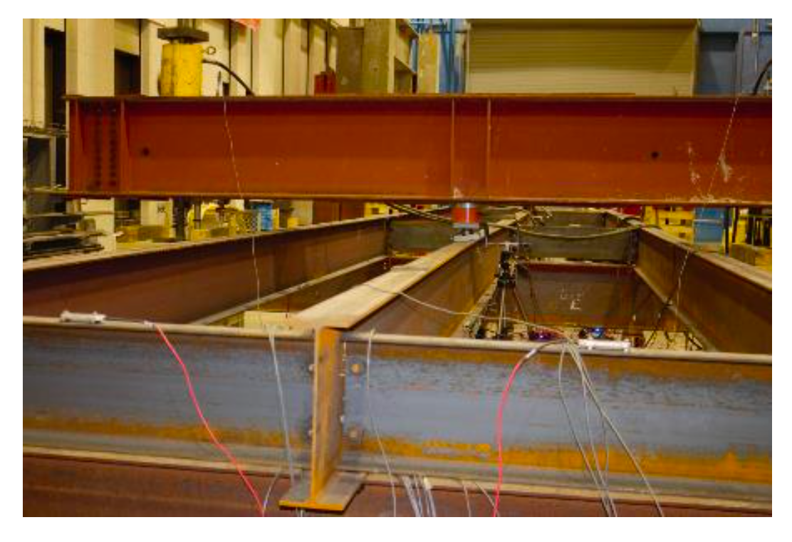
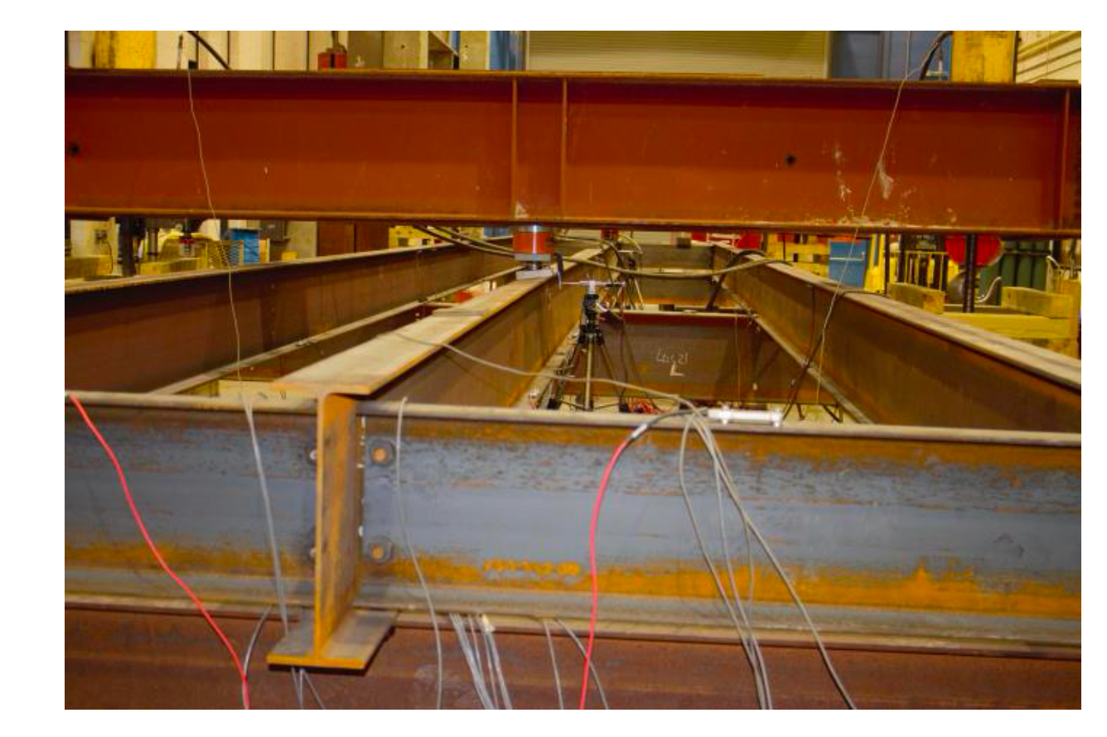
TEST FRAME

Slide 24
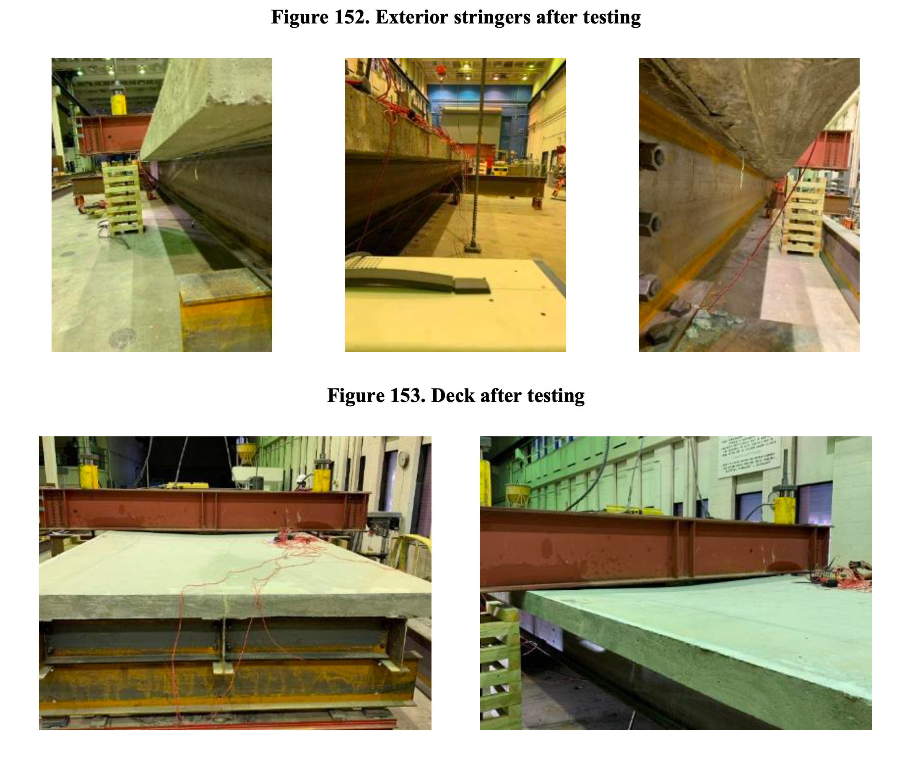

Slide 25
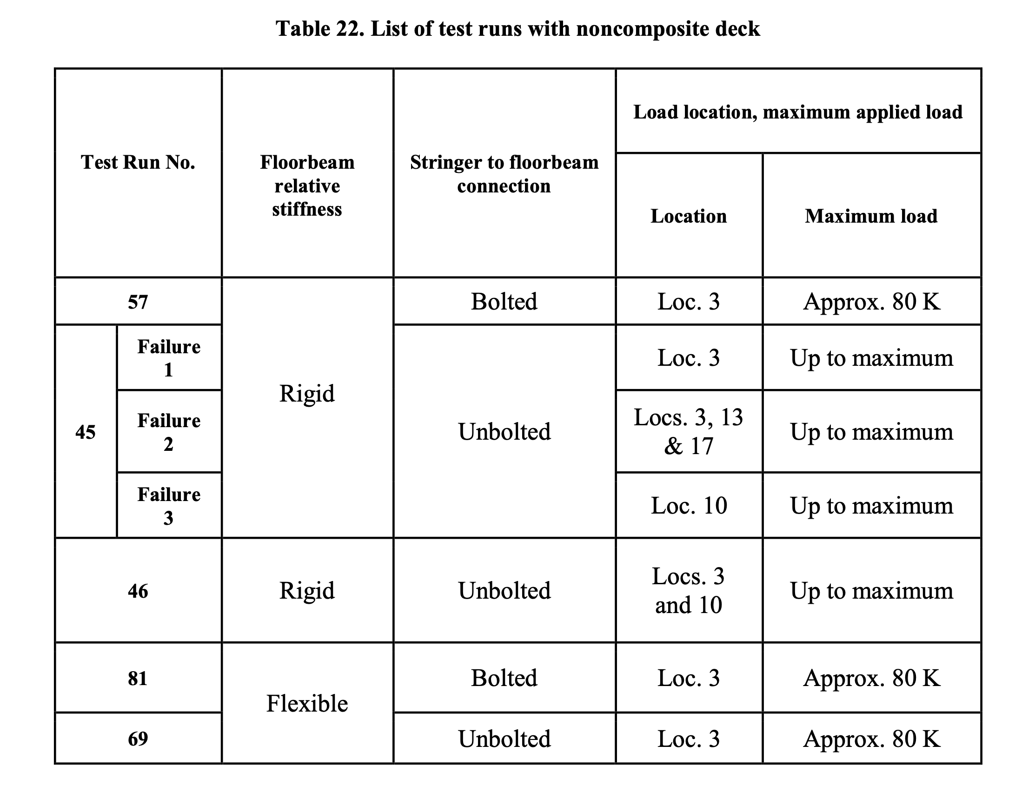

Slide 26
FINITE ELEMENT ANALYSIS (FEA)
ANSYS SOFTWARE.
COMBINATION OF STATIC, LINEAR EIGENVALUE BUCKLING, AND NON-LINEAR BUCKLING ANALYSIS WERE PERFORMED.
STRINGERS MODELED WITH SHELL ELEMENTS.
DECK MODELED WITH SOLID ELEMENTS.
FEA MODEL WAS CALIBRATED AGAINST TEST DATA.
FEA WAS SHOWN TO PROVIDE COMPARABLE RESULTS WITH THE TEST DATA.

Slide 27
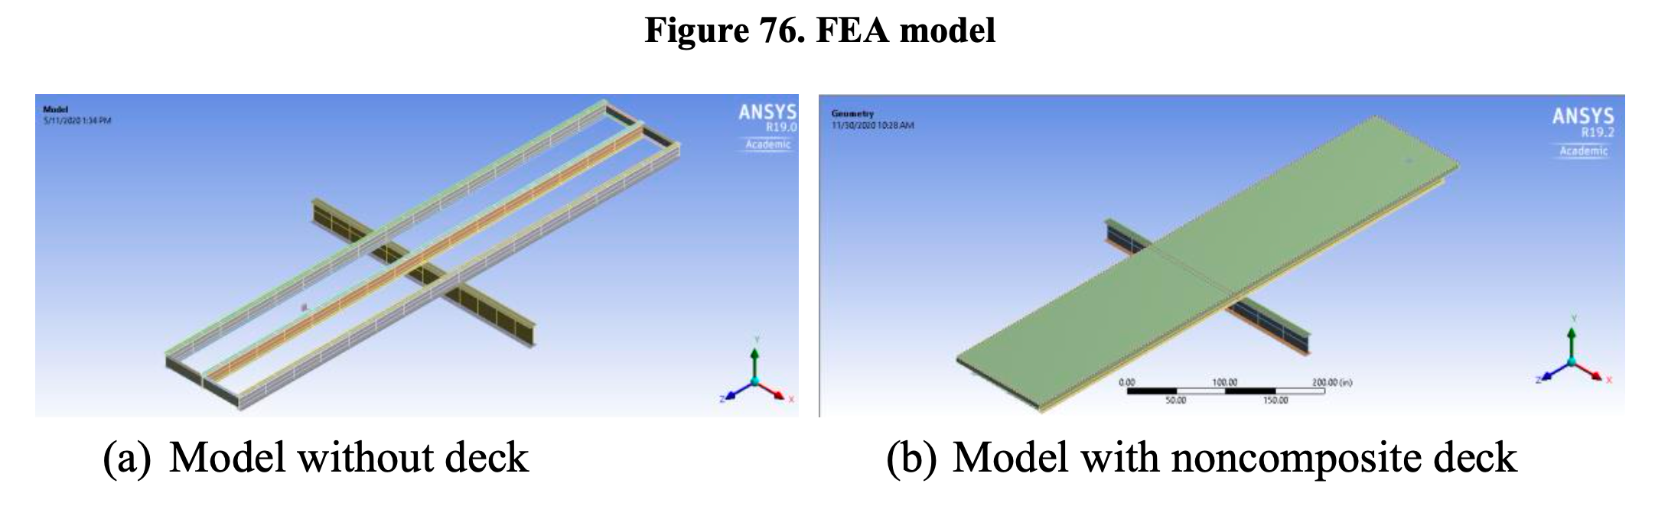
FINITE ELEMENT ANALYSIS

Slide 28
LAB FINDINGS
STRINGERS IN POSITIVE MOMENT REACHED FULL YIELD MOMENT.
WITH ONE SPAN LOADED STRINGERS IN NEGATIVE MOMENT DEVELOPED A MOMENT GRADIENT CORRESPONDING TO A C_{b} of 2.43 to 2.73. (COMPARED TO CALCULATED VALUE OF 1.12).
WITH BOTH SPANS LOADED STRINGERS IN NEGATIVE MOMENT REACHED YIELD.
CONFIRMED THAT ASSUMING CONTRAFLEXURE POINTS CAN NOT BE TREATED AS A BRACING POINT.
NON-COMPOSITE DECKS CAN NOT FULLY BRACE MEMBER SUFFICIENTLY TO USE HALF SPAN AS UNBRACED LENGTH.

Slide 29
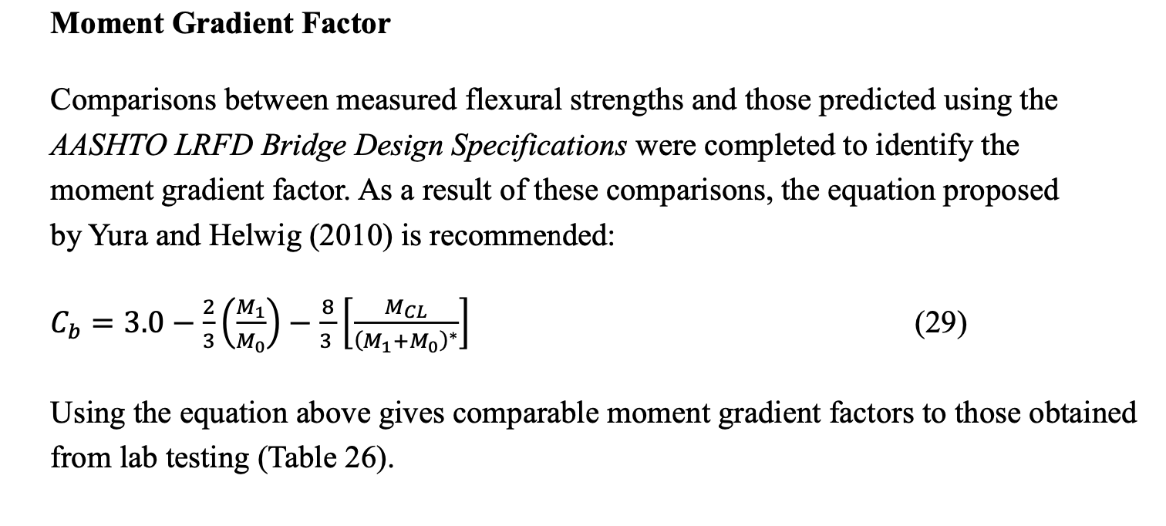
MOMENT GRADIENT FACTOR

Slide 30
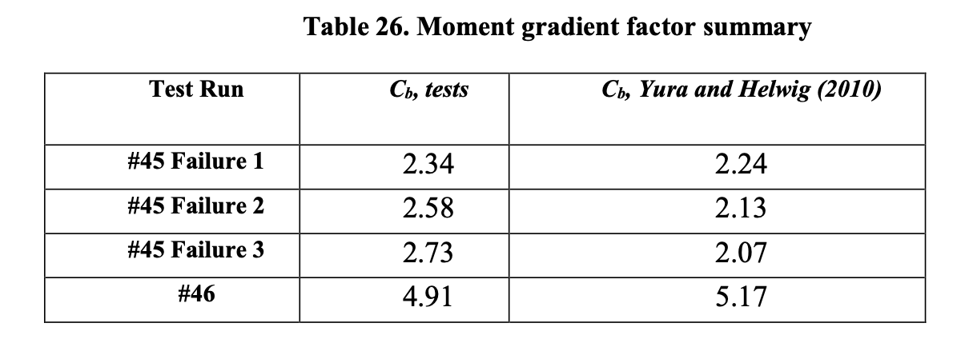
MOMENT GRADIENT FACTOR

Slide 31
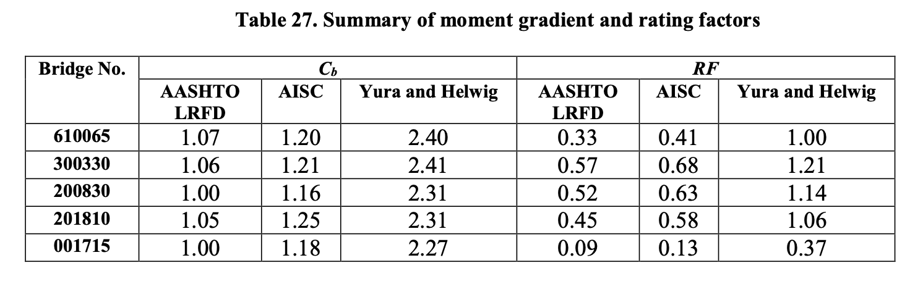
RATING IMPROVEMENT

Slide 32
CONCLUSION FROM RESEARCH
MOMENT GRADIENTS CALCULATED USING THE EQUATIONS PROPOSED BY YURA AND HELWIG (2010) CAN BE SAFELY USED WITH CONFIDENCE.
SHOULD USE FULL SPAN LENGTH AS UNBRACED LENGTH.
IT IS CONSERVATIVE TO MODEL FLOORBEAMS SUPPORTING STRINGERS AS RIGID SUPPORTS.

Slide 33
PRACTICAL USE
C_{B} CAN NOT BE DIRECTLY OVERRIDDEN IN BrR, BUT CAPACITY CAN BE OVERRIDDEN IN BrR. THIS ONE OPTION TO ADDRESS OUR RATING ISSUE. NOT THE BEST OPTION FOR LADOTD.
EXCELLENT DETAILED INFORMATION PROVIDED BY BrR IN THE IN THE SPEC CHECKER CAN BE PULLED OUT AND USED IN C_{b} CALCULATIONS. BrR MAKES THIS A SIMPLE AND EASY PROCESS. THIS IS THE BEST SOLUTION FOR LADOTD.
AS PART OF THE RESEARCH PROJECT A SPREAD SHEET WAS DEVELOPED THAT CAN BE USED AS PLUG AND PLAY WITH BrR RESULTS TO USE THE YURA AND HELWIG METHODOLOGY EASILY.

Slide 34
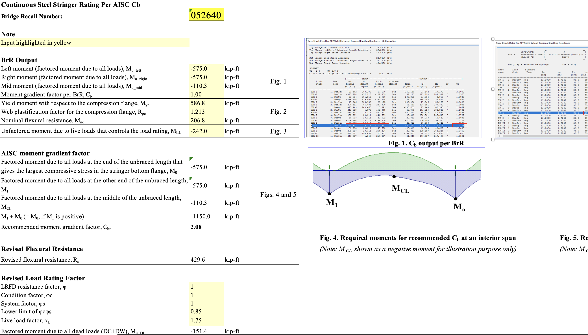
SCREEN SHOTS OF SPREAD SHEET

Slide 35
MOVING FORWARD
TALK TO ME IF YOU ARE INTERESTED IN THE RESEARCH REPORT OR SPREAD SHEET.
AASHTO SHOULD ADOPT THE YURA AND HELWIG (2010) EQUATION AS AN ACCEPTABLE ALTERNATIVE METHOD FOR RATING AND PUT IN THE MBE.
ONCE THIS HAPPENS THIS METHOD CAN BE ADDED TO BrR. ESPECIALLY IF OTHER STATES HAVE SIMILAR ISSUES.

Slide 36
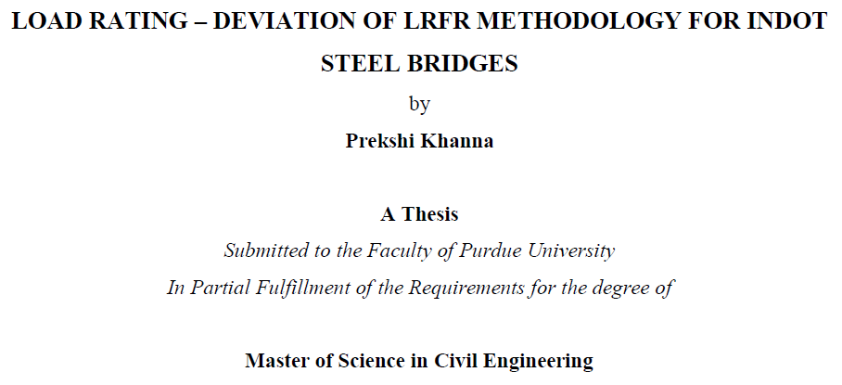
ADDITIONAL REPORT USED AS REFERENCE

Slide 37
QUESTIONS?
THE END.

