Slide 1



Virtis/Opis
Technical Update
Virtis Opis BRIDGEWare
Users Group Meeting 2010
Nashville, Tennessee

Slide 2
6.0 Release (July 2008)
Opis R/C Superstructure LRFD Analysis and Specification Checking
Opis Substructure LRFD Analysis and Specification Checking
Truss Panel Point Maximum Forces and Concurrent Forces Reports
First official release of the substructure module
Provide access to load data required for gusset plate analysis
First increment of the new AASHTO LRFD Engine

Slide 3
6.1 Release (Fall 2009)
Opis P/S Superstructure LRFD Analysis and Specification Checking
Virtis R/C and P/S Superstructures LRFR Analysis
Virtis Truss Floorbeam LFD Analysis
Second increment of the new AASHTO LRFD Engine
First release of the AASHTO LRFR Engine

Slide 4
6.1 Release (Fall 2009)
Superstructure Wizard
Analysis Control Settings
Steel Girder Fishbelly Web Profile
(Incident 1091)
LRFD Distribution Factor Wizard
(Incident 1033)
User-defined Truck Library

Slide 5


6.1 Release (Fall 2009)
Diaphragm Wizard Enhancement
(Incident 3853)
Shear Stirrup Wizard
(Incident 3855)
Allow 1979 AASHTO Prestressed Concrete Shear Code
(Incident 4135)
NSG Vehicle Schematic Printing
(Incident 7421)
Allow LRFD Refined and Approximate Prestress Loss Methods
(Incident 7938)

Slide 6

6.1 Release (Fall 2009)
Allow Pre-2005 Interim Prestress Loss Calculations
(Incident 8087)
Allow Prestress Transformed Section Properties (3310)
Include Prestress Elastic Losses and Gains (8001)

Slide 7
6.2 Release (August 2010)
Opis Steel Superstructure LRFD Analysis and Specification Checking
Virtis Steel Superstructures LRFR Analysis
Opis 2008 Interim Spec Updates (LRFD)
Third increment of the new AASHTO LRFD Engine
Second increment of the AASHTO LRFR Engine

Slide 8
6.2 Release (August 2010)
Added Pitch and Gage Input for Steel Beams
Added Control Option for Ignoring Deck Reinforcement for Negative Moment Capacity
Truss Analysis Enhancements
Added Control Option for Concrete for BRASS LRFR To Rate Longitudinal Reinf Based on Article 5.8.3.5

Slide 9

6.2 Release (August 2010)
Moment Magnification for Substructure
R/C Hinge
Shear Stud Wizard

Slide 10
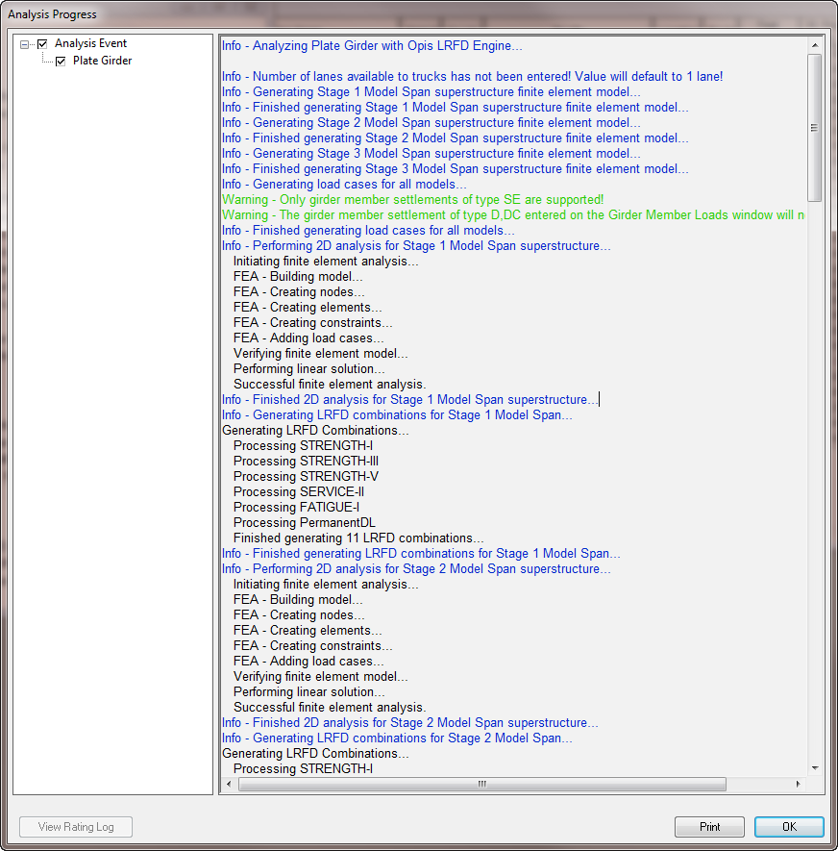
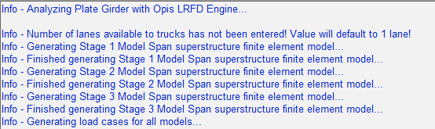
AASHTO LRFD Spec Checking
Generate the models for each stage of construction

Slide 11
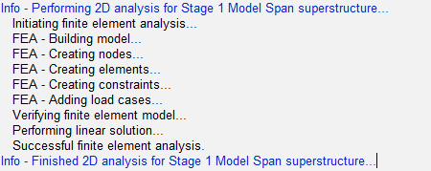
AASHTO LRFD Spec Checking
Analyze each stage of construction

Slide 12
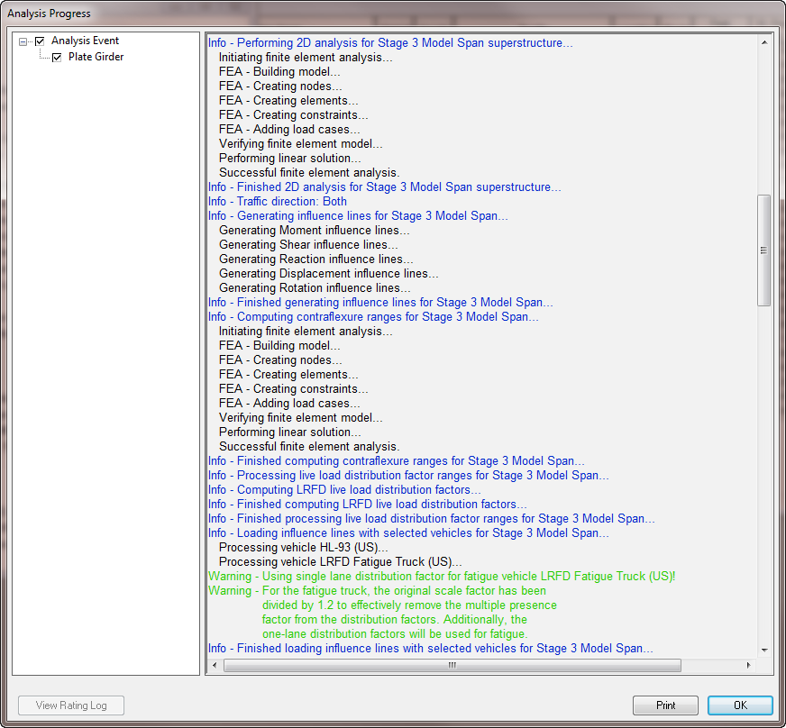
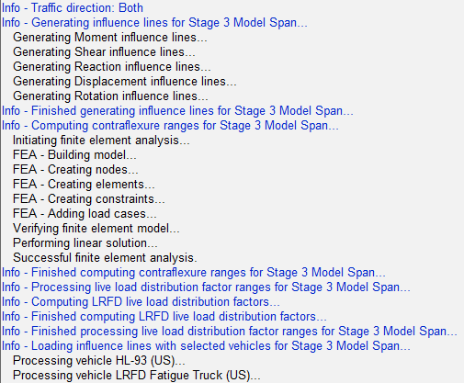
AASHTO LRFD Spec Checking
Generate influence lines,
Compute contraflexure ranges,
Load influence lines

Slide 13
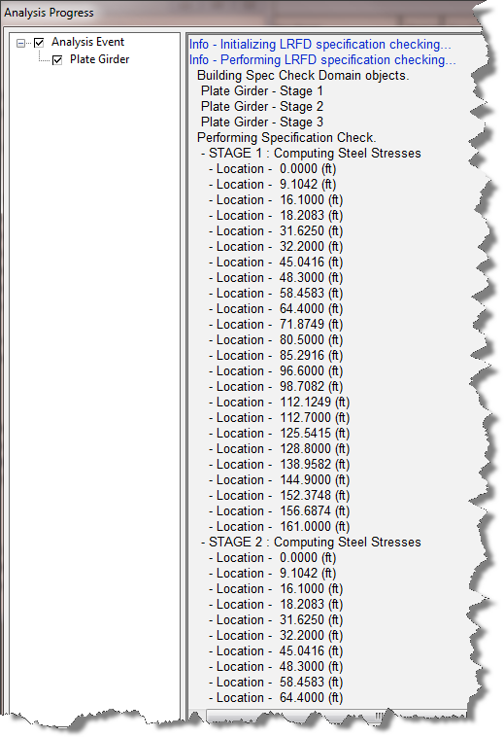
AASHTO LRFD Spec Checking
Specification Checking
  First pass through each stage
    Compute stresses
  Determine stresses in the unbraced lengths
  Second pass through each stage
    Compute capacities

Slide 14
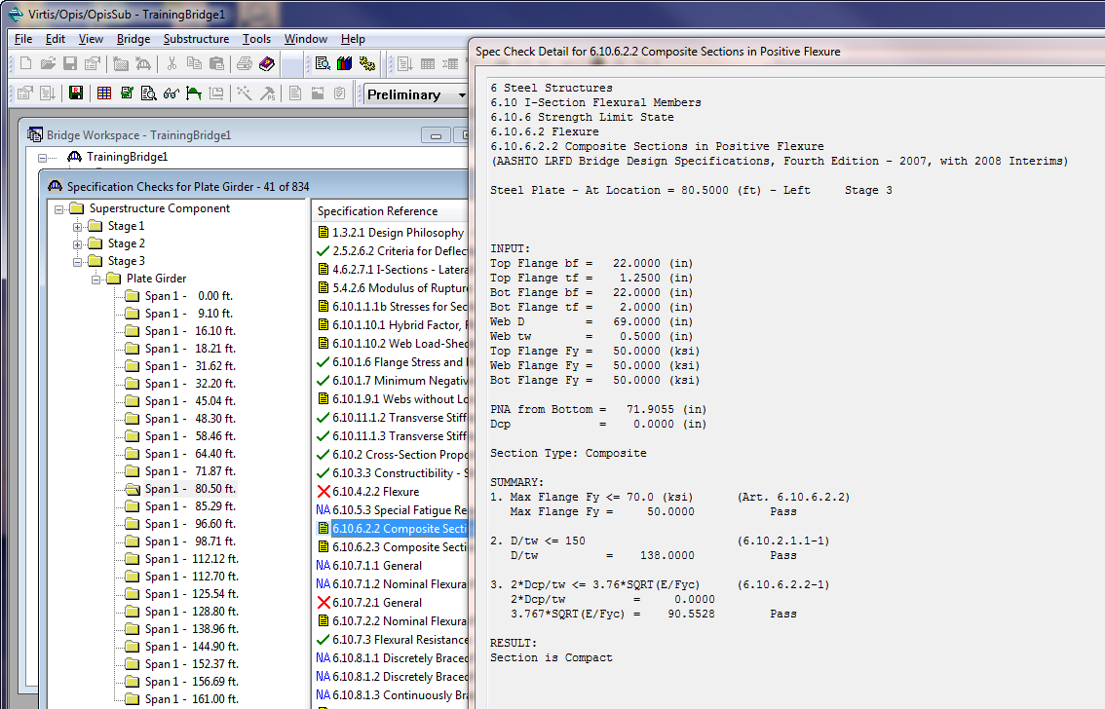
AASHTO LRFD Spec Checking

Slide 15
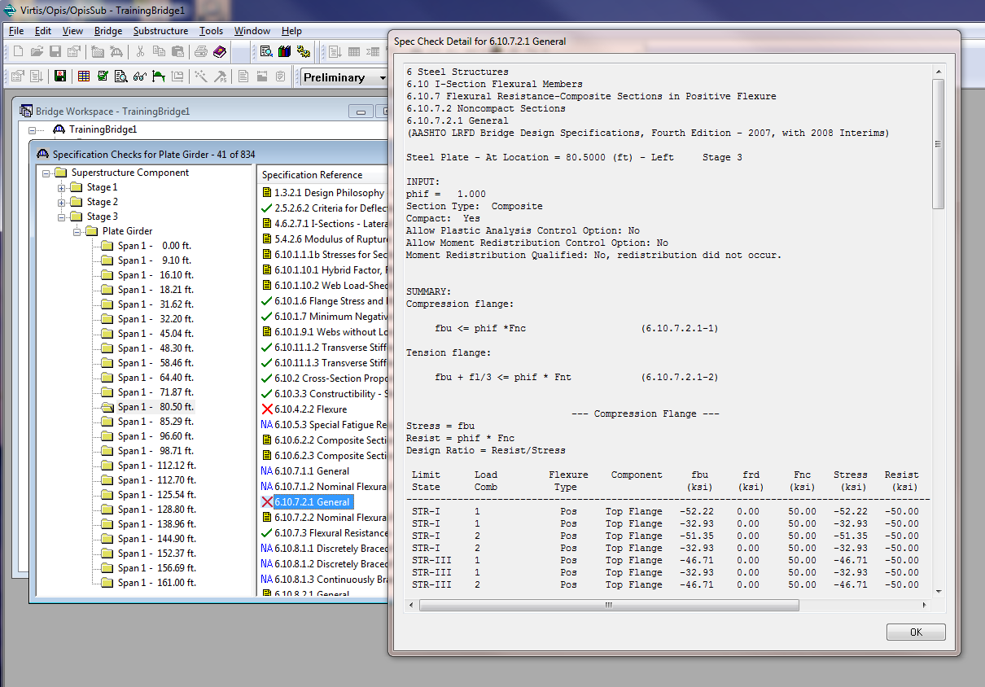
AASHTO LRFD Spec Checking

Slide 16
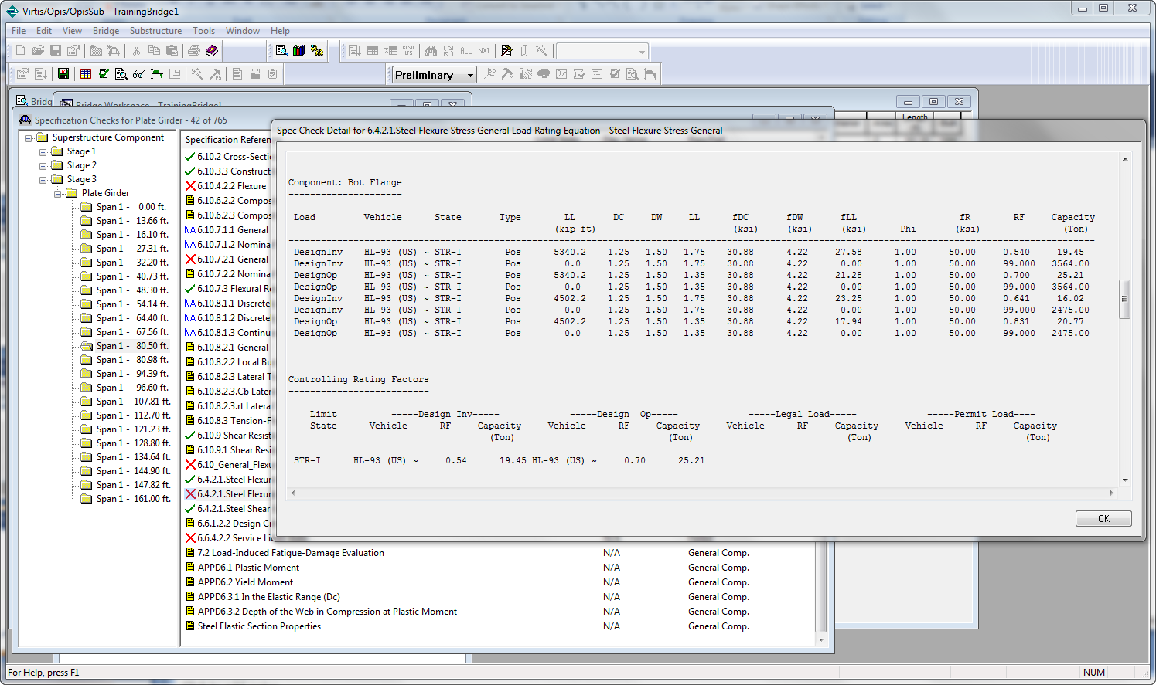
AASHTO LRFR Spec Checking

Slide 17
Truss Analysis
 | Longitudinal Truss |  | Floor
 | Deck-Through | Other | Truss
Counters |  | ü
Suspended spans |  | ü
Eccentricity (for rating, not analysis) | ü | ü
Identify deck nodes | ü
Element loads |  |  | ü
Beam and truss elements |  |  | ü

Slide 18
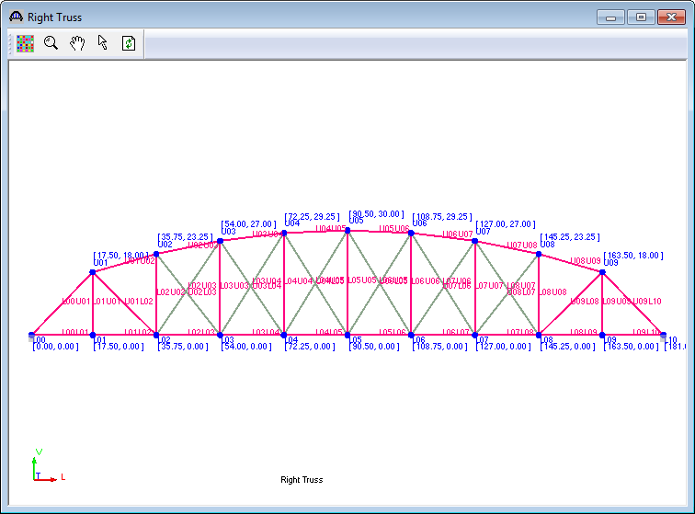
Truss Analysis - Counters

Slide 19
Truss Analysis - Counters
Nonlinear Analysis – structure model changes as the vehicle moves across the bridge
Model the counters as tension-only elements – FE engine automatically removes tension-only elements subjected to compression.
Generate a load case for each vehicle position to be evaluated (include DL + LL in the load case)
Scan the analysis results for the critical actions to be used in the rating

Slide 20
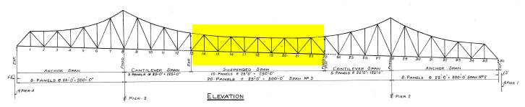
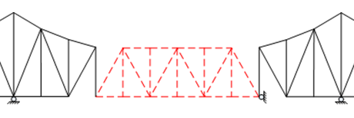
Truss Analysis – Suspended Span

Slide 21
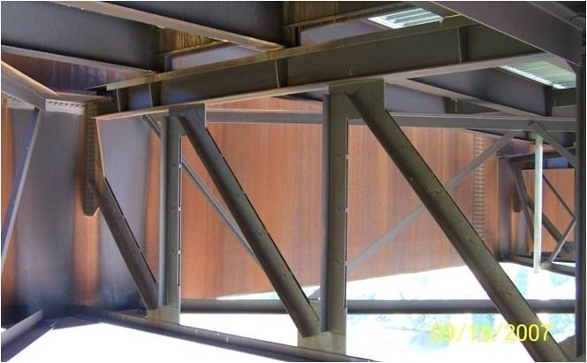
Truss Analysis – Floor Truss
Floor truss with element loads – stringers positioned between panel points.

Slide 22
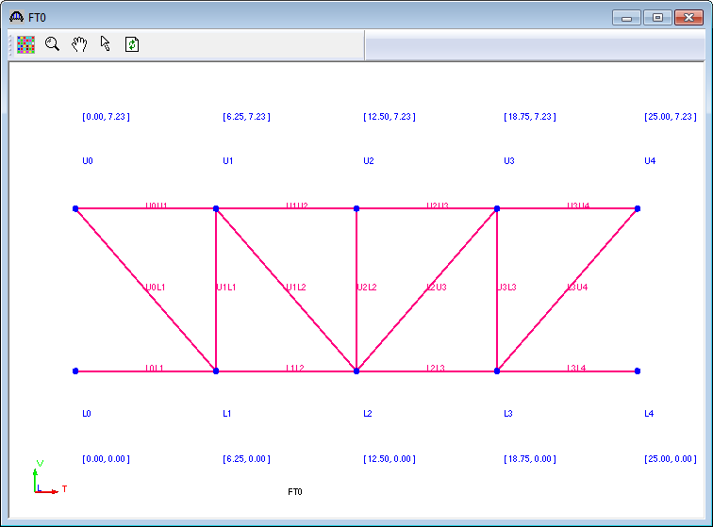
Truss Analysis – Floor Truss
Model the floor truss with beam elements
Rate for axial and moment interaction

Slide 23
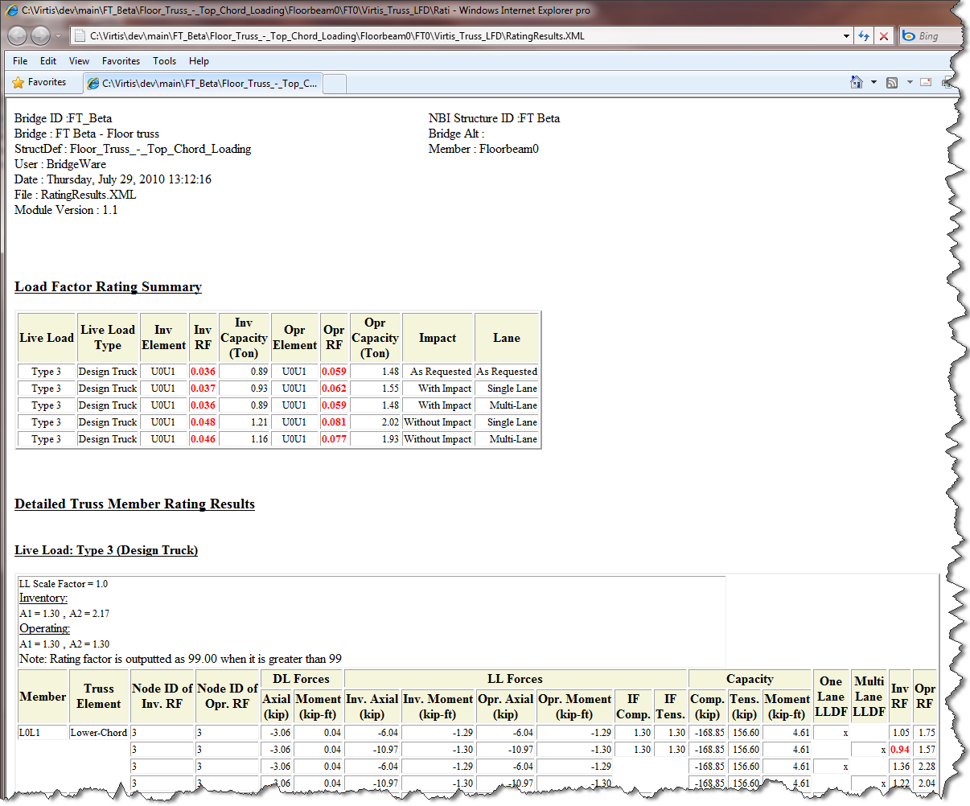
Truss Analysis – Floor Truss

Slide 24

6.3 Release (June 2011)
Virtis Superstructure LFR Analysis
Sunset BRASS from Virtis/Opis
New Detailed LFR report
Addition of Crystal Reports Option for the Report Tool
Substructure LRFR Rating

Slide 25
6.3 Release (June 2011)
Illinois Nonstandard Gage Enhancement (VI 7991)
Allow R/C T-beam Web Thickness To Vary
Floor Trusses – Add 3 New Cross Sections
Montana Corrugated Metal Deck Rating
New Call Interface To Enable Virtis Ratings From Permit/Routing Software (Oklahoma)

Slide 26
6.3 Release (June 2011)
Support for Windows 7
64 bit Version
Implement LRFD article 5.8.3.5 in LRFR analysis (AASHTO engine)
2008 LRFR Spec Updates
API Updates (Superstructure, FE engine, spec-checker)

Slide 27
6.3 Release (June 2011)
Implement LFR Spec-Check Module for Floor Truss
LRFR for Nonstandard Gage Analysis
Michigan LRFR Enhancement
LRFD Spec Updates

Slide 28
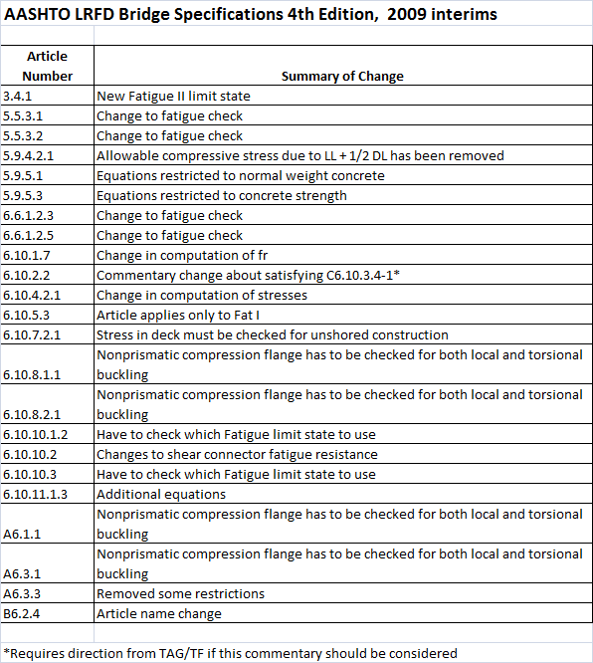
Spec Updates

Slide 29
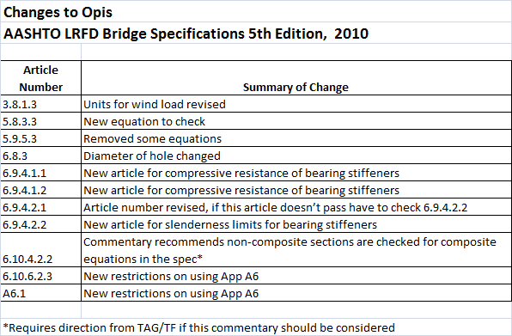
Spec Updates

Slide 30
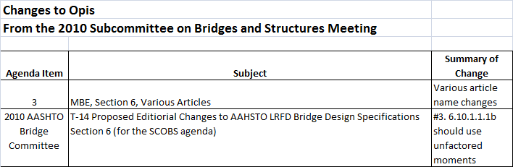
Spec Updates

Slide 31
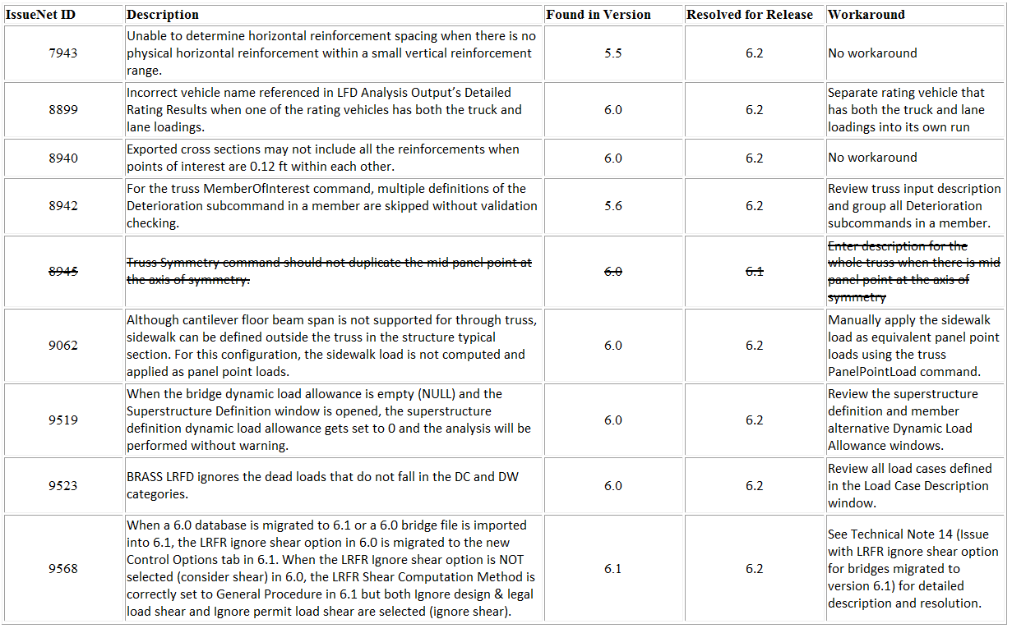
Critical Bug Report

Slide 32
Thank you

