Slide 1
VOBUG 2011 – Helena, MT Bentley 3rd Party Devel. Update
Ronald A. Love, PE

Slide 2
Discussion Items
LARS Connector for Virtis 6.2
LARS Export Update
Other initiatives that leverage Virtis data

Slide 3
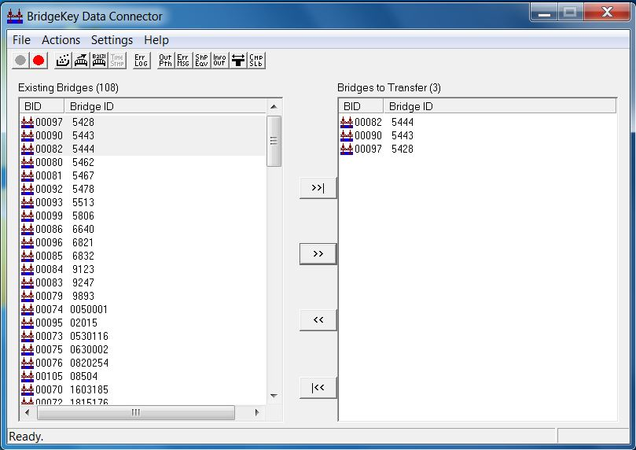
LARS Connector Update
LARS Connector 1.00.08.00 for Virtis 6.2 – no more enhancements/maintenance. Currently available
LARS Connector 1.00.09.00 for Virtis 6.3. available on or before 8/12/2011.

Slide 4
LARS Export Update
Planned for a pre-June 2011 release
Delays due to several reasons…
Committed to providing LARS Export
Originally planned a single ASR/LRF/LRFR release
Now planning ASD/LFR end of Q4 2011 (beta testing continues)
LRFR Q1 2012

Slide 5
Other Development Initiatives
Leverage Virtis for used by other Bentley Bridge processes
Extending the LARS Connector to process additional data
aka the PowerBridge Connector (for now….)

Slide 6
New 3rd Party Initiatives
Leap Bridge
Virtis DB
LARS Bridge
PBM
uStn based modeling platform
RM Bridge
4D Design/Analysis

Slide 7
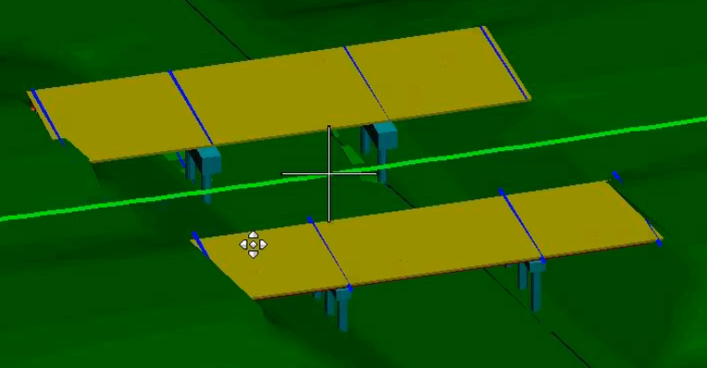
Potential Uses
Integrate with other civil data like alignments, DTM…
  Interactive data edit and review
Work with data in MicroStation
Access to more advanced analysis capabilities of RM Bridge, Leap Bridge and possibly STAAD
  3D analysis/rating including NSG vehicles
  Seismic analysis
  other
Planning
Design
Fabrication
Construction
Operations & Maintenance

Slide 8
Demonstration

Slide 9
Questions?

Slide 10
Thanks!

Slide 11
Notes

