Slide 1
FHWA Update
2011 VOBug Meeting
Helena, MT
Thomas Saad, P. E.
FHWA Resource Center
Phone: 708.283.3521
E-mail: thomas.saad@dot.gov

Slide 2
FHWA Bridge Program Priorities
Every Day Counts (EDC) - ABC and PFBE
LTBPP
New Highway Legislation
NBIS Oversight and Compliance

Slide 3
Every Day Counts (EDC) Initiative
‘Identify and deploy innovation aimed at shortening project delivery, enhancing highway safety and protecting the environment. ‘
Lead by Office of Secretary of Transportation (OST) and FHWA
Dozens of National Events and Summits, partnering with AASHTO and TRB, to mainstream key innovations
Very specific goals for deploying selected technologies/practices in every State

Slide 4
Every Day Counts (EDC) Technologies
Prefabricated Bridge Elements and Systems (PBES) for ABC
Geosynthetic Reinforced Soil Integrated Bridge System (GRSIBS)
Adaptive Signal Control
Warm-Mix Asphalt
Safety Edge
Design-Build
Construction Manager/General Contractor

Slide 5
Long-Term Bridge Performance (LTBP) Program
National , strategic $100 M, 20-year research program aimed at improving bridge performance
Instrument and monitor in-service bridges across the nation and collect research quality data to:
Develop best maintenance and preservation strategies
New generation of bridge inspection tools and procedures
Life cycle cost models
Bridge deterioration models
Quality, consistent data for calibration of bridge design and analysis codes
20 topic areas defined by the bridge community and growing…

Slide 6


Developmental & Execution Phases
Knowledge
Gaps
Focus Group
Meetings
Identify Objective and Practical
Bridge Performance Issues
Bridge
Performance
Primer
Identify Data
Needs
15 SHAs
Develop a Data Infrastructure
Protocols For Data Collection
Field Investigation
- Pilot Study
- Long-Term Data
Collection
  Design the Experimental Program
  Bridge Assessment Decision Tool
Notes:
FYI, The FHWA initiated the LTBP in April of 2008 with the objective of developing a HQ Quantitative bridge database from a representative sample of bridges through detailed inspection and monitoring….
Through a competitive process, Rutgers/CAIT was awarded a contract to
The program has two phases
The blue shaded boxes show the Developmental phase activities and the black box shows the execution phase …..

Slide 7
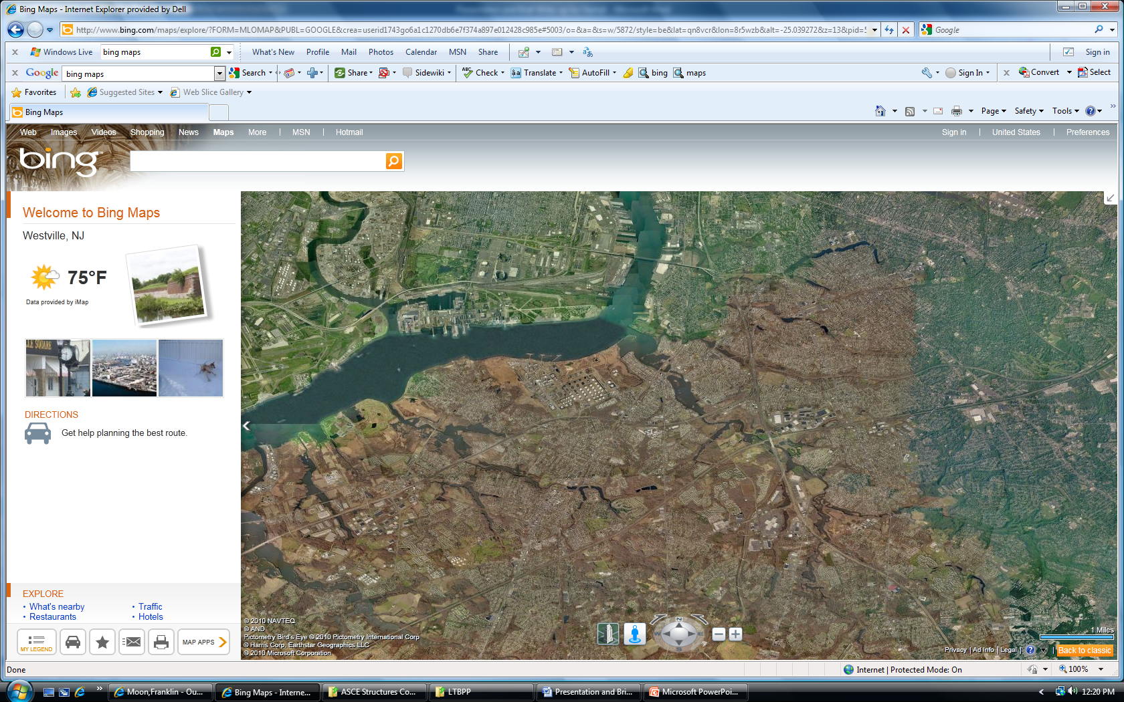
Reference Bridge and Supporting Cluster
Visual Inspection
Non-standard
Arms length
Segmental
Conventional Tools
Reference Bridge
Cluster bridges
Comparison: Reference vs. Cluster
Identify discrepancies – establish root causes
Establish typical levels of variability
Approximate Scale: 30 mi

Slide 8
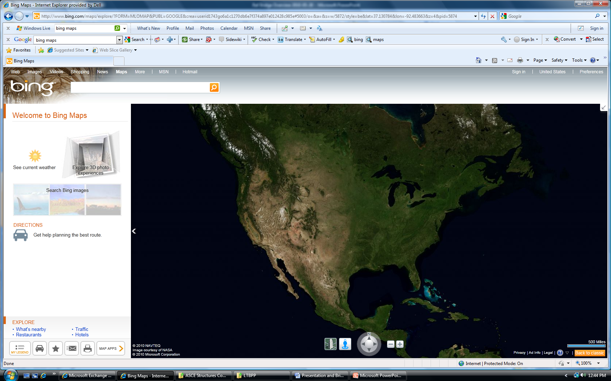
Multiple Clusters of Similar Bridges
Cluster of Bridge Type A
Comparison: Cluster vs. Cluster
Identify influences of climate, traffic, maintenance practices, etc.
Approximate Scale: 3000 mi

Slide 9
Clusters of Different Bridge Types
Cluster of Bridge Type A
Cluster of Bridge Type B
Comparison: Bridge Type A vs. Bridge Type B
Establish relative importance controlling for local variability, climate effects, maintenance, etc.
Approximate Scale: 3000 mi

Slide 10
LTBPP – Next Steps before Execution Phase
Organize/Initiate Stakeholder Groups: AASHTO, Industry, TRB
LTBPP State Coordinators Meeting in September 2011
  Each State has named a Program Coordinator
  Coordinator will be contact for dissemination of products and monitoring of bridges in each State
Two vacancy announcements for this program: LTBPP Outreach Manager and LTBPP Research Engineer

Slide 11
Latest Highway Bill Proposal
Two-year Surface Transportation bill referred to as MAP-21: moving Ahead for progress in the 21st Century
Consolidate numerous highway programs into 5:
National Highway Performance Program
Transportation Mobility Program
National Freight Program
Congestion Mitigation and Air Quality Improvement Program
Highway Safety Improvement Program
FHWA has established a new Performance Management Office

Slide 12
Implementation of FHWA NBIS Program Oversight Procedures
New uniform procedures in place for FHWA Division Offices to review NBIS compliance to achieve uniformity
Seven new full-time positions in FHWA Office of Bridge Technology
  Four (4) Bridge Safety Engineers
  Load Rating Engineer
  Scour Engineer
  Bridge Preservation Engineer

Slide 13
FHWA Memorandums Under Development
Responsibilities of State Transportation Agency – Addresses State responsibility for local bridge inspection and rating
  23 CFR 650.307(a)
  23 U.S.C. 302
  Section 1.36 of 23 CFR
Drafted and pending:
  Reporting LRFR Ratings to the National Bridge Inventory
  ‘Assigned’ Load Ratings
  Inspection of Fracture Critical Bridge Elements

Slide 14
NBIS Oversight
Division office schedule:
June 30: 75% of Divisions have review status of 10 metrics underway
September 30: 75% of Divisions have review status of all metrics underway
December 31: 100% of Divisions have final determination of all metrics
FHWA/AASHTO Task Group has been established

Slide 15
FHWA/NHI Bridge Design and Analysis Training Courses
NHI Course 130081:
  Load and Resistance Factor Design (LRFD) for Highway Bridge Superstructures
  2 to 5-day training courses on steel and concrete superstructure design w/ Reference Manual
NHI Course 130082:
  Load and Resistance Factor Design (LRFD) for Highway Bridge Substructures and Earth Retaining Structures
  1 to 5-day training course on LRFD foundation, pier and wall design
NHI Course 130092:
  Load and Resistance Factor Rating (LRFR) for Highway Bridges
  2 to 5-day training courses on rating and analyzing concrete and steel bridge superstructure and substructure elements

Slide 16
FHWA/NHI Bridge Design and Analysis Training Courses
NHI Course 130093:
  LRFD Seismic Analysis and Design of Highway Bridges
  5-day training course on LRFD Seismic Design of Bridges with Reference Manual
NHI Course 130094:
  LRFD Seismic Analysis and Design of Tunnels, Walls and other Geotechnical Features
  5-day training course on LRFD Seismic Analysis of retaining walls, earthworks and buried structures with Reference Manual
NHI Course 130095:
  LRFD: Design and Analysis of Skewed and Horizontally Curved Steel Bridges
  4-day training course with Reference Manual

Slide 17
Concluding Thoughts
No better time to seek staffing and funding for load rating and bridge inspection and management
Make program changes thinking to the future as you update design and load rating procedures
Era of bridge management and preservation may replace era of ‘build and rebuild’ – V/O users have access to the data needed to better manage and operate the bridge network

