Slide 1

Idaho Load Rating Program
Shanon Murgoitio, P.E.
Idaho Transportation Department
Scott Wood, P.E.
HDR Engineering

Slide 2
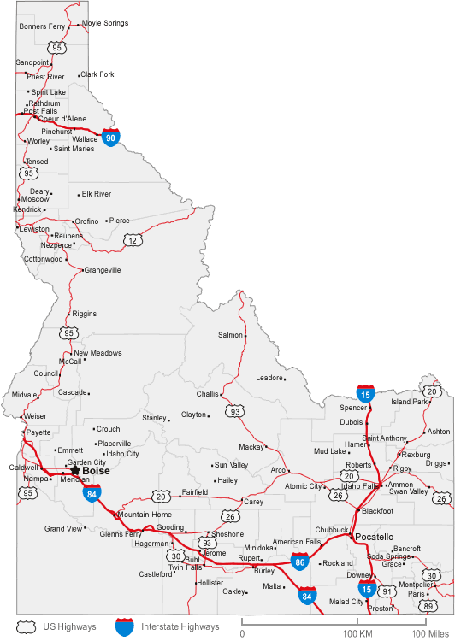
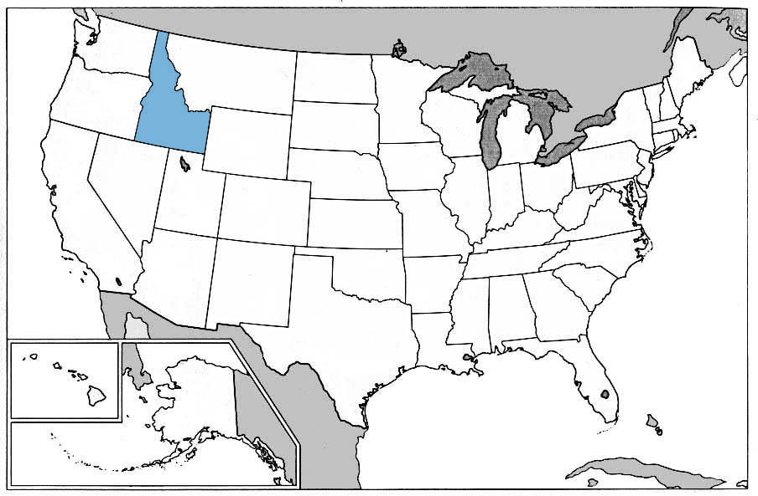
State of Idaho
Population of 1.5 Million
48,180 Miles of Public Roads
4,130 Bridges
  1,308 State System
  2,346 Local System (cities, counties, etc.)
  476 Other (Forest Service, other agencies)
9% are Structurally Deficient
Average Age is 39
1,100 are over 50 yrs. old.
Notes:
Simply go over information. Highlight roughly 70% of bridges are local. Responsible for inspection and load rating, but little or no control over maintenance or use of structure. Challenge to get plans or get information on when work is planned to be done. Point out large state in size, and small in population

Slide 3
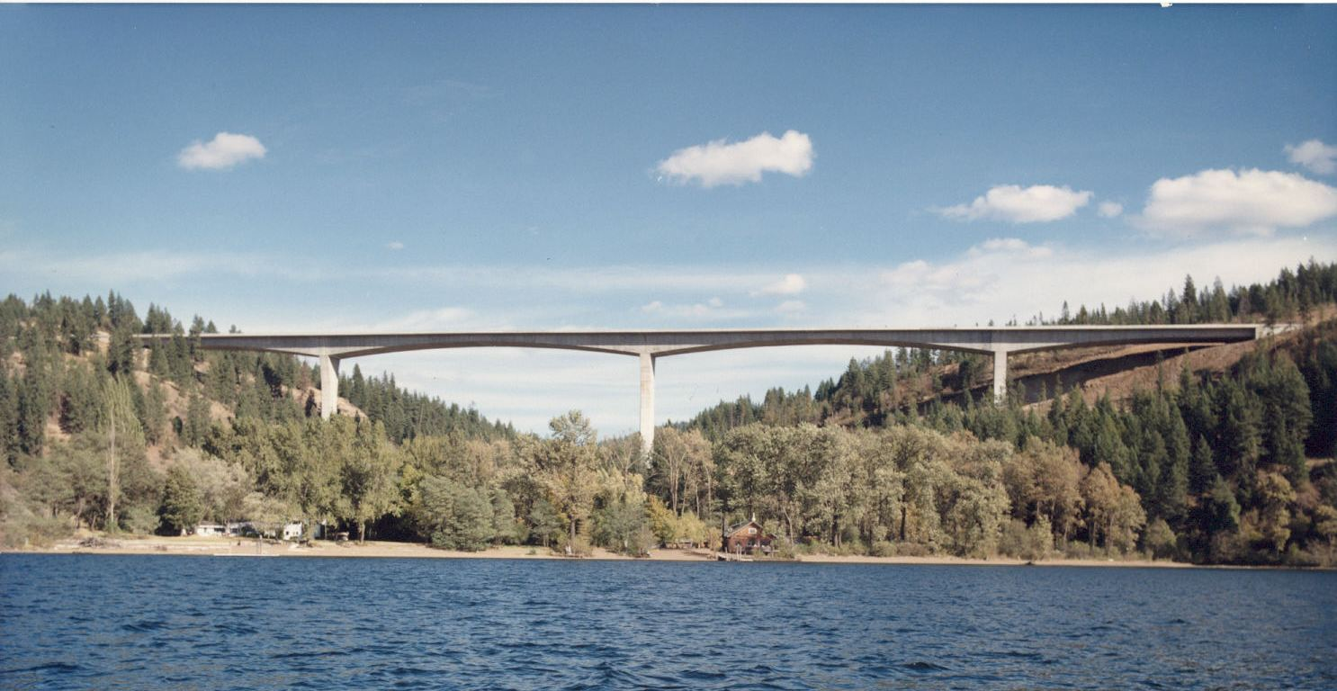
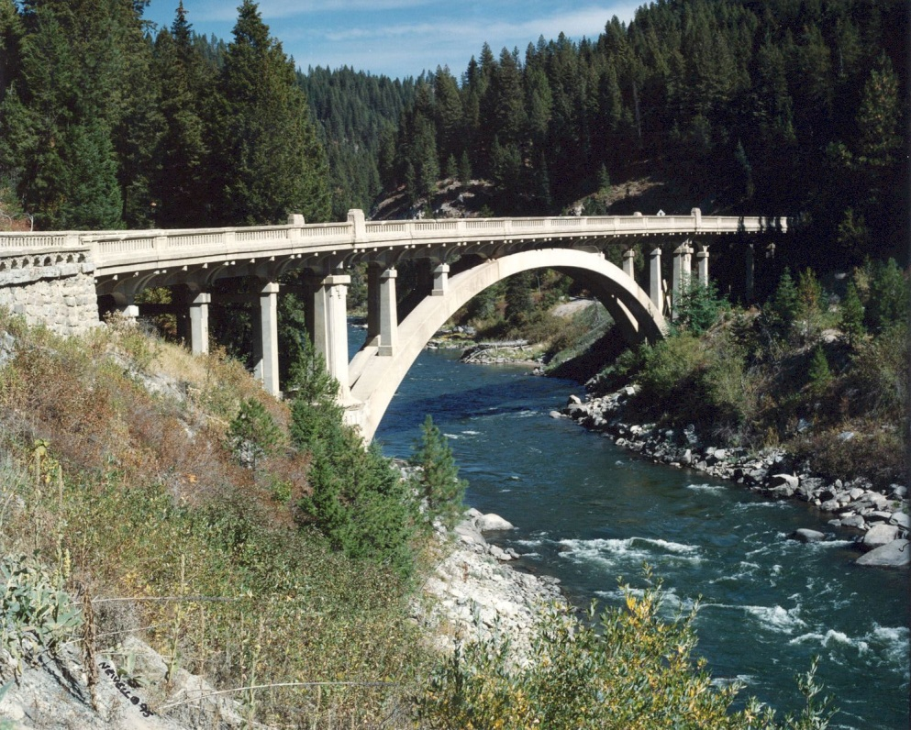
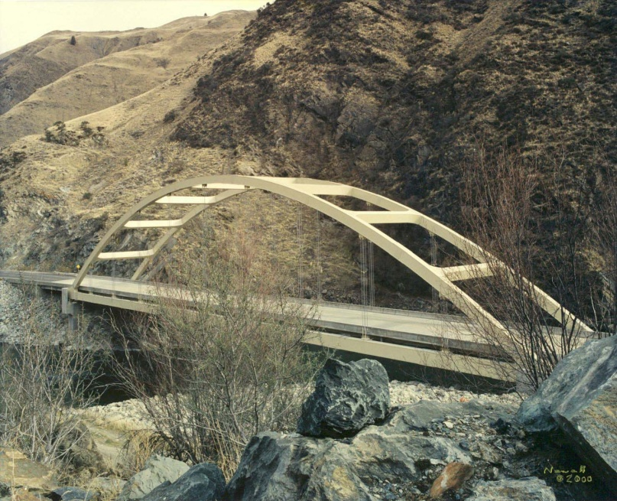
Idaho Bridges

Slide 4
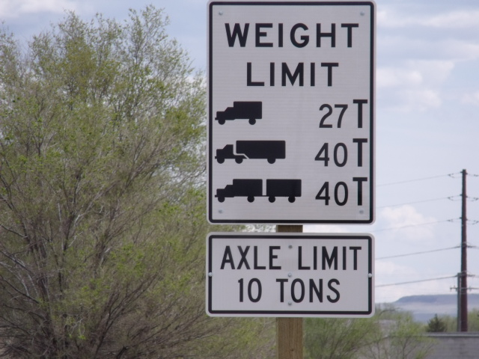
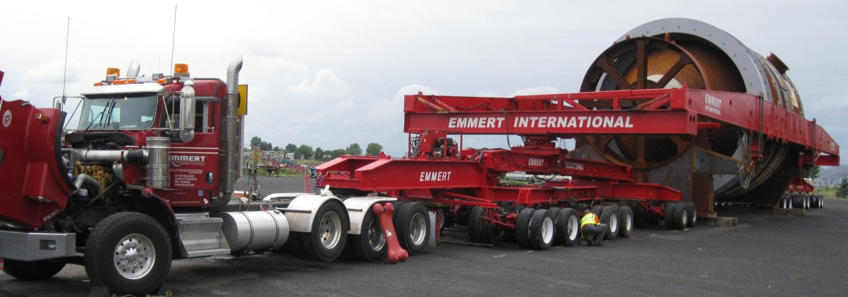
What are Load Ratings Used For?
  Load posting decisions
  Issuance of overweight permits both annual and single trip
  Allowing overlays (extra weight)
  Rehabilitation vs. replacement decisions
Notes:
Quickly read though bullets. Highlight the importance of getting quality load ratings due to daily use of files to control overweight permit vehicles. On average 1500 overweight vehicles are analyzed by ITD bridge per year. We do have a screening process so not every overweight vehicle request requires a bridge analysis, but that screening process is based on the ratings for our Idaho Legal trucks.

Slide 5
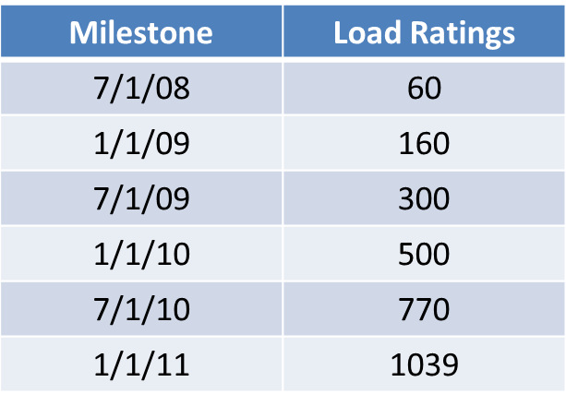

Idaho Gets Serious About Load Rating!
August 2007 - Minnesota Bridge Failure
December 2007 – Load rating action plan developed per direction of the FHWA
  1,039 bridges identified by FHWA to be load rated over the next 3 years (1/3 of inventory)
  6 month milestones were set
Ready – Set – Go!
Notes:
At this time, only one load rater at ITD that had very limited time to devote to load rating due to the growth of the number of overweight vehicle analysis required. Can’t hold up commerce! ITD suffering from lack of man power.

Slide 6

Why VIRTIS?
Formally used BARS
Rates multiple bridge types in one program
One database
Ability to migrate to updated versions

Slide 7

Develop a Plan / Evaluate Performance
Plan to meet milestones
  Hire load rating consultants using Federal Bridge Program money (approx. $1 million/year)
First milestone 7/1/08 (60 bridges)
  60+ new load ratings complete
  New search of database shows 1056 bridges now need to be load rated
Why did number increase?
  New bridges built but no load ratings done
  Inspectors identified new bridges as “re-analysis required” due to condition change
  Inherited bridges from local agencies
Notes:
Initially encouraged, but short lived once FHWA evaluation was done. Talk about around this time ITD sole load rater / overweight vehicle bridge analyst retires and position is unmanned for 6 months. As with many retirees, they are most appreciated once they leave. Two full time load raters were eventually hired and retiree was hired back as a consultant to do overweight vehicle bridge analysis.

Slide 8

Contracts
Started with small contracts (<$250k) with consultants off prequalified list.
  Pros:
    Large resource pool
    Quick to get under contract
  Cons:
    Time consuming to manage so many contracts
    Consistency difficult to achieve between consultants
Summer of 2010 put out a request for Statement of Qualification. Awarded contract to consultant team.
Notes:
Talk about how things are going well. Everyone has been working together for a couple of years now and is functioning as a team. Pooling resources and solving problems together.

Slide 9
Detective Work
Check upcoming bridge replacement/rehabilitation projects.
Provide detailed information to consultants during the contract scoping phase.
  Design Plans
  Shop Drawings
  Inspection Reports
  Inspection Photos
Review design calculations if needed. (consultant)
Site visit if needed. (ITD)
Notes:
Information is provided to consultant electronically via our ITD ftp site. Talk about how consultants expected to come look for design calculation if rating results are not reasonable. Microphise machine time consuming and difficult to use. Occasionally information we have for a bridge has a discrepancy that needs to be resolved by a site visit. Ask bridge inspector to swing when they can. If this is not possible may swap out bridge.

Slide 10

Examples of “Surprises”
Bridge has been widened. No plans for old portion.
Bridge appears prestressed concrete, but is actually precast concrete that was post tensioned at the site.
Deck truss with top chord acting as bending member and truss member because deck rests directly on top chord.
Structure rates low per current code, but is in good condition.
Bridge is replaced very soon after it is load rated.
Bridge has been set on fire.
Notes:
Emphasize that most “surprises” come from county bridges. Little control or knowledge about their work, especially if no state or federal money is involved. Tell story about Jim here and how more than one timber bridge has been set on fire by ditch burning.

Slide 11
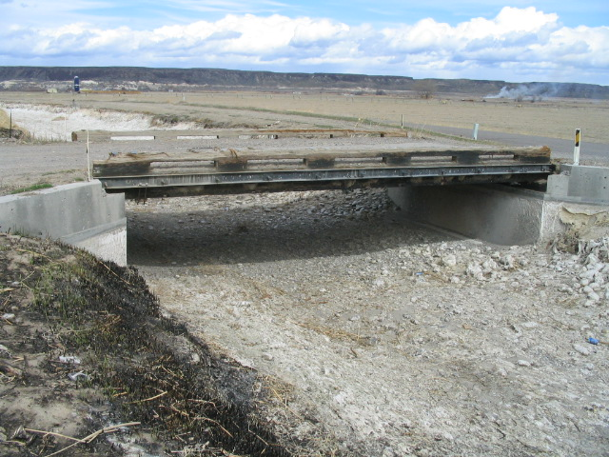
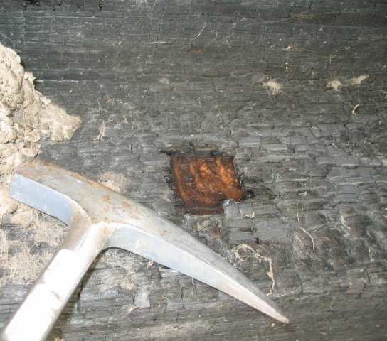
Inspection Report Notes, “County should discuss ditch burning with irrigation district, continued burning under structure will quickly decrease life of the this structure.”
Bridge 28317
Sheep Camp Rd. over Grandview Irrigation Canal

Slide 12
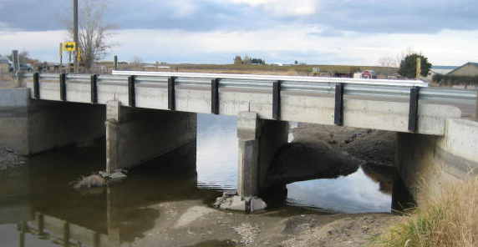
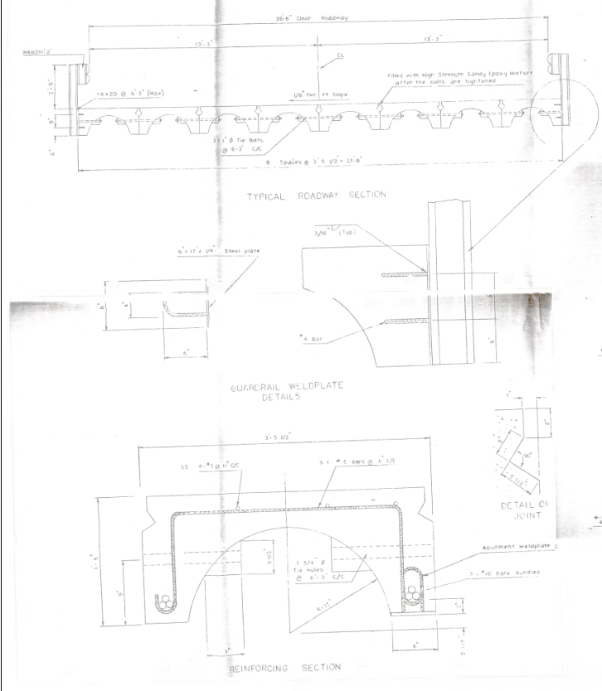
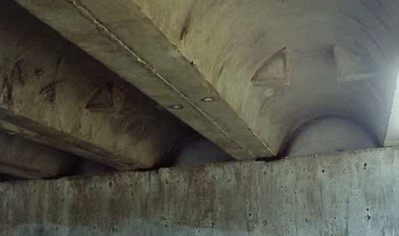
Local Highway District Homemade Girders

Slide 13
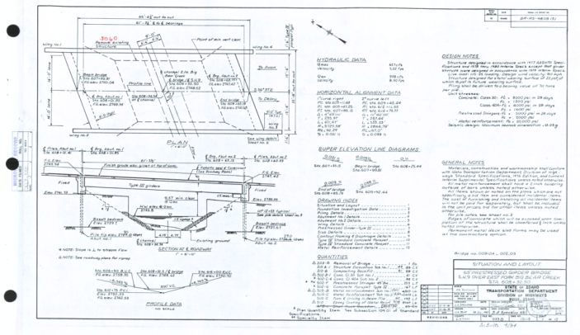
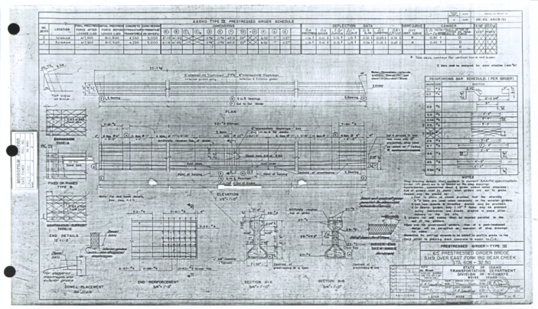
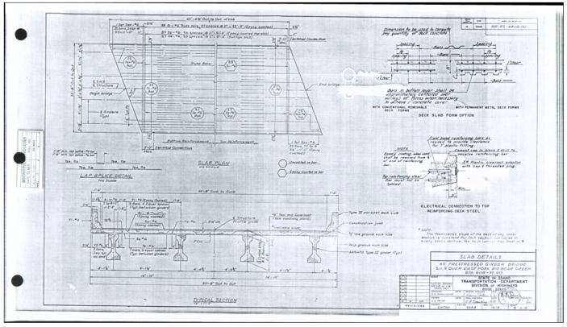
Scope of Work & Manhours
Provided by ITD:
Bridge list
Drawings
Inspection Reports
Photos

Slide 14
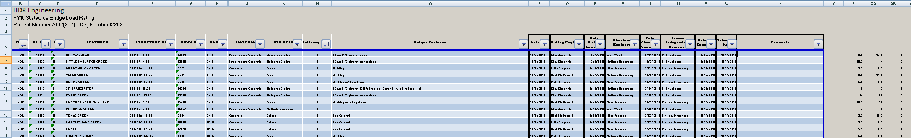
Estimating Manhours
Look through design plans and shop drawings
Estimate hours based on bridge type, number of spans, geometry, additional features, etc.
Estimate takes 3 to 4 minutes per bridge

Slide 15
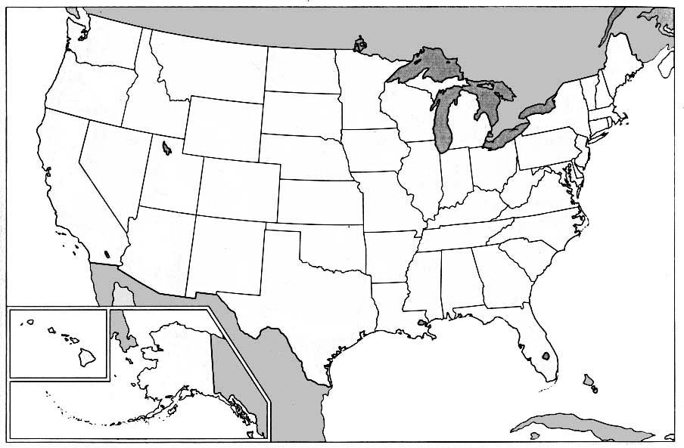


Remote Offices & Subconsultants
Notes:
Boise, Portland, Spokane, Missoula, Denver, Mesquite, Nevada

Slide 16
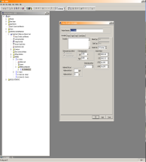
Rating Computer Programs
VIRTIS
LEAP CONBOX
MDX
LARSA
Microsoft Excel
Mathcad

Slide 17
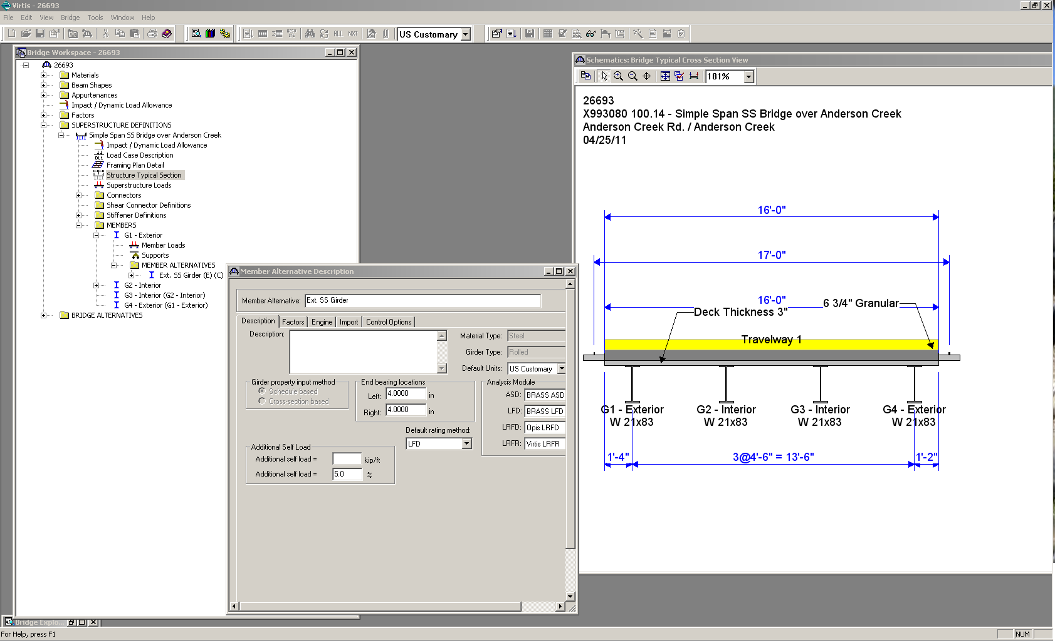
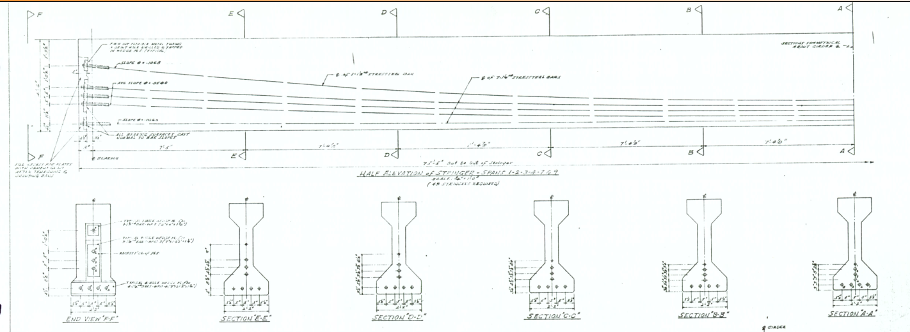
Bridge Types Rated in VIRTIS
Prestressed Concrete
Reinforced Concrete
Post-tensioned Concrete
Straight Steel
Culverts or Stifflegs
Trusses

Slide 18
ITD Load Ratings
Typically rate the girders only
Vertical loads only (DL & LL)
No Site Visit
No distress and/or deterioration effects included in rating
  Load ratings deteriorated by ITD
Actual wearing surface
LFD / LRFR

Slide 19
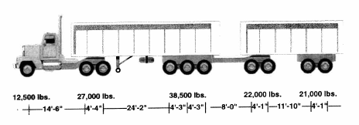

Idaho Live Loads
Design Load (H-15, HS-20, HS-25, HL-93)
ITD Type 3 (27 Tons)
ITD Type 3S2 (39.50 Tons)
ITD Type 3-3 (39.50 Tons)
Idaho 121k
“Superload” (ITD considering adding)

Slide 20
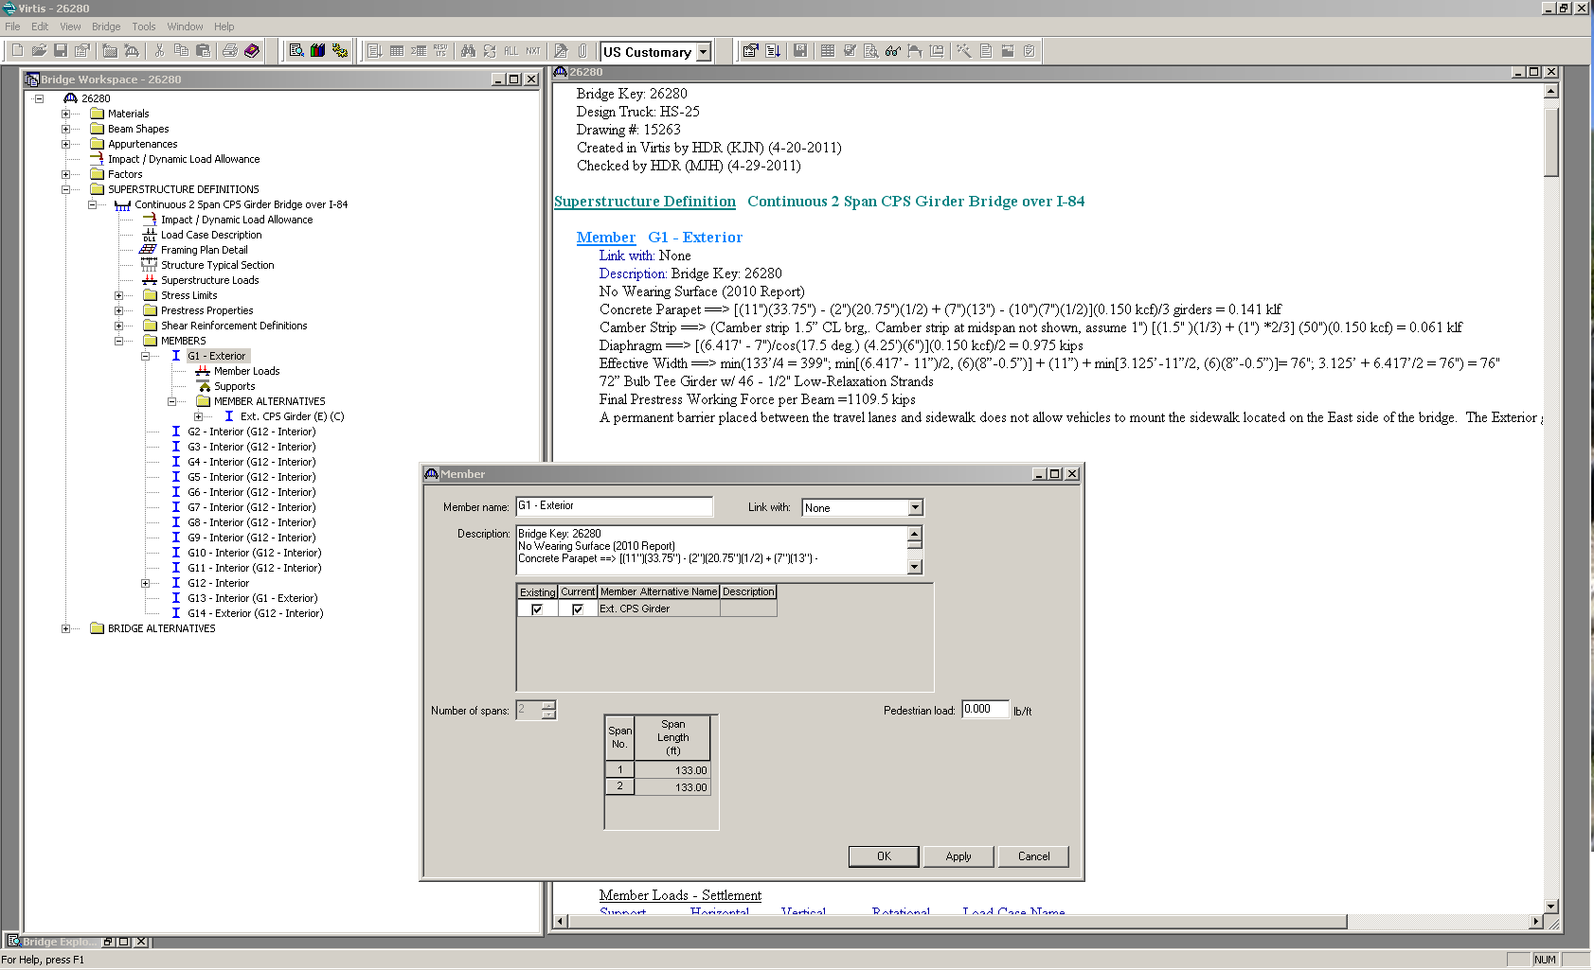

Slide 21
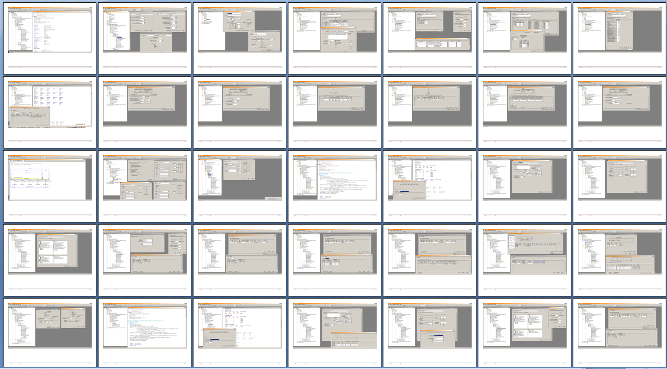
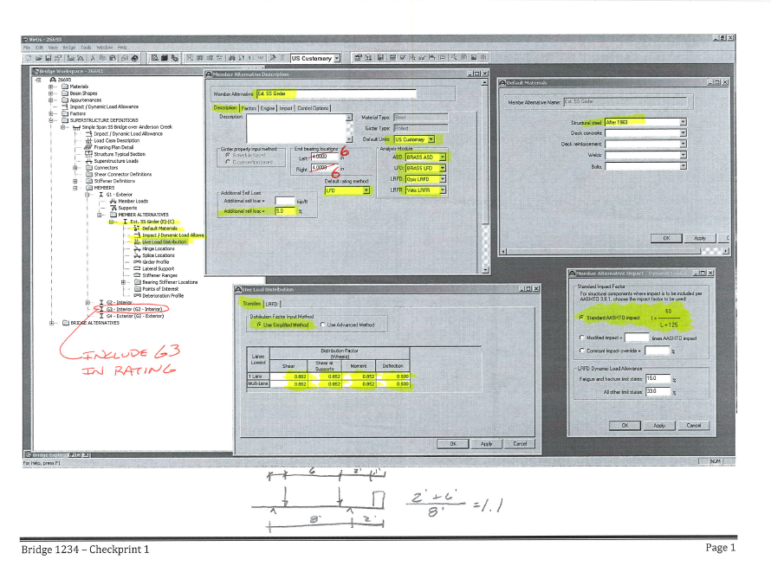
Checking

Slide 22
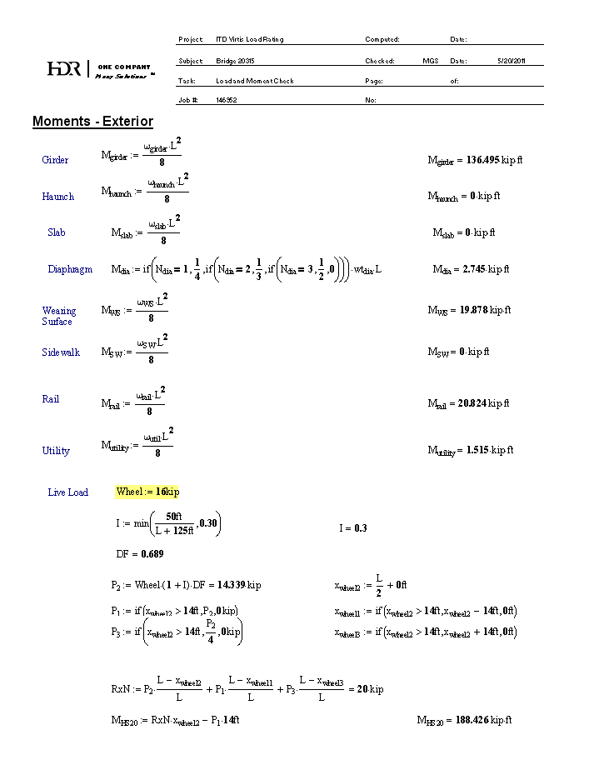
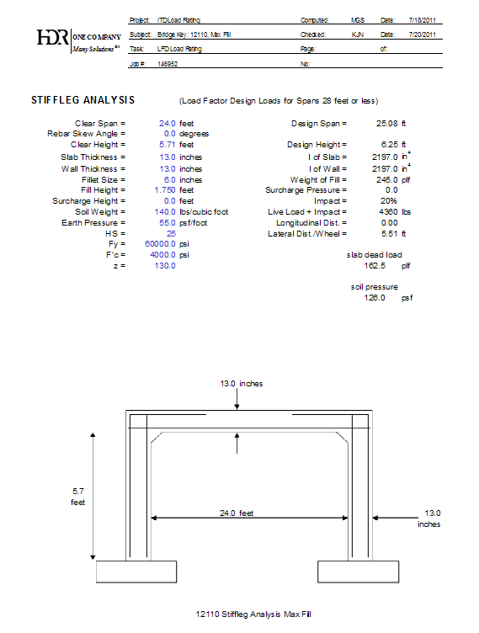
Rating Factor Verification
Required when design load 0.9< R.F. < 1.5
Done for all controlling ratings
Custom Spreadsheets or STLBRIDGE
Original design calculations

Slide 23
Independent Senior Review
Required in Contract
“Another Check”
Not Involved in Rating or Checking
Verify Check Done and Backchecked
Consistency

Slide 24

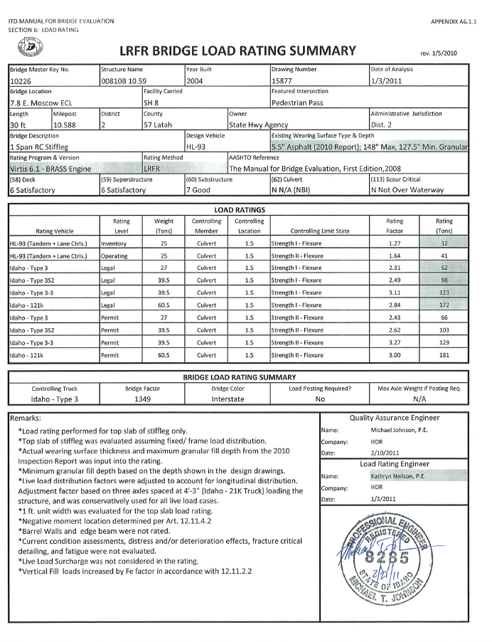

Deliverables
Load Rating Summary Form
Supporting Calculations (If Req’d)
VIRTIS .xml File

Slide 25
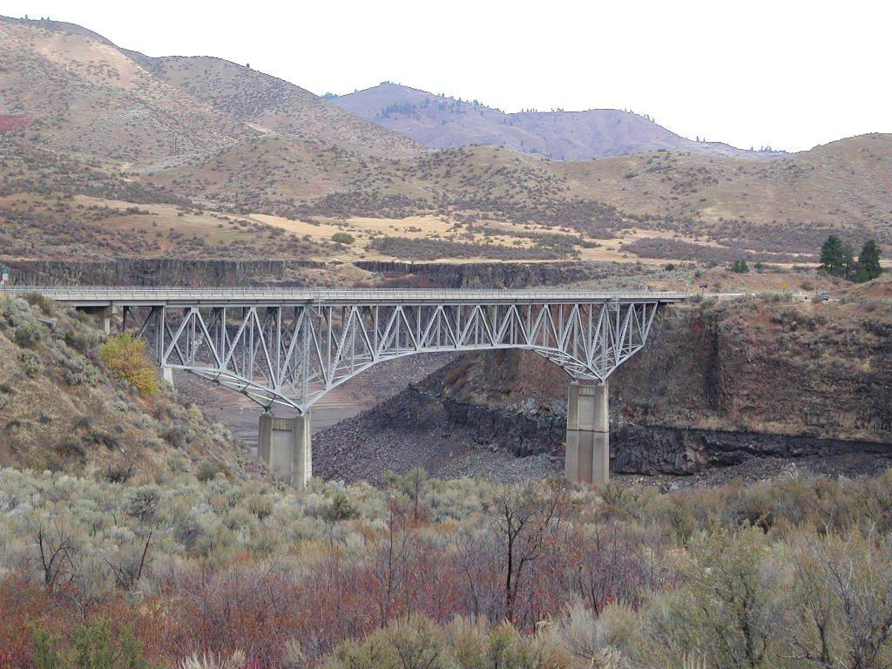
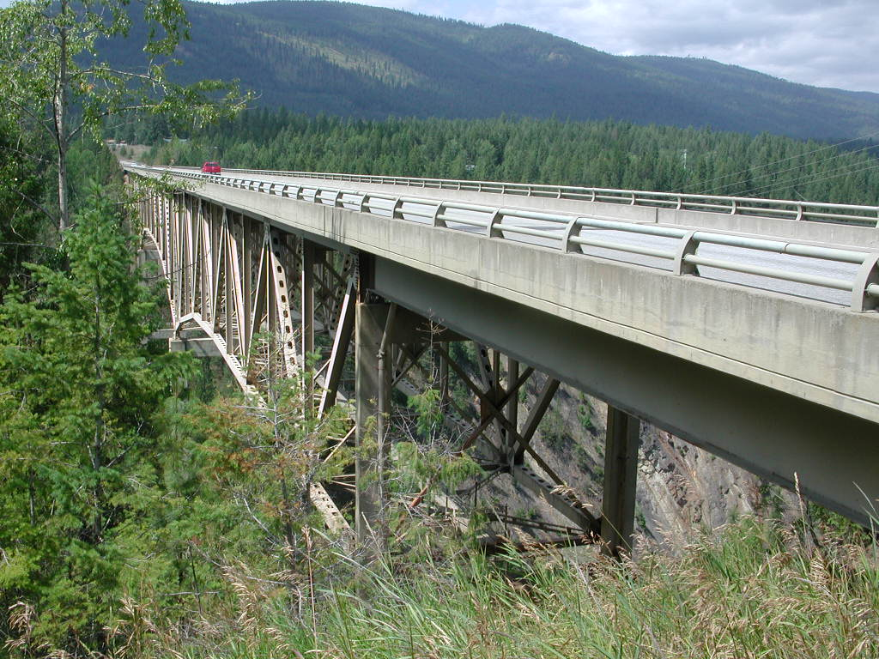
Truss Bridge Ratings

Slide 26
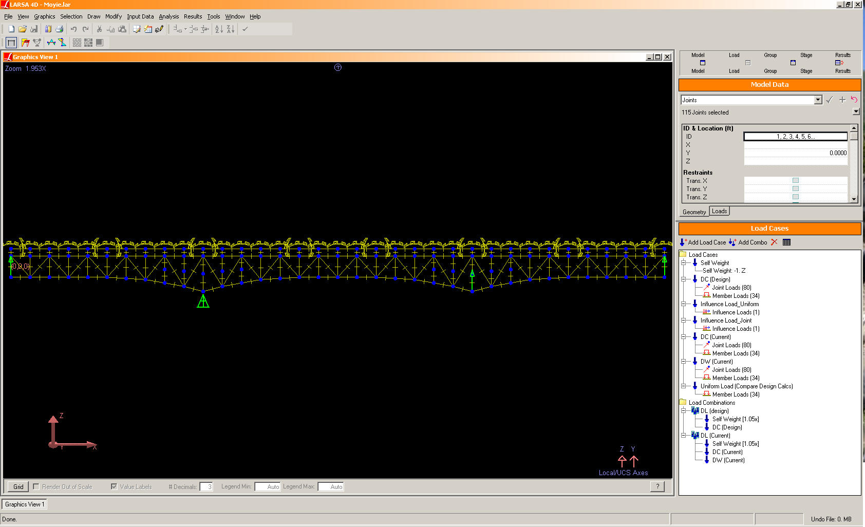
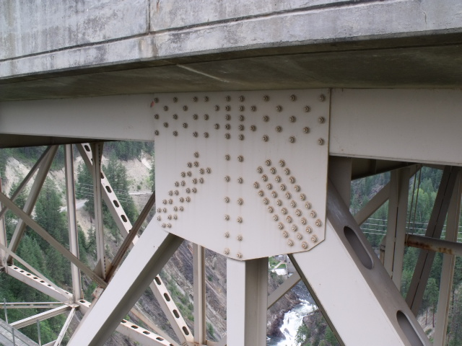
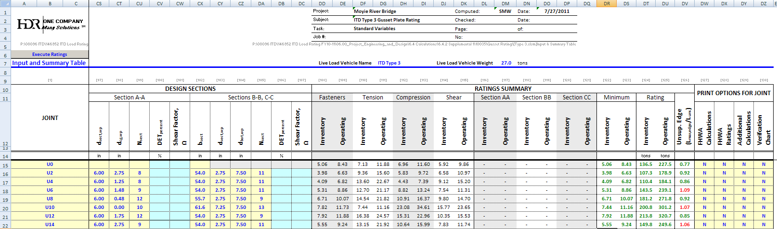
Truss Bridge Ratings
AASHTO Guide Specifications for Strength Design of Truss Bridges
FHWA Load Rating Guidance and Examples For Bolted and Riveted Gusset Plates in Truss Bridges

Slide 27
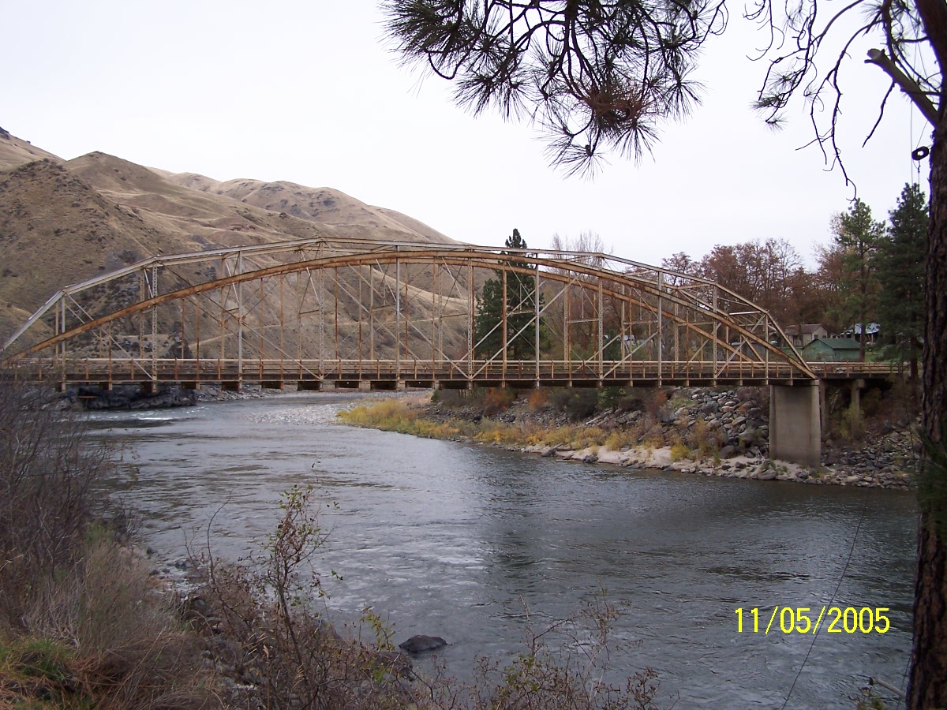

Slide 28
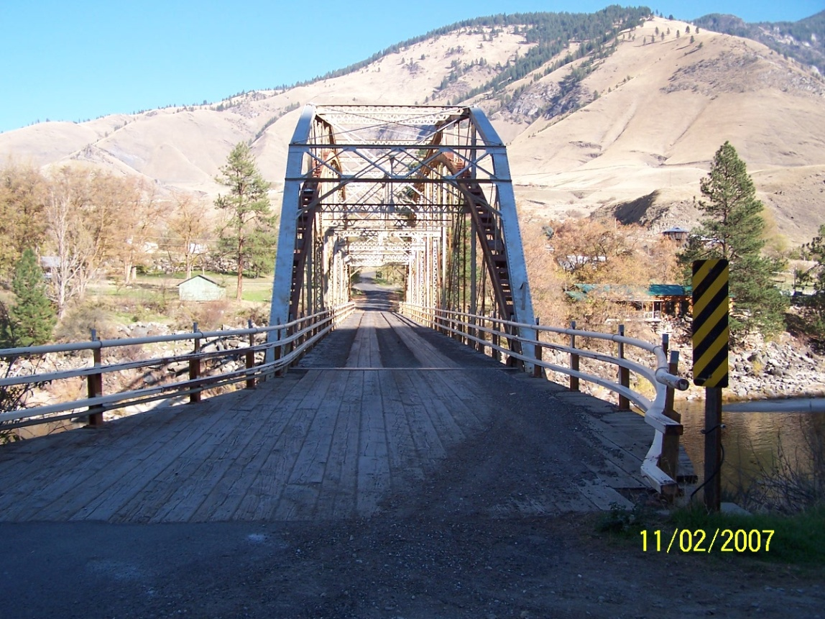

Slide 29
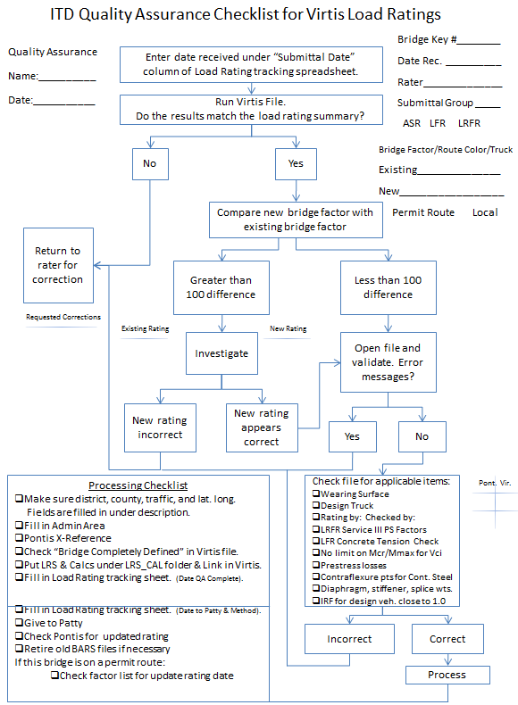

ITD QA
Processing Checklist
Consistency
Assisted by Vander Boegh Engineering

Slide 30
Look for Ways to Improve
  Require all new bridge designs to be accompanied by a load rating when submitted .
  Do more research during the contract scoping phase to prevent “surprises” during contract.
  Provide flexibility in contract to accommodate any “surprises” that may arise.
  Make sure Q/A and Q/C policies are well developed and strictly followed.
  At the completion of every contract have a brainstorming session on how to improve the next contract.
  Rework FHWA load rating plan.
Notes:
Now we have people to manage contracts. Promoting consistency and emphasizing quality was a big focus and a big job. Not many firms can do 300 load ratings in 6 months. Many firms were used and many of them utilized more than one office. Surprises came up and had to be dealt with. Revised load rating plan in November of 2009. Agreed to more overall bridges, but postponed some of the FHWA specifically identified ones.

Slide 31
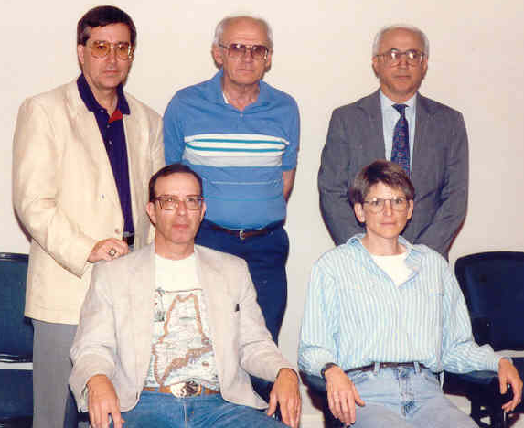
Task Force Trivia
Identify the members of the 1995 task force shown in photo.
Gerry Gingras
Vermont
Yavous Gonulsen
Illinois
Dave Ekern
Minnesota
Kathleen Slinger
Idaho
Gale Barnhill
Nebraska

