Slide 1
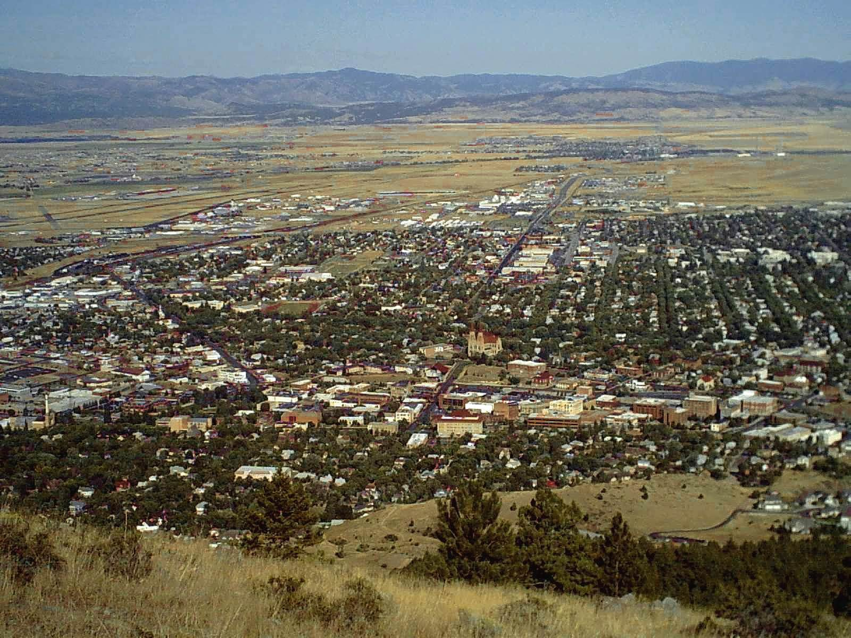
Validation of loads on OPIS Substructure
David Warner
Helena, MT
August 2011

Slide 2
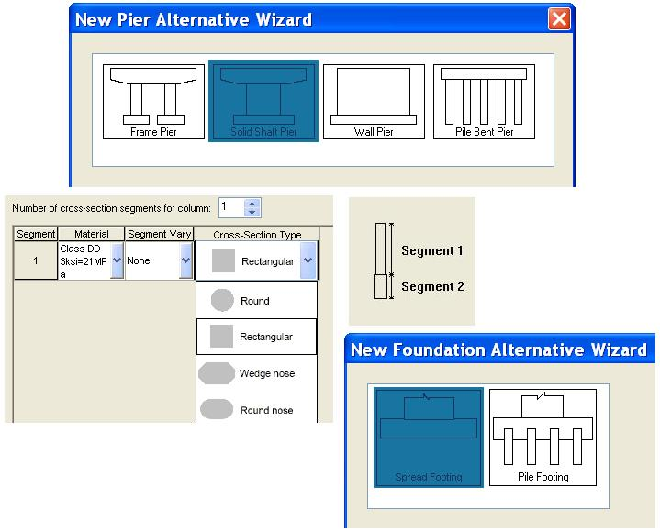
Opis Substructure
Peeling open the black box
Hammerhead
Single column
Spread footing

Slide 3
Confirming Loads
I checked my coworkers pier design, then,
  Another coworker and I discussed testing Opis Substructure.
    Back in 6.0.
Modeling which follows is for a Spread footing, single column, hammerhead.
  Blend of coworkers design and my checking techniques, then verified step by step in Substructure.
Help designers verify software
  Ultimately the engineer’s responsible.

Slide 4
Validation of Dead, then Live loads.
Objectives
By these methods.
Substructure model assumed complete. Loads confirmed only.
Confirm self weights and superstructure DL’s
    Compare DL by hand with OPIS.
    When comfortable with DL, add in one lane of Live load.
Show HL-93 Truck pair plus lane by hand.
    Add one lane Live load and gather spread footing pressure results. Service 1 limit state, DC, DW, LL (one lane), no other loads. Compare results of OPIS and those by hand.
Familiarize
  Show steps to reanalyze
  Show steps to spec check
  Show where to find results

Slide 5
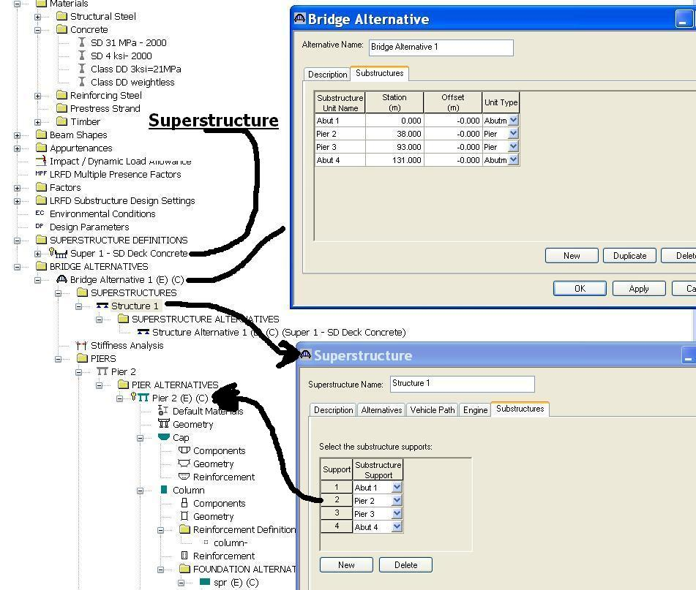
Substructures Superstructure connection
Top Down.
Substructure piers start in the Bridge Alternative
Abutments aren’t analyzed directly, but…
  A pier with one very short span might imitate an abutment.
Notes:
Need opis superstructure span lengths at a minimum to define a substructure. It’s the stationing of the superstructure spans which locates substructure piers.
Notice Abutments aren’t even shown.
We need to make a bridge alternative so a bridge will be rated from the bridge explorer, its here names and stations for substructures begin.

Slide 6
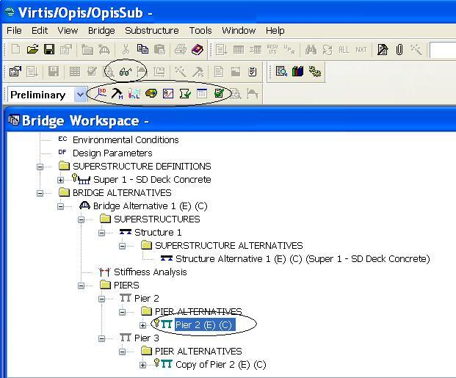
Pier buttons
3D schematic
  Many views.
Generate Model
  Nodes, releases
Load Combinations
  Service 1, Strength
Load Pallet
  DC, DW, LL, etc.
Analyze Substructure
  analyze
Spec Check
  Populate checks
Substructure Tabular Results
  customizable
View Analysis Output
  Preformed reports
Spec Check Detail
  recognizable
Buttons only visible with pier alternative highlighted.
Notes:
To the right of the word “Preliminary” and the eye glasses. Highlight the pier alternative as pictured to make buttons appear.
Glasses are short formed reports, like just development lengths in the cap.
3D schematic is detailed dimensioning and result views (next slide – Shear)
Generate model change number of points of interest, or fixity.
Load combinations, service 1 only in my presentation.
Load Pallete toggle use or don’t use loads, overrides defined.
Analyze substructure needed when anything could have changed at load.
Spec check populates tables of results with new loads and resistances
if you’ve not changed a load, only say, rebar size, use spec check alone.
Substructure tabular results create and save report styles. Extensive options here.
Spec check detail is what I’ll show you for my spread footing pressures.

Slide 7
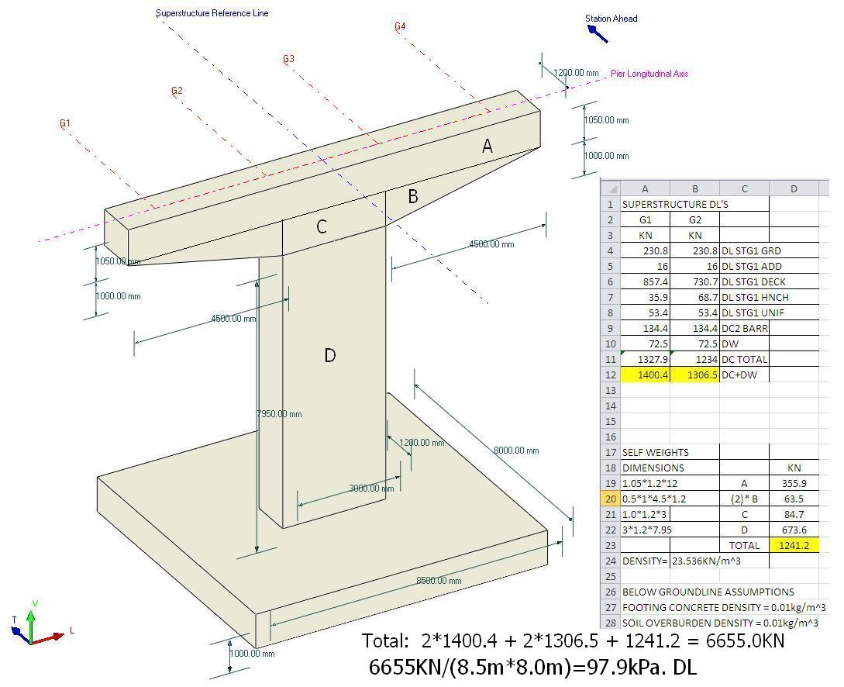
Pier geometry and DL’s
3-D Schematic button (previous slide) then click isometric view, and detailed dimensioning
Super Dead Loads by hand.
Girders, Deck, Additional, Self Weights.
table of DL’s of Superstructure
then Substructure
Note DL and Pressure
Notes:
All the superstructure DL and substructure SW except footing self weight. Yield the pressure on the footing bottom.
Note: ignoring footing concrete weight, and soil overburden weight, for model simplification.
Options here include detailed dimensioning, Moment and shear results,

Slide 8
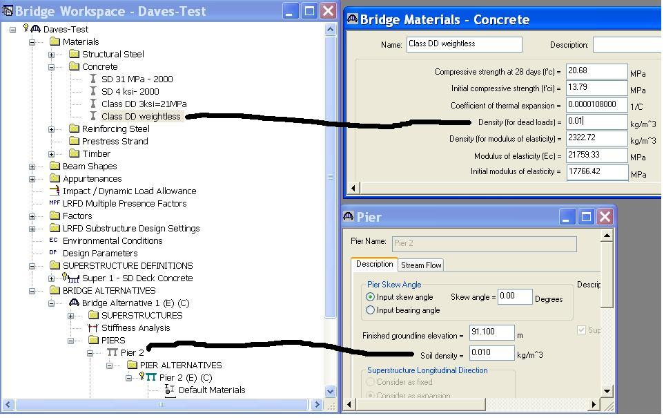
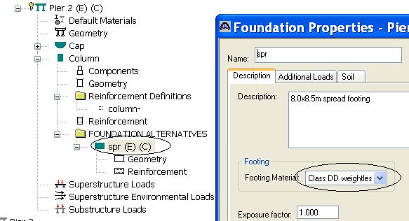
Weightless concrete or soil
Start with few loads. Add in more loads once confident of the results.
Notes:
Slowly add in loads as you want them to be part of your model.

Slide 9
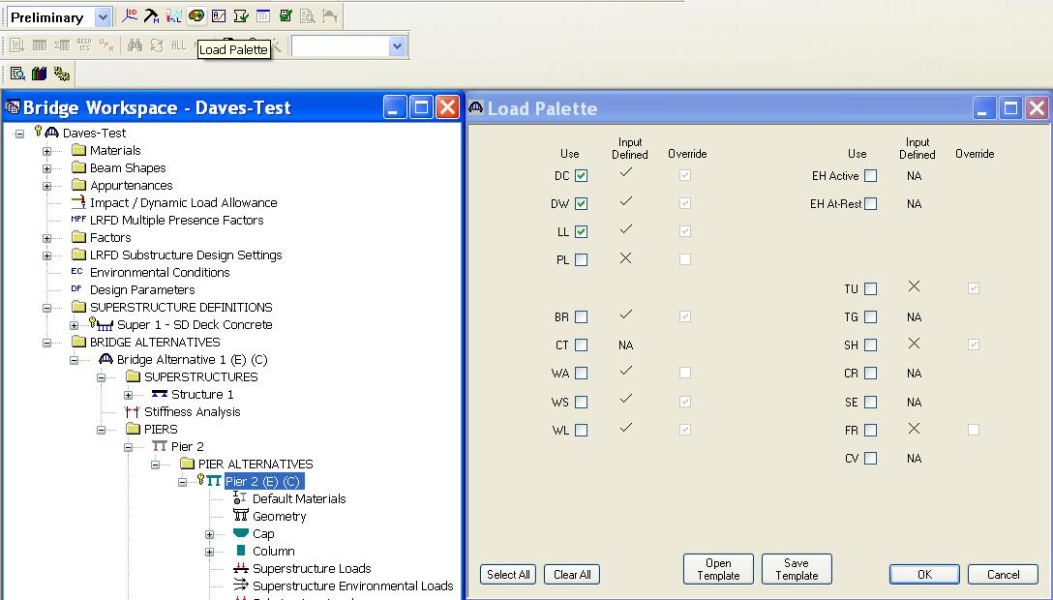
Load Palette
Turn off all but DC.
Verify
Add next
Verify
Repeat… Gain model confidence.
Notes:
DC includes Self Weight. Depending on your design, it’s unlikely DC + DW will cause a moment.
Good check, Do dead loads alone produce any moments?
Best to get comfortable with DC + DW before adding other loads.

Slide 10
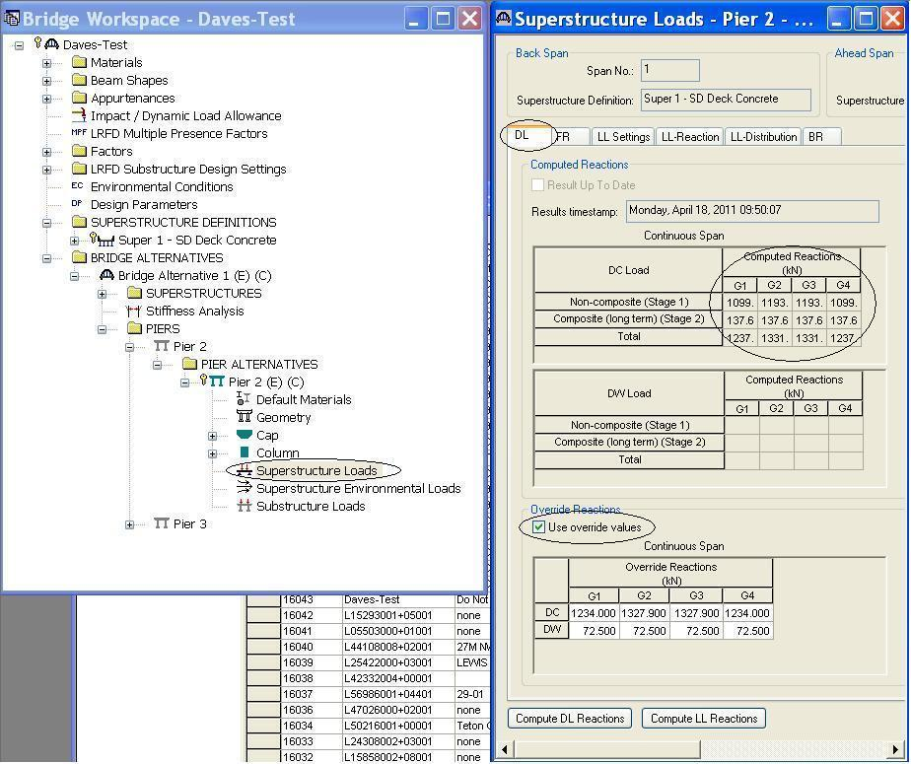
DL by Override
Time Stamp.
Dead loads from Opis Superstructure
If there’s 2 or more piers, they easily copy/paste.
Dead loads entered manually.
Once Overrides verified; turn off. Thus using Opis loads.
Notes:
Enter overrides, or From excel spreadsheet shown prior.
Compute DL Reactions. OPIS Super.
Compute DL reactions will work only when all piers are defined. If your piers are all similar copy/paste is really quick.

Slide 11
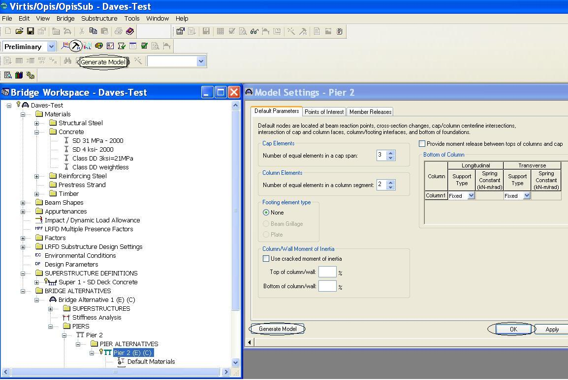
Every step shown.
Generate Model, Generate model button bottom left, ok
Analyze Substructure, review any errors/warnings, continue analysis
Spec Check, continue with Spec Check (Loads same, only change is rebar?)
Review Results
  Substructure Tabular Results Spec Check Detail View Analysis Output
  Everything + customizable Components basic reports
Notes:
This covers every base if loads and or dimensions have changed.
2) Gathers load results.
3) Populated spec check, and tabled results.
4)
a)Customizable templates.
b)Quick find for spread footing pressures.
c)May contain a your results in premade format (i.e. summary of cap reinforcement and development lengths at section change locations)

Slide 12
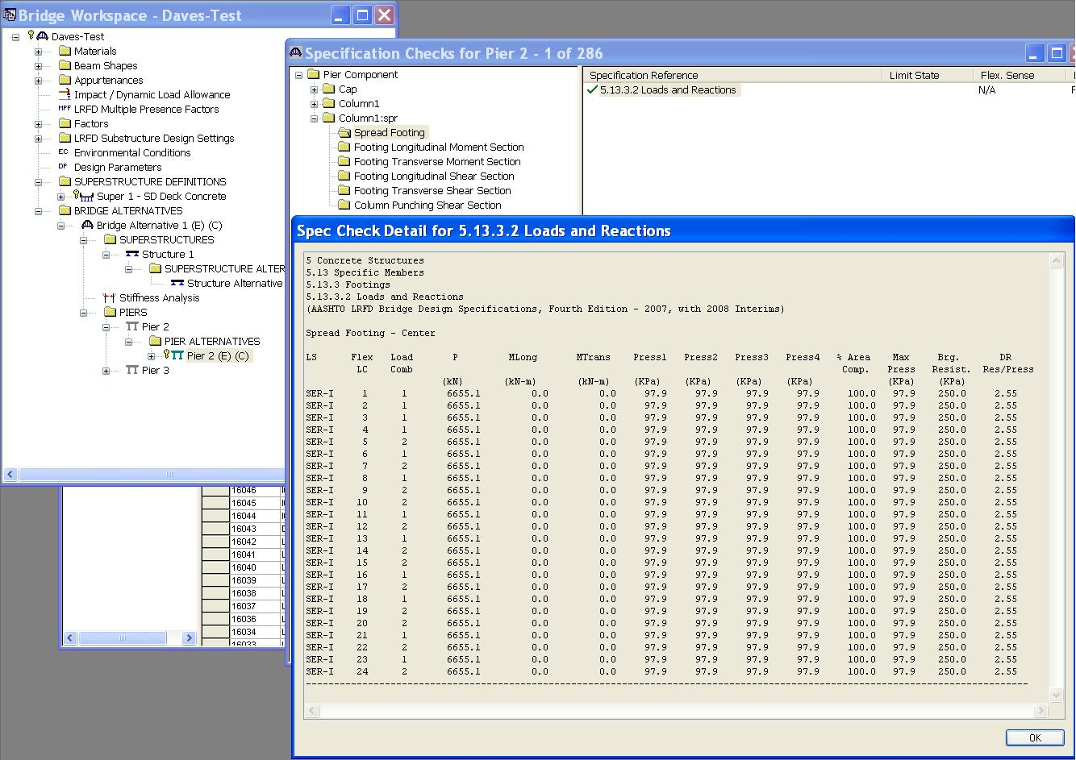
DL only results
Remember Pier Geometry and DL sheet?
I know 97.9kPa and 6655KN are results.
No moment = symmetry
gain model confidence
Turn off override DL, analyze again.
Notes:
Unlikely to be a moment associated with Dead Load and Self Weight only.
Mtrans Mlong zero.

Slide 13
Dead loads DC, DW ok?
Dead loads
  Correct moment
  Correct axial
Additional dead loads?
  Go back to add dead loads
    Additional self weights
    Soil
Move on to Live loads.

Slide 14
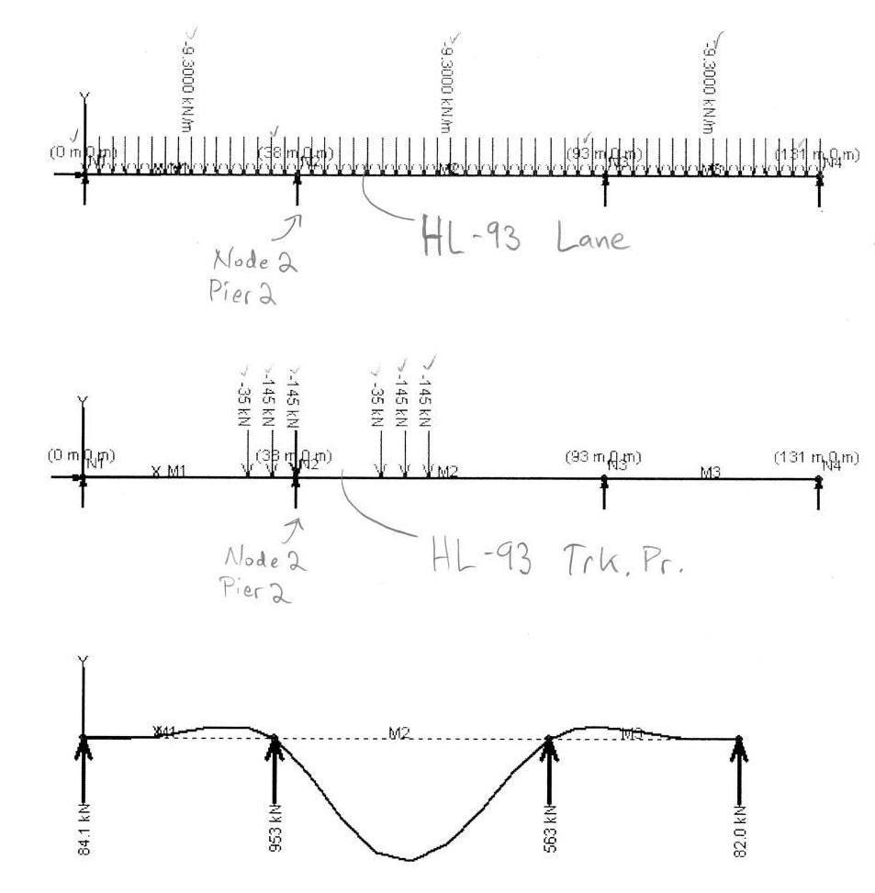
HL-93 Truck pair + Lane controls transverse moment at pier
Unfactored lane
Unfactored truck pair
Notes:
The maximum live load at the pier is a truck pair plus lane load.
Later we’ll add multiple presence factor.
Perhaps this bridge is deflection controlled.

Slide 15
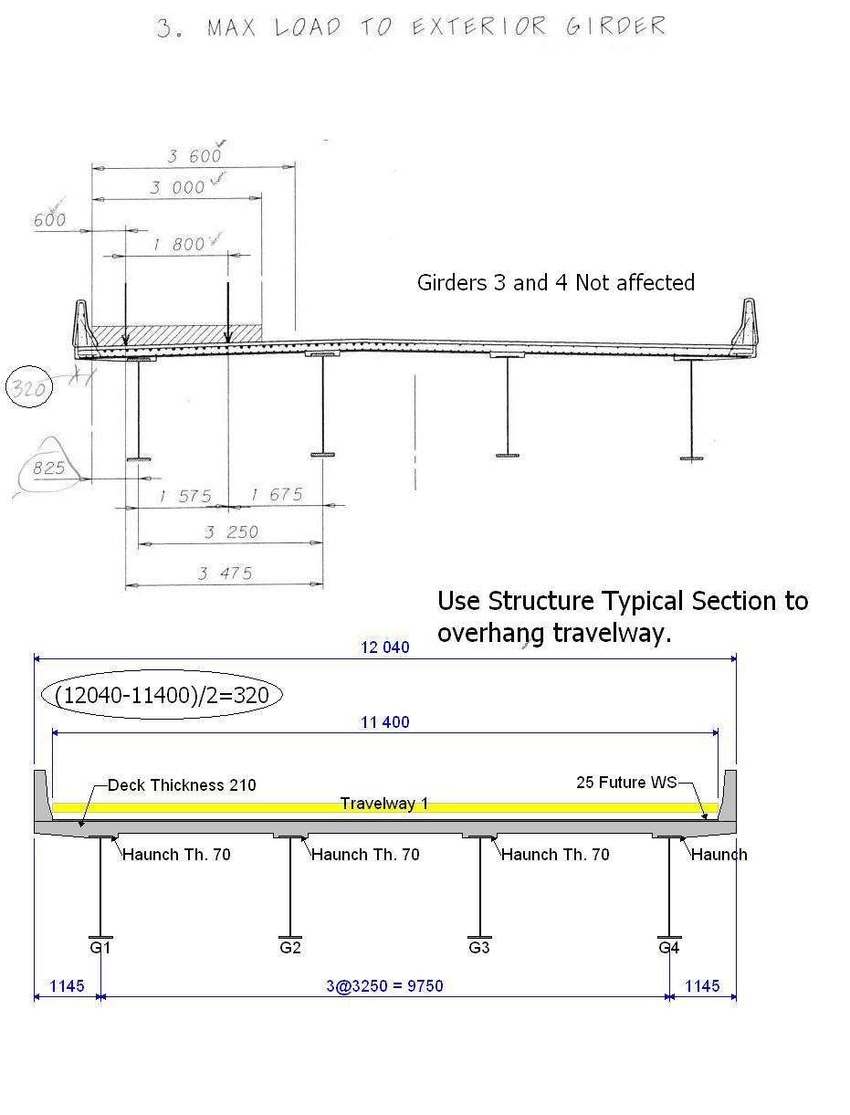
Match design load placement transversely to OPIS’s travelway
Note distance: Travelway from edge of deck: 320mm this case.
Notes:
Above microstation sketches.
Below Opis typical section.
Pay special attention to travelway distance from edge of deck.
Pictured is LL1.
Not pictured, LL2, Shift 3.0m lane to right side of 3.6m width.
Later we define that 3.6m width to stay at edge of travelway.

Slide 16
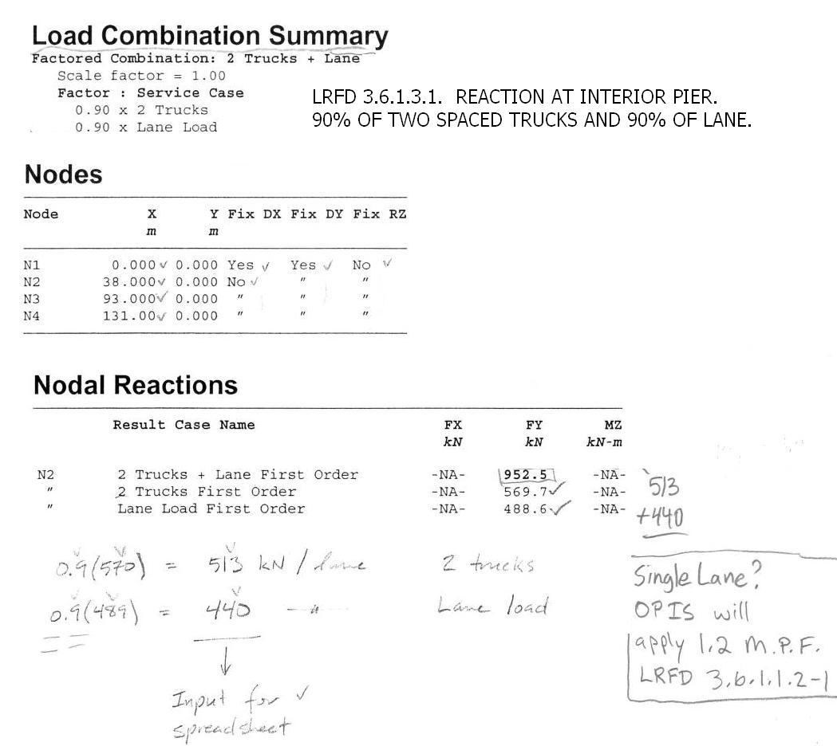
Live load results per Lane width
Notes:
Making single lane of live load to produce maximum overturning of pier.
90% truck 90% lane
Nodes
Reactions.

Slide 17
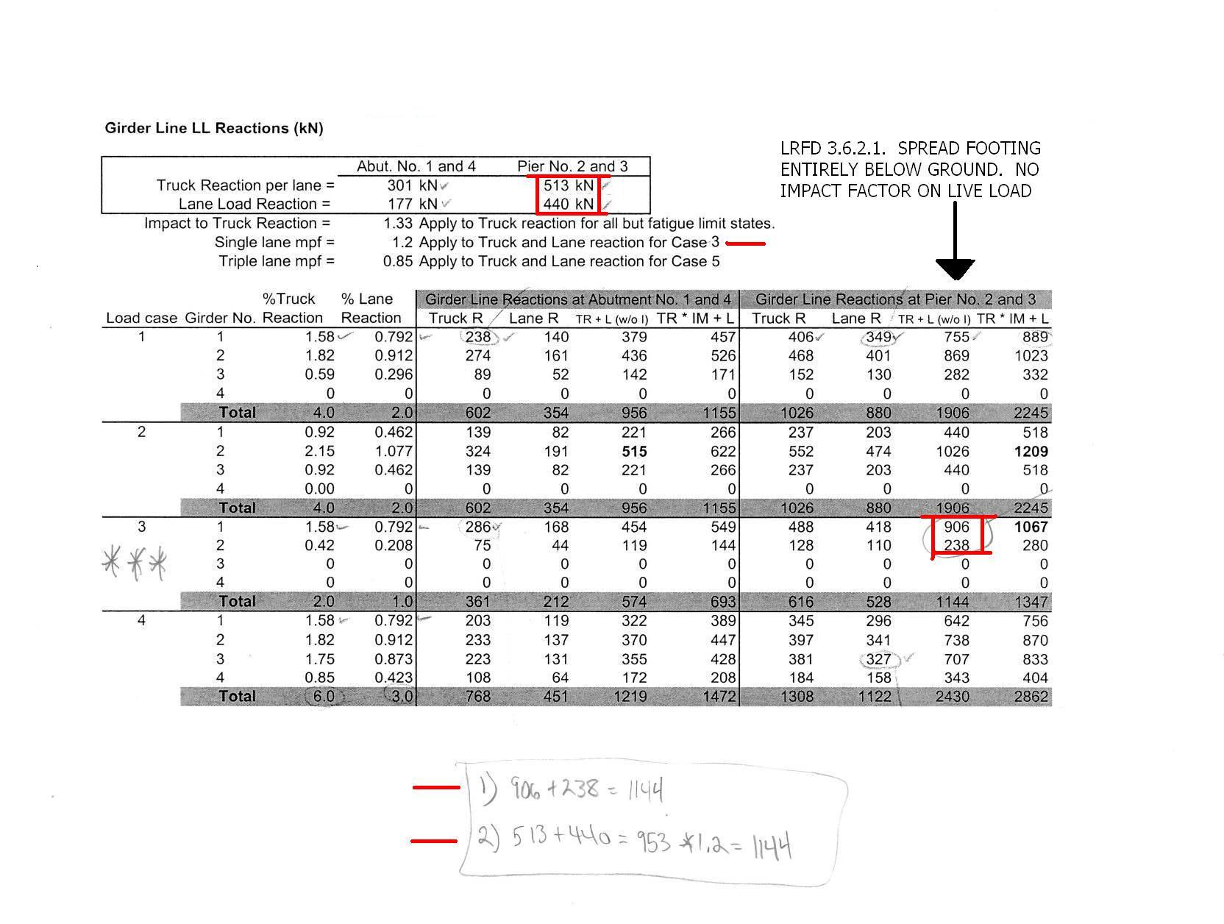
Girder line reactions from lane loads
Notes:
Input truck and lane, output girder reactions.
Tributary area method.
Truck and lane have MPF added.
Last two columns, without or with impact on truck.

Slide 18
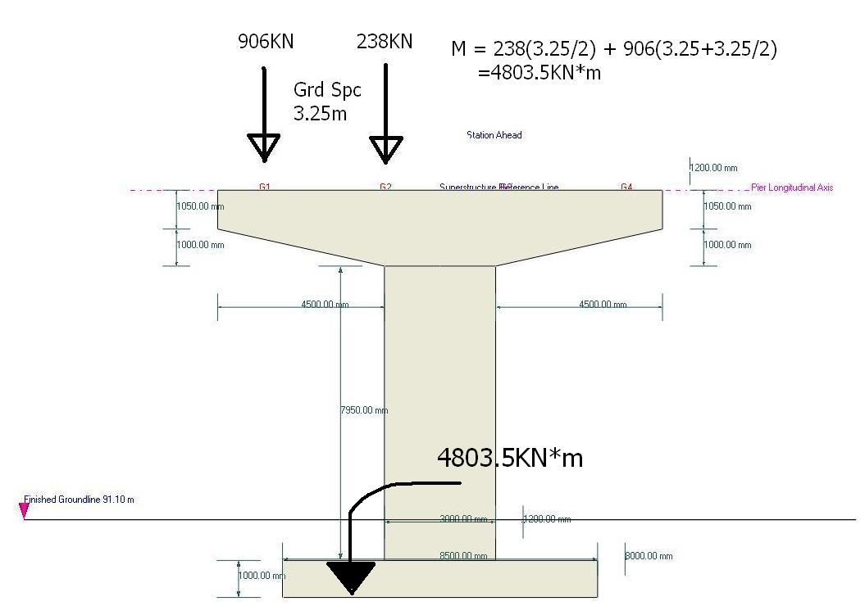
Pier geometry with girder LL reactions
Finished Groundline
Depending on your foundation type may need to find equations to help match your work to Opis Substructure results.
Notes:
One of the detailed dimensions is finished ground line.
Simple statics.
Ground line: only works in this view. If you look at groundline in ISO-metric view, all below ground stuff covered up.

Slide 19
Effective footing width
MDT Str. Man. Fig 20.2C. Internet link below
Eccentricity (e) = Moments/Vertical loads LRFD 11.6.3.2. (following page)
Vertical loads
  DL = 6655KN – same as OPIS
  LL = 906+238 = 1144KN 90% truck pair + Lane
  DL + LL = 7799KN total axial.
e = 4803.5/7799 = 0.616m
With these values I’ll verify OPIS results.
http://www.mdt.mt.gov/other/bridge/external/structures-manual/part_II/chp-20-final.pdf
Notes:
Now I’ll get into the exact calculations for a spread footing.

Slide 20
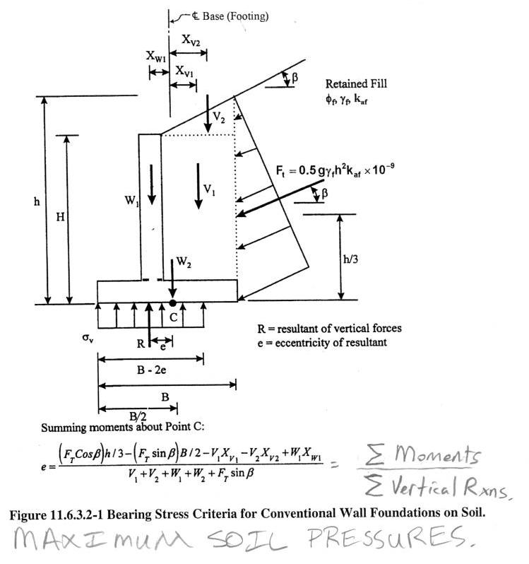
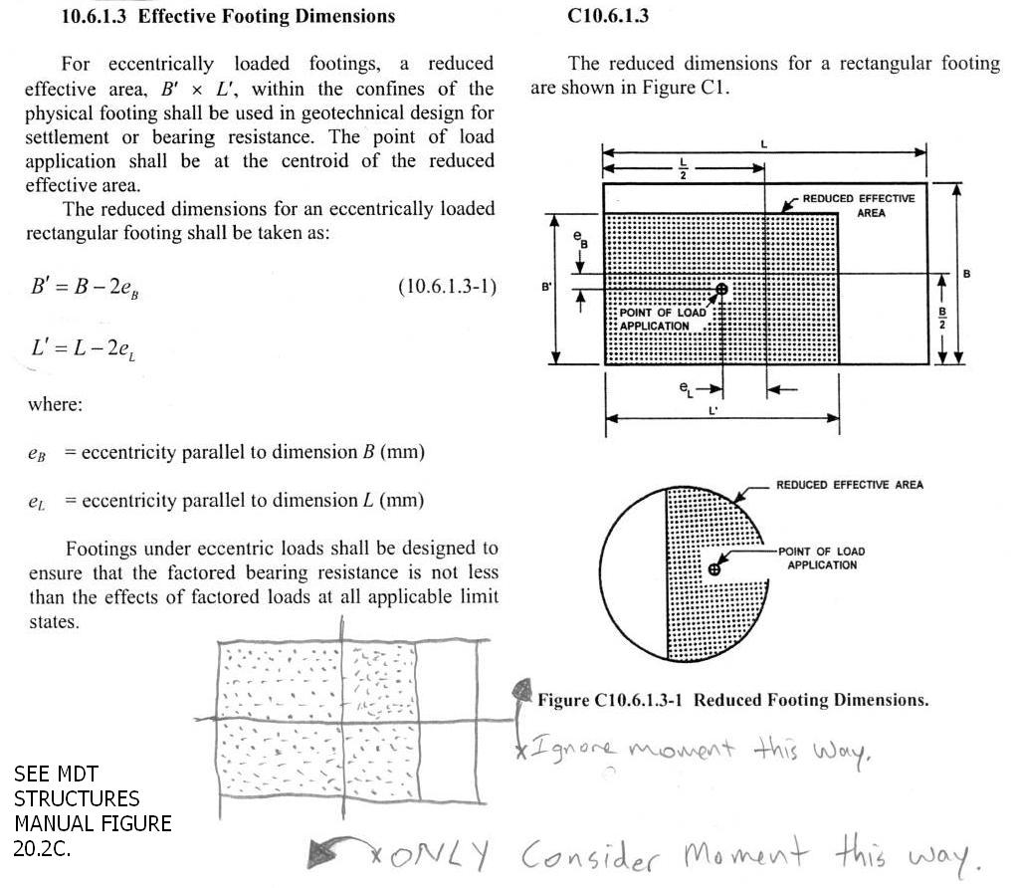
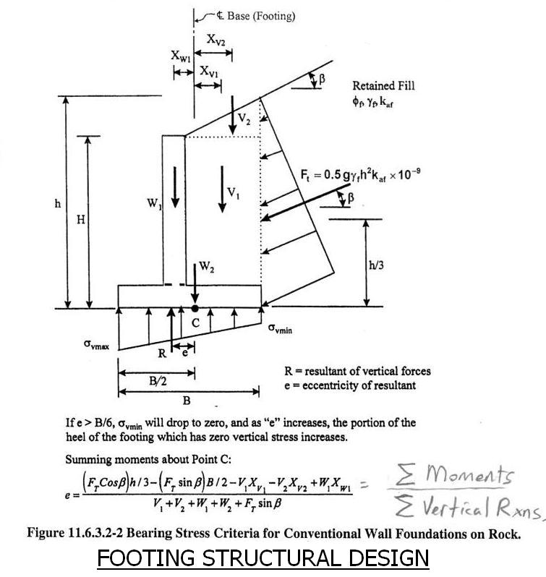
Top two identical:
equal pressure
e same both cases
Bottom picture and its equations are what were used for structural footing design while checking coworkers pier
And Opis reports in Spec Chec Detail Loads and Reactions on spread footings the same pressure distribution
See also LRFD: 10.6.1.4; 10.6.5; C5.13.3.6.1-1.
Notes:
Eccentricity is important for geotechnical max pressures, as well as verifying Opis spread footing results, which correspond to footing structural loading.

Slide 21
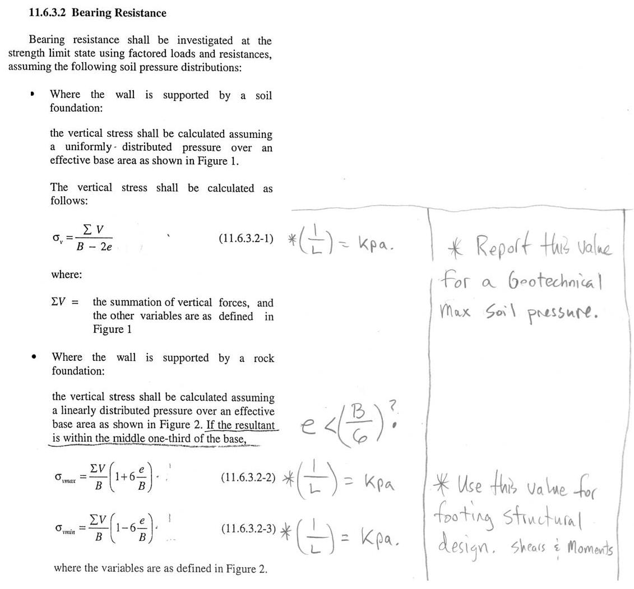
Verify model. Compare Spec Check
I know all the variables shown here,
now we’ll have Opis place the superstructure Live load on the pier.
And compare the two a few slides.
As shown on Loads and Reactions table (following)
Max Pressure ---------------------
And
Min Pressure-----------------------
Notes:
Using our own Vertical reactions, live load moment, and eccentricity, we gather max and min footing pressures.
Notice the eccentricity less than footing width divided by 6. this will almost always be the case, but there are other eqns not shown which must be used.
8.5m/6=1.42m e=0.62m ok.

Slide 22
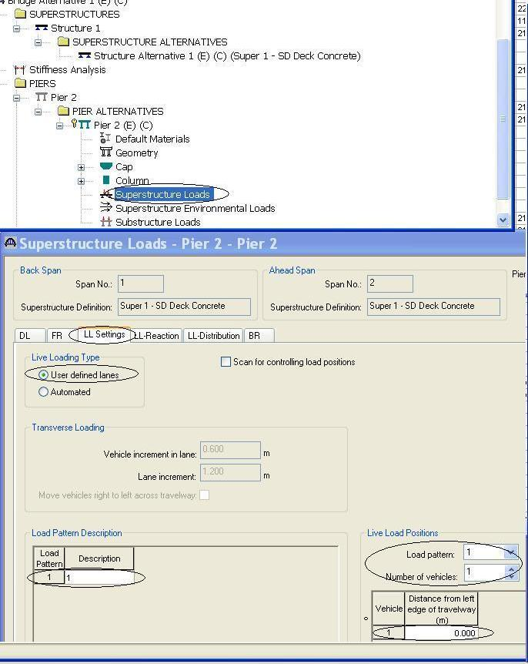
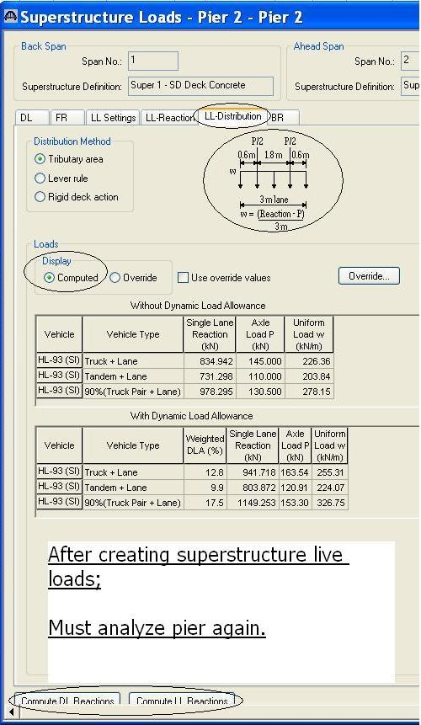
Opis’s Live Load: One Lane far side of travelway
Override Live Loads
Compute DL and LL Reactions will only work with all pier defined
Notes:
Two tabs for Live Load settings. “LL settings” “LL distribution” This is where the number of LL arrangements is made.
Note: pictured vehicle, distribution method, computed values, and, distance from left edge of travelway.
Pictured 3.0m lane, fits inside 3.6m width. In two arrangements with 0.60m vehicle increment in lane. LL1, and LL2.
0.00m distance from edge of travelway keeps vehicle over cap edge.
Click Compute Live Load Reactions. Pull Live loads from Opis Superstructure.
Substructure will compute DL and LL reactions only after all piers are defined. Luckily the copy past is very easy.

Slide 23
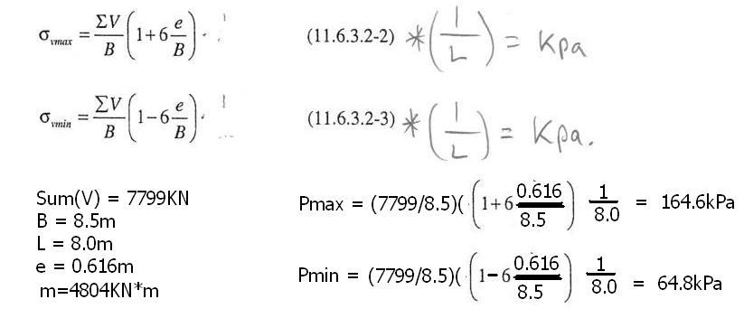
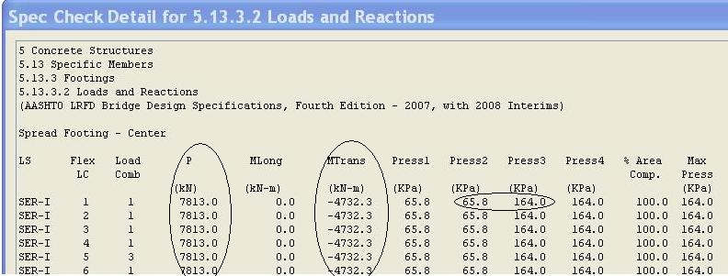
We’ve analyzed again: Results for DL + LL
My work by hand for D.L. and L.L. with resulting footing pressures.
OPIS’s spread footing results table.
97.9kPa down to 65kPa due to overturning

Slide 24
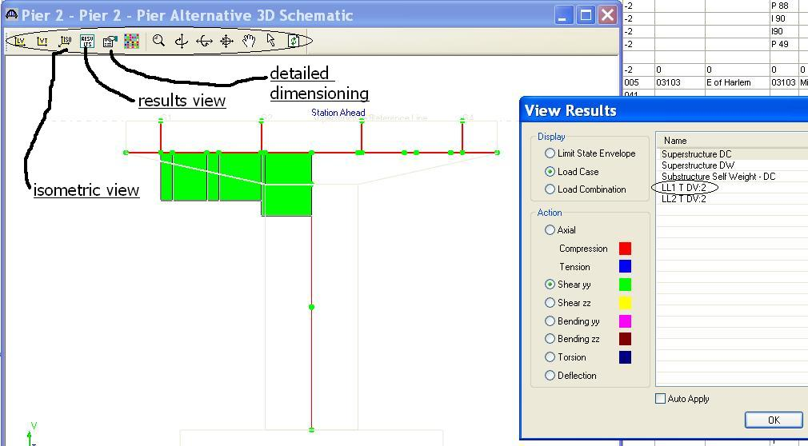
Many ways for viewing results.
Shear in the cap due to live load.
3D schematic – results view
Notes:
Shear results one lane far side of cap.

Slide 25
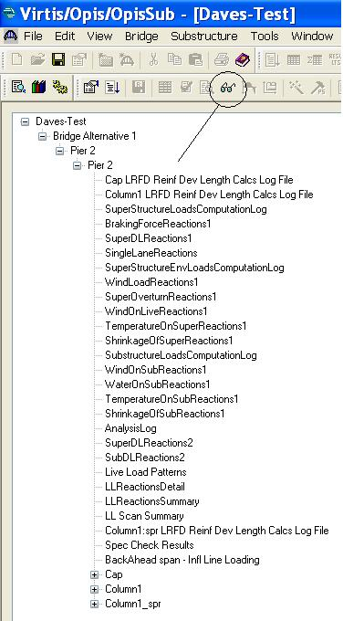
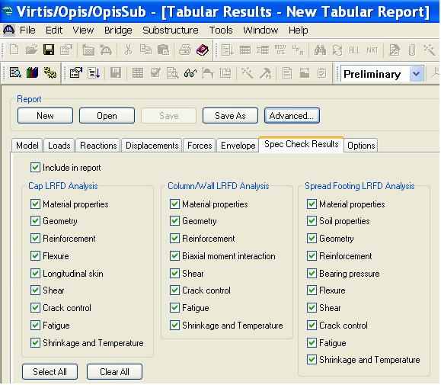
Authoring Report Styles.
Glasses: Many useful preformed reports
New Tabular Report.xml; Viewed in internet browser. Give a unique name, otherwise new overwrites old. Find files in install folder
Spec Check Results

Slide 26
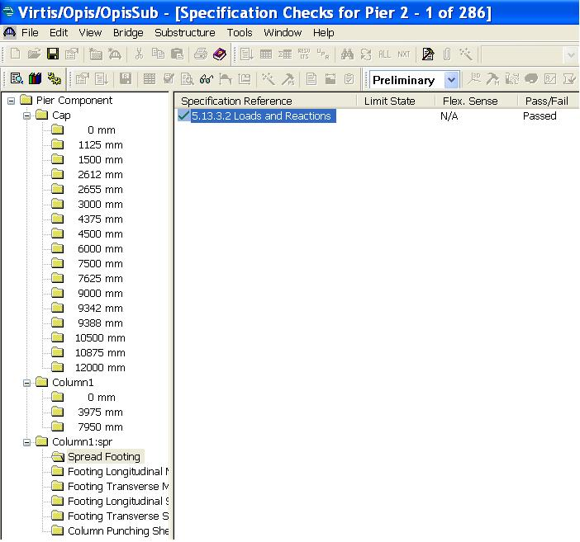
Specification Check
Most recognizable to OPIS Superstructure users. OPIS Substructure Spec Check.

Slide 27
Questions and comments
Opis Substructure
  Questions?
  dwarner@mt.gov email any questions.

