Slide 1
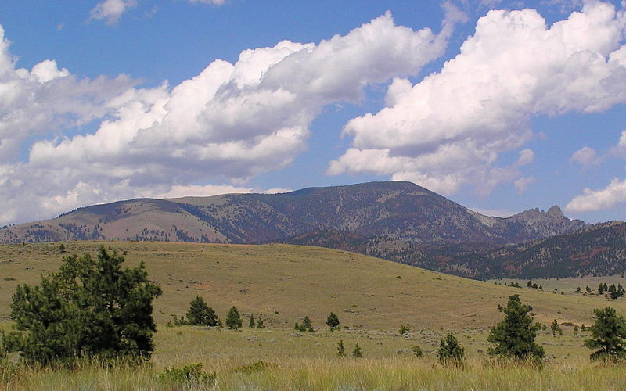
Virtis-Opis Update
Virtis-Opis User Group Training Meeting
Helena – August 2011

Slide 2
Virtis / Opis Update
Virtis / Opis Version 6.3
Released July 2011!

Slide 3
Enhancements for 6.3
New AASHTO engine for Load Factor Rating
  For steel and concrete multi-girder superstructures.
  For steel floor systems (floor beams and stringers).
New AASHTO engine for Allowable Stress Rating
  For steel and concrete multi-girder superstructures.
  For steel floor systems (floor beams and stringers).

Slide 4
Enhancements for 6.3
Specification updates
  AASHTO Standard Specifications for Highway Bridges, 17th Edition (LFD/ASD)
  AASHTO LRFD Bridge Design Specifications 4th and 5th Editions and Interims 2008 through 2010 (LRFD)
  AASHTO Manual for Bridge Evaluation 1st and 2nd Editions and Interims (LFR/ASR/LRFR)

Slide 5
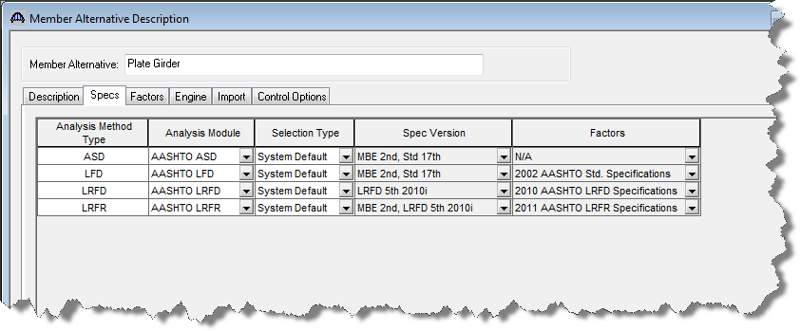
Enhancements for 6.3
Selection of the specification version

Slide 6
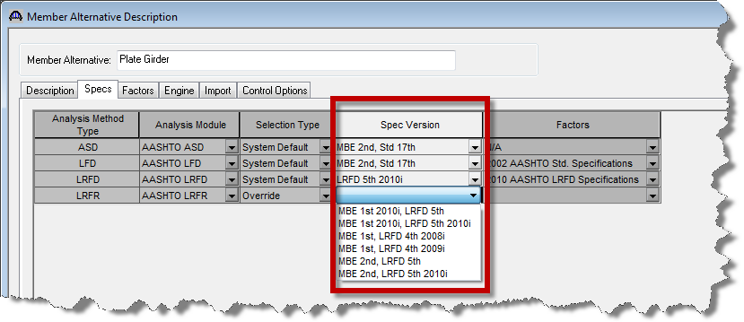
Enhancements for 6.3
For the AASHTO engines a spec version can be selected…

Slide 7
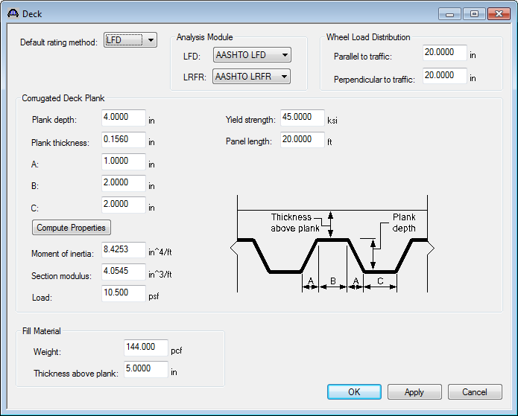
Enhancements for 6.3
Corrugated Metal Deck Rating
  Standard gage rating of the deck
  Nonstandard gage rating of the supporting beam
  Nonstandard gage rating of the deck

Slide 8
Enhancements for 6.3
Michigan LRFR Enhancement
  User-defined Strength I load factor override by vehicle for legal loads.
  Apply a lane load along with a permit vehicle for span length between 200 and 300 ft. and for negative moment.
  An option to gap out the permit vehicle lane load.

Slide 9
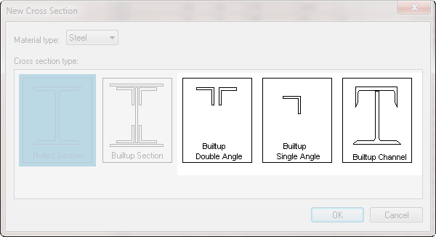
Enhancements for 6.3
Added three new cross sections for floor trusses
Added double angles for longitudinal trusses

Slide 10
Enhancements for 6.3
User requested enhancements (voted on by the User Group)
  Point of Interest Capacity Override (for the 6.4 release)
  Shear Stirrup Design Tool for Prestress
  Truss LL Distribution Factor Computation

Slide 11
Enhancements for 6.3
Support for Windows 7
API Updates for Third-Party Developers
  Superstructure Domain
  AASHTO Finite Element Engine

Slide 12
Enhancements for 6.3
Implemented the new AASHTO LFR specification checking for floor trusses
Added a software interface for Permit/Routing systems

Slide 13
Enhancements for 6.3
Implemented several new control options to further control the analysis and reporting
Added printing of rating results to the Bridge Explorer
Numerous additional smaller enhancements

Slide 14
Wyoming BRASS
Wyoming BRASS will no longer be delivered with Virtis/Opis starting with 6.3
All necessary capabilities of BRASS have been implemented in the AASHTO engines
BRASS will continue to be available for use as a third-party engine licensed through Wyoming DOT

Slide 15
Virtis/Opis Goals
Develop V/O analysis engine (AASHTO engine)
Match/exceed BRASS capabilities
3D analysis
Bridge Types used by majority of the agencies
Continue to advance substructure modeling/analysis
Improve interface and reporting
Continue to advance 3rd party development
Notes:
Specification checking for Steel Multi-Girder Superstructure
The new AASHTO LRFD reinforced and prestressd concrete specification checking engine will be enhanced to perform specification checking for steel multi-girder superstructures. The export module will be modified to compute dead load, live load and LRFD distribution factor for steel beams and the spec controller classes will be enhanced. The module will rely heavily on existing modules written for the substructure module and the recently completed non-standard gage (NSG) enhancement. The cross section types to be supported are I shapes comprised of rolled beams and welded plate girders
LRFR Enhancements
Including the addition of LRFR capabilities for multi-girder steel superstructures in the spec-check module
Addition of LRFR Rating of Piers
This will include the cap, columns, footings and drilled shafts.

Slide 16
Virtis/Opis Steps to Advance Goals
Prepare for expiration of BRASS agreement
Develop full 3D (refined) analysis
Add new bridge and substructure types
Update input/output
Continue to discuss 3rd party issues with outside developers
Notes:
Specification checking for Steel Multi-Girder Superstructure
The new AASHTO LRFD reinforced and prestressd concrete specification checking engine will be enhanced to perform specification checking for steel multi-girder superstructures. The export module will be modified to compute dead load, live load and LRFD distribution factor for steel beams and the spec controller classes will be enhanced. The module will rely heavily on existing modules written for the substructure module and the recently completed non-standard gage (NSG) enhancement. The cross section types to be supported are I shapes comprised of rolled beams and welded plate girders
LRFR Enhancements
Including the addition of LRFR capabilities for multi-girder steel superstructures in the spec-check module
Addition of LRFR Rating of Piers
This will include the cap, columns, footings and drilled shafts.

Slide 17
Virtis/Opis Goals – Analysis
AASHTO Engine – LRFD/LRFR/LFR (2009-2011)
Match/exceed BRASS capabilities (July 2011)
Use current or previous LRFD/LRFR Specifications (July 2011)
Full 3D analysis (July 2012)
Gusset Plate Analysis (July 2012)
Notes:
Specification checking for Steel Multi-Girder Superstructure
The new AASHTO LRFD reinforced and prestressd concrete specification checking engine will be enhanced to perform specification checking for steel multi-girder superstructures. The export module will be modified to compute dead load, live load and LRFD distribution factor for steel beams and the spec controller classes will be enhanced. The module will rely heavily on existing modules written for the substructure module and the recently completed non-standard gage (NSG) enhancement. The cross section types to be supported are I shapes comprised of rolled beams and welded plate girders
LRFR Enhancements
Including the addition of LRFR capabilities for multi-girder steel superstructures in the spec-check module
Addition of LRFR Rating of Piers
This will include the cap, columns, footings and drilled shafts.

Slide 18
Virtis/Opis Goals – Bridge Types
Steel Corrugated Deck (July 2011)
RC Culverts (July 2012)
RC Slab Systems (July 2012)
Steel Curved Girders (July 2013)
RC Box Girders (July 2013)
Post-Tensioned Multicell Box Beams (July 2013)
Notes:
Specification checking for Steel Multi-Girder Superstructure
The new AASHTO LRFD reinforced and prestressd concrete specification checking engine will be enhanced to perform specification checking for steel multi-girder superstructures. The export module will be modified to compute dead load, live load and LRFD distribution factor for steel beams and the spec controller classes will be enhanced. The module will rely heavily on existing modules written for the substructure module and the recently completed non-standard gage (NSG) enhancement. The cross section types to be supported are I shapes comprised of rolled beams and welded plate girders
LRFR Enhancements
Including the addition of LRFR capabilities for multi-girder steel superstructures in the spec-check module
Addition of LRFR Rating of Piers
This will include the cap, columns, footings and drilled shafts.

Slide 19
Virtis/Opis Goals – Substructure
Drilled shaft analysis & specification checking (July 2012)
Substructure LRFR rating (July 2013)
Notes:
Specification checking for Steel Multi-Girder Superstructure
The new AASHTO LRFD reinforced and prestressd concrete specification checking engine will be enhanced to perform specification checking for steel multi-girder superstructures. The export module will be modified to compute dead load, live load and LRFD distribution factor for steel beams and the spec controller classes will be enhanced. The module will rely heavily on existing modules written for the substructure module and the recently completed non-standard gage (NSG) enhancement. The cross section types to be supported are I shapes comprised of rolled beams and welded plate girders
LRFR Enhancements
Including the addition of LRFR capabilities for multi-girder steel superstructures in the spec-check module
Addition of LRFR Rating of Piers
This will include the cap, columns, footings and drilled shafts.

Slide 20
Virtis/Opis Goals – Beyond 2013
Updated GUI, include trusses
Stronger reporting tools
Frame analysis
Ratings for Bridge Decks
Integral Abutments
Steel Box Girders
Notes:
Specification checking for Steel Multi-Girder Superstructure
The new AASHTO LRFD reinforced and prestressd concrete specification checking engine will be enhanced to perform specification checking for steel multi-girder superstructures. The export module will be modified to compute dead load, live load and LRFD distribution factor for steel beams and the spec controller classes will be enhanced. The module will rely heavily on existing modules written for the substructure module and the recently completed non-standard gage (NSG) enhancement. The cross section types to be supported are I shapes comprised of rolled beams and welded plate girders
LRFR Enhancements
Including the addition of LRFR capabilities for multi-girder steel superstructures in the spec-check module
Addition of LRFR Rating of Piers
This will include the cap, columns, footings and drilled shafts.

Slide 21
Beta TAG
Reviews mockups and other proposals
Tests product in spring
Important opportunity to be involved in development of the product
Upcoming presentation on how to test the product
Contact Dean Teal (KSDOT), TAG Chair for more information
Notes:
Specification checking for Steel Multi-Girder Superstructure
The new AASHTO LRFD reinforced and prestressd concrete specification checking engine will be enhanced to perform specification checking for steel multi-girder superstructures. The export module will be modified to compute dead load, live load and LRFD distribution factor for steel beams and the spec controller classes will be enhanced. The module will rely heavily on existing modules written for the substructure module and the recently completed non-standard gage (NSG) enhancement. The cross section types to be supported are I shapes comprised of rolled beams and welded plate girders
LRFR Enhancements
Including the addition of LRFR capabilities for multi-girder steel superstructures in the spec-check module
Addition of LRFR Rating of Piers
This will include the cap, columns, footings and drilled shafts.

Slide 22
Upcoming Brainstorming Session
Last one in 2008
Allows TF to measure the pulse of the UG in terms of “big ticket” items – what’s important now?
More conceptual rather than focusing on specific enhancements
TF uses results to map out next 3-5 years
Notes:
Specification checking for Steel Multi-Girder Superstructure
The new AASHTO LRFD reinforced and prestressd concrete specification checking engine will be enhanced to perform specification checking for steel multi-girder superstructures. The export module will be modified to compute dead load, live load and LRFD distribution factor for steel beams and the spec controller classes will be enhanced. The module will rely heavily on existing modules written for the substructure module and the recently completed non-standard gage (NSG) enhancement. The cross section types to be supported are I shapes comprised of rolled beams and welded plate girders
LRFR Enhancements
Including the addition of LRFR capabilities for multi-girder steel superstructures in the spec-check module
Addition of LRFR Rating of Piers
This will include the cap, columns, footings and drilled shafts.

Slide 23
Virtis & Opis Licenses
Virtis
Opis
Notes:
Currently 65 agency licenses of Virtis and Opis and 172 consultant licenses. Numbers on charts don’t include a handful of Academic licenses.

Slide 24
BRIDGEWare Task Force
Chairperson | Tim Armbrecht | Illinois
Pontis TF - Vice Chair | Mike Johnson | California
Pontis TF | Francois Ghanem | New York
Pontis TF | Ralph Phillips | Connecticut
Pontis TF | Mark Faulhaber | Kentucky
Pontis FHWA | Wade Casey | FHWA
V/O TF | Dean Teal | Kansas
V/O TF | Bryan Silvis | Virginia
V/O TF | Joshua Sletten | Utah
V/O TF | Amjad Waheed | Ohio
V/O FHWA | Tom Saad | FHWA

Slide 25

Questions & Comments
Thanks for your continued support

