Slide 1
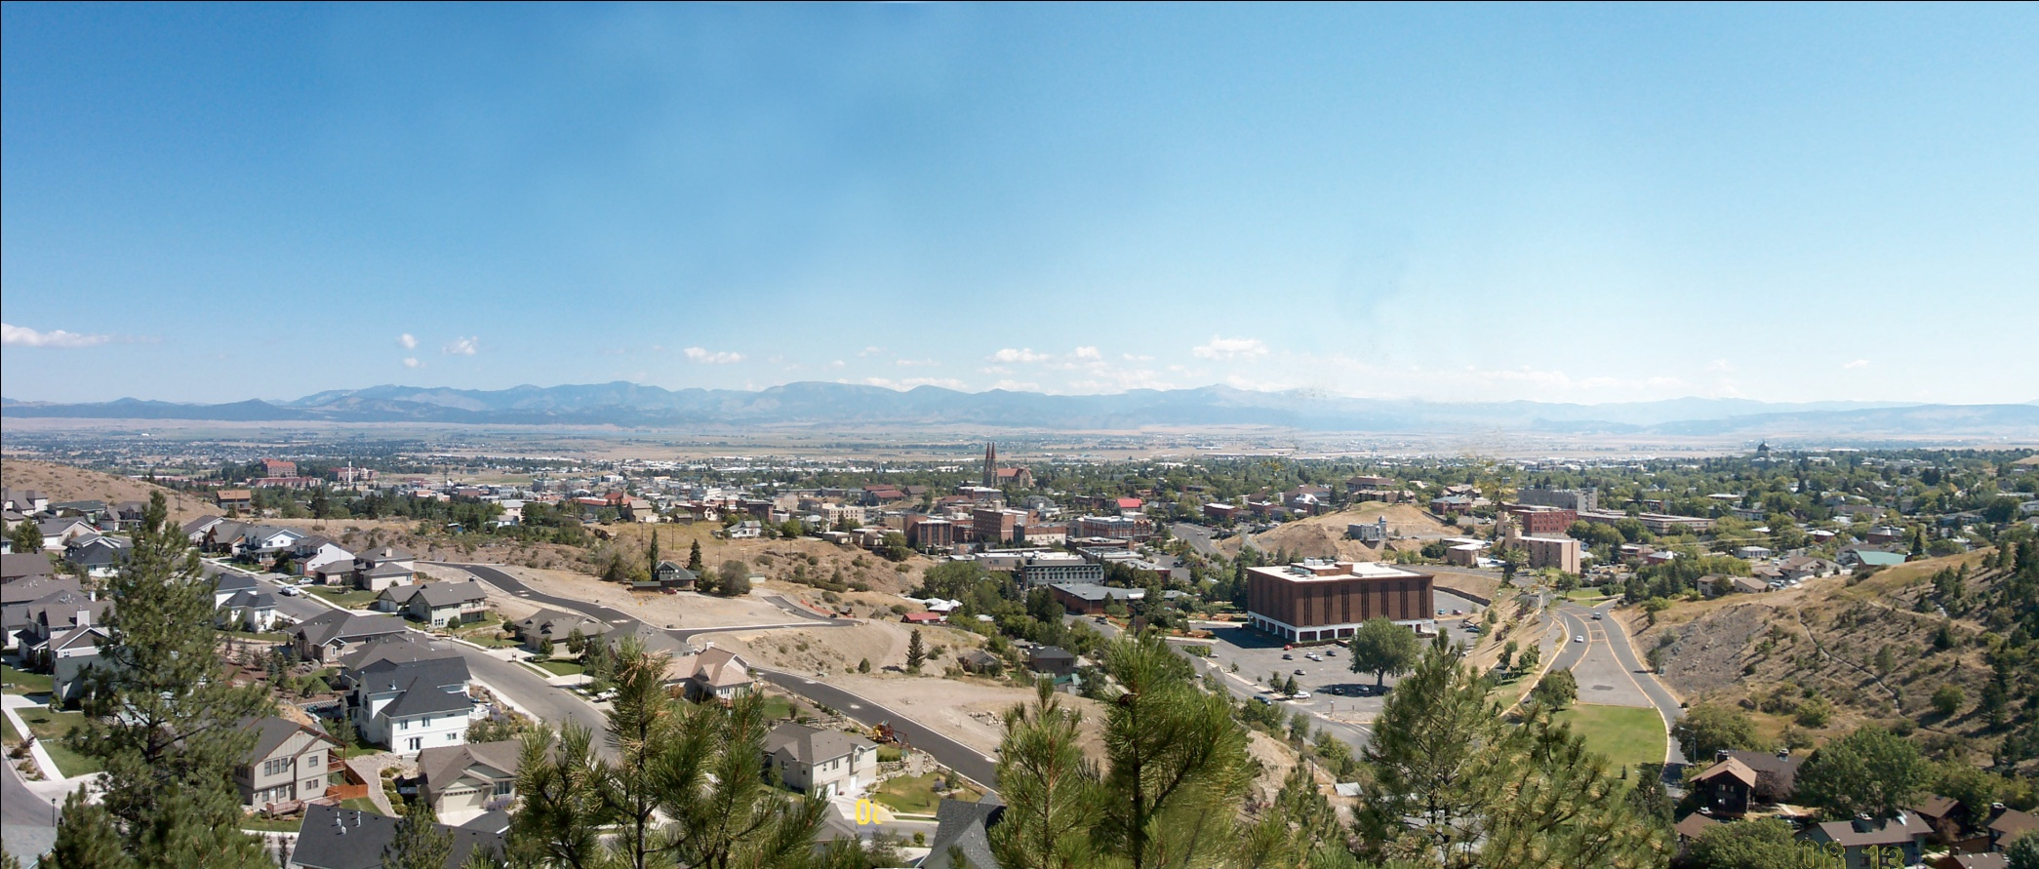
Virtis/Opis Technical Update
Virtis Opis Bridgeware
User Group 2011 Conference
Helena, Montana

Slide 2


6.3 New Features
New AASHTO LFR/ASR Engine for girder, floor and truss system and line superstructures
LRFD RC
LRFR RC/PS
LRFR Steel
LRFD Steel
LRFD PS
LFR RC/PS/Steel
ASR RC/PS/Steel
6.0
6.1
6.2
6.3
Notes:
Development timeline of the AASHTO superstructure analysis engine, 6.0 release is the first increment for LRFD RC superstructure, 6.0 is also the first release of the Opis substructure module, which includes the Opis substructure LRFD analysis and spec check engine
6.3 release matches the BRASS engine capabilities in Virtis/Opis

Slide 3
6.3 New Features
Analysis Modules Naming Convention
6.2 | 6.3
Virtis LFD | Virtis LFD | Based on PennDOT BAR7
Virtis ASD | Virtis ASD
Virtis Simplified ASD | Virtis Simplified ASD | For BARS non-detailed section
Opis LRFD | AASHTO LRFD | AASHTO Engine
Virtis LRFR | AASHTO LRFR
 | AASHTO LFD
 | AASHTO ASD
Virtis Truss LFD | AASHTO Truss LFD

Slide 4
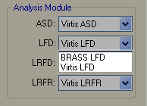
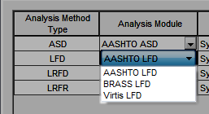
6.3 New Features
6.2
6.3
New AASHTO Engine
Notes:
In 6.3, the drop drown will still have the BRASS engine selection. If BRASS LFD was selected in 6.2, it will still show up as the selected LFD analysis module in 6.3. But when you try to run, not available.

Slide 5
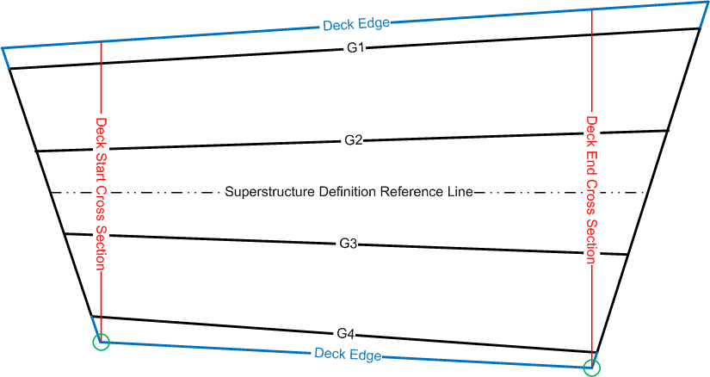
6.3 New Features
New AASHTO LFR/LRFR Deck Engine for corrugated metal deck rating
Notes:
Based on the AASHTO superstructure engine, similar to floor beam analysis, model the deck (parapet, medium sitting on top) instead of the girder (deck, parapet, medium sitting on top)
Only available for system superstructure definition (girder, floor and truss)
If start section is different than the end section, will evaluate 2 cross sections, pick the section with the critical results for reporting

Slide 6
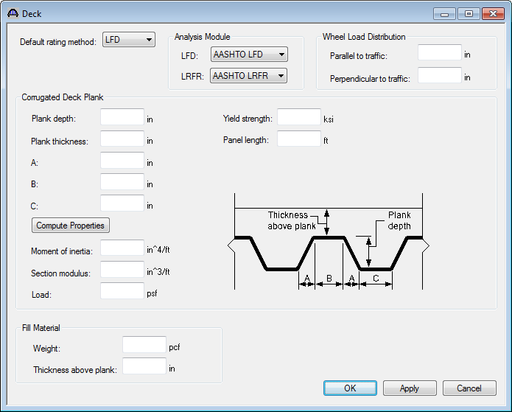
6.3 New Features
Notes:
Corrugated deck can rest on timber and steel members
Traffic direction from left to right

Slide 7
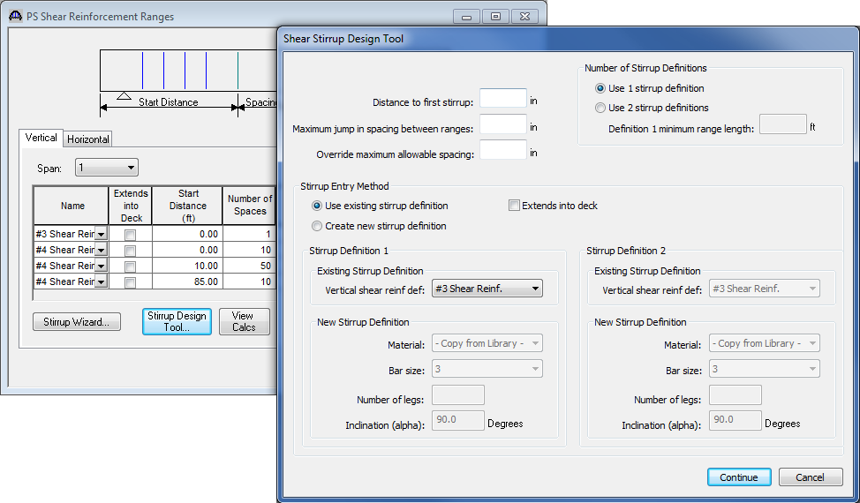
6.3 New Features
Shear Stirrup Design Tool for prestress beam
Notes:
The tool is accessible from the PS Shear Reinforcement Ranges window, allow 2 different stirrup definitions
Press Continue will start the analysis and complete with the required stirrup spacing at each tenth point and critical dv point
With the required spacing, ranges can be generated based on Max # of ranges per span and Min # of stirrups per ranges

Slide 8
6.3 New Features
AASHTO Manual for Bridge Evaluation Specification updates
  1st Edition with 2010 Interim
  2nd Edition
AASHTO LRFD Specification updates
  4th Edition with 2009 Interim
  5th Edition
  5th Edition with 2010 Interim
Notes:
In addition to MBE 1st edition, 6.3 supports …
In 6.2, the supported LRFD spec is 4th edition with 2008 interim. … are added in 6.3.

Slide 9
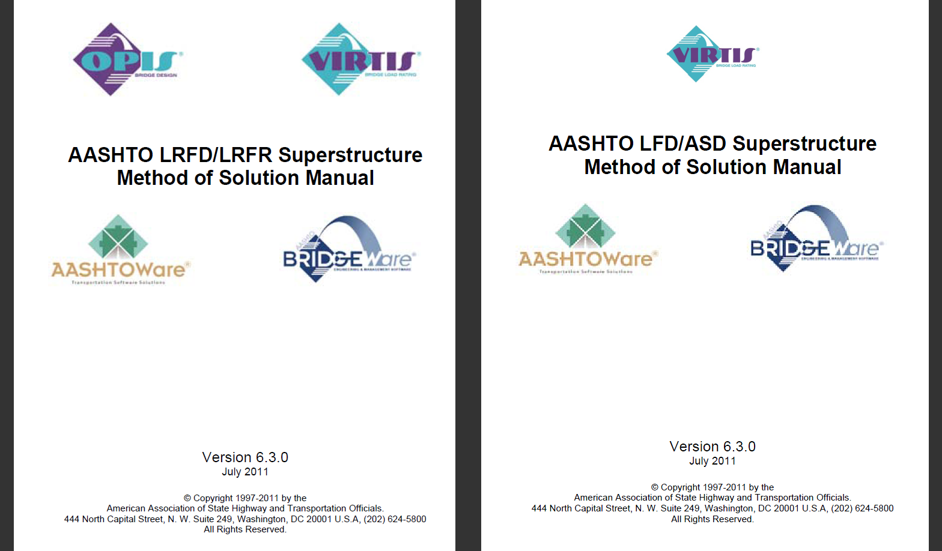
6.3 New Features
Notes:
Open these Method of Solution Manuals from the Help menu.
Assumptions and Limitations, Flow charts …

Slide 10
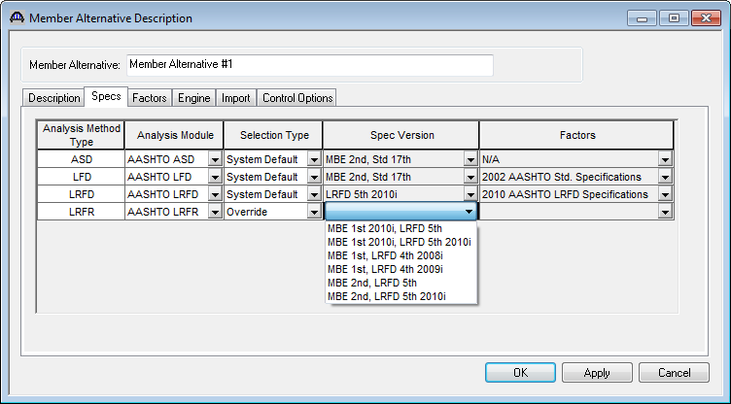
6.3 New Features
Selection of specification edition for specification checking
Notes:
Member Alternative window, 6.2 has the first 2 columns, selection of spec version and also the selection of load factors for the analysis, spec version and load factors association
Selection type, System Default or Override, …

Slide 11
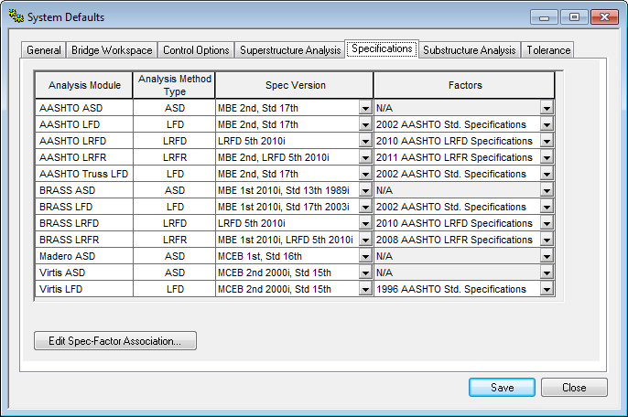
6.3 New Features
Notes:
System Defaults window Specifications tab, association of spec version and load factors for each available analysis method type in each engine

Slide 12
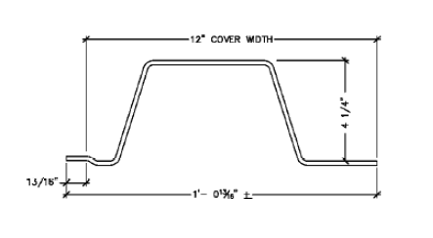
6.3 New Features
NSG analysis of superstructure with corrugated metal deck
  New orthotropic shell finite element
  New corrugated material properties
Notes:
Account for variation in stiffness between transverse and longitudinal directions

Slide 13
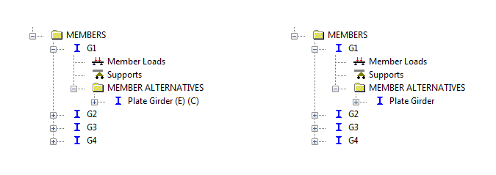
6.3 New Features
NSG analysis processing for the case when there is only one member alternative defined for a member and the member alternative is not marked as Existing
Notes:
6.2, superstructure, superstructure alternative, the selected superstructure definition, each member, the existing member alternative

Slide 14
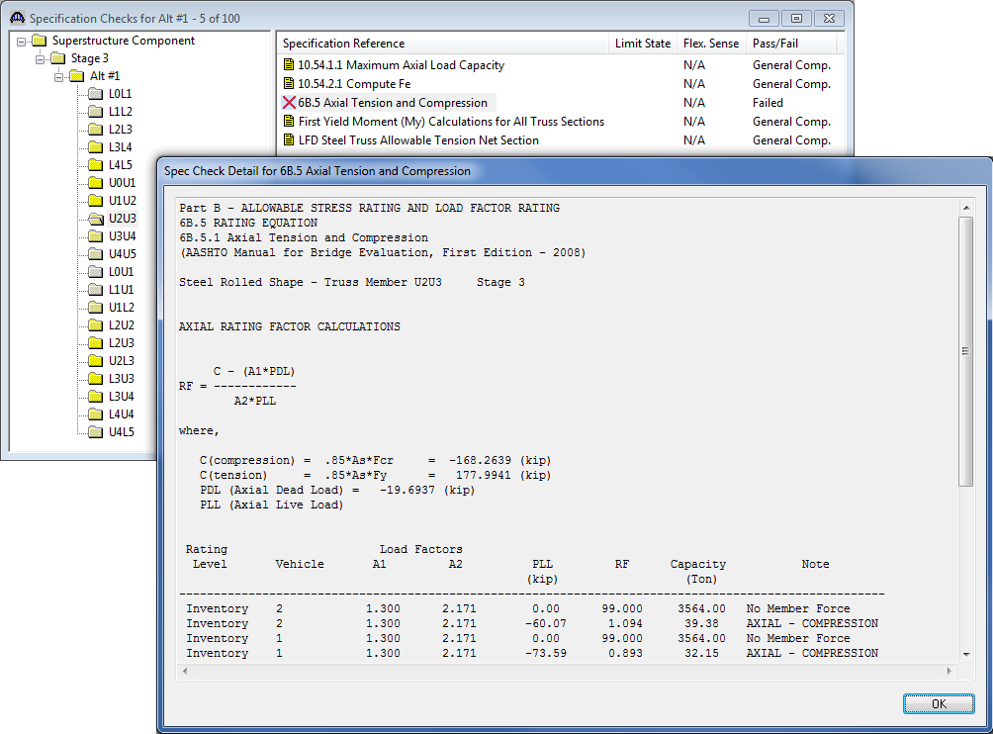
6.3 New Features
LFR specification checking for floor truss analysis
Notes:
For the case that floor truss members are modeled as beam elements
Hook up the LFR spec check module in the new AASHTO LFR engine for floor truss rating
Model truss member as beam element, allow Element loads and Interaction Rating for Axial and Bending
Spec check viewer, detail spec check results and rating computation for each floor truss member

Slide 15
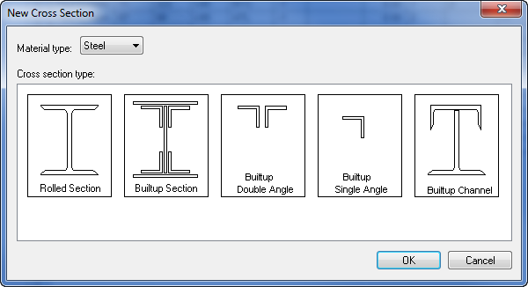
6.3 New Features
Single Angle, Back-to-Back Angles and Built-up Channel cross sections for floor truss analysis
Notes:
In 6.2, only 2 cross section types are available for floor truss

Slide 16
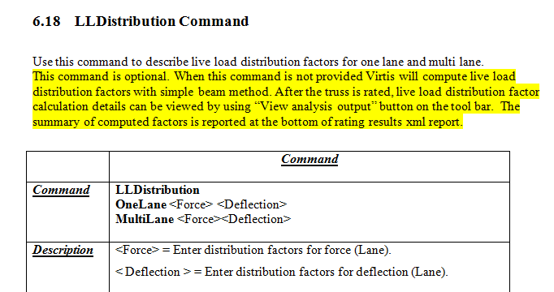
6.3 New Features
Live load distribution factor computation for longitudinal truss analysis
Notes:
Truss Input Command Language Manual, LLDistribution command is optional in 6.3, not entered …
Open the detail computation file from the Analysis Output window, the computed LL distribution factors are also listed in the truss rating results report

Slide 17

6.3 New Features
AASHTO LRFR Engine control option to ignore Service III PS tensile stress rating for the top of prestress beam
  Rating at the top of beam will not be computed in MBE 6.4.2.1

Slide 18
6.3 New Features
AASHTO LRFD/LRFR Engine control option to consider splitting resistance article
  Consider the splitting resistance of the pretensioned anchorage zone as per LRFD 5.10.10.1
  For prestress beam only

Slide 19
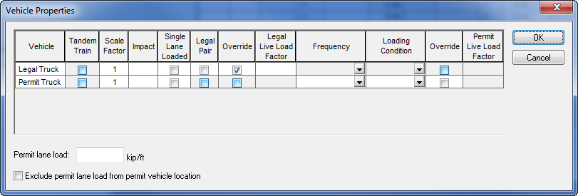
6.3 New Features
AASHTO LRFR Engine analysis option for overriding legal live load factor, considering additional permit lane load and excluding permit lane load from permit vehicle location
Notes:
Vehicle Properties dialog
Consider additional lane load with permit vehicles for spans between 200 and 300 ft and when checking negative moments in continuous span bridges

Slide 20
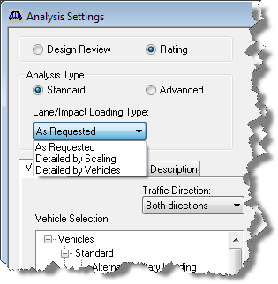
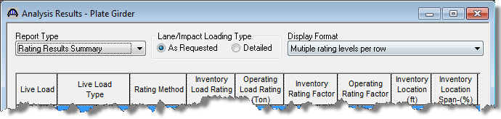
6.3 New Features
AASHTO LFR/ASR Engine analysis option for applying with/without impact and single/multi lane live load combinations
Processing vehicle HS 20-44 (As Requested)...
Processing vehicle HS 20-44 (With Impact, Single Lane)...
Processing vehicle HS 20-44 (With Impact, Multi-Lane)...
Processing vehicle HS 20-44 (Without Impact, Single Lane)...
Processing vehicle HS 20-44 (Without Impact, Multi-Lane)...
Notes:
Analysis Settings window, By vehicles – A vehicle for each combinations

Slide 21
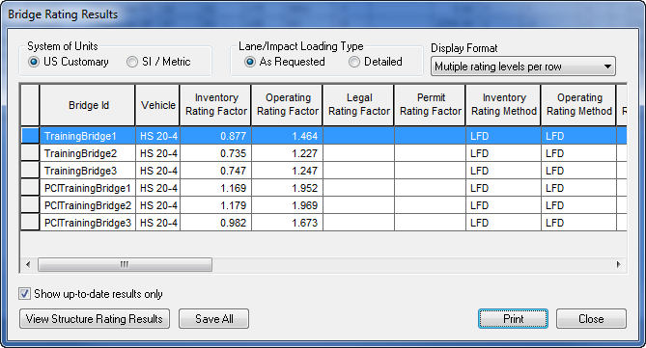
6.3 New Features
Bridge Explorer rating results printing

Slide 22
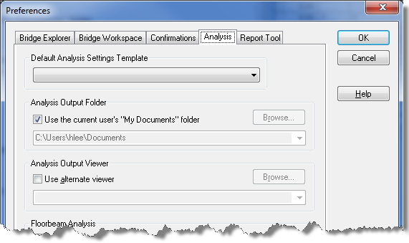
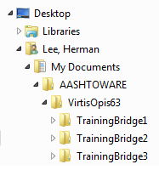
6.3 New Features
Support for Windows 7 (32-bit and 64-bit)
  Help files conversion
  Application file structure reorganization
  User-defined Analysis Output Folder
Notes:
hlp to chm
3 types of file: Virtis/Opis application, data used by the application, data generated by the user (Program Files, ProgramData, My Documents)
Windows 7 Client Software Logo Program

Slide 23

6.3 New Features
  Virtual address space per process
  (32-bit vs. 64-bit Operating System)
64-bit: 8 TB = 8192 GB
32-bit: 2 GB

Slide 24
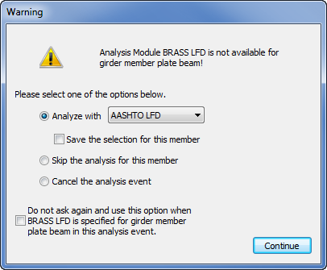
6.3 New Features
3rd-party engine registration
  Formal analysis engine registration process
  Include Help documentation registration
Notes:
Registered vs. Available

Slide 25
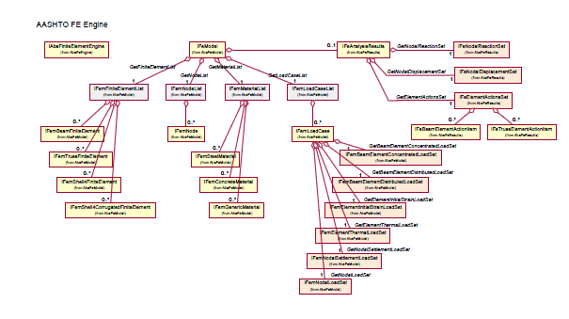
6.3 New Features
Application Program Interface documentation updates
  Last update is for 5.6 release
  Include AASHTO FE Engine API documentation and object model

Slide 26
6.4 Enhancements
User Group enhancements
3D analysis for multi-girder superstructures
RC slab system
Drilled shaft analysis and specification checking
RC box culvert LRFD design and rating
Model mild steel in prestress beam
Truss cross sections and graphics

Slide 27
6.4 Enhancements
General preferences
Data exchange for non-bridge data
Report Tool using Crystal Reports
Detailed LRFR analysis report
Lane load processing enhancement
Specification checker API documentation
Limit states selection
Substructure results report topics

Slide 28

Questions & Comments
Thank you for your continued support!

