Slide 1


Differences Between
BRASS and AASHTO
Standard Spec Engines
Virtis Opis BRIDGEWare
Users Group Meeting 2011
Helena, Montana

Slide 2
Standard Spec refers to ASD and LFD found in the AASHTO Standard Specifications
AASHTO Std Engine Version 6.3 and BRASS-GIRDER Version 6.0.3 are compared

Slide 3
General Features
Impact Factor Calculation
AASHTO Std Engine
BRASS-GIRDER
According to Article 3.8.2.2 for the loaded length L. Uses the span length of the point of interest.
For moment, L = average span length of the spans on which the vehicle is located.
For shear, L = loaded portion of the span. For a given node, two lengths are considered, L1 and L2. Initially, L1 = span length and L2 = zero. If the front or rear axle is on the span and left of the node point, L1 = distance from the left support to the node point. If the front or rear axle is on the span and right of the node point, L2 = distance from the node point to the right support. Then, L = max of L1 and L2.

Slide 4
General Features
Live Load Distribution Factors
AASHTO Std Engine
BRASS-GIRDER
Uses the corresponding distribution factors for shear and moment. If the shear factor is not entered, the moment factor will be used for shear effects.
Computed if not entered.
Uses the moment distribution factor for both moment and shear effects.

Slide 5
General Features
Transverse Live Load Application to Floorbeams
AASHTO Std Engine
BRASS-GIRDER
Applies the transverse live load at the stringer locations
Applies transverse live load directly to the floor beam as though the stringers do not exist

Slide 6
General Features
Algorithm to Locate the Critical Vehicle Positions
AASHTO and BRASS may result in different critical vehicle positions. The relative difference in live load actions is usually within 5%.
AASHTO Std Engine
BRASS-GIRDER
Loads influence lines by positioning the vehicle over the peaks. Applies each axle and the CG of the vehicle to the peak.
Marches the vehicle across the influence line based on a wheel advancement denominator input by the user.

Slide 7
Steel Girders
Member Stiffness Used in Structural Analysis
AASHTO Std Engine
BRASS-GIRDER
Composite sections are determined based on the entered shear connector ranges. Where shear connectors are present, the beam plus slab properties are considered in the FE model.
Uses positive flexure properties (beam + slab) in positive moment regions and negative flexure properties (beam + rebar) in negative moment regions. These regions are entered by the user in the BRASS LFD/ASD Engine Properties window.

Slide 8
Steel Girders
Article 10.48.3 Transitions
The maximum strength of sections with geometric properties falling between the limits of Articles 10.48.1 and 10.48.2 may be computed by straight-line interpolation, except that the web thickness must always satisfy Article 10.48.1.1(b).
AASHTO Std Engine
BRASS-GIRDER
Implemented
Not implemented

Slide 9
Steel Girders
Article 10.57.2 Composite Sections
At composite sections, the maximum overload flange stress shall not exceed 0.95Fy. …
AASHTO Std Engine
BRASS-GIRDER
Uses 0.95 factor
Uses 0.80 factor for composite sections in negative moment regions.

Slide 10
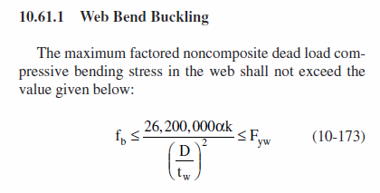
Steel Girders
Article 10.57 OVERLOAD
… Web bend-buckling shall be checked for the overload according to Equation (10-173)…
AASHTO Std Engine
BRASS-GIRDER
Implemented
Not implemented

Slide 11
Steel Girders
Allow Plastic Analysis Control Option
AASHTO Std Engine
BRASS-GIRDER
Implemented. Plastic moment capacity is computed if the section meets the Spec requirements to be considered compact.
Not implemented. Uses its Member Alternative engine properties to indicate the adjacent support POI are compact. If these POI are compact, plastic analysis is allowed if the section meets the spec requirements. If not, plastic analysis is not allowed. This engine setting is done on a span basis, so one span could be analyzed plastic while another one wouldn’t be.

Slide 12
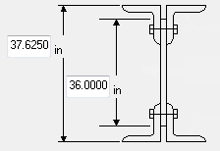
Steel Girders
Built-up Section Web Depth
AASHTO Std Engine
BRASS-GIRDER
Uses plate depth entered by user
Computes web depth as back-back angle depth minus the flange thicknesses

Slide 13
Steel Girders
Rate Bearing Stiffeners Control Option
AASHTO Std Engine
BRASS-GIRDER
Not implemented
Implemented

Slide 14
Steel Girders
ASD – Consider holes in tension flanges when computing allowable tension stress
AASHTO Std Engine
BRASS-GIRDER
Considers holes in tension flanges when computing the allowable stress as per MBE Tables 6B.6.2.1.1 and 6B.6.2.1.2.
Does not consider holes in the beam.

Slide 15

Prestressed Concrete Girders
Prestressing Steel Tension Rating Factor
AASHTO Std Engine
BRASS-GIRDER
Implemented
Not implemented

Slide 16

Prestressed Concrete Girders
Article 9.20.2.2
AASHTO Std Engine
BRASS-GIRDER
No limit on Mcr/Mmax
Controlled by engine data:
  No limit on Mcr/Mmax
  Limit Mcr/Mmax to 1.0

Slide 17
Prestressed Concrete Girders
Prestressing Force Along the Length of Beam
AASHTO Std Engine
BRASS-GIRDER
Varies linearly from zero to a force corresponding to stress fse at the transfer length and to a force corresponding to stress f*su at the development length and beyond
Constant

Slide 18
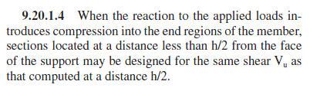
Prestressed Concrete Girders
Article 9.20.1.4
AASHTO Std Engine
BRASS-GIRDER
Implemented. Sections located within h/2 from face of support are evaluated for shear acting at the h/2 location.
Not implemented

Slide 19
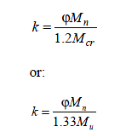
Prestressed Concrete Girders
MBE 6B.5.3.3 Prestressed Concrete
Use flexural strength reduction factor k when ΦMn is less than 1.2Mcr
AASHTO Std Engine
BRASS-GIRDER
Implemented. Controlled by a control option on the Member Alternative window.
Not implemented

Slide 20
Prestressed Concrete Girders
Support Positions
AASHTO Std Engine
BRASS-GIRDER
Uses simple span bearing span lengths for DL1 analysis and centerline of support span lengths for DL2 and LL analyses. Analysis points considered for DL1 analysis correspond to tenth points of the continuous span lengths used for DL2 and LL analyses. Analysis points for which the results are reported correspond to tenth points of the continuous span lengths.
Uses the same support positions, simple span bearing span lengths or centerline of support span lengths, for all stages. Non-composite stage is considered as simple spans and composite stage as continuous spans.

Slide 21
Prestressed Concrete Girders
Analysis Points of Interest
AASHTO Std Engine
BRASS-GIRDER
Tenth points and user-defined points of interest. Section change points selection will cause ratings to be computed at the h/2 distance from support, drape points, etc.
Tenth points and user-defined points of interest only

Slide 22
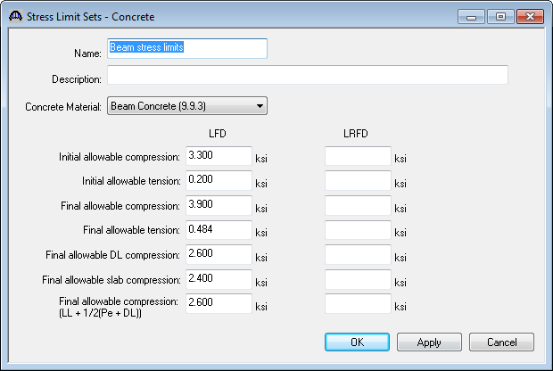
Prestressed Concrete Girders
Load Factor
Concrete Stress Limits
AASHTO Std Engine
BRASS-GIRDER
Uses the values entered on the Stress Limits Sets window. If the values are not entered, computes the allowables as per the Std Specifications.
Does not use the values entered on the Stress Limits Sets window. Computes the allowables as per the Std Specifications.

Slide 23
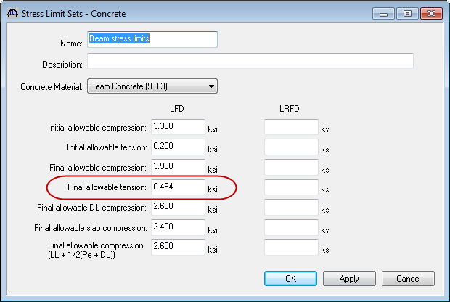
Prestressed Concrete Girders
Final Allowable
Tensile Stress
AASHTO Std Engine
BRASS-GIRDER
Uses the LFD Final allowable tension in the Stress Limit Sets window. If this value is not entered, uses the INVY ASD Factors P/S Concrete Tens. in the Member Alternative window. If INV ASD factor is not entered, the allowable is computed as per the Std Spec.
Uses the INVY ASD Factors P/S Concrete Tens. in the Member Alternative window. If INV ASD factor is not entered, the allowable is computed as per the Std Spec.

Slide 24
Prestressed Concrete Girders
Composite Slab Designation
AASHTO Std Engine
BRASS-GIRDER
Considers regions of the deck to be composite if the effective slab thickness and width are entered on the Deck Profile window and one of the following are entered on the PS Shear Reinforcement Ranges window:
  Vertical reinforcement extends into deck
  "Composite" horizontal reinforcement range entered
  Horizontal shear reinforcement range entered
Considers the total length of deck to be composite if the effective slab thickness and width are entered on the Deck Profile window.

Slide 25


Reinforced Concrete Girders
LFD Shear Capacity
AASHTO Std Engine
BRASS-GIRDER
Advanced AASHTO Eq. 8-48
Simplified AASHTO Eq. 8-49

Slide 26



Reinforced Concrete Girders
ASD Shear Capacity
AASHTO Std Engine
BRASS-GIRDER
Advanced AASHTO Eq. 8-4
Simplified AASHTO equation in Article 8.15.5.2.1

Slide 27
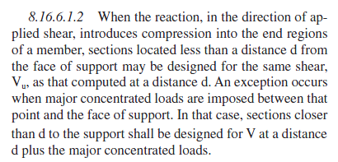
Reinforced Concrete Girders
Article 8.16.6.1.2
AASHTO Std Engine
BRASS-GIRDER
Implemented. Sections located within d from face of support are evaluated for shear acting at the d location.
Only the support locations are evaluated for shear acting at the d location.

Slide 28
Thank you

