Slide 1


Differences Between
BRASS and AASHTO
LRFD/LRFR Engines
Virtis Opis BRIDGEWare
Users Group Meeting 2011
Helena, Montana

Slide 2
AASHTO LRFD Engine Version 6.3 and BRASS-GIRDER(LRFD) Version 2.0.3 are compared

Slide 3
Steel Girders
Moment Redistribution Control Option
AASHTO LRFD Engine
BRASS-GIRDER(LRFD)
Implemented
Not implemented

Slide 4
Steel Girders
Wind Effects
AASHTO LRFD Engine
BRASS-GIRDER(LRFD)
Implemented
Not implemented

Slide 5
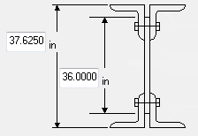
Steel Girders
Built-up Section Web Depth
AASHTO LRFD Engine
BRASS-GIRDER(LRFD)
Uses plate depth entered by user
Computes web depth as back-back angle depth minus the flange thicknesses

Slide 6
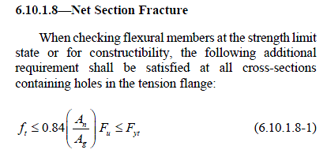
Steel Girders
Article 6.10.1.8 Net Section Fracture
AASHTO LRFD Engine
BRASS-GIRDER(LRFD)
Implemented
Not implemented

Slide 7
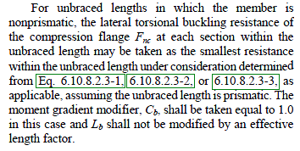
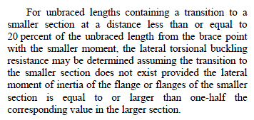
Steel Girders
Article 6.10.8.2.3 LTB Resistance
For nonprismatic sections:
AASHTO LRFD Engine
BRASS-GIRDER(LRFD)
Implemented
Not implemented

Slide 8
Prestressed Concrete Girders
Loss and Stress Calculations
AASHTO LRFD Engine
BRASS-GIRDER(LRFD)
Control option allows you to pick gross or transformed section properties
Uses gross section properties

Slide 9
Prestressed Concrete Girders
Loss Calculations
AASHTO LRFD Engine
BRASS-GIRDER(LRFD)
Loss Methods
  AASHTO Approximate
  AASHTO Refined
  AASHTO Pre-2005 interim Refined
Elastic gains can be included
Loss Methods
  AASHTO Approximate
  AASHTO Refined
  Lump Sum
  PCI
Elastic gains cannot be included

Slide 10
Prestressed Concrete Girders
Article 5.10.10.1 Splitting Resistance
AASHTO LRFD Engine
BRASS-GIRDER(LRFD)
Implemented
Not implemented

Slide 11

Prestressed Concrete Girders
Article 5.8.3.4.3
AASHTO LRFD Engine
BRASS-GIRDER(LRFD)
No limit on Mcre/Mmax
Controlled by engine data:
  No limit on Mcre/Mmax
  Limit Mcre/Mmax to 1.0

Slide 12
Prestressed Concrete Girders
Support Positions
AASHTO LRFD Engine
BRASS-GIRDER(LRFD)
Uses simple span bearing span lengths for DL1 analysis and centerline of support span lengths for DL2 and LL analyses. Analysis points considered for DL1 analysis correspond to tenth points of the continuous span lengths used for DL2 and LL analyses. Analysis points for which the results are reported correspond to tenth points of the continuous span lengths.
Uses the same support positions, simple span bearing span lengths or centerline of support span lengths, for all stages. Non-composite stage is considered as simple spans and composite stage as continuous spans.

Slide 13
Prestressed Concrete Girders
Composite Slab Designation
AASHTO LRFD Engine
BRASS-GIRDER(LRFD)
Considers regions of the deck to be composite if the effective slab thickness and width are entered on the Deck Profile window and one of the following are entered on the PS Shear Reinforcement Ranges window:
  Vertical reinforcement extends into deck
  "Composite" horizontal reinforcement range entered
  Horizontal shear reinforcement range entered
Considers the total length of deck to be composite if the effective slab thickness and width are entered on the Deck Profile window.

Slide 14
Reinforced Concrete Girders
Article 5.8.3.4.3
AASHTO LRFD Engine
BRASS-GIRDER(LRFD)
No limit on Mcre/Mmax
Controlled by engine data:
  No limit on Mcre/Mmax
  Limit Mcre/Mmax to 1.0

Slide 15
Thank you

